Slide 1
Wed 28 Oct 2026 · Instagram, Facebook, LinkedIn
Soil news: restored land can look finished while its soil fungi lag behind
3 slides follow · images · Wormhole post n20261024a
Notes:
Can a restored landscape look finished while the life in its soil is still catching up? 🌳
A team at Flinders University in Australia, led by Professor Martin Breed, went back to replanted former farmland and sampled its soil fungi again six years later. What the fungi do in the soil kept recovering over those six years, while the fungal community as a whole changed very little.
The researchers point to the land's farming history and the high nutrient levels still in those soils as a likely brake. Trees and shrubs are the part of restoration we can see and count. The soil food web follows on its own timeline, and it deserves to be measured too.
Read the study through the link in bio.
#SoilFoodWeb #SoilFungi #EcologicalRestoration #LivingSoil #SoilHealth #SoilBiology

Slide 2
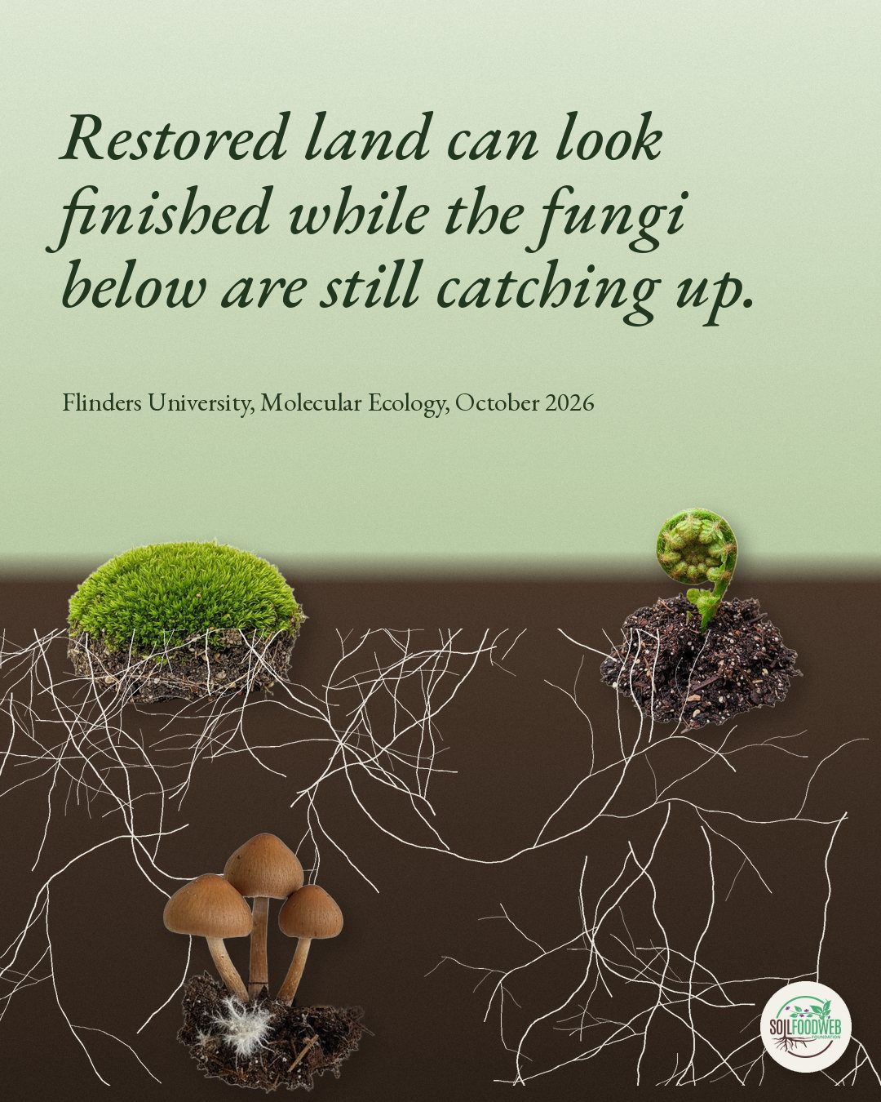
Notes:
Restored land can look finished while the fungi below are still catching up. Flinders University, Molecular Ecology, October 2026

Slide 3
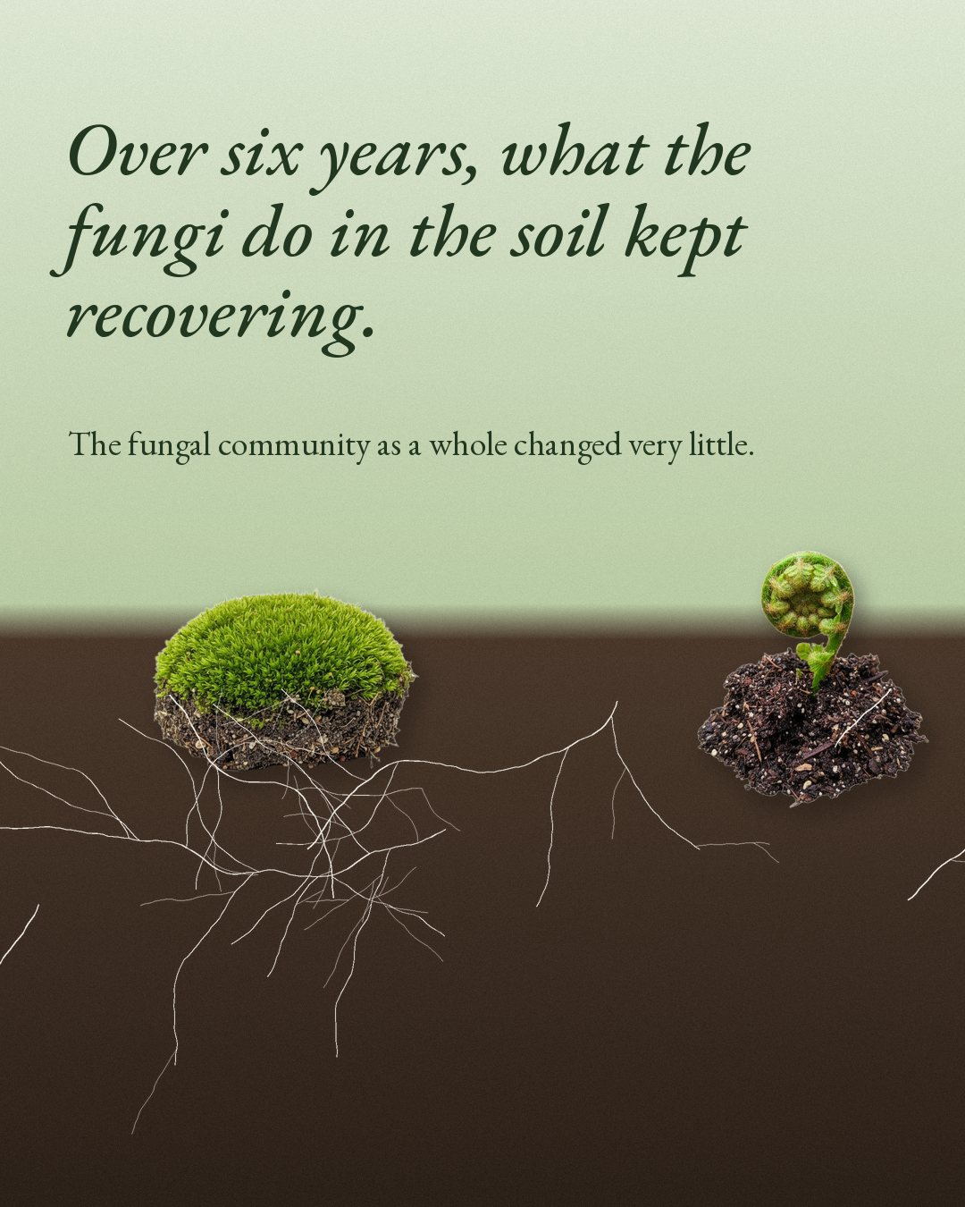
Notes:
Over six years, what the fungi do in the soil kept recovering. The fungal community as a whole changed very little.

Slide 4
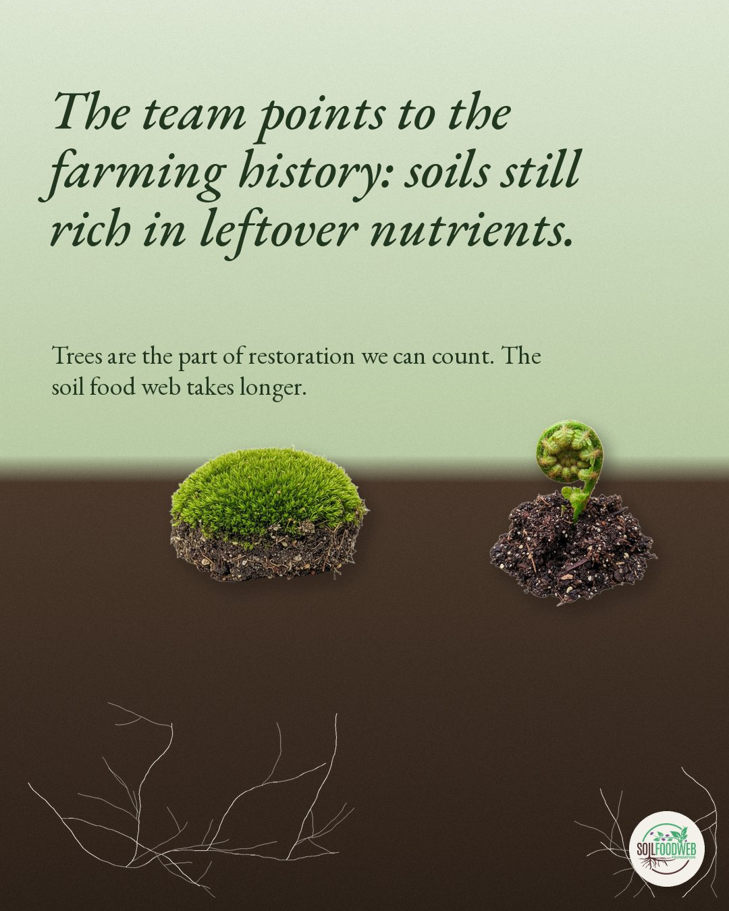
Notes:
The team points to the farming history: soils still rich in leftover nutrients. Trees are the part of restoration we can count. The soil food web takes longer.

Slide 5
Fri 30 Oct 2026 · Instagram, Facebook, LinkedIn
Research pick from Carla: mycorrhizal fungi extend cotton's phosphorus reach 15-fold
2 slides follow · images · Wormhole post k20261030
Notes:
Mycorrhizal fungi reached about 30 mm from cotton roots and carried phosphorus back to the plant. That is 15 times the soil a cotton root reaches for phosphorus on its own.
Our mentor Dr. Carla Portugal shared this field study with the team, and it is too good to keep to ourselves. Researchers grew cotton in the field at different phosphorus fertilizer rates and measured fungal hyphae at set distances from the roots.
What they found:
1. Arbuscular mycorrhizal hyphae took up and moved phosphorus up to 3 cm from the root surface.
2. Hyphal growth followed soil-available phosphorus. Low soluble P promoted the hyphae. High soluble P held them back.
3. The root's influence on the hyphae faded with distance.
4. Cotton took up the most phosphorus at a moderate rate, 150 kg P2O5 per hectare, so the authors recommend balancing fertilizer with the fungal pathway.
This matches what Dr. Elaine Ingham taught for decades: plants trade the sugars they make for nutrients the fungi bring in, and heavy soluble fertilizer switches that trade down.
Carla's caveat: the study looks at one crop, mycorrhizal fungi and soil chemistry only. It leaves out the grazers, predators and the rest of the soil food web, and it measures what happens in one field. It is a strong paper to follow.
Mai et al. 2019, European Journal of Soil Biology. Link in bio.
#SoilFoodWeb #SoilBiology #Mycorrhizae #Phosphorus #SoilHealth #RegenerativeAgriculture #SoilScience

Slide 6
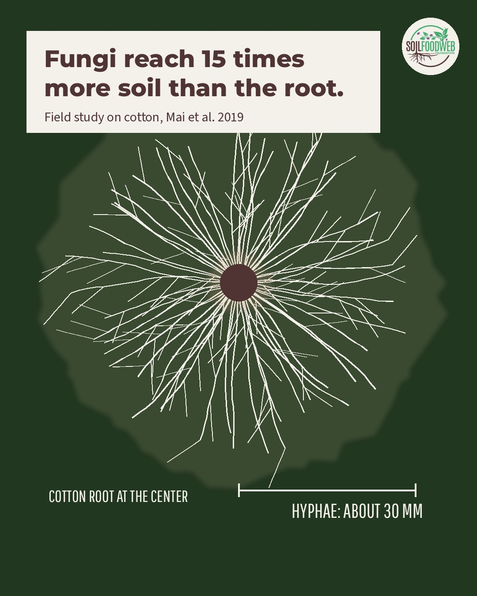
Notes:
Fungi reach 15 times more soil than the root.

Slide 7
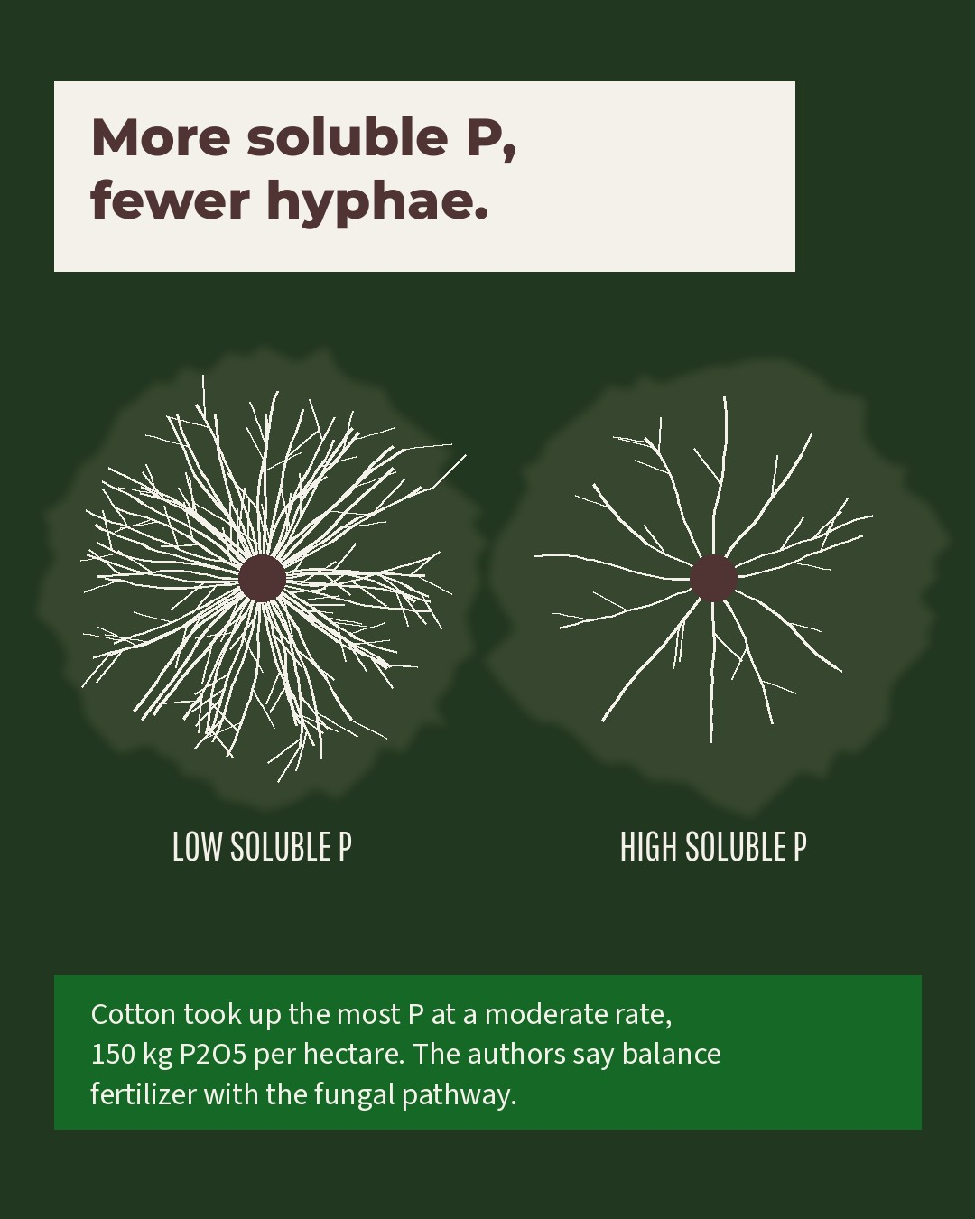
Notes:
More soluble P, fewer hyphae.

Slide 8
Sat 31 Oct 2026 · Instagram, Facebook, LinkedIn
Fun Soil News: October 2026
4 slides follow · images · Wormhole post p17
Notes:
Three soil stories from October that made our microscopes jealous. 🔬🍄
Yunnan, China: researchers at the Kunming Institute of Botany described Dianjunus rex, nicknamed D-rex. Its fruiting bodies grow up to 50 cm tall and 2.2 kg, straight from the woody roots of Chinese cork oak. That makes it the largest known in the phylum Ascomycota, and its family dates back about 65 million years, roughly a million years after the mass extinction that ended the age of dinosaurs. (Frontiers in Fungal Biology, 2026)
Konstanz, Germany: in forest soil at the University of Konstanz botanical garden, bacteria fully broke down films of new bioplastics in about 250 to 330 days. The team found the enzyme behind it anchored to the outside of the bacterial cell, and they think the cells eat their way into the film, leaving cell-sized holes. Ordinary polyethylene barely changed. (The ISME Journal, 2026)
South Australia: Flinders University resampled the same restoration plantings over six years. The jobs soil fungi do, cycling nutrients and breaking down organic matter, kept recovering. The mix of fungal species changed far less, and old fertiliser legacies may be holding it back. (Molecular Ecology, 2026)
Which one would you put under the microscope first? Tell us below. 💚
#FunSoilNews #SoilFoodWeb #SoilBiology #Fungi #SoilMicrobiology #LivingSoil

Slide 9
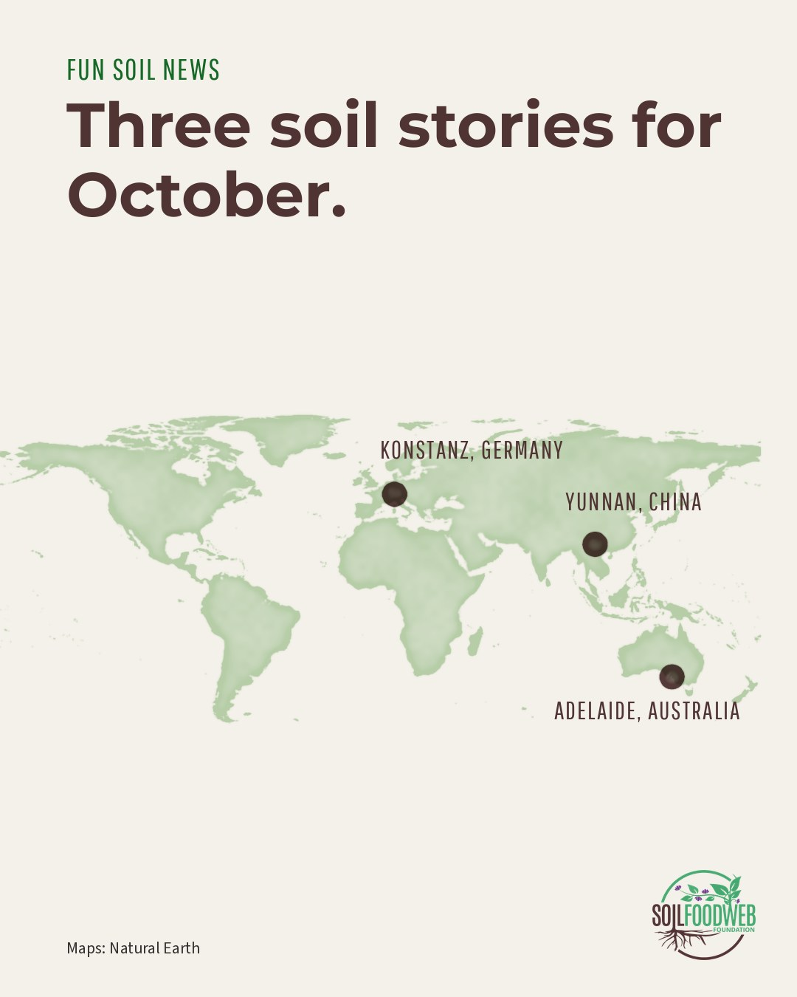
Notes:
FUN SOIL NEWS Three soil stories for October. YUNNAN, CHINA KONSTANZ, GERMANY ADELAIDE, AUSTRALIA

Slide 10
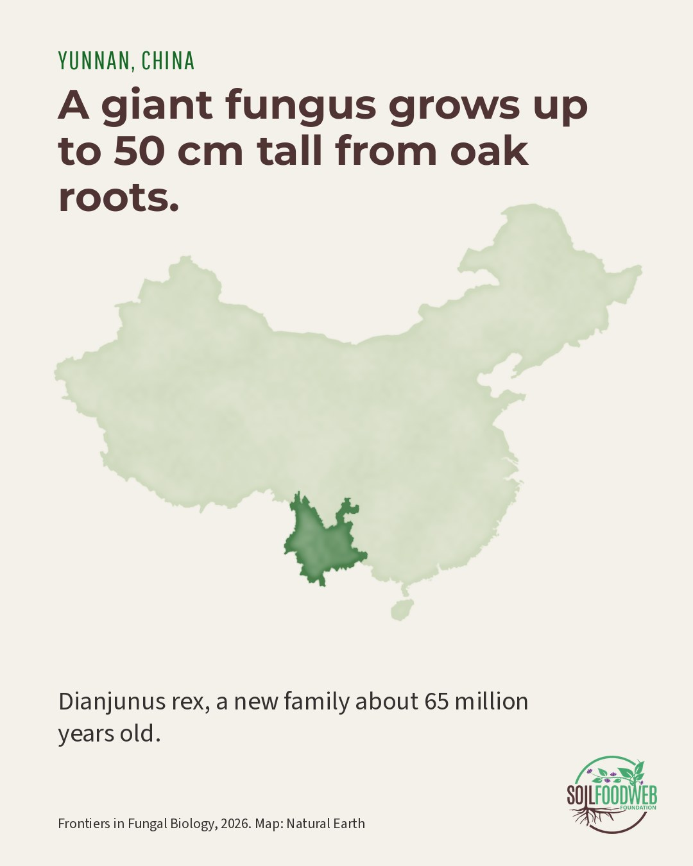
Notes:
YUNNAN, CHINA A giant fungus grows up to 50 cm tall from oak roots. Dianjunus rex, a new family about 65 million years old.

Slide 11
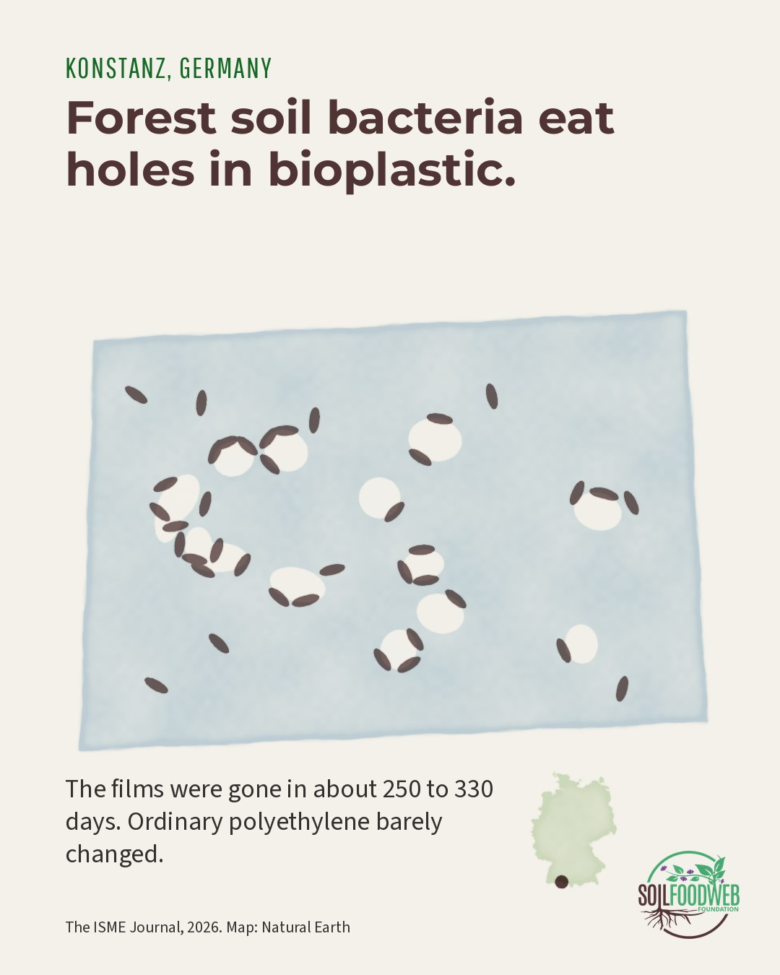
Notes:
KONSTANZ, GERMANY Forest soil bacteria eat holes in bioplastic. The films were gone in about 250 to 330 days. Ordinary polyethylene barely changed.

Slide 12
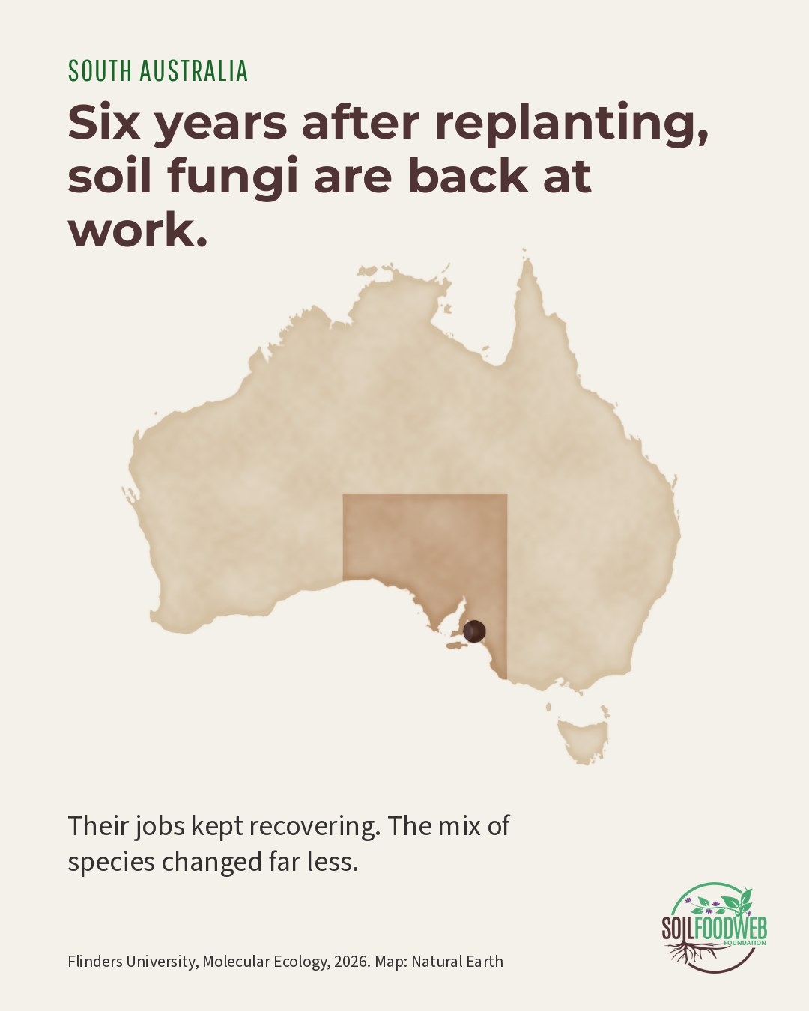
Notes:
SOUTH AUSTRALIA Six years after replanting, soil fungi are back at work. Their jobs kept recovering. The mix of species changed far less.

Slide 13
Sun 8 Nov 2026 · Instagram
Save Soil shoutout: soil may hold 59% of all life on Earth
1 slide follow · images · Wormhole post ss-05
Notes:
Soil may be home to 59% of all life on Earth (Anthony et al., PNAS 2023). 🔬
Bacteria, archaea, fungi, protozoa, nematodes, mites, springtails, earthworms, beetles. Save Soil's (Isha Foundation) paper on soil degradation and biodiversity walks through how they build the ground: microbes feed on sugars from roots and make sticky substances, fungal hyphae bind particles into crumbs, and earthworms and mites open channels for air and water.
About 33% of the world's soils are already moderately to highly degraded. Every one of those organisms is what regeneration brings back.
Link in bio: https://consciousplanet.org/en/save-soil/news/soil-degradation-and-biodiversity-loss
#SaveSoil #ConsciousPlanet #SoilFoodWeb #SoilHealth #SoilBiology #LivingSoil

Slide 14
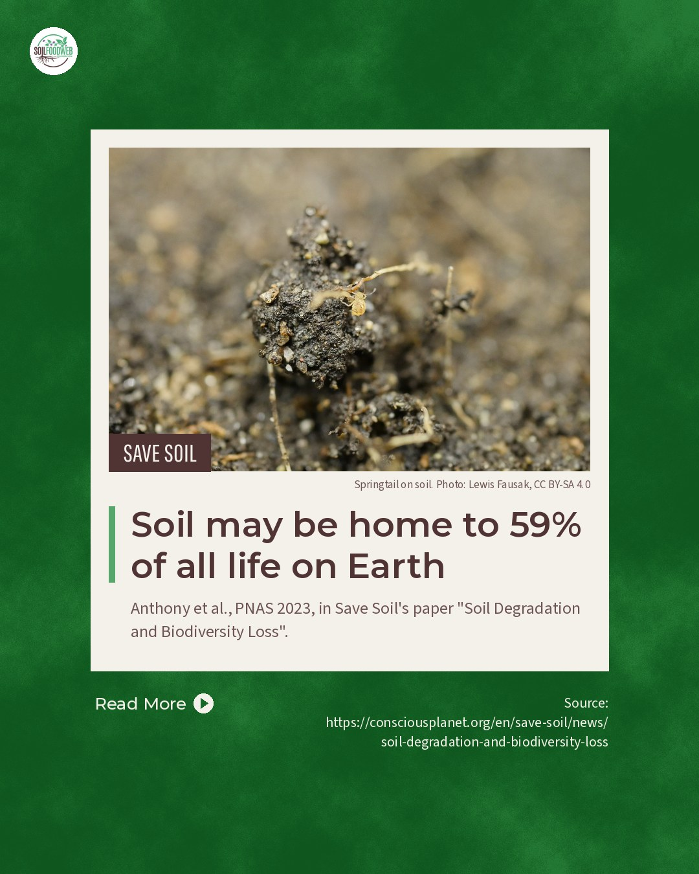
Notes:
Soil may be home to 59% of all life on Earth

Slide 15
Tue 17 Nov 2026 · LinkedIn
Save Soil shoutout: tillage releases carbon that soil life locked away
1 slide follow · images · Wormhole post ss-04
Notes:
A plough releases carbon that soil life spent years locking away.
Roots feed microbes, microbes make sticky polysaccharides, fungal hyphae wrap soil particles into aggregates, and carbon inside those crumbs is shielded from decomposition. Tillage breaks the crumbs open.
A meta-analysis of 46 studies found tilled soils emitted 21% more CO2 than untilled ones, and 29% more where soil organic carbon was below 1% (Abdalla et al. 2016). A six-year field trial measured 51% less CO2 on average under no-till with surface mulch (Mühlbachová et al. 2023).
Save Soil (Isha Foundation) gathers these in their paper on regenerative agriculture and climate.
What has cutting tillage looked like on the land you work with?
https://consciousplanet.org/en/save-soil/news/mitigating-climate-change-through-soil-revitalization-using-regenerative-ag
#SaveSoil #NoTill #SoilCarbon #SoilHealth #SoilFoodWeb

Slide 16
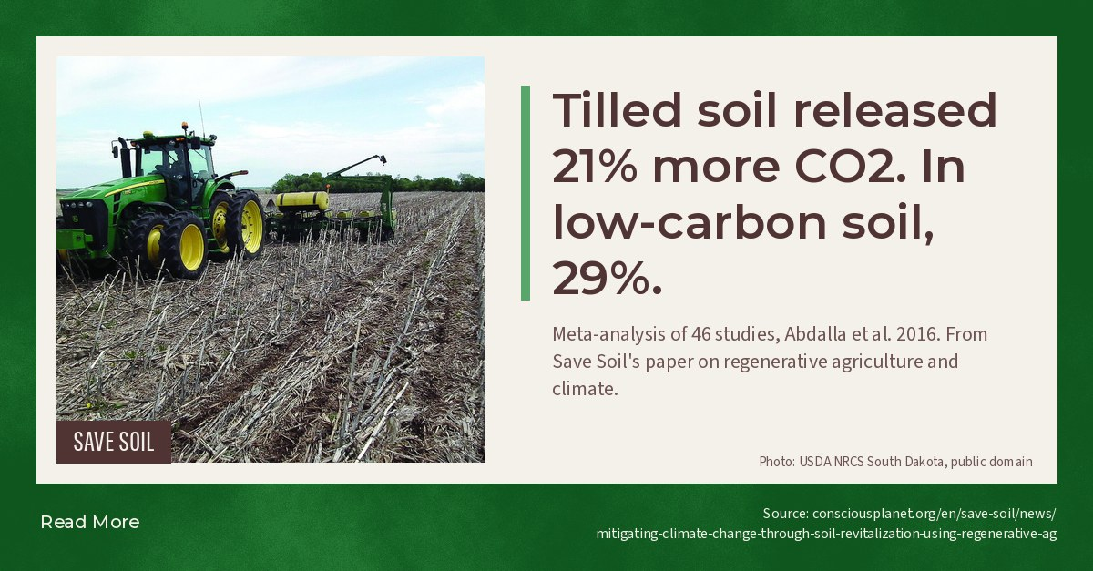
Notes:
Tilled soil released 21% more CO2. In low-carbon soil, 29%.

Slide 17
Wed 18 Nov 2026 · Instagram, Facebook, LinkedIn
Shoutout: beopen.earth
3 slides follow · images · Wormhole post ev-02
Notes:
There is now an open map of the bacteria and fungi in more than 100,000 soil samples from over 90 countries.
BeOpen, an open project by Biome Makers, collects, sequences and analyses every sample with the same protocol, so a sample from one continent can be compared directly with one from another. Researchers get free access to raw reads and processed data. Regulators can see which soil microorganisms have been found in each region, with every data point linked to where it came from. Labs can join as contributors with the Becrop Standard protocol.
Over 200 research partners and 3,000 datasets so far. Supported by the European Union and powered by Fields4Ever.
Go explore the Atlas: https://beopen.earth/atlas
#SoilFoodWeb #SoilMicrobiome #SoilBiology #OpenScience #SoilHealth

Slide 18
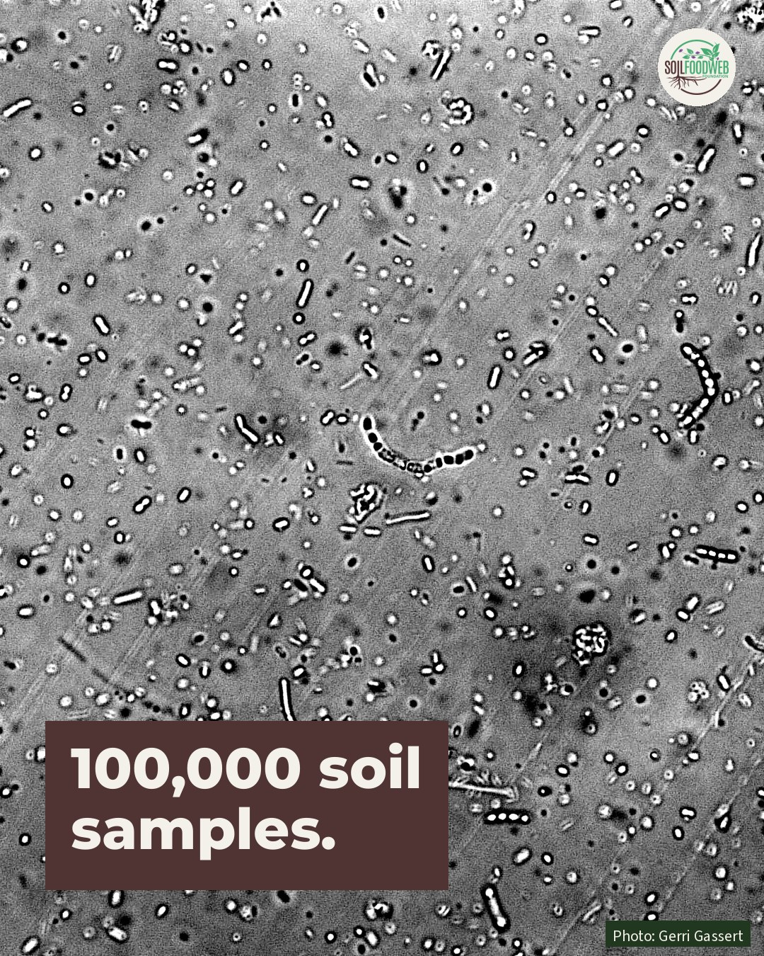
Notes:
100,000 soil samples, one open atlas.

Slide 19
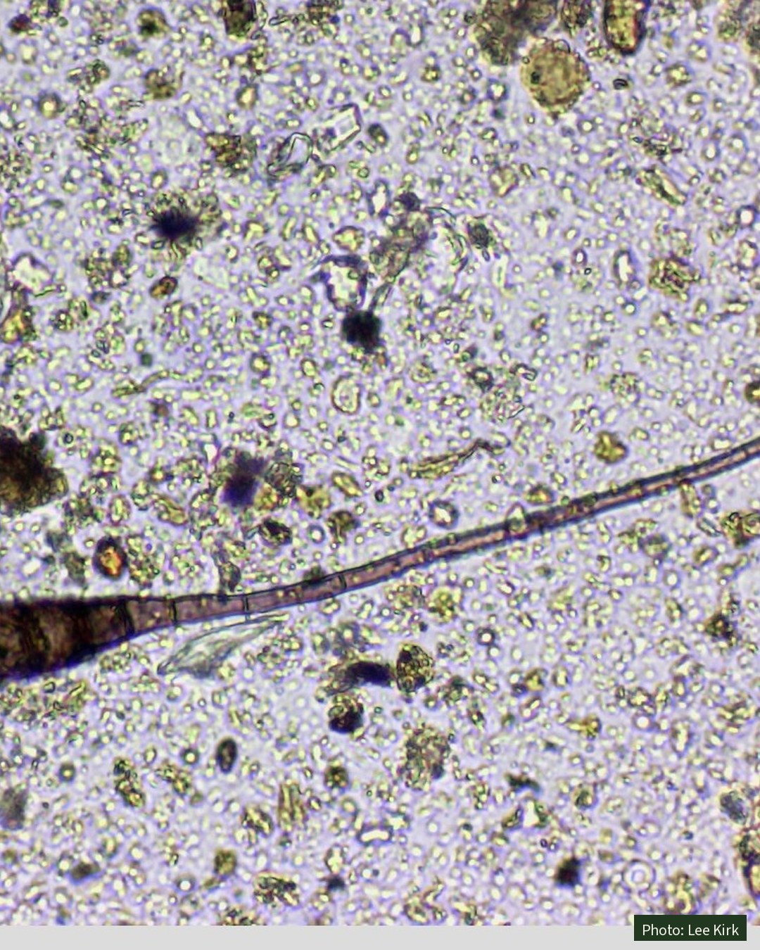
Notes:
Photo only: fungal hypha.

Slide 20
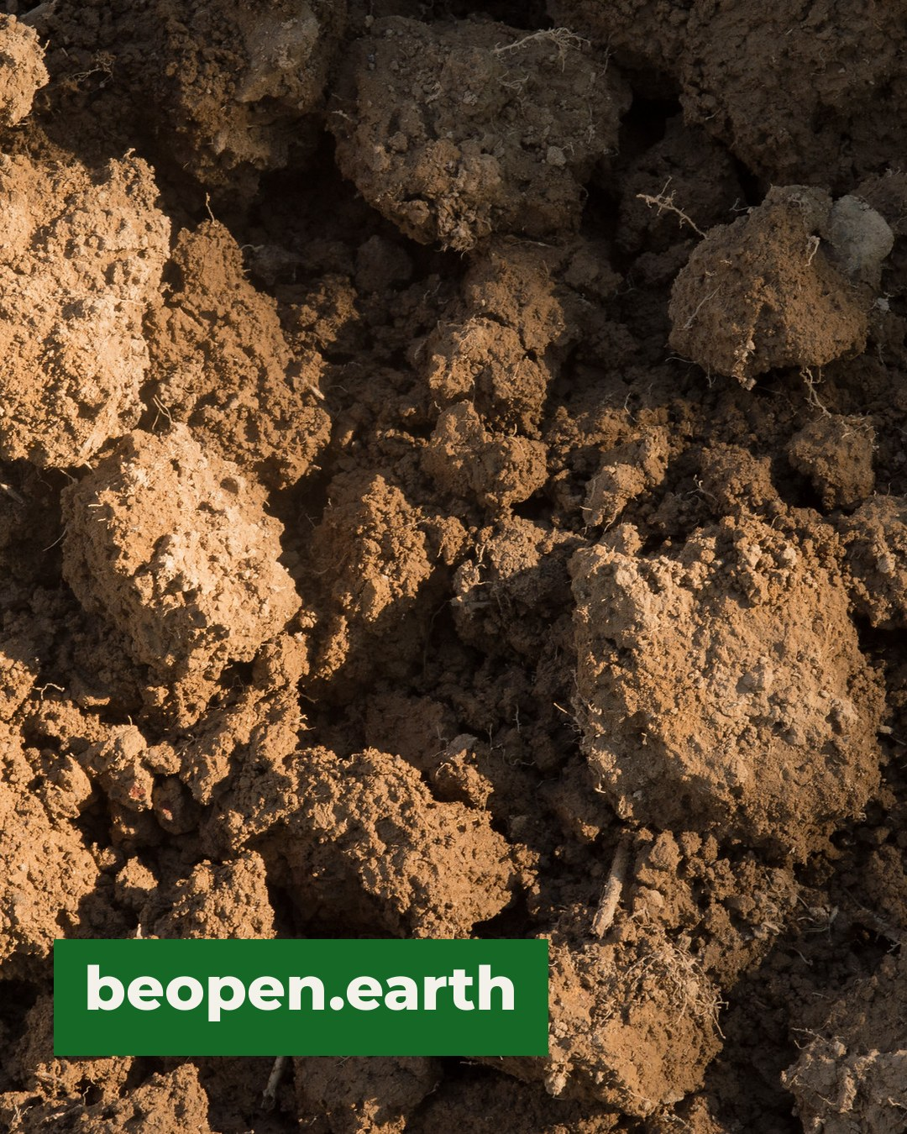
Notes:
Explore it at beopen.earth

Slide 21
Thu 19 Nov 2026 · LinkedIn
Save Soil shoutout: Secure Soil, Save Life
1 slide follow · images · Wormhole post ss-07
Notes:
Soil is starting to be written into law as a matter of security.
Three recent steps: the IUCN's mandate, from the World Conservation Congress, to develop a global legal instrument for soil security; the Pan-African Parliament's endorsement of a Model Law on sustainable soil management; and the European Union's Soil Monitoring Law.
Secure Soil, Save Life, from the Aroura Soil Security Think Tank, IUCN's World Commission on Environmental Law and Save Soil (Isha Foundation), calls soil "the planet's quiet infrastructure": it feeds people, filters water, regulates climate and holds biodiversity.
Should soil be treated as critical infrastructure where you work?
https://consciousplanet.org/en/save-soil/news/secure-soil-save-life
#SaveSoil #SoilSecurity #SoilPolicy #SoilHealth #SoilFoodWeb

Slide 22
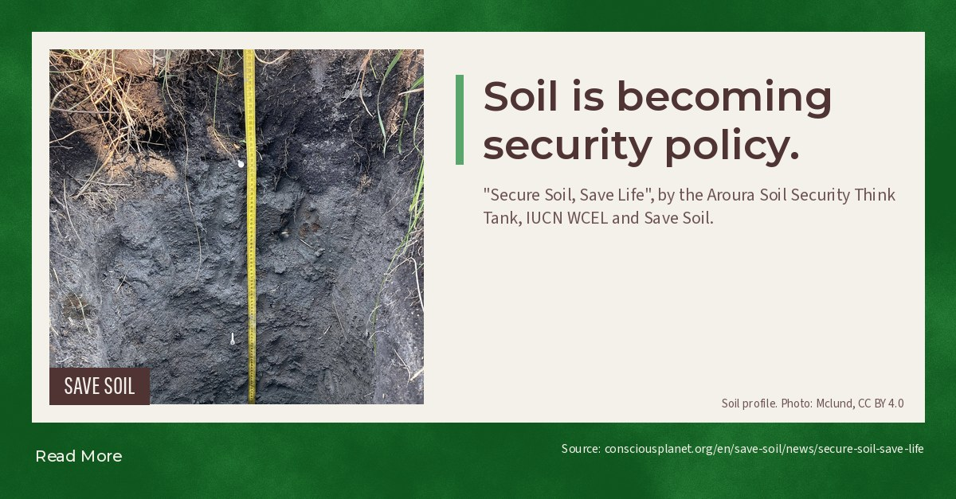
Notes:
Soil is becoming security policy.

Slide 23
Thu 19 Nov 2026 · Instagram
Save Soil shoutout: the soil carbon sponge cools the land
4 slides follow · images · Wormhole post ss-08
Notes:
Land with living soil runs cooler than bare ground, and water is the reason. 💧
Save Soil's (Isha Foundation) report The Soil Carbon Sponge, built on Walter Jehne's work, explains it. Soil rich in organic matter soaks up rain and holds it. Plants pull that water up and release it through their leaves, and evaporation carries heat away. When soil degrades, the water runs off, and the same sunlight heats the air instead.
From the soil food web side: the sponge is built by biology. Fungal hyphae and bacterial glues hold the pores open, and cover crops and mulch keep it from drying out.
Link in bio: https://consciousplanet.org/en/save-soil/news/the-soil-carbon-sponge
#SaveSoil #ConsciousPlanet #SoilFoodWeb #SoilHealth #SoilBiology #LivingSoil

Slide 24
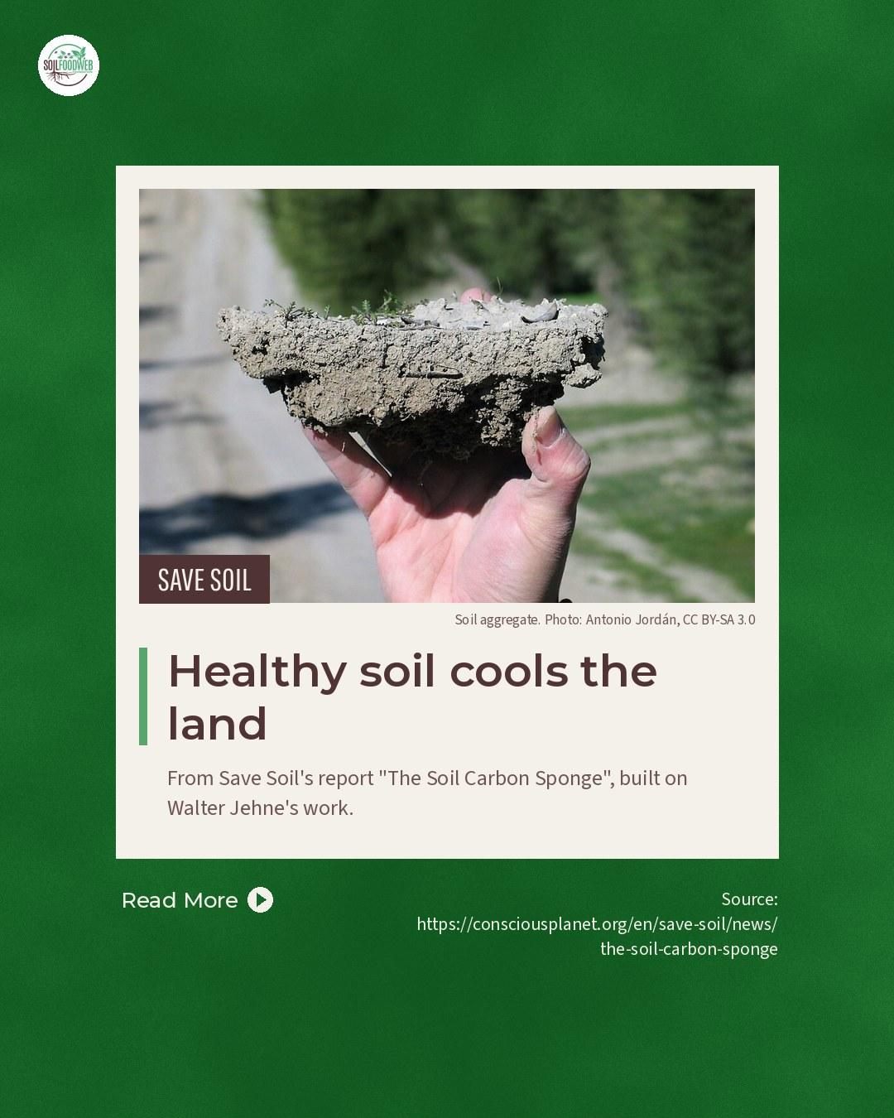
Notes:
Healthy soil cools the land

Slide 25
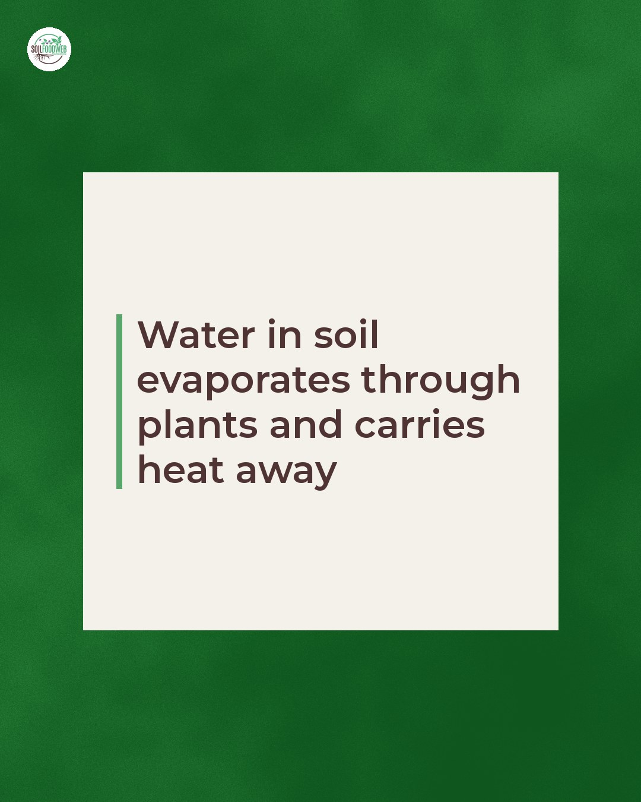
Notes:
Water in soil evaporates through plants and carries heat away

Slide 26
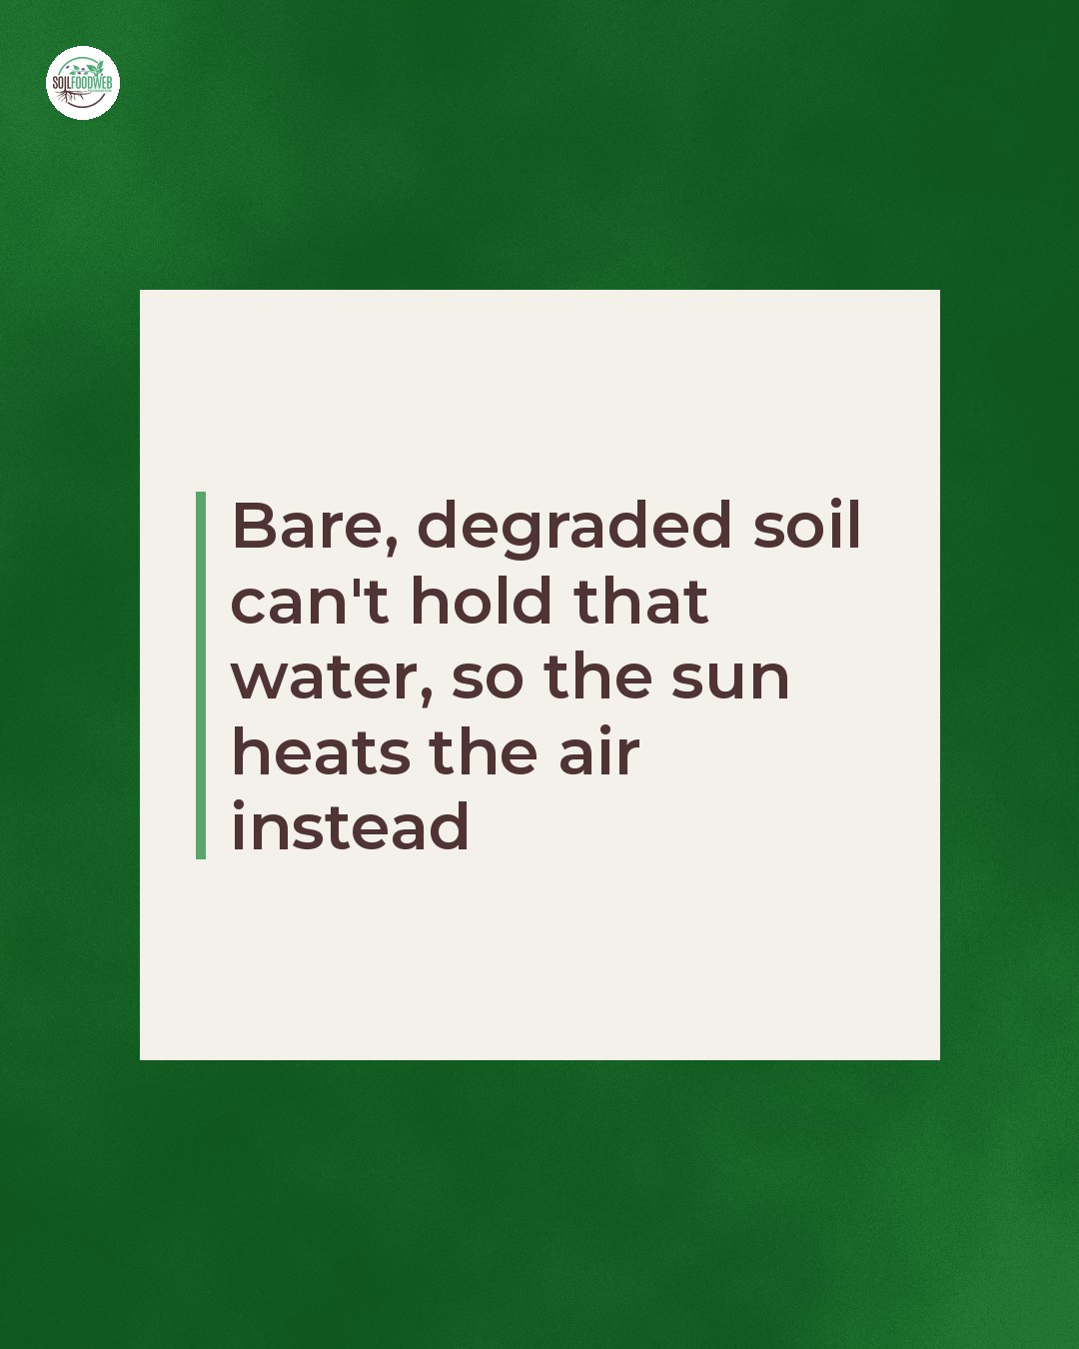
Notes:
Bare, degraded soil can't hold that water, so the sun heats the air instead

Slide 27
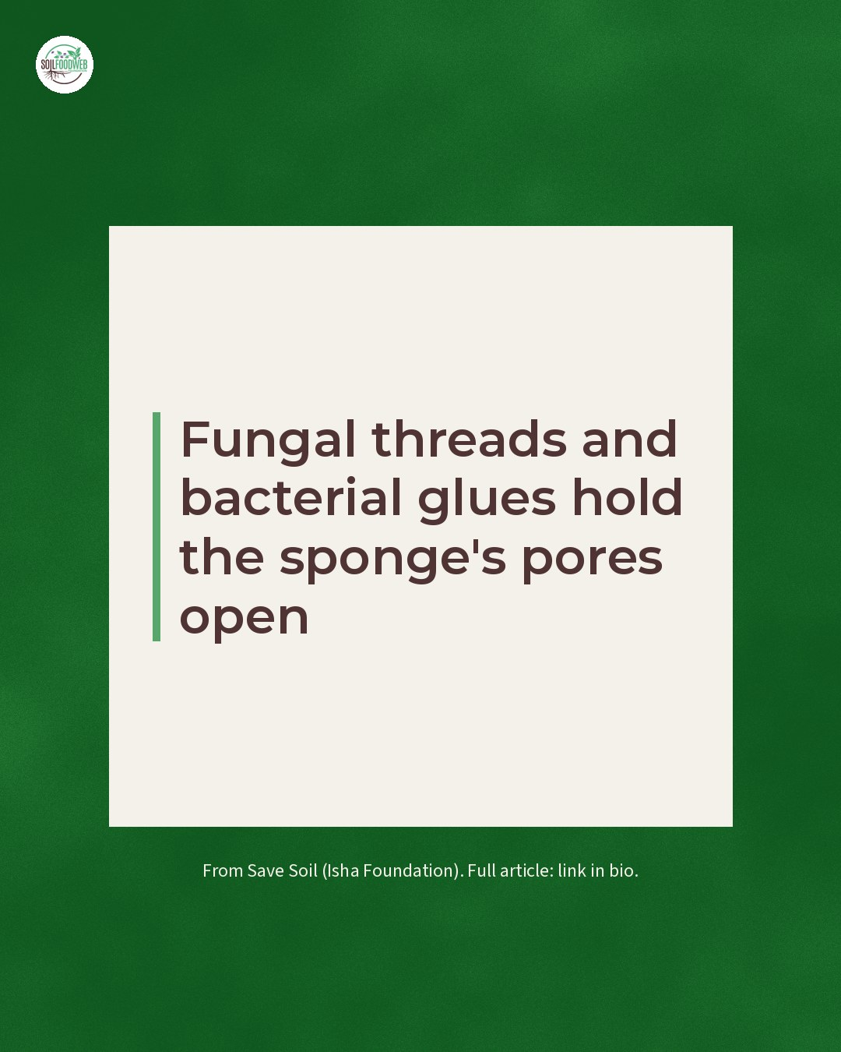
Notes:
Cover crops and mulch keep the ground from baking

Slide 28
Fri 20 Nov 2026 · Instagram, Facebook, LinkedIn
New study: regenerative farms store 39% more soil carbon
8 slides follow · editable · Wormhole post news-1000farms
Notes:
The most regenerative farms stored 39% more carbon in their soil. 🌱
A new peer-reviewed paper from Ecdysis Foundation's 1000 Farms Initiative measured working farms across North America. Compared with the most conventional farms, the most regenerative farms had 39% more total soil carbon, 77% more total fungi, and more soil microbes, insects, plants and birds. Yields matched national averages, and net profit per acre was similar.
One finding stands out for everyone who works with soil biology: a single regenerative practice on its own changed nothing. The results came from managing the whole system.
🔗 Read the full paper at the link in our bio.
#RegenerativeAgriculture #SoilCarbon #SoilHealth #SoilFoodWeb

Slide 29



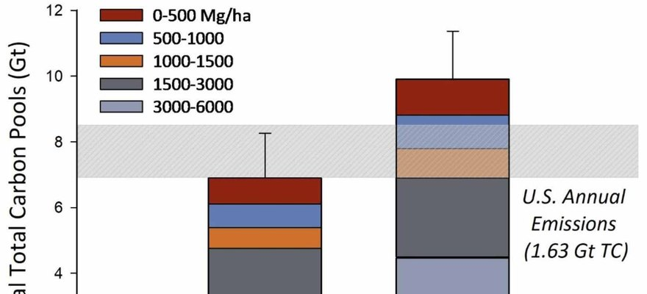


ENVIRONMENTAL RESEARCH: FOOD SYSTEMS
Figure 2, Lundgren et al. 2026, CC BY 4.0
Regenerative farms stored 39% more soil carbon
A study of working farms across North America.
Read More
Source:
doi.org/10.1088/2976-601X/ae8f4e

Slide 30


1,000 Farms
The 1000 Farms Initiative measured working farms across North America, from the most conventional to the most regenerative. Led by Ecdysis Foundation.

Slide 31


39% more soil carbon
on the most regenerative farms.

Slide 32


+181% total fungi
in the most regenerative soils (figure 3 of the paper).

Slide 33


More life everywhere
Soil microbes, insects, plants and birds. The more biodiversity, the more carbon stored.

Slide 34

Same yields
Yields matched national averages, and net profit per acre was similar.

Slide 35

The whole system counts
Farms using one regenerative practice alone looked like conventional farms.

Slide 36


Read the paper
Lundgren et al., Environmental Research: Food Systems, 2026. Link in bio.

Slide 37
Fri 20 Nov 2026 · Instagram
Save Soil shoutout: Valluvan's coconut farm, 0.86% to 2.33% organic matter
6 slides follow · images · Wormhole post ss-01
Notes:
Valluvan's yields did nothing for three years. Then they climbed. 🌴
His Tamil Nadu coconut farm started at 0.86% soil organic matter. He dug trenches between the coconut rows and filled them with leaf litter, stopped burning fronds, mulched around every crop, and planted nutmeg, banana, black pepper, turmeric and timber trees in layers under the palms.
From year four the coconuts rose: 140 nuts per tree, up from 90-100. By year seven the soil read 1.5% organic matter, and the latest test reads 2.33%. Fertiliser costs are under a tenth of what they were.
In 2018, after two years of drought, more than 1,200 mm of rain fell in a few days. His neighbours' open wells stood 6-7 feet lower than his.
That buried leaf litter is food for fungi and bacteria, and their glues and threads are what turn soil into a sponge.
Full case study from Save Soil (Isha Foundation). Link in bio: https://consciousplanet.org/en/save-soil/news/save-soil-movement-model-farm-proof-of-concept
#SaveSoil #ConsciousPlanet #SoilFoodWeb #SoilHealth #SoilBiology #LivingSoil

Slide 38
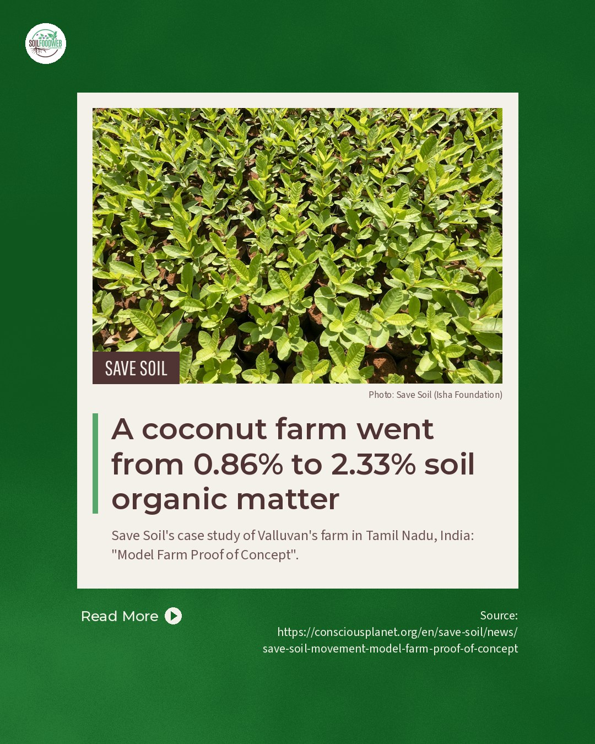
Notes:
A coconut farm went from 0.86% to 2.33% soil organic matter

Slide 39
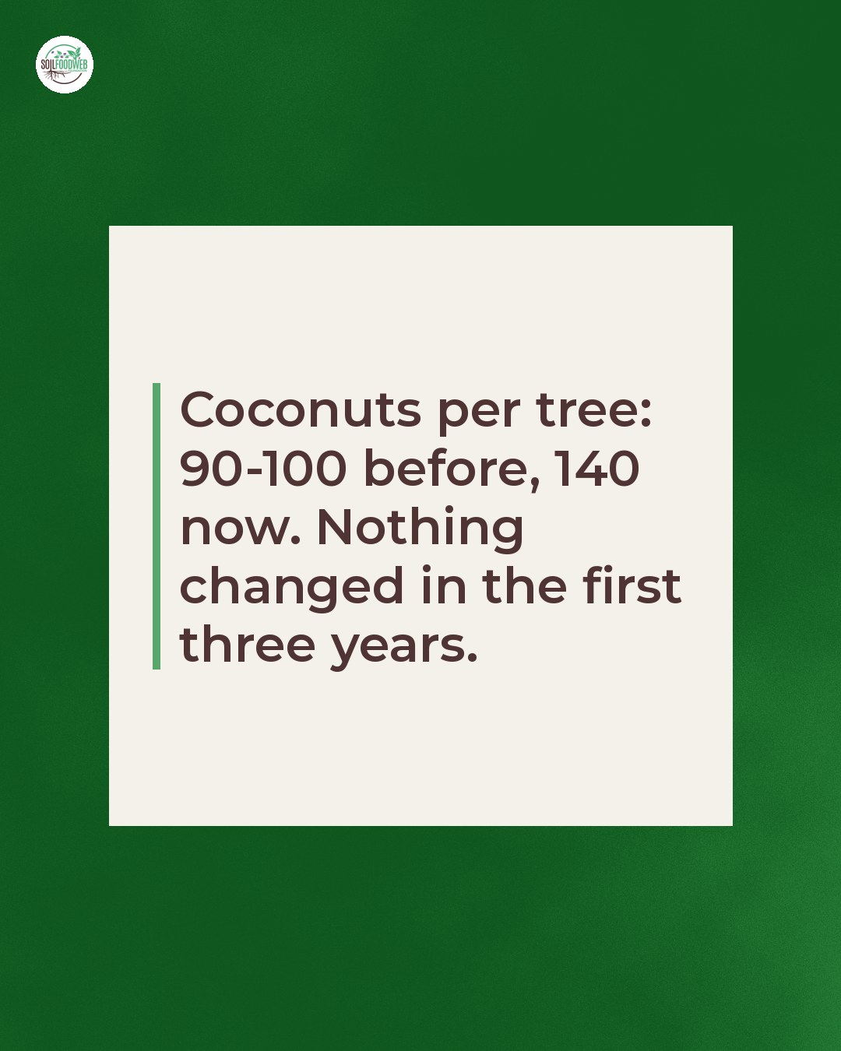
Notes:
Coconuts per tree: 90-100 before, 140 now. Nothing changed in the first three years.

Slide 40
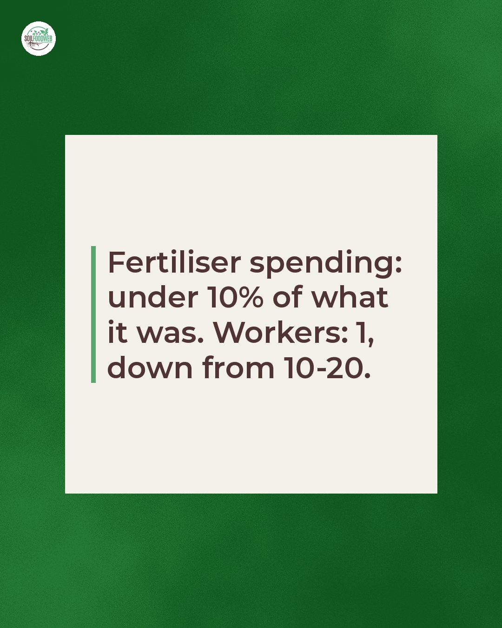
Notes:
Fertiliser spending: under 10% of what it was. Workers: 1, down from 10-20.

Slide 41
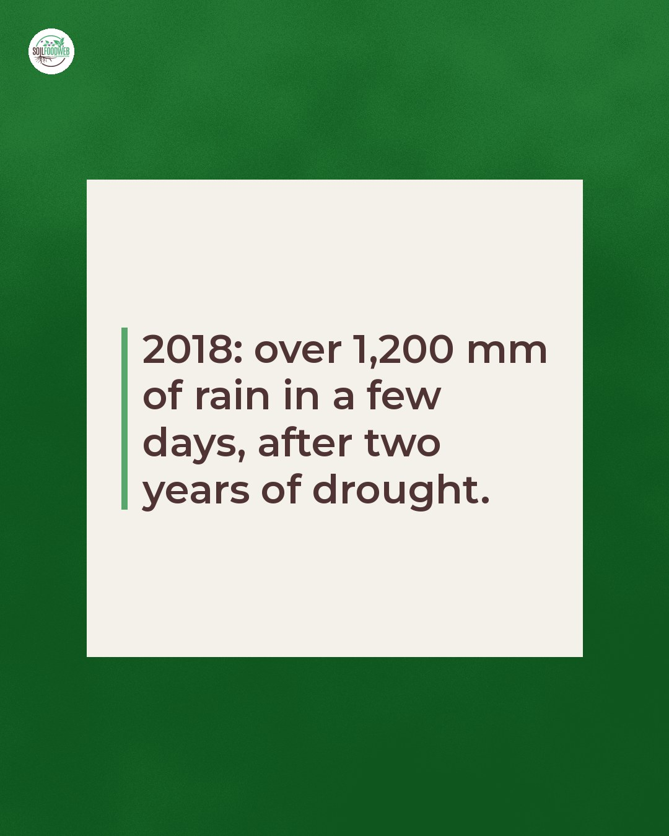
Notes:
2018: over 1,200 mm of rain in a few days, after two years of drought.

Slide 42
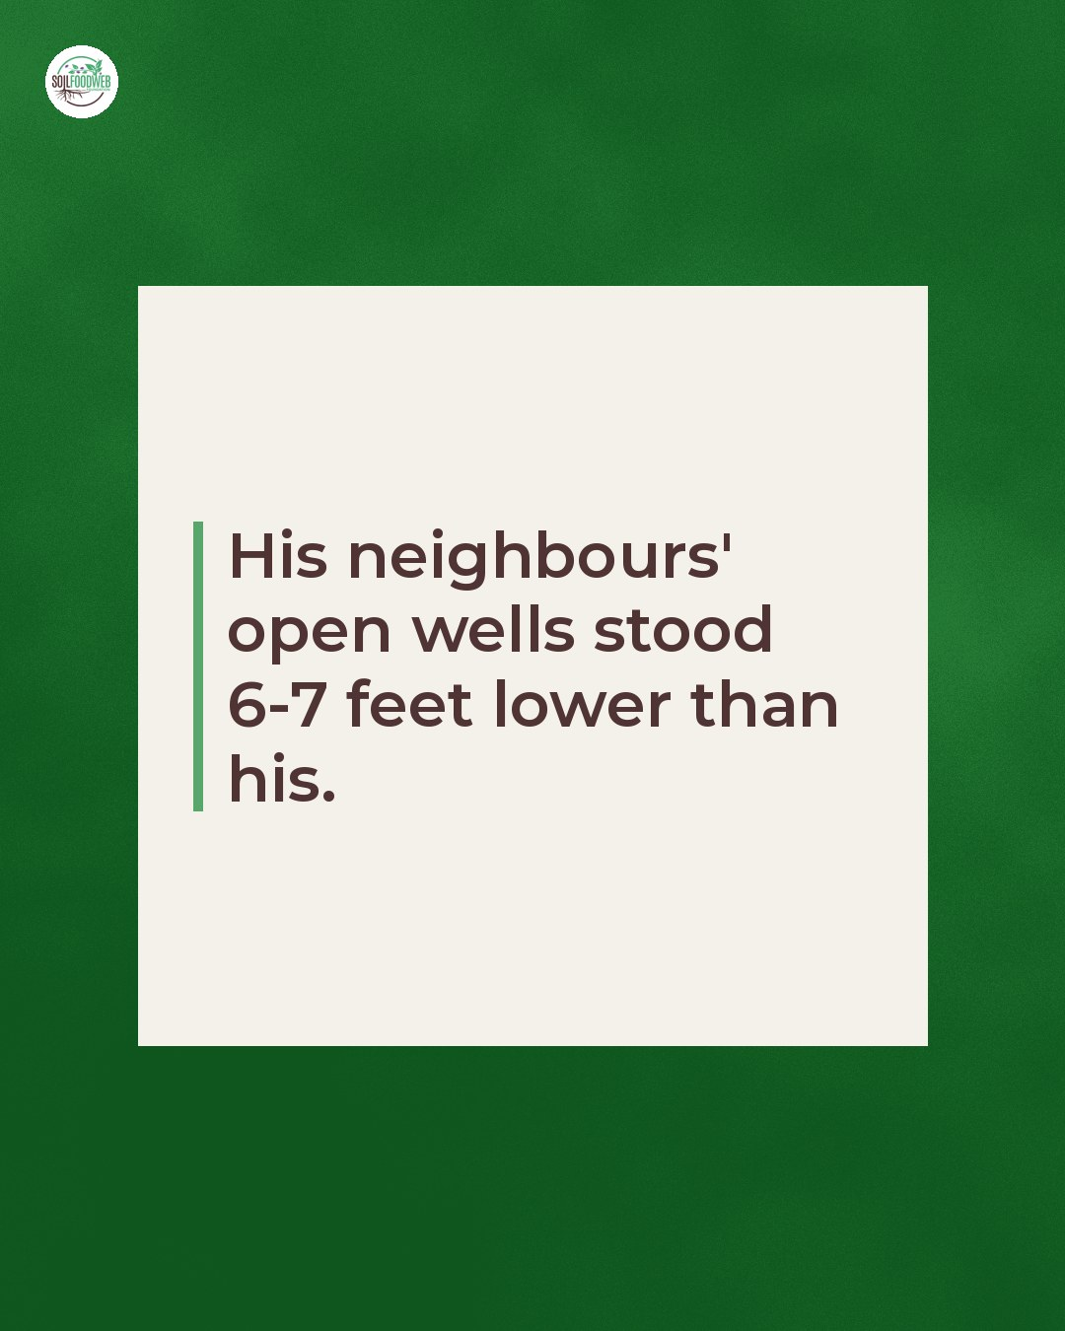
Notes:
His neighbours' open wells stood 6-7 feet lower than his.

Slide 43
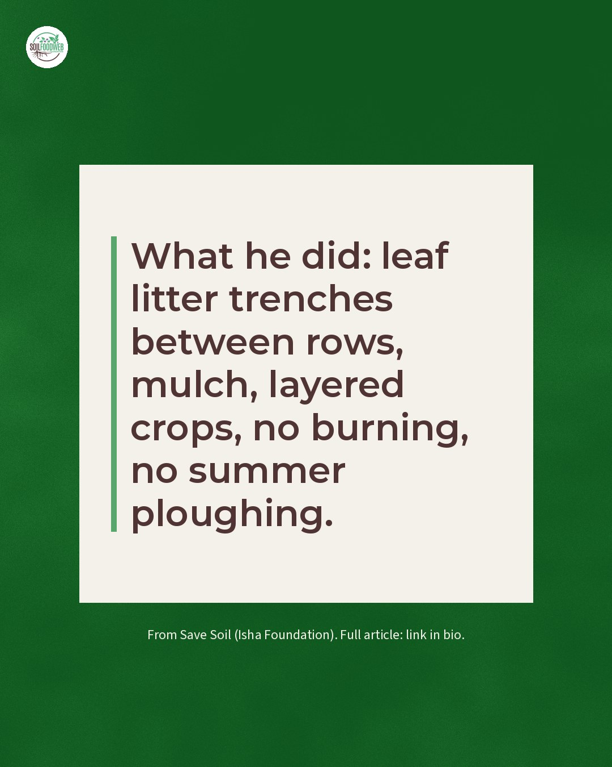
Notes:
What he did: leaf litter trenches between rows, mulch, layered crops, no burning, no summer ploughing.

Slide 44
Sun 22 Nov 2026 · Instagram
Save Soil shoutout: 5 numbers that show what soil life does
6 slides follow · images · Wormhole post ss-02
Notes:
Same almond yields, twice the profit, and water that soaks in six times faster. 🌱
That is one of the numbers Save Soil (Isha Foundation) gathered to argue that soil biology belongs in how countries track climate adaptation. Our favourites:
1. Infiltration 6x faster in regenerative almond orchards (LaCanne et al. 2021).
2. Microbial biomass carbon 133% higher in regenerative organic systems (Mäder et al. 2025).
3. Diversified rotations had 2.4 to 13.5 times more earthworm biomass than rye monoculture in a long-term Lithuanian trial (Bogušas et al. 2022).
4. Glomalin-related soil protein, made by mycorrhizal fungi, up 24% under perennial pasture restoration (Abán et al. 2025).
5. In drought years, maize in legume and manure systems outyielded conventional by 38 to 137% (Lotter et al. 2003).
Every one of these is the soil food web at work. Save this for the next time someone asks whether biology shows up in the numbers.
Link in bio: https://consciousplanet.org/en/save-soil/news/soil-as-a-lead-indicator-of-the-global-goal-on-adaptation-gga
#SaveSoil #ConsciousPlanet #SoilFoodWeb #SoilHealth #SoilBiology #LivingSoil

Slide 45
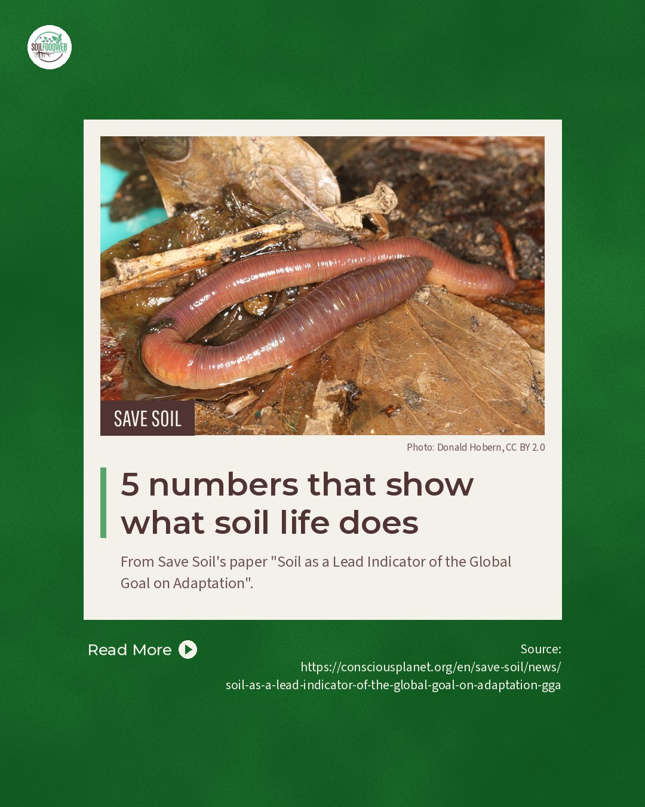
Notes:
5 numbers that show what soil life does

Slide 46
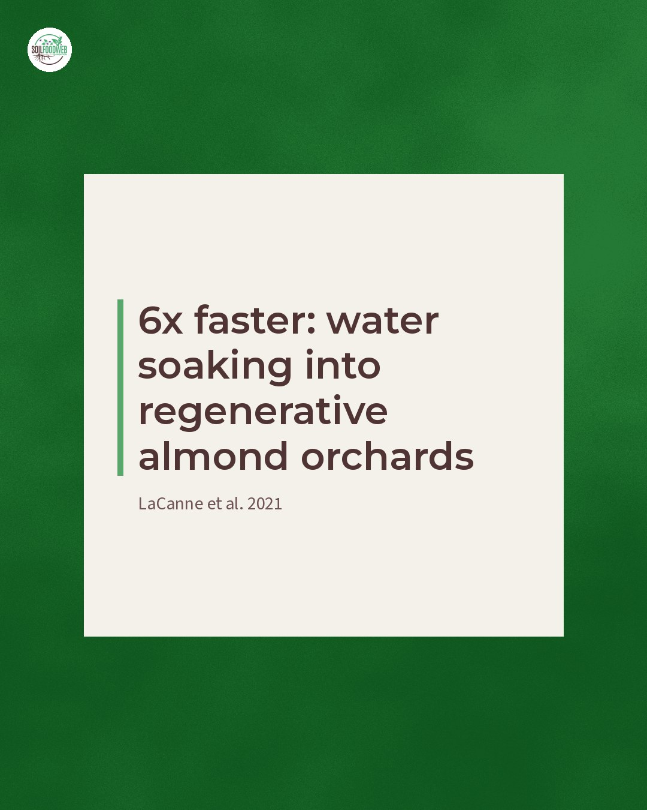
Notes:
6x faster: water soaking into regenerative almond orchards (LaCanne et al. 2021)

Slide 47
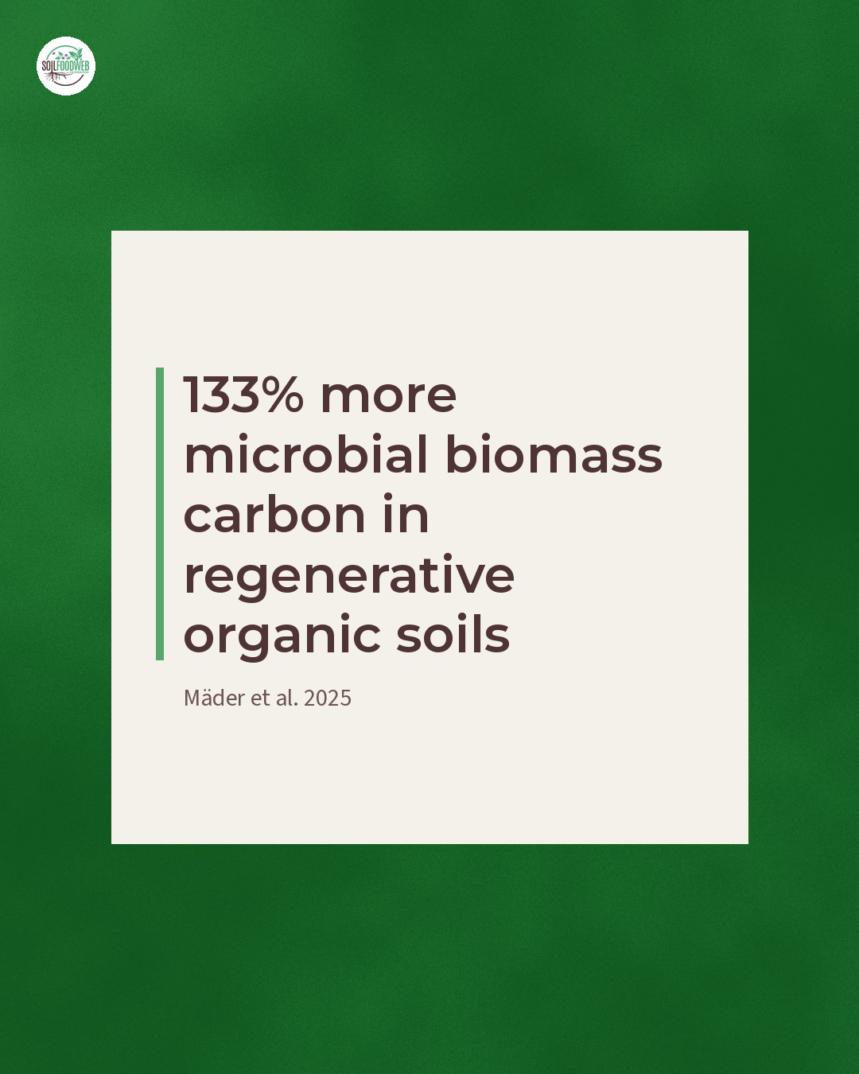
Notes:
133% more microbial biomass carbon in regenerative organic soils (Mäder et al. 2025)

Slide 48
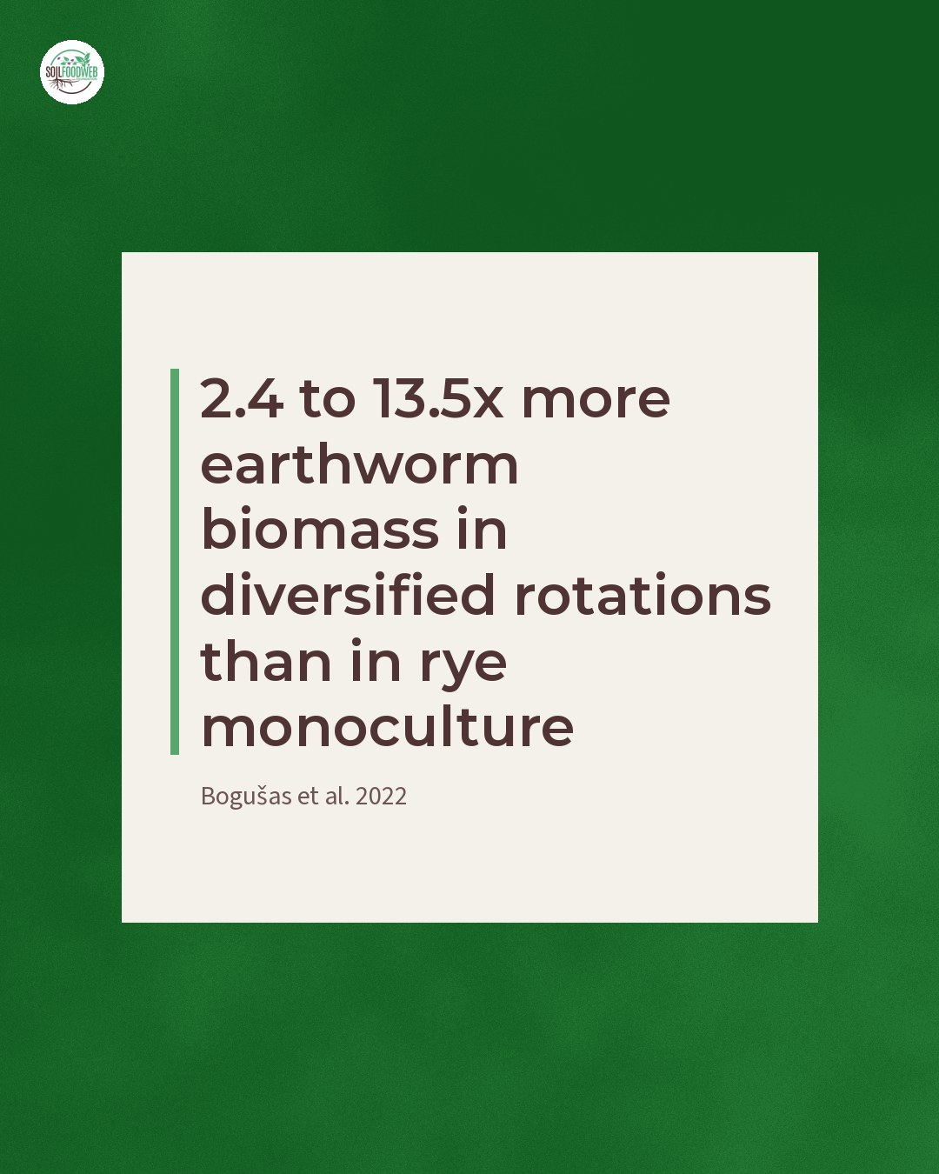
Notes:
2.4 to 13.5x more earthworm biomass in diversified rotations than in rye monoculture (Bogušas et al. 2022)

Slide 49
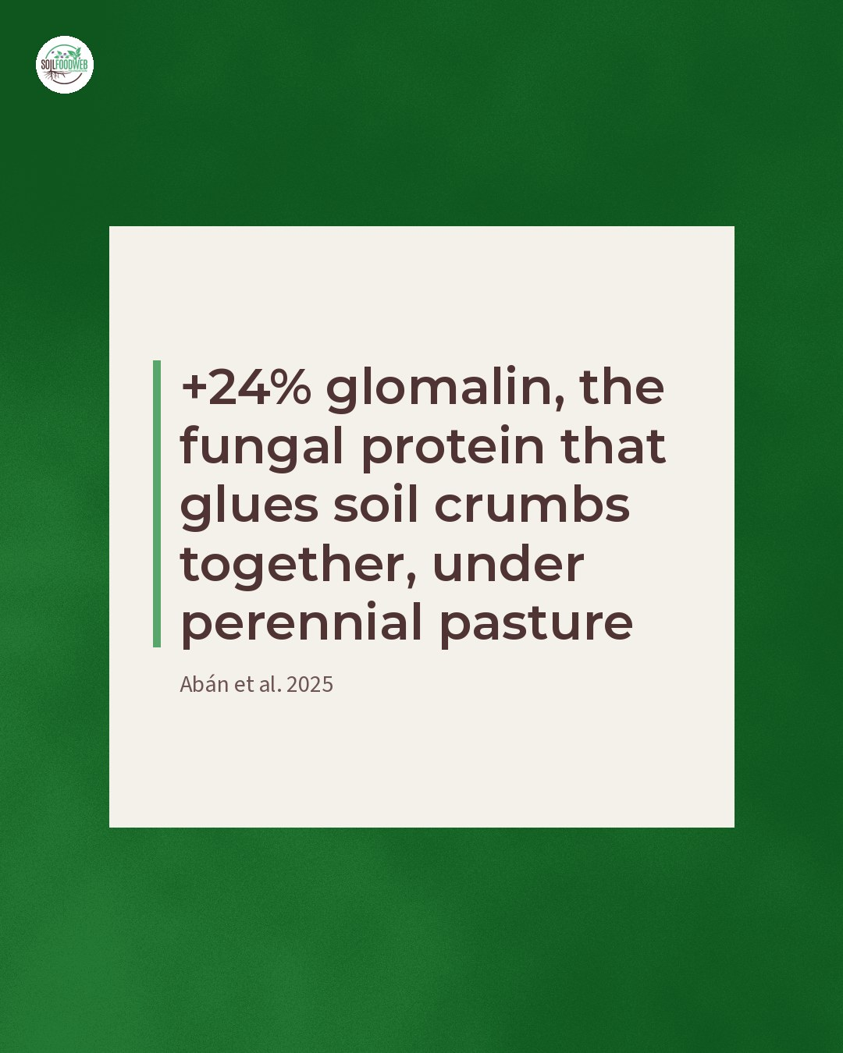
Notes:
+24% glomalin, the fungal protein that glues soil crumbs together, under perennial pasture (Abán et al. 2025)

Slide 50
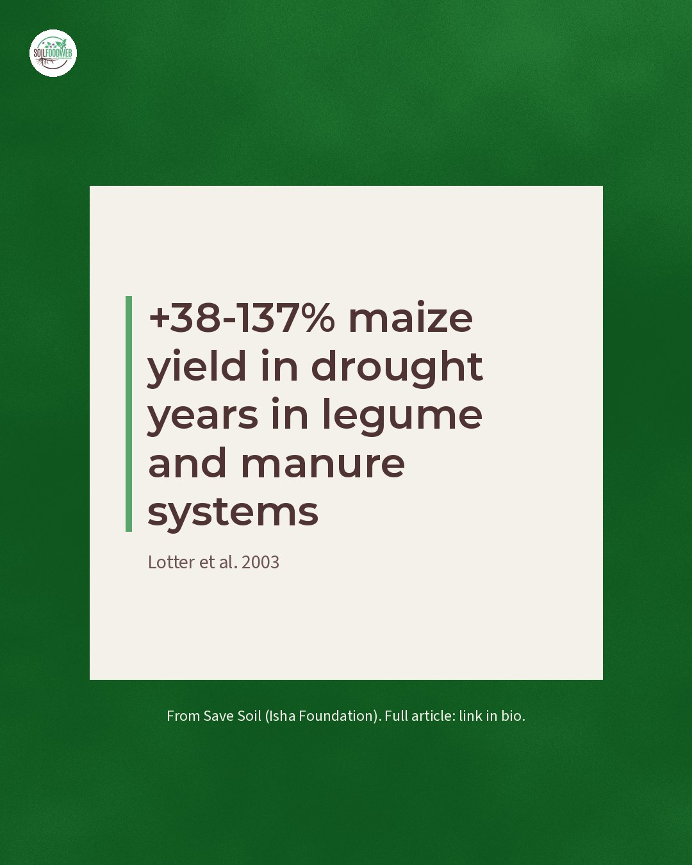
Notes:
+38-137% maize yield in drought years in legume and manure systems (Lotter et al. 2003)

Slide 51
Tue 24 Nov 2026 · LinkedIn
Save Soil shoutout: COP30, USD 1 trillion for energy, USD 9 billion for agriculture
1 slide follow · images · Wormhole post ss-03
Notes:
COP30's Action Agenda put nearly USD 1 trillion behind renewable energy and modern grids. Agriculture and food systems: USD 9 billion.
Save Soil's (Isha Foundation) COP30 analysis lays out the gap. The Sharm el-Sheikh Joint Work, the only official negotiation track on agriculture and food systems, closed with no outcome, and its mandate ends in 2026. Their verdict on the USD 9 billion: an order of magnitude too small to unlock what soils can do for the climate.
What would it take for soil to get its own line in climate finance?
https://consciousplanet.org/en/save-soil/news/cop30-a-turning-point-for-climate-action-but-agriculture-and-soils-left-behind
#SaveSoil #COP30 #ClimateFinance #SoilHealth #SoilFoodWeb

Slide 52
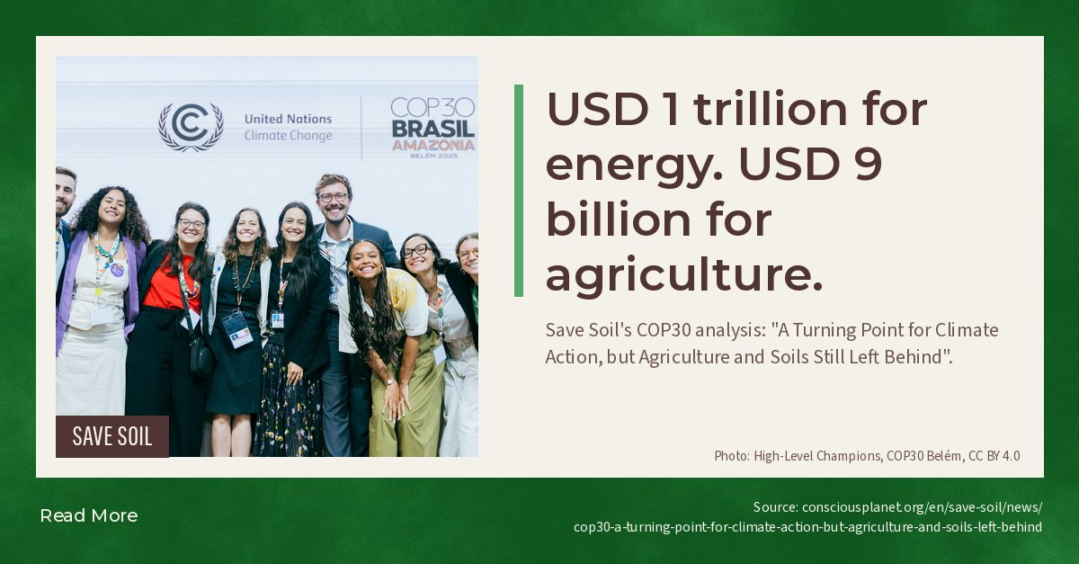
Notes:
USD 1 trillion for energy. USD 9 billion for agriculture.

Slide 53
Tue 24 Nov 2026 · Instagram
Save Soil shoutout: healthy soil and healthy humans
5 slides follow · images · Wormhole post ss-06
Notes:
In baboons, the soil they lived on shaped their gut bacteria 15 times more strongly than their genes. 🦠
In people, a study of over 1,000 adults found that less than 8% of the gut microbiome is inherited (Rothschild et al. 2018). The rest comes from what we eat and where we live, and soil is part of that.
The same soil life decides what is in our food. Mycorrhizal fungi move copper, iron, nitrogen, phosphorus and zinc into roots. Rhizobia in legume roots fix nitrogen from the air.
From Save Soil's (Isha Foundation) paper Healthy Soil and Healthy Humans. Link in bio: https://consciousplanet.org/en/save-soil/news/healthy-soil-and-healthy-humans
#SaveSoil #ConsciousPlanet #SoilFoodWeb #SoilHealth #SoilBiology #LivingSoil

Slide 54
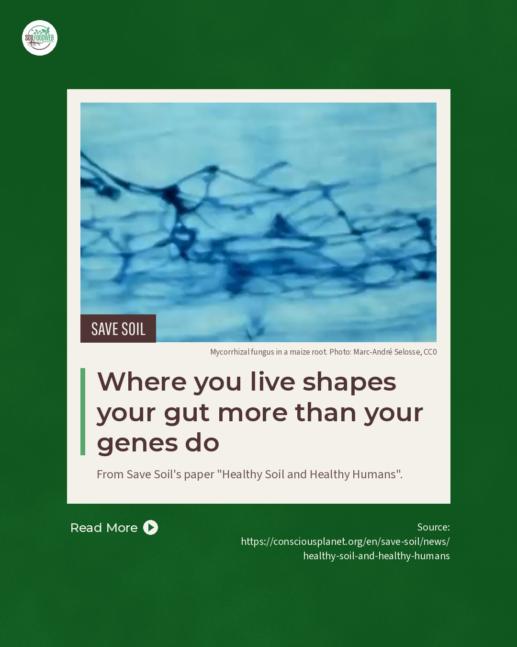
Notes:
Where you live shapes your gut more than your genes do

Slide 55
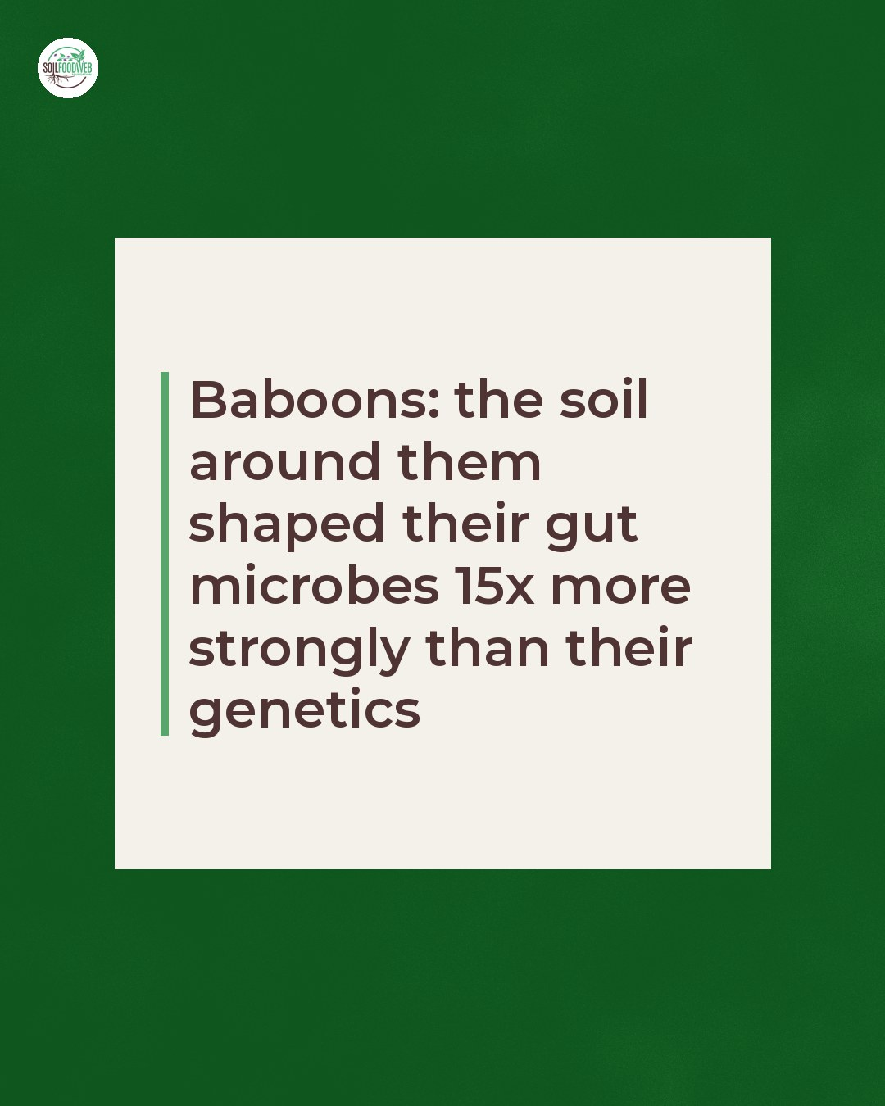
Notes:
Baboons: the soil around them shaped their gut microbes 15x more strongly than their genetics

Slide 56
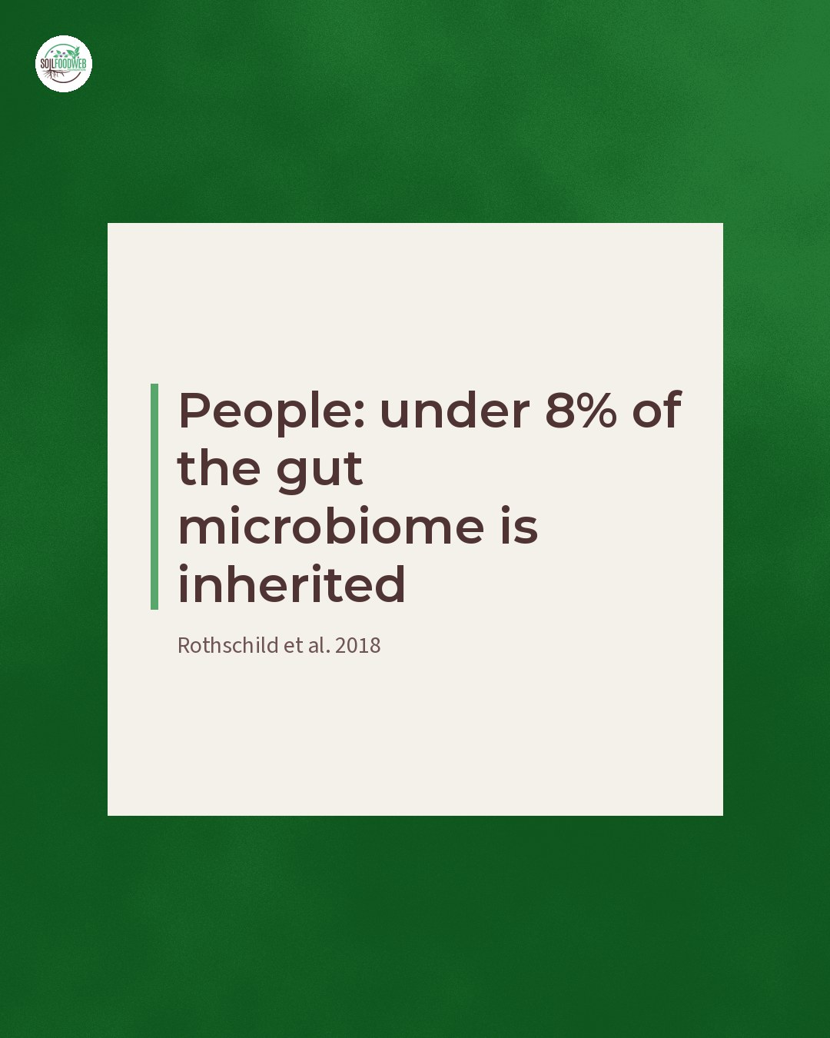
Notes:
People: under 8% of the gut microbiome is inherited (Rothschild et al. 2018)

Slide 57
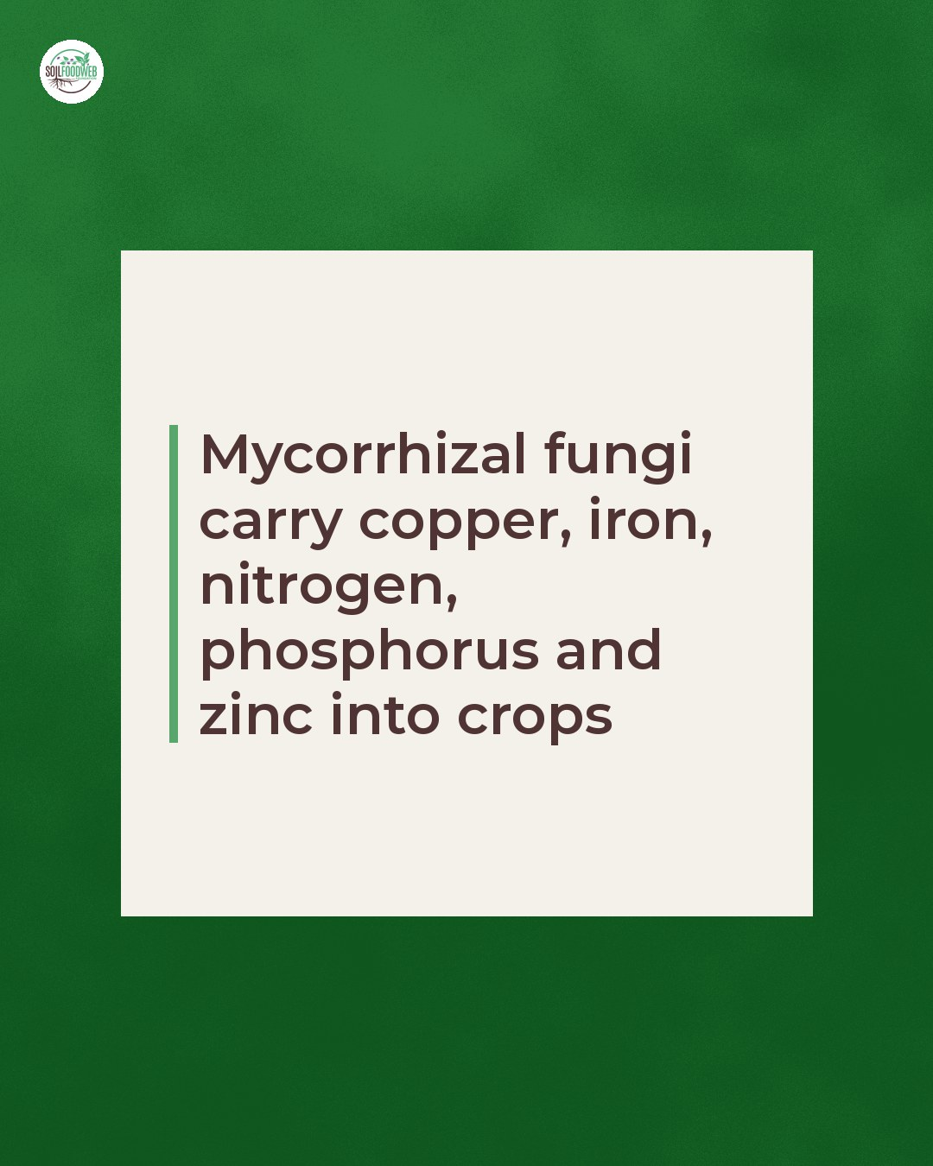
Notes:
Mycorrhizal fungi carry copper, iron, nitrogen, phosphorus and zinc into crops

Slide 58
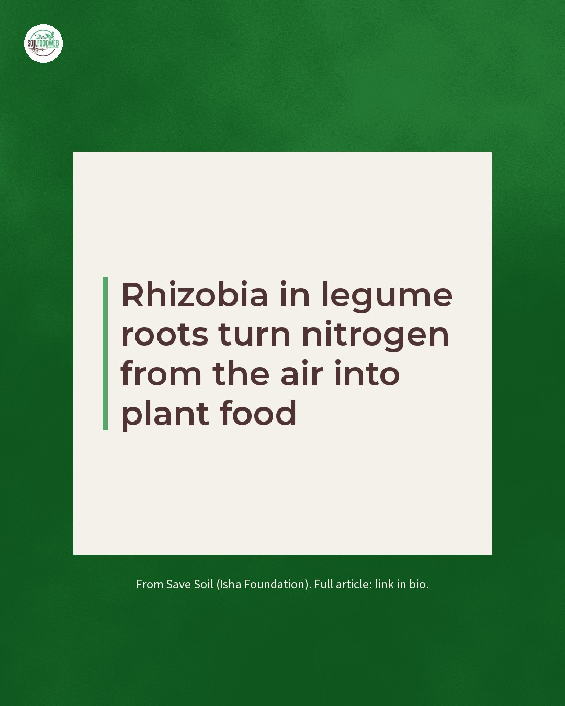
Notes:
Rhizobia in legume roots turn nitrogen from the air into plant food

Slide 59
Fri 27 Nov 2026 · Instagram, Facebook, LinkedIn
Fun Soil News: November 2026
6 slides follow · editable · Wormhole post pl20261127
Notes:
Five pieces of good soil news from around the world this month. 🌍
[One line per story, with the country and the source.]
📤 Send this to a friend who needs good news.
#FunSoilNews #SoilHealth #GoodNews #SoilFoodWeb

Slide 60

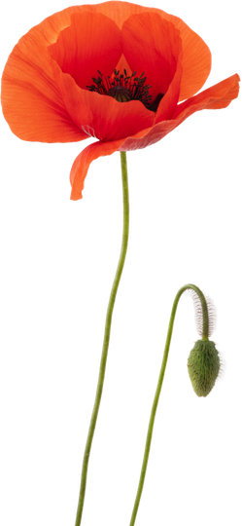


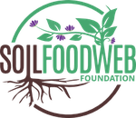
Fun Soil News: November 2026.

Slide 61



FUN SOIL NEWS · NOVEMBER 2026
Story 1. Country in big type, one sentence, source.

Slide 62


FUN SOIL NEWS · NOVEMBER 2026
Story 2. Country in big type, one sentence, source.

Slide 63


FUN SOIL NEWS · NOVEMBER 2026
Story 3. Country in big type, one sentence, source.

Slide 64

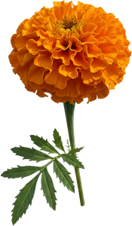
FUN SOIL NEWS · NOVEMBER 2026
Story 4. Country in big type, one sentence, source.

Slide 65

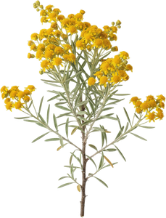
FUN SOIL NEWS · NOVEMBER 2026
Story 5. Country in big type, one sentence, source.

Slide 66
Fri 18 Dec 2026 · Instagram, Facebook, LinkedIn
Fun Soil News: December 2026
6 slides follow · editable · Wormhole post pl20261218
Notes:
Five pieces of good soil news to end the year. 🌍
[One line per story, with the country and the source.]
📤 Send this to a friend who needs good news.
#FunSoilNews #SoilHealth #GoodNews #SoilFoodWeb

Slide 67

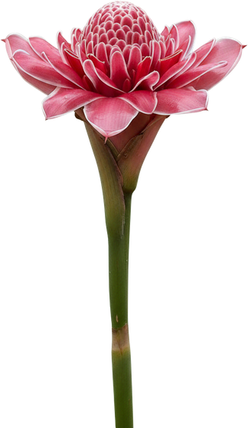
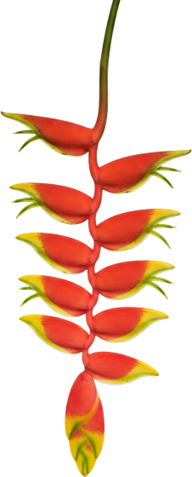
Fun Soil News: December 2026.

Slide 68

FUN SOIL NEWS · DECEMBER 2026
Story 1. Country in big type, one sentence, source.

Slide 69

FUN SOIL NEWS · DECEMBER 2026
Story 2. Country in big type, one sentence, source.

Slide 70

FUN SOIL NEWS · DECEMBER 2026
Story 3. Country in big type, one sentence, source.

Slide 71


FUN SOIL NEWS · DECEMBER 2026
Story 4. Country in big type, one sentence, source.

Slide 72

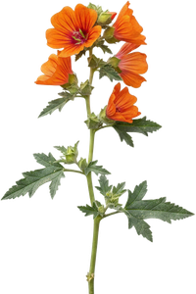
FUN SOIL NEWS · DECEMBER 2026
Story 5. Country in big type, one sentence, source.

Slide 73
Sat 9 Jan 2027 · LinkedIn
Save Soil shoutout (LinkedIn): 10 billion microorganisms in a gram of soil
1 slide follow · images · Wormhole post j20270109b
Notes:
One gram of soil holds about 10 billion microorganisms, from thousands of different species.
That figure opens Save Soil's (Isha Foundation) article "What's Missing? Life. A Microscopic View of Why Living Soils Are So Crucial", by Lu Yu. It describes soil as minerals, organisms and organic matter interacting in the soil food web, and it cites Dr. Elaine Ingham: the nutrients plants need for hundreds of years are already in the sand, silt and clay. Microbes make them available.
The practices it points to are the ones our students learn: minimal or no tillage, cover crops all year and animals back on cropland. Save Soil has gathered more than 700 sustainable soil management practices from around the world.
If you work in agriculture: how many of your management decisions start with the biology?
https://consciousplanet.org/save-soil/news/a-microscopic-view-of-why-living-soils-are-so-crucial
#SaveSoil #SoilFoodWeb #SoilBiology #SoilHealth #RegenerativeAgriculture

Slide 74
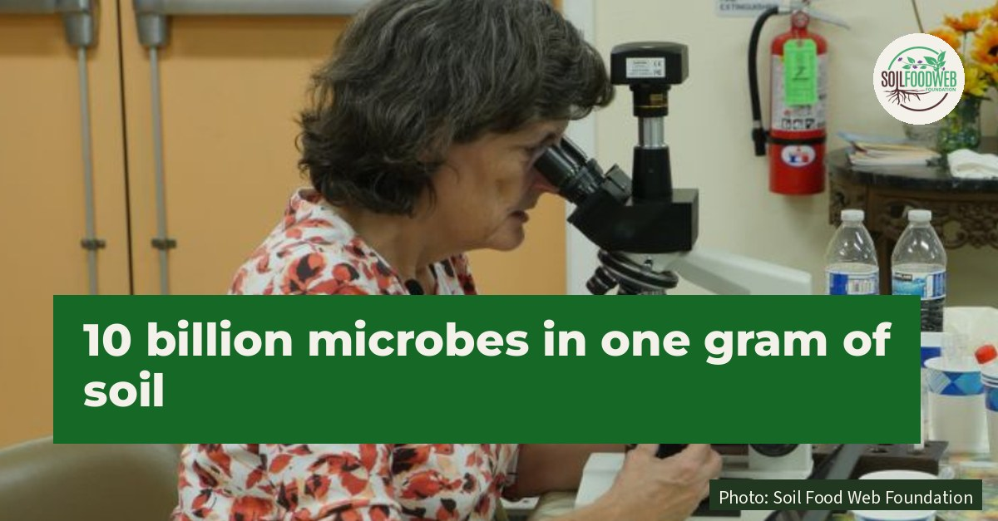
Notes:
About 10 billion microorganisms in one gram of soil.

Slide 75
Sat 23 Jan 2027 · LinkedIn
Save Soil shoutout (LinkedIn): fertility trees, 33 million planted in West Africa
1 slide follow · images · Wormhole post j20270123a
Notes:
33 million trees, planted by farmers to feed their soil.
APAF, the Association for the Promotion of Fertility Trees, Agroforestry and Forestry, started in Togo in 1991. By the end of 2024 it counted 88,051 hectares of agroforestry fields, 6,255 hectares of forest and 33,138,080 fertility, forest and fruit trees planted, with 68,051 farming families taking part across Togo, Côte d'Ivoire, Burkina Faso, Senegal, Cameroon and Benin.
Fertility trees are mostly legumes. Their deep taproots partner with Rhizobium bacteria and mycorrhizal fungi, and farmers grow coffee, cocoa, cashew, banana, maize, millet and sorghum in their shade. Dr. Nathalie Benziwa Johnson of the University of Lomé calls it "a sustainable agricultural technique that requires no fossil fuels."
Save Soil (Isha Foundation) published the full interview.
Which tree partners are farmers in your region using to rebuild soil?
https://consciousplanet.org/save-soil/news/restoring-africas-soils-through-fertility-trees-an-interview-with-dr-nathalie-ben

Slide 76
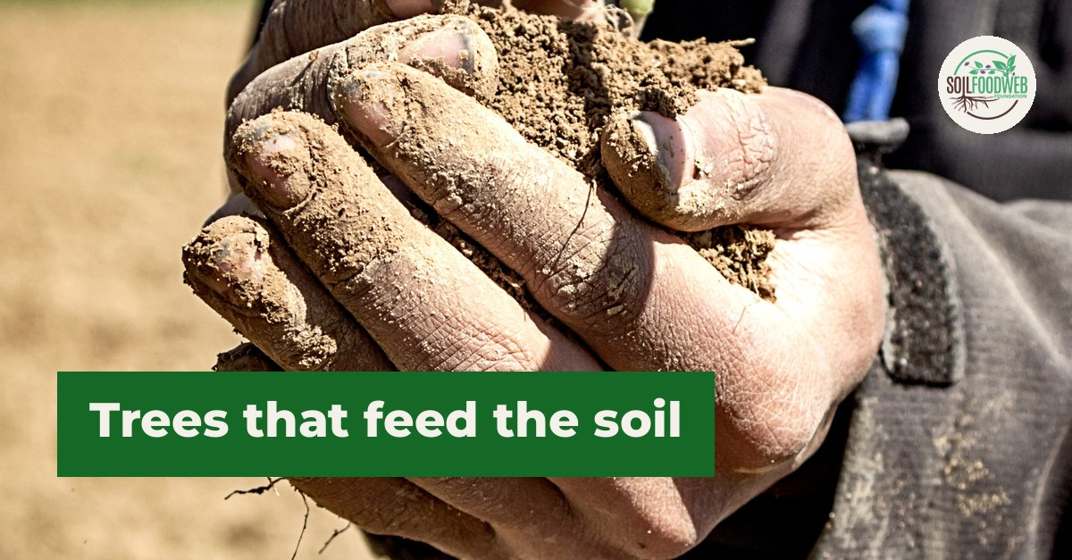
Notes:
Fertility trees: 33 million planted across West Africa.

Slide 77
Date TBD · Instagram, Facebook, LinkedIn
Soil news: a mustard plant shares nutrients with an ancient soil fungus
3 slides follow · images · Wormhole post n20261023a
Notes:
A plant that biologists thought could never partner with fungi just traded food with one! 🌱
Researchers at the University of Sheffield, led by Professor Katie Field, grew Arabidopsis, a small mustard plant and the most studied plant in biology, alongside an ancient soil fungus called a Mucoromycotina fine root endophyte. The mustard family lost the genes most plants use to welcome fungal partners millions of years ago, so everyone assumed it could not do this. The new study shows it can.
The fungus carried nitrogen and phosphorus from the soil into the plant's shoots, and in return it received more than 260% more of the plant's carbon. It did the plant no harm.
Cabbage, canola and mustard belong to the same family, and the team now wants to learn what this means for crops. Professor Jurriaan Ton calls it an "ideal model system" for finding out how plants build this other kind of partnership. Taking it from the lab to the field could cut reliance on "expensive chemical fertilisers".
For us it is one more reminder that the soil food web reaches further than the textbooks said.
Read the University of Sheffield story through the link in bio.
#SoilFoodWeb #SoilBiology #SoilFungi #LivingSoil #PlantScience

Slide 78
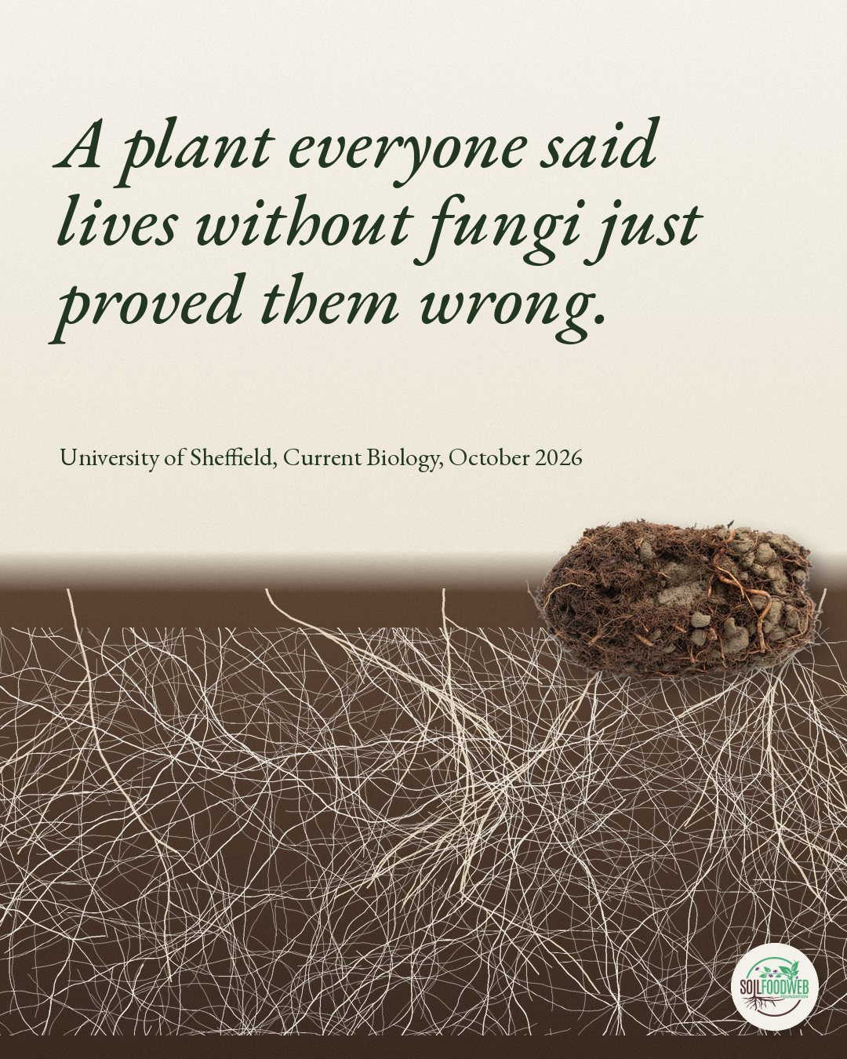
Notes:
A plant everyone said lives without fungi just proved them wrong. University of Sheffield, Current Biology, October 2026

Slide 79
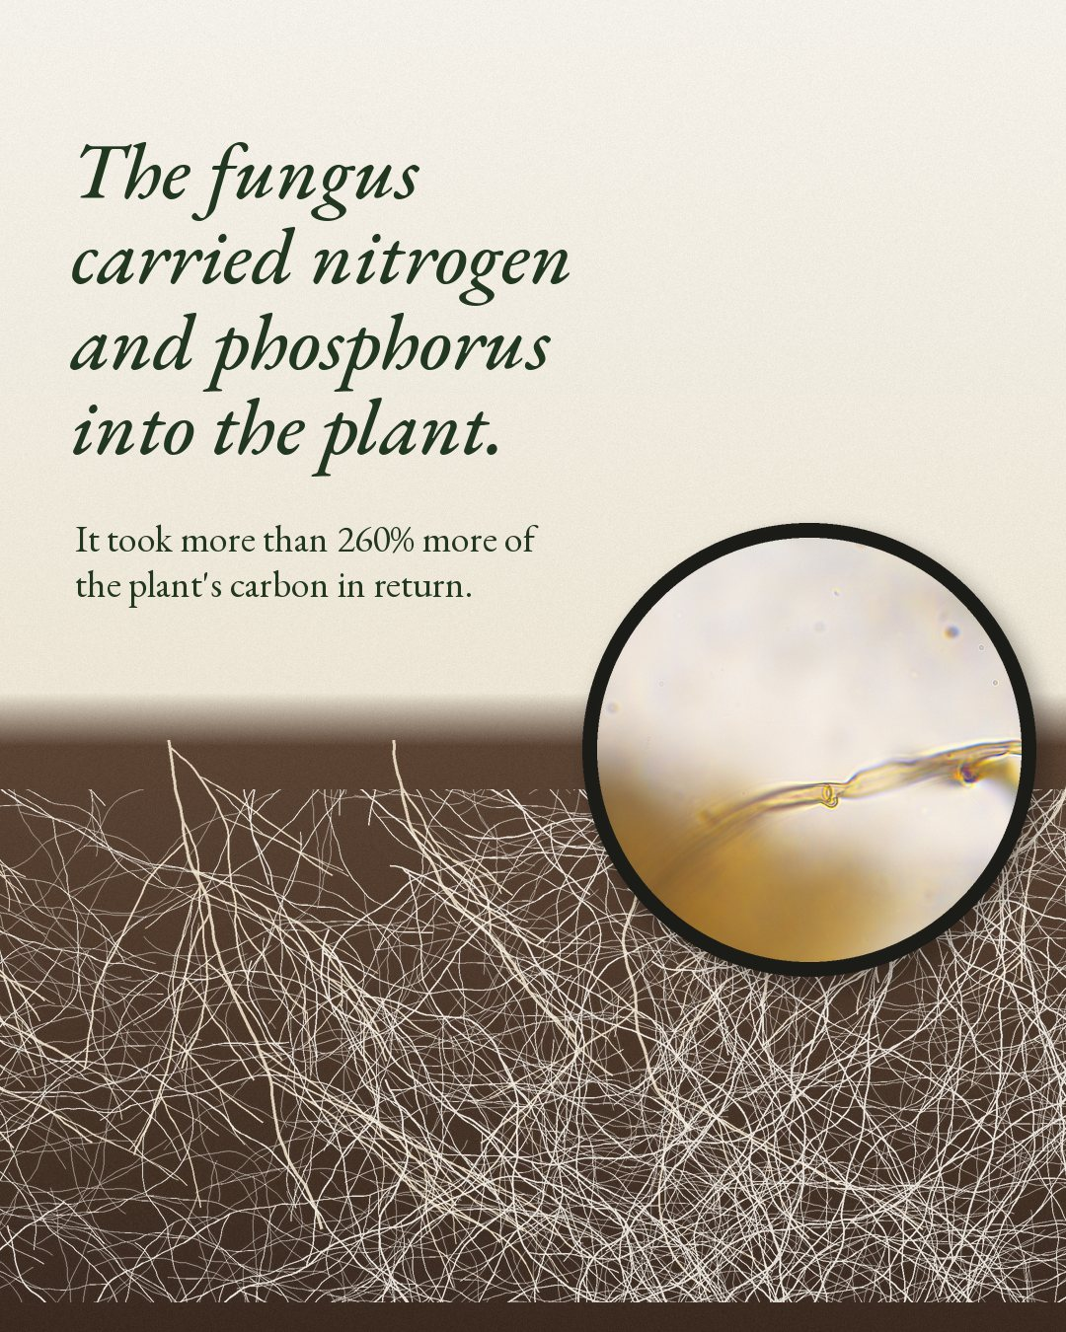
Notes:
The fungus carried nitrogen and phosphorus into the plant. It took more than 260% more of the plant's carbon in return.

Slide 80
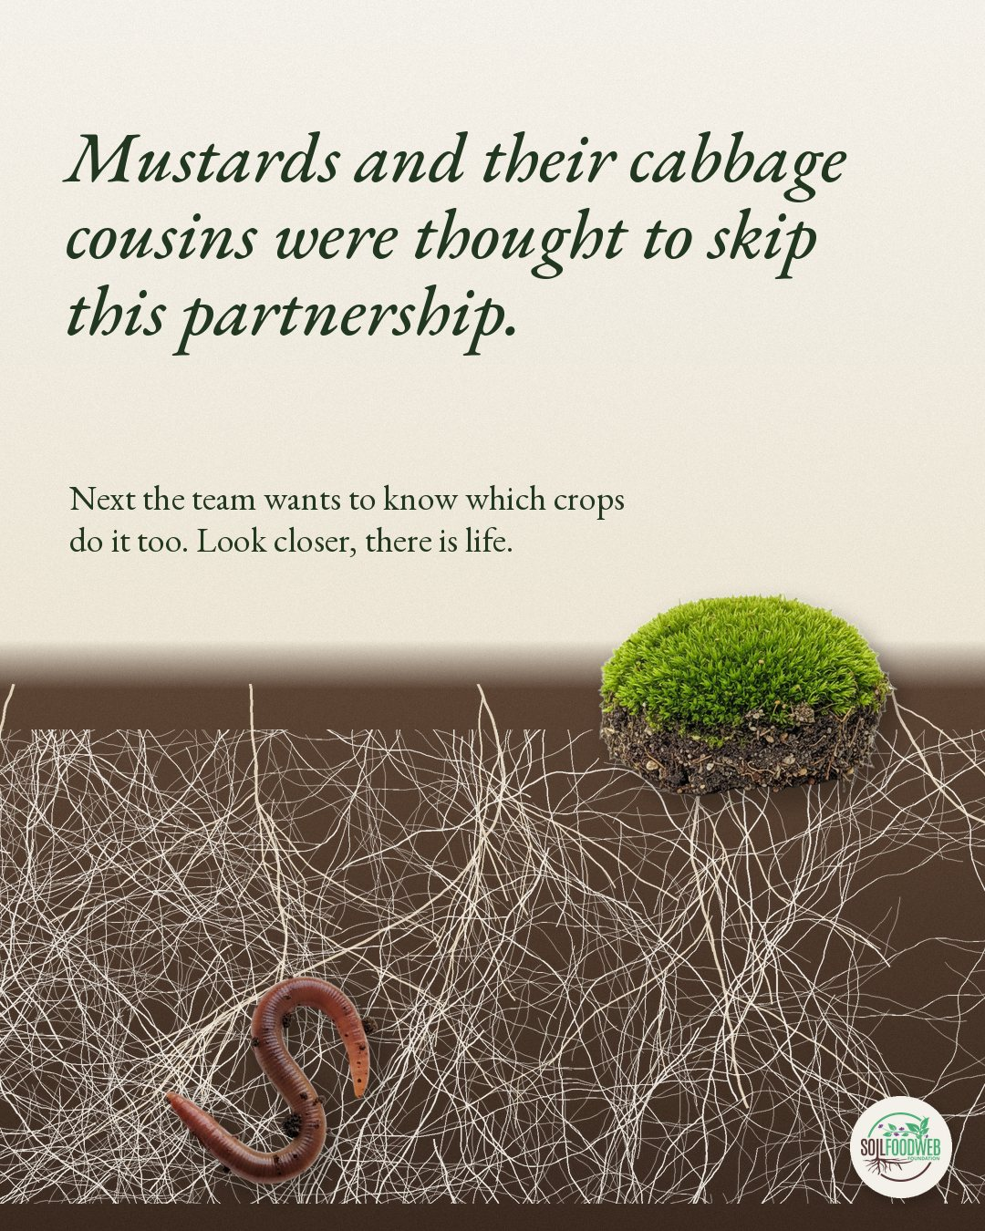
Notes:
Mustards and their cabbage cousins were thought to skip this partnership. Next the team wants to know which crops do it too. Look closer, there is life.

