Slide 1







Foundation Courses + Compost Intensive
Fall Enrollment Special
Until 2 December.

Slide 2


The Foundation Courses teach you to work out what your soil needs.
Four courses, 63 lectures and about 150 hours of study, with 40+ years of Dr. Elaine's knowledge. Self-paced, start the day you enroll.

Slide 3


The Compost Intensive Course teaches you to make it.
Ten weeks online, with a 90-minute live session with a mentor every week, alongside a global cohort of peers. You build 2 compost piles right where you live.

Slide 4


For farmers, ranchers, agronomists, consultants and gardeners
At any scale. The Compost Intensive covers thermophilic piles, vermicompost, USDA thermal composting and large-scale windrows.

Slide 5


Plus hundreds of hours
with Dr. Elaine
Learn directly from the founder of the Soil Food Web School, in our legacy webinar archive recorded live with Dr. Elaine Ingham. 40+ years of her knowledge, science and land management practices, proven across the globe.

Slide 6


Start today.
Pick your season.
01
Start today
4 courses, self-paced
02
Pick your cohort
January, May or August 2027
03
Build 2 compost piles
Right where you live
Fall Enrollment Special
Until 2 December.

Slide 7

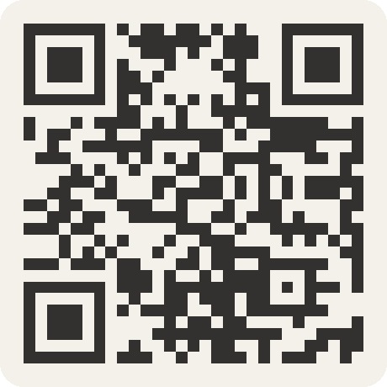
Foundation Courses + Compost Intensive
Fall Enrollment Special
Until 2 December.

