Slide 1


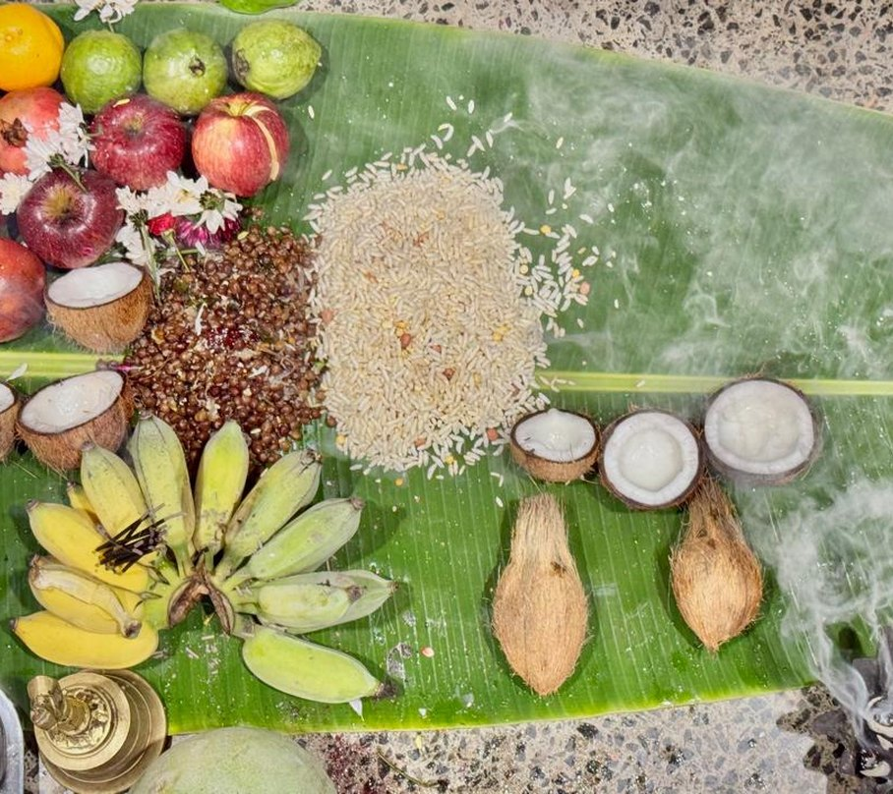

Happy Pongal!
To every farmer in Tamil Nadu.
Our India workshop, October 2026

