Slide 1


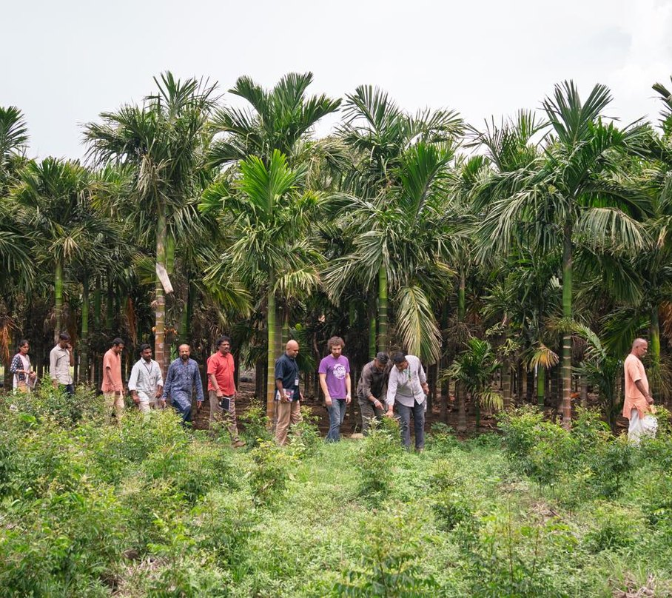

Happy Kisan Diwas
Thank you to every farmer in India.
Our Accelerator Workshop at the Save Soil farm, Coimbatore, October 2026

