Slide 1



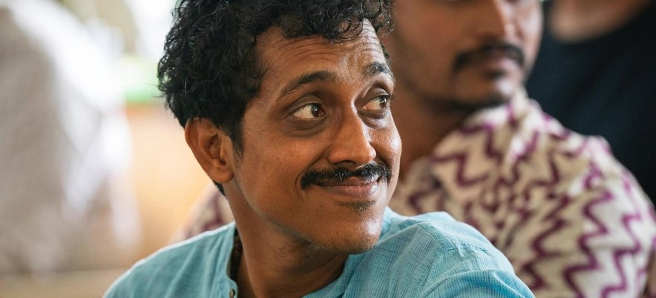


The Times of India
Photo: Soil Food Web Foundation, Coimbatore
From 10 countries to one farm in Coimbatore
Our India Accelerator Workshop, in the news.
Read More
Source:
timesofindia.indiatimes.com/
articleshow/135370094.cms

Slide 2


46 participants
From seven Indian states, the Netherlands, Australia, Iran, the United States and Costa Rica.

Slide 3


10 days on a working farm
At Sadhguru's Save Soil Regenerative Revolution farm, in collaboration with Isha Outreach.

Slide 4


61 at the seminar first
The two-day Life in the Soil Seminar ran on 16 and 17 October.

Slide 5


Read the article
The Times of India, 30 October 2026. Link in bio.

