Slide 1







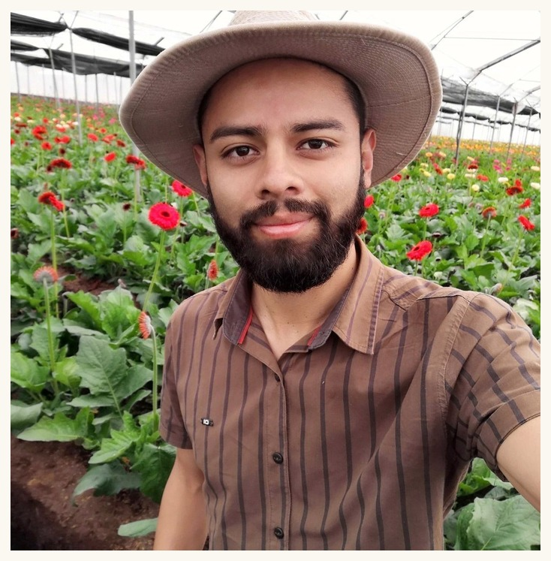












Gerald Ramirez
Soil Food Web Mentor
Notes:
Gerald Ramirez (p06). Linnea's flower-frame design, from her Tommy Tepper image.

