Slide 1

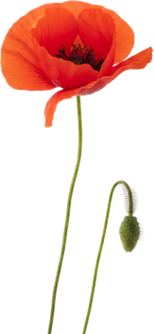





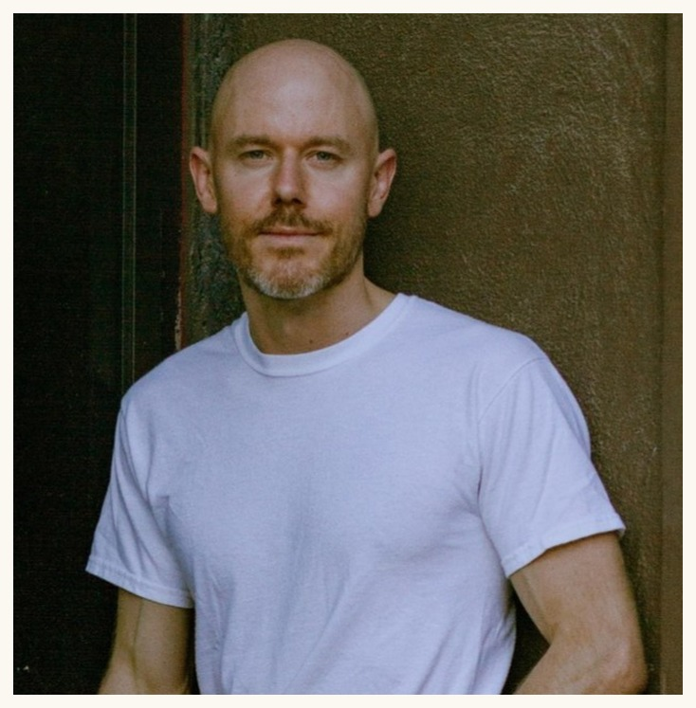




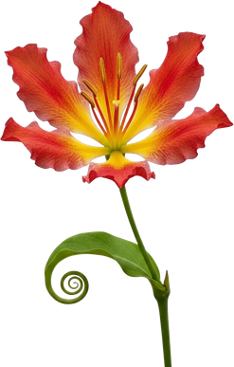







Brian Daubenspeck
Soil Food Web Mentor
Notes:
Brian Daubenspeck (d11). Linnea's flower-frame design, from her Tommy Tepper image.

