Slide 1







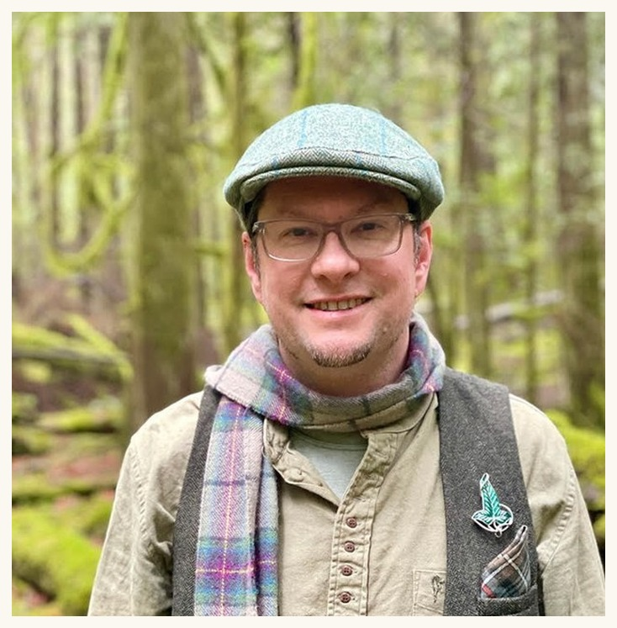




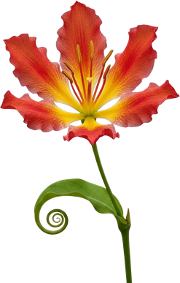







Delvin Solkinson
Soil Food Web Mentor
Notes:
Delvin Solkinson (d12). Linnea's flower-frame design, from her Tommy Tepper image.

