Slide 1
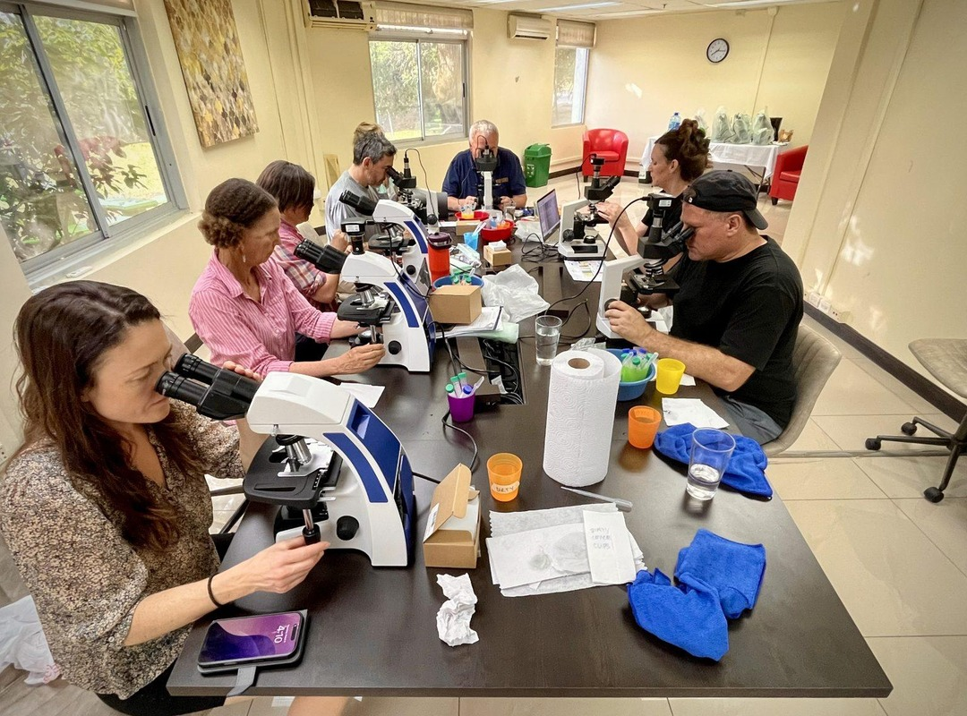

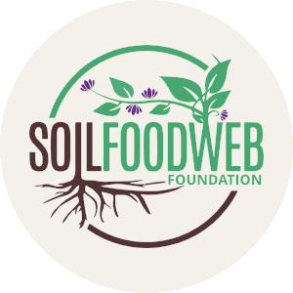
Last call for the early bird.
Foundation Courses and the Compost Intensive

Slide 2
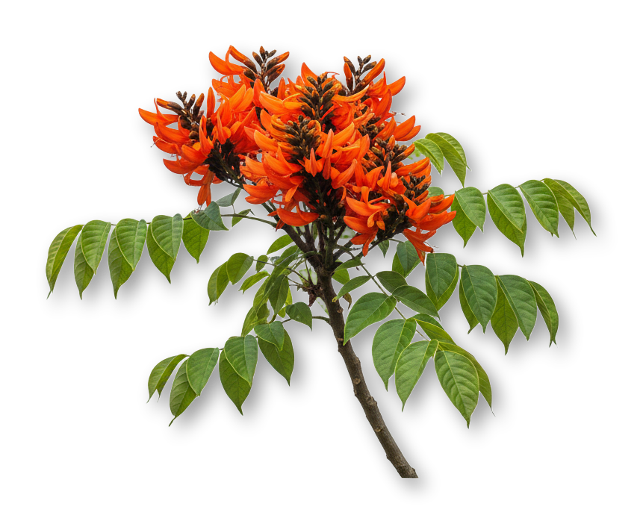

Foundation Courses
How the soil food web works, compost, extracts and teas, and the microscope.
Online, at your own pace.

Slide 3

Compost Intensive
A group program open to anyone, with no prerequisites. Starts 18 January.
The early bird for both ends 1 November. Link in bio.

