Slide 1
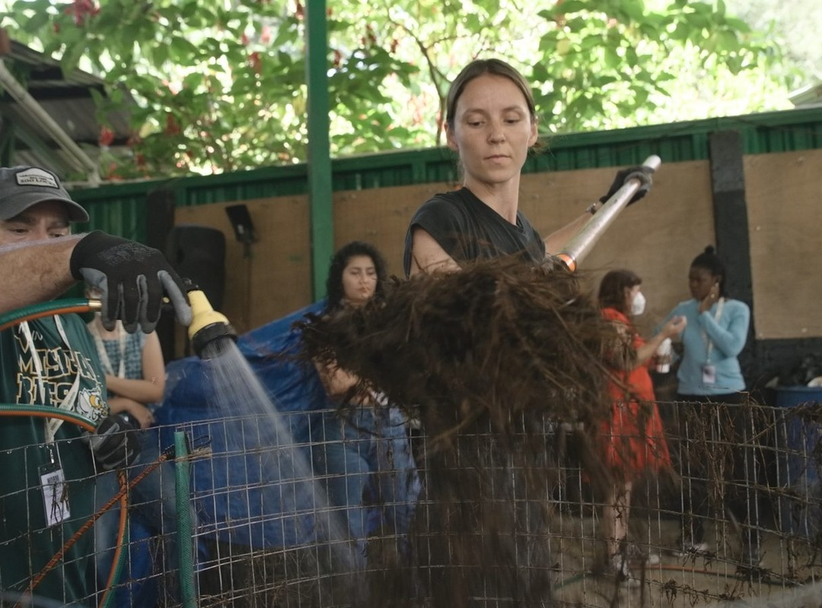


Some piles are built to fail.
Costa Rica, 18 to 29 January 2027

Slide 2

On purpose.

Slide 3
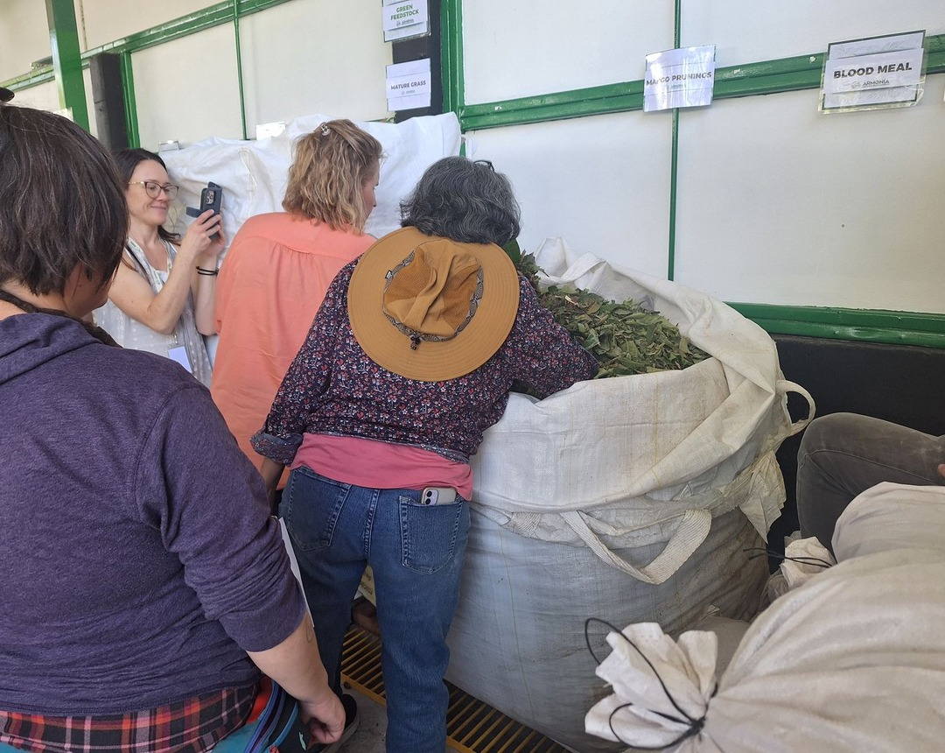


Students build several piles at once.
Some are designed to succeed. Some are designed to go wrong.

Slide 4
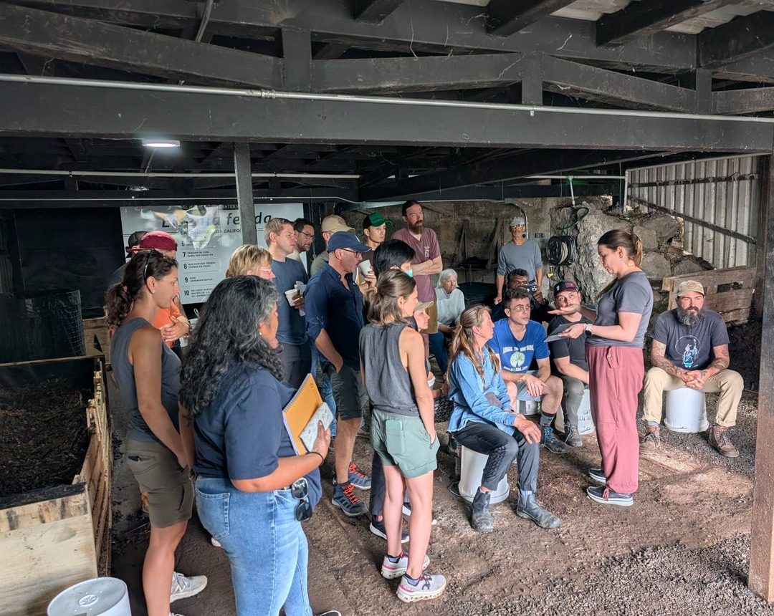
Then you diagnose them and turn them around.
With a mentor beside you.

Slide 5

“The most is learned from failed piles.”
Loida Vasquez, Director of Advanced Education

Slide 6

18 to 29 January 2027
Accelerator Workshop at Armonía Agricultura Orgánica, near San José, Costa Rica
Register, link in bio

