Slide 1
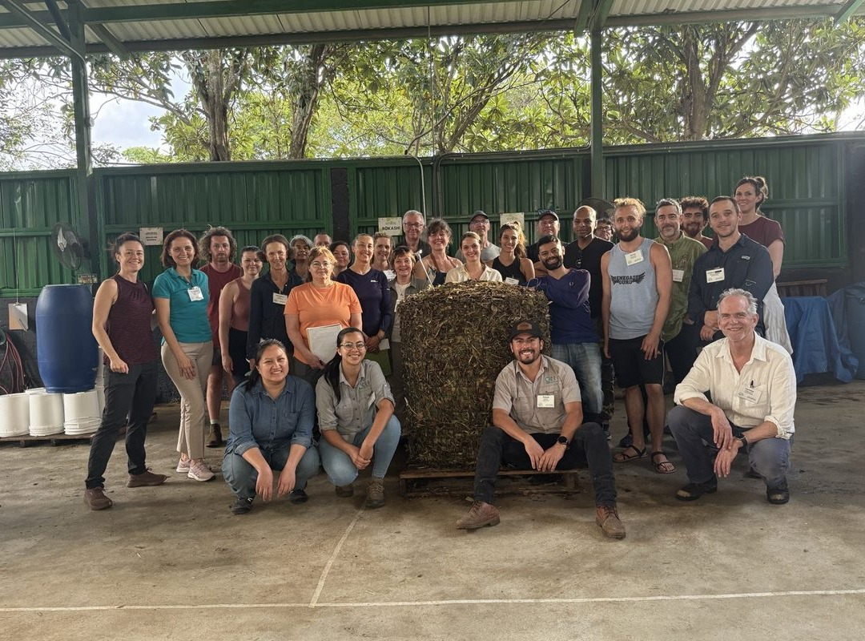


We're going back to Costa Rica.
Accelerator Workshop · 18 to 29 January 2027

Slide 2
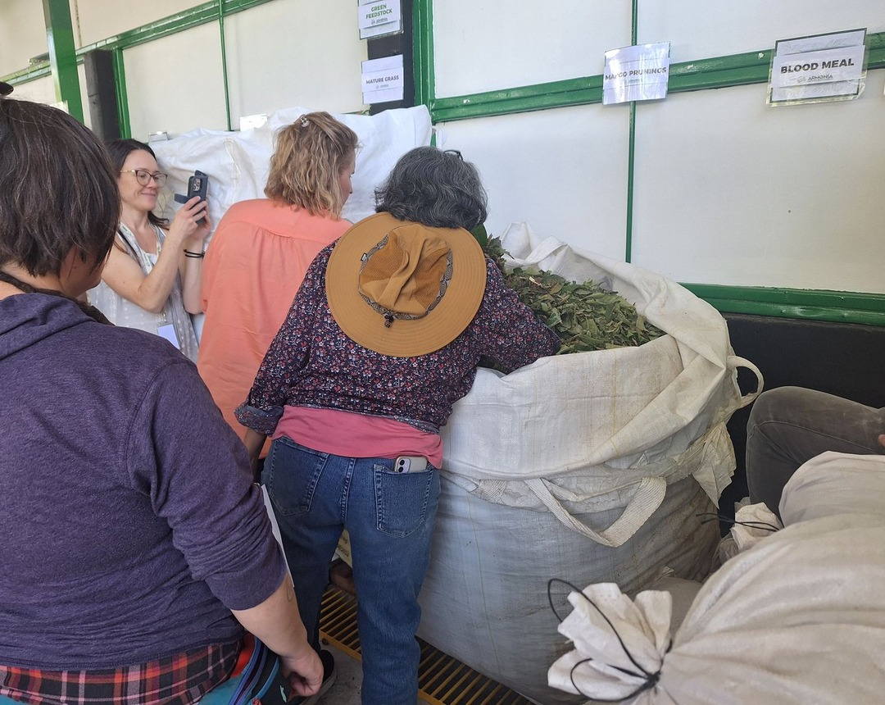


Ten days of compost piles, extracts and the microscope.
Week one: compost. Week two: liquid amendments.

Slide 3


Where we learn
Armonía Agricultura Orgánica, an organic farm on a school campus, 11 km north of San José.

Slide 4
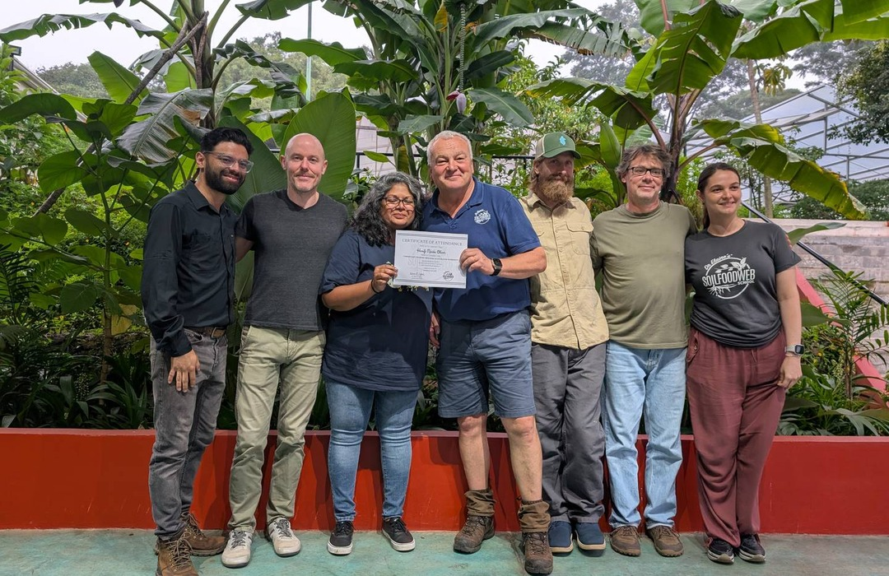

The early bird ends 4 November.
18 to 29 January 2027
Register, link in bio

