Slide 1
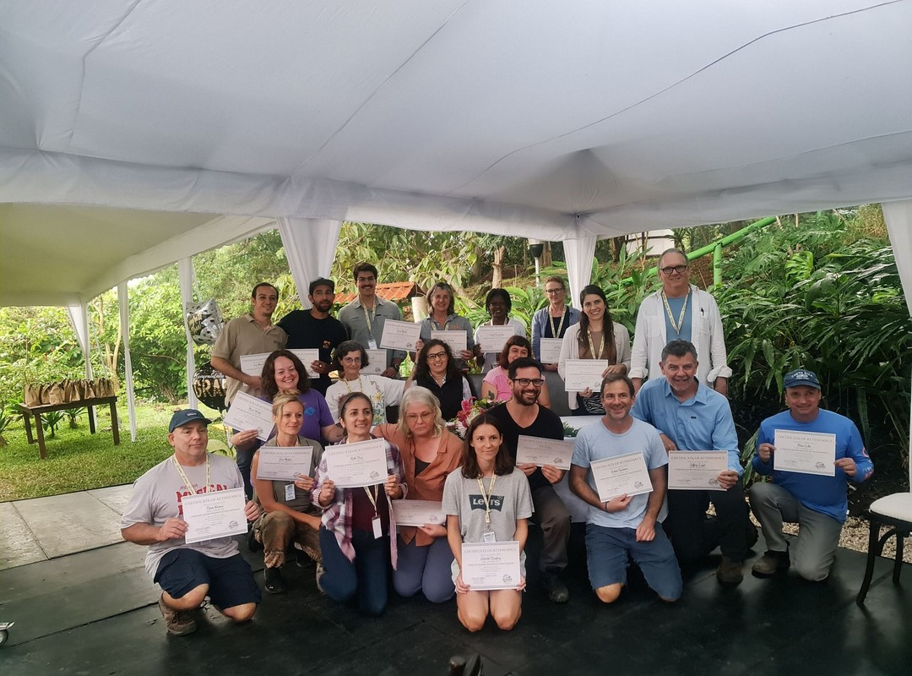


Every event in one place.
soilfoodweb.com/events

Slide 2


What you'll find
Free webinars
In-person workshops
Course start dates

Slide 3


soilfoodweb.com/events
Save it, check back often, and share it with a soil-loving friend. Link in bio.

