Slide 1

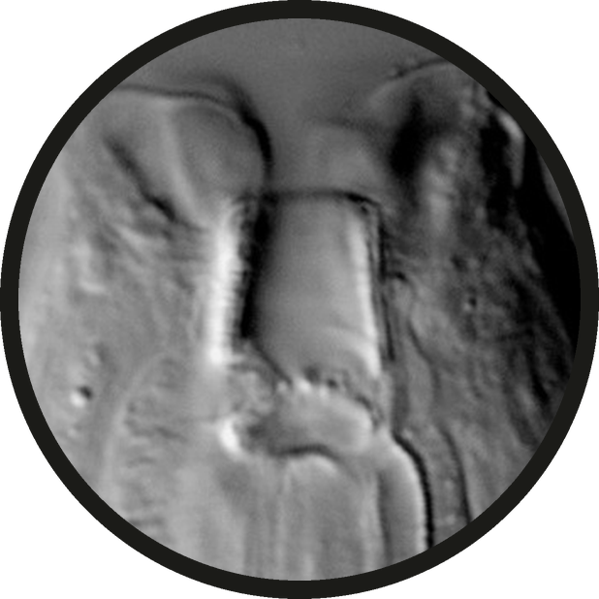


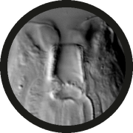
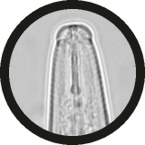



Bacterial feeder: open, tube-shaped mouth
the open mouth tube
Micrograph: Tandingan De Ley et al. 2023, PLOS ONE, CC BY 4.0 (cropped)

Slide 2

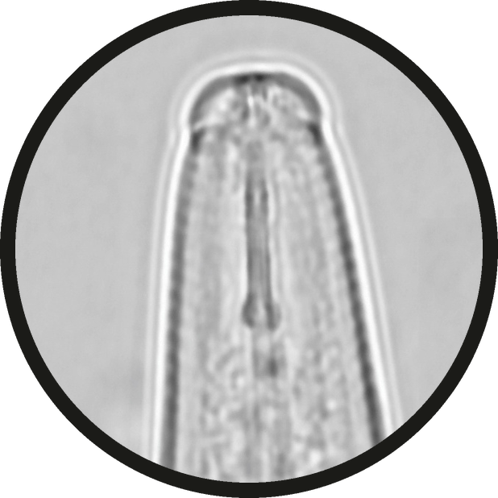

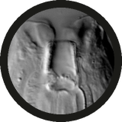
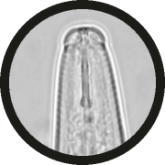
Fungal feeder: a thin stylet to pierce hyphae
the thin stylet
Micrograph: Munawar et al. 2024, Microorganisms, CC BY 4.0 (cropped)

Slide 3

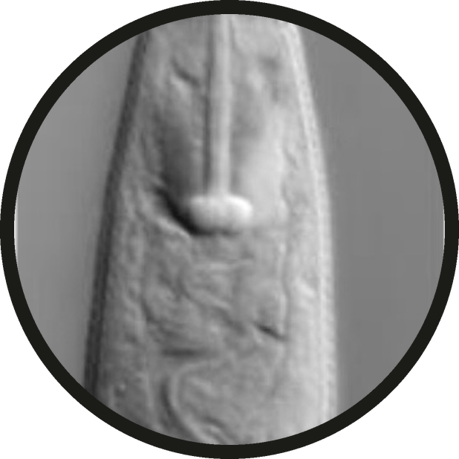


Root feeder: a heavy stylet to pierce roots
the heavy stylet with knobs
Micrograph: Handoo et al. 2021, Plants, CC BY 4.0 (cropped)

Slide 4

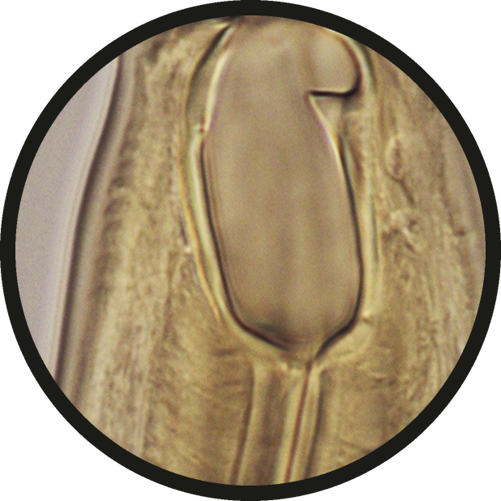


Predator: teeth or a wide mouth
a wide mouth with a tooth
Micrograph: Altash et al. 2024, ZooKeys, CC BY 4.0 (cropped)

Slide 5





Read the mouth, know the job.
bacterial feeder
fungal feeder
root feeder
predator
Micrographs: Tandingan De Ley 2023, Munawar 2024, Handoo 2021, Altash 2024; CC BY 4.0

