Slide 1
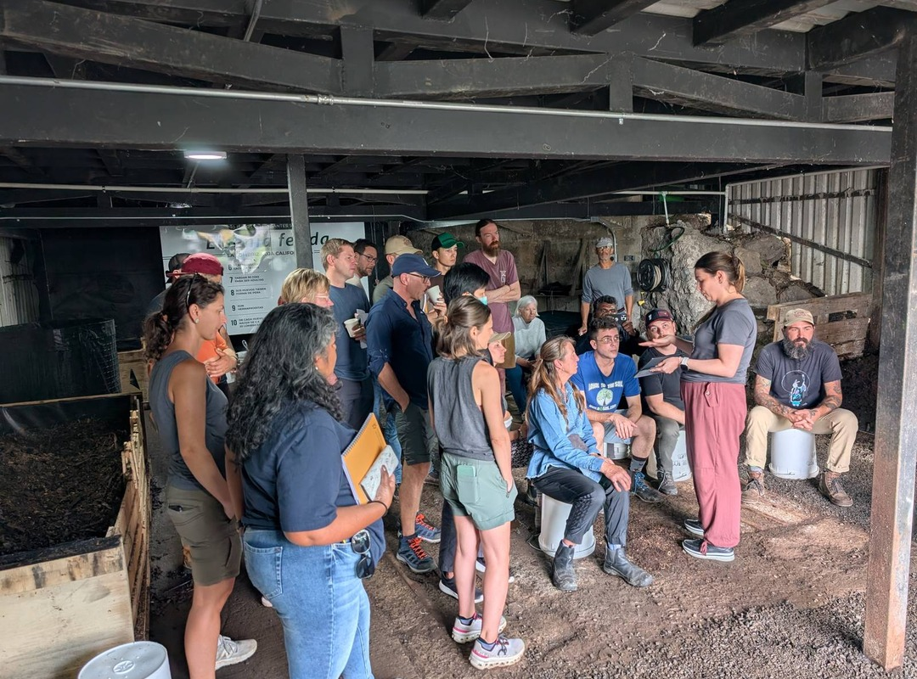


We are going back to Armonía.
Accelerator Workshop, Costa Rica · 18 to 29 January 2027

Slide 2



Our fifth Costa Rica workshop, and our fourth at Armonía Agricultura Orgánica.
An organic farm 11 km north of San José.

Slide 3
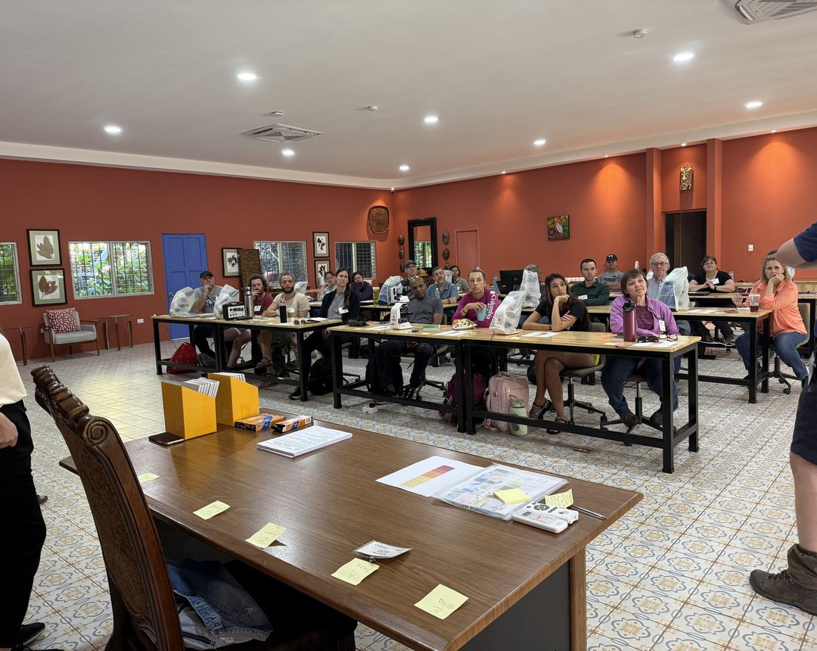
An organic farm on a school campus.
Armonía has primary and secondary schools, and a restaurant fed by its own farm.

Slide 4
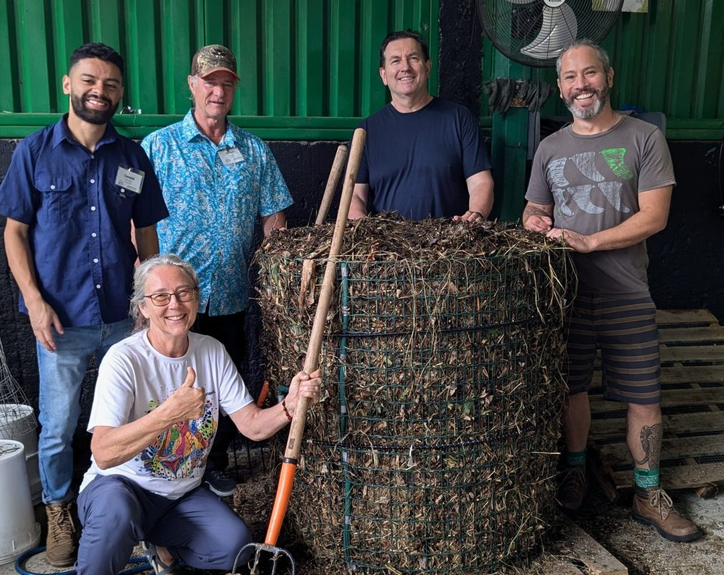

You build compost where children grow up knowing where food comes from.

Slide 5

18 to 29 January 2027
Accelerator Workshop at Armonía Agricultura Orgánica, near San José, Costa Rica
Register, link in bio

