Slide 1
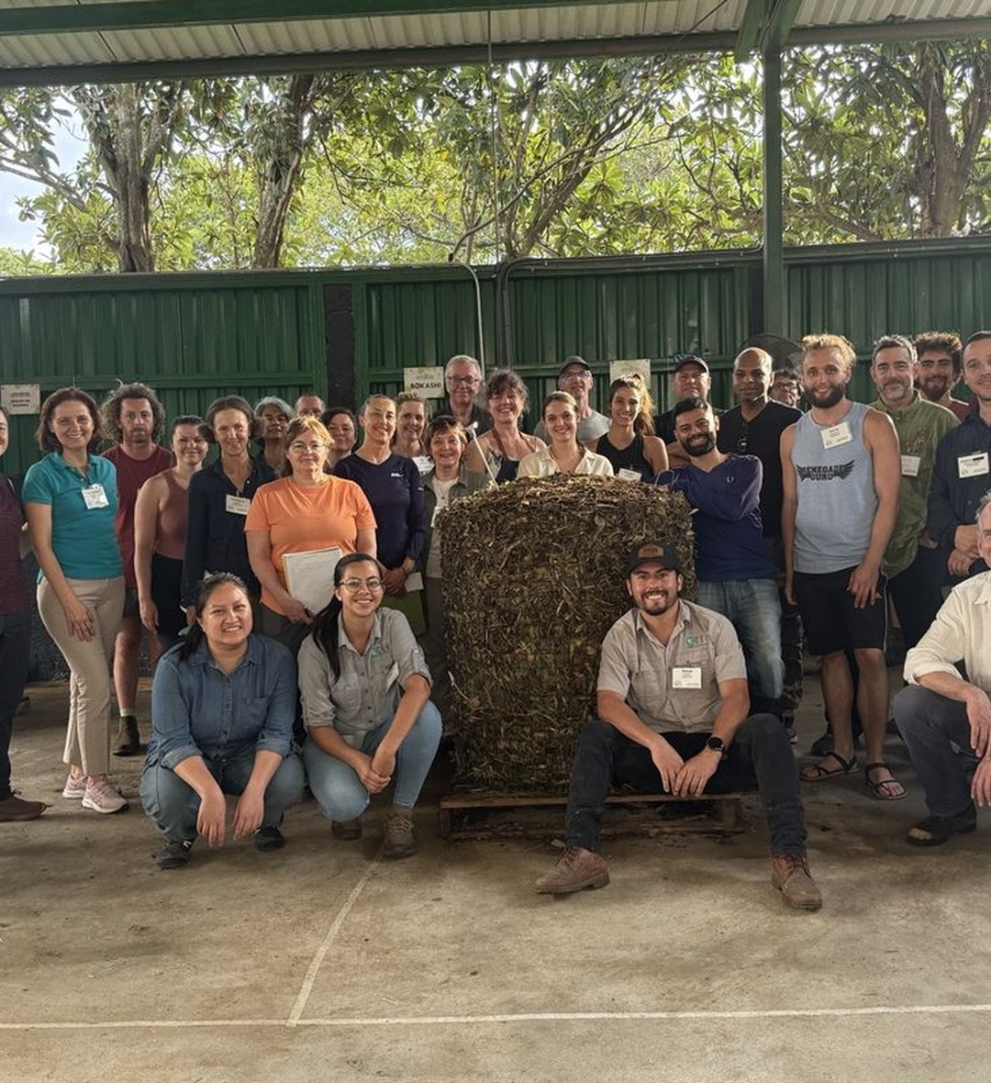


We're going back to Costa Rica.
Accelerator Workshop · 18 to 29 January 2027

Slide 2
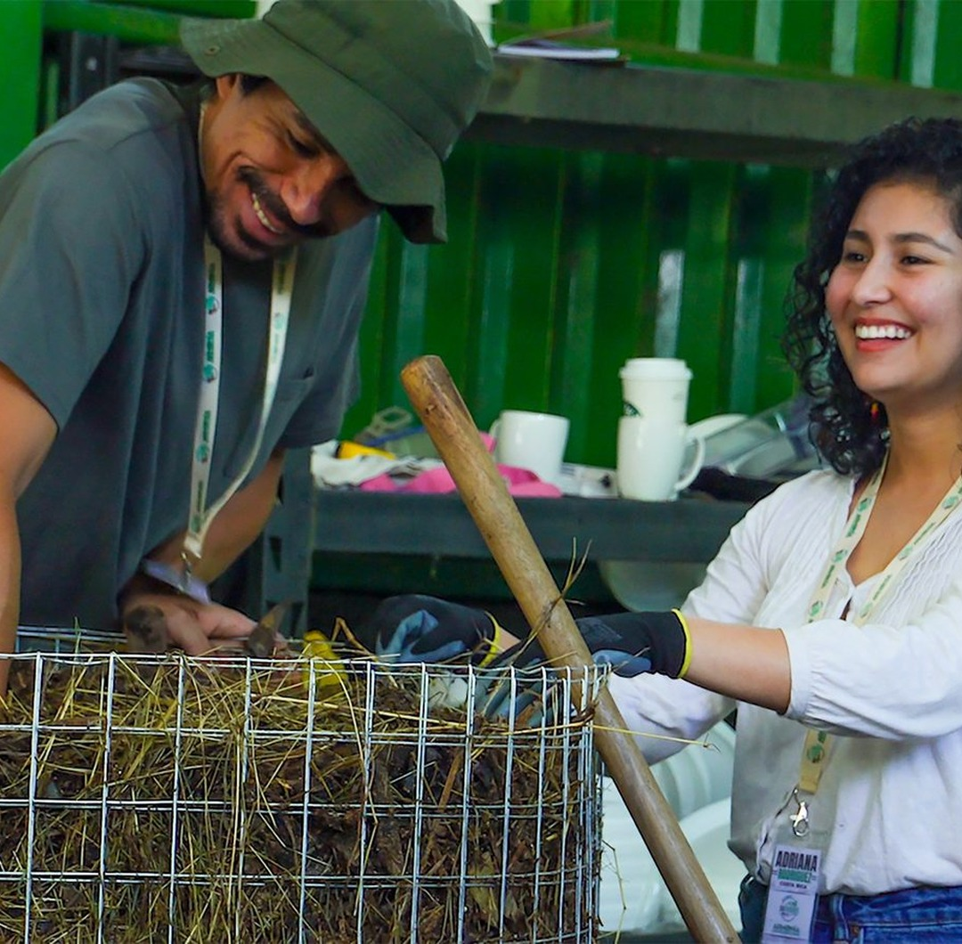


A year of hands-on experience in 10 days.
What takes 18 to 24 months alone, you do here in two weeks, with mentors beside you.

Slide 3

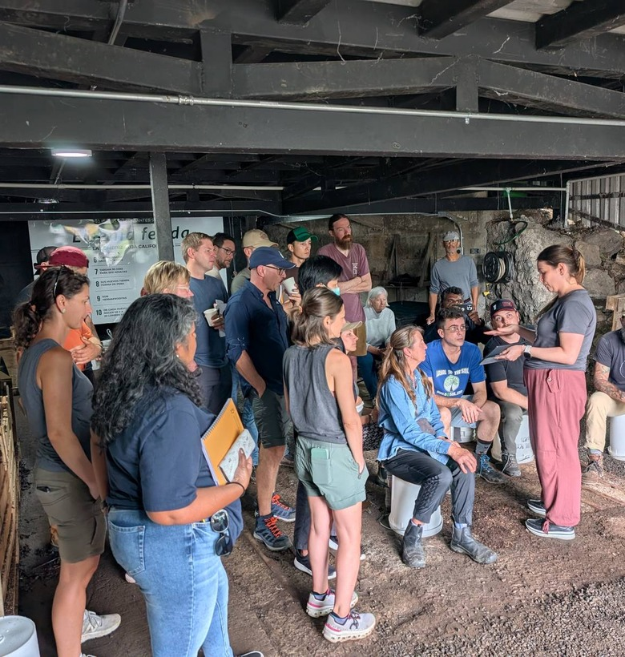

Where we learn
Armonía Agricultura Orgánica, an organic farm on a school campus, 11 km north of San José.

Slide 4
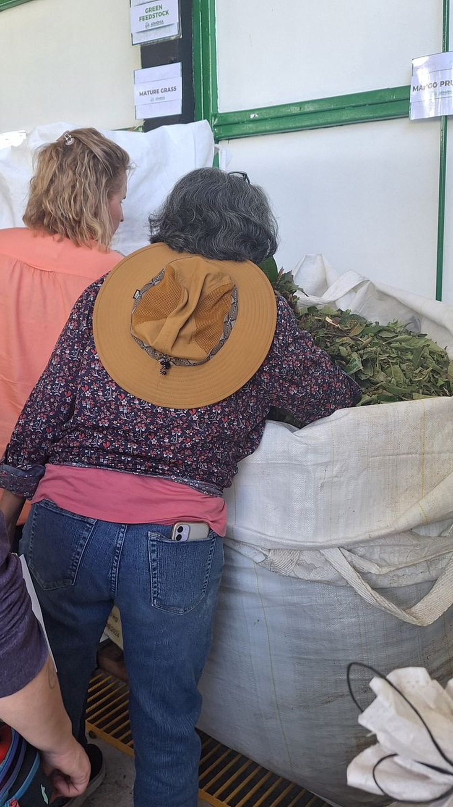

WEEK ONE
Compost
Feedstocks
Recipes
Building the pile
Hydrating
Monitoring
Turning
Troubleshooting
Several thermophilic piles, built from scratch with your team.

Slide 5
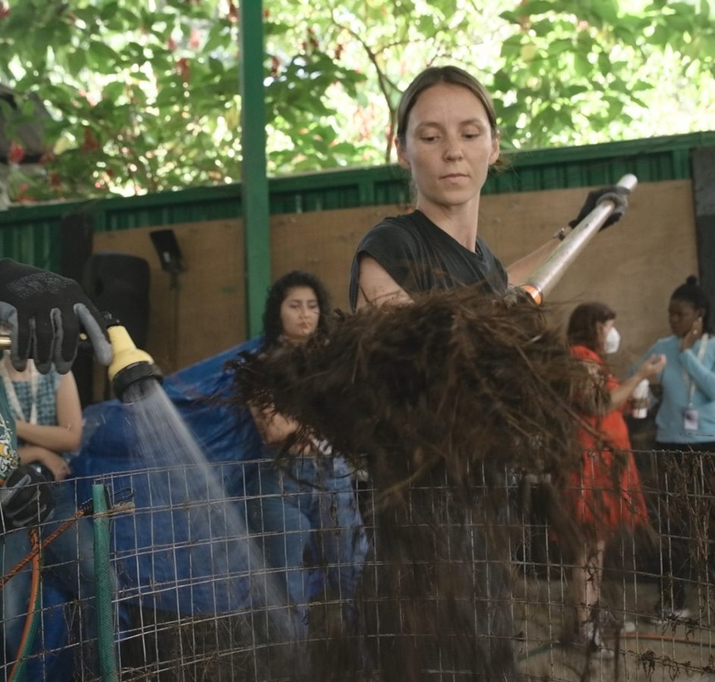
Some piles are built to fail.
On purpose. Rescuing a failing pile is where you learn the most.

Slide 6
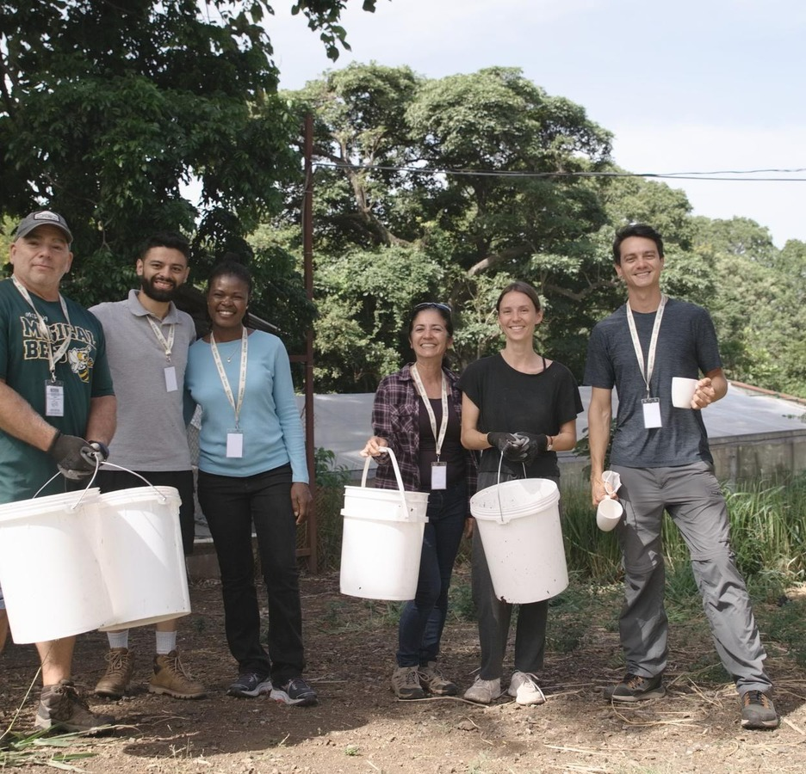
THE WEEKEND
A break in Costa Rica
Check your piles in the morning, then explore the towns nearby.

Slide 7
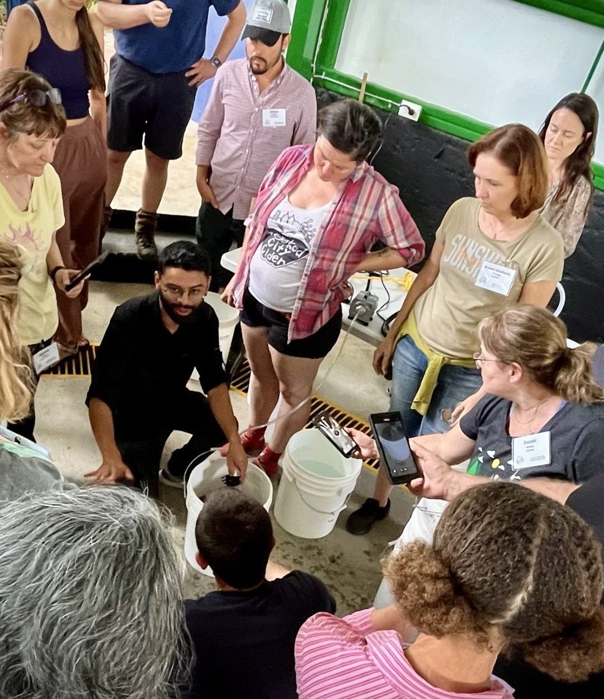
WEEK TWO
Liquid amendments
Extracts · teas · nematode extractions · protozoan infusions · field application

Slide 8
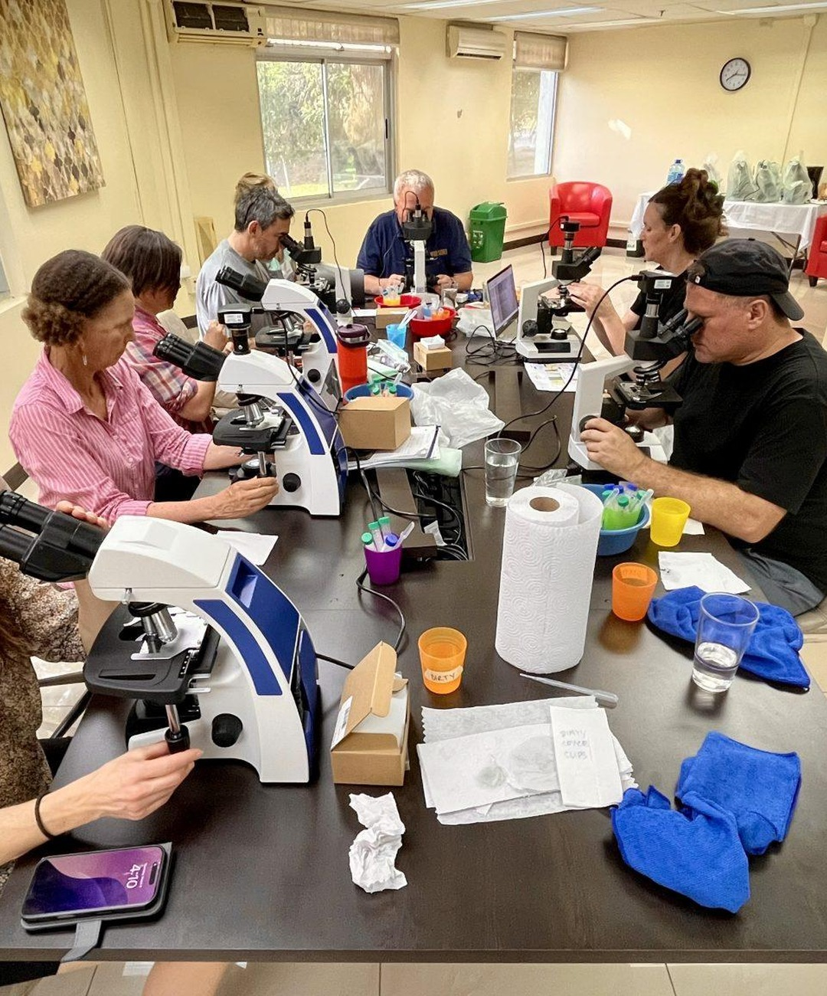
At the microscope, every day
You check everything you make. Microscopes are on site.

Slide 9
“Be prepared to work hard, listen, and watch everything very intently! You will meet some awesome people and make new friends for life.”
Donell Frank, Costa Rica workshop, March 2025

Slide 10
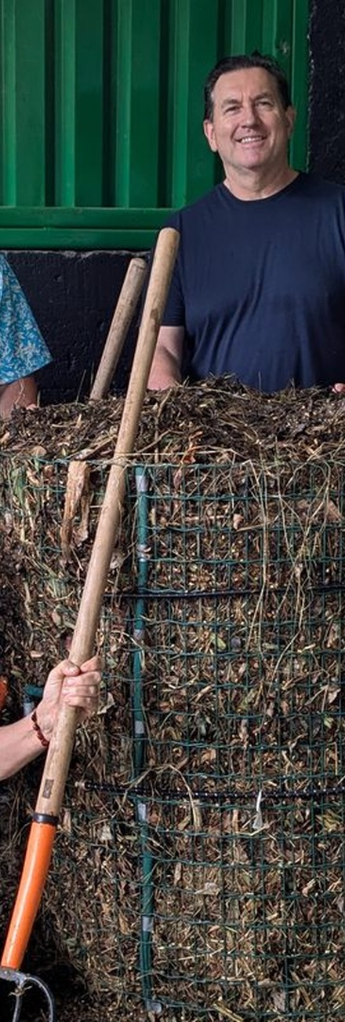
What's included
10 days of training and fieldwork
The chance to graduate BioComplete™ Compost Production and Biological Liquid Amendments
2 weeks of live access to mentors
Course materials after the workshop
Lunch on site, Monday to Friday
SFW swag to take home

Slide 11
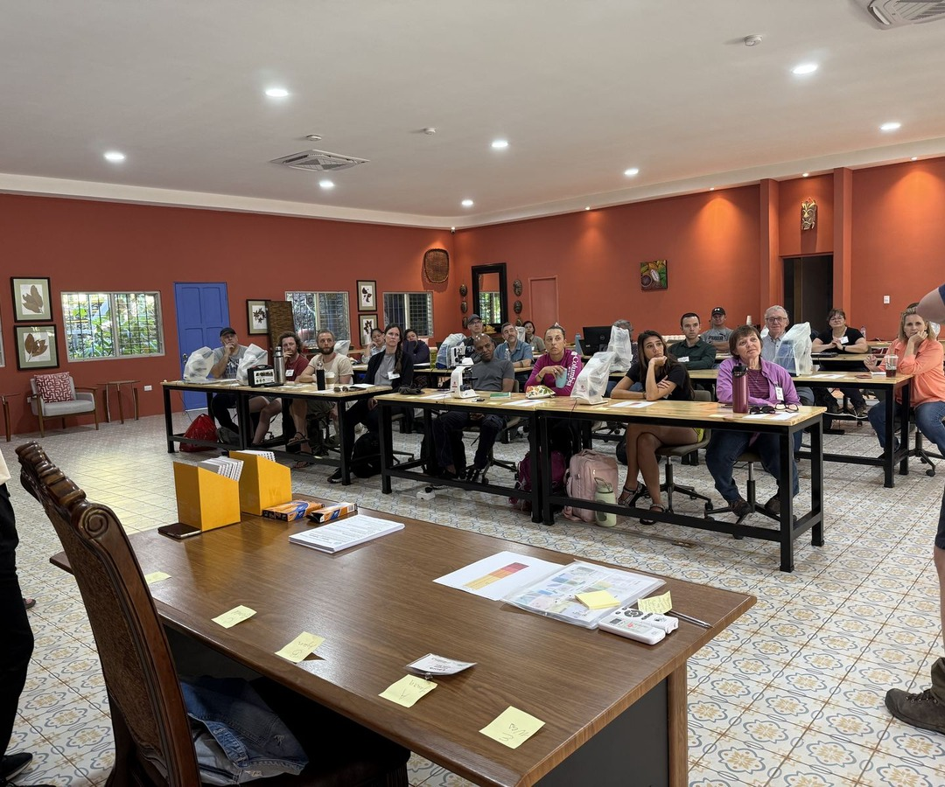
Who can join?
Foundation Courses students who have finished Foundation Course 3 before 18 January.
You take a short online pre-workshop course, and book your own room nearby.

Slide 12
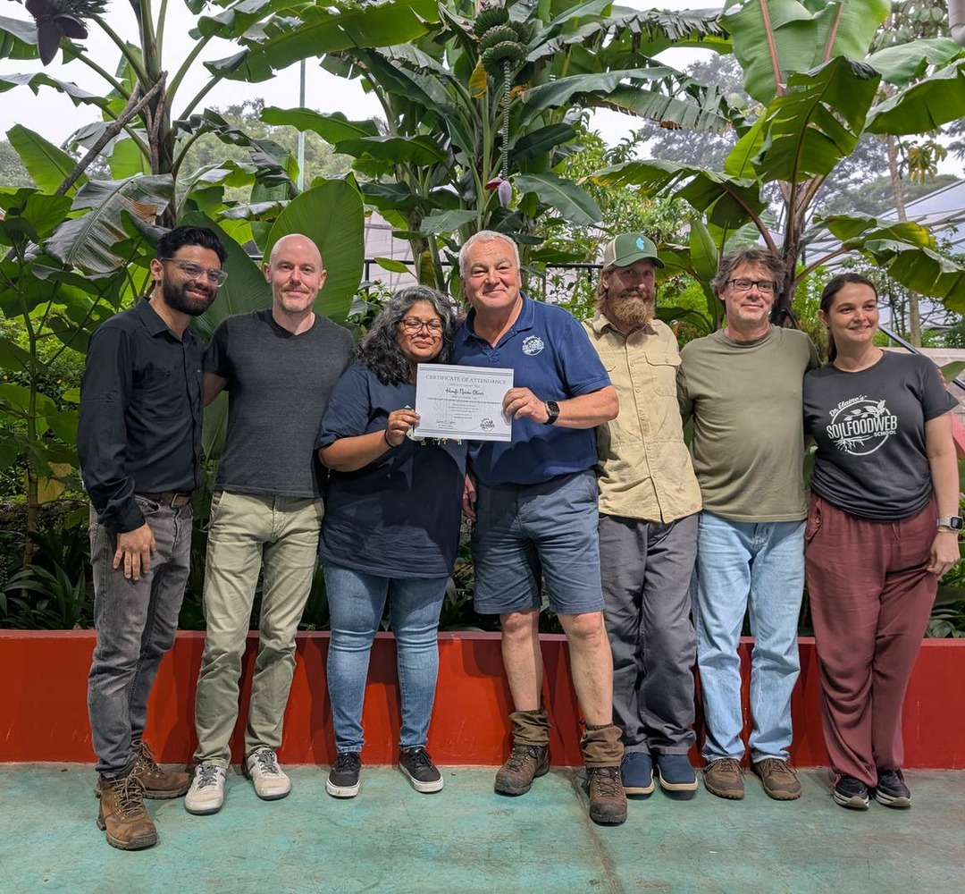
The early bird ends 4 November.
Accelerator Workshop, Costa Rica
18 to 29 January 2027

Slide 13
Costa Rica,
here we come.
18 to 29 January 2027

