Slide 1



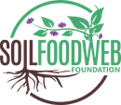
Happy Small
Business Saturday
Meet Colleen Dempster
of Rewild Soils

Slide 2

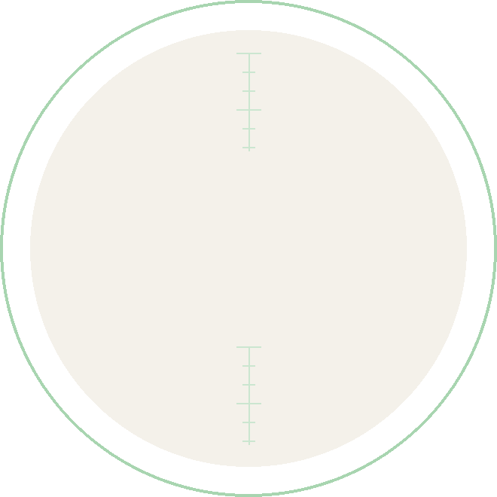

A Soil Food Web
certified lab since
2022
Re-certified every year, with
more than 300 microbial reports

Slide 3


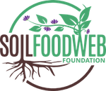
“
Most people have never seen the microbes that make up the soil food web, so I show pictures and do live microscope demonstrations
Colleen Dempster

Slide 4


Colleen’s path
Started slowly
as a stay-at-home mom, alongside another part-time job
2022
opened a Soil Food Web certified lab, re-certified every year
Now
in the final stages of the Soil Food Web Consultant Program

Slide 5

“
Making compost and exploring samples under the microscope will always be something I enjoy
Colleen believes rewilding soils with microbes is about restoring systems and people’s connection with the Earth

Slide 6


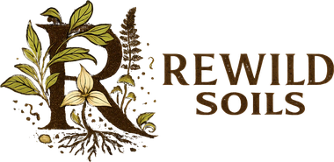
The Foundation Courses teach you to work out what your soil needs
Learn to assess bacteria, fungi, protozoa, and nematodes
Link in bio
With thanks to Colleen Dempster

