Slide 1
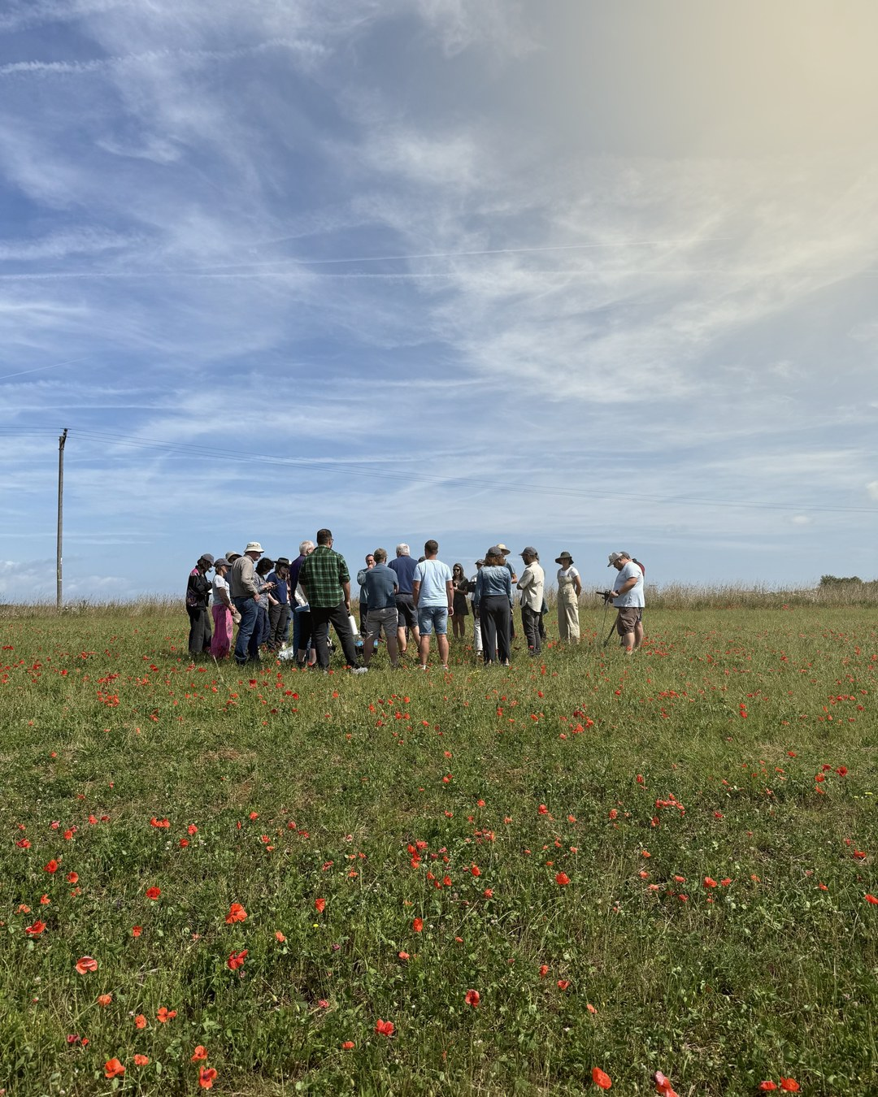
What does Regenerative actually mean?
And who gets to decide?
Notes:
Sunny 1: poppy field, Wild Ken Hill

Slide 2
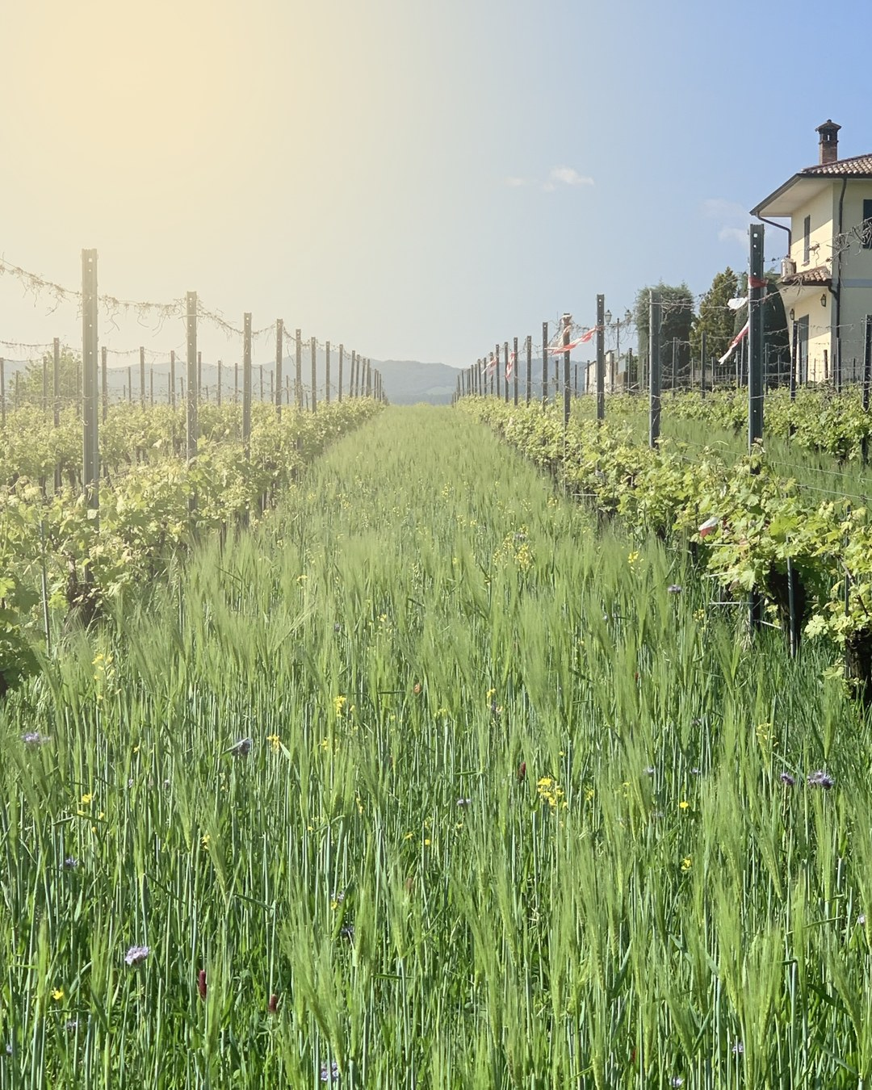
What does Regenerative actually mean?
And who gets to decide?
Notes:
Sunny 2: cover crops, Capri

Slide 3



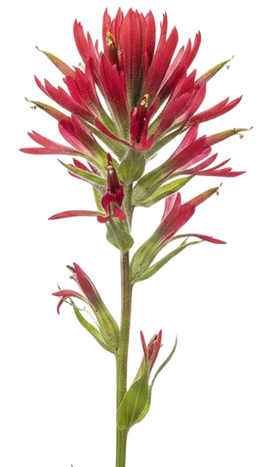
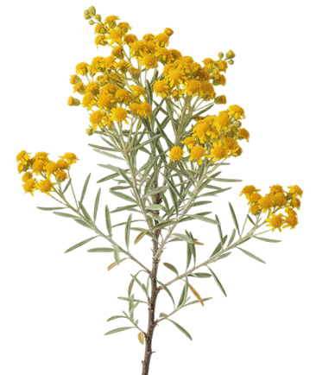



What does Regenerative actually mean?
And who gets to decide?
Notes:
Sunny 3: morning sun, flowers

Slide 4

What does Regenerative actually mean?
And who gets to decide?
Notes:
Text-post rules 1: cracked to alive

Slide 5


What does
actually mean?
And who gets to decide?
Notes:
Text-post rules 3: soil in the letters

Slide 6
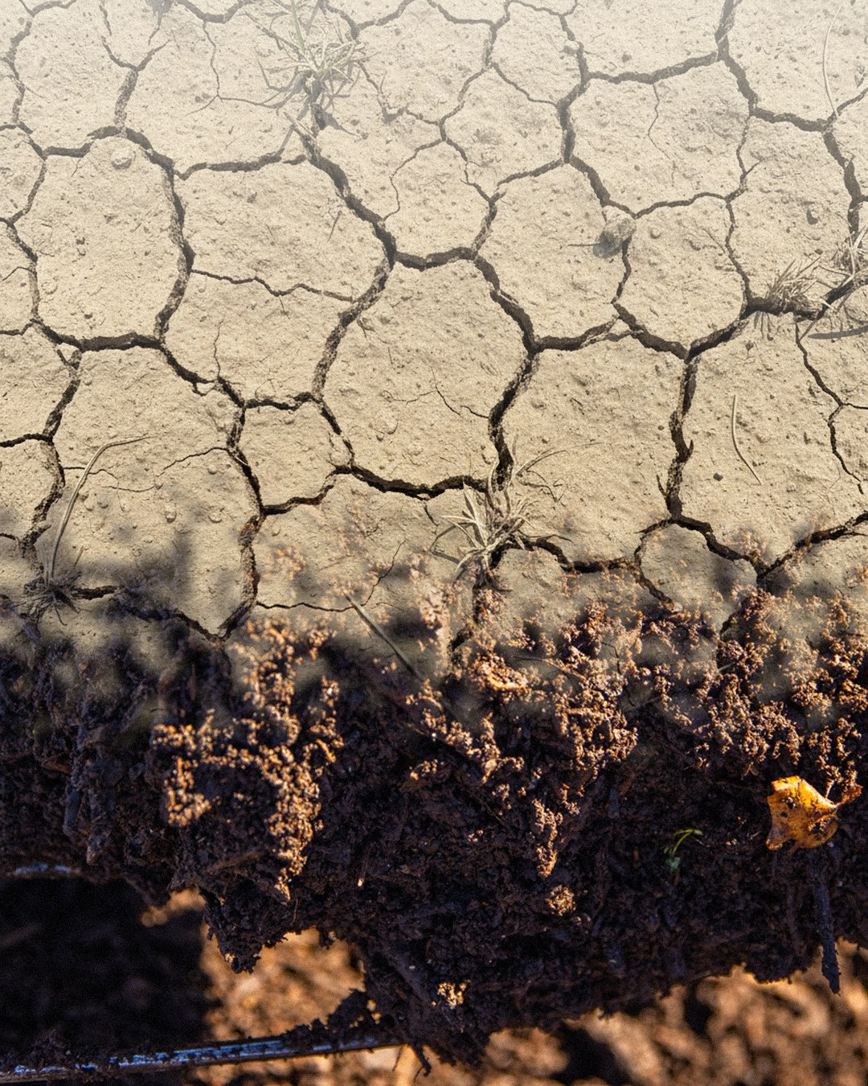


What does Regenerative actually mean?
And who gets to decide?
Notes:
Concept 1: cracked to alive

Slide 7


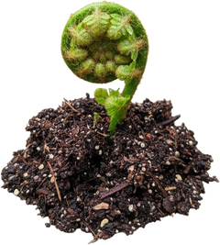


What does
actually mean?
And who gets to decide?
Notes:
Concept 3: soil in the letters

Slide 8

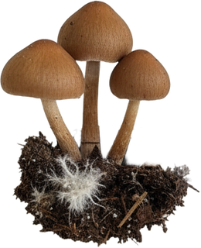

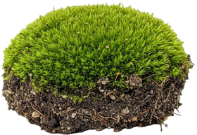
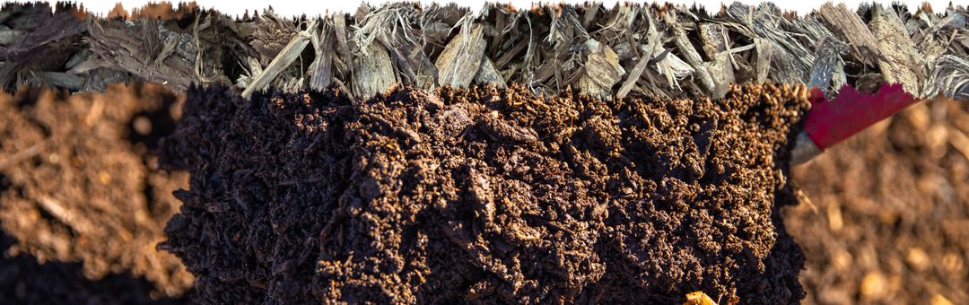
What does Regenerative actually mean?
And who gets to decide?
Notes:
Single image 1: cream and soil

Slide 9


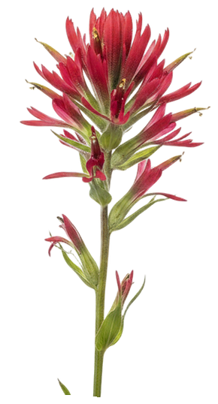



What does Regenerative actually mean?
And who gets to decide?
Notes:
Single image 2: deep green, flowers

Slide 10

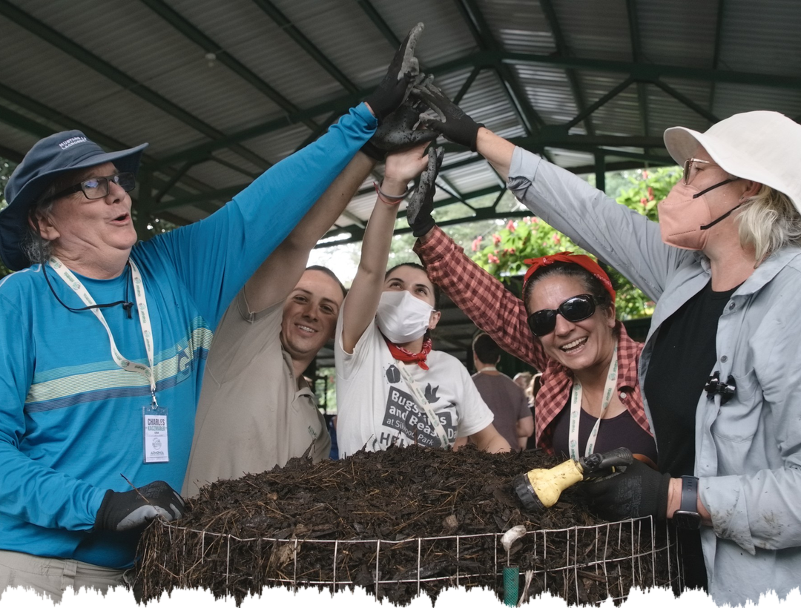
What does Regenerative actually mean?
And who gets to decide?
Notes:
Single image 3: one photo

Slide 11



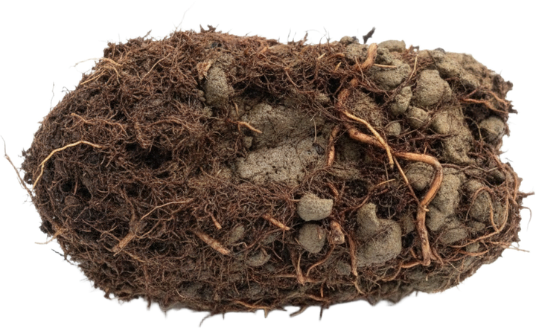


What does Regenerative actually mean?
And who gets to decide?
Notes:
Carousel A, slide 1 of 5

Slide 12

A destination
or a direction?
Notes:
Carousel A, slide 2 of 5

Slide 13
A certified status
or a way of thinking?
Notes:
Carousel A, slide 3 of 5

Slide 14
A premium product,
or a standard everyone who works the land can reach?
Notes:
Carousel A, slide 4 of 5

Slide 15

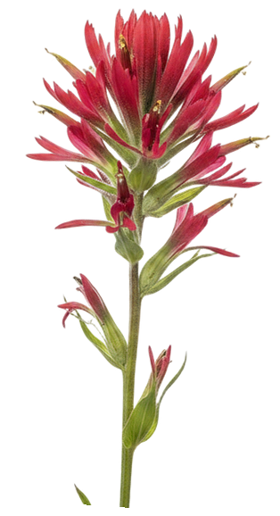



Living soil in the hands of every person who works the land.
What does regenerative mean to you? Tell us in the comments.
Notes:
Carousel A, slide 5 of 5

Slide 16


What does Regenerative actually mean?
And who gets to decide?
Notes:
Carousel B: deep green ground, slide 1 of 5

Slide 17

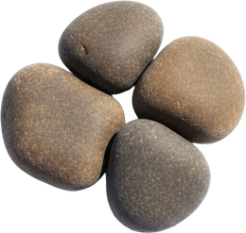
A destination
or a direction?
Notes:
Carousel B: deep green ground, slide 2 of 5

Slide 18


A certified status
or a way of thinking?
Notes:
Carousel B: deep green ground, slide 3 of 5

Slide 19


A premium product,
or a standard everyone who works the land can reach?
Notes:
Carousel B: deep green ground, slide 4 of 5

Slide 20





Living soil in the hands of every person who works the land.
What does regenerative mean to you? Tell us in the comments.
Notes:
Carousel B: deep green ground, slide 5 of 5

Slide 21



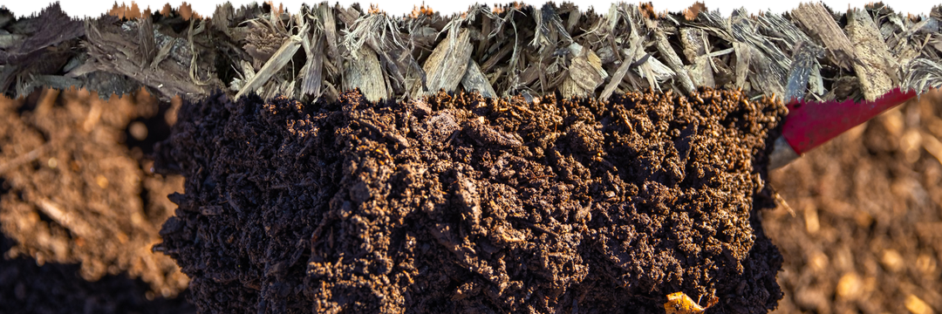

What does Regenerative actually mean?
And who gets to decide?
Notes:
Carousel C: the soil line, slide 1 of 5

Slide 22

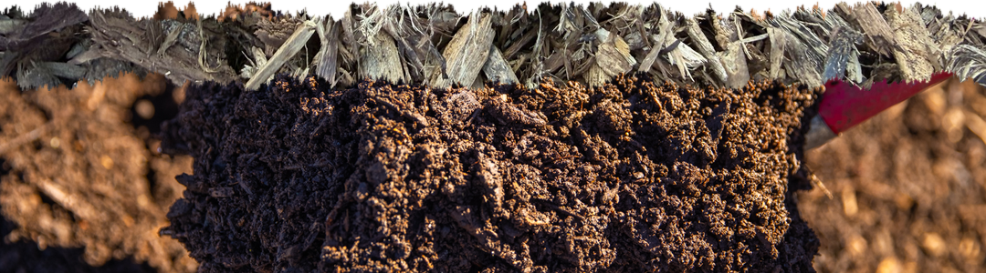
A destination
or a direction?
Notes:
Carousel C: the soil line, slide 2 of 5

Slide 23

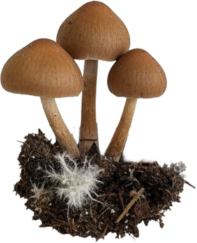
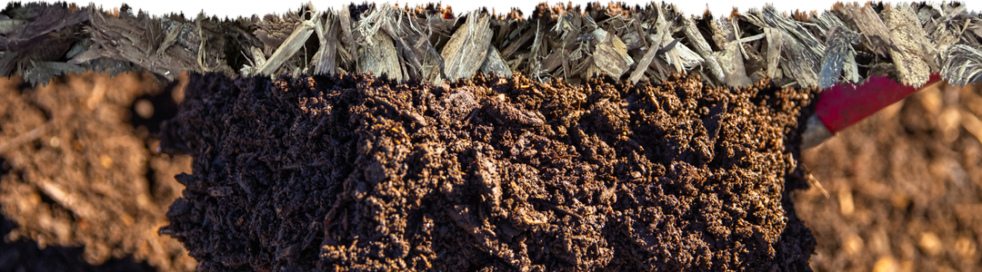
A certified status
or a way of thinking?
Notes:
Carousel C: the soil line, slide 3 of 5

Slide 24


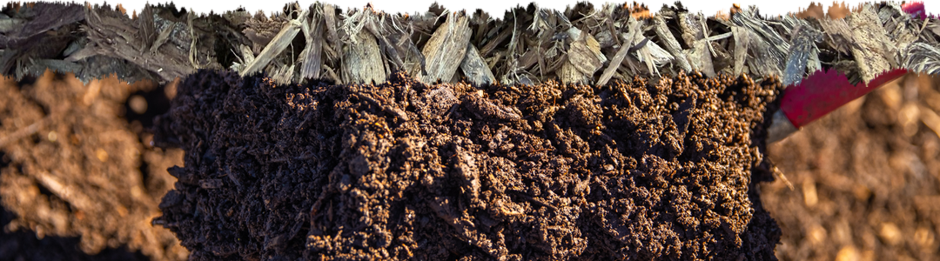
A premium product,
or a standard everyone who works the land can reach?
Notes:
Carousel C: the soil line, slide 4 of 5

Slide 25


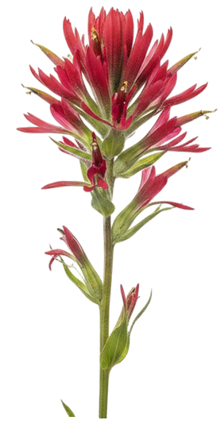



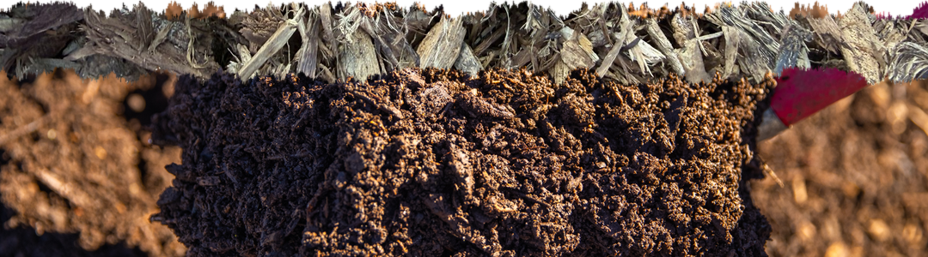
Living soil in the hands of every person who works the land.
What does regenerative mean to you? Tell us in the comments.
Notes:
Carousel C: the soil line, slide 5 of 5

Slide 26


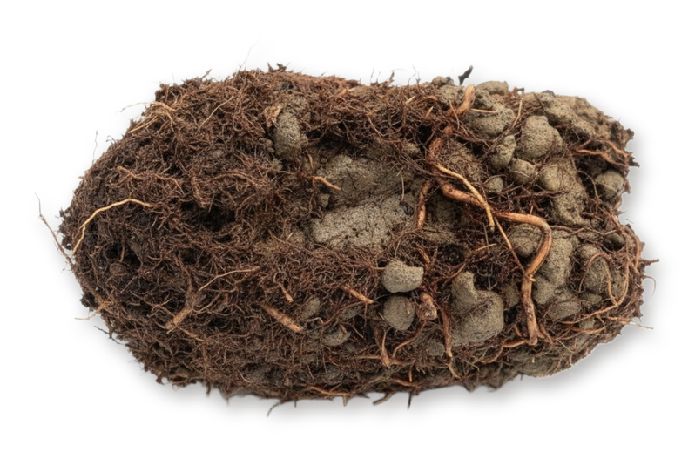
What does Regenerative actually mean?
And who gets to decide?
Notes:
Carousel D: specimen sheet, slide 1 of 5

Slide 27




A destination
or a direction?
Notes:
Carousel D: specimen sheet, slide 2 of 5

Slide 28



A certified status
or a way of thinking?
Notes:
Carousel D: specimen sheet, slide 3 of 5

Slide 29


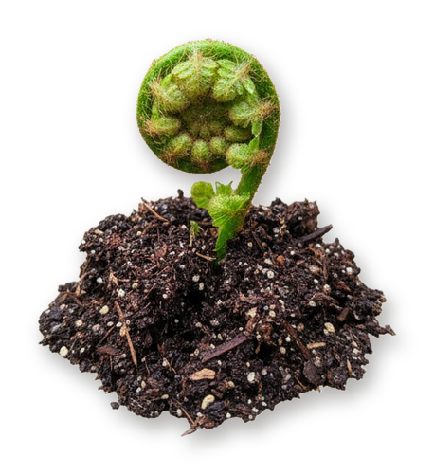
A premium product,
or a standard everyone who works the land can reach?
Notes:
Carousel D: specimen sheet, slide 4 of 5

Slide 30






Living soil in the hands of every person who works the land.
What does regenerative mean to you? Tell us in the comments.
Notes:
Carousel D: specimen sheet, slide 5 of 5

Slide 31
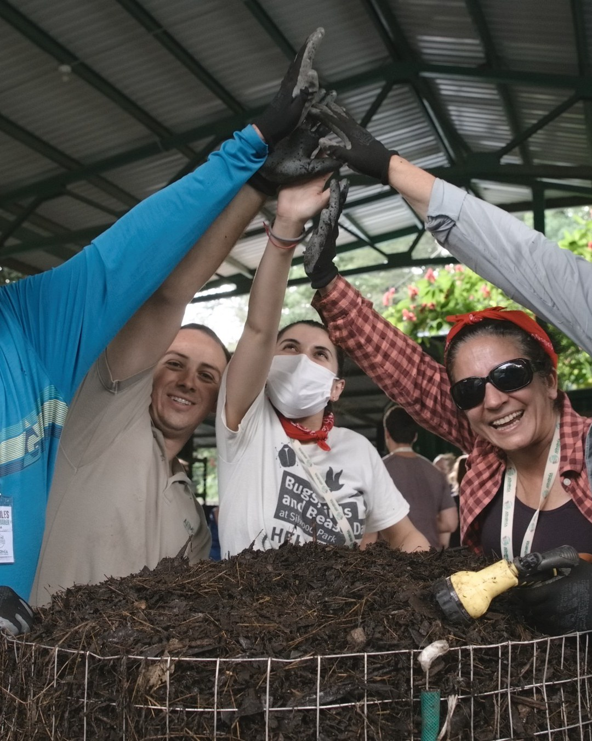

What does Regenerative actually mean?
And who gets to decide?
Notes:
Carousel E: one photo only, slide 1 of 5

Slide 32
A destination
or a direction?
Notes:
Carousel E: one photo only, slide 2 of 5

Slide 33
A certified status
or a way of thinking?
Notes:
Carousel E: one photo only, slide 3 of 5

Slide 34

A premium product,
or a standard everyone who works the land can reach?
Notes:
Carousel E: one photo only, slide 4 of 5

Slide 35


Living soil in the hands of every person who works the land.
What does regenerative mean to you? Tell us in the comments.
Notes:
Carousel E: one photo only, slide 5 of 5

