Slide 1




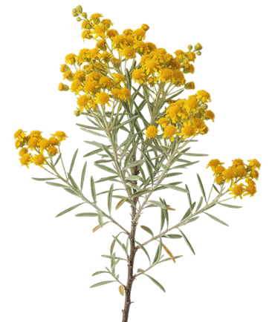



What does Regenerative actually mean?
And who gets to decide?

