Slide 1
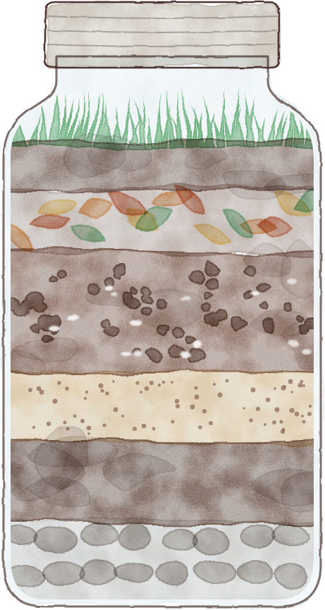
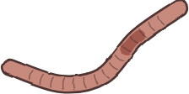
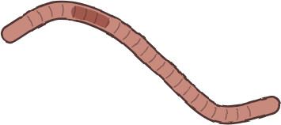



Happy World
Earthworm Day!
What can the worms in your life
tell you about your soil?
Fallen leaves: the
worms’ dinner table
Air pores and
aggregates
Worms working with
the microbes
Crumbly casts
Notes:
Fonts: Fredoka (titles, labels) and Montserrat (body), free on Google Fonts. Illustration drawn in code (no AI). Arrows are editable lines.

Slide 2
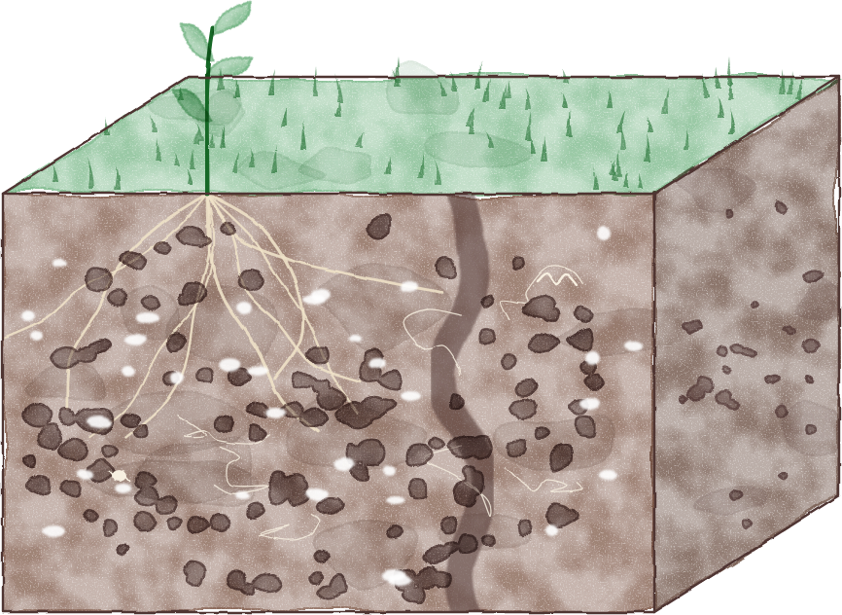




Worms thriving in your soil
They need good structure to survive, with air pores and
aggregates the biology has built. When they are present and
happy, it usually means many other beneficial organisms are too.
Roots, fungi
and more
Air pores
Aggregates
Burrows
Notes:
Fonts: Fredoka (titles, labels) and Montserrat (body), free on Google Fonts. Illustration drawn in code (no AI). Arrows are editable lines.

Slide 3
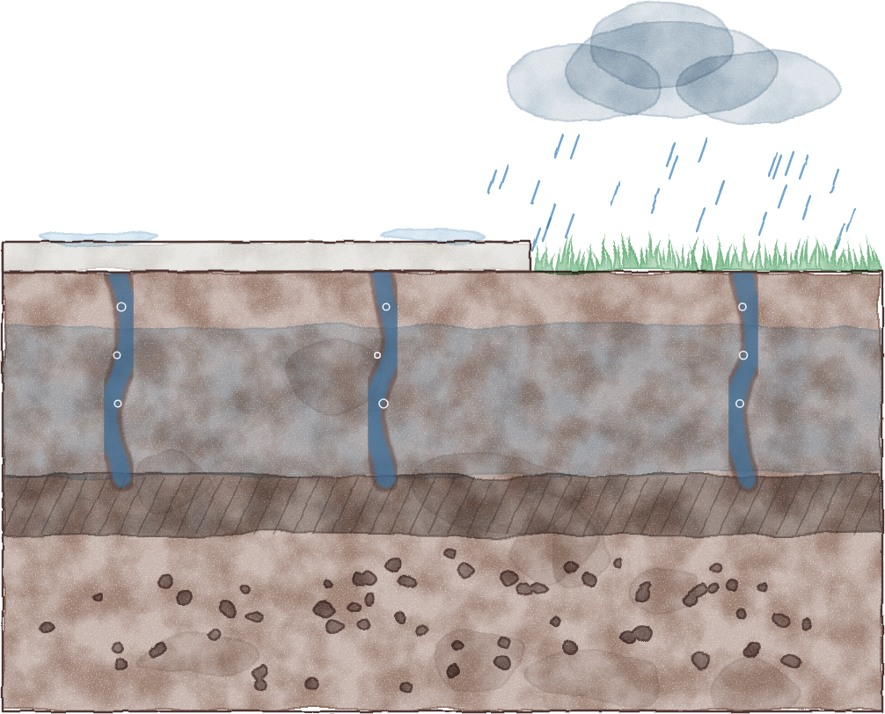
Worms on the sidewalk
after heavy rain
Lots of worms on the sidewalk
after rain can mean water is sitting
in your soil and filling their
burrows.
Water fills
the burrows
Burrows
flooded
Compaction
layer
This often signals your soil needs better structure and
more organic matter.
Notes:
Fonts: Fredoka (titles, labels) and Montserrat (body), free on Google Fonts. Illustration drawn in code (no AI). Arrows are editable lines.

Slide 4
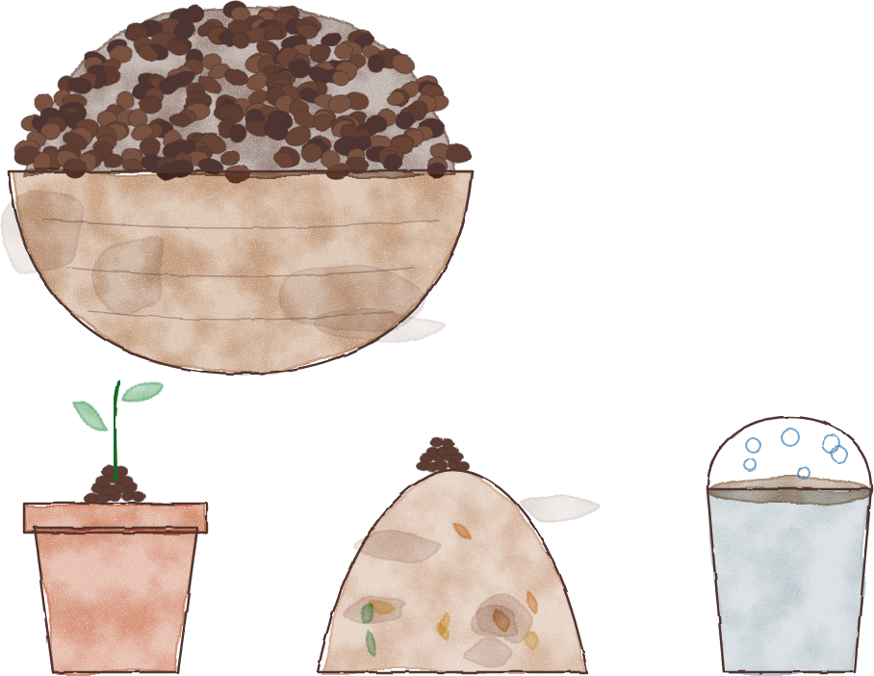

What about worm bins?
Handfuls of small, crumbly casts
You can make
vermicompost year-round
indoors.
Direct
compost
An inoculant
for piles
Teas and
extracts
Notes:
Fonts: Fredoka (titles, labels) and Montserrat (body), free on Google Fonts. Illustration drawn in code (no AI). Arrows are editable lines.

Slide 5
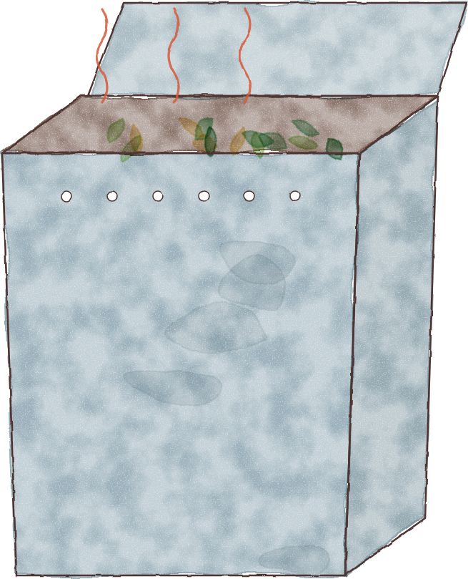



Worms climbing out
of the worm bin?
Low oxygen or too
much heat from fresh,
high-nitrogen food
added in high
quantities is sending
them looking for an
exit.
Slow down the
feeding and let
them cool off.
Notes:
Fonts: Fredoka (titles, labels) and Montserrat (body), free on Google Fonts. Illustration drawn in code (no AI). Arrows are editable lines.

Slide 6
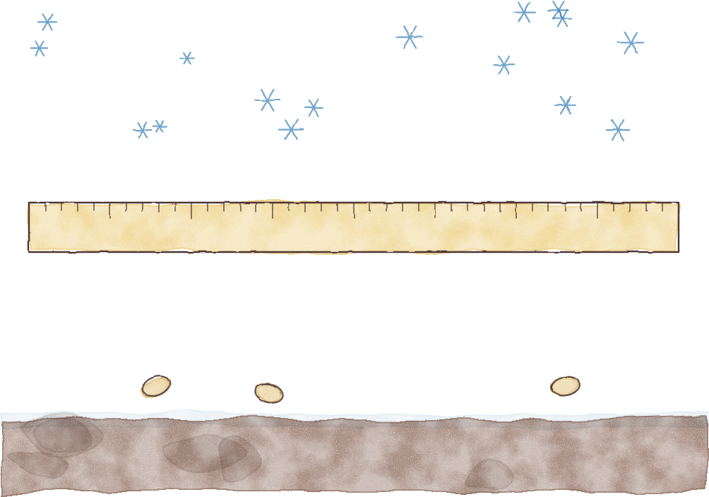
Smaller worms
in cooler months
This isn’t an issue. Many are babies that have just hatched,
and they grow slowly until warm weather speeds them up.
Cocoons
Just
hatched
Notes:
Fonts: Fredoka (titles, labels) and Montserrat (body), free on Google Fonts. Illustration drawn in code (no AI). Arrows are editable lines.

Slide 7
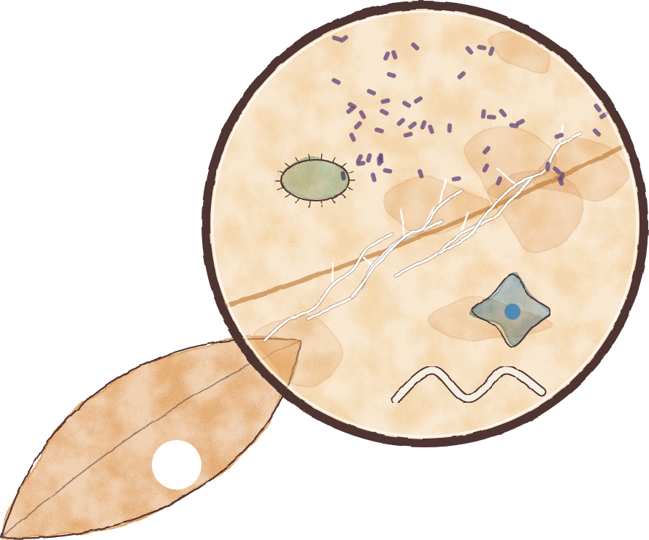
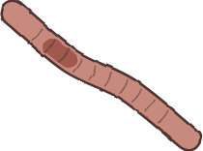
Fun fact
Worms lean on microbes to break
down leaves
They take a bite and feed on the bacteria, fungi, protozoa and
nematodes living on the surface of those foods.
Bacteria
Fungi
Protozoa
Nematodes
Notes:
Fonts: Fredoka (titles, labels) and Montserrat (body), free on Google Fonts. Illustration drawn in code (no AI). Arrows are editable lines.

