Slide 1
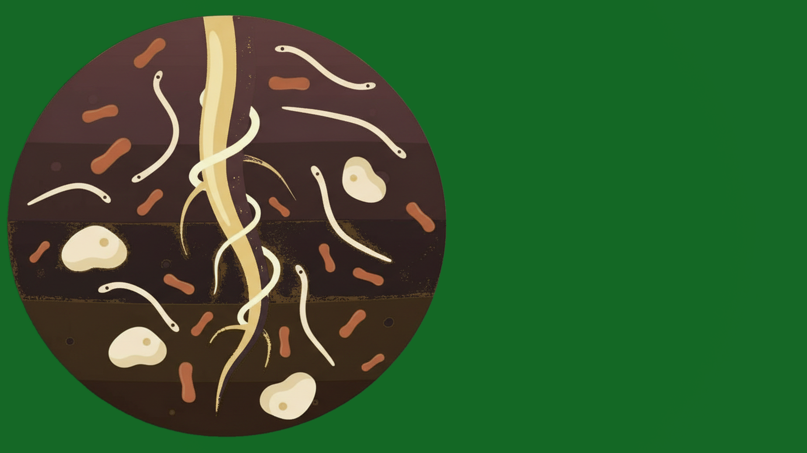


What is the
Soil Food Web?

Slide 2
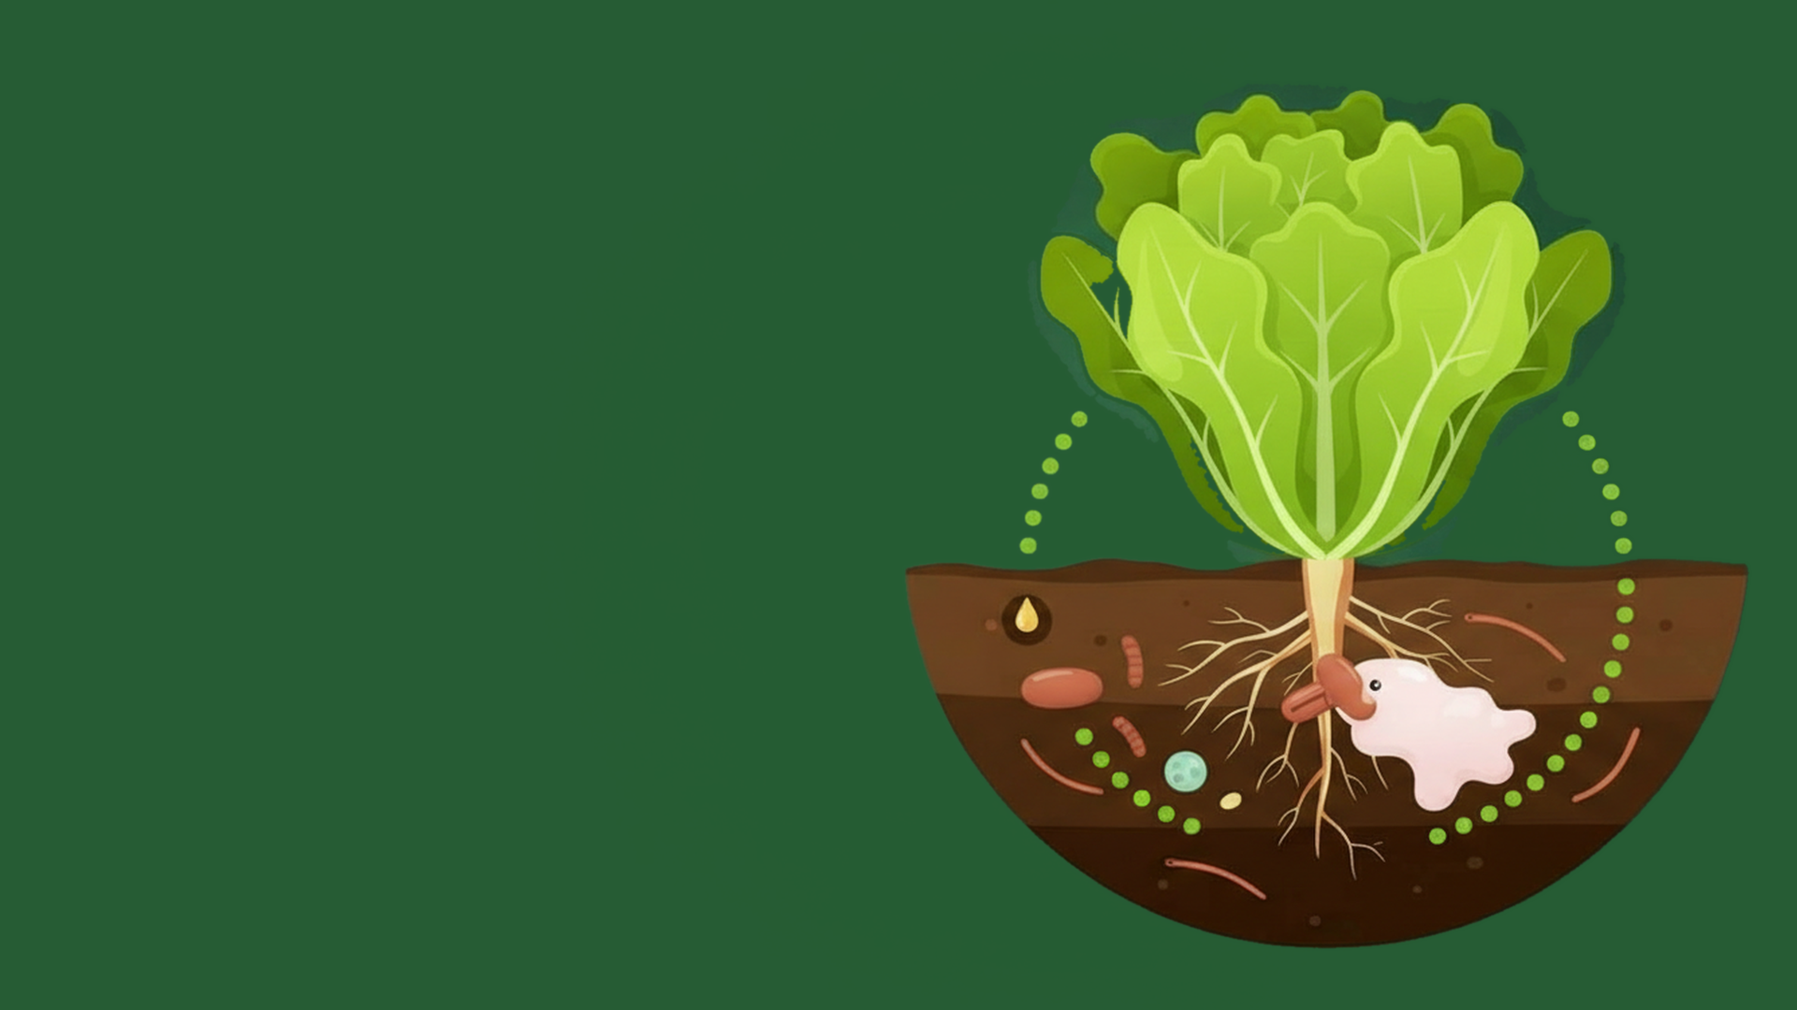
Nutrient
Cycling

Slide 3
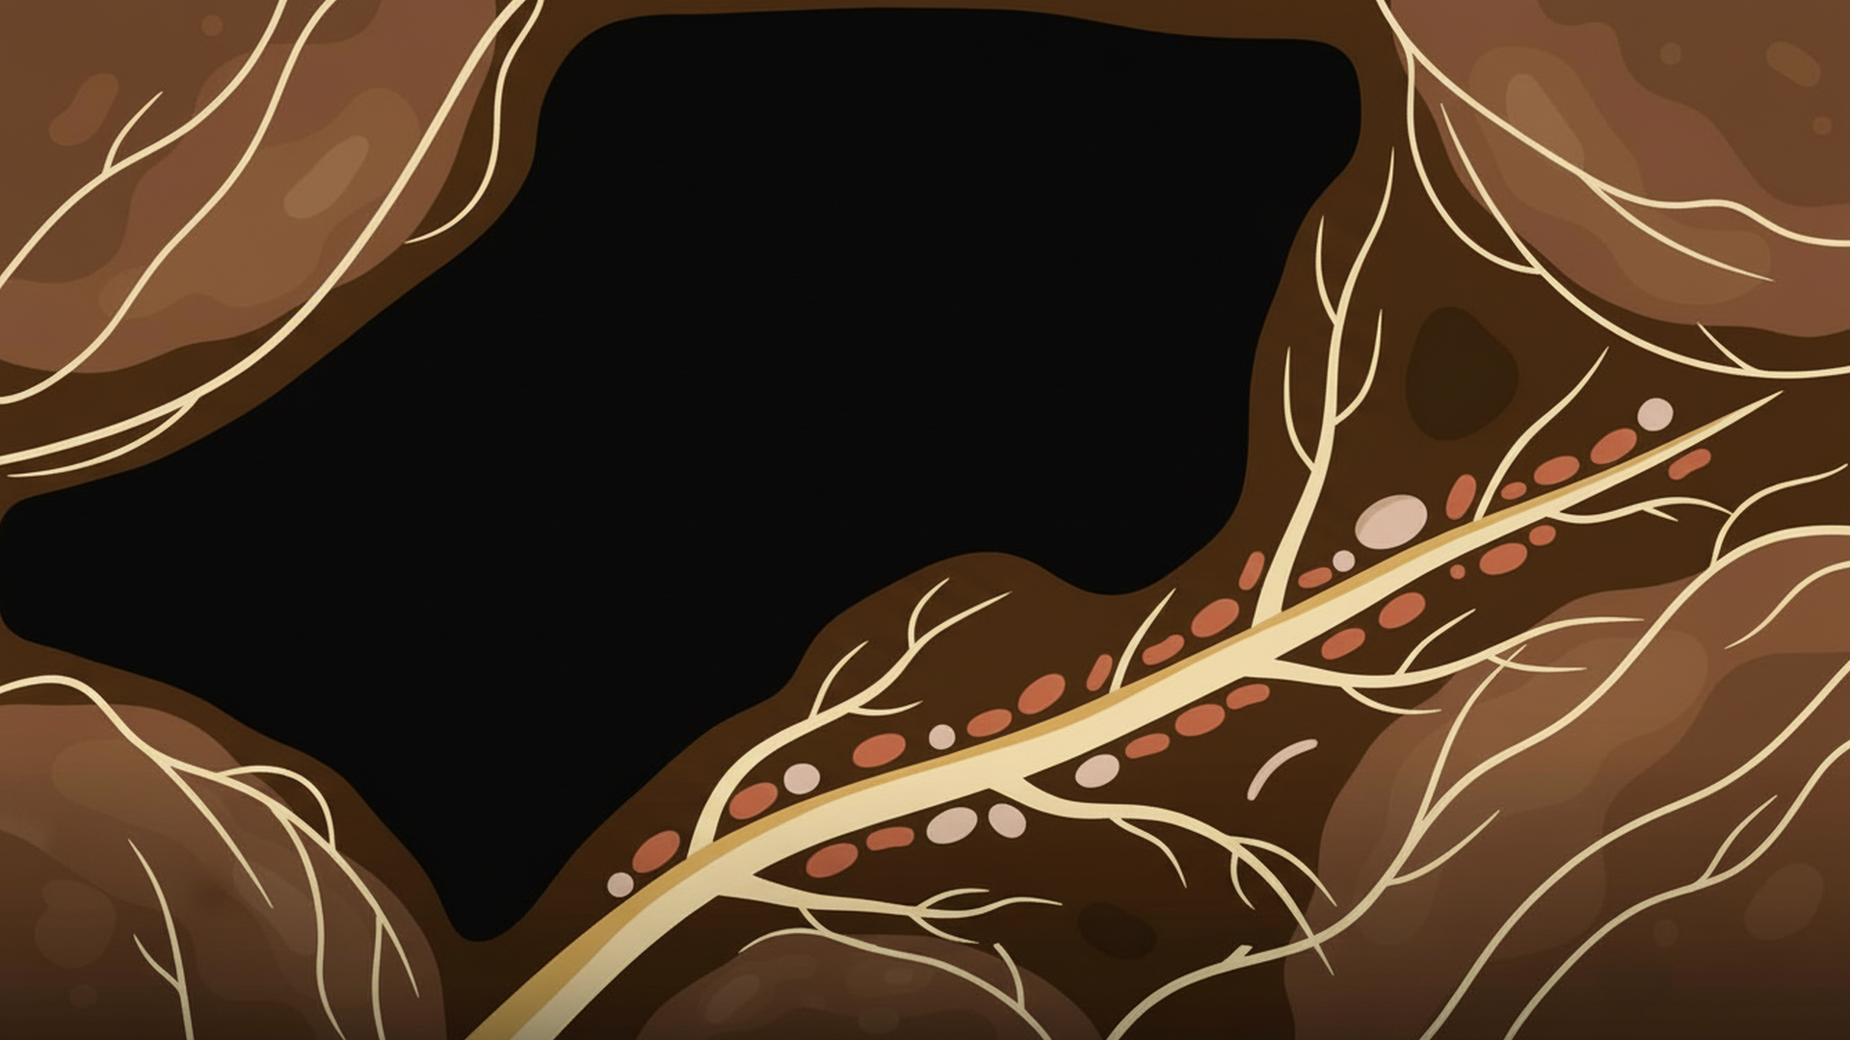
Formation of
Structure

Slide 4
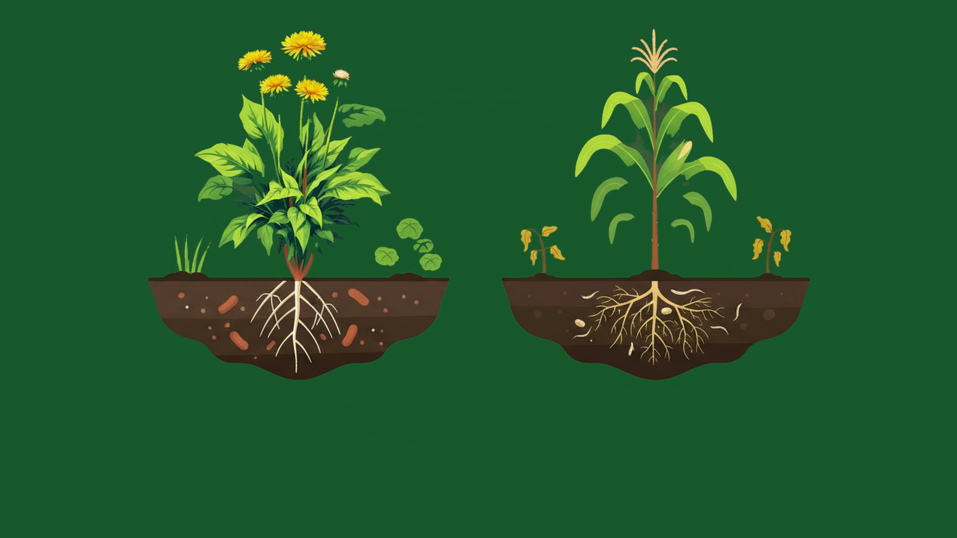

Weed Suppression

Slide 5
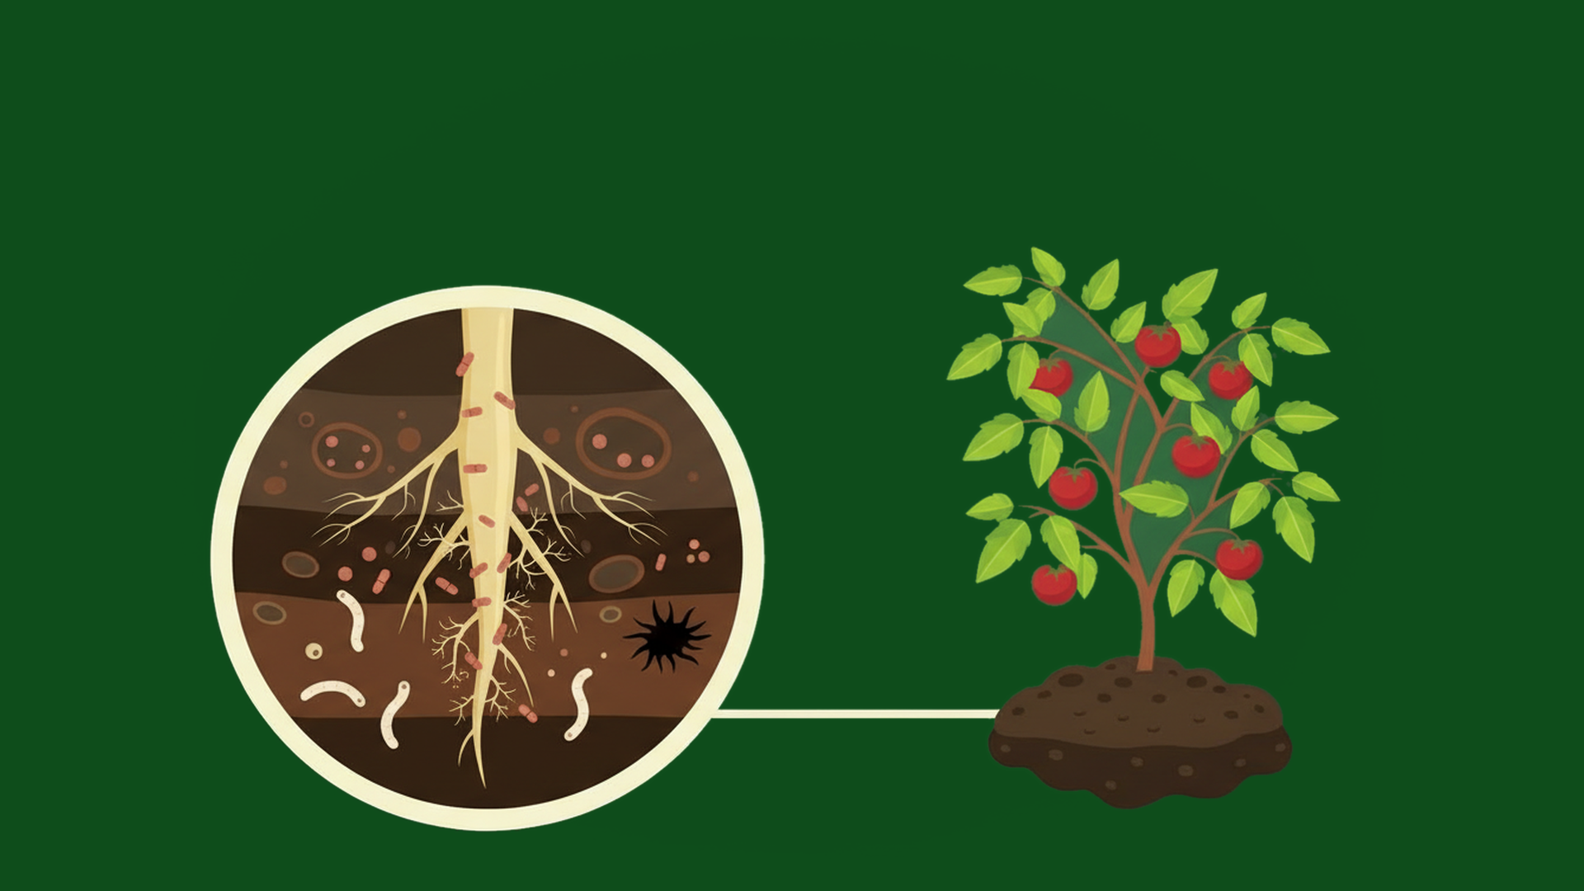
Inhibiting Pests
& Diseases

Slide 6
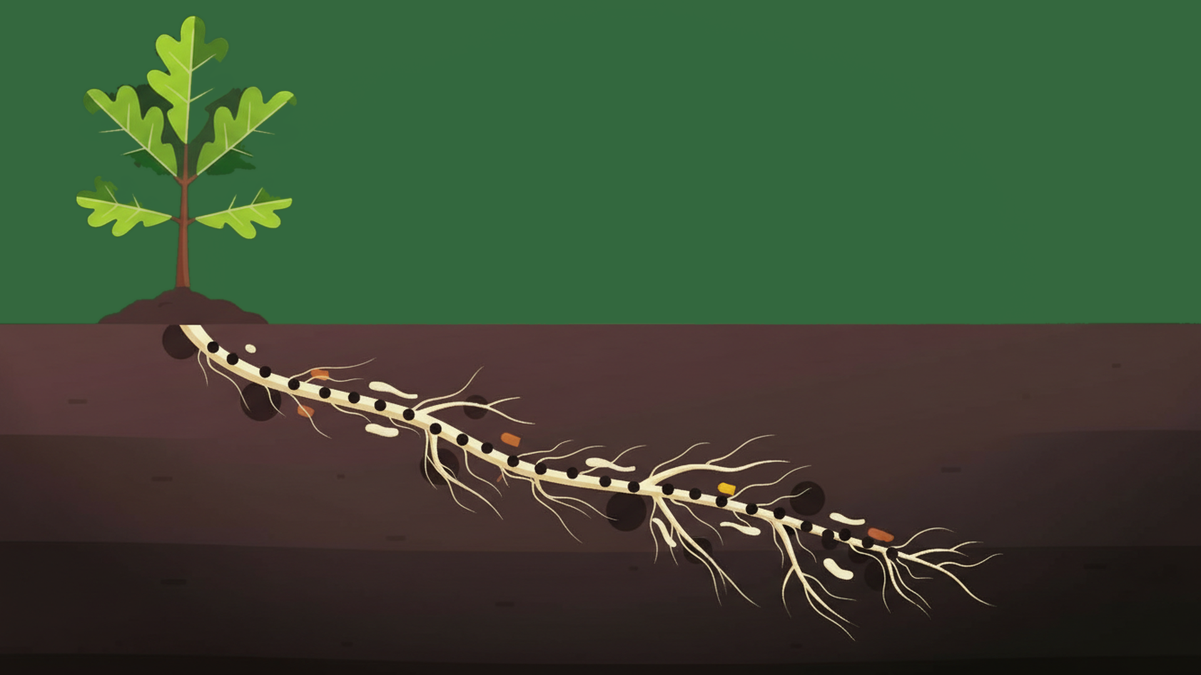

Sequestering
Carbon

