Slide 1

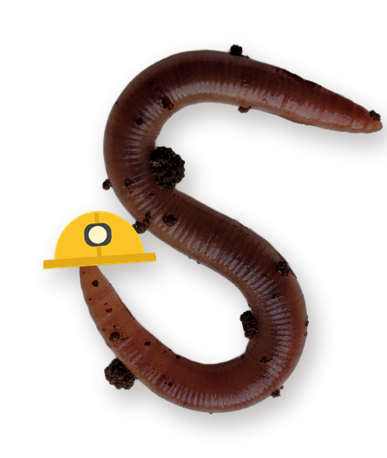
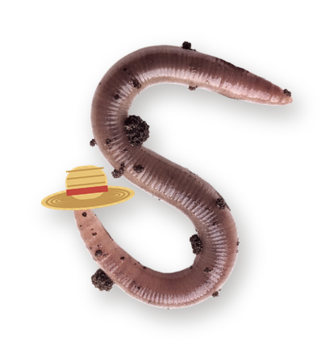
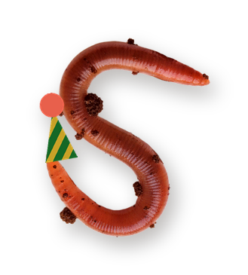
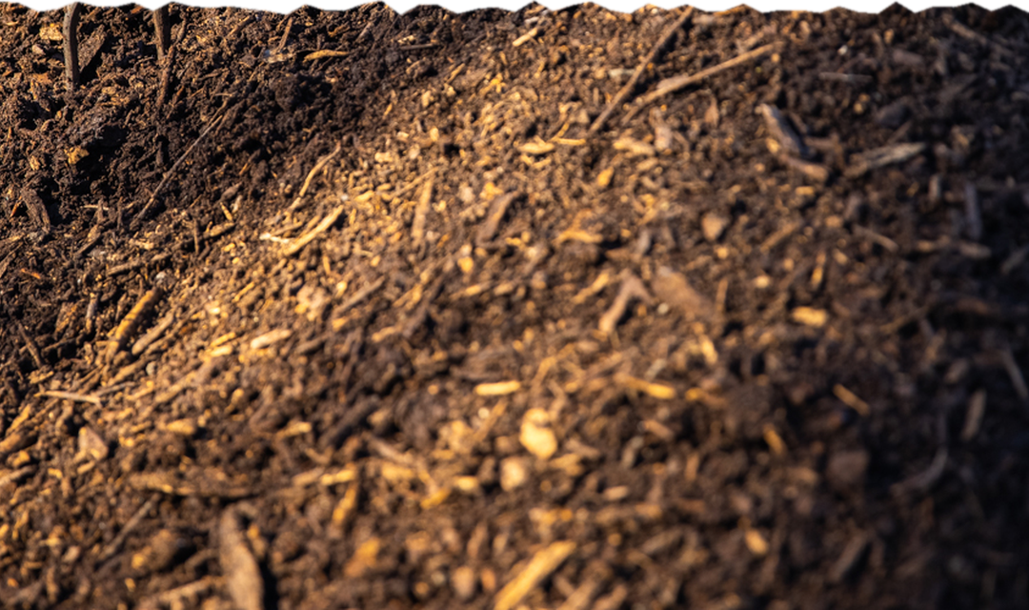

Is World Earthworm Day even a thing?

Slide 2


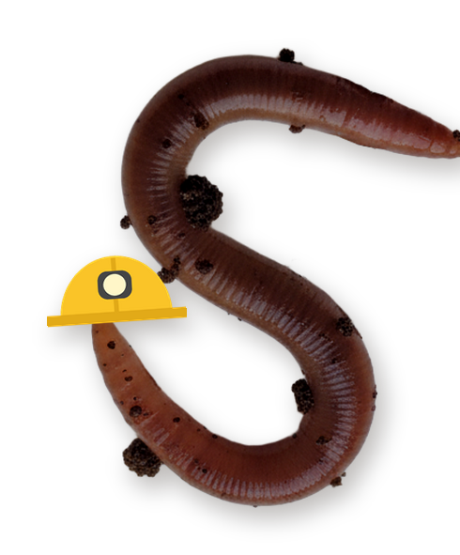
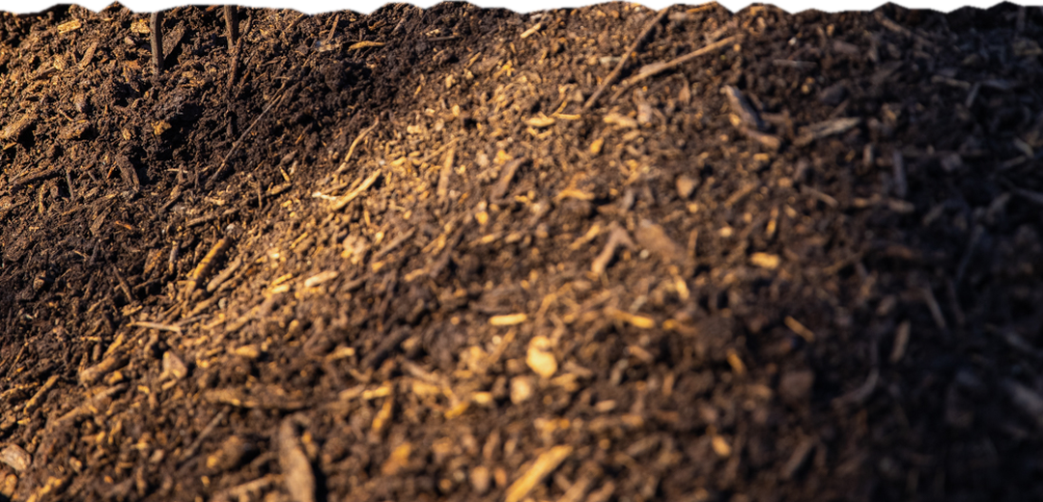
Yes, it's real.
In 2016 the Earthworm Society of Britain nominated 21 October as World Earthworm Day, and they chose October to honor Charles Darwin, since his book on worms was published that month.

Slide 3
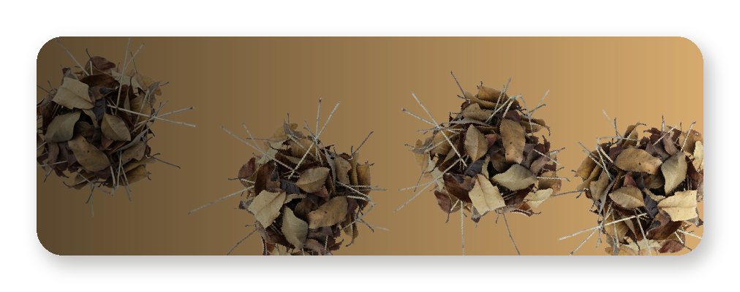
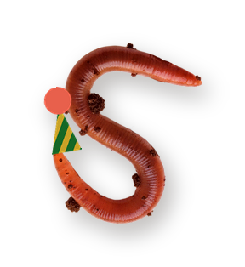
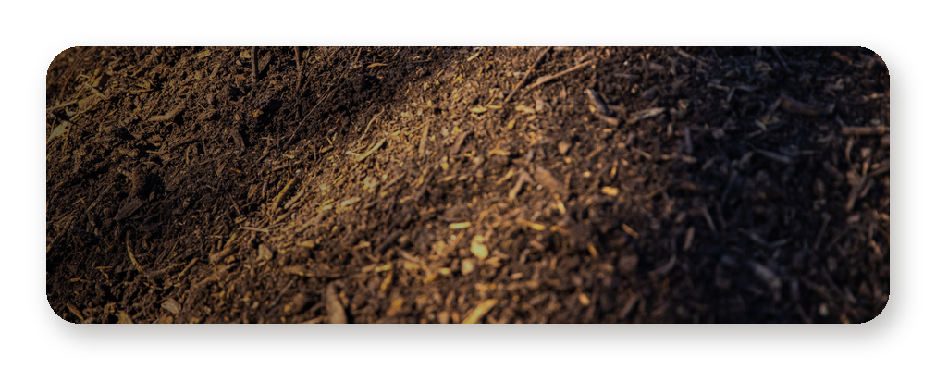
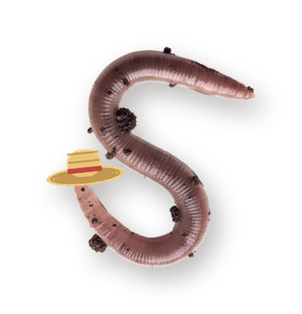
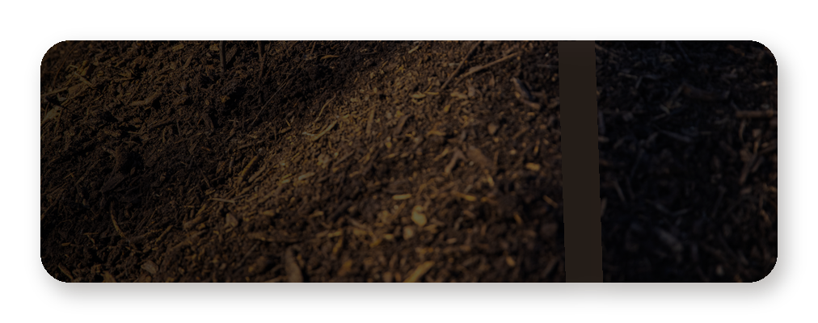
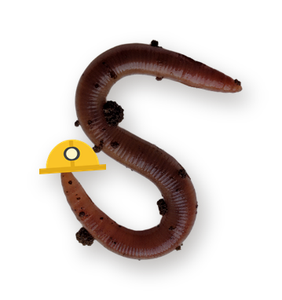
Which earthworm are you today?
Epigeic. Lives in the leaf litter and eats fast.
Endogeic. Stays in the topsoil and eats its way through it.
Anecic. Digs deep vertical burrows and comes up at night.

