Slide 1

How It Works video thumbnails
Science-illustration options for the six videos, in SFW colours.
Each video has 3 to 5 options, lettered A to E. Reply with one letter per video.

Slide 2
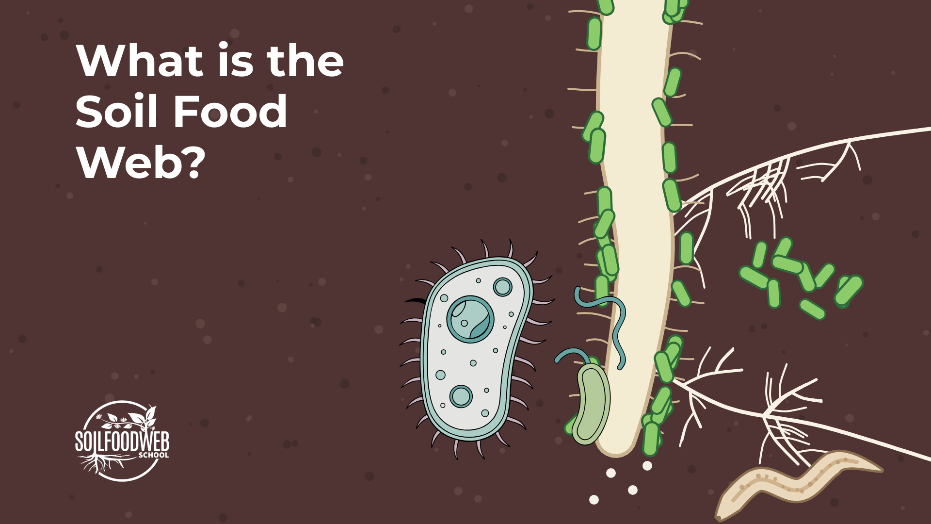
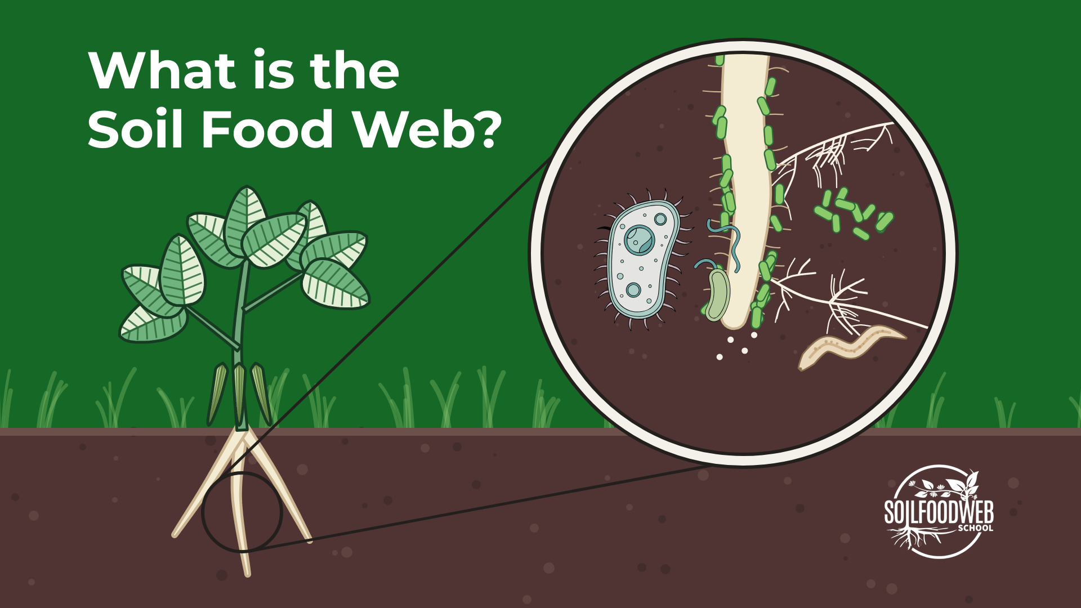
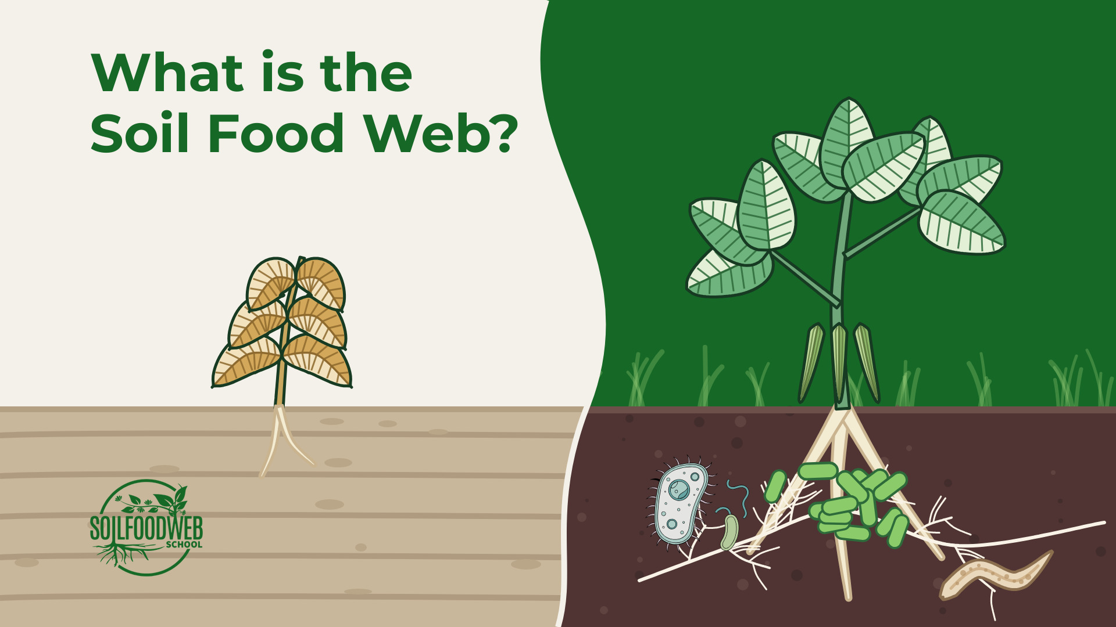
1 What is the Soil Food Web?
Option A
Option B
Option C
Notes:
Option A (file what-is-the-soil-food-web-A.jpg): Close-up: root tip with bacteria, fungi, a protozoan and a nematode, on Soil Brown
Option B (file what-is-the-soil-food-web-B.jpg): Bean plant on Food Web Green, magnifier on its root zone
Option C (file what-is-the-soil-food-web-D.jpg): SFW wave layout: lifeless compacted soil vs a bean in living soil with its food web

Slide 3
Notes:
What is the Soil Food Web?, option A (file what-is-the-soil-food-web-A.jpg): Close-up: root tip with bacteria, fungi, a protozoan and a nematode, on Soil Brown

Slide 4
Notes:
What is the Soil Food Web?, option B (file what-is-the-soil-food-web-B.jpg): Bean plant on Food Web Green, magnifier on its root zone

Slide 5
Notes:
What is the Soil Food Web?, option C (file what-is-the-soil-food-web-D.jpg): SFW wave layout: lifeless compacted soil vs a bean in living soil with its food web

Slide 6
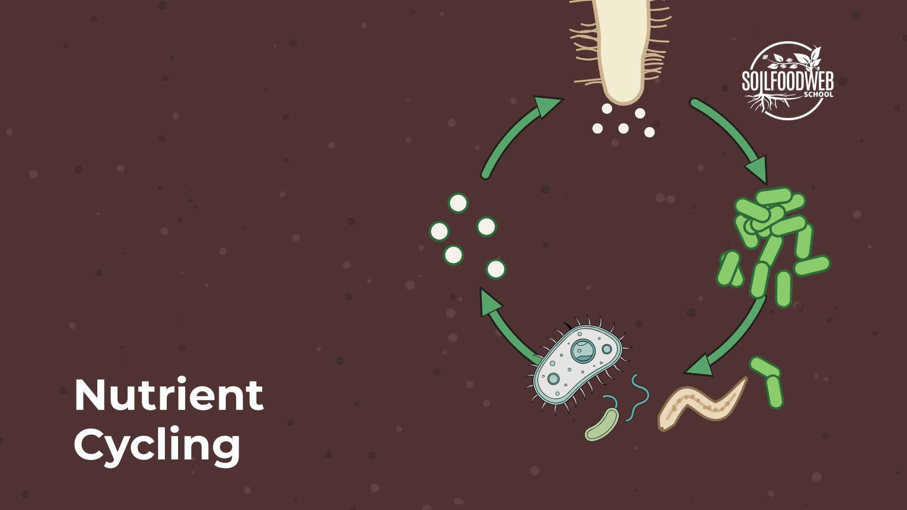
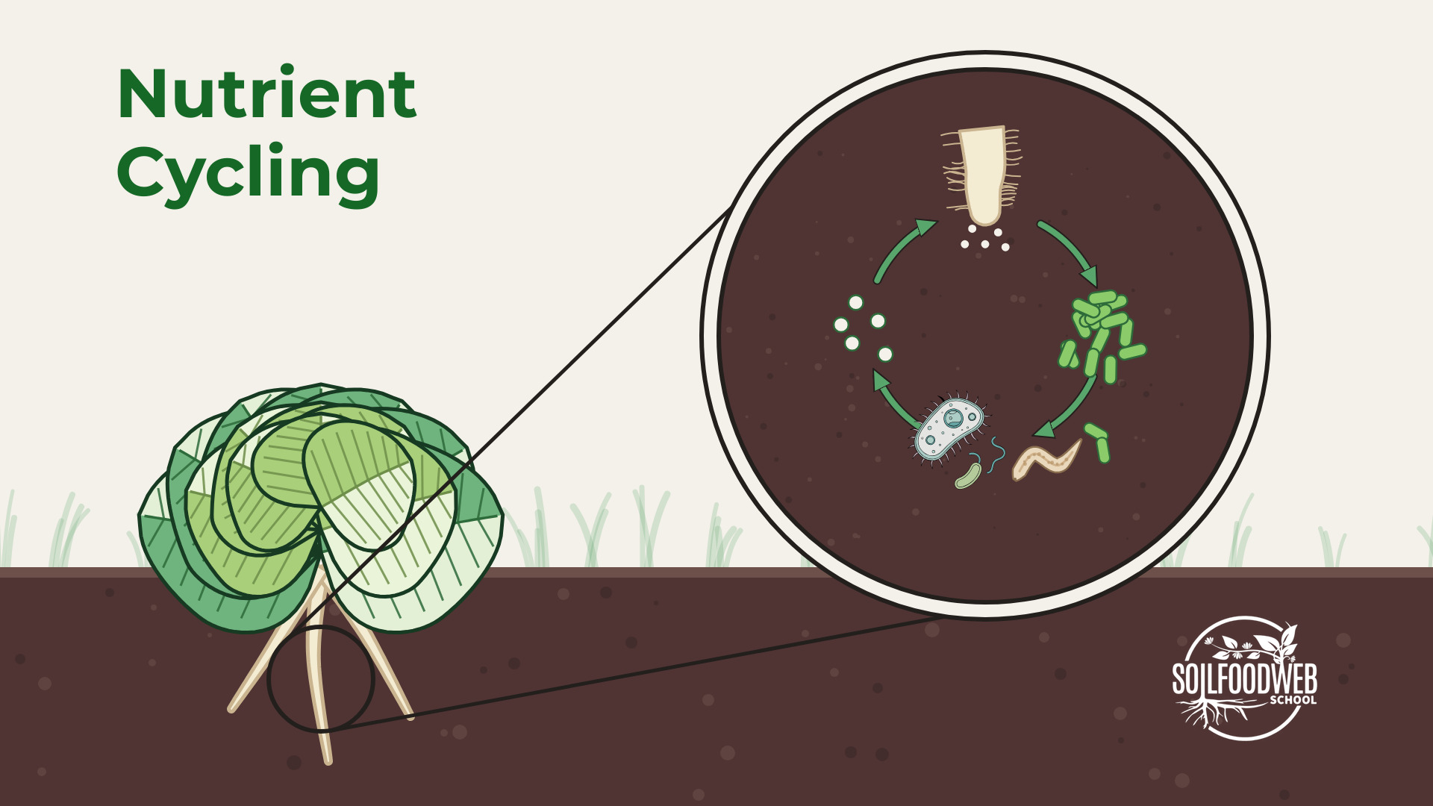
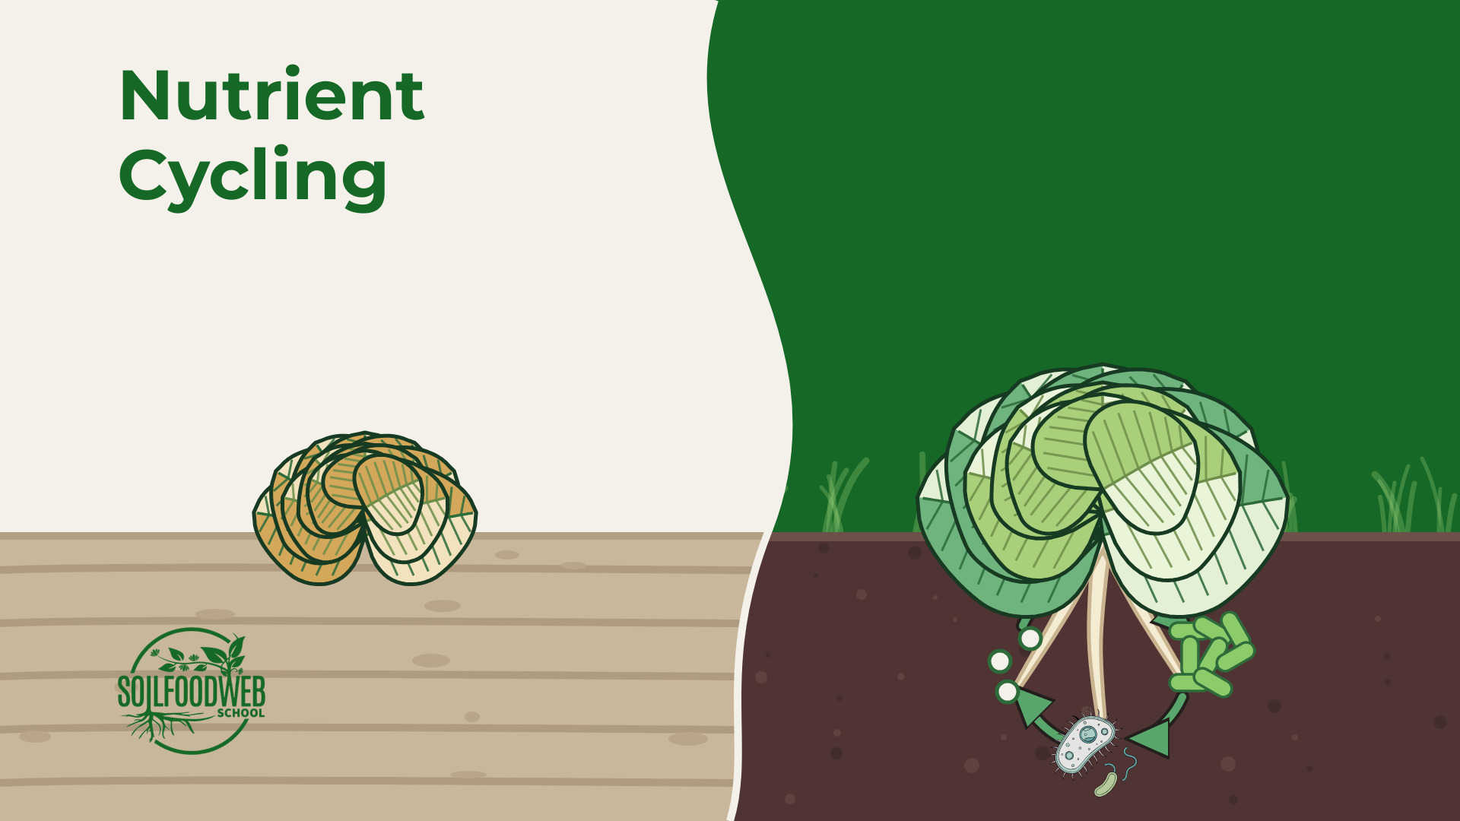
2 Nutrient Cycling
Option A
Option B
Option C
Notes:
Option A (file nutrient-cycling-A.jpg): Close-up: protozoan eats bacteria, nutrients flow to the root hair
Option B (file nutrient-cycling-B.jpg): Lettuce on Organic Cream, magnifier on the nutrient loop
Option C (file nutrient-cycling-D.jpg): SFW wave layout: yellowing lettuce vs a lush lettuce with the nutrient cycle at its roots

Slide 7
Notes:
Nutrient Cycling, option A (file nutrient-cycling-A.jpg): Close-up: protozoan eats bacteria, nutrients flow to the root hair

Slide 8
Notes:
Nutrient Cycling, option B (file nutrient-cycling-B.jpg): Lettuce on Organic Cream, magnifier on the nutrient loop

Slide 9
Notes:
Nutrient Cycling, option C (file nutrient-cycling-D.jpg): SFW wave layout: yellowing lettuce vs a lush lettuce with the nutrient cycle at its roots

Slide 10
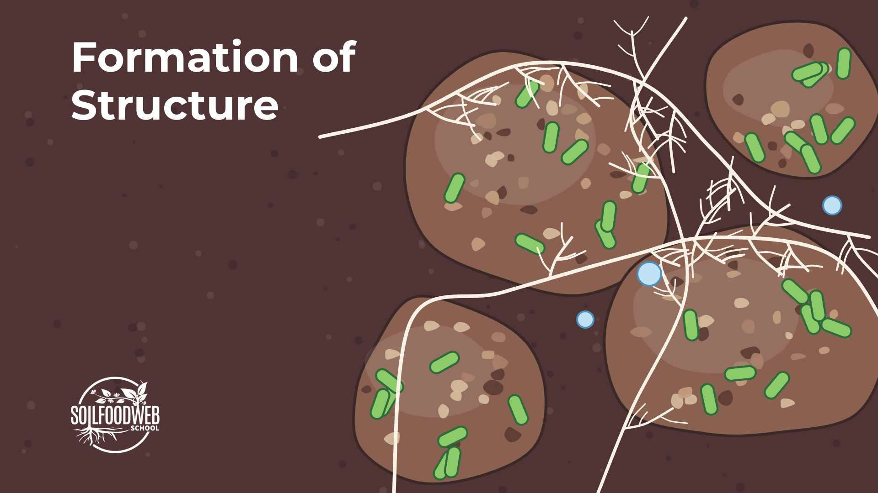
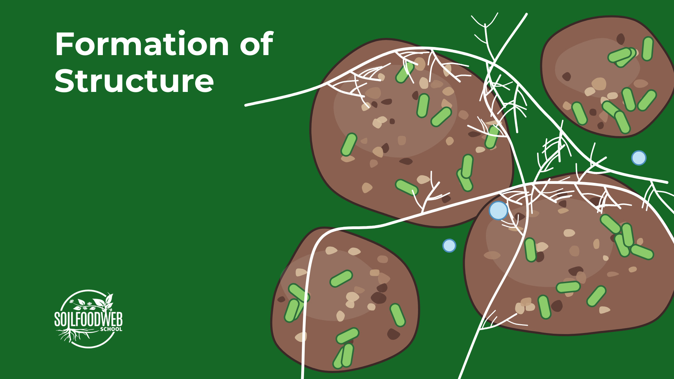
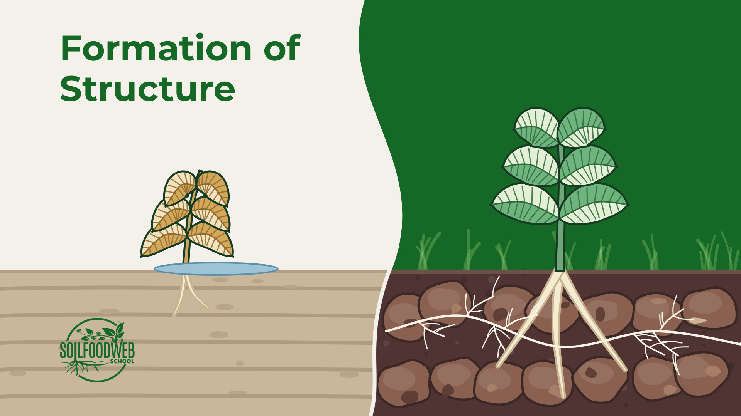
3 Formation of Structure
Option A
Option B
Option C
Notes:
Option A (file formation-of-structure-A.jpg): Soil crumbs glued by bacteria, woven by fungal threads, on Soil Brown
Option B (file formation-of-structure-B.jpg): The same crumbs as a specimen on Food Web Green
Option C (file formation-of-structure-D.jpg): SFW wave layout: compacted soil with standing water vs crumbly aggregates woven by fungi

Slide 11
Notes:
Formation of Structure, option A (file formation-of-structure-A.jpg): Soil crumbs glued by bacteria, woven by fungal threads, on Soil Brown

Slide 12
Notes:
Formation of Structure, option B (file formation-of-structure-B.jpg): The same crumbs as a specimen on Food Web Green

Slide 13
Notes:
Formation of Structure, option C (file formation-of-structure-D.jpg): SFW wave layout: compacted soil with standing water vs crumbly aggregates woven by fungi

Slide 14
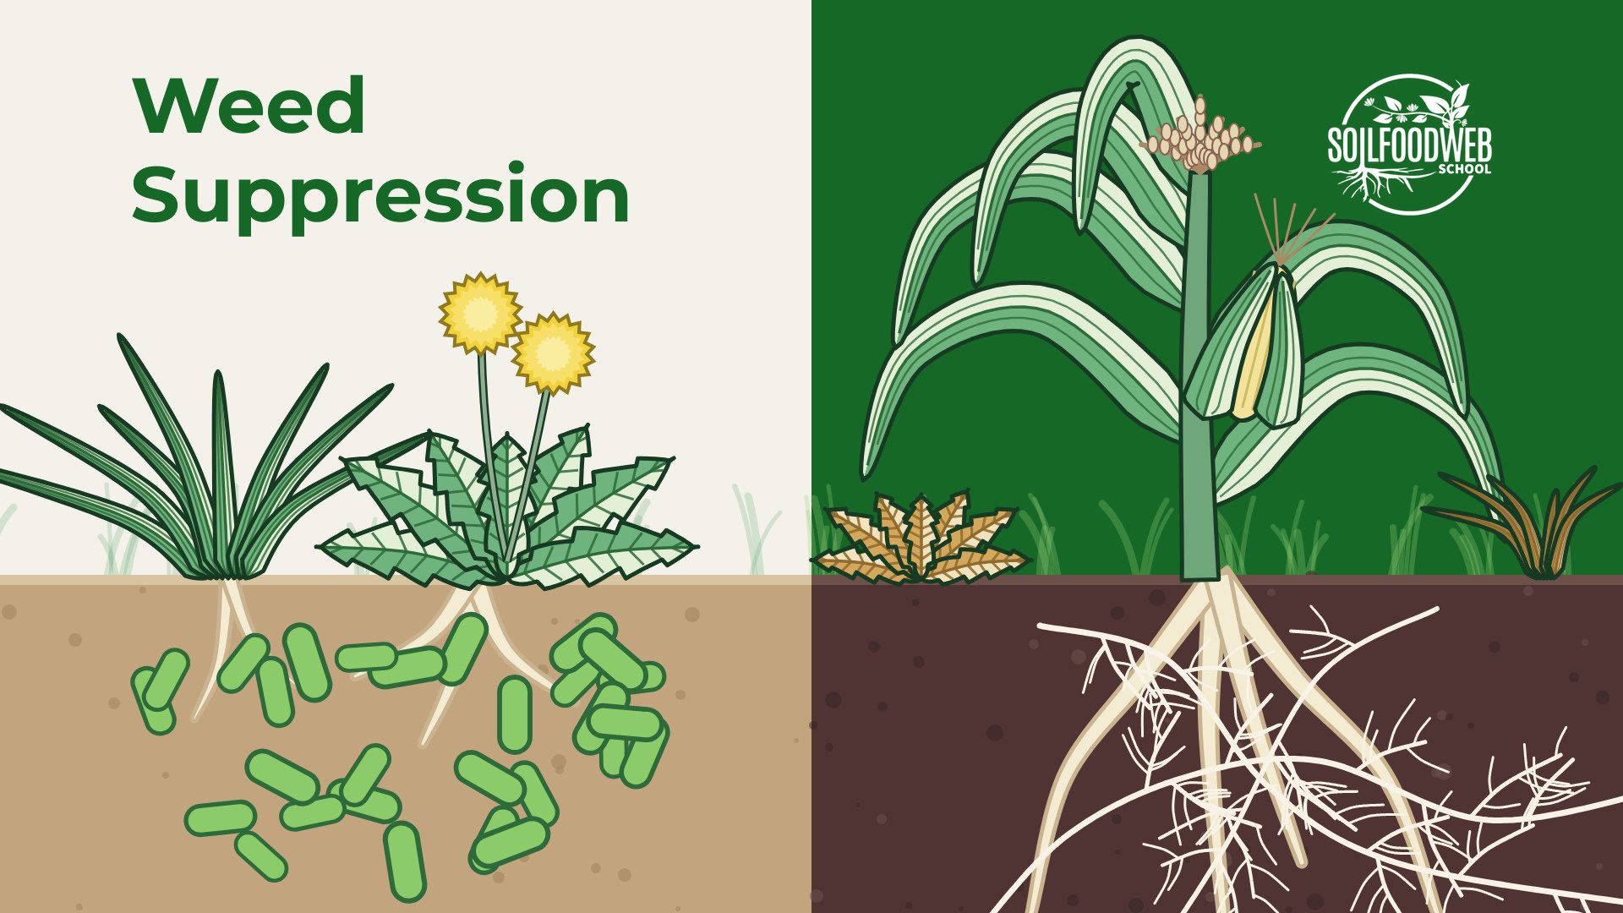
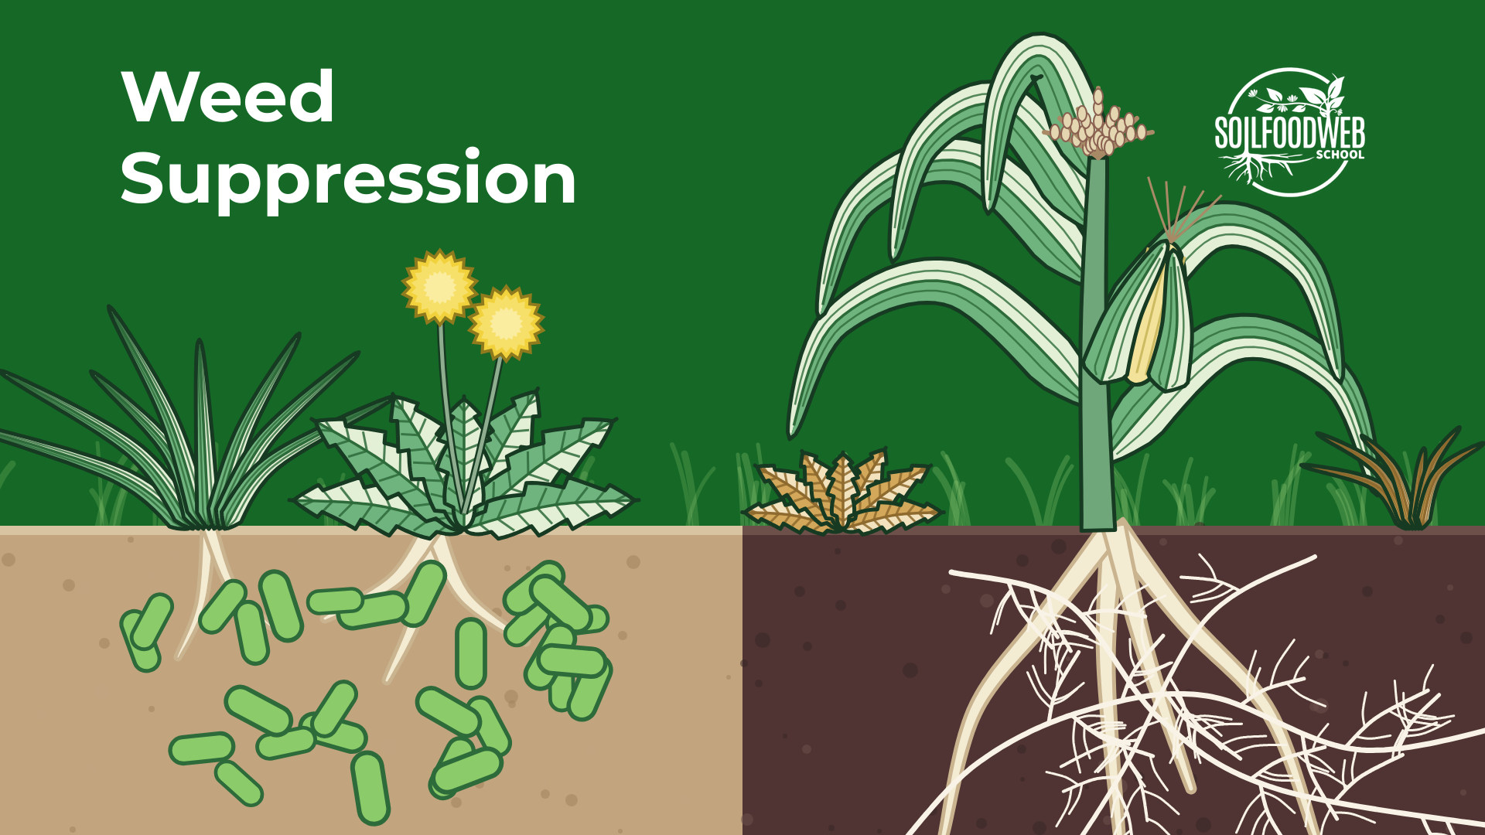
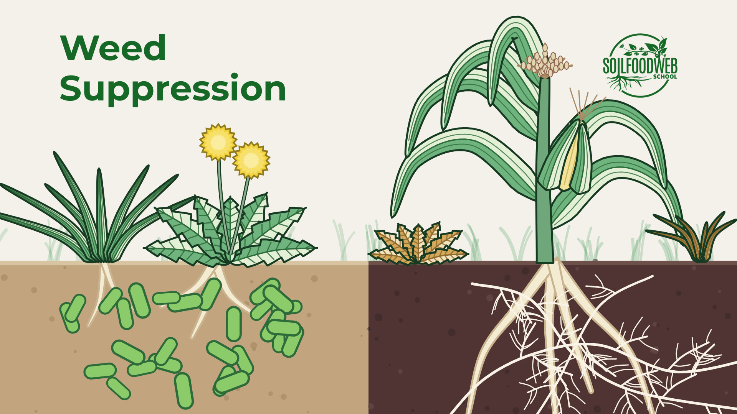
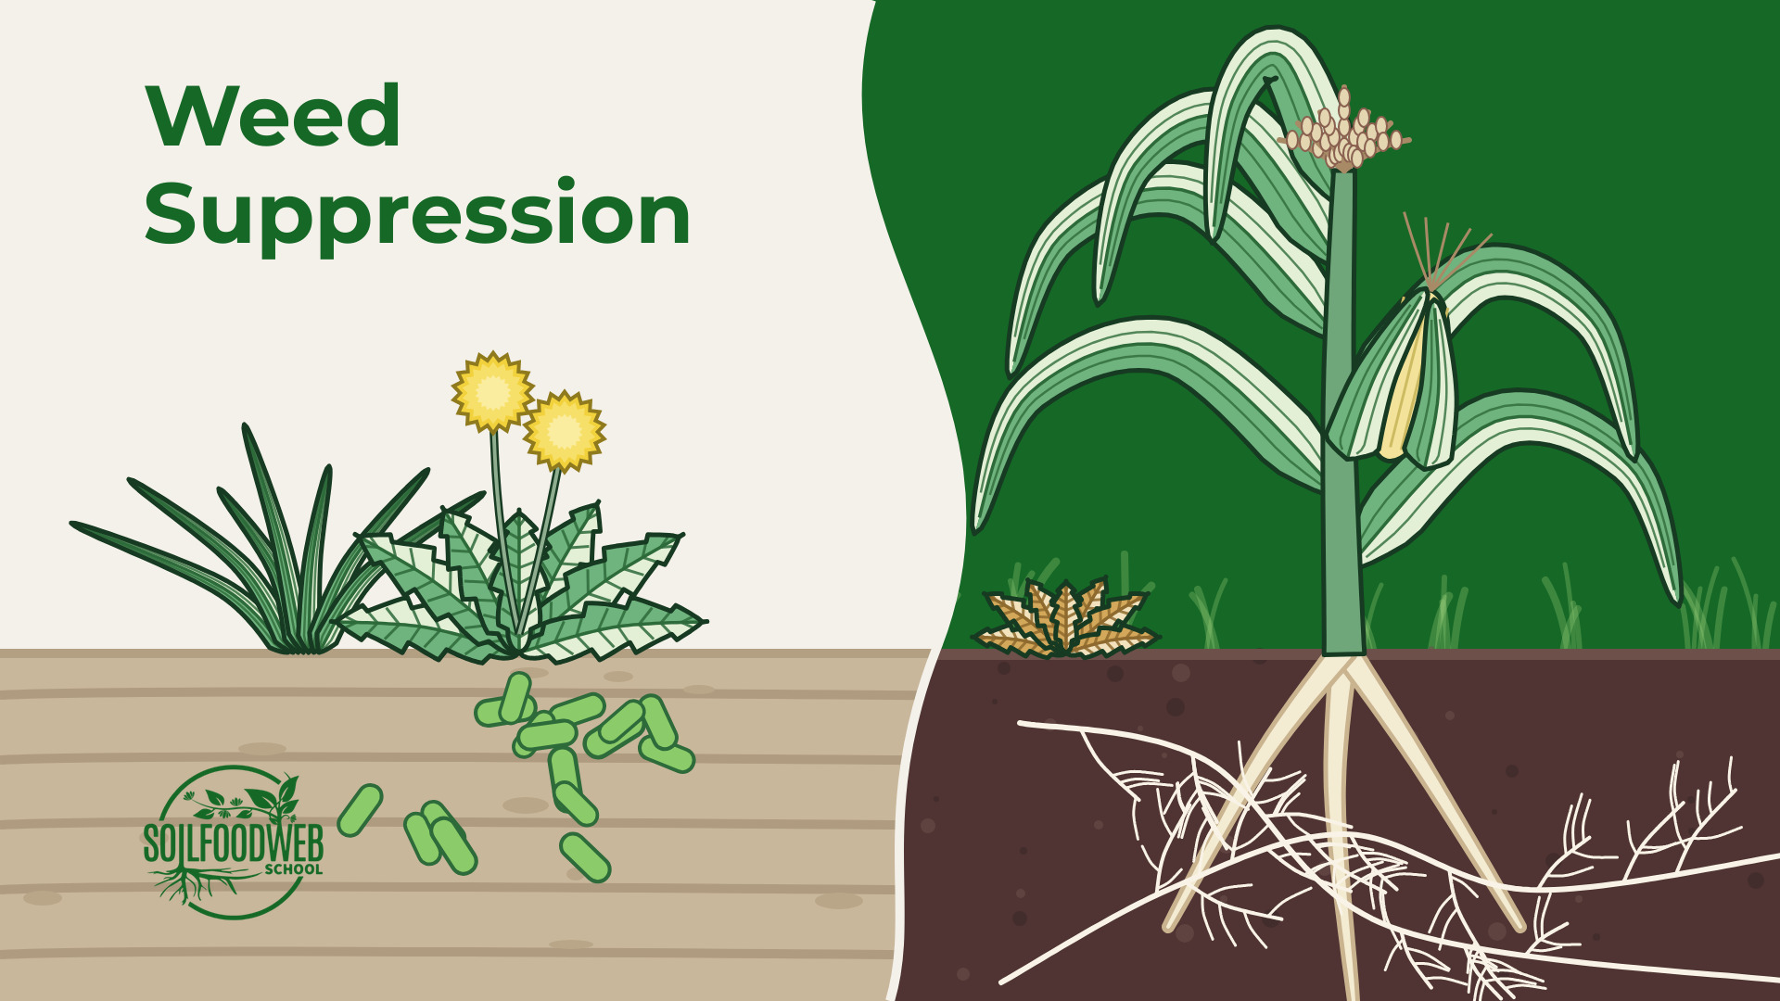
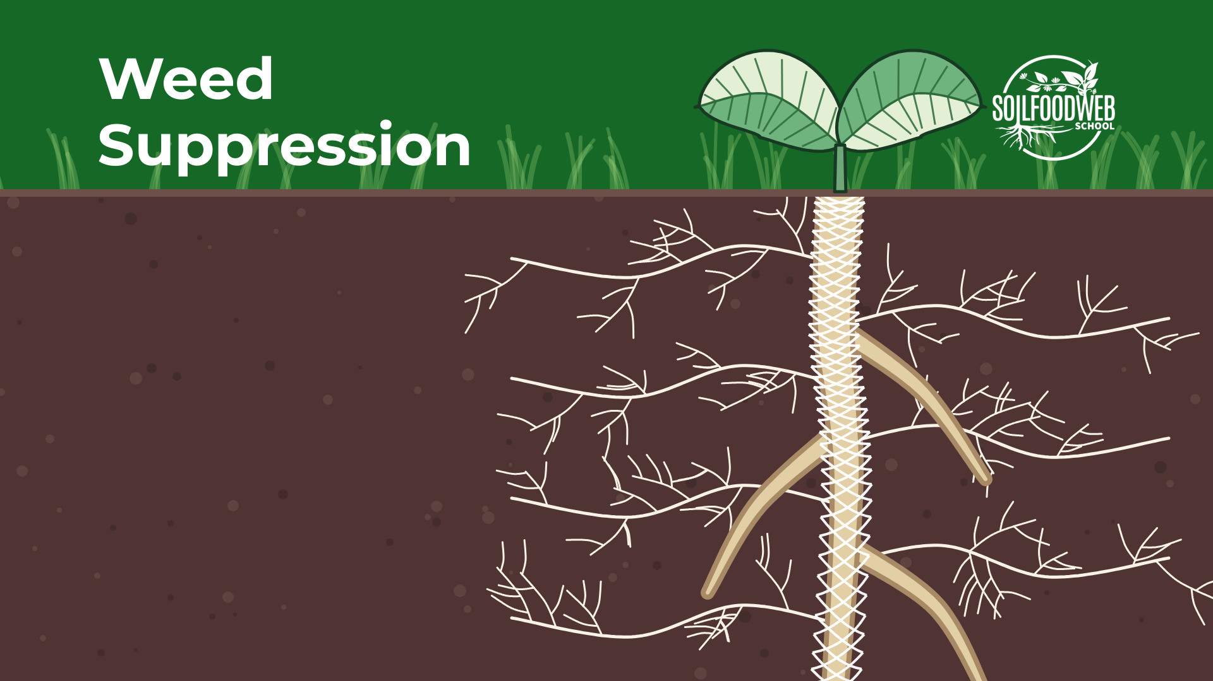
4 Weed Suppression
Option A
Option B
Option C
Option D
Option E
Notes:
Option A (file weed-suppression-A.jpg): Weeds in bacterial soil vs corn in fungal soil; cream and green sky like the reference
Option B (file weed-suppression-B.jpg): Same, Food Web Green sky
Option C (file weed-suppression-C.jpg): Same, Organic Cream sky
Option D (file weed-suppression-D.jpg): SFW wave layout: weeds in bacterial soil vs corn in fungal soil
Option E (file weed-suppression-E.jpg): Close-up: a seedling root wrapped in a mycorrhizal fungal net

Slide 15
Notes:
Weed Suppression, option A (file weed-suppression-A.jpg): Weeds in bacterial soil vs corn in fungal soil; cream and green sky like the reference

Slide 16
Notes:
Weed Suppression, option B (file weed-suppression-B.jpg): Same, Food Web Green sky

Slide 17
Notes:
Weed Suppression, option C (file weed-suppression-C.jpg): Same, Organic Cream sky

Slide 18
Notes:
Weed Suppression, option D (file weed-suppression-D.jpg): SFW wave layout: weeds in bacterial soil vs corn in fungal soil

Slide 19
Notes:
Weed Suppression, option E (file weed-suppression-E.jpg): Close-up: a seedling root wrapped in a mycorrhizal fungal net

Slide 20
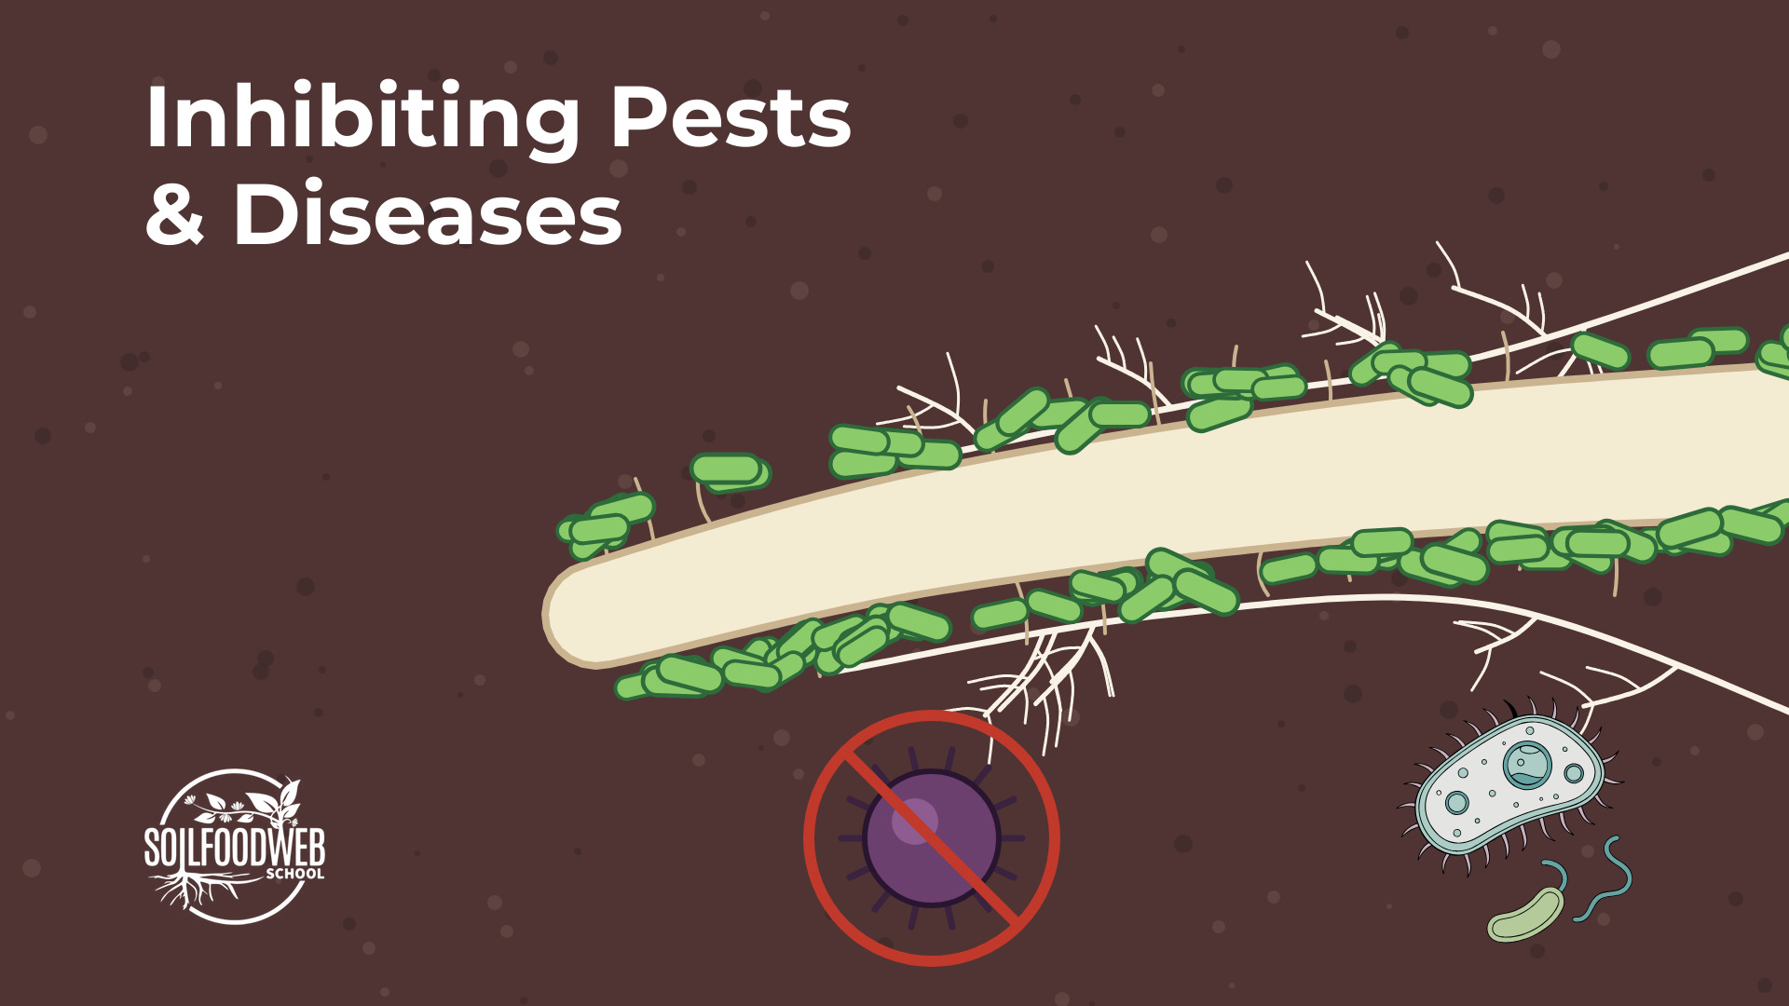
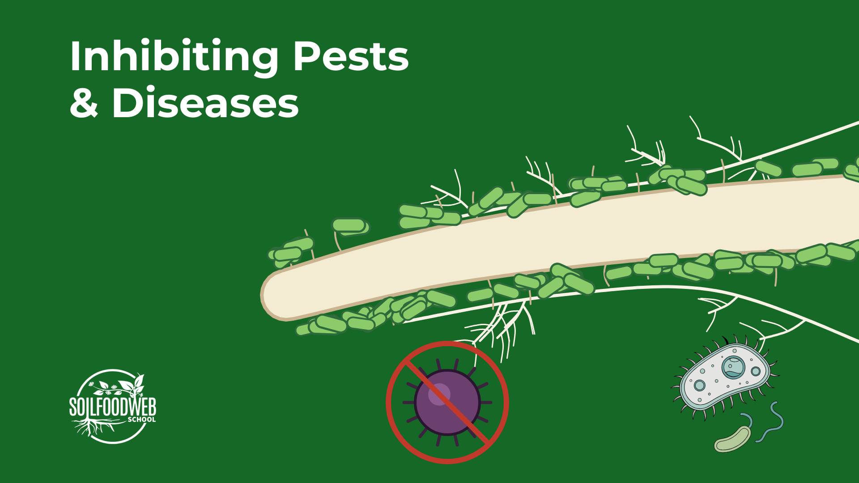
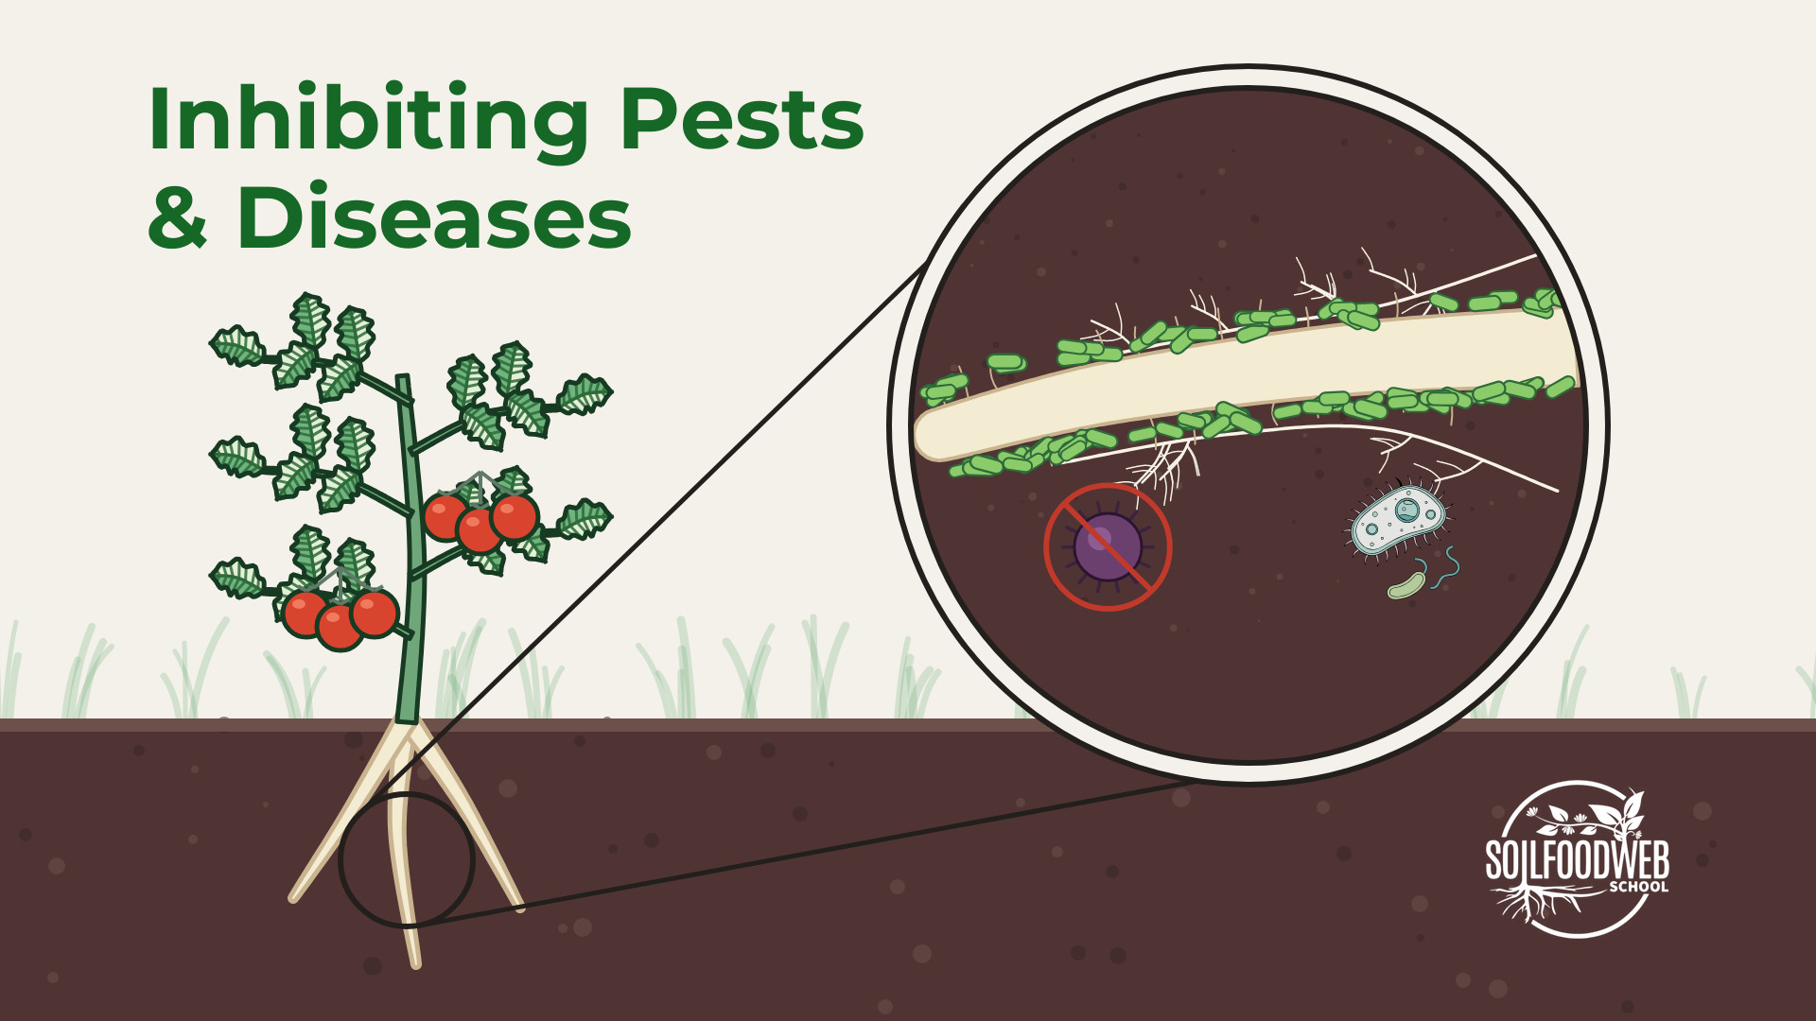
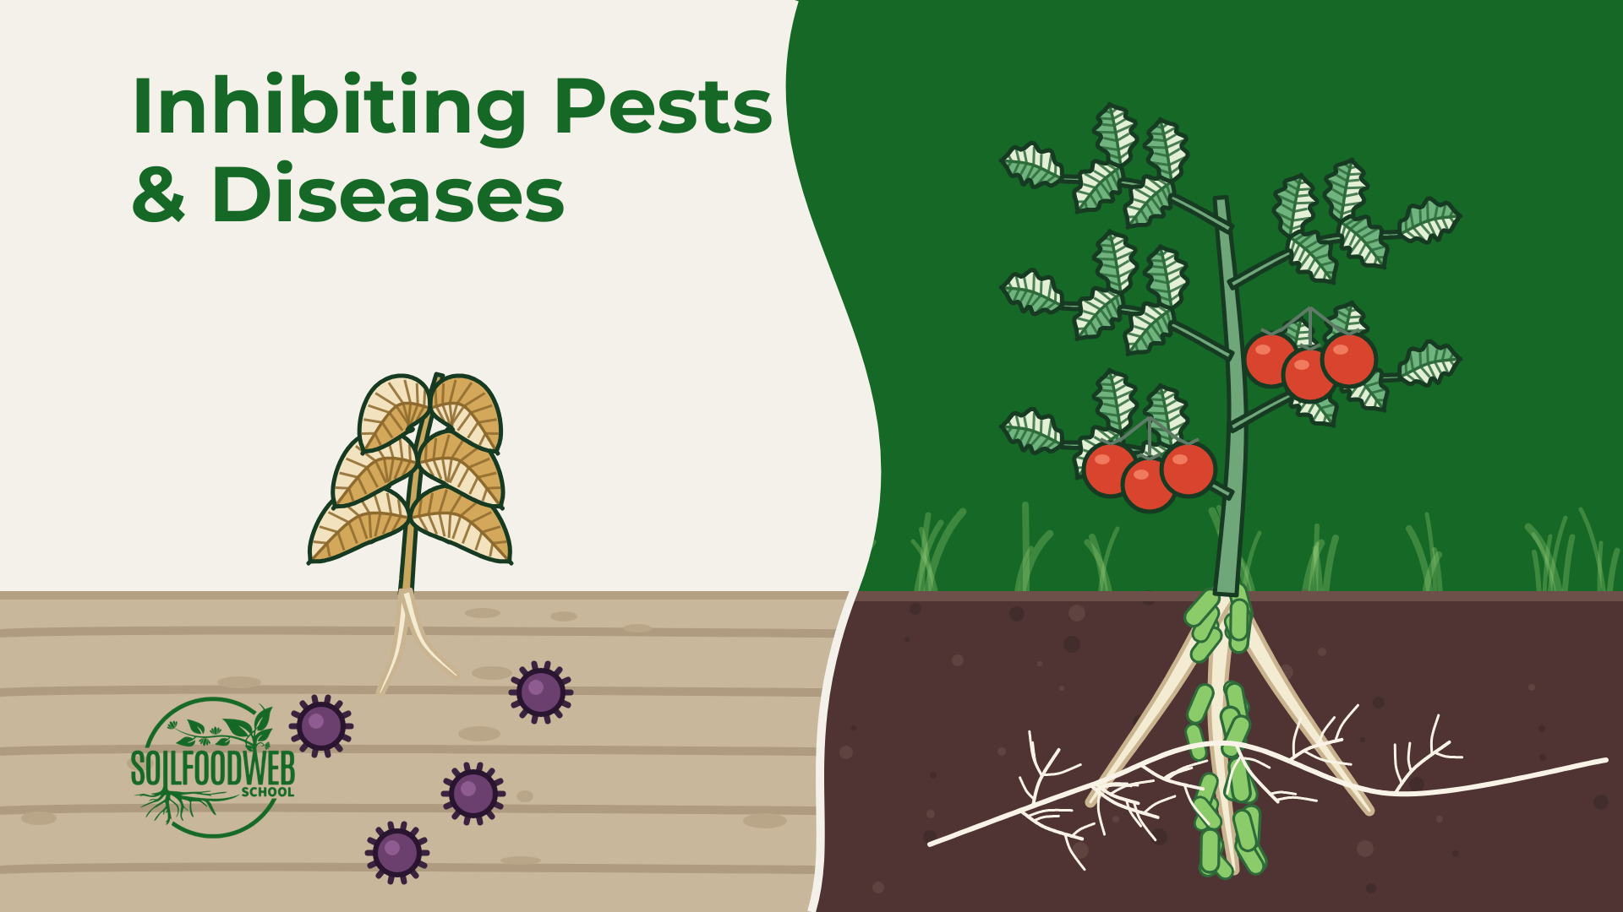
5 Inhibiting Pests & Diseases
Option A
Option B
Option C
Option D
Notes:
Option A (file inhibiting-pests-and-diseases-A.jpg): Close-up: root sleeved in beneficials, pathogen kept out, on Soil Brown
Option B (file inhibiting-pests-and-diseases-B.jpg): The same as a specimen on Food Web Green
Option C (file inhibiting-pests-and-diseases-C.jpg): Tomato on Organic Cream, magnifier on its root zone
Option D (file inhibiting-pests-and-diseases-D.jpg): SFW wave layout: wilting plant among pathogens vs a tomato whose roots are covered by beneficials

Slide 21
Notes:
Inhibiting Pests & Diseases, option A (file inhibiting-pests-and-diseases-A.jpg): Close-up: root sleeved in beneficials, pathogen kept out, on Soil Brown

Slide 22
Notes:
Inhibiting Pests & Diseases, option B (file inhibiting-pests-and-diseases-B.jpg): The same as a specimen on Food Web Green

Slide 23
Notes:
Inhibiting Pests & Diseases, option C (file inhibiting-pests-and-diseases-C.jpg): Tomato on Organic Cream, magnifier on its root zone

Slide 24
Notes:
Inhibiting Pests & Diseases, option D (file inhibiting-pests-and-diseases-D.jpg): SFW wave layout: wilting plant among pathogens vs a tomato whose roots are covered by beneficials

Slide 25
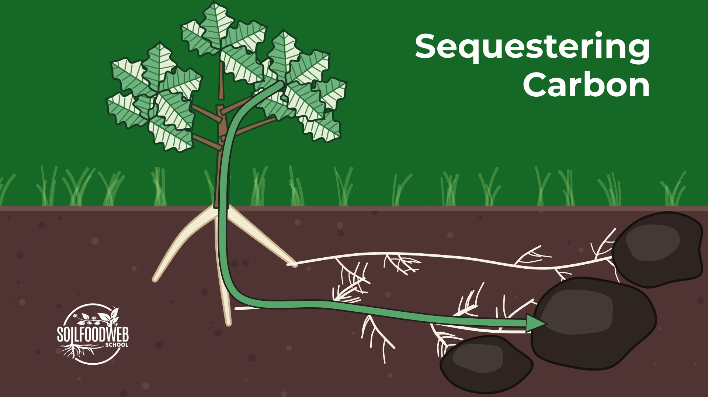
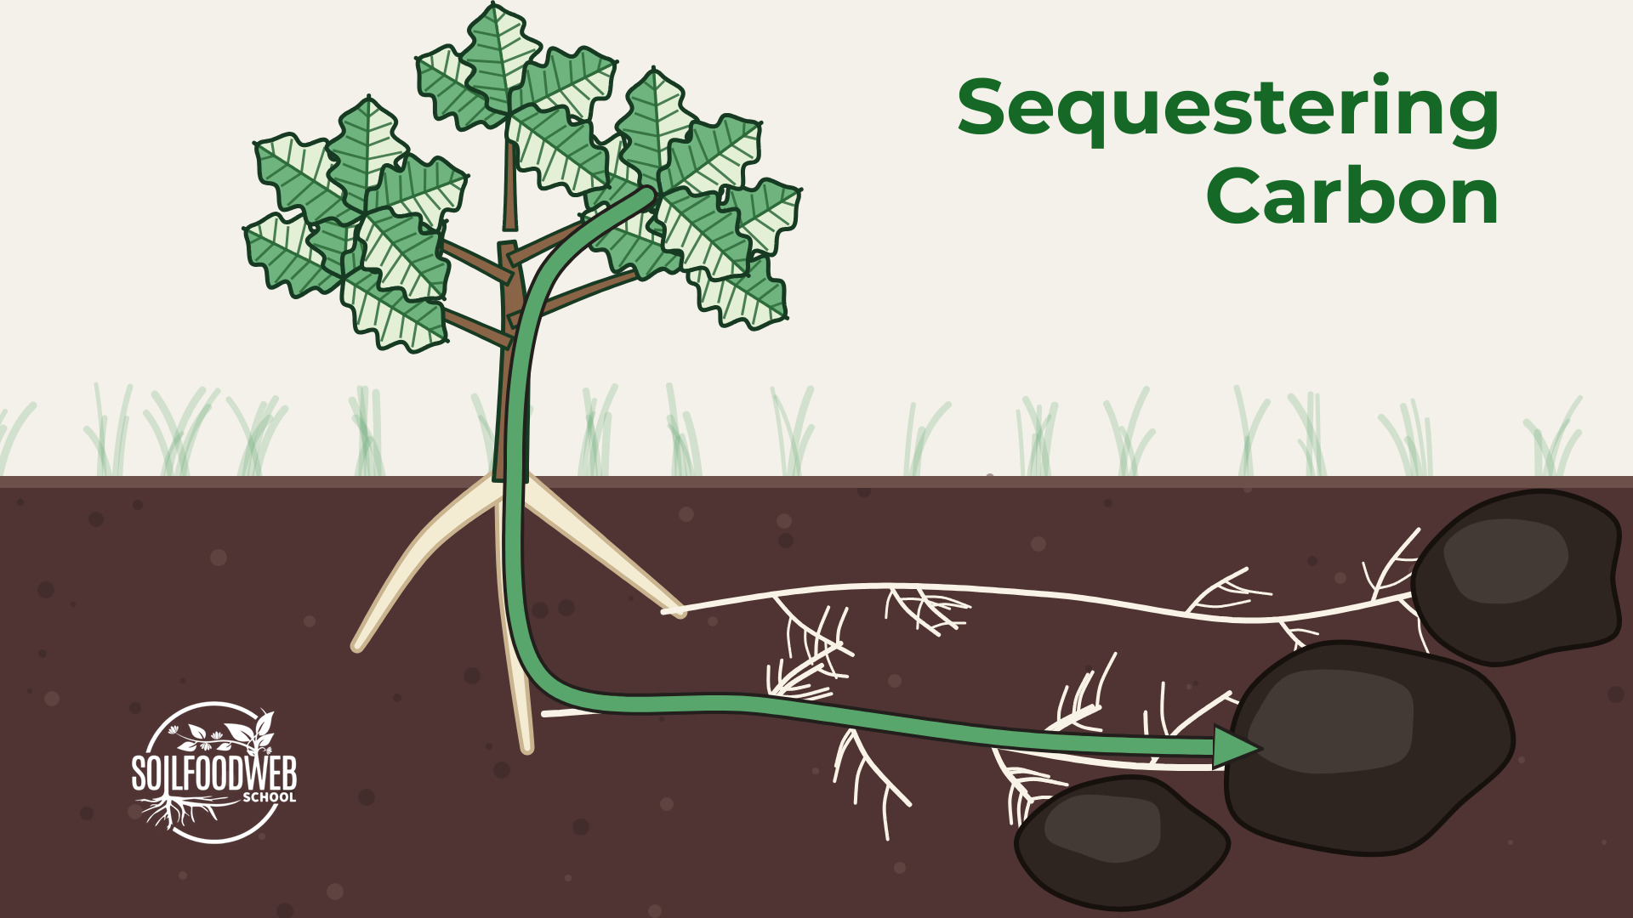
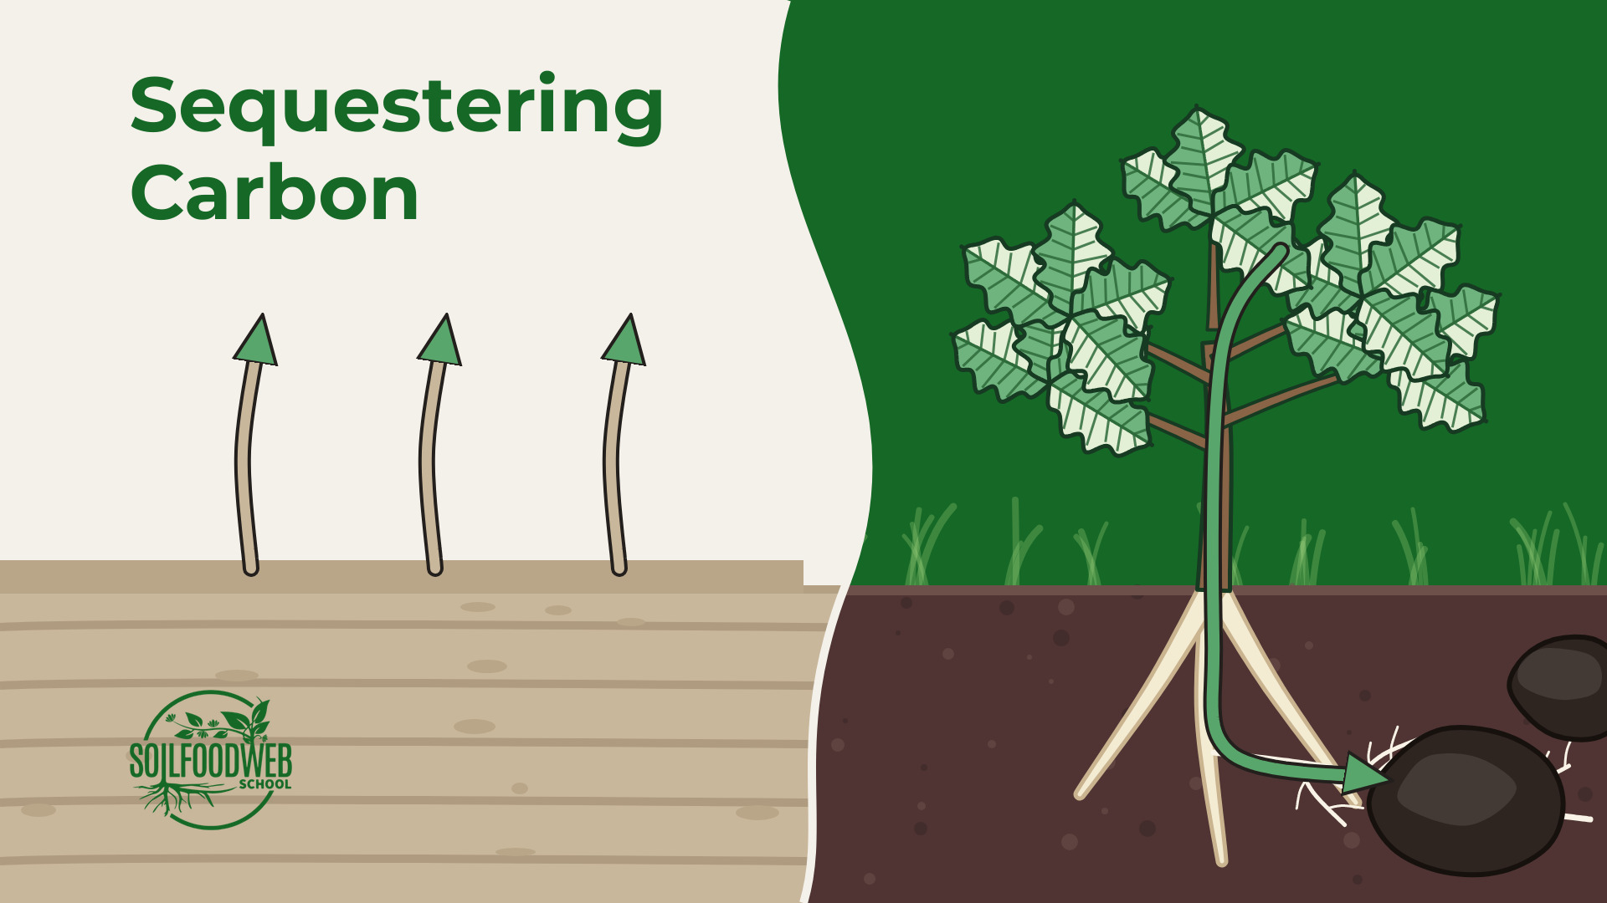
6 Sequestering Carbon
Option A
Option B
Option C
Notes:
Option A (file sequestering-carbon-A.jpg): Oak on Food Web Green: carbon flows down roots and fungal threads into dark soil clumps
Option B (file sequestering-carbon-B.jpg): Same, Organic Cream sky
Option C (file sequestering-carbon-D.jpg): SFW wave layout: bare soil losing carbon to the air vs an oak sending carbon down into the soil

Slide 26
Notes:
Sequestering Carbon, option A (file sequestering-carbon-A.jpg): Oak on Food Web Green: carbon flows down roots and fungal threads into dark soil clumps

Slide 27
Notes:
Sequestering Carbon, option B (file sequestering-carbon-B.jpg): Same, Organic Cream sky

Slide 28
Notes:
Sequestering Carbon, option C (file sequestering-carbon-D.jpg): SFW wave layout: bare soil losing carbon to the air vs an oak sending carbon down into the soil

