Slide 1
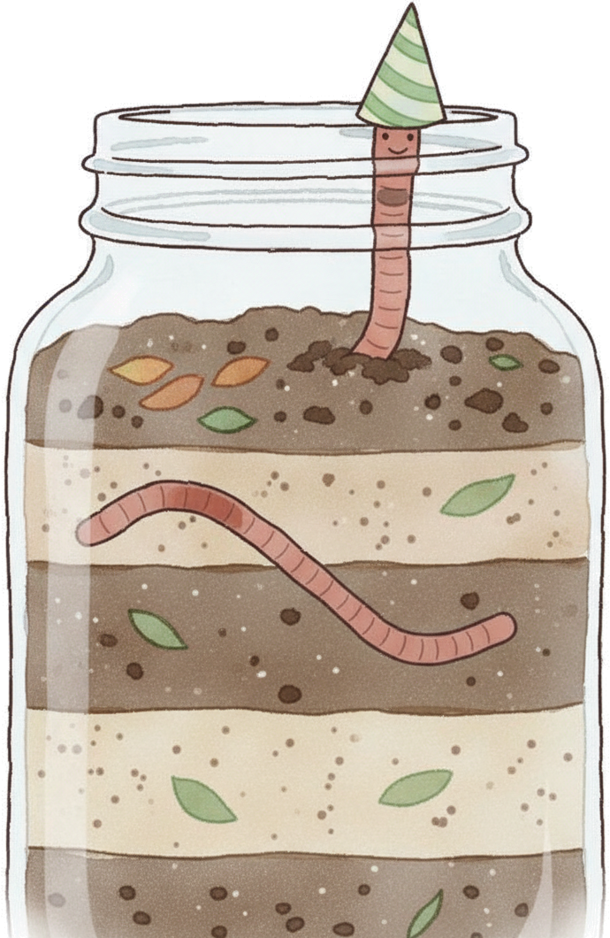

Is World Earthworm
Day even a thing?
Notes:
Fonts: Fredoka (headings, labels) and Montserrat (body), free on Google Fonts and in Canva.

Slide 2
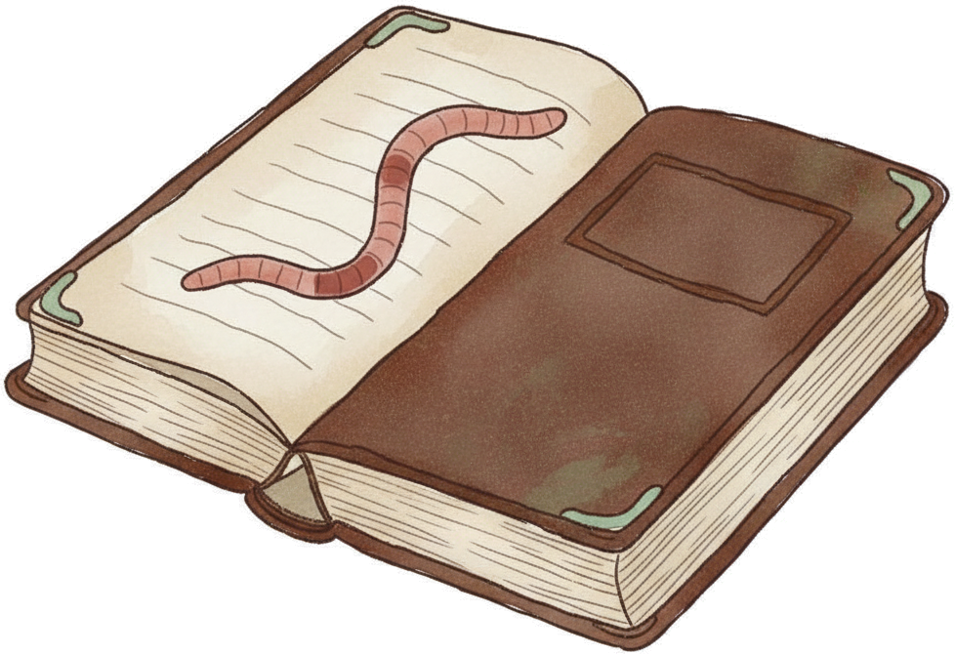
Yes! Since 2016.
The Earthworm Society of Britain picked 21
October to honour Charles Darwin. His
book on worms came out in October 1881.
Notes:
Source: Earthworm Society of Britain, World Worm Day: https://www.earthwormsoc.org.uk/worldwormday

Slide 3

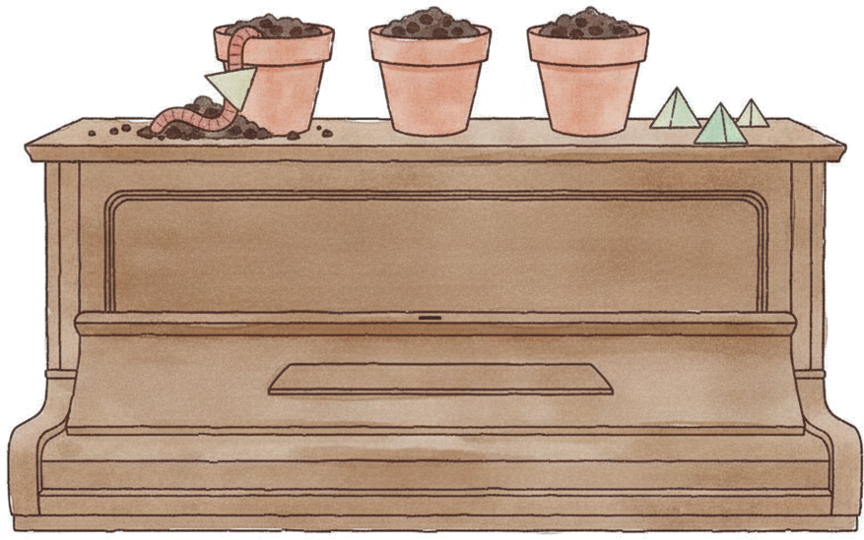
Darwin was obsessed
He played the piano to
his worms
He tested how they pull
leaves underground with
paper triangles
Notes:
Sources: Darwin Correspondence Project, letter 13460 (3,500 copies of Worms vs 600 of Origin at the 1881 sale): https://www.darwinproject.ac.uk/view/letters/DCP-LETT-13460 ; Nautilus on the piano and paper triangle experiments: https://nautil.us/why-darwin-admired-the-humble-earthworm-361515

Slide 4
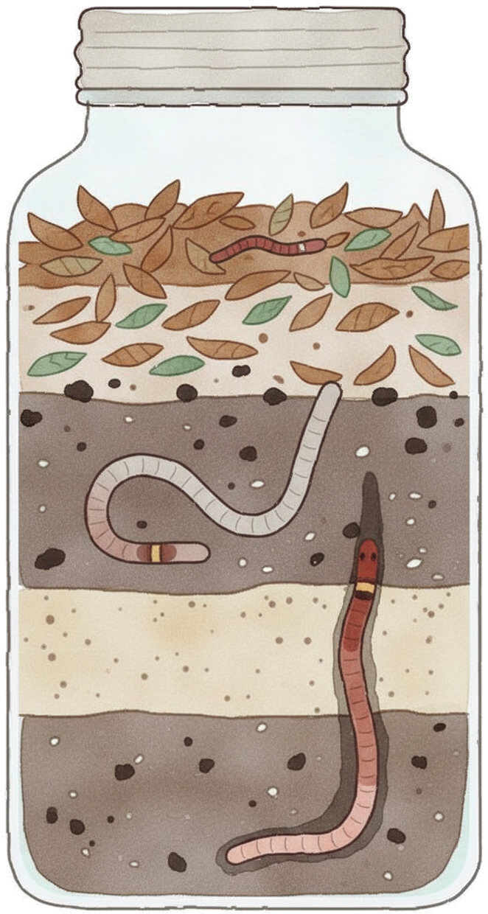
Meet the three worms
The Composter
(epigeic). Small and
red. Lives in the leaves
and turns them into
compost.
The Mixer (endogeic).
Pale. Eats its way
through the topsoil.
The Engineer (anecic).
Big and dark-headed.
Digs deep tunnels and
pulls leaves down at
night.
Notes:
Sources: Bouché 1977 (ecological groups); Colorado State Extension: https://extension.colostate.edu/resource/earthworms

Slide 5
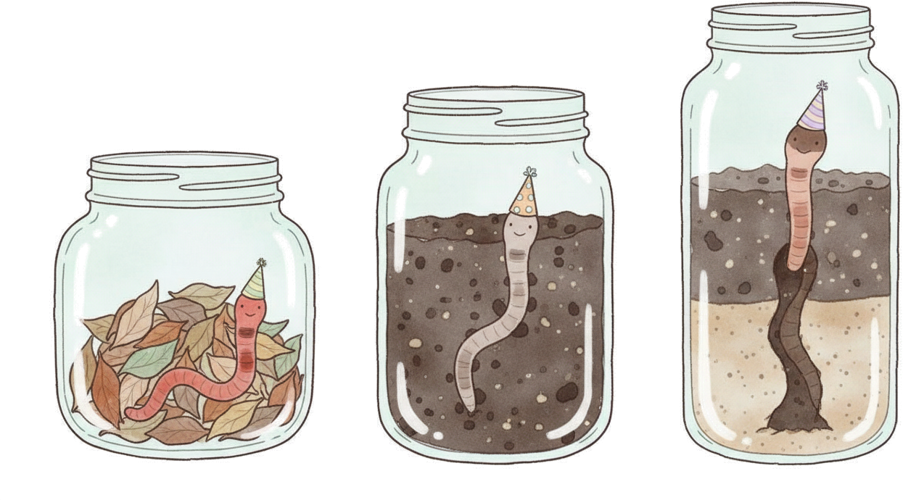
Which worm are you
today?
The Composter
The Mixer
The Engineer
Notes:
Leave y = 1250 to 1500 empty for the poll sticker: The Composter / The Mixer / The Engineer.

