Slide 1
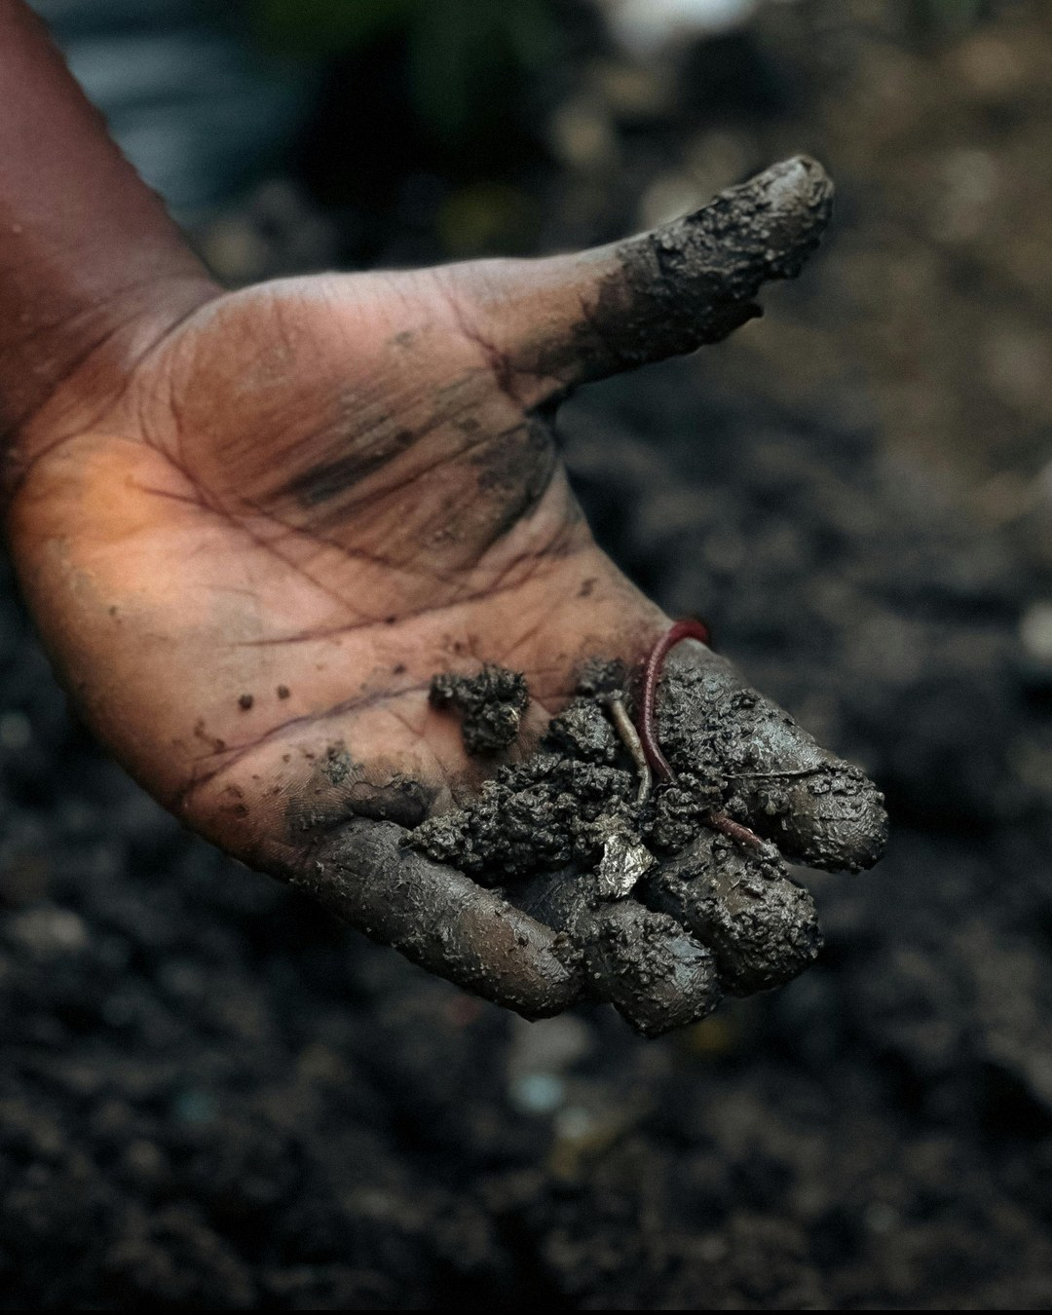

How do worms work their magic?
World Earthworm Day, 21 October

