Slide 1
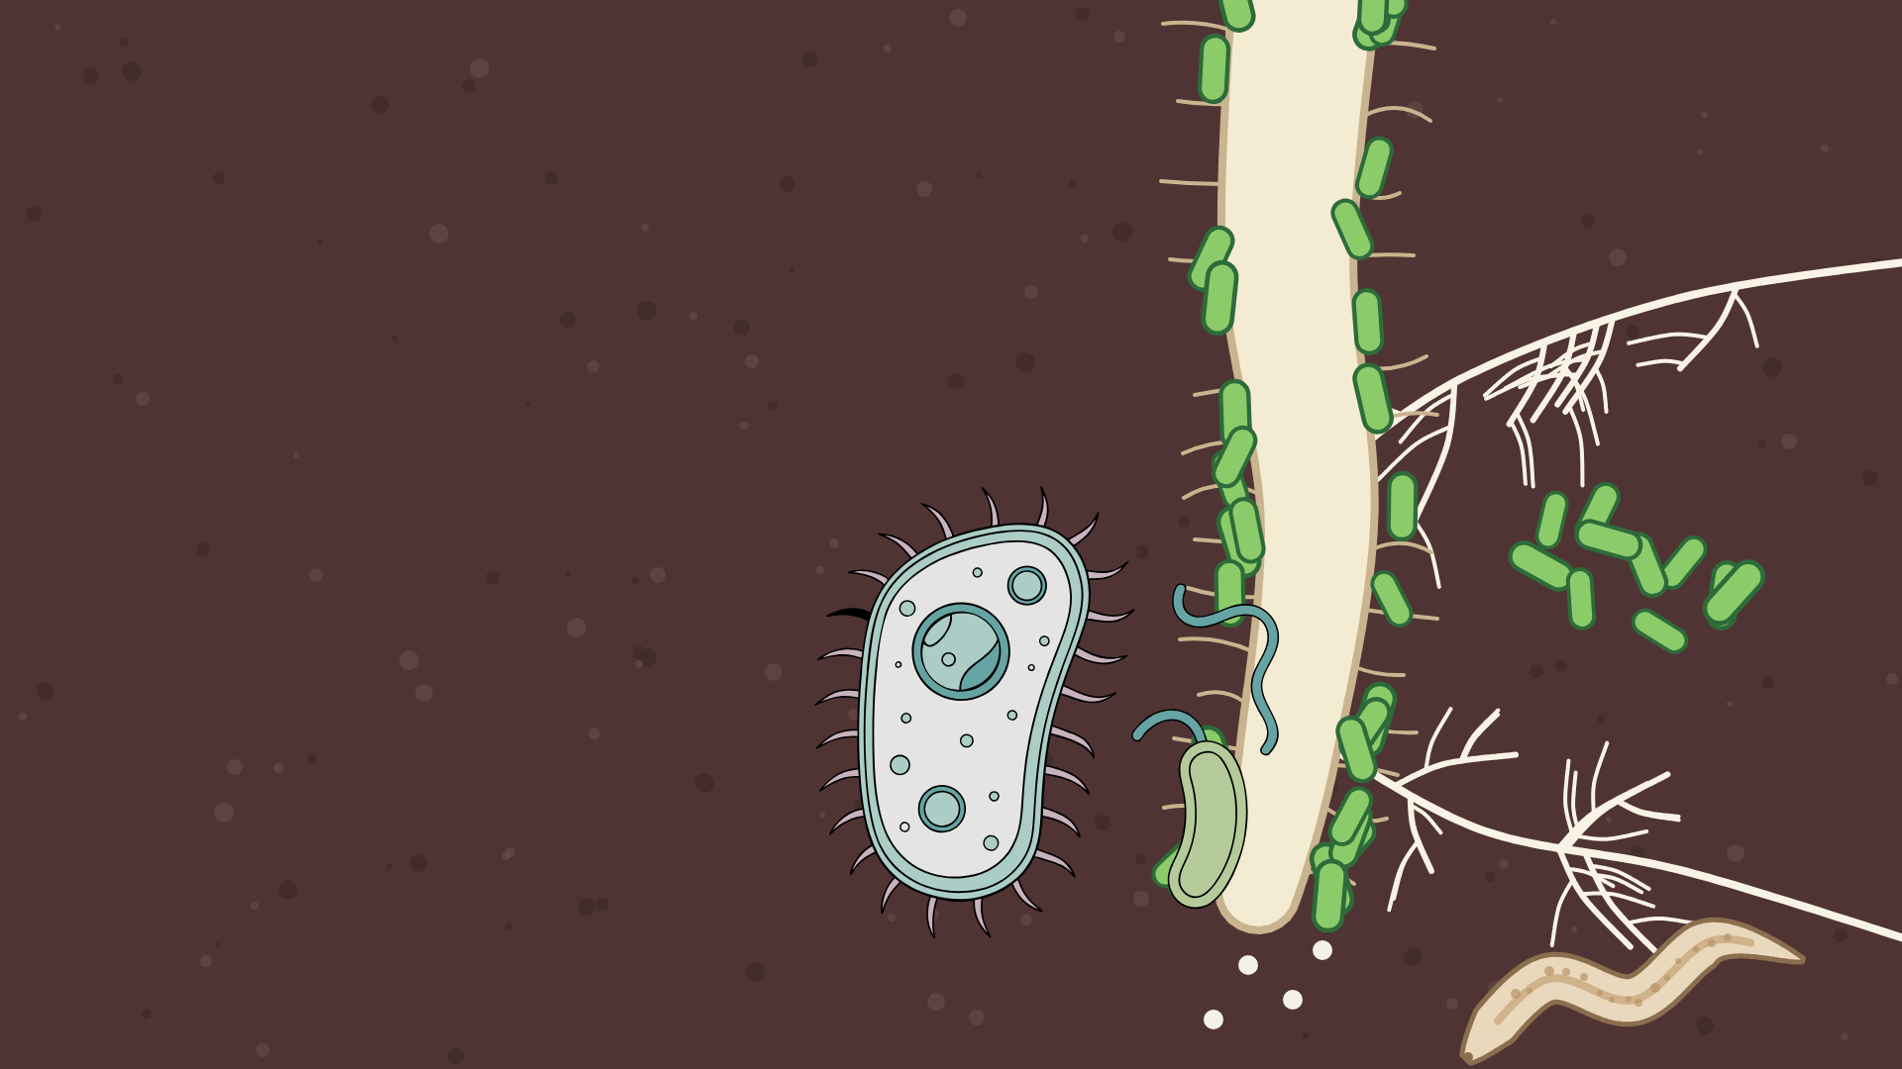

What is the
Soil Food
Web?
Notes:
What is the Soil Food Web?, option A: Close-up: root tip with bacteria, fungi, a protozoan and a nematode, on Soil Brown. Vector illustration (no AI image generation).

Slide 2
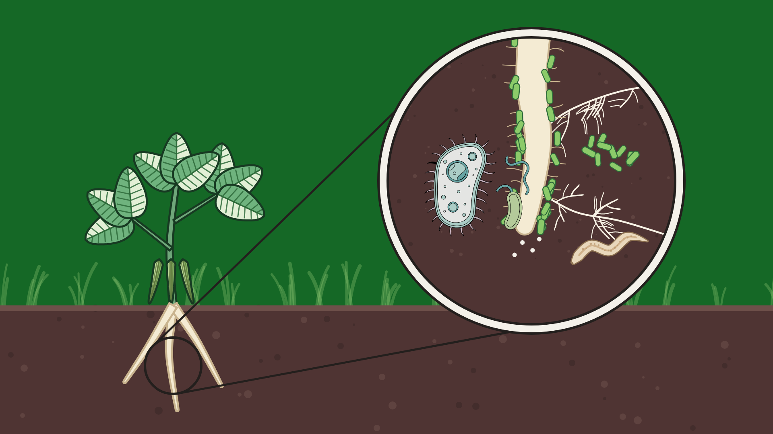
What is the
Soil Food Web?
Notes:
What is the Soil Food Web?, option B: Bean plant on Food Web Green, magnifier on its root zone. Vector illustration (no AI image generation).

Slide 3
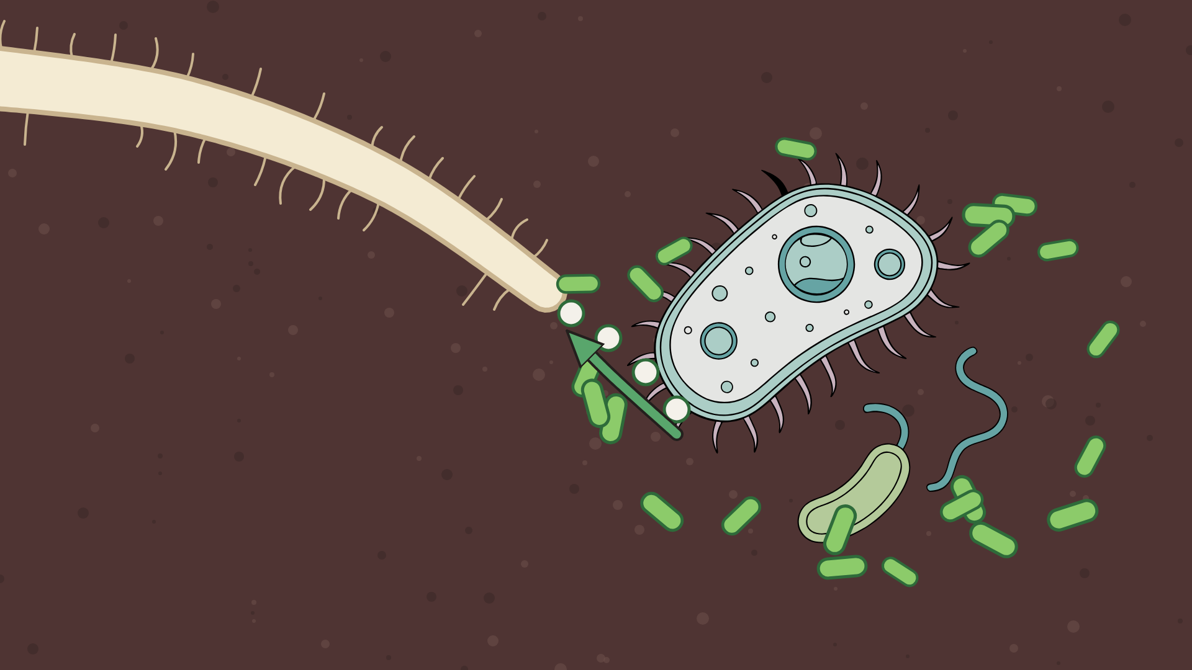
Nutrient
Cycling
Notes:
Nutrient Cycling, option A: Close-up: protozoan eats bacteria, nutrients flow to the root hair. Vector illustration (no AI image generation).

Slide 4
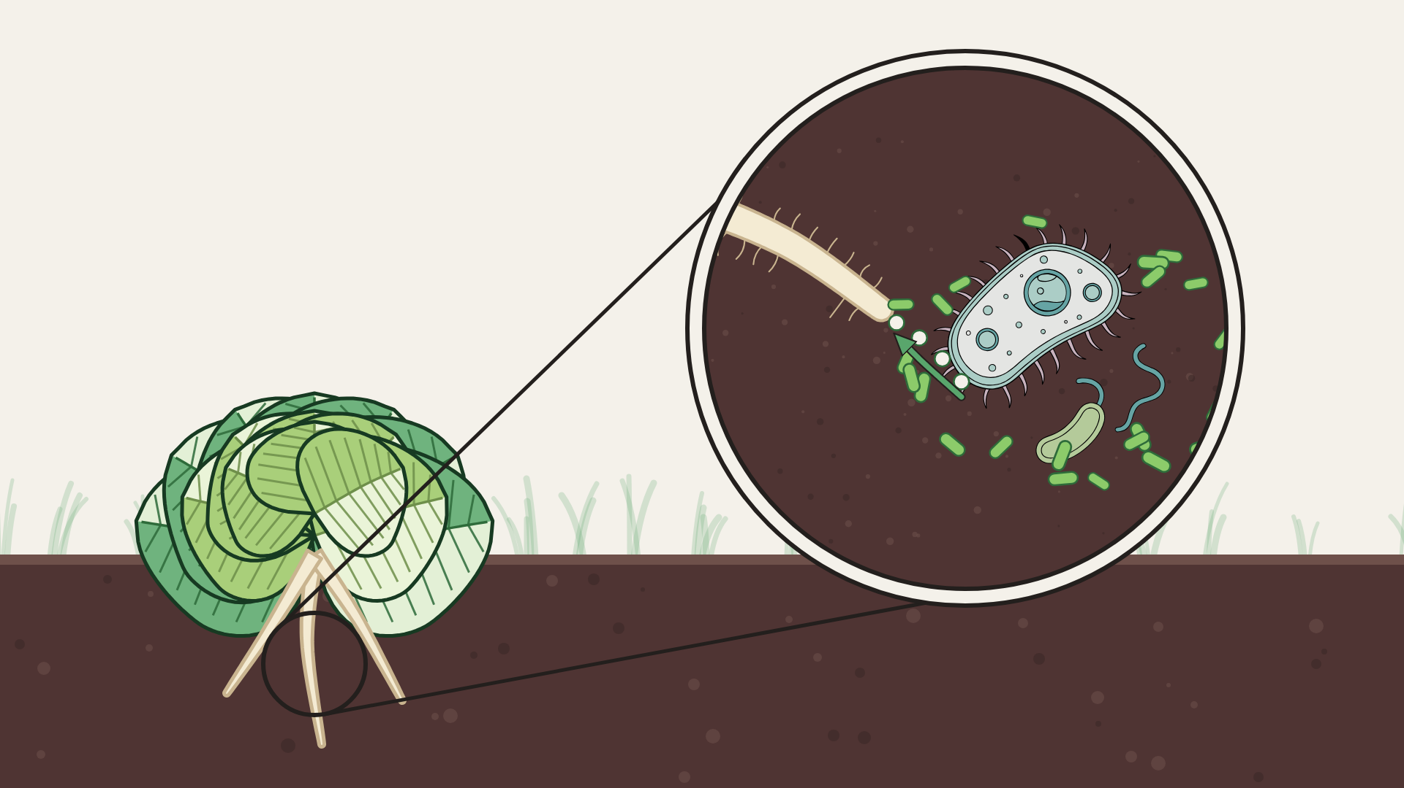
Nutrient
Cycling
Notes:
Nutrient Cycling, option B: Lettuce on Organic Cream, magnifier on the nutrient loop. Vector illustration (no AI image generation).

Slide 5
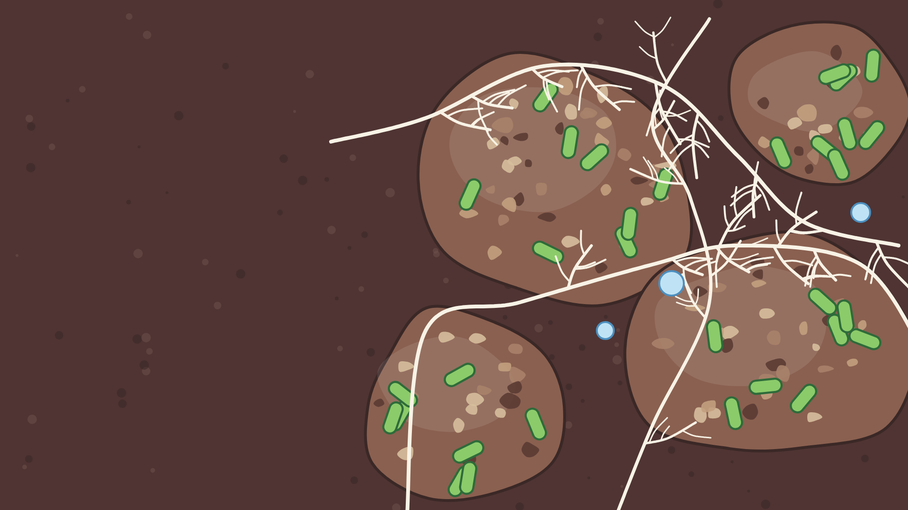
Formation of
Structure
Notes:
Formation of Structure, option A: Soil crumbs glued by bacteria, woven by fungal threads, on Soil Brown. Vector illustration (no AI image generation).

Slide 6
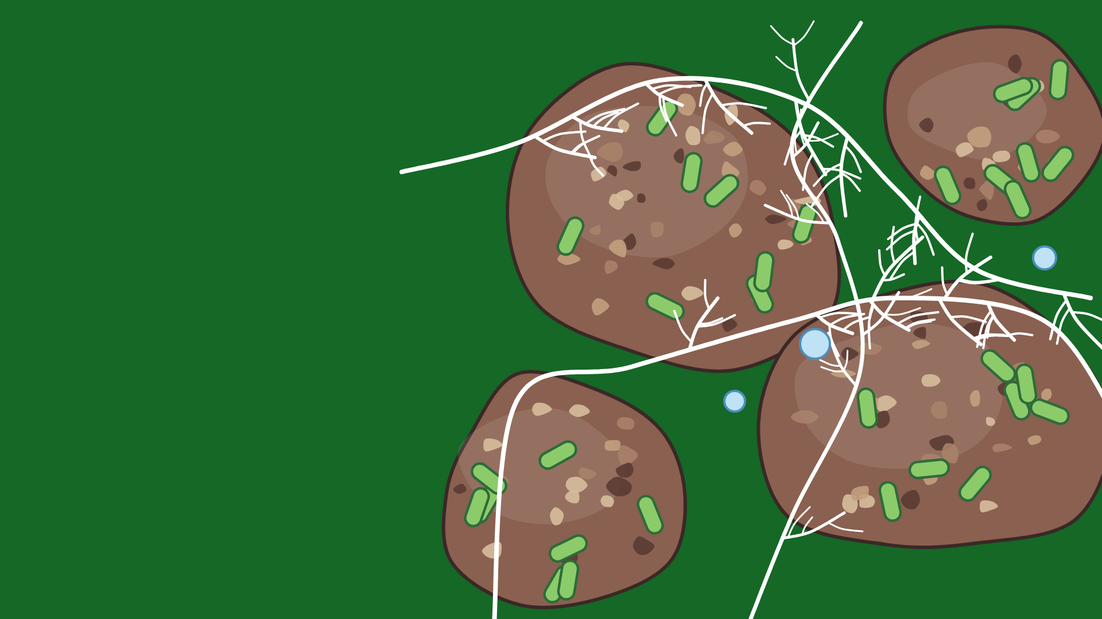
Formation of
Structure
Notes:
Formation of Structure, option B: The same crumbs as a specimen on Food Web Green. Vector illustration (no AI image generation).

Slide 7
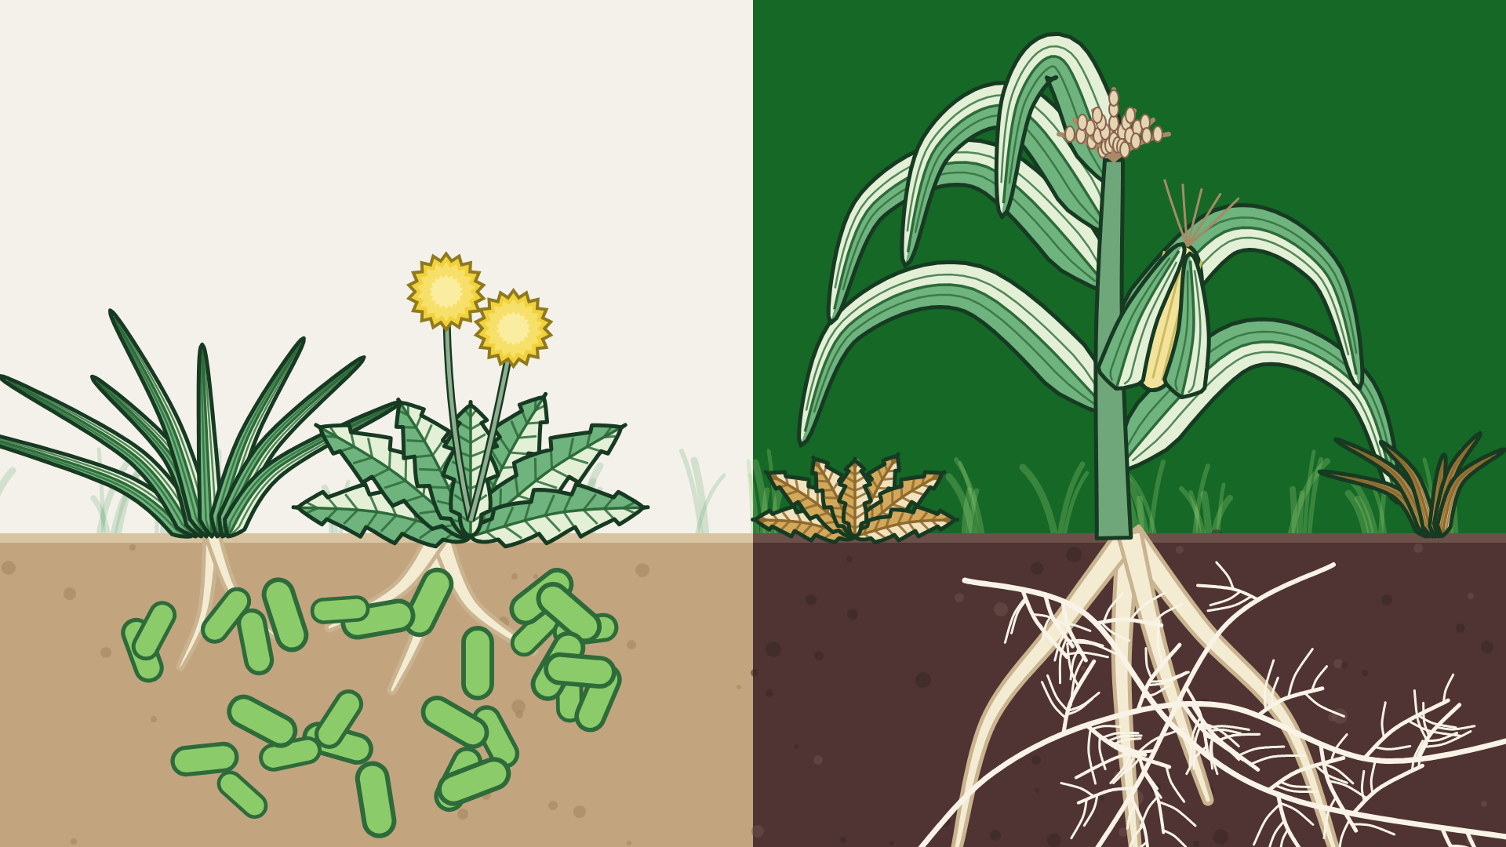
Weed
Suppression
Notes:
Weed Suppression, option A: Weeds in bacterial soil vs corn in fungal soil; cream and green sky like the reference. Vector illustration (no AI image generation).

Slide 8
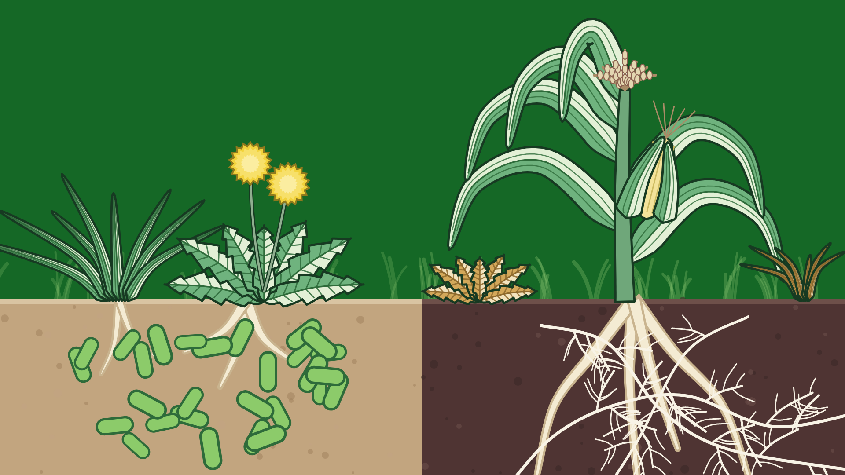
Weed
Suppression
Notes:
Weed Suppression, option B: Same, Food Web Green sky. Vector illustration (no AI image generation).

Slide 9
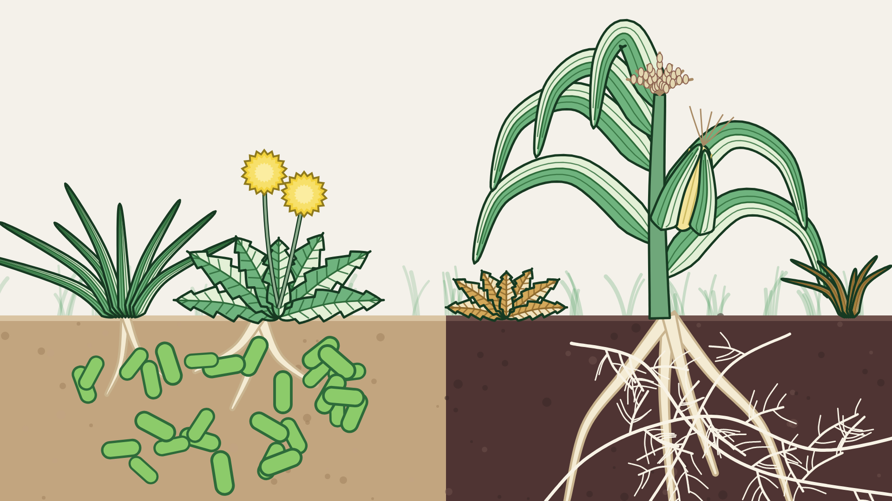

Weed
Suppression
Notes:
Weed Suppression, option C: Same, Organic Cream sky. Vector illustration (no AI image generation).

Slide 10
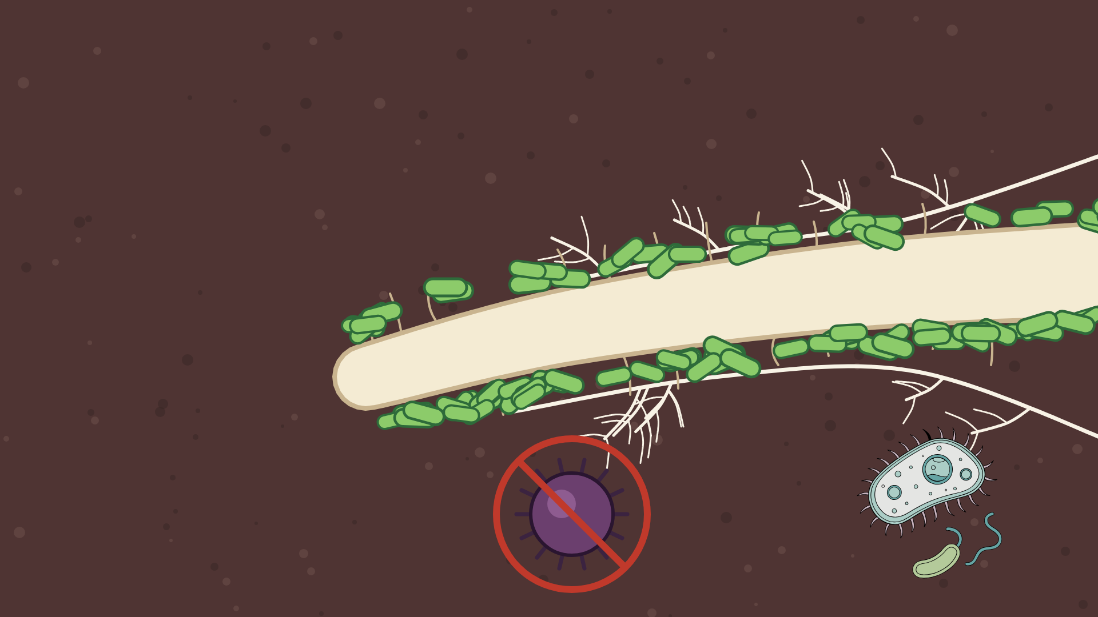
Inhibiting Pests
& Diseases
Notes:
Inhibiting Pests & Diseases, option A: Close-up: root sleeved in beneficials, pathogen kept out, on Soil Brown. Vector illustration (no AI image generation).

Slide 11
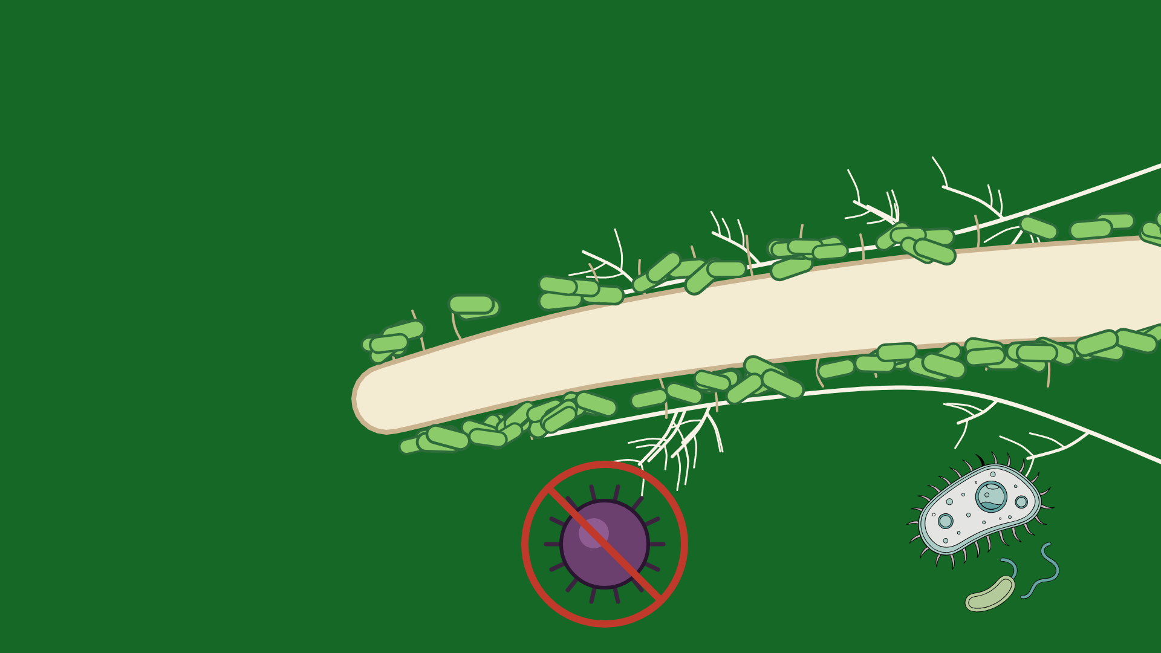
Inhibiting Pests
& Diseases
Notes:
Inhibiting Pests & Diseases, option B: The same as a specimen on Food Web Green. Vector illustration (no AI image generation).

Slide 12
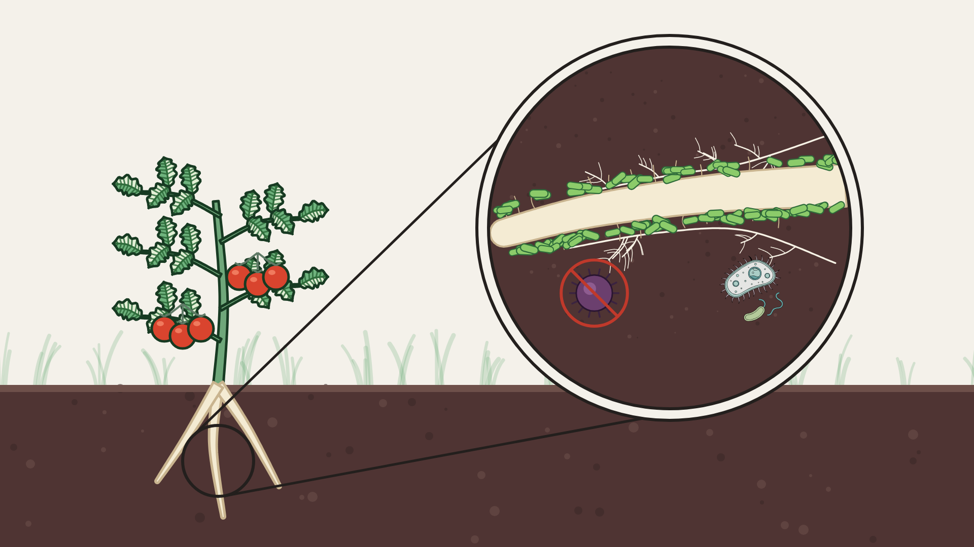
Inhibiting Pests
& Diseases
Notes:
Inhibiting Pests & Diseases, option C: Tomato on Organic Cream, magnifier on its root zone. Vector illustration (no AI image generation).

Slide 13
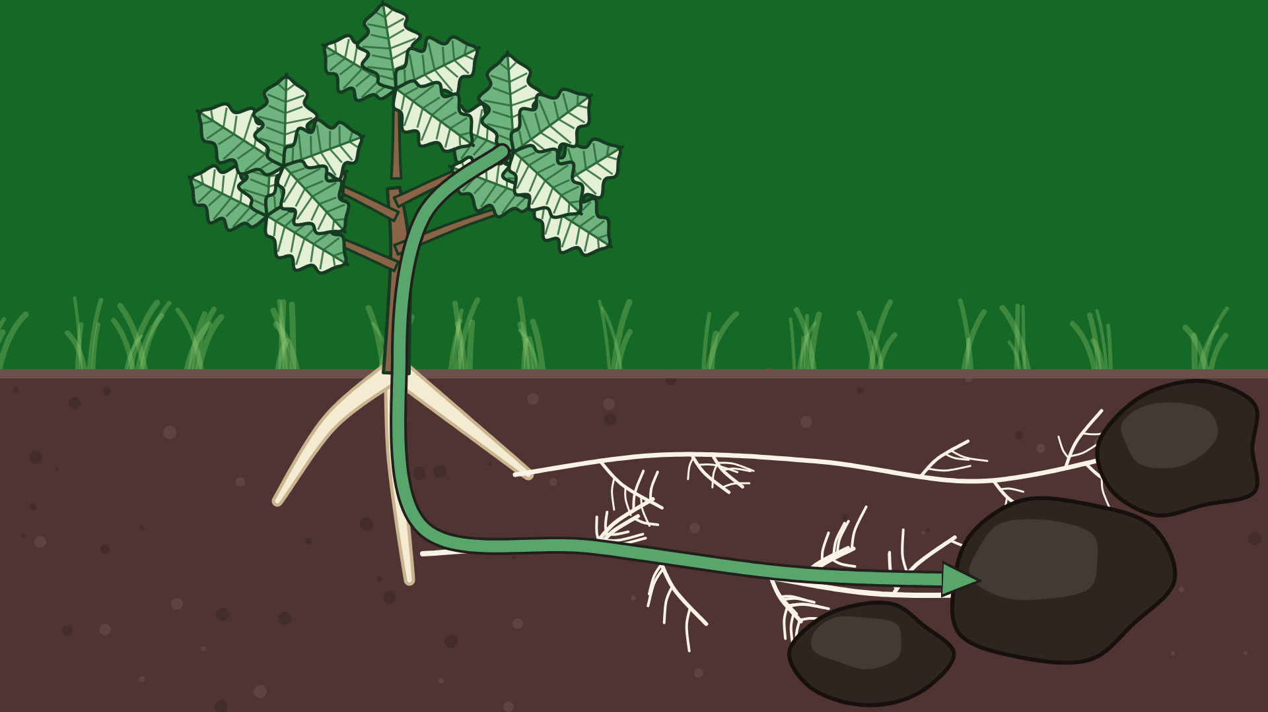
Sequestering
Carbon
Notes:
Sequestering Carbon, option A: Oak on Food Web Green: carbon flows down roots and fungal threads into dark soil clumps. Vector illustration (no AI image generation).

Slide 14
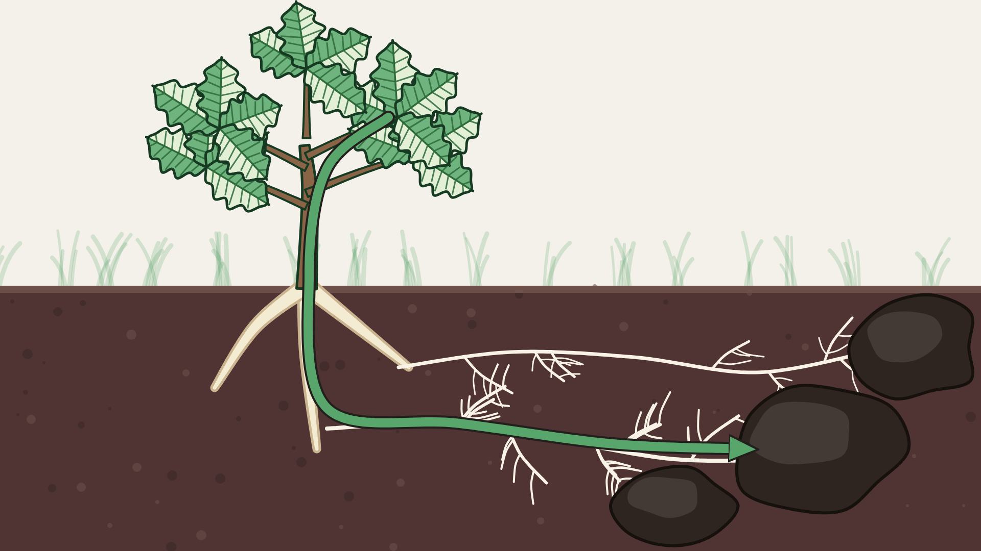
Sequestering
Carbon
Notes:
Sequestering Carbon, option B: Same, Organic Cream sky. Vector illustration (no AI image generation).

