Slide 1
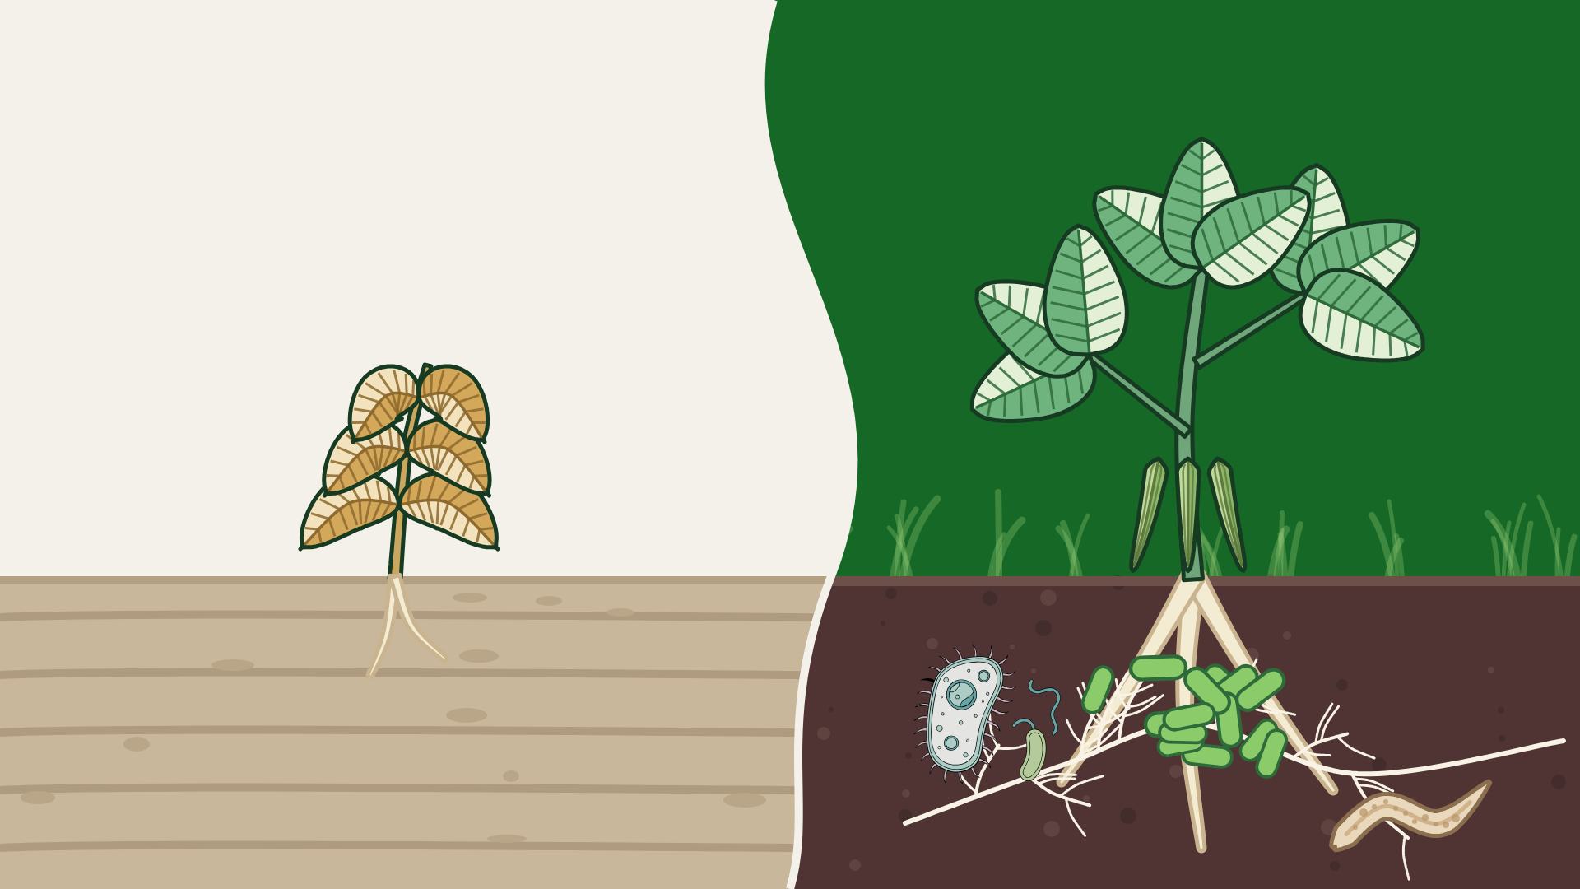

What is the
Soil Food Web?
Notes:
What is the Soil Food Web?: SFW wave layout: lifeless compacted soil vs a bean in living soil with its food web. Vector illustration, no AI image generation. Title is live text (Montserrat Bold).

Slide 2
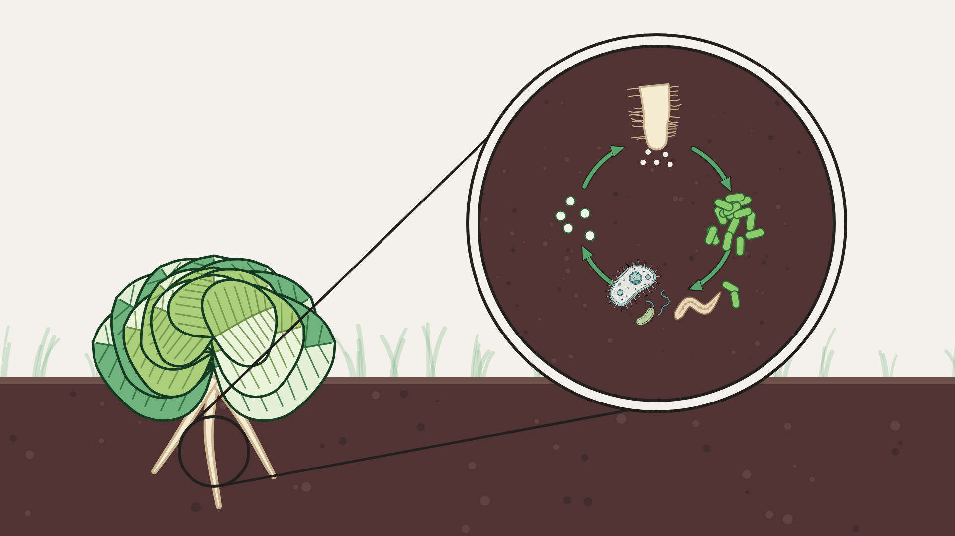

Nutrient
Cycling
Notes:
Nutrient Cycling: Lettuce on Organic Cream, magnifier on the nutrient loop. Vector illustration, no AI image generation. Title is live text (Montserrat Bold).

Slide 3
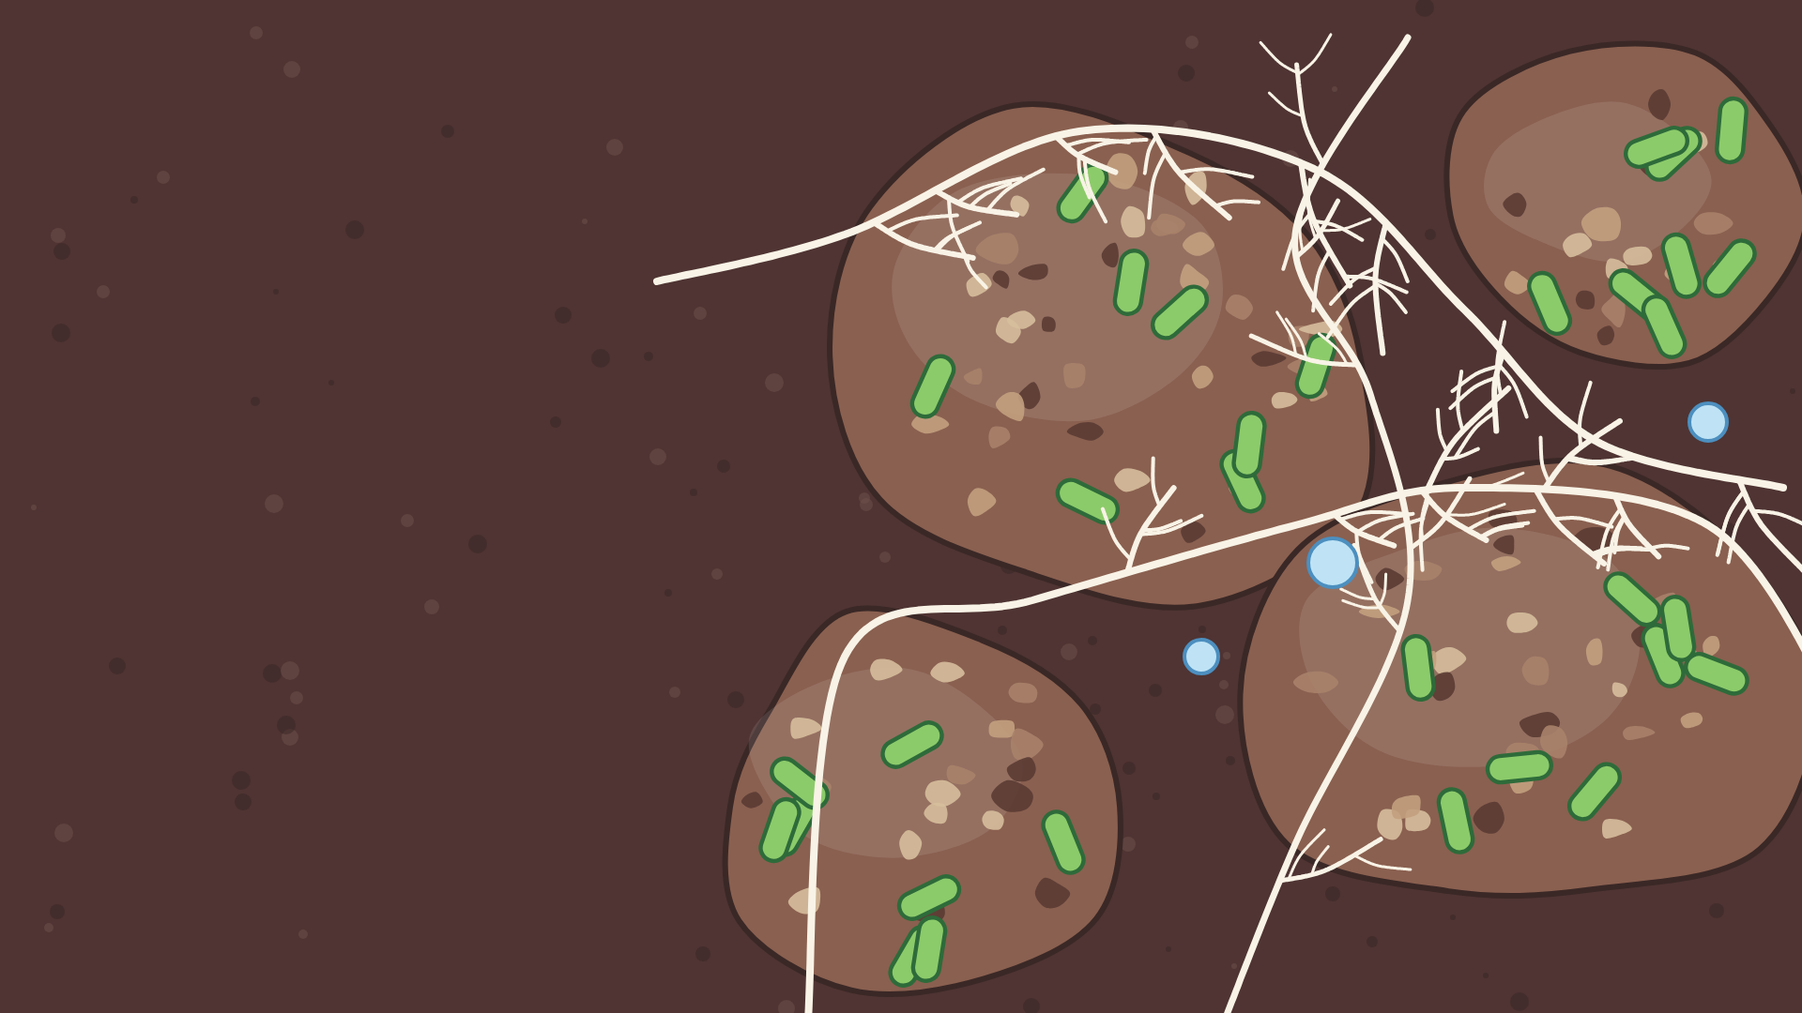
Formation of
Structure
Notes:
Formation of Structure: Soil crumbs glued by bacteria, woven by fungal threads, on Soil Brown. Vector illustration, no AI image generation. Title is live text (Montserrat Bold).

Slide 4
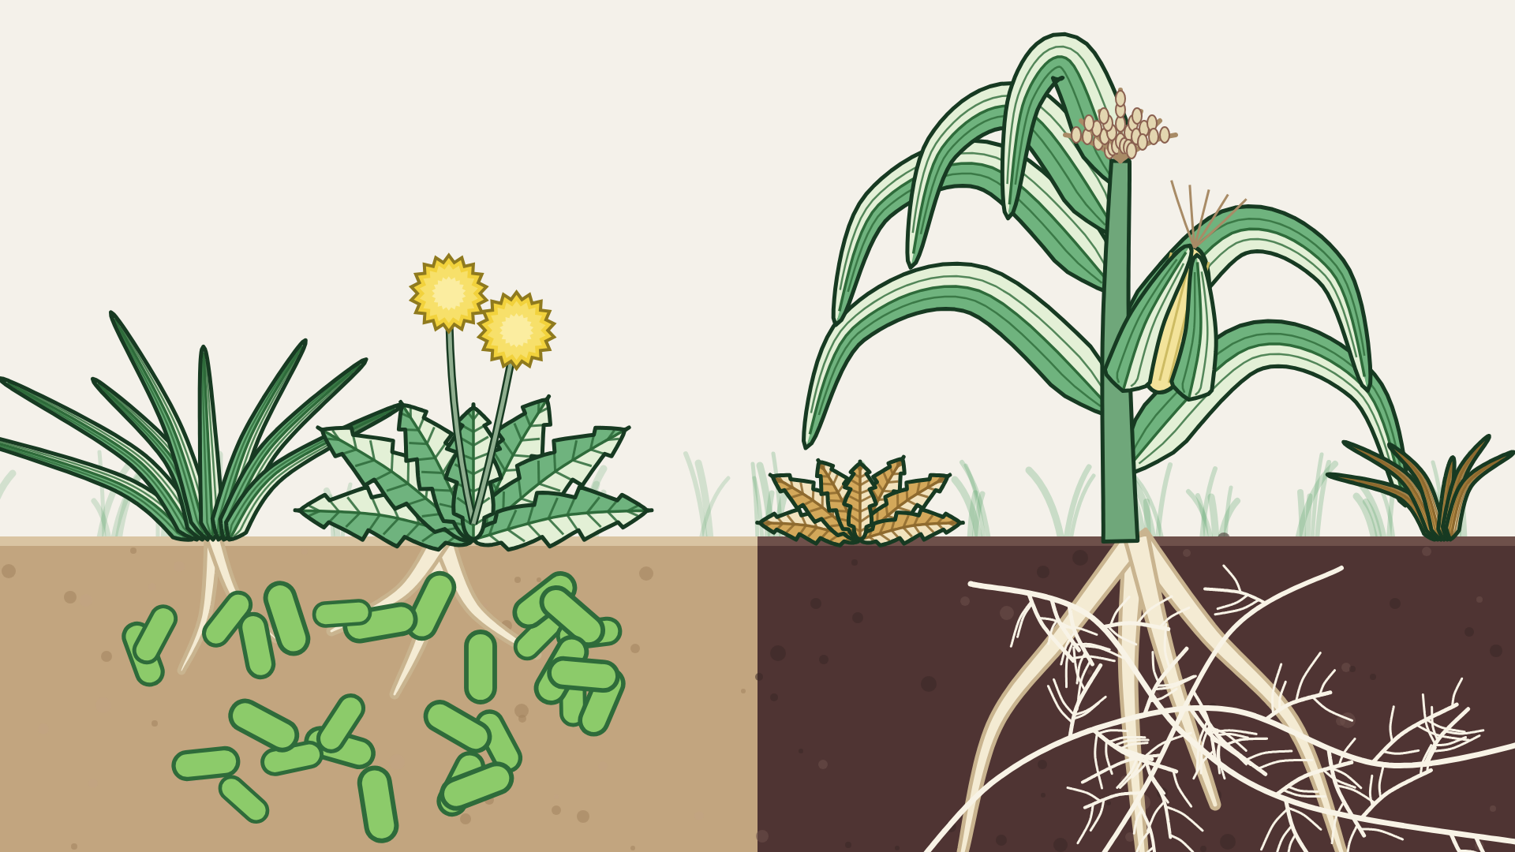
Weed
Suppression
Notes:
Weed Suppression: Same, Organic Cream sky. Vector illustration, no AI image generation. Title is live text (Montserrat Bold).

Slide 5
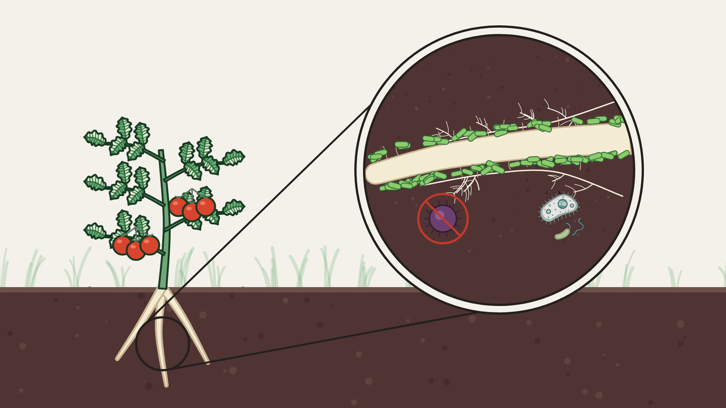
Inhibiting Pests
& Diseases
Notes:
Inhibiting Pests & Diseases: Tomato on Organic Cream, magnifier on its root zone. Vector illustration, no AI image generation. Title is live text (Montserrat Bold).

Slide 6
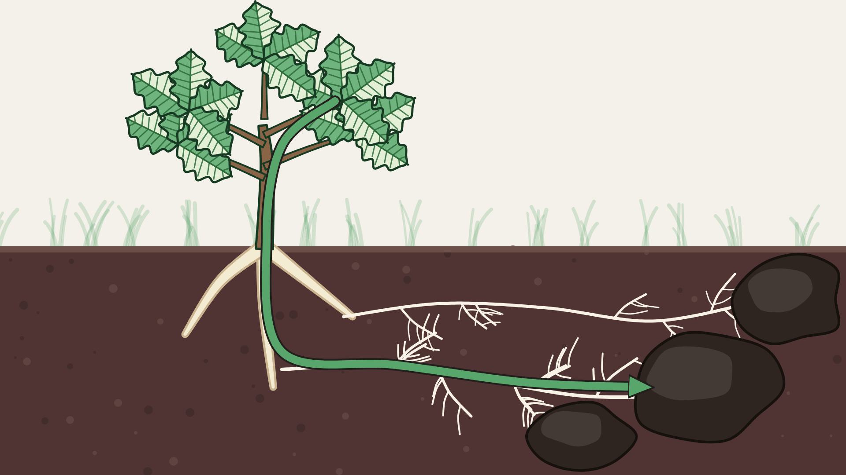
Sequestering
Carbon
Notes:
Sequestering Carbon: Same, Organic Cream sky. Vector illustration, no AI image generation. Title is live text (Montserrat Bold).

