Slide 1
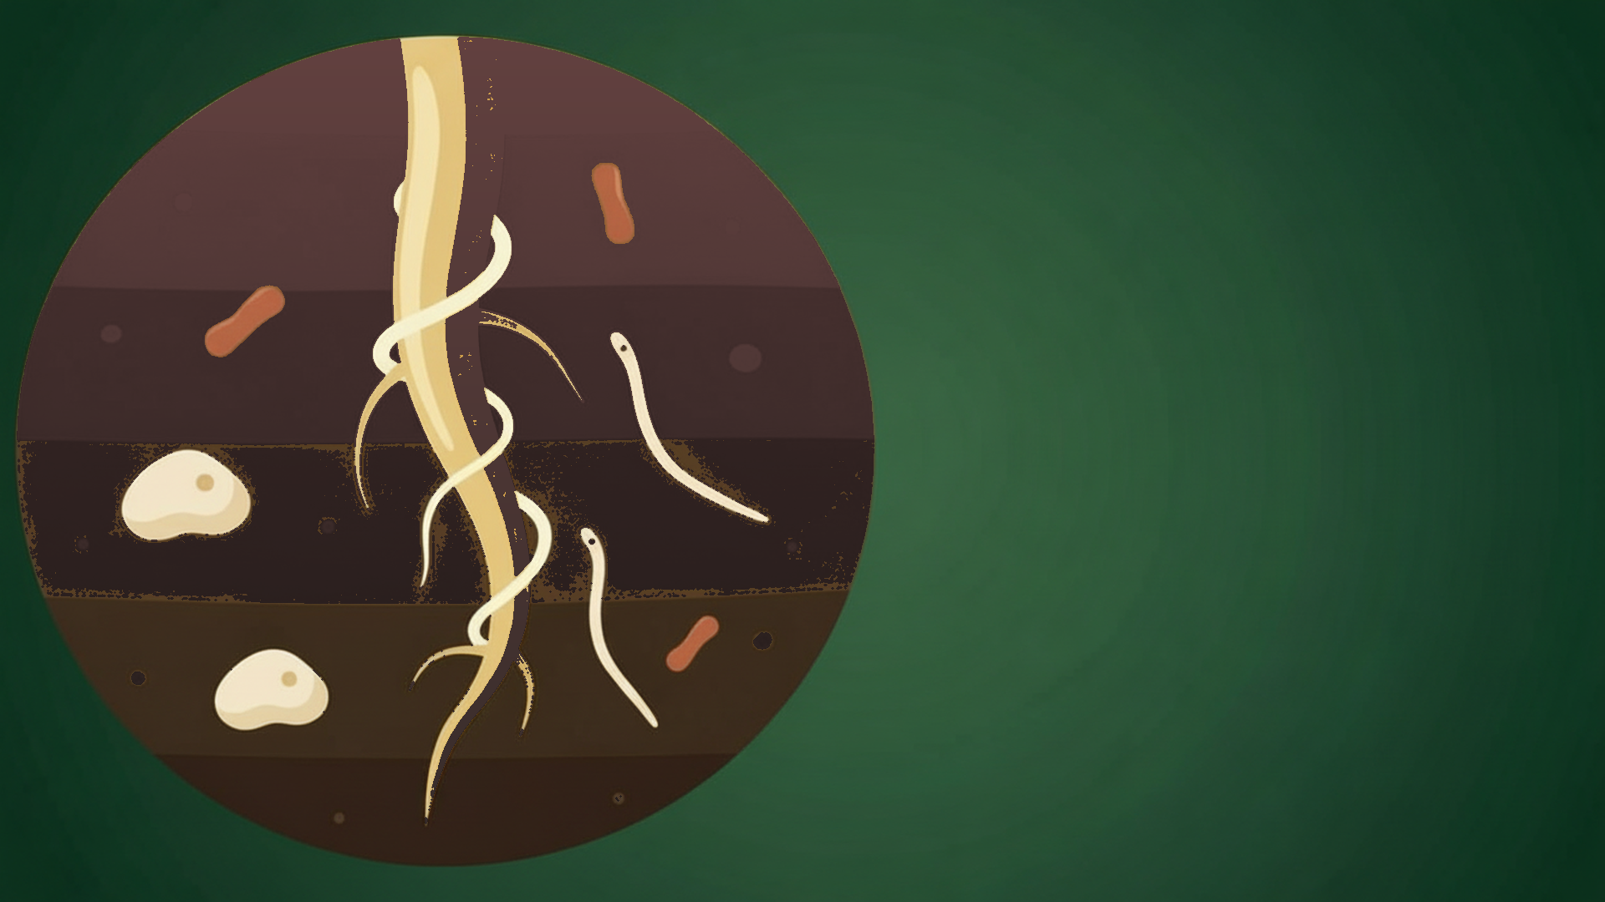


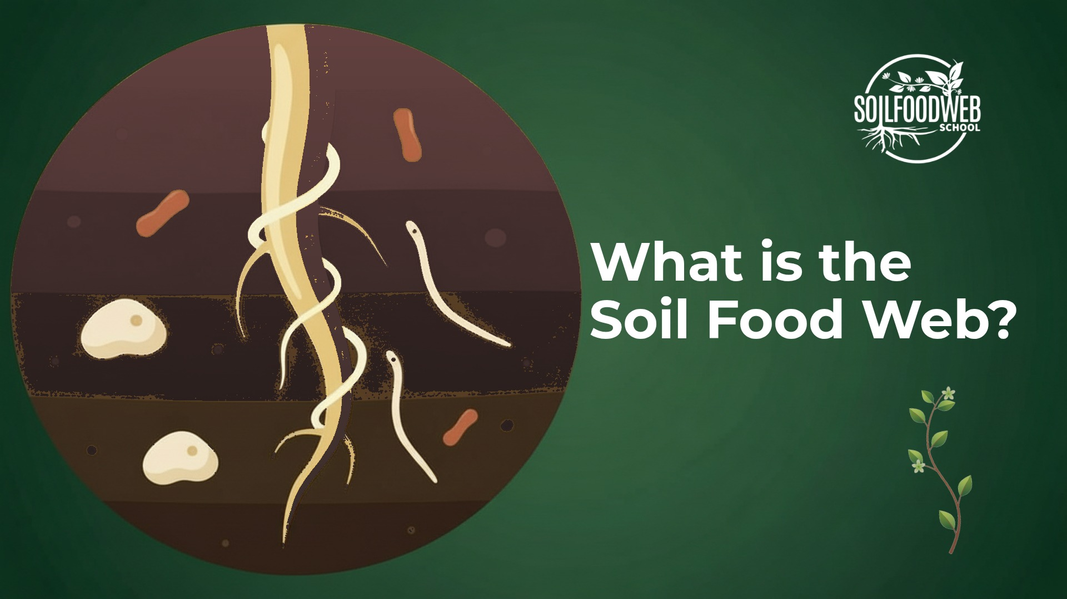
What is the
Soil Food Web?
Notes:
Video 1: What is the Soil Food Web?
Version 6 (latest): SFW green palette

Slide 2
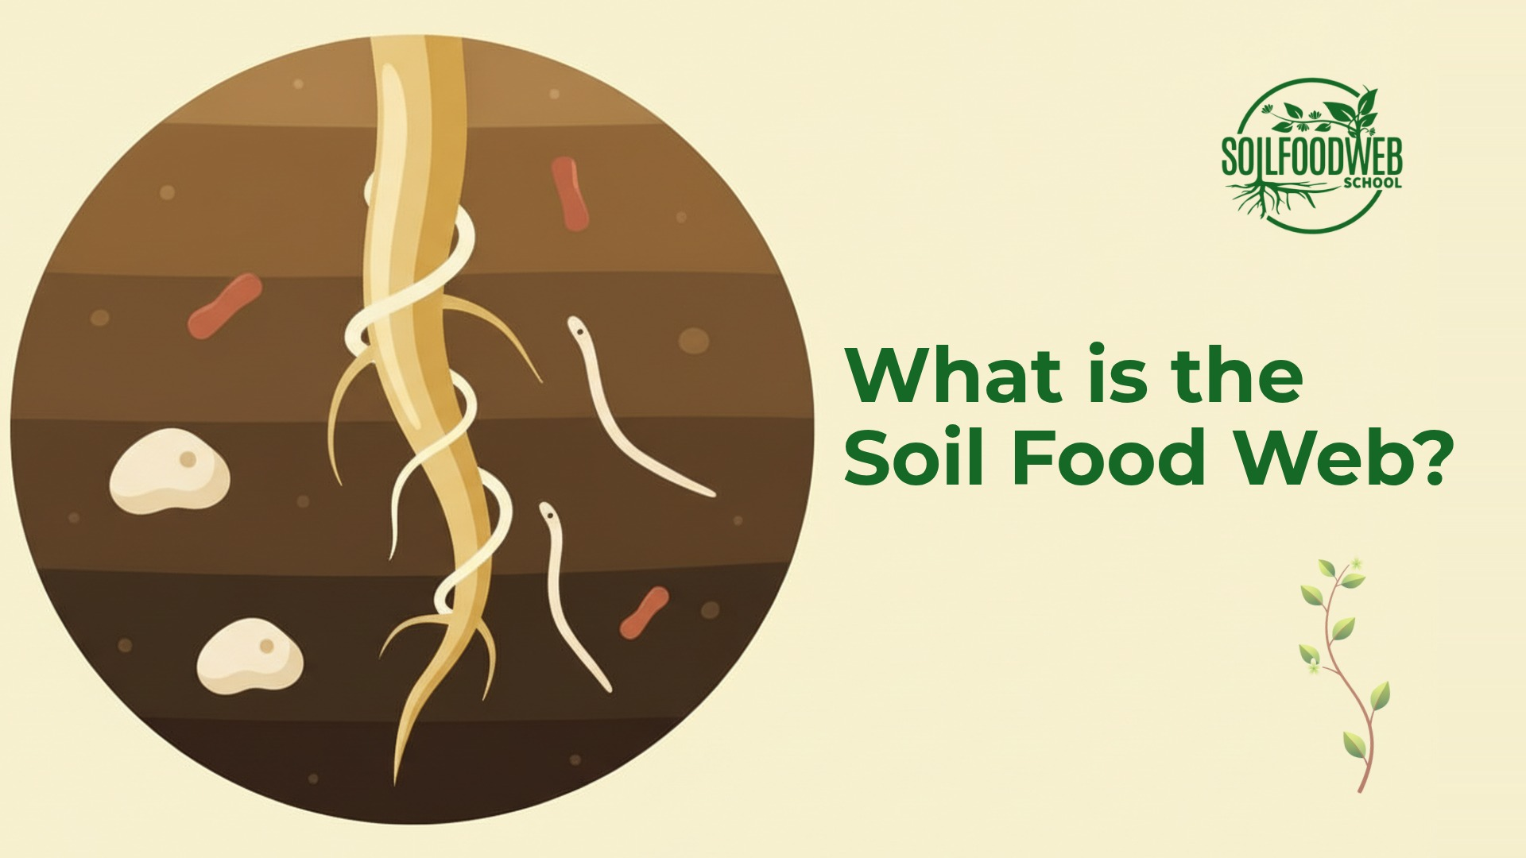
Notes:
Video 1: What is the Soil Food Web?
Version 5: six compositions, cream

Slide 3
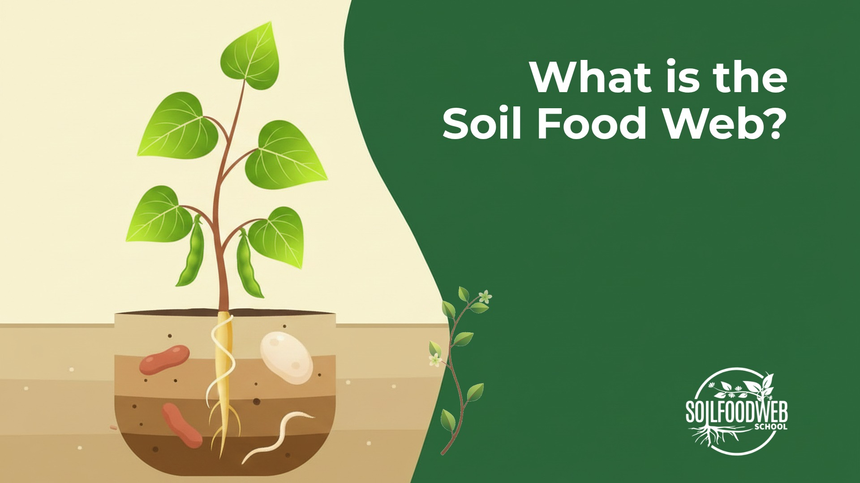
Notes:
Video 1: What is the Soil Food Web?
Version 4: nano-banana, shared template

Slide 4
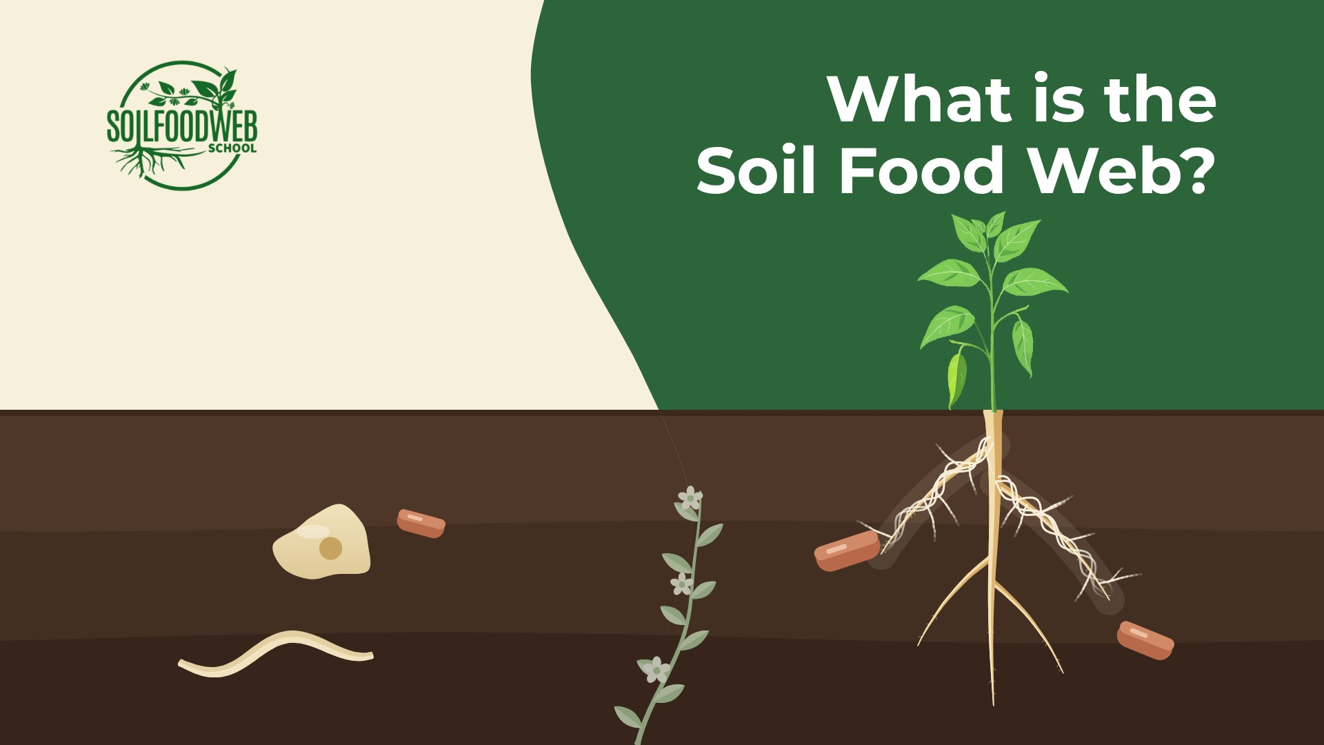
Notes:
Video 1: What is the Soil Food Web?
Version 3: Kontext plants, shared template

Slide 5

Notes:
Video 1: What is the Soil Food Web?
Version 2: hero plants, shared template

Slide 6
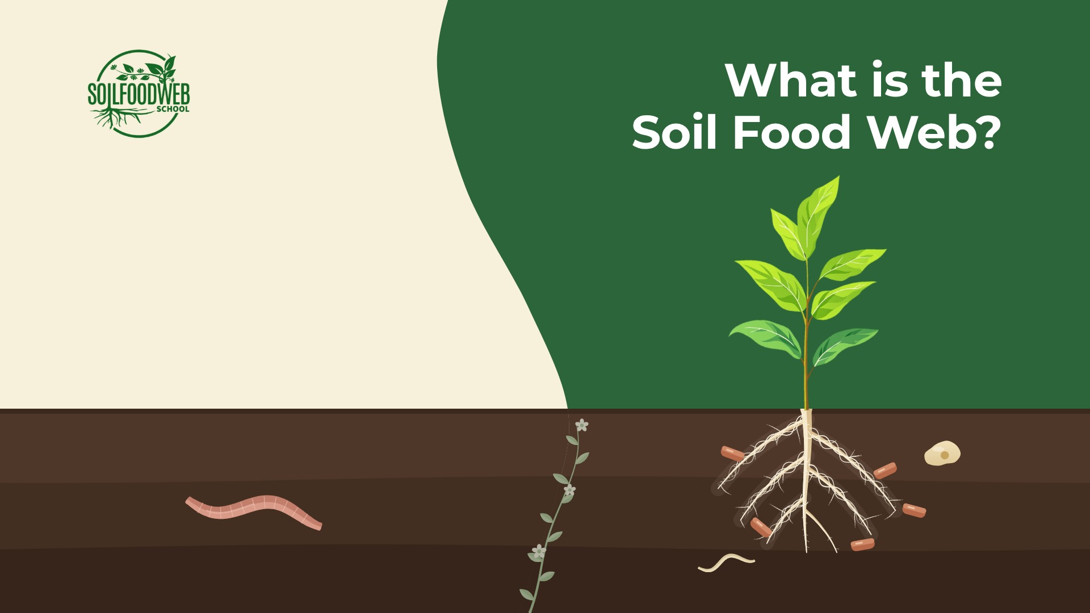
Notes:
Video 1: What is the Soil Food Web?
Version 1: shared template

Slide 7
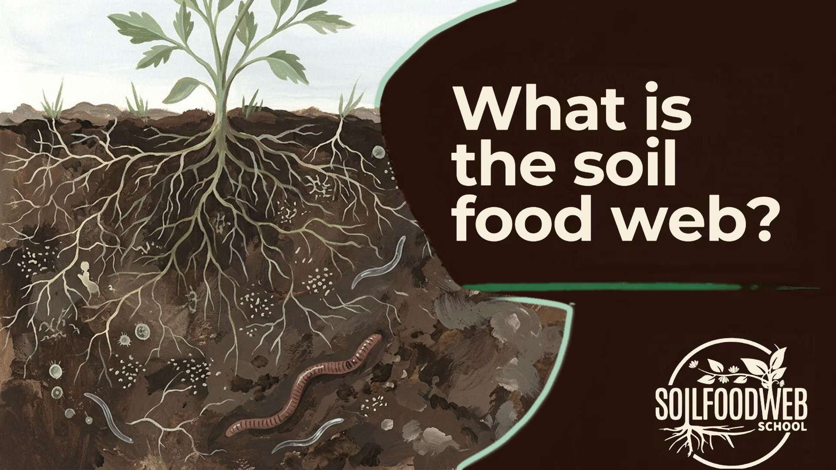
Notes:
Video 1: What is the Soil Food Web?
Early gouache version A (original site panel)

Slide 8
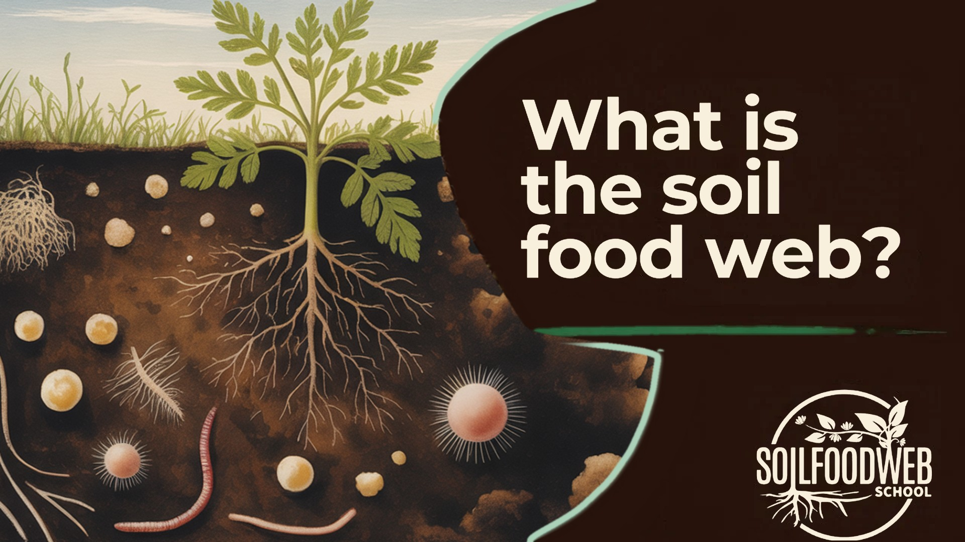
Notes:
Video 1: What is the Soil Food Web?
Early gouache version B (original site panel)

Slide 9
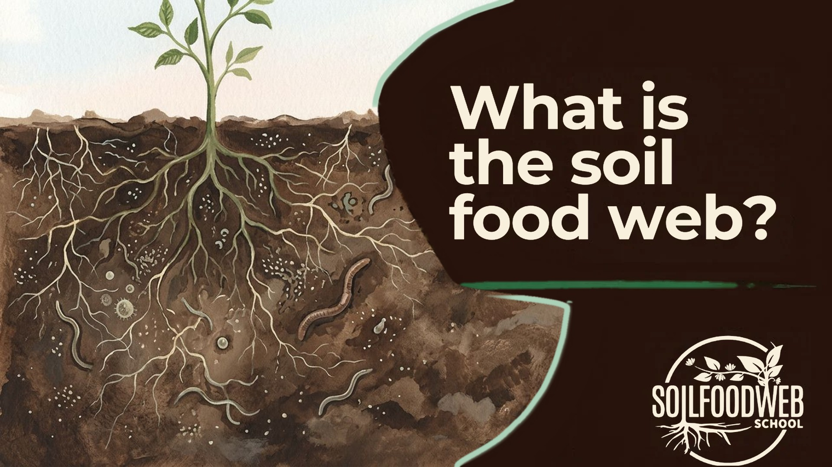
Notes:
Video 1: What is the Soil Food Web?
Early gouache version C (original site panel)

Slide 10
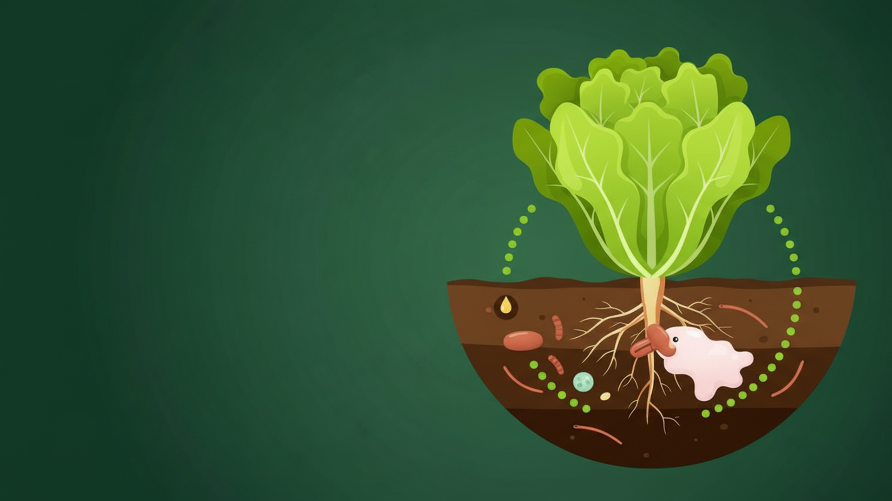
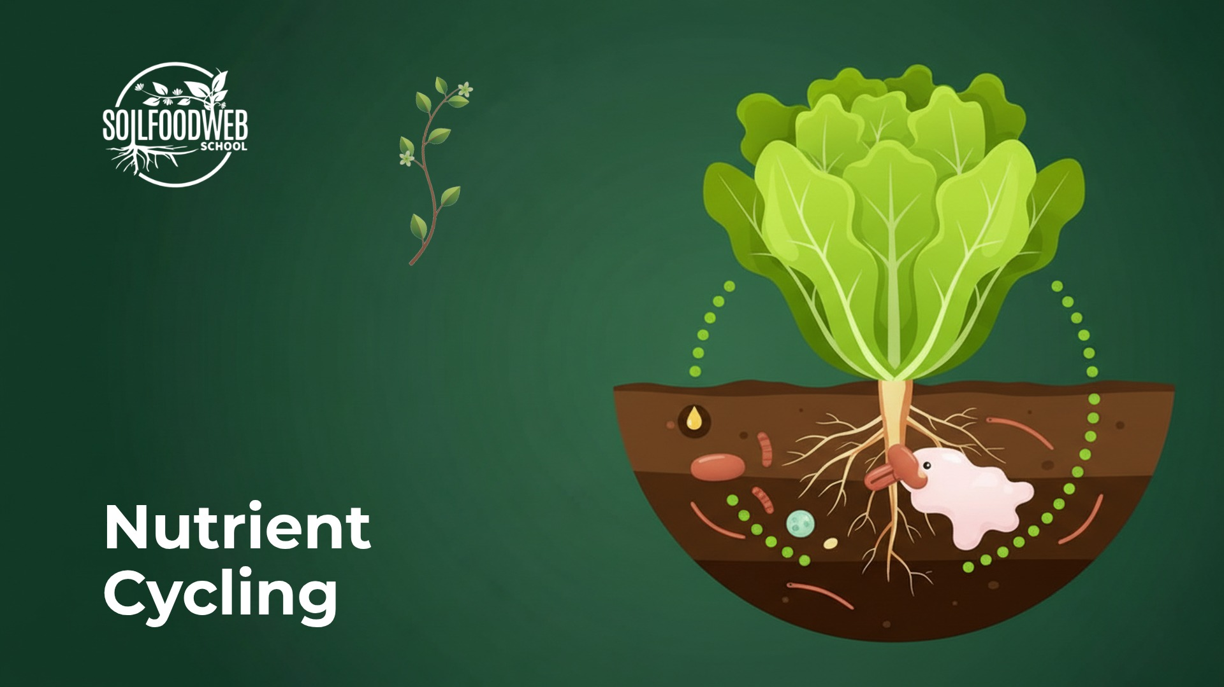
Nutrient
Cycling
Notes:
Video 2: Nutrient Cycling
Version 6 (latest): SFW green palette

Slide 11
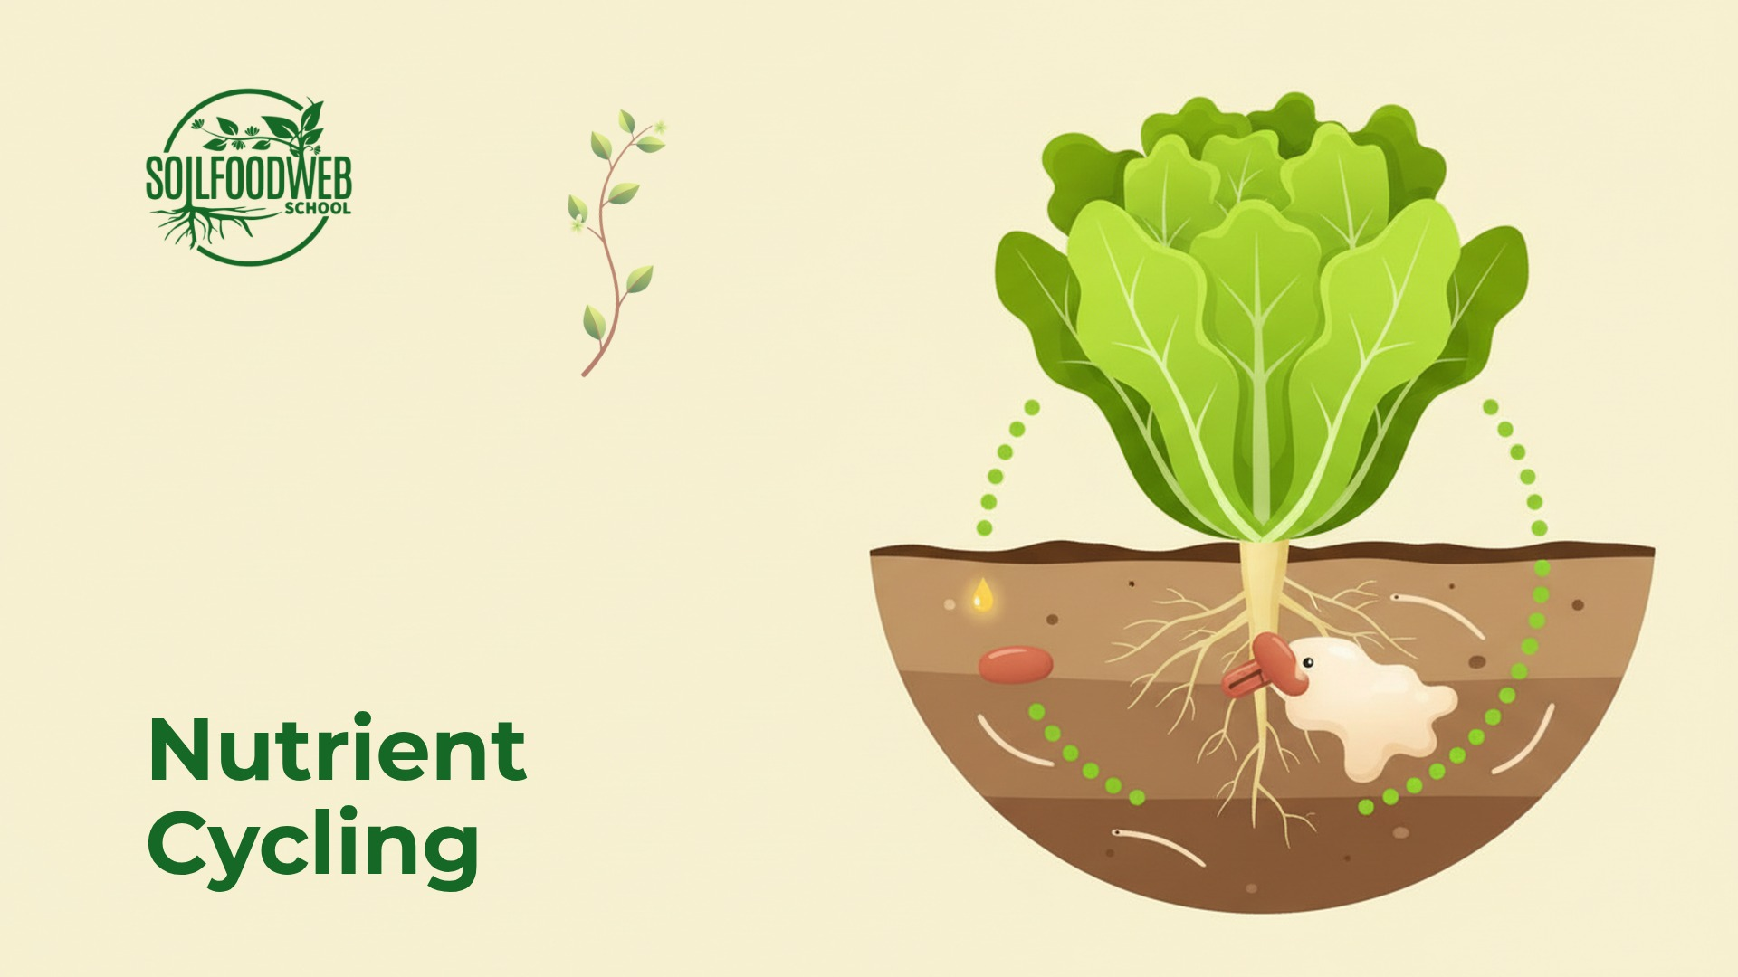
Notes:
Video 2: Nutrient Cycling
Version 5: six compositions, cream

Slide 12
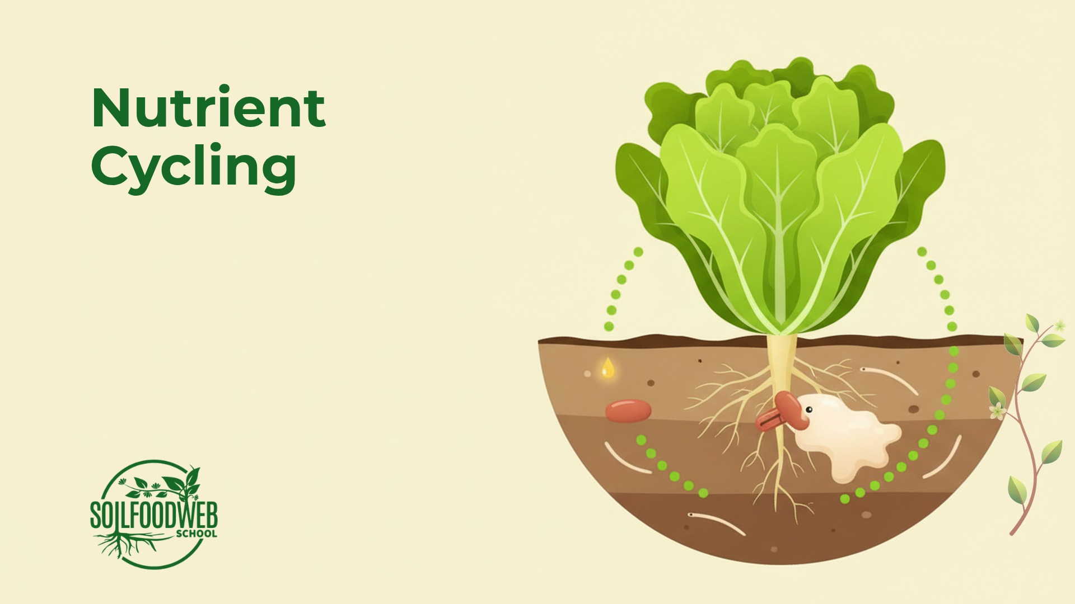
Notes:
Video 2: Nutrient Cycling
Version 4: nano-banana, shared template

Slide 13
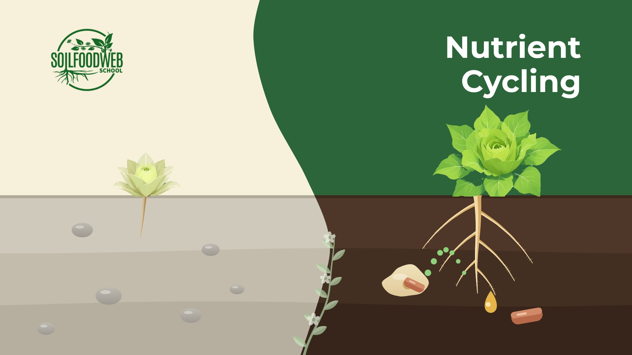
Notes:
Video 2: Nutrient Cycling
Version 3: Kontext plants, shared template

Slide 14
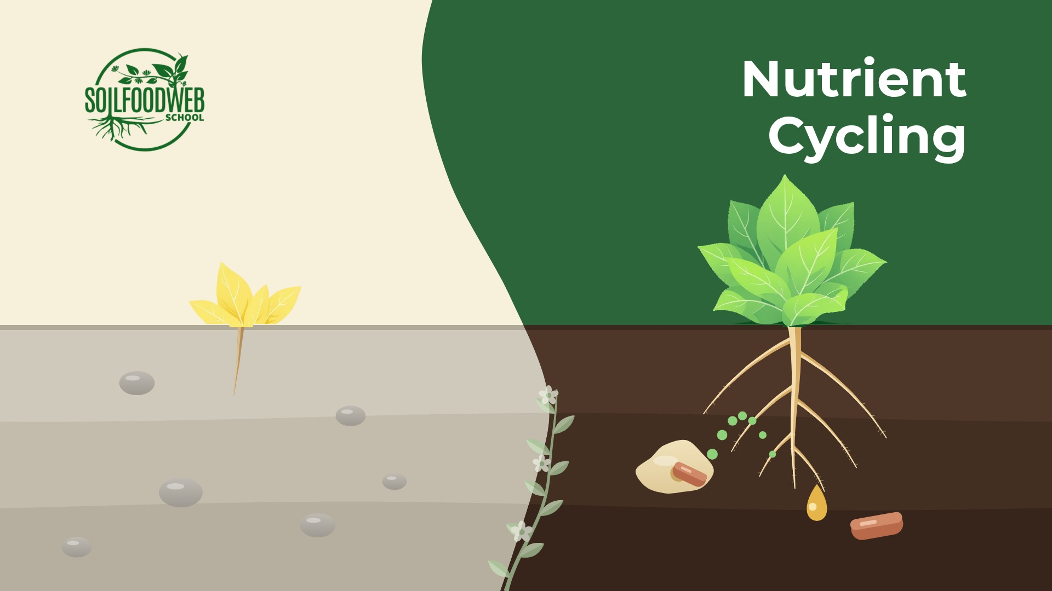
Notes:
Video 2: Nutrient Cycling
Version 2: hero plants, shared template

Slide 15
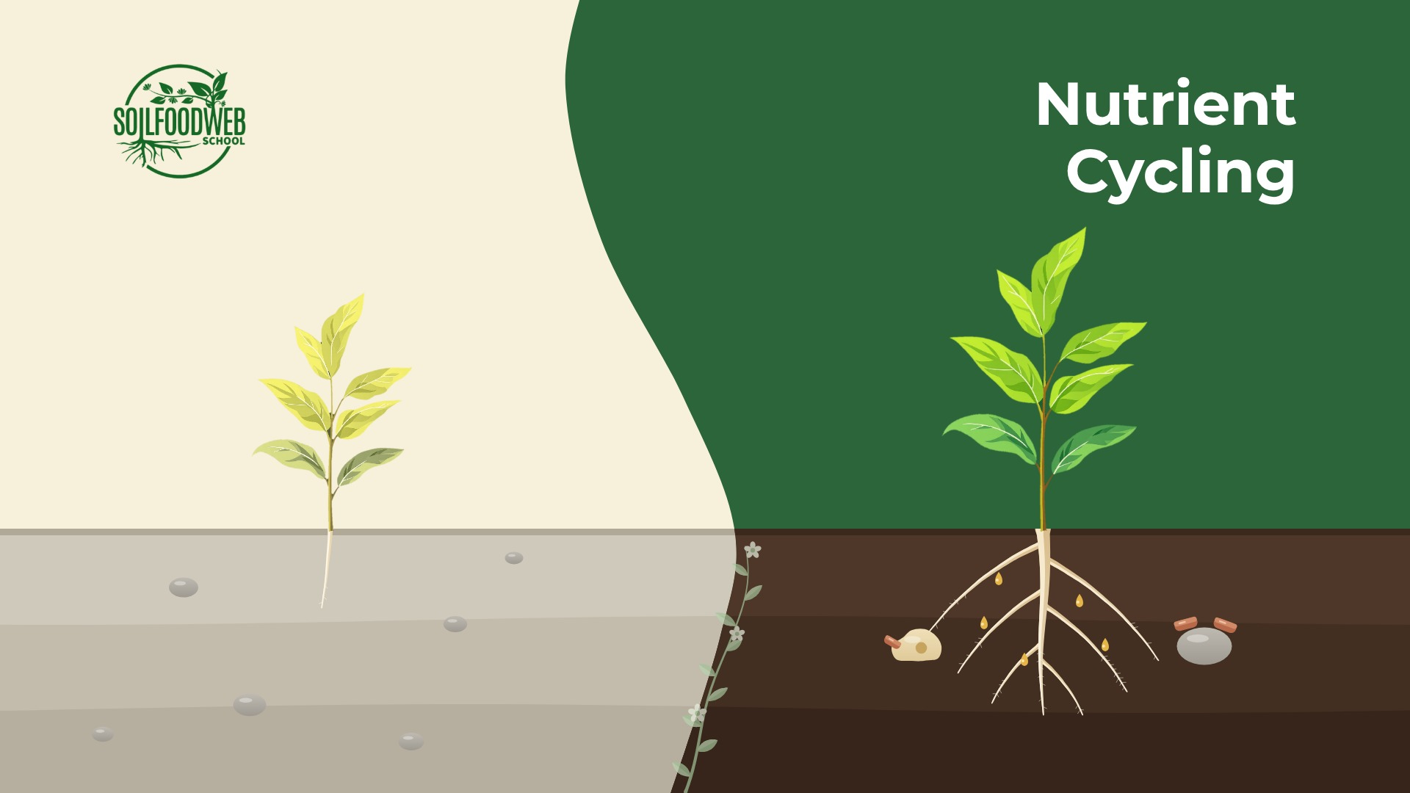
Notes:
Video 2: Nutrient Cycling
Version 1: shared template

Slide 16
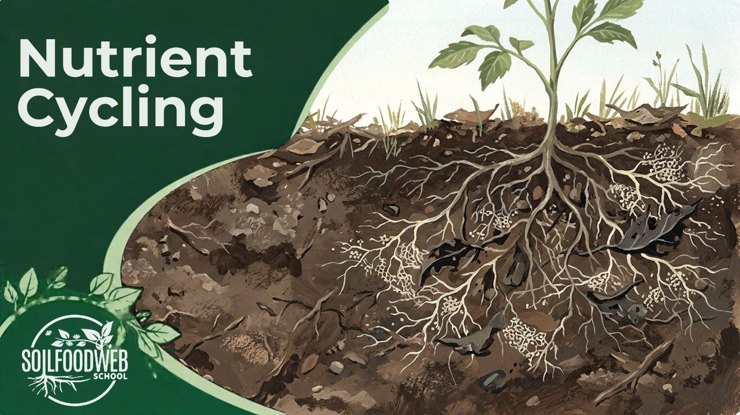
Notes:
Video 2: Nutrient Cycling
Early gouache version A (original site panel)

Slide 17
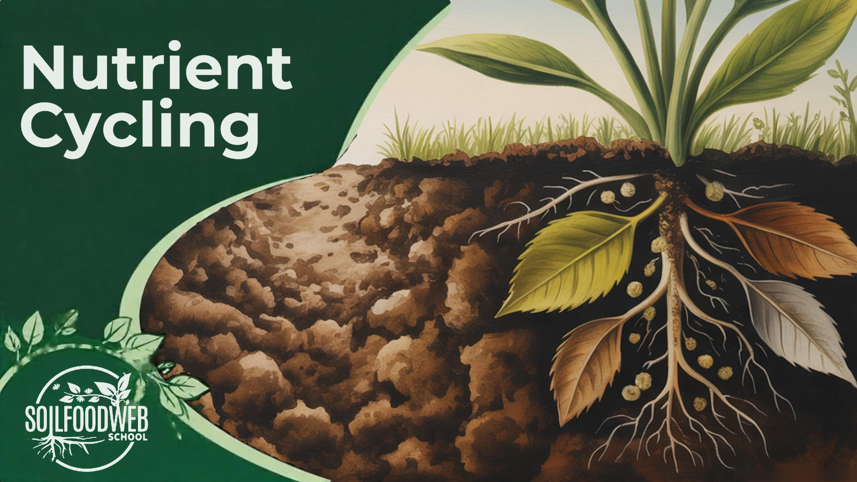
Notes:
Video 2: Nutrient Cycling
Early gouache version B (original site panel)

Slide 18
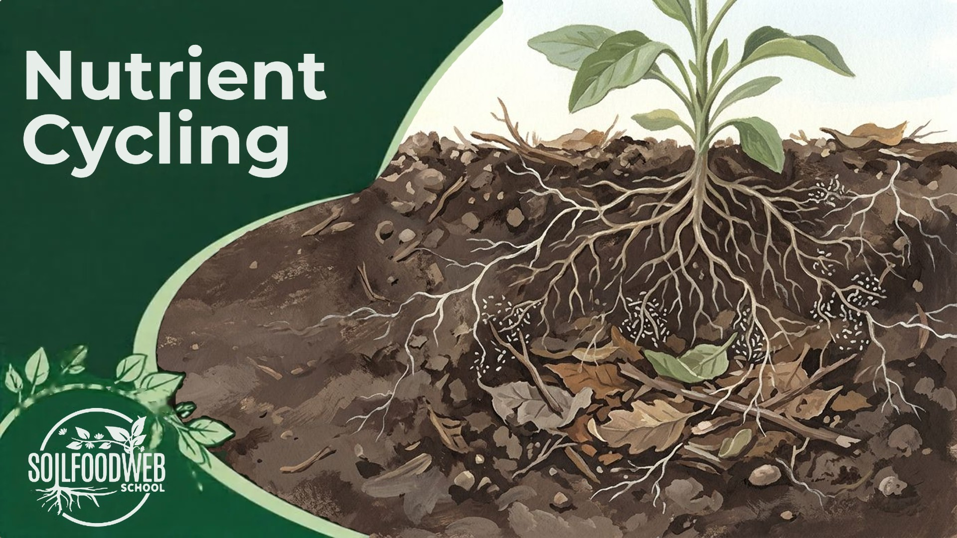
Notes:
Video 2: Nutrient Cycling
Early gouache version C (original site panel)

Slide 19
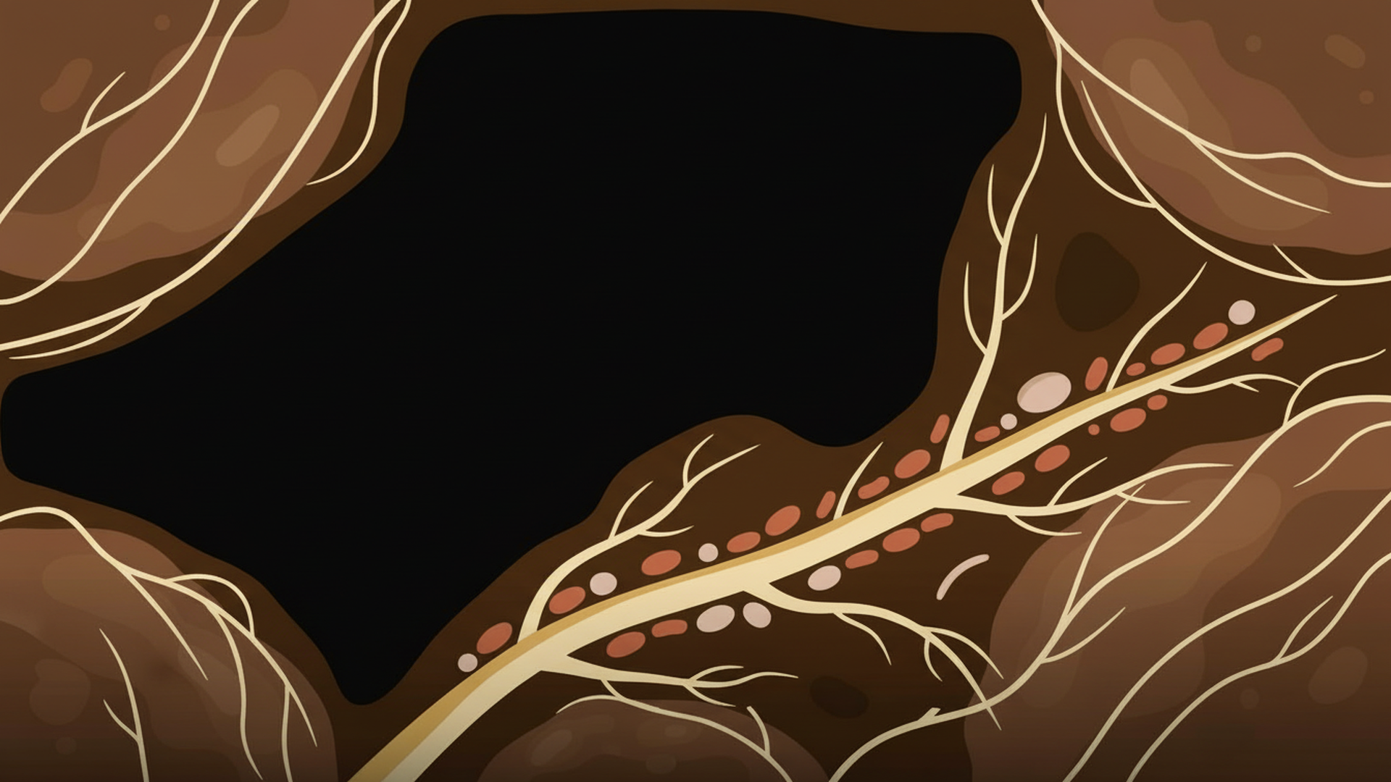
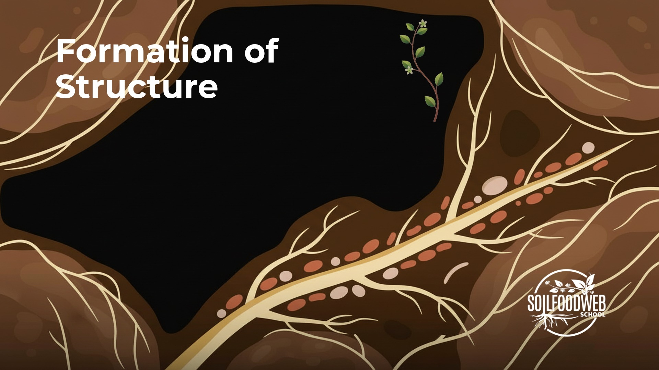
Formation of
Structure
Notes:
Video 3: Formation of Structure
Version 6 (latest): SFW green palette

Slide 20
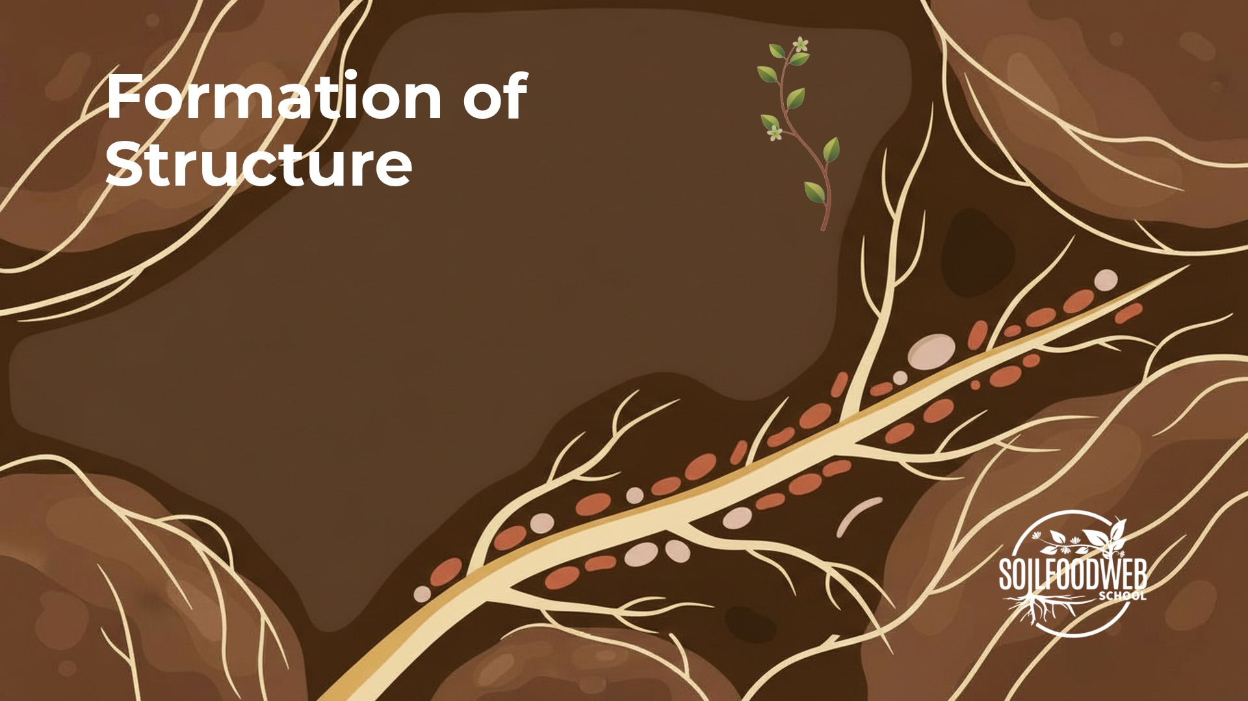
Notes:
Video 3: Formation of Structure
Version 5: six compositions, cream

Slide 21
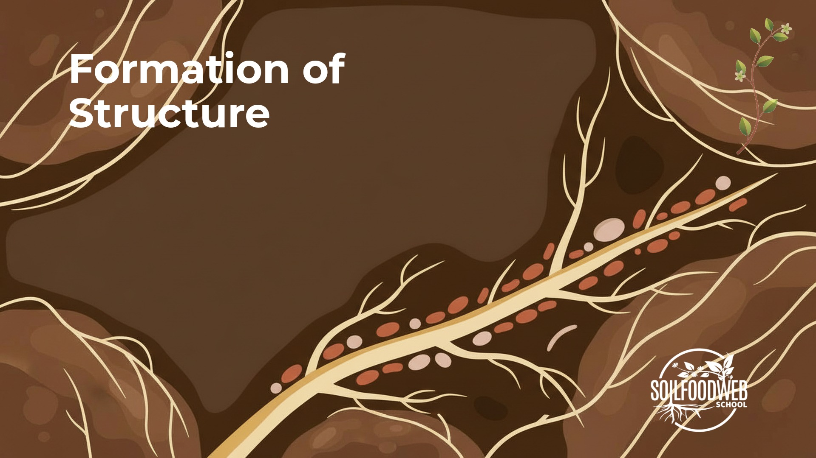
Notes:
Video 3: Formation of Structure
Version 4: nano-banana, shared template

Slide 22
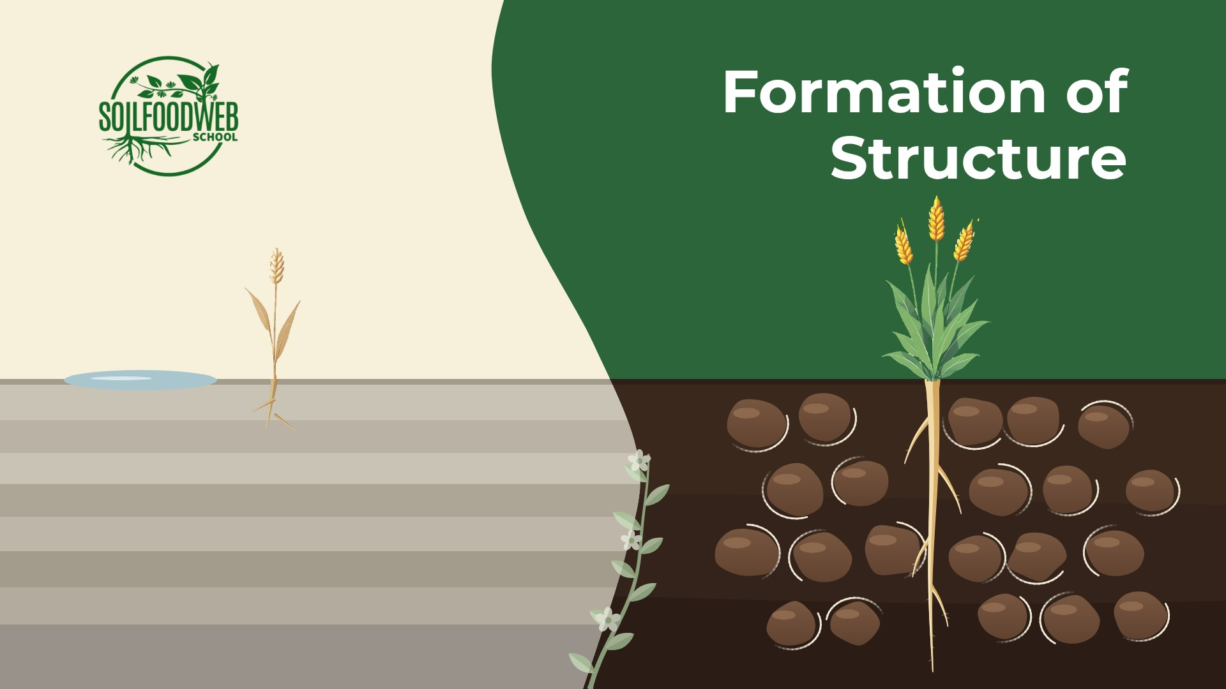
Notes:
Video 3: Formation of Structure
Version 3: Kontext plants, shared template

Slide 23
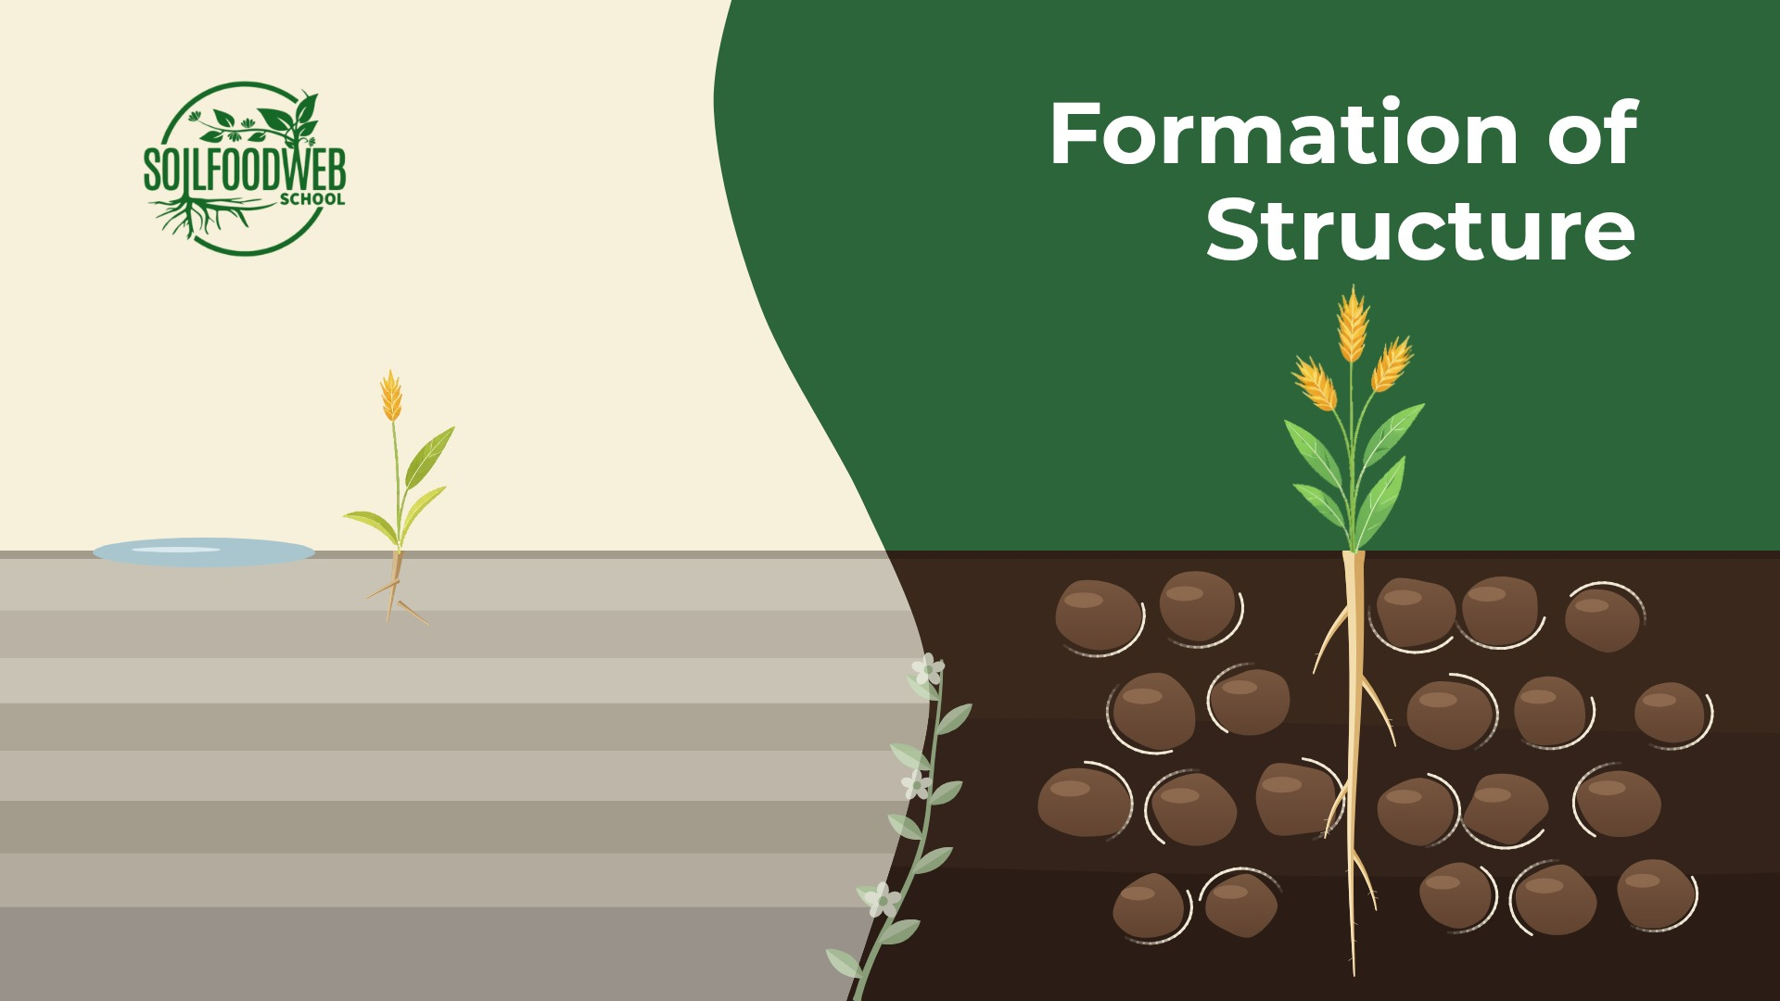
Notes:
Video 3: Formation of Structure
Version 2: hero plants, shared template

Slide 24
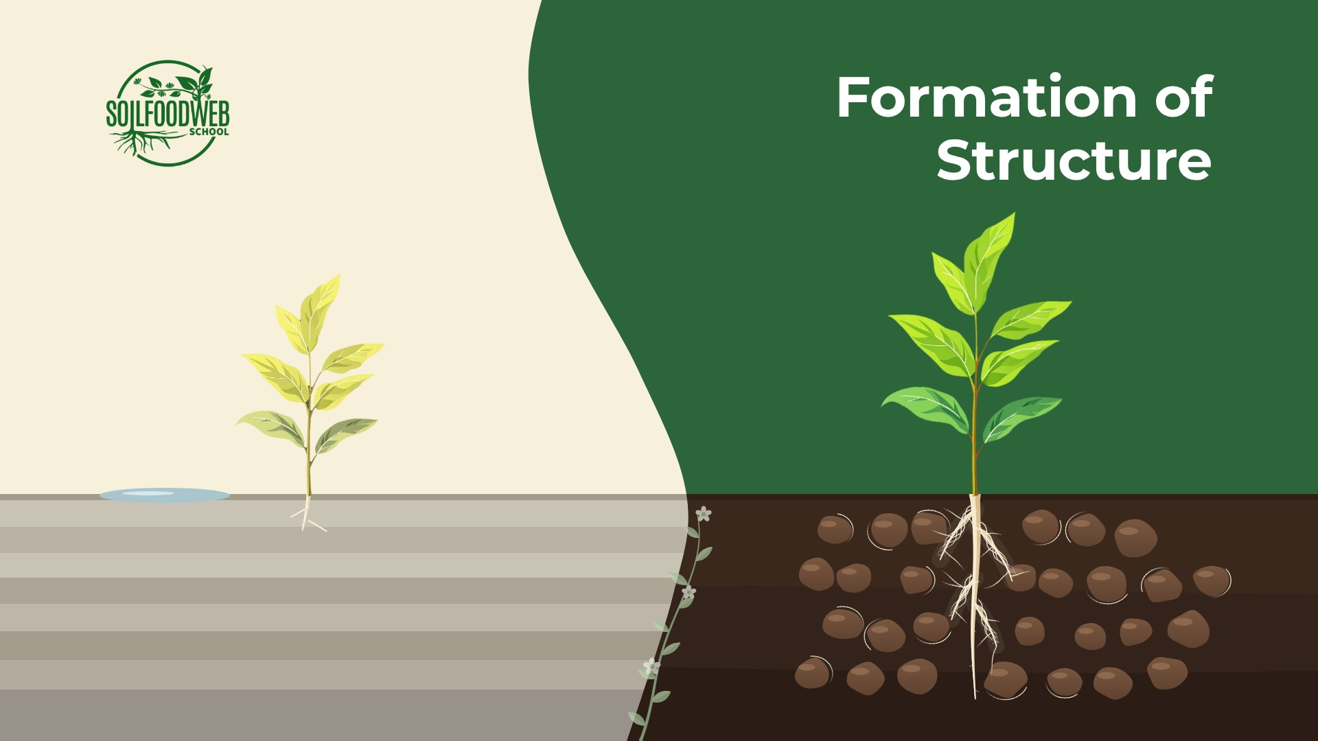
Notes:
Video 3: Formation of Structure
Version 1: shared template

Slide 25
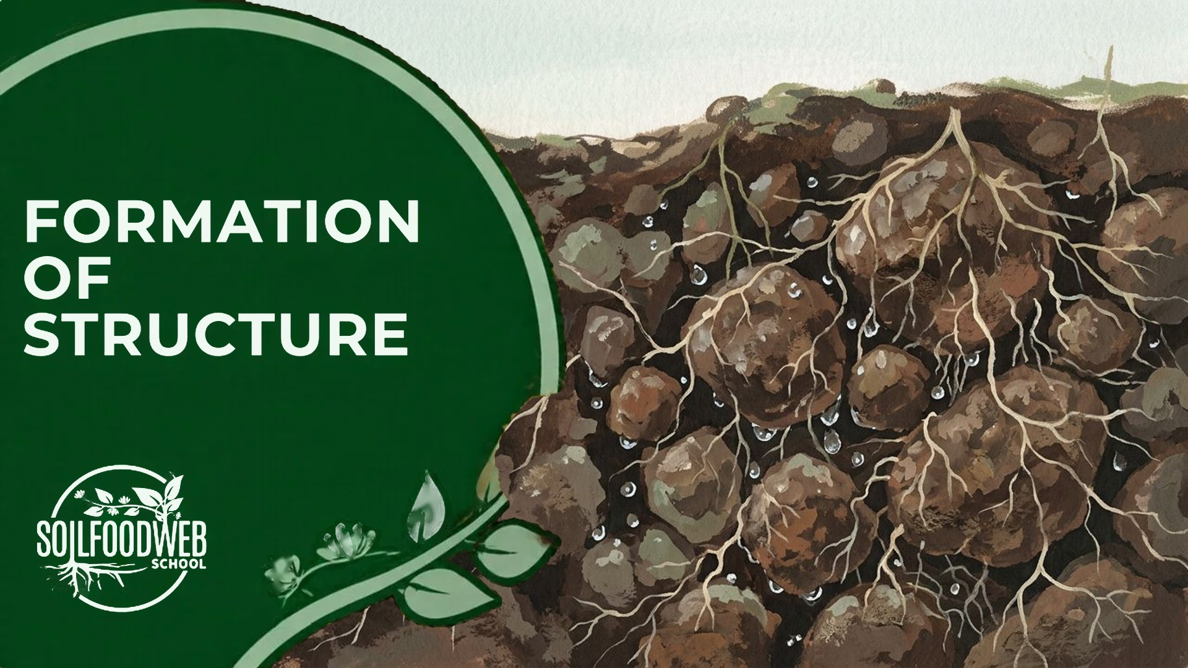
Notes:
Video 3: Formation of Structure
Early gouache version A (original site panel)

Slide 26
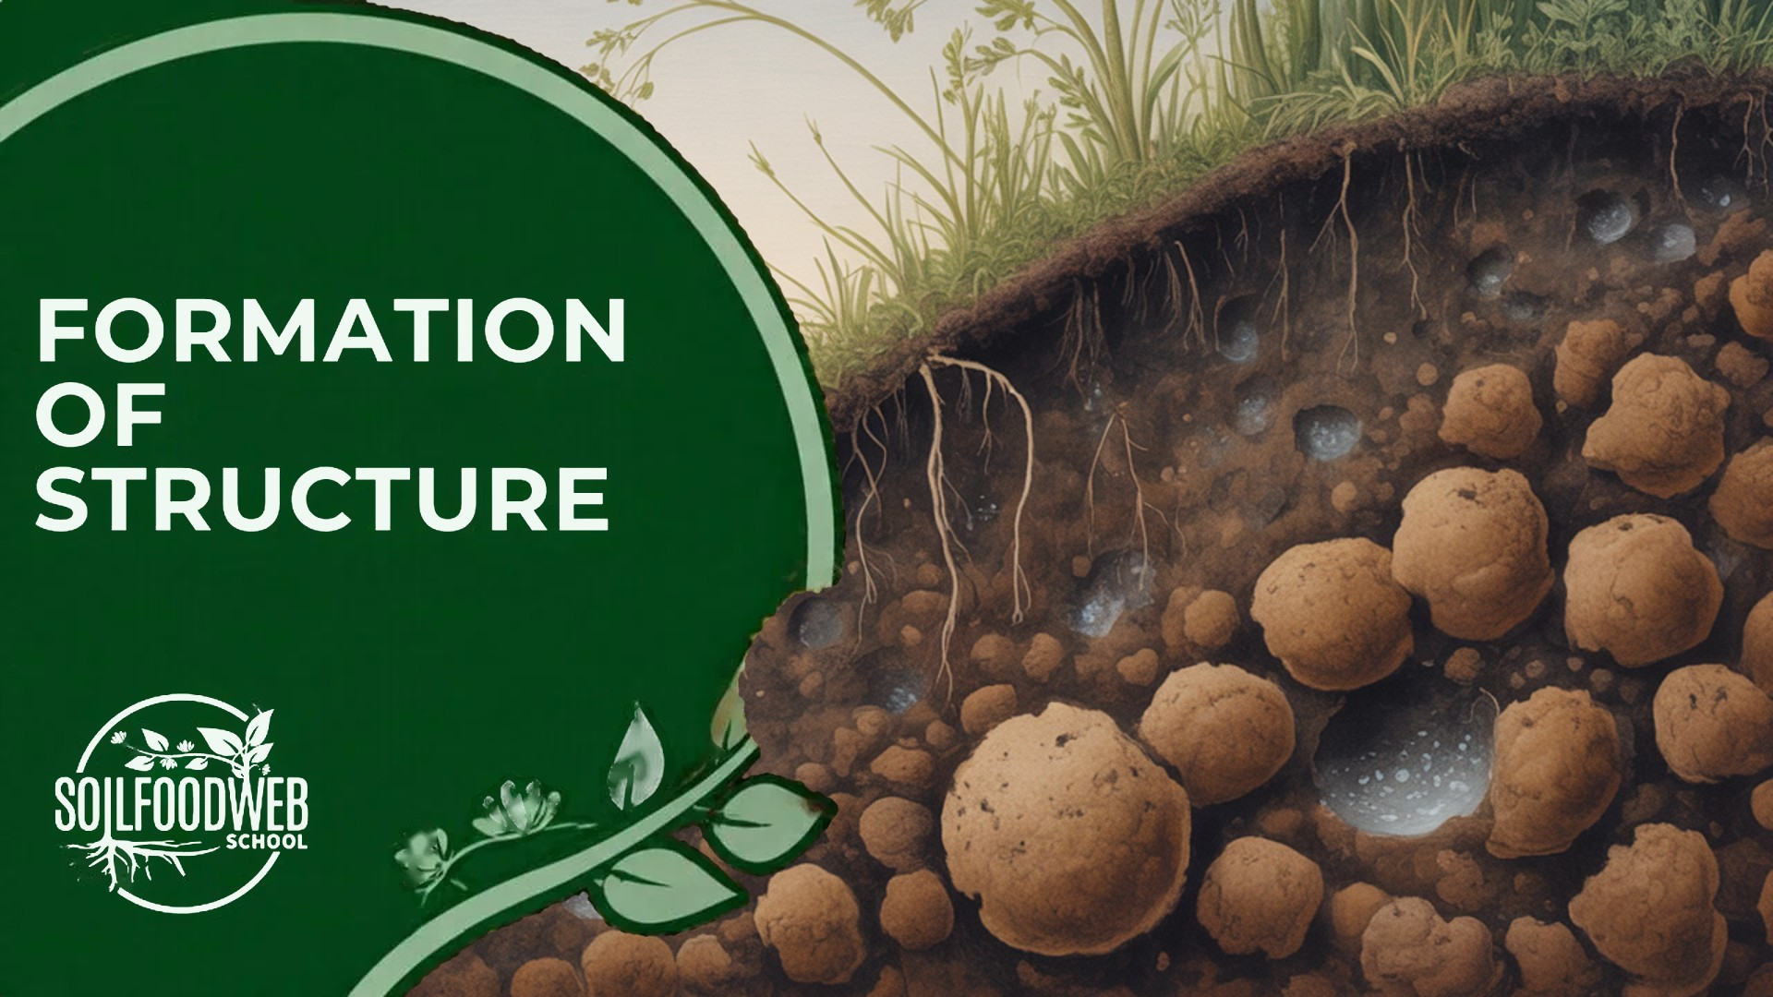
Notes:
Video 3: Formation of Structure
Early gouache version B (original site panel)

Slide 27
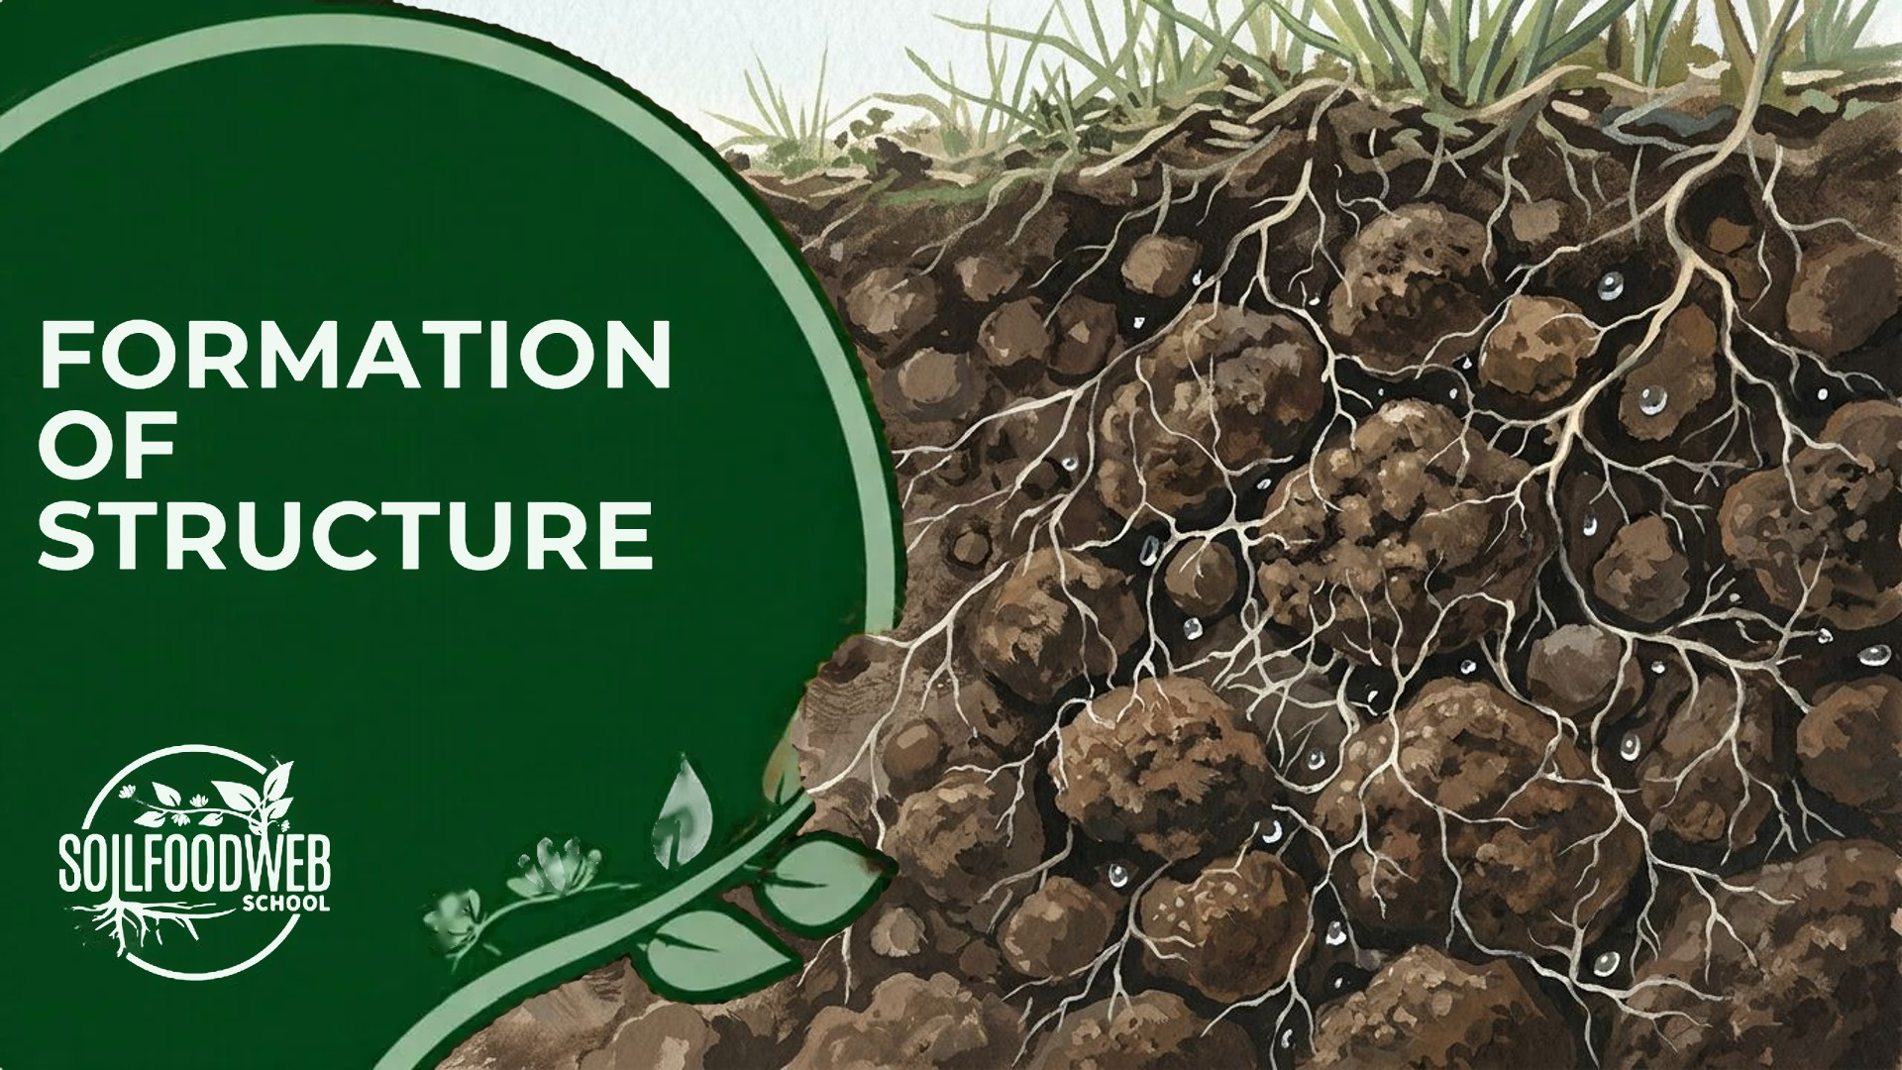
Notes:
Video 3: Formation of Structure
Early gouache version C (original site panel)

Slide 28
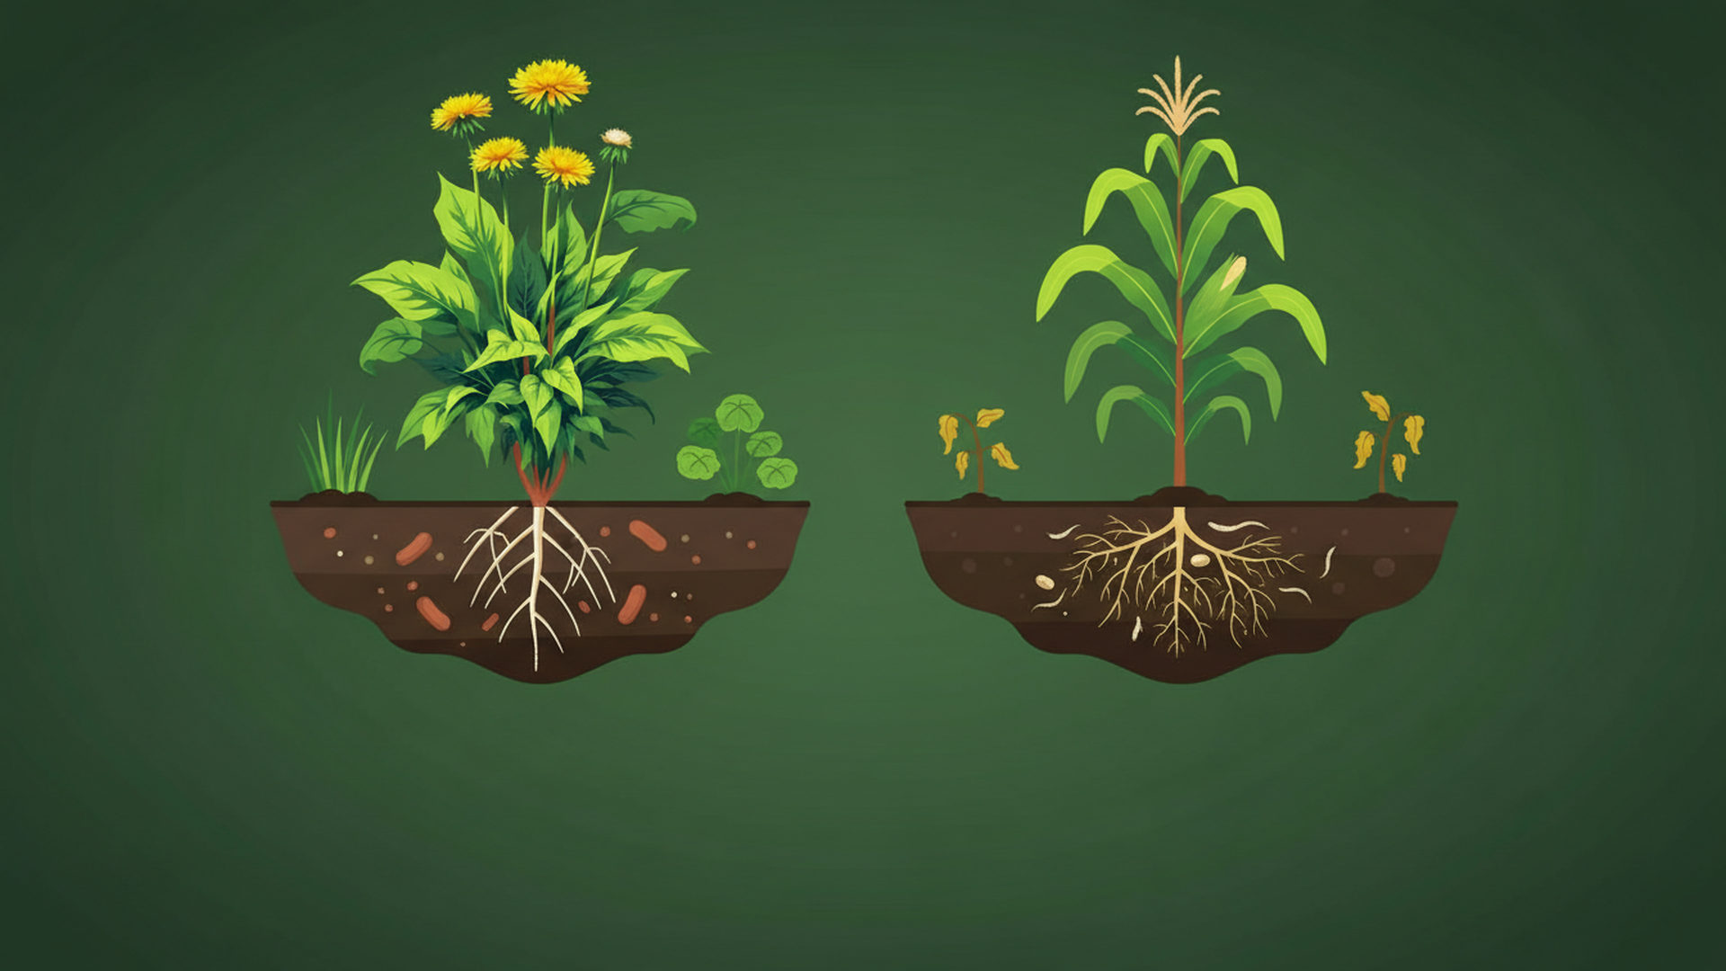

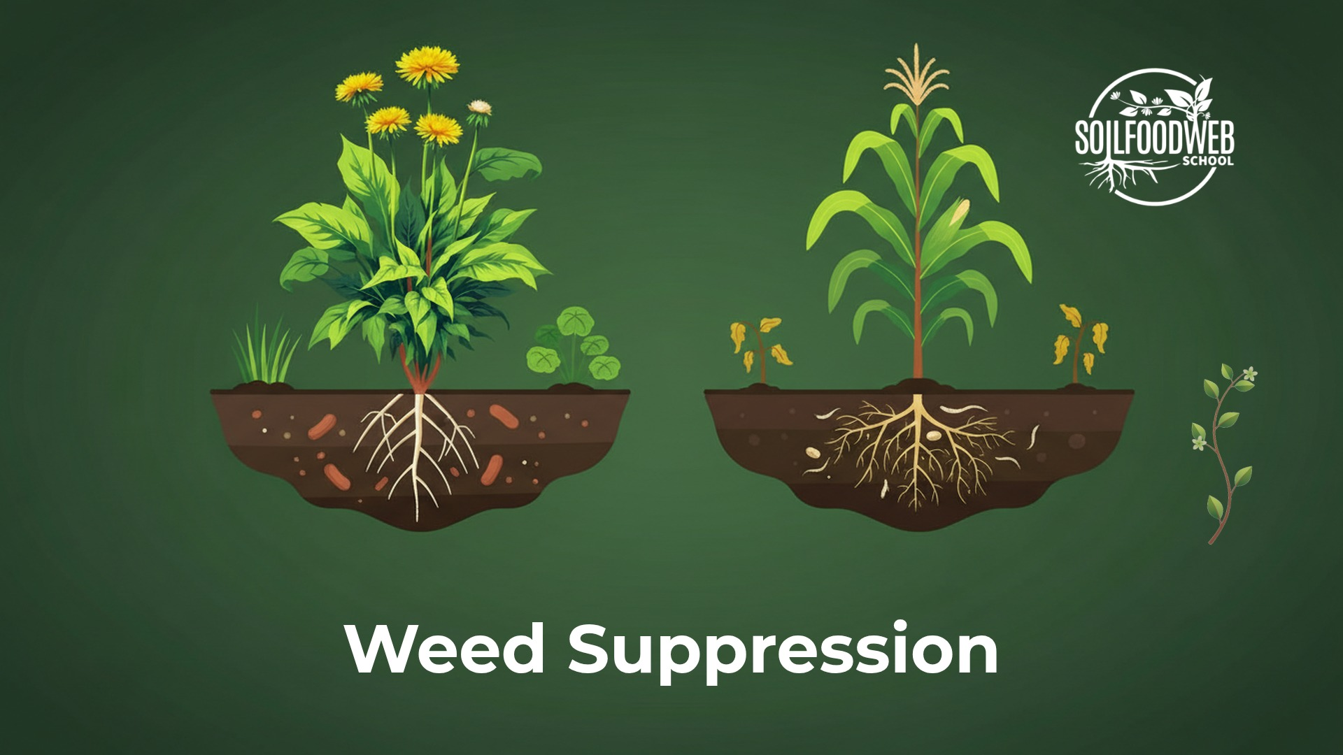
Weed Suppression
Notes:
Video 4: Weed Suppression
Version 6 (latest): SFW green palette

Slide 29
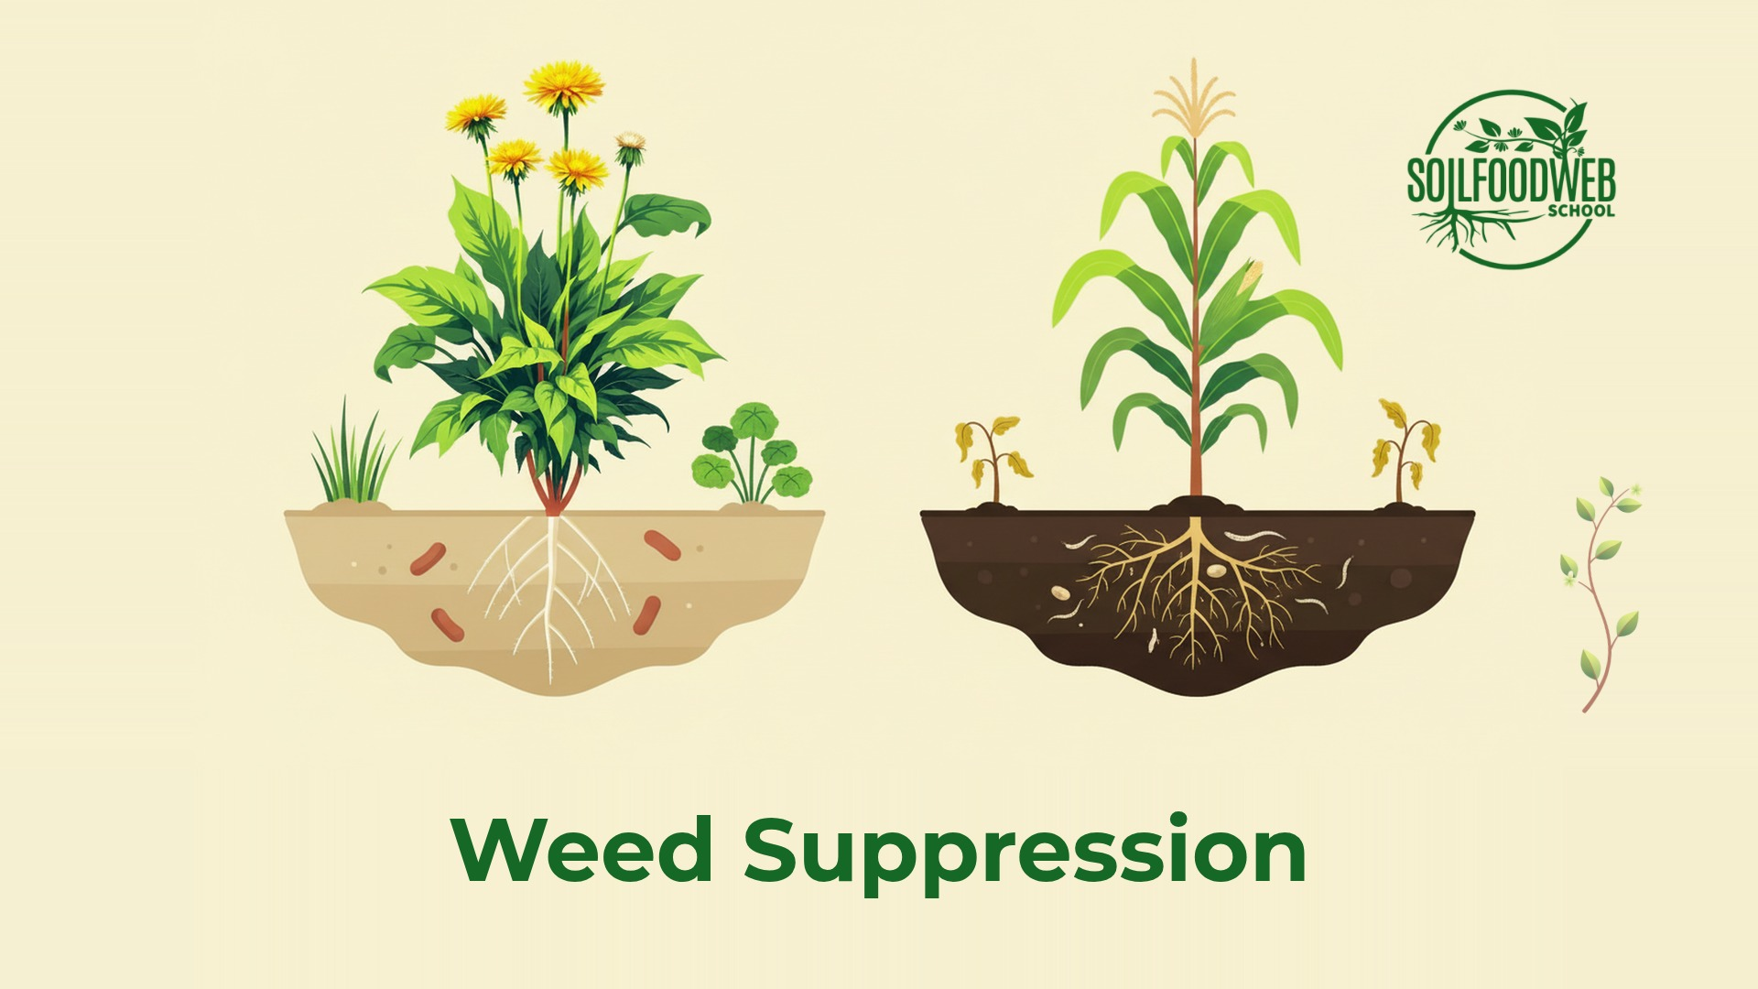
Notes:
Video 4: Weed Suppression
Version 5: six compositions, cream

Slide 30
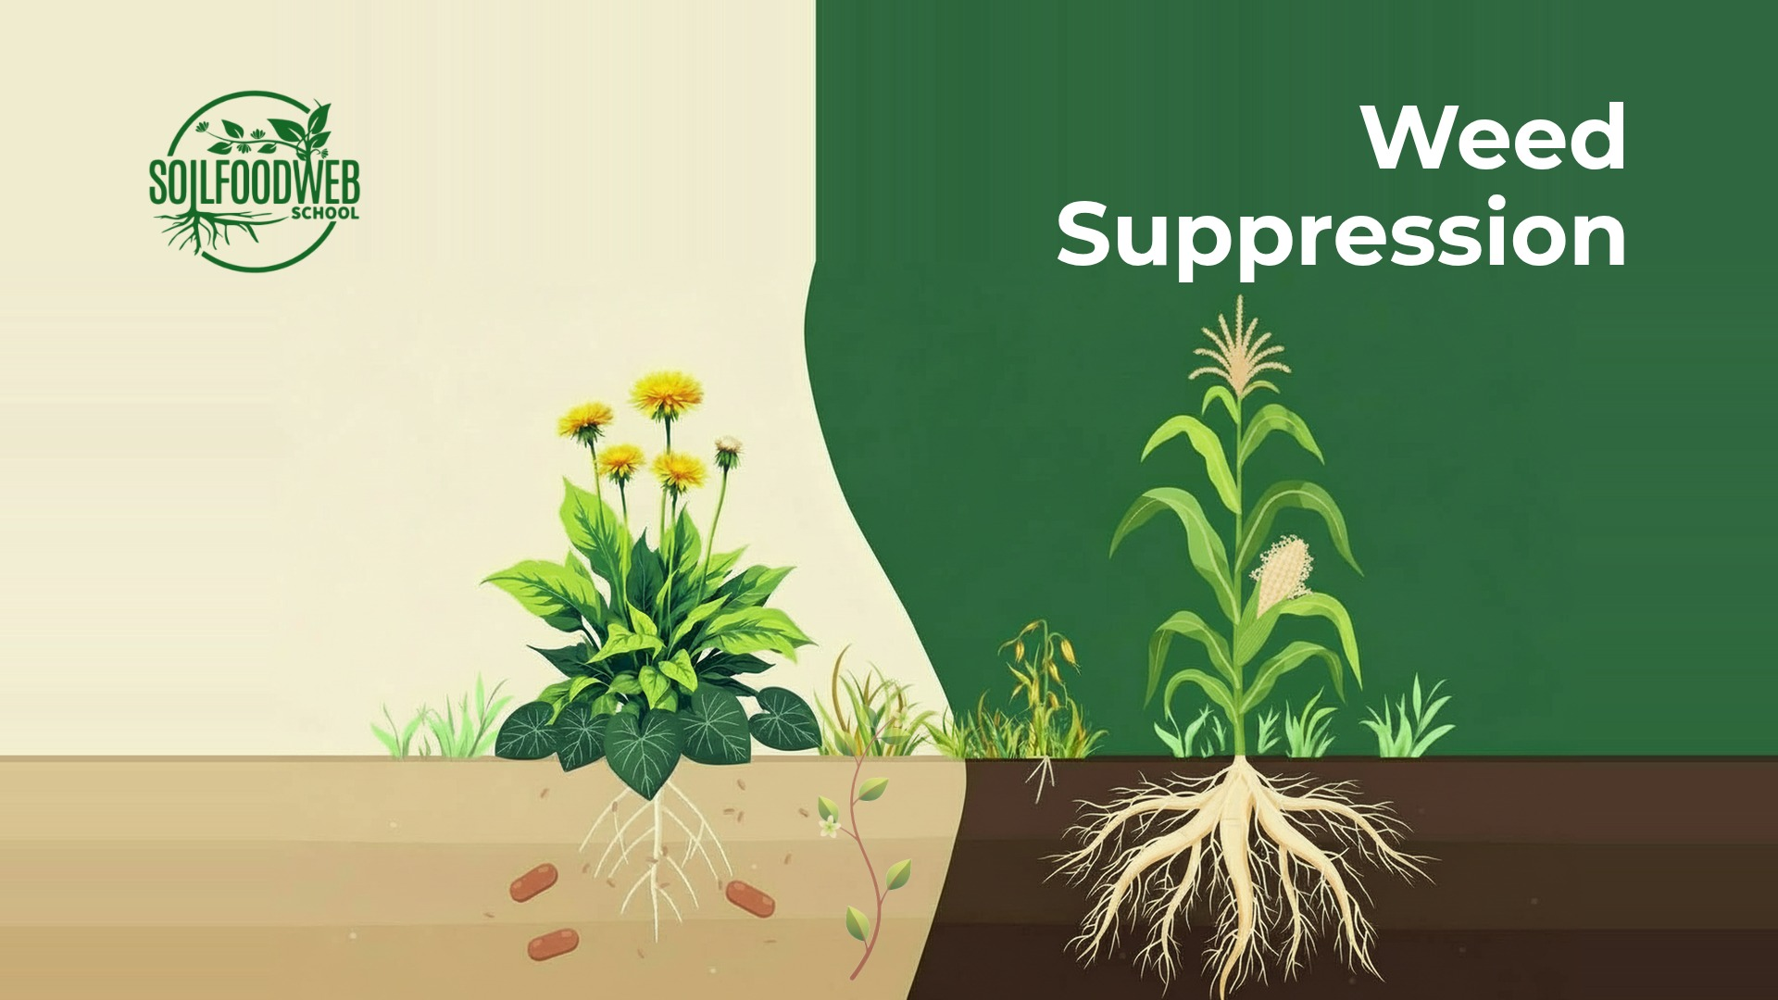
Notes:
Video 4: Weed Suppression
Version 4: nano-banana, shared template

Slide 31
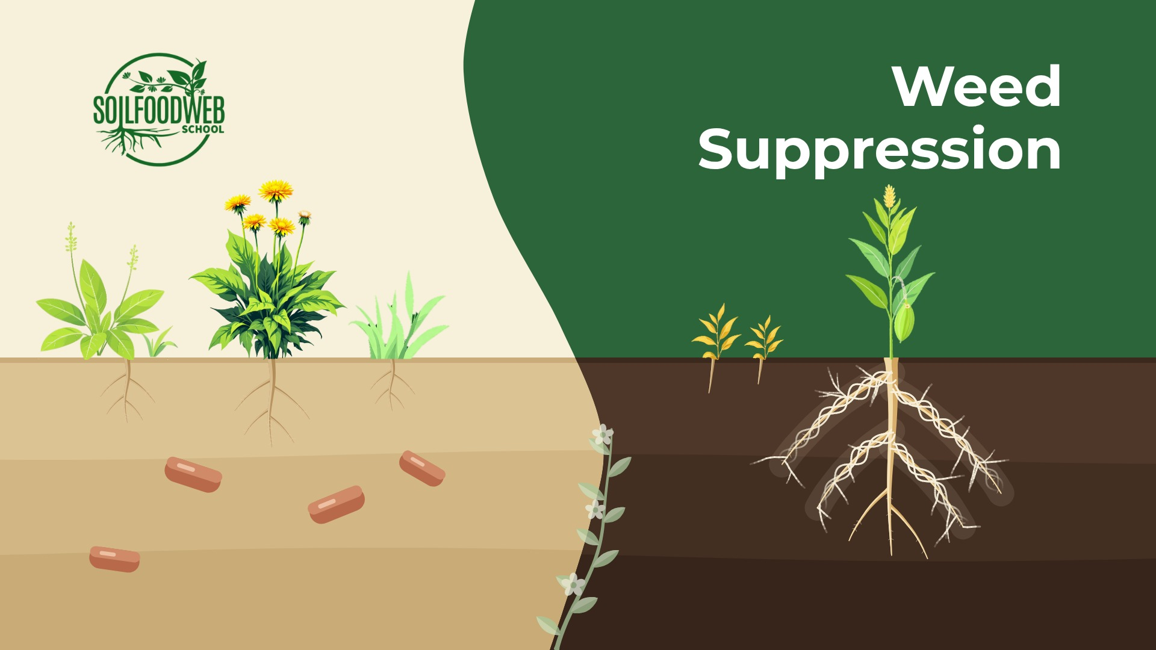
Notes:
Video 4: Weed Suppression
Version 3: Kontext plants, shared template

Slide 32
Notes:
Video 4: Weed Suppression
Version 2: hero plants, shared template

Slide 33
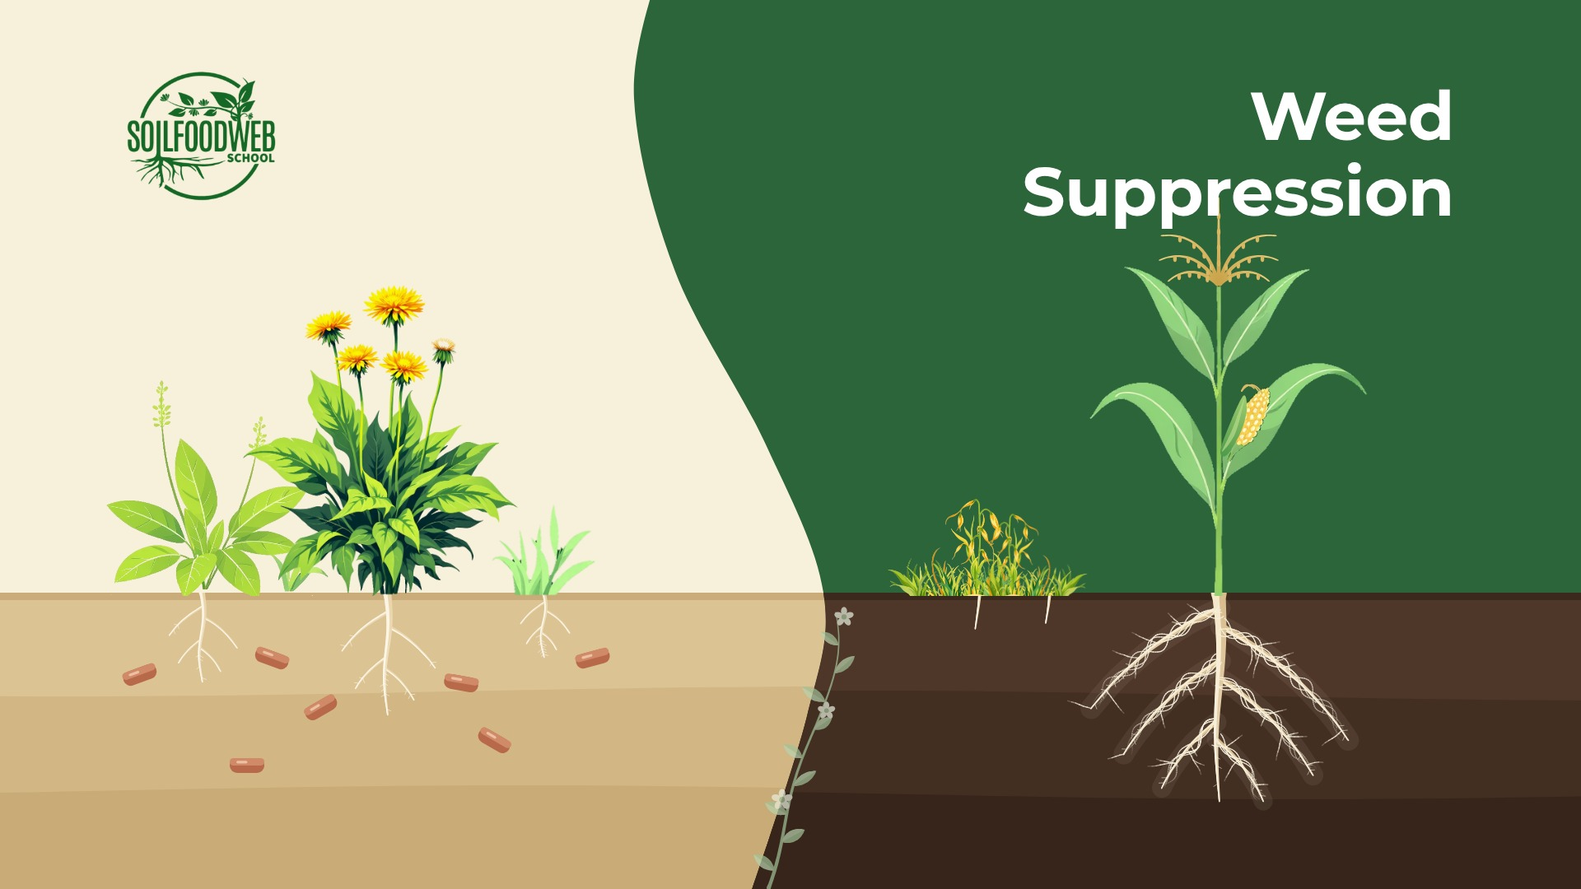
Notes:
Video 4: Weed Suppression
Version 1: shared template

Slide 34
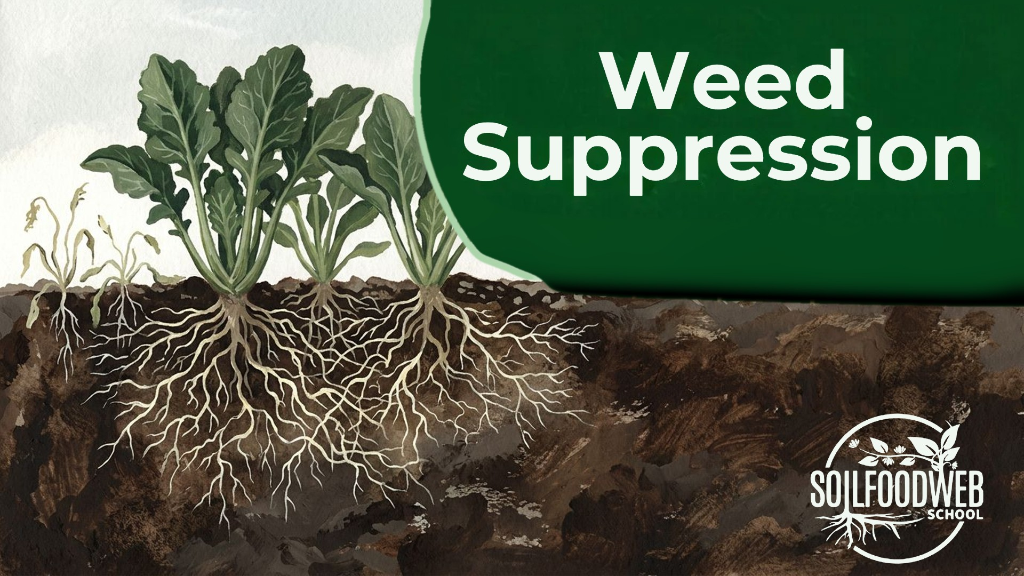
Notes:
Video 4: Weed Suppression
Early gouache version A (original site panel)

Slide 35

Notes:
Video 4: Weed Suppression
Early gouache version B (original site panel)

Slide 36

Notes:
Video 4: Weed Suppression
Early gouache version C (original site panel)

Slide 37
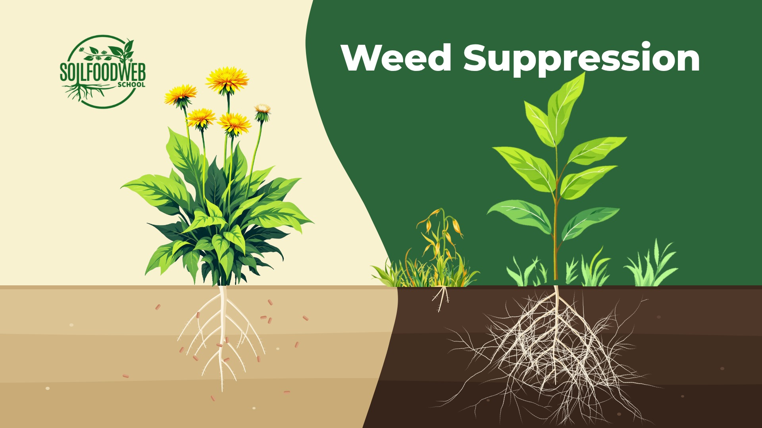
Notes:
Video 4: Weed Suppression
Weed Suppression: dandelion + seedling (favourite)

Slide 38
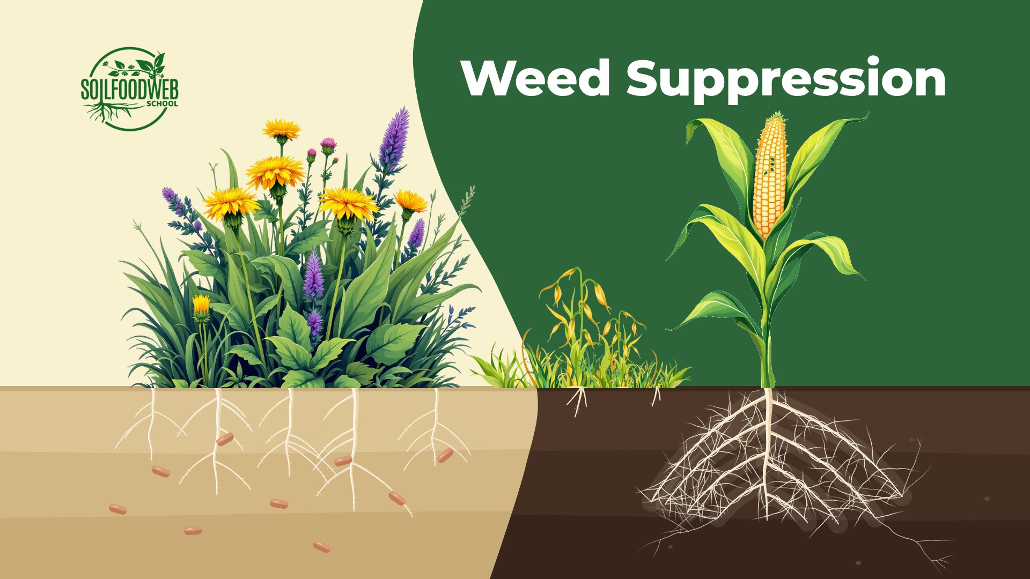
Notes:
Video 4: Weed Suppression
Weed Suppression: weed patch + corn

Slide 39
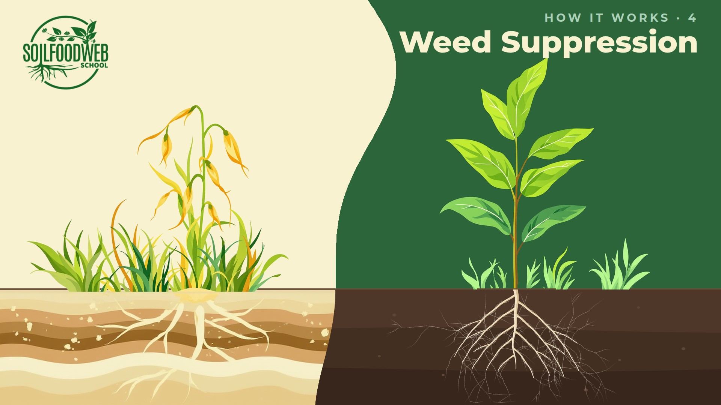
Notes:
Video 4: Weed Suppression
Weed Suppression: flow layout, redrawn roots

Slide 40
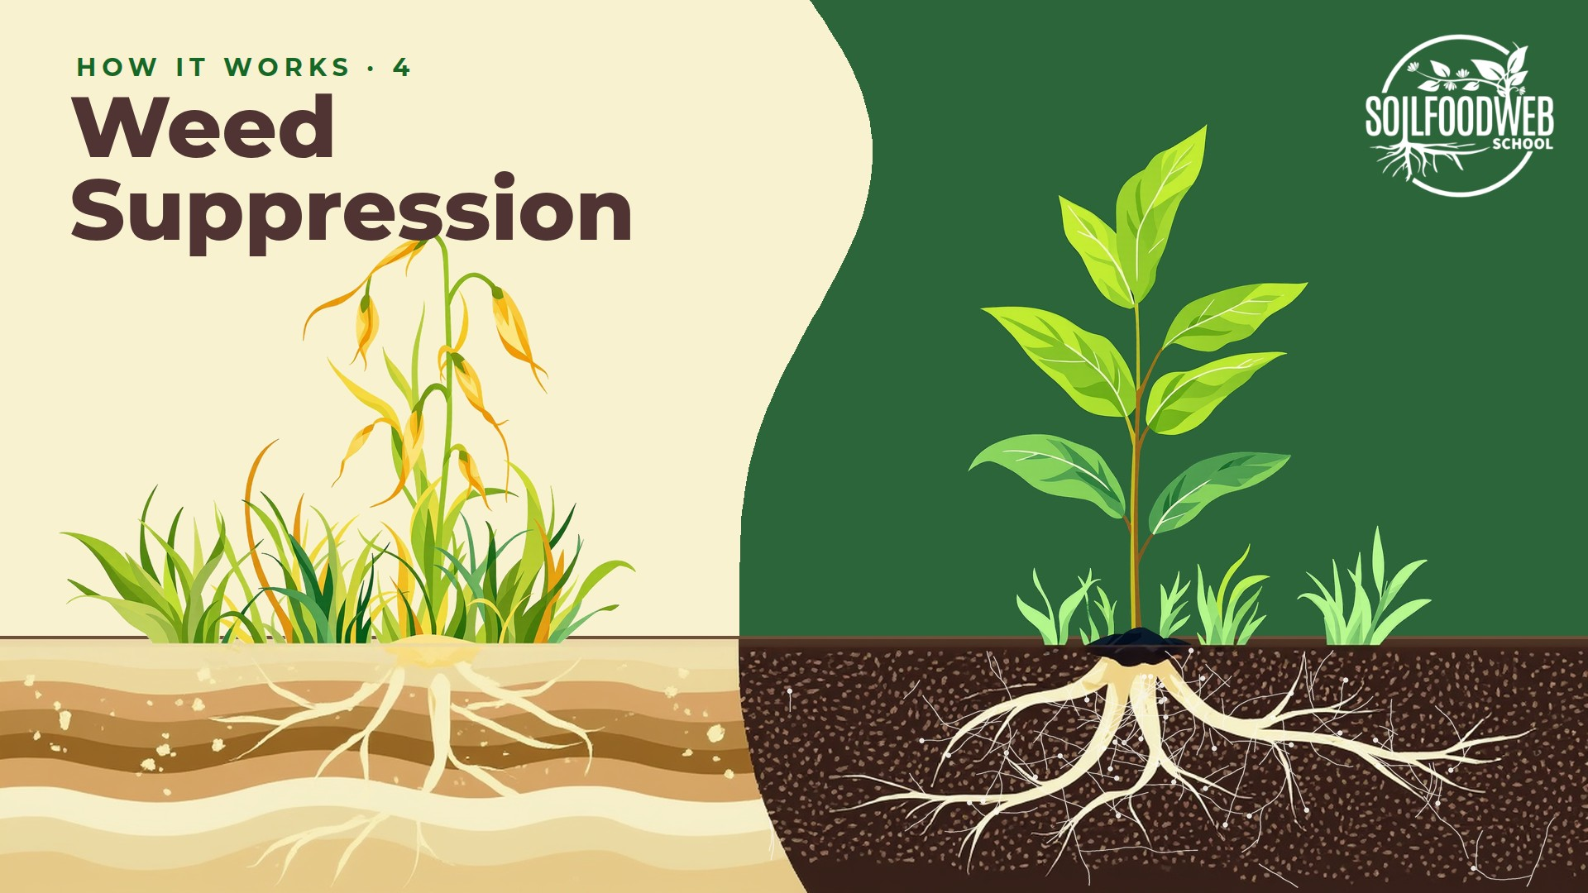
Notes:
Video 4: Weed Suppression
Weed Suppression: flow layout option 1

Slide 41
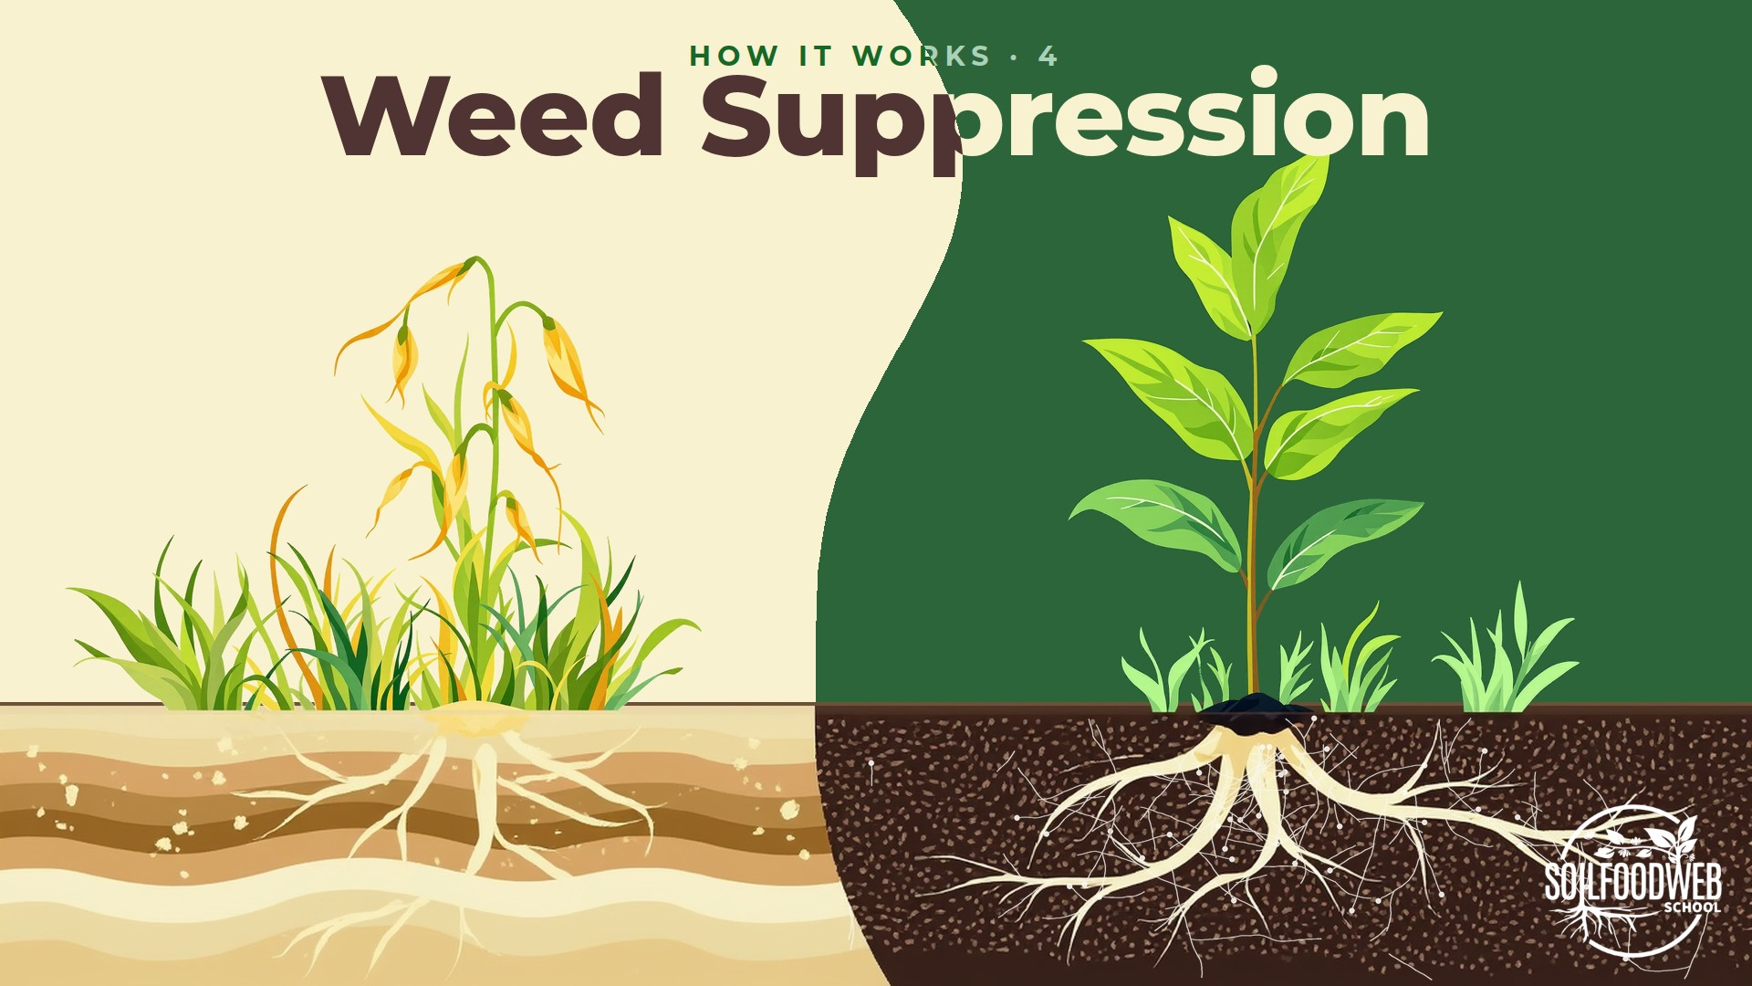
Notes:
Video 4: Weed Suppression
Weed Suppression: flow layout option 2

Slide 42
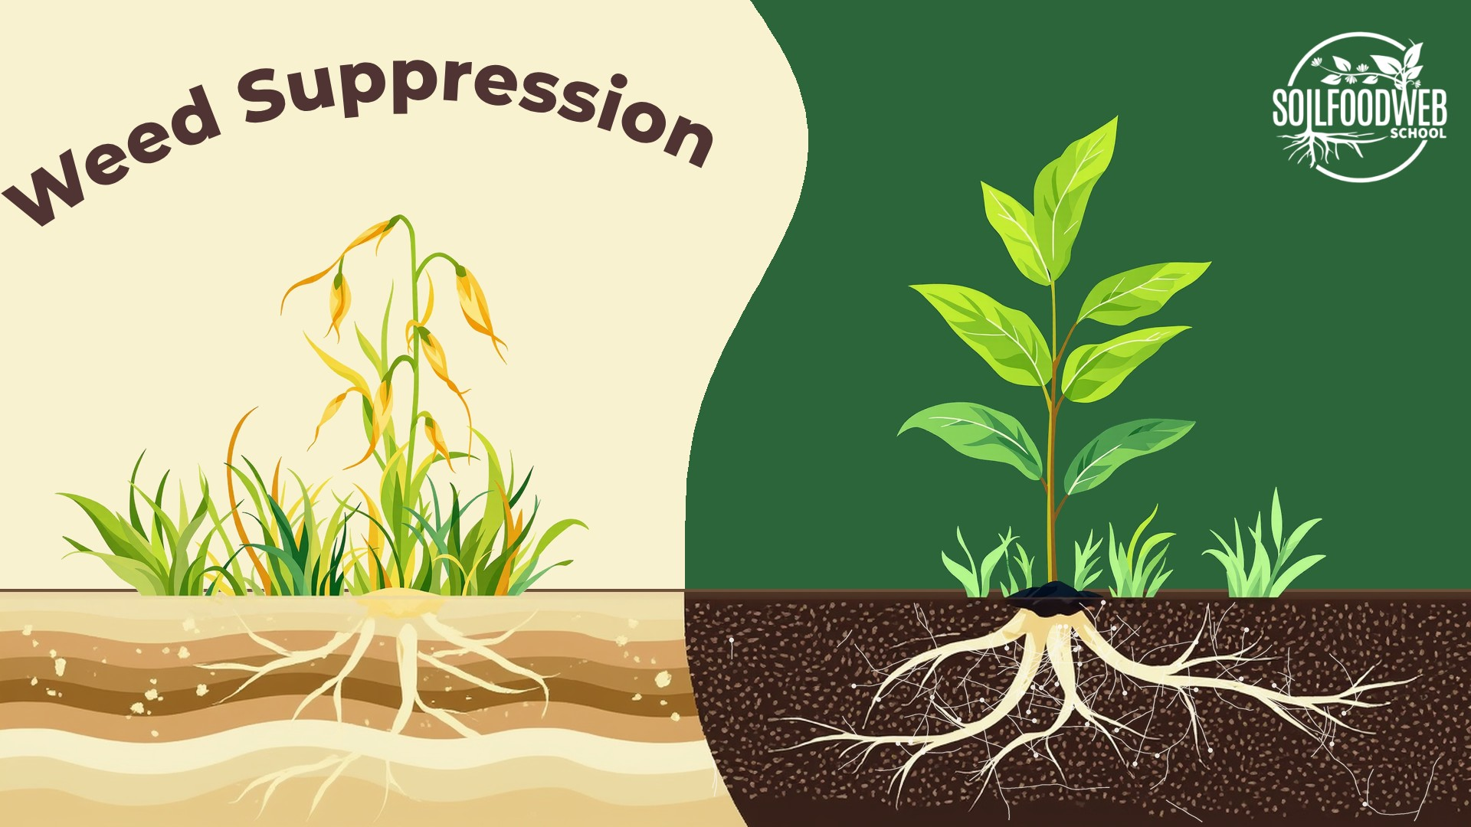
Notes:
Video 4: Weed Suppression
Weed Suppression: flow layout option 3

Slide 43
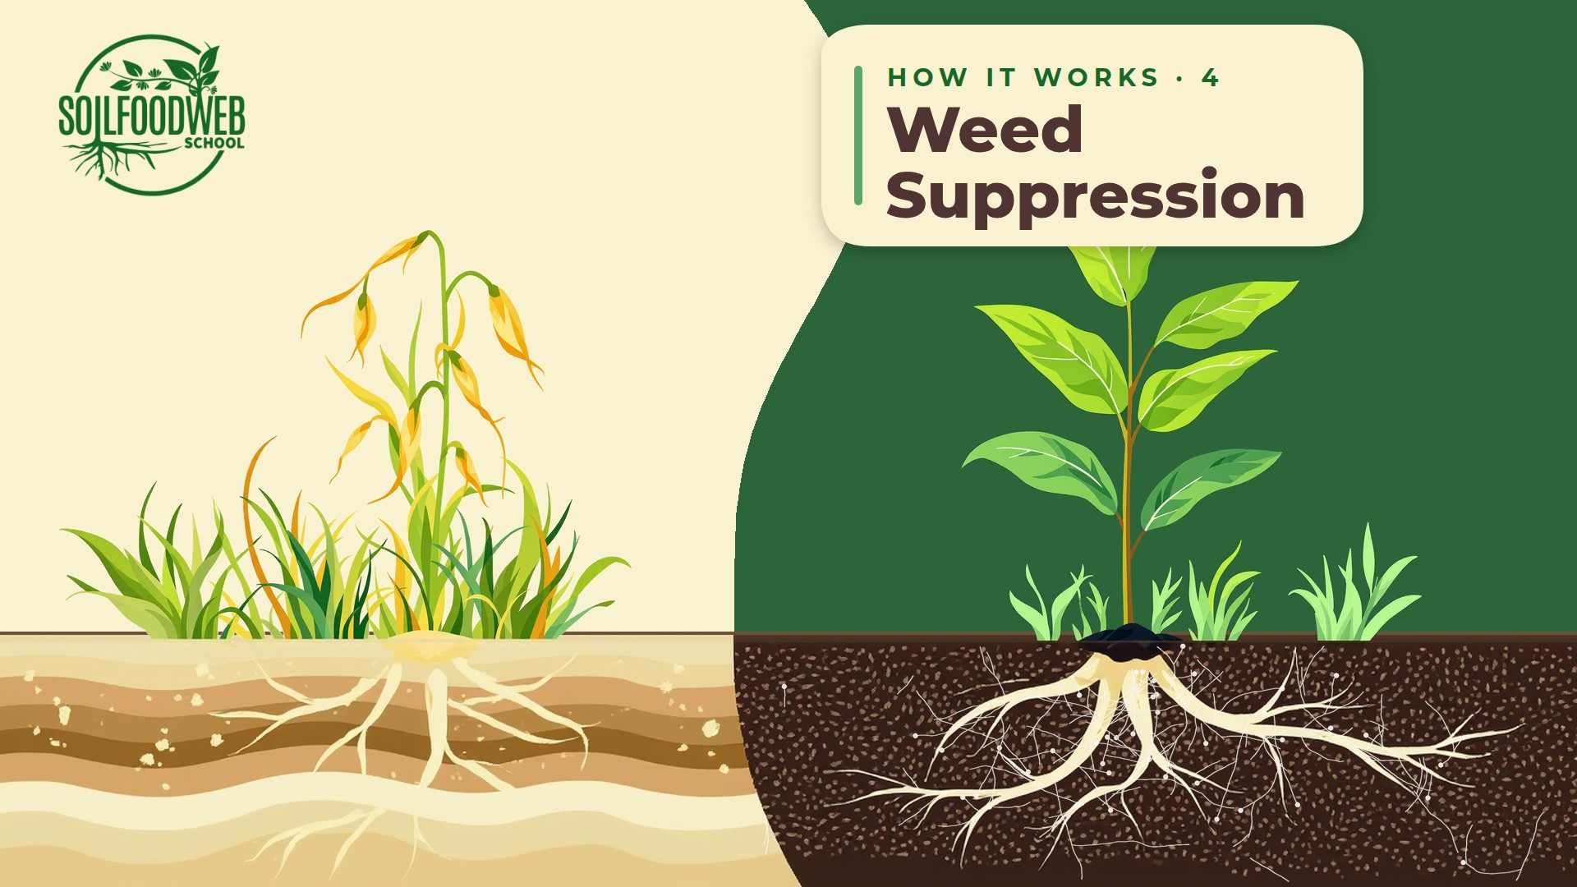
Notes:
Video 4: Weed Suppression
Weed Suppression: flow layout option 4

Slide 44
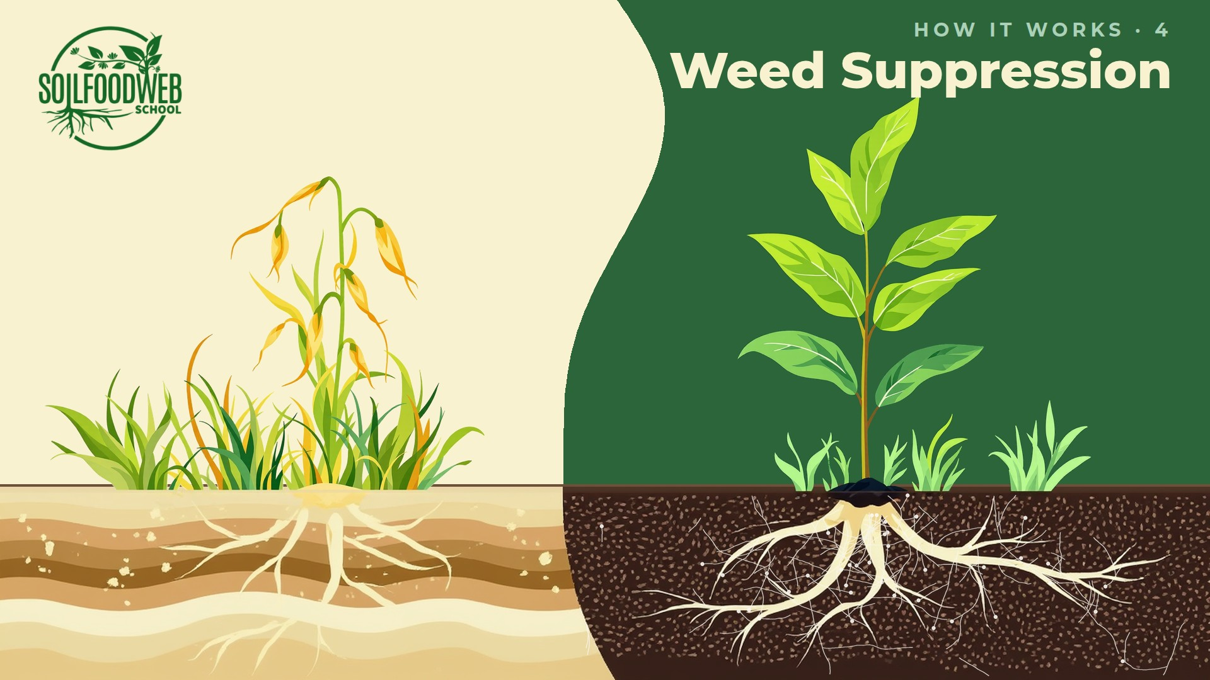
Notes:
Video 4: Weed Suppression
Weed Suppression: flow layout option 5

Slide 45
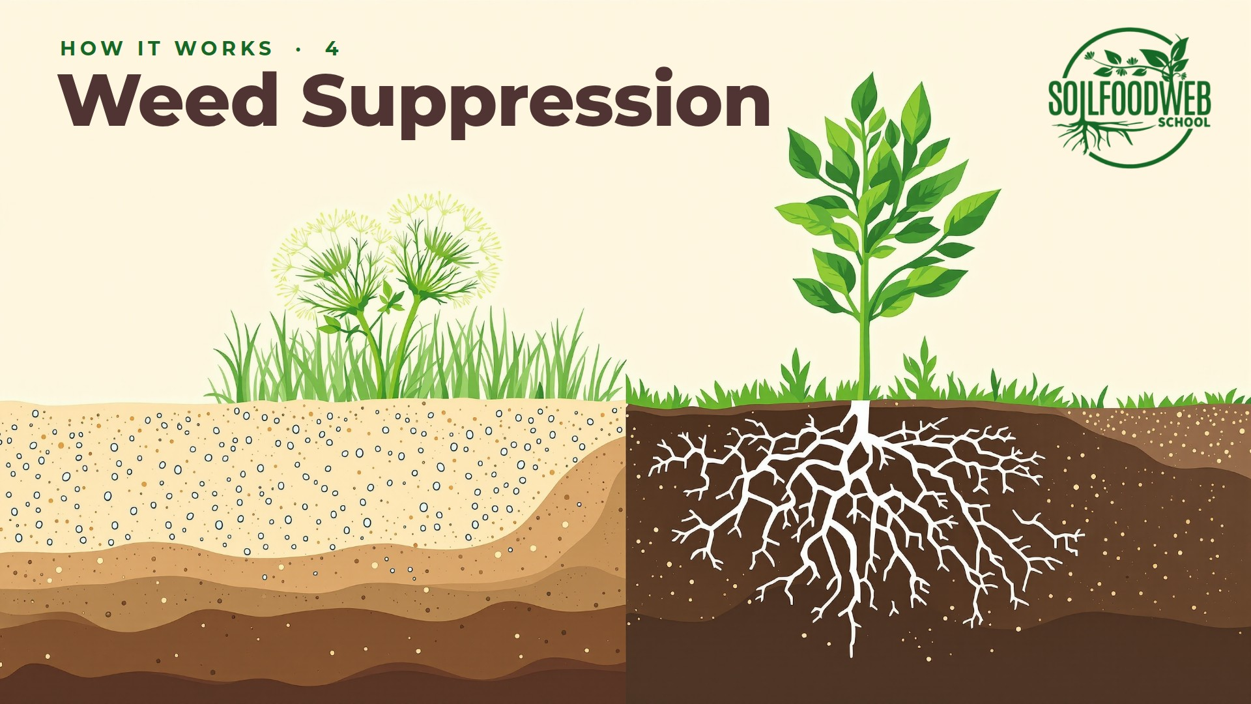
Notes:
Video 4: Weed Suppression
Weed Suppression: freestyle design 1

Slide 46

Notes:
Video 4: Weed Suppression
Weed Suppression: freestyle design 2

Slide 47
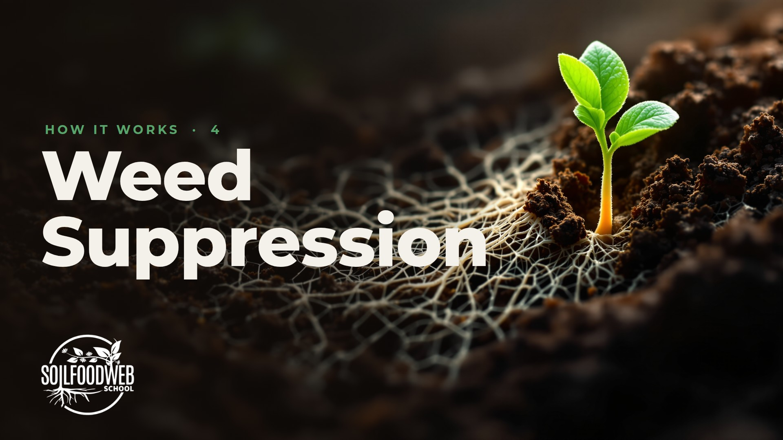
Notes:
Video 4: Weed Suppression
Weed Suppression: freestyle design 3

Slide 48
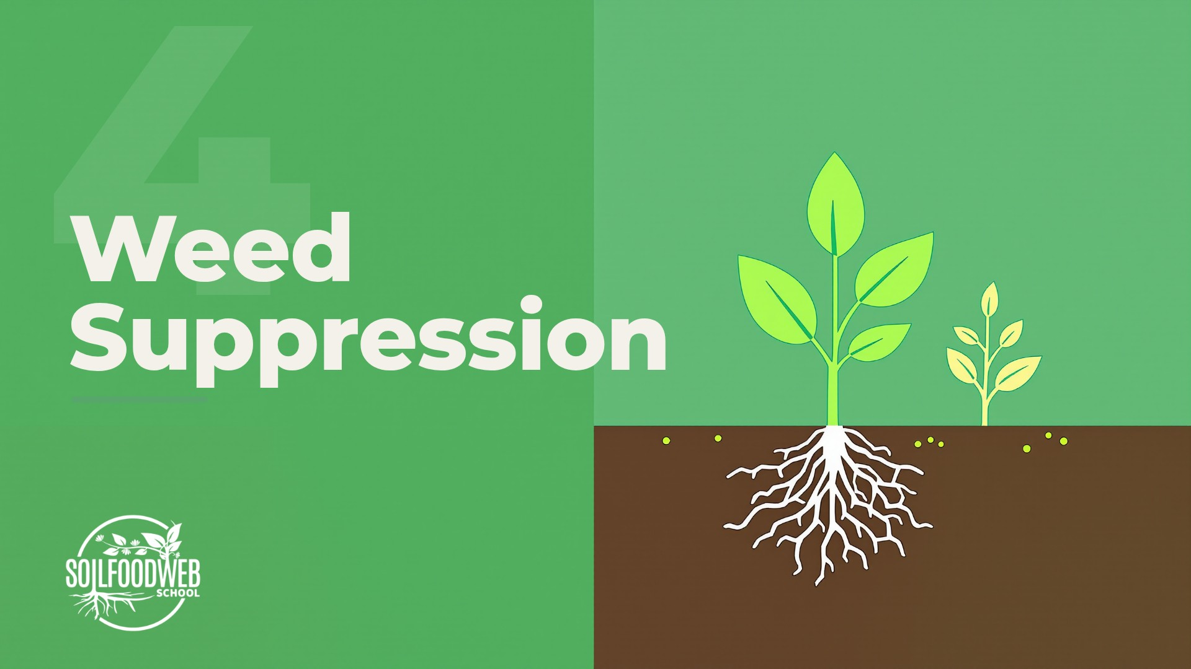
Notes:
Video 4: Weed Suppression
Weed Suppression: freestyle design 4

Slide 49

Notes:
Video 4: Weed Suppression
Weed Suppression: freestyle design 5

Slide 50
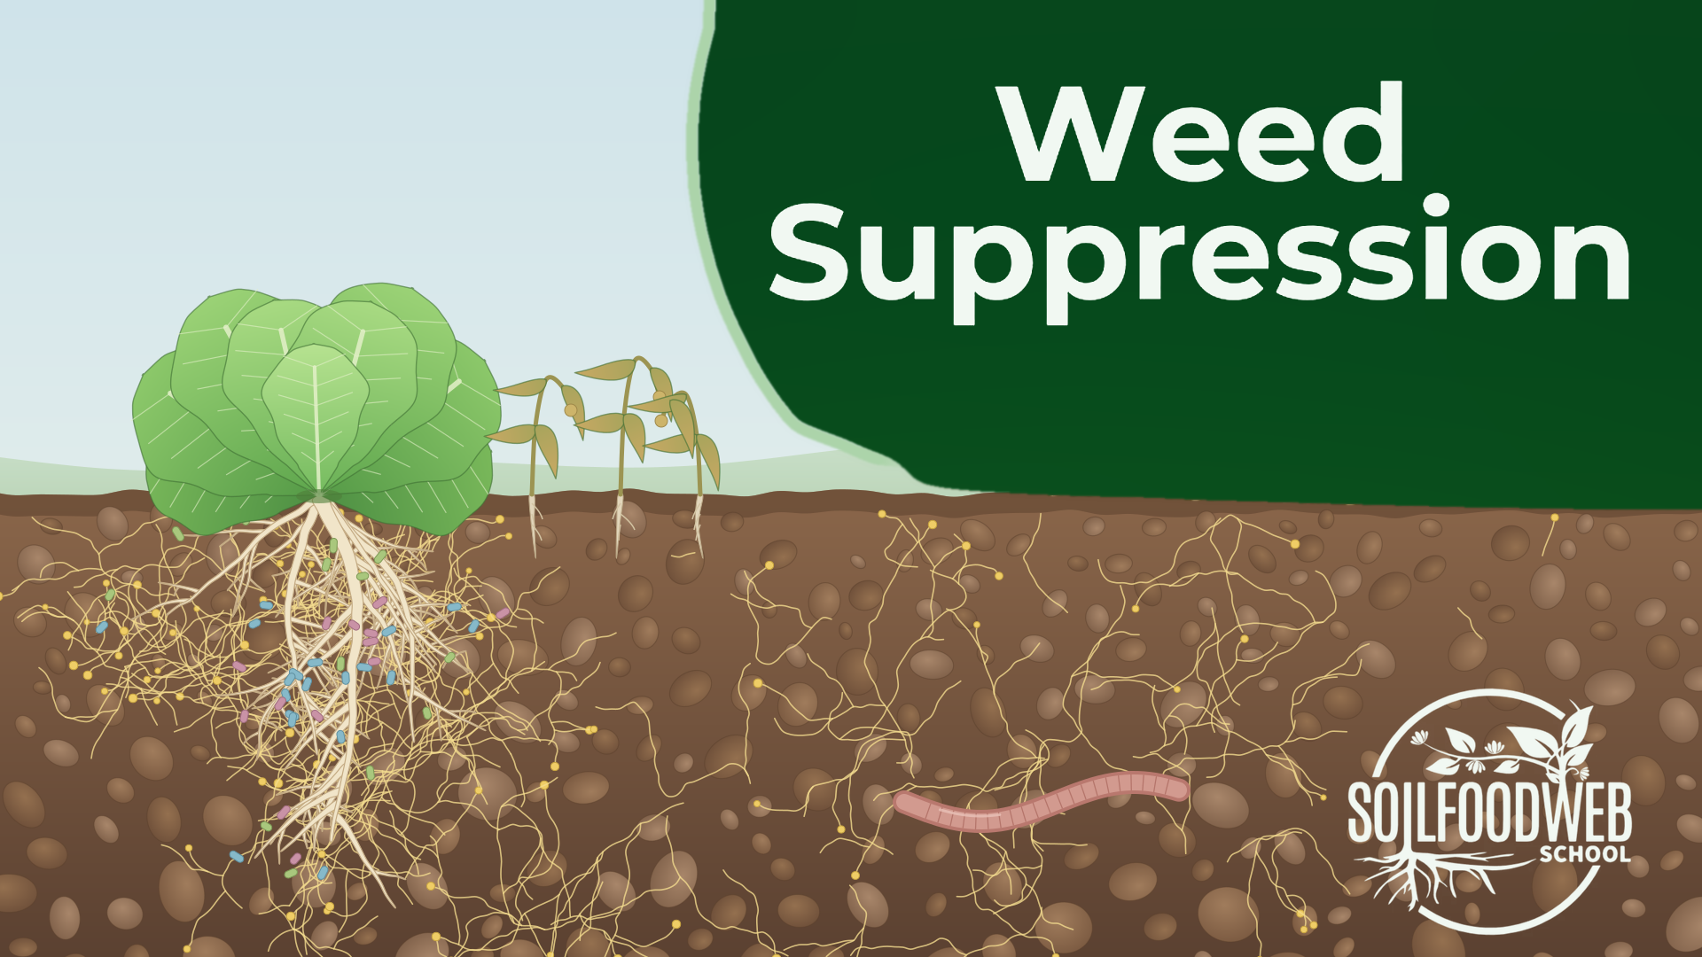
Notes:
Video 4: Weed Suppression
Weed Suppression: vector trial

Slide 51
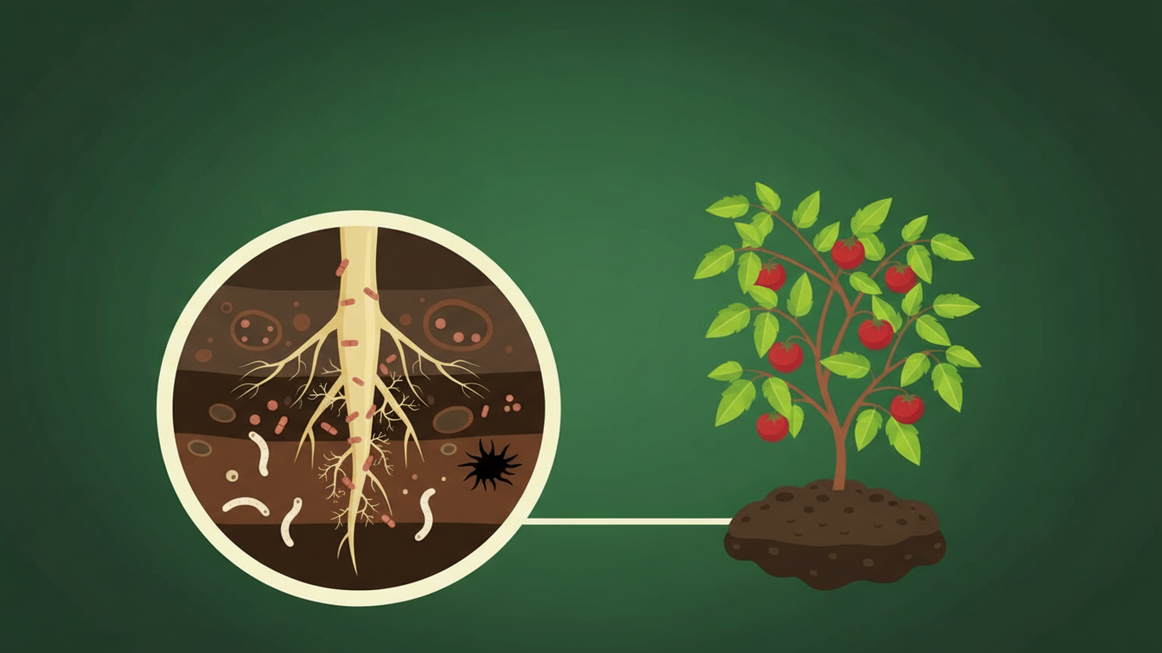
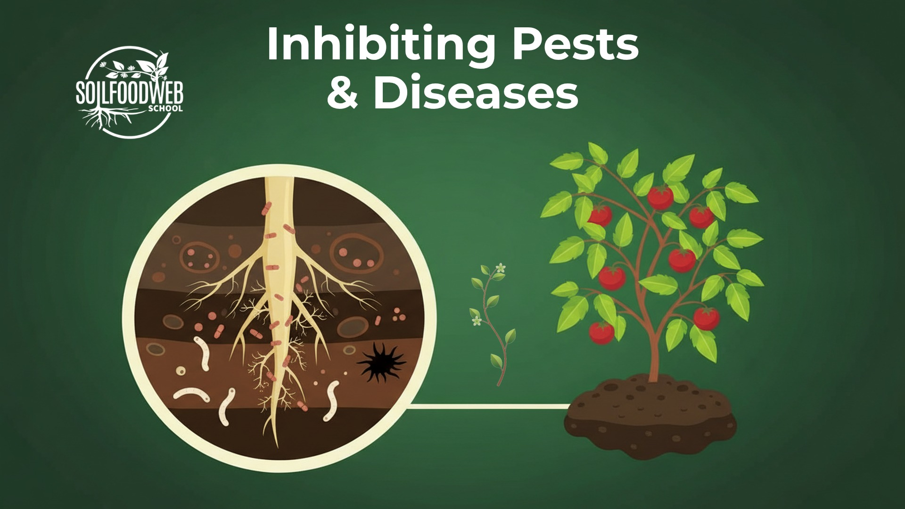
Inhibiting Pests
& Diseases
Notes:
Video 5: Inhibiting Pests & Diseases
Version 6 (latest): SFW green palette

Slide 52

Notes:
Video 5: Inhibiting Pests & Diseases
Version 5: six compositions, cream

Slide 53

Notes:
Video 5: Inhibiting Pests & Diseases
Version 4: nano-banana, shared template

Slide 54

Notes:
Video 5: Inhibiting Pests & Diseases
Version 3: Kontext plants, shared template

Slide 55

Notes:
Video 5: Inhibiting Pests & Diseases
Version 2: hero plants, shared template

Slide 56

Notes:
Video 5: Inhibiting Pests & Diseases
Version 1: shared template

Slide 57

Notes:
Video 5: Inhibiting Pests & Diseases
Early gouache version A (original site panel)

Slide 58

Notes:
Video 5: Inhibiting Pests & Diseases
Early gouache version B (original site panel)

Slide 59

Notes:
Video 5: Inhibiting Pests & Diseases
Early gouache version C (original site panel)

Slide 60



Sequestering
Carbon
Notes:
Video 6: Sequestering Carbon
Version 6 (latest): SFW green palette

Slide 61

Notes:
Video 6: Sequestering Carbon
Version 5: six compositions, cream

Slide 62

Notes:
Video 6: Sequestering Carbon
Version 4: nano-banana, shared template

Slide 63

Notes:
Video 6: Sequestering Carbon
Version 3: Kontext plants, shared template

Slide 64

Notes:
Video 6: Sequestering Carbon
Version 2: hero plants, shared template

Slide 65

Notes:
Video 6: Sequestering Carbon
Version 1: shared template

Slide 66

Notes:
Video 6: Sequestering Carbon
Early gouache version A (original site panel)

Slide 67

Notes:
Video 6: Sequestering Carbon
Early gouache version B (original site panel)

Slide 68

Notes:
Video 6: Sequestering Carbon
Early gouache version C (original site panel)

