Slide 1


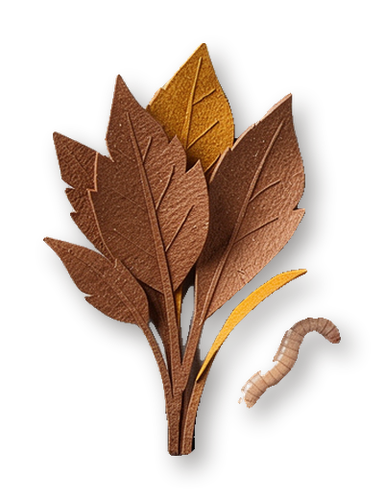
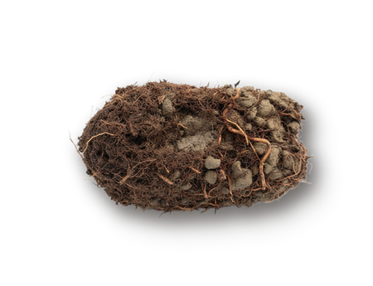
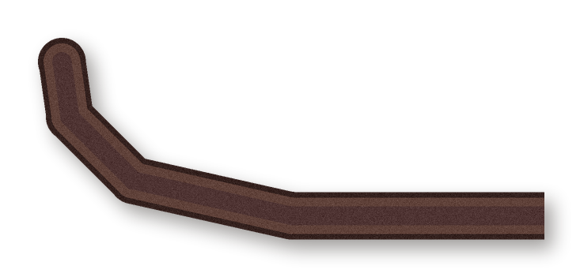
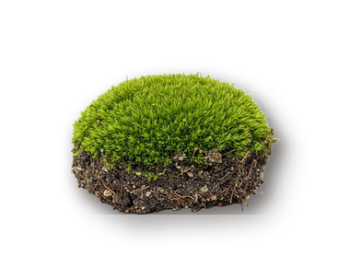
Worm holes are real.
They're in your
garden.
Look for leaves standing up in the lawn. That's a
worm's front door.
Notes:
Source: Charles Darwin, The Formation of Vegetable Mould through the Action of Worms, 1881. Darwin Online: http://darwin-online.org.uk/

Slide 2
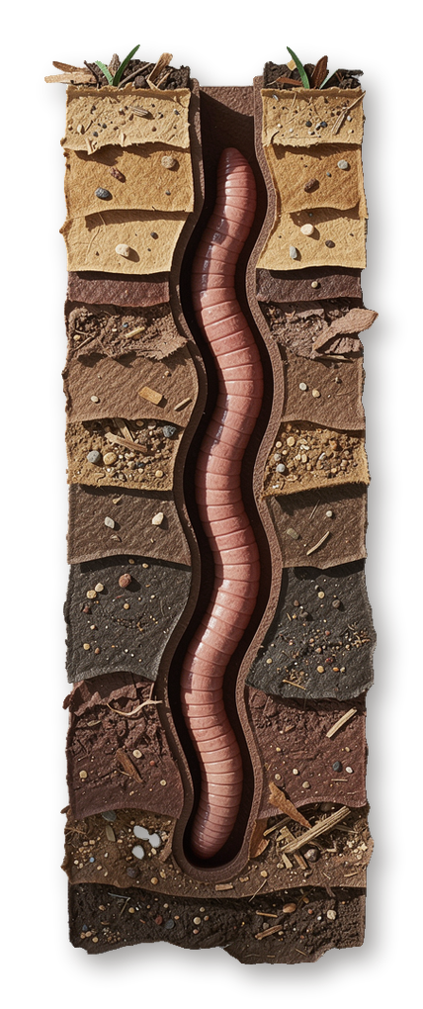
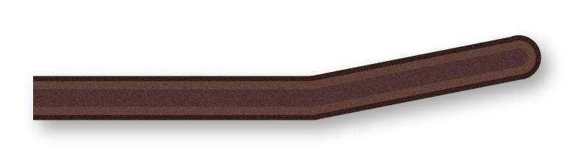
Nightcrawlers
dig straight
down, up to
2 meters.
2 m

Slide 3
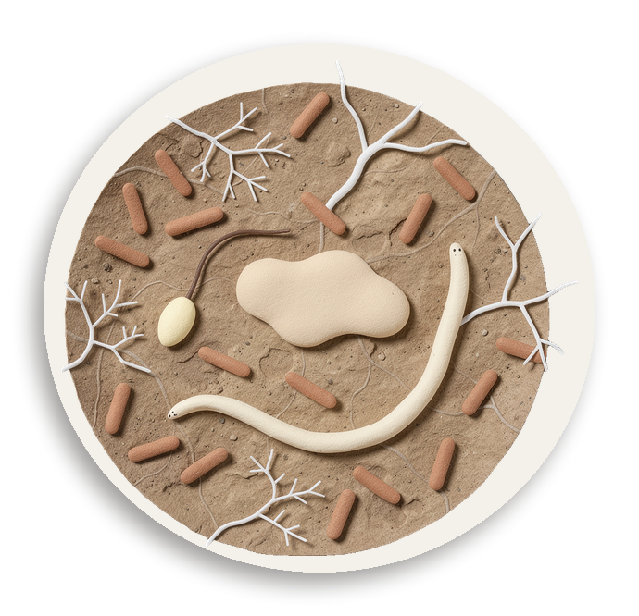

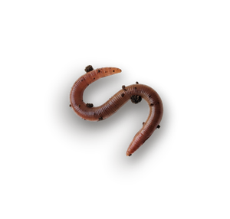
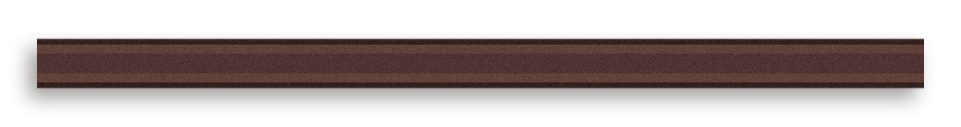
The burrow wall is a
microbe city.
Up to 9 times more microbial activity than the
soil around it.
Notes:
Source: Tiunov and Scheu 1999, burrow walls of Lumbricus terrestris: https://www.nies.go.jp/chiiki1/protoz/refere/id6999/6910.htm

Slide 4

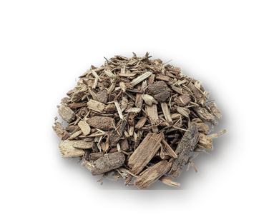
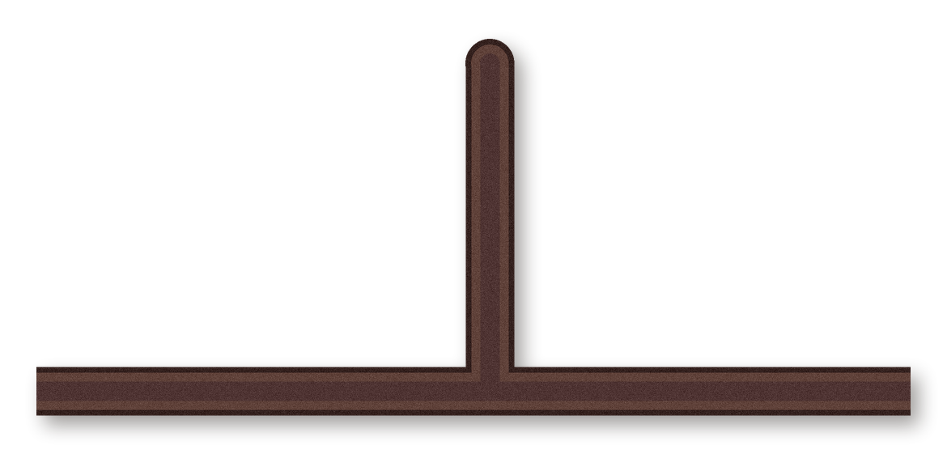
The burrows are
plumbing.
Rain runs straight down the tunnels, deep into
the soil.
Notes:
Source: Capowiez et al. 2015, Biology and Fertility of Soils: https://doi.org/10.1007/s00374-015-1036-x

Slide 5
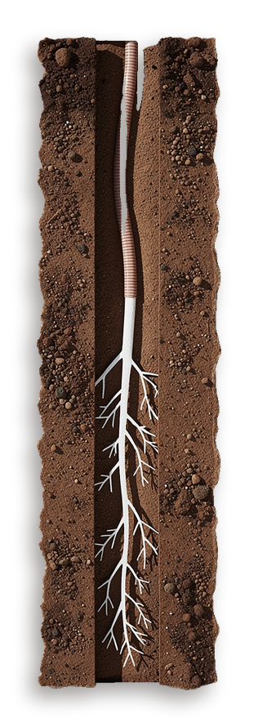
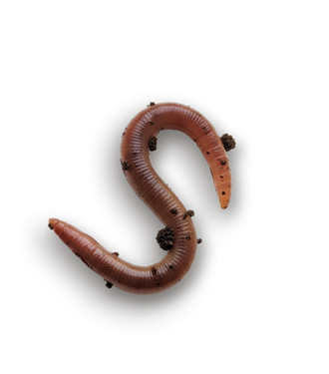
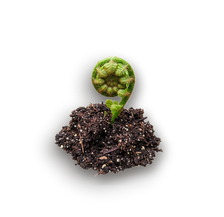
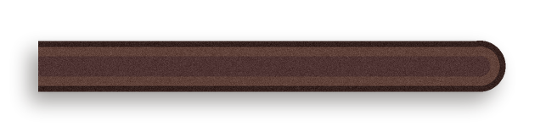
Roots follow the
worms down.
They grow along the nitrogen-rich burrow walls
into the subsoil.
Notes:
Source: Kautz, Athmann and Köpke 2014: https://orgprints.org/23806/

Slide 6
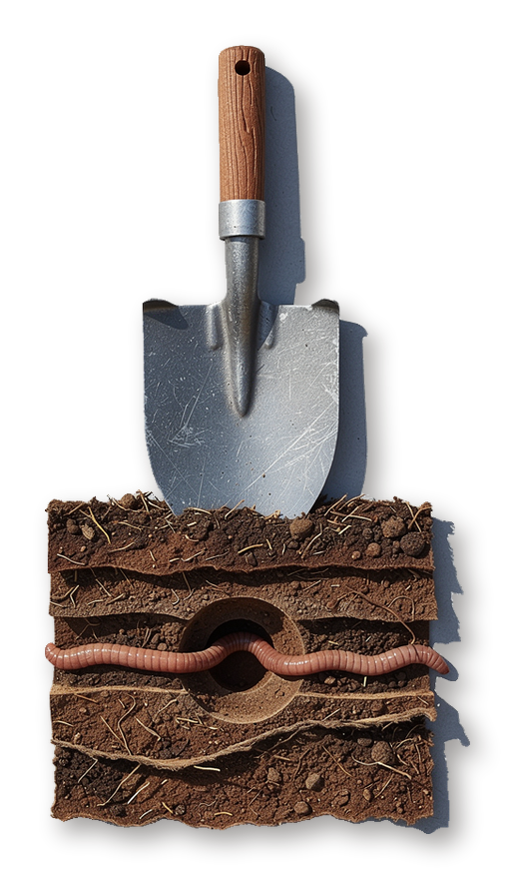
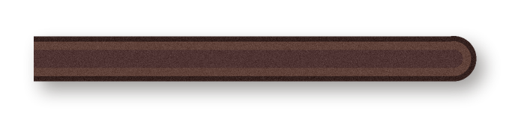
Plowing cuts the
pipes.
No-till fields have 137% more earthworms than
plowed ones.
137%
Notes:
Source: Briones and Schmidt 2017, Global Change Biology: https://doi.org/10.1111/gcb.13744

