Slide 1



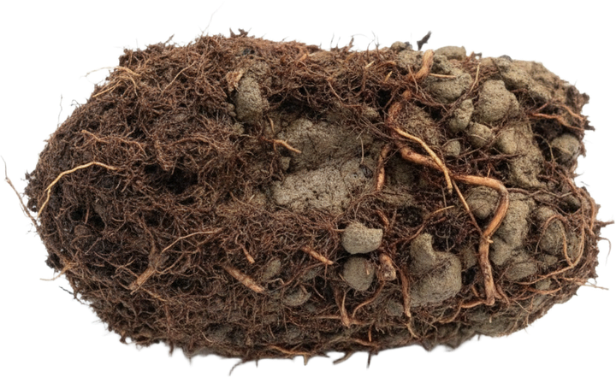

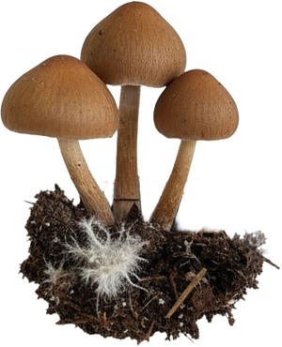
What does Regenerative actually mean?
And who gets to decide?

Slide 2

A destination
or a direction?

Slide 3
A certified status
or a way of thinking?

Slide 4
A premium product,
or a standard everyone who works the land can reach?

Slide 5

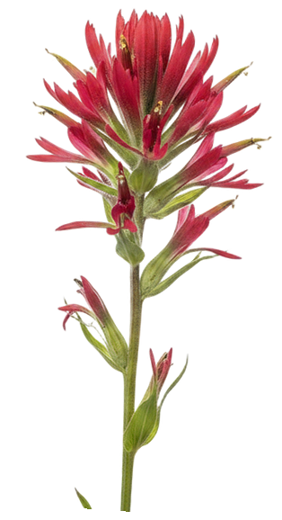



Living soil in the hands of every person who works the land.
What does regenerative mean to you? Tell us in the comments.

