Slide 1




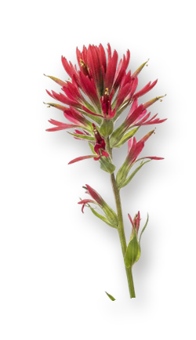
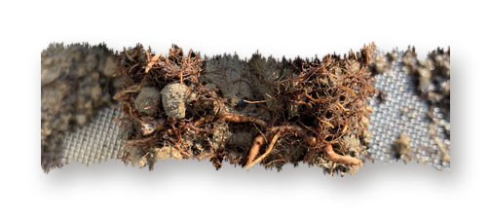



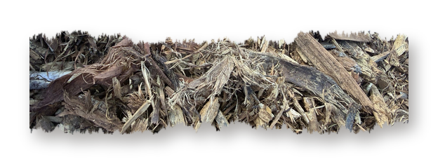
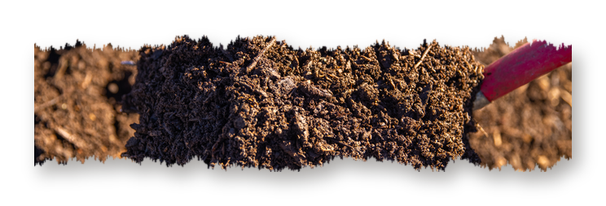


Today we turn 1 🎂
One year as a 501(c)(3) nonprofit.

Slide 2





A year ago, we became a nonprofit foundation to carry Dr. Elaine Ingham's work to everyone who wants to learn it.

Slide 3


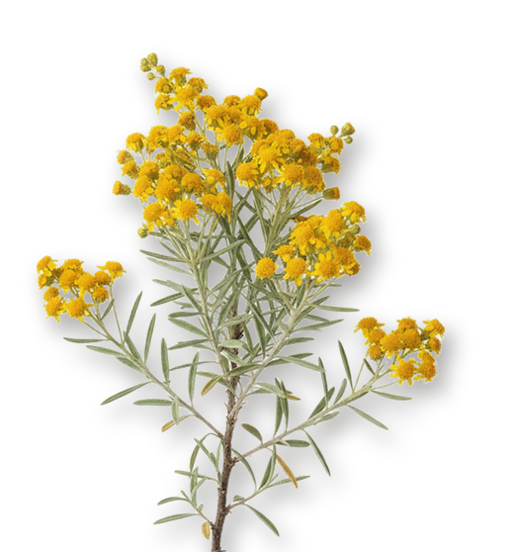


More than $72,000
in full scholarships in June alone, plus around $250,000 in partial scholarships.

Slide 4


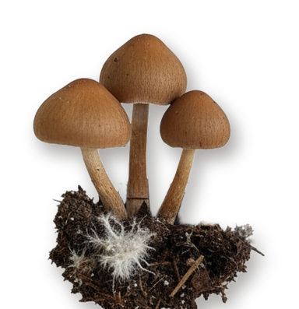
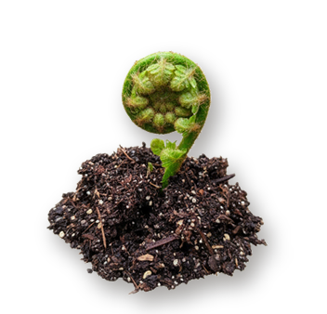

35
live events, with guests like Vandana Shiva, David Holmgren and Mary Cole.

Slide 5





Our first course in Spanish.

Slide 6





Our first workshop in Asia!
Hosted at the Save Soil Farm in Coimbatore India.

Slide 7




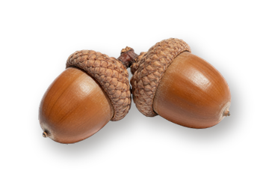
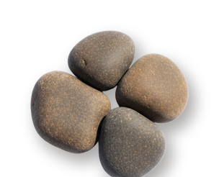
Foundation courses that no longer expire, weekly office hours, and every support message answered within 48 hours.

Slide 8

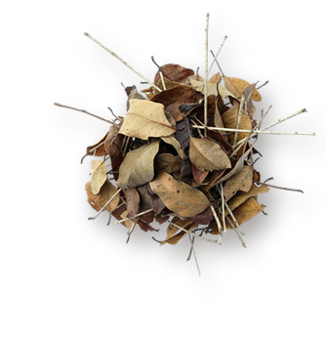
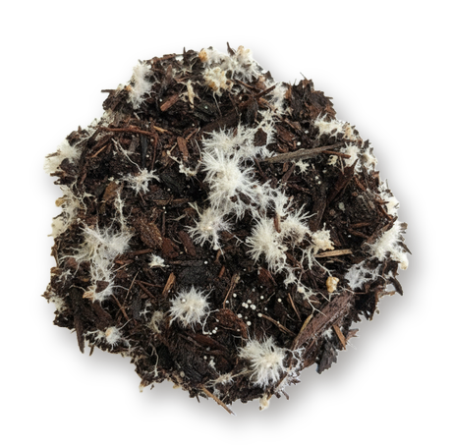

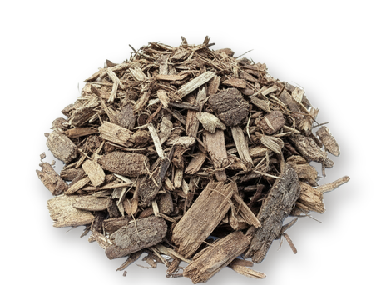
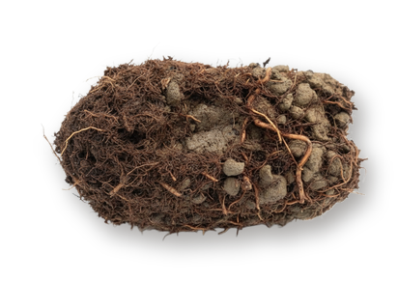
Launched our Compost Intensive Course, the first in a series of online group programs.

Slide 9







Thank you for growing with us. Here's to year two. 💚

