Slide 1

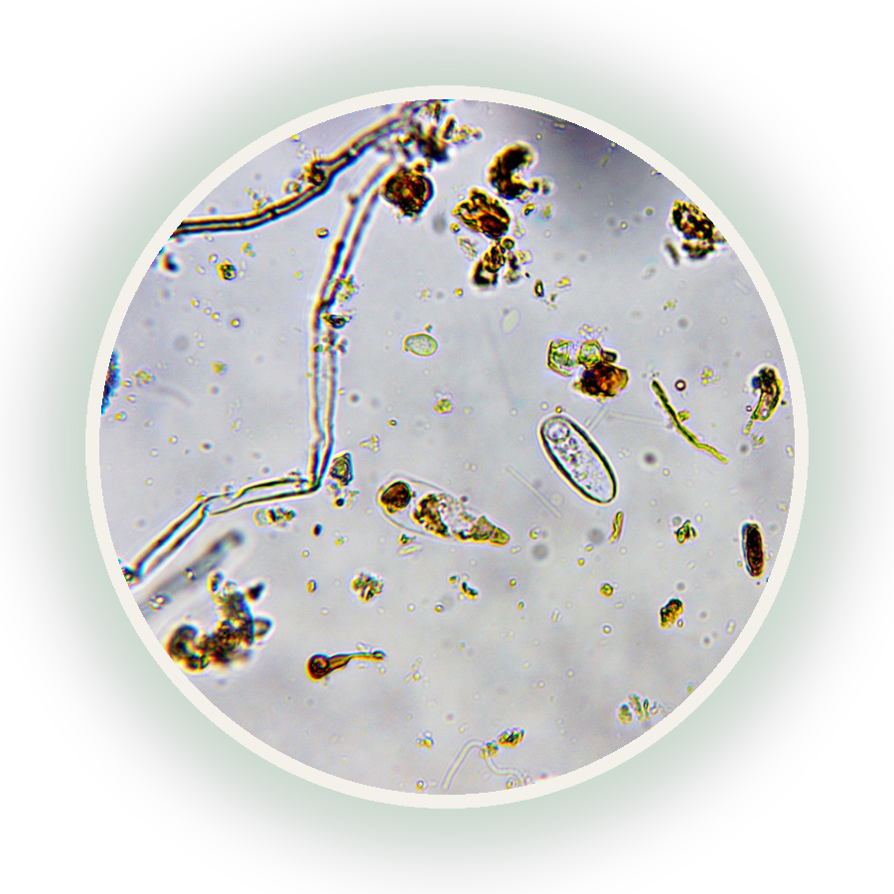

What does Regenerative actually mean?
And who gets to decide?
Photo: Luke Hardy, 40x

