Slide 1
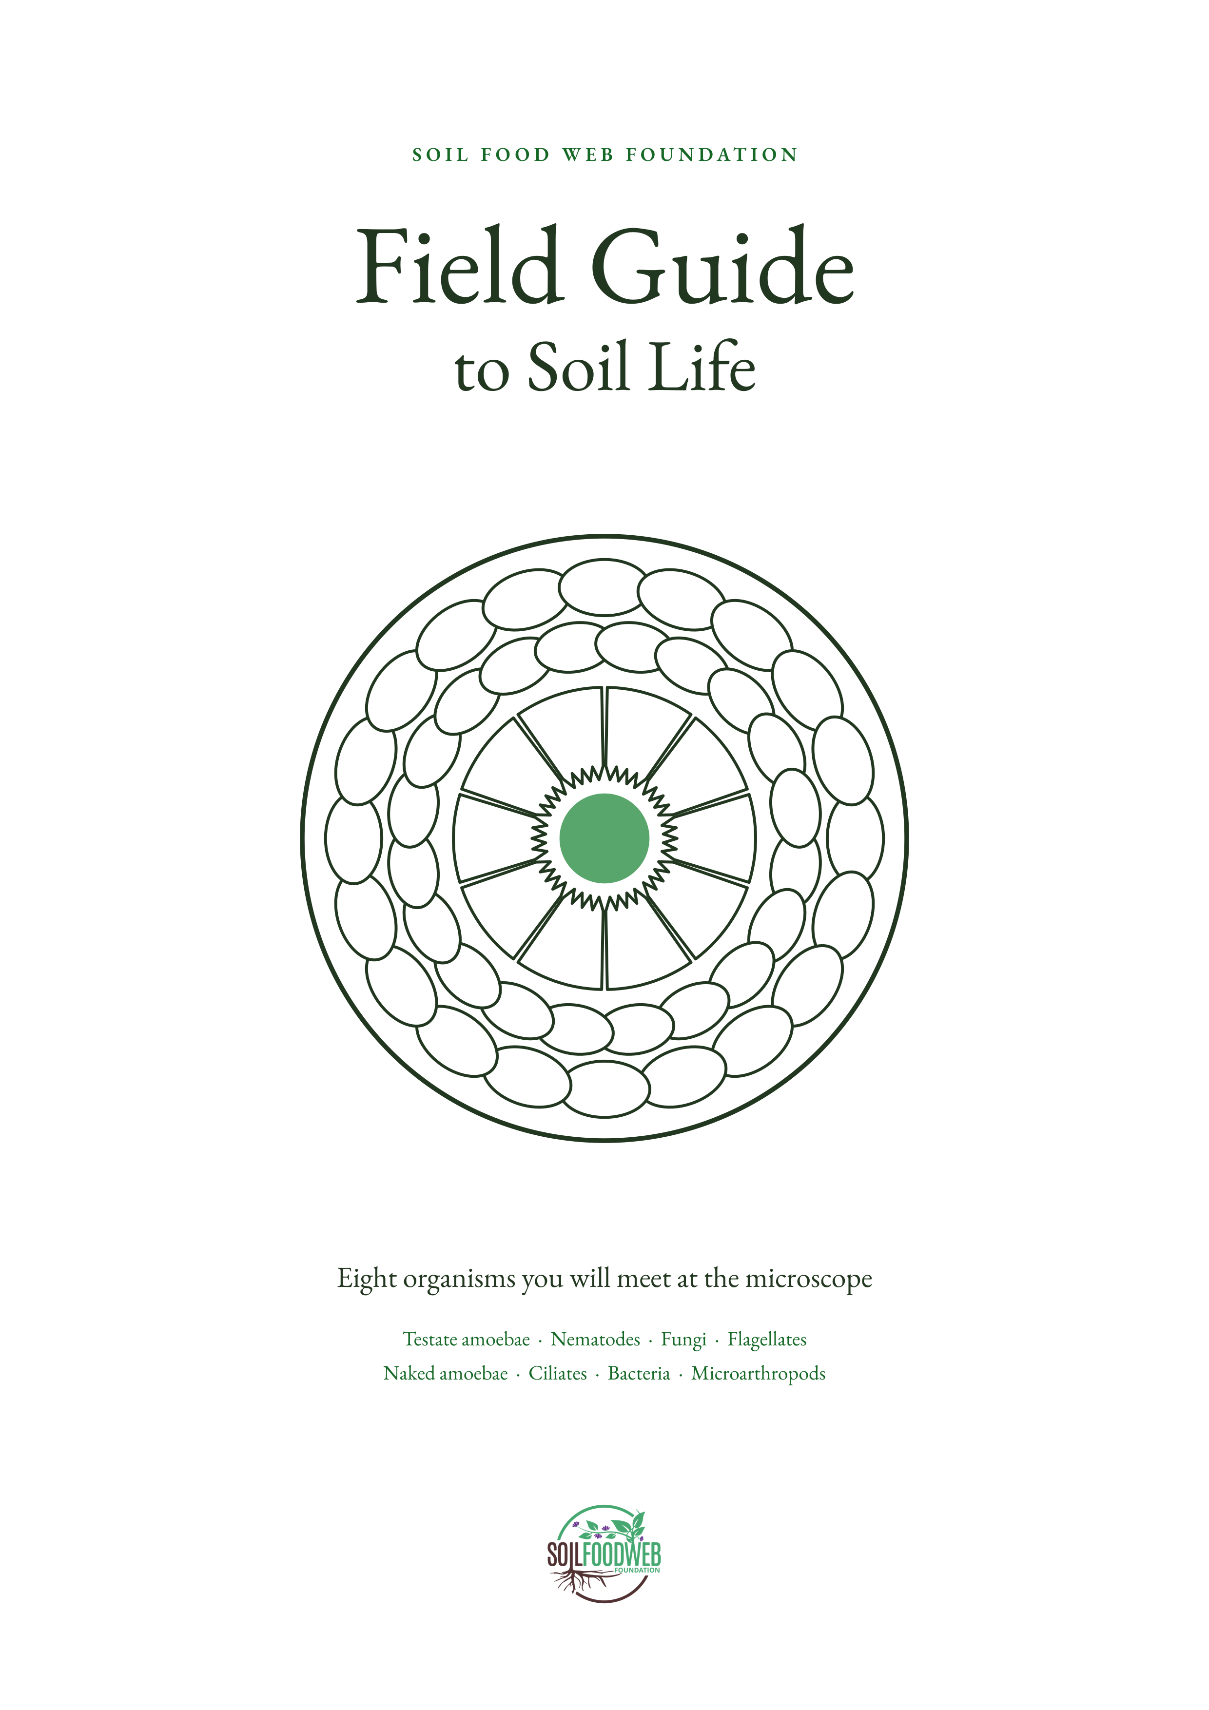
Notes:
Front cover. Soil Food Web Foundation, Field Guide to Soil Life.

Slide 2
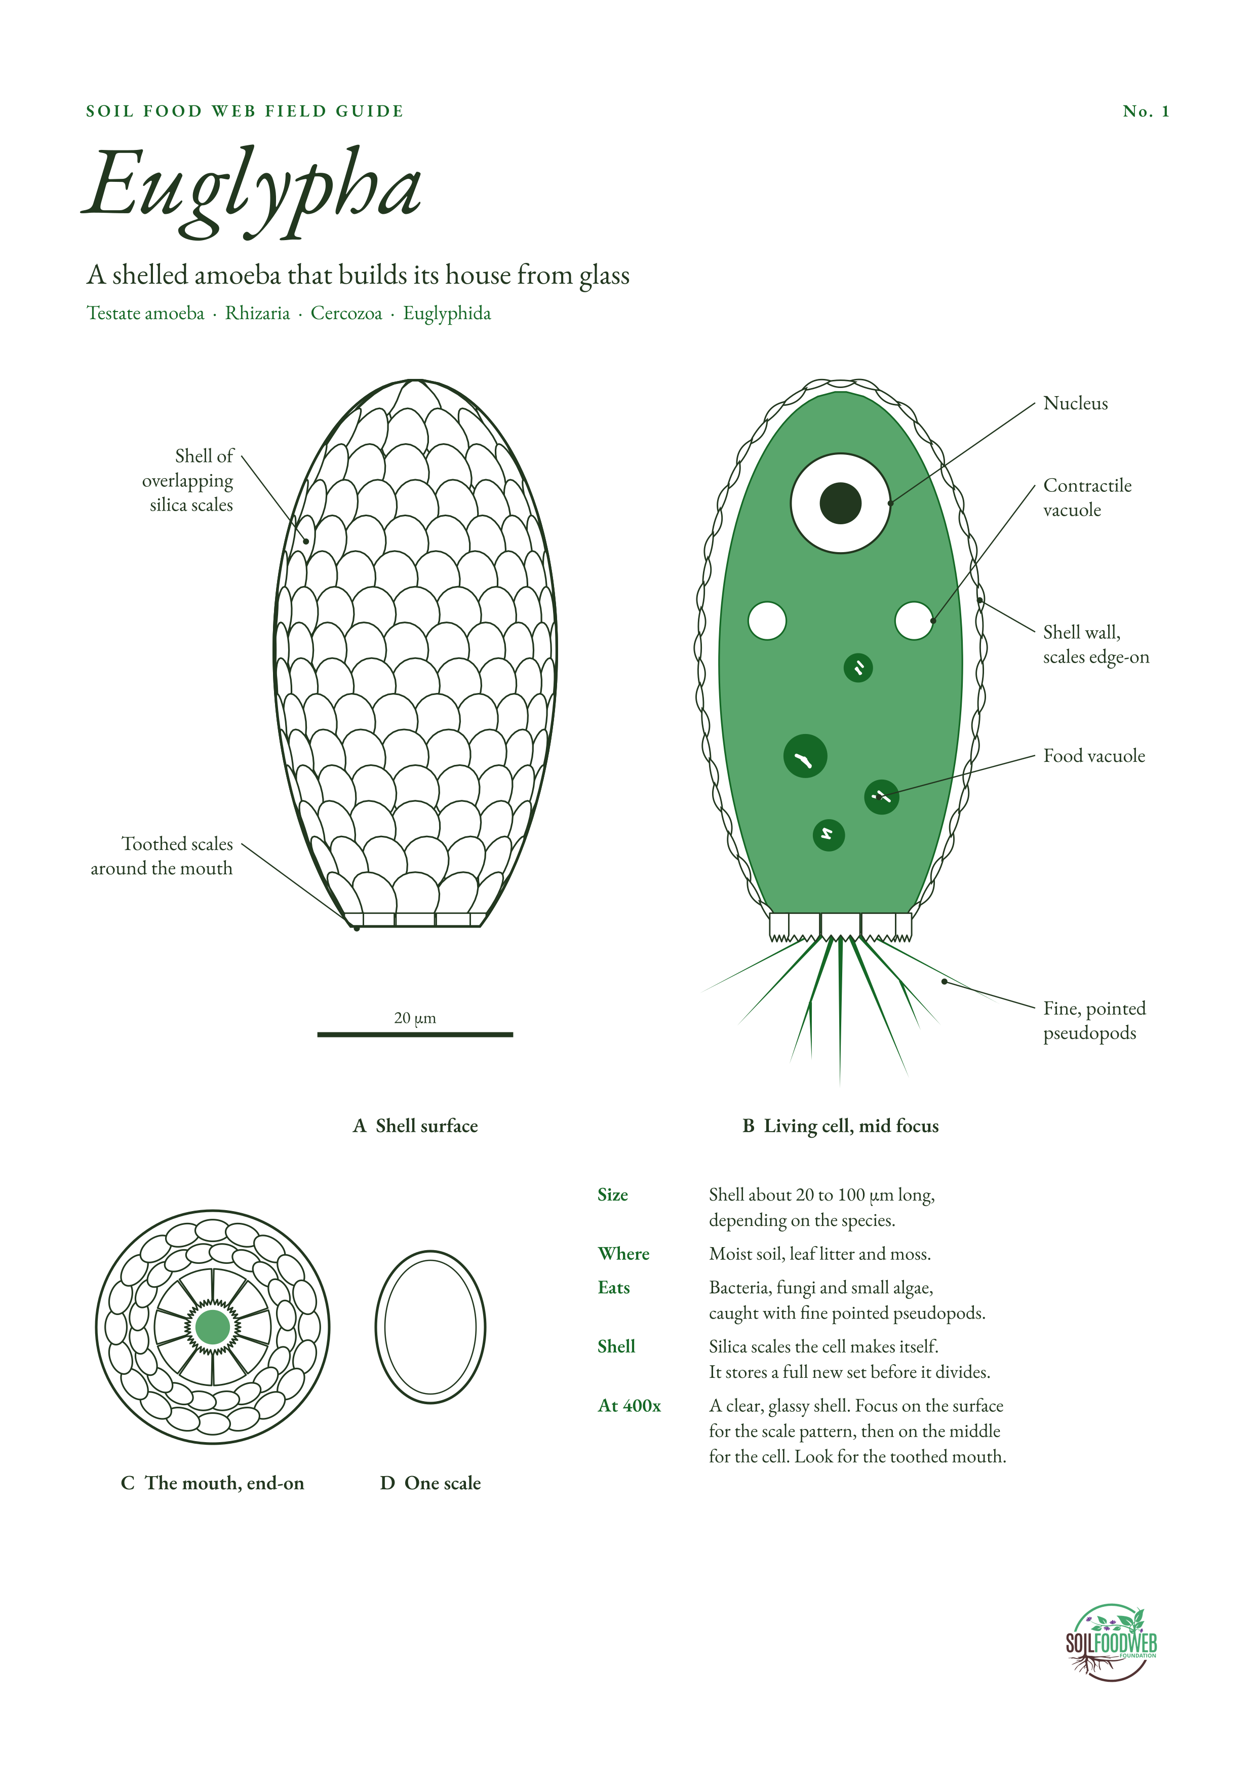
Notes:
No. 1 Euglypha (testate amoeba). Sources:
1. Shell of silica scales made by the cell; toothed scales at the mouth; species sizes: https://arcella.nl/euglypha/
2. Euglypha rotunda: 8 to 14 apertural plates, shell 22 to 60 µm: https://arcella.nl/euglypha-rotunda
3. Euglypha strigosa: 10 to 13 apertural plates, shell 45 to 100 µm: https://arcella.nl/?p=3010
4. Leidy (1879), Fresh-water Rhizopods of North America, plate XXXV, Euglypha alveolata: https://archive.org/details/freshwaterrhizop00leid
5. Modern light-microscope photos, Euglypha tuberculata: https://www.protisten.de/home-new/testatamoeboids-infra/cercozoa-testate2/imbricatea2/euglyphida2/euglypha-tuberculata
6. Modern light-microscope photos, Euglypha filifera: https://www.protisten.de/home-new/testatamoeboids-infra/cercozoa-testate2/imbricatea2/euglyphida2/euglypha-filifera/

Slide 3
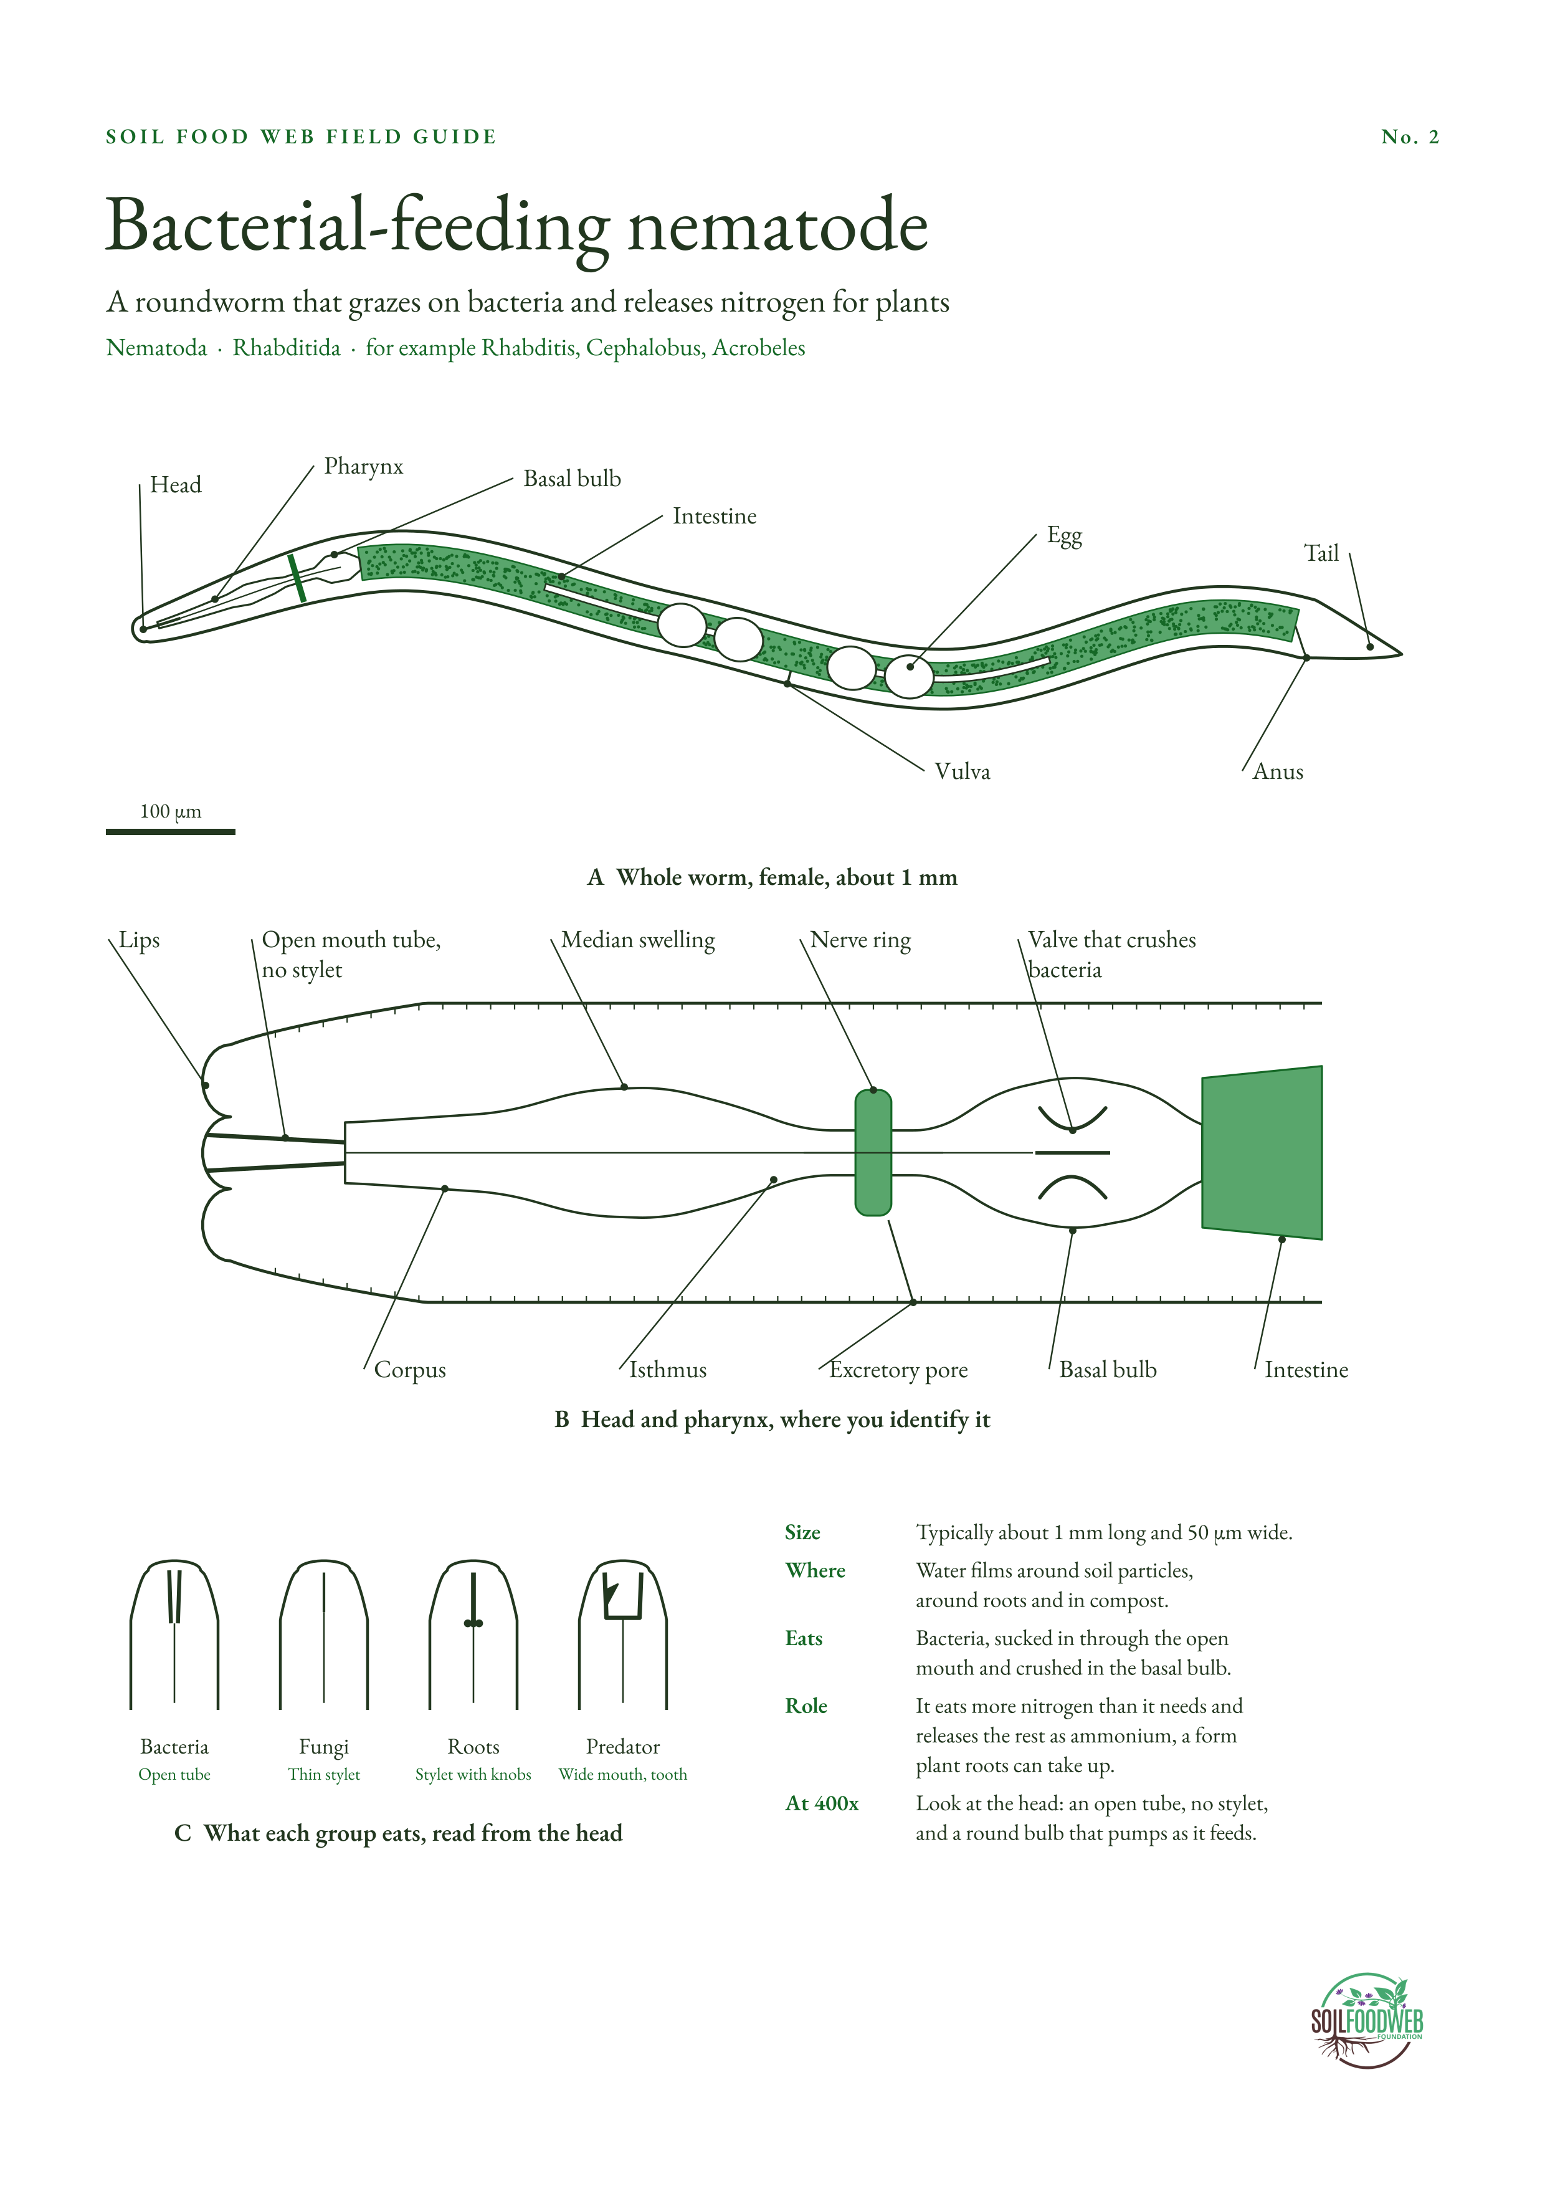
Notes:
No. 2 Bacterial-feeding nematode. Sources:
1. Size about 1 mm long and 50 µm wide; release of ammonium (USDA Soil Biology Primer, Nematodes): https://webarchive.library.unt.edu/eot2008/20090305025704/http:/soils.usda.gov/sqi/concepts/soil_biology/nematodes.html
2. Bacterial feeders excrete excess nitrogen as ammonia (UC Davis Nemaplex, The Role of Nematodes in Soil Fertility): https://nemaplex.ucdavis.edu/Ecology/fertil.htm
3. Bacterial feeders release more inorganic N than fungal feeders (eOrganic): https://eorganic.org/node/4495
4. Plant-parasitic nematodes, stylet and size (APS Introduction to Nematodes): https://apsnet.org/edcenter/Pages/IntroNematodes.aspx

Slide 4
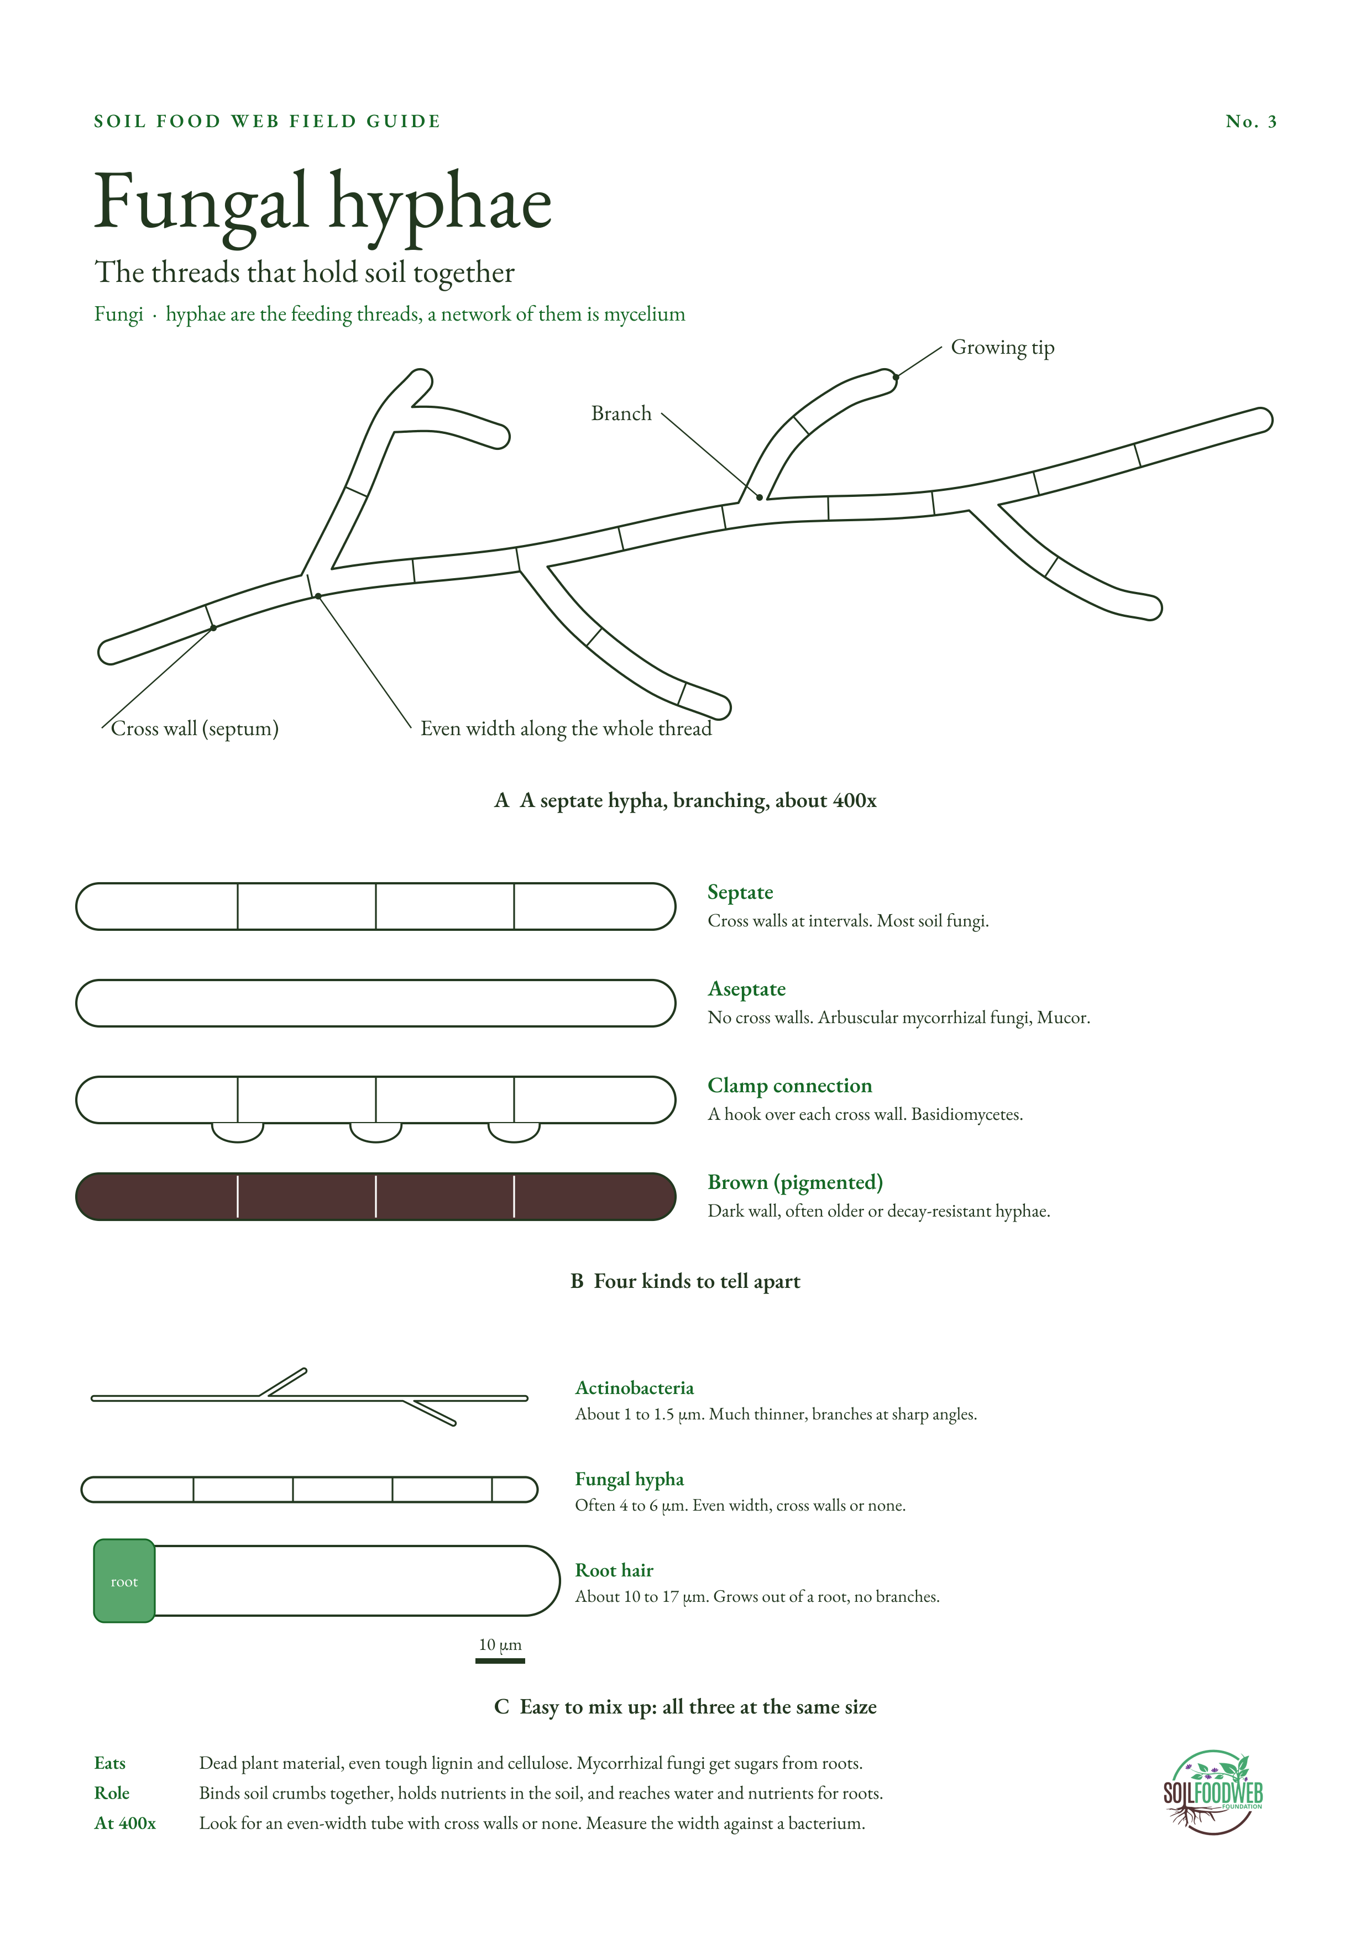
Notes:
No. 3 Fungal hyphae. Sources:
1. Hyphae average 4 to 6 µm wide (Hyphae overview): https://graphsearch.epfl.ch/en/concept/51480
2. Actinobacteria 1 to 1.5 µm; beneficial fungi usually wider than 2.5 µm (Soil Food Web teaching material): https://pt.soilfoodweb.com/?p=2331
3. Root hairs about 10 to 17 µm wide (Root hair): https://www.wikipedia.org/wiki/Root_hair

Slide 5
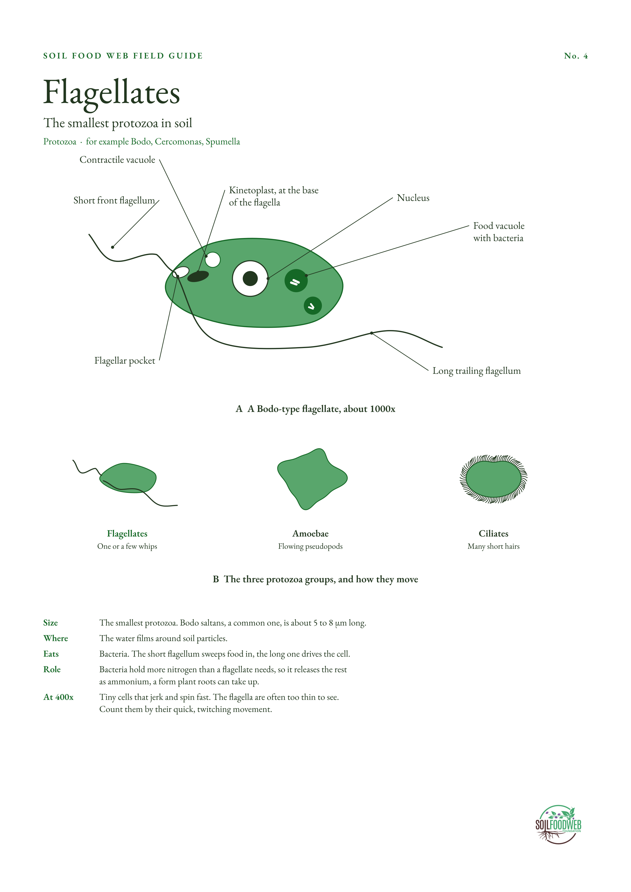
Notes:
No. 4 Flagellates. Sources:
1. Flagellates are the smallest protozoa; protozoa release ammonium (USDA Soil Biology Primer, Protozoa): https://webarchive.library.unt.edu/eot2008/20090115191603/http:/soils.usda.gov/sqi/concepts/soil_biology/protozoa.html
2. Bodo saltans: 5 to 8 µm, two unequal flagella from a flagellar pocket, kinetoplast near their base (fine-structure study): https://archive.org/download/biostor-266060/biostor-266060.pdf
3. Short flagellum sweeps food in, long flagellum moves the cell (Kinetoplastids): https://www.microscopemaster.com/kinetoplastids.html

Slide 6
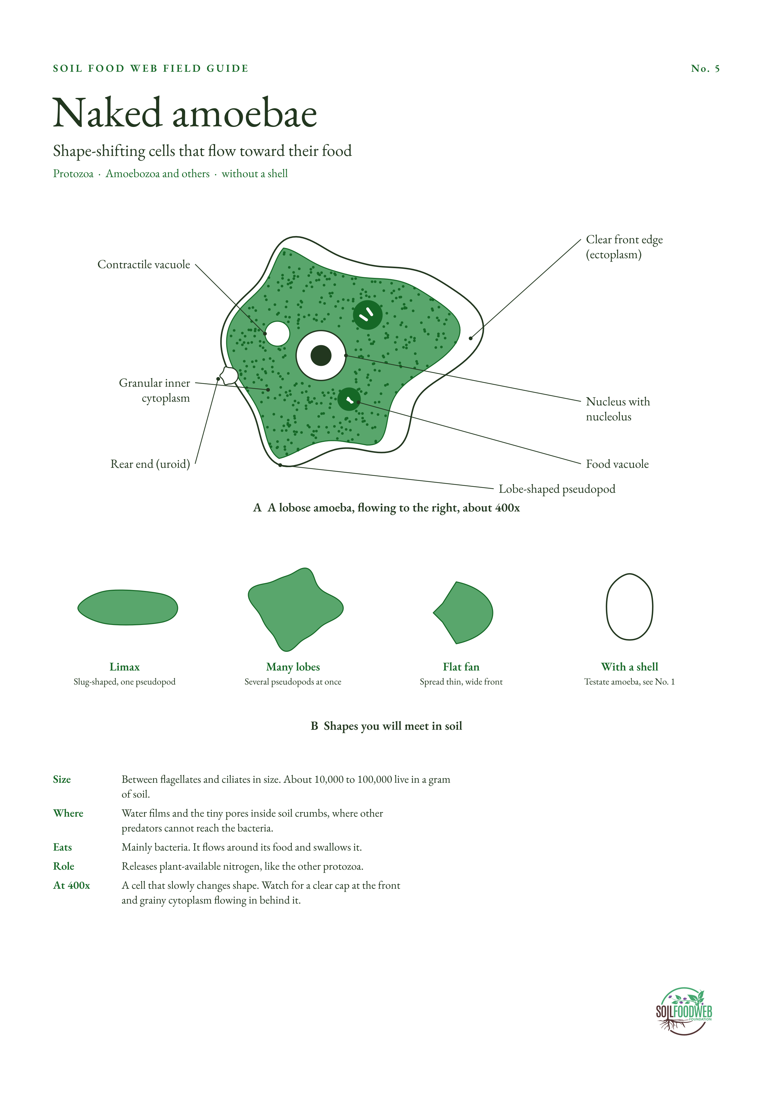
Notes:
No. 5 Naked amoebae. Sources:
1. Amoebae are between flagellates and ciliates in size (USDA Soil Biology Primer, Protozoa): https://webarchive.library.unt.edu/eot2008/20090115191603/http:/soils.usda.gov/sqi/concepts/soil_biology/protozoa.html
2. About 10,000 to 100,000 naked amoebae per gram of soil (Soil Ecology Wiki, Naked amoebae): https://soil.evs.buffalo.edu/index.php/Naked_amoebae
3. Small, flexible amoebae graze bacteria in pores others cannot reach: https://www.academia.edu/94782295

Slide 7
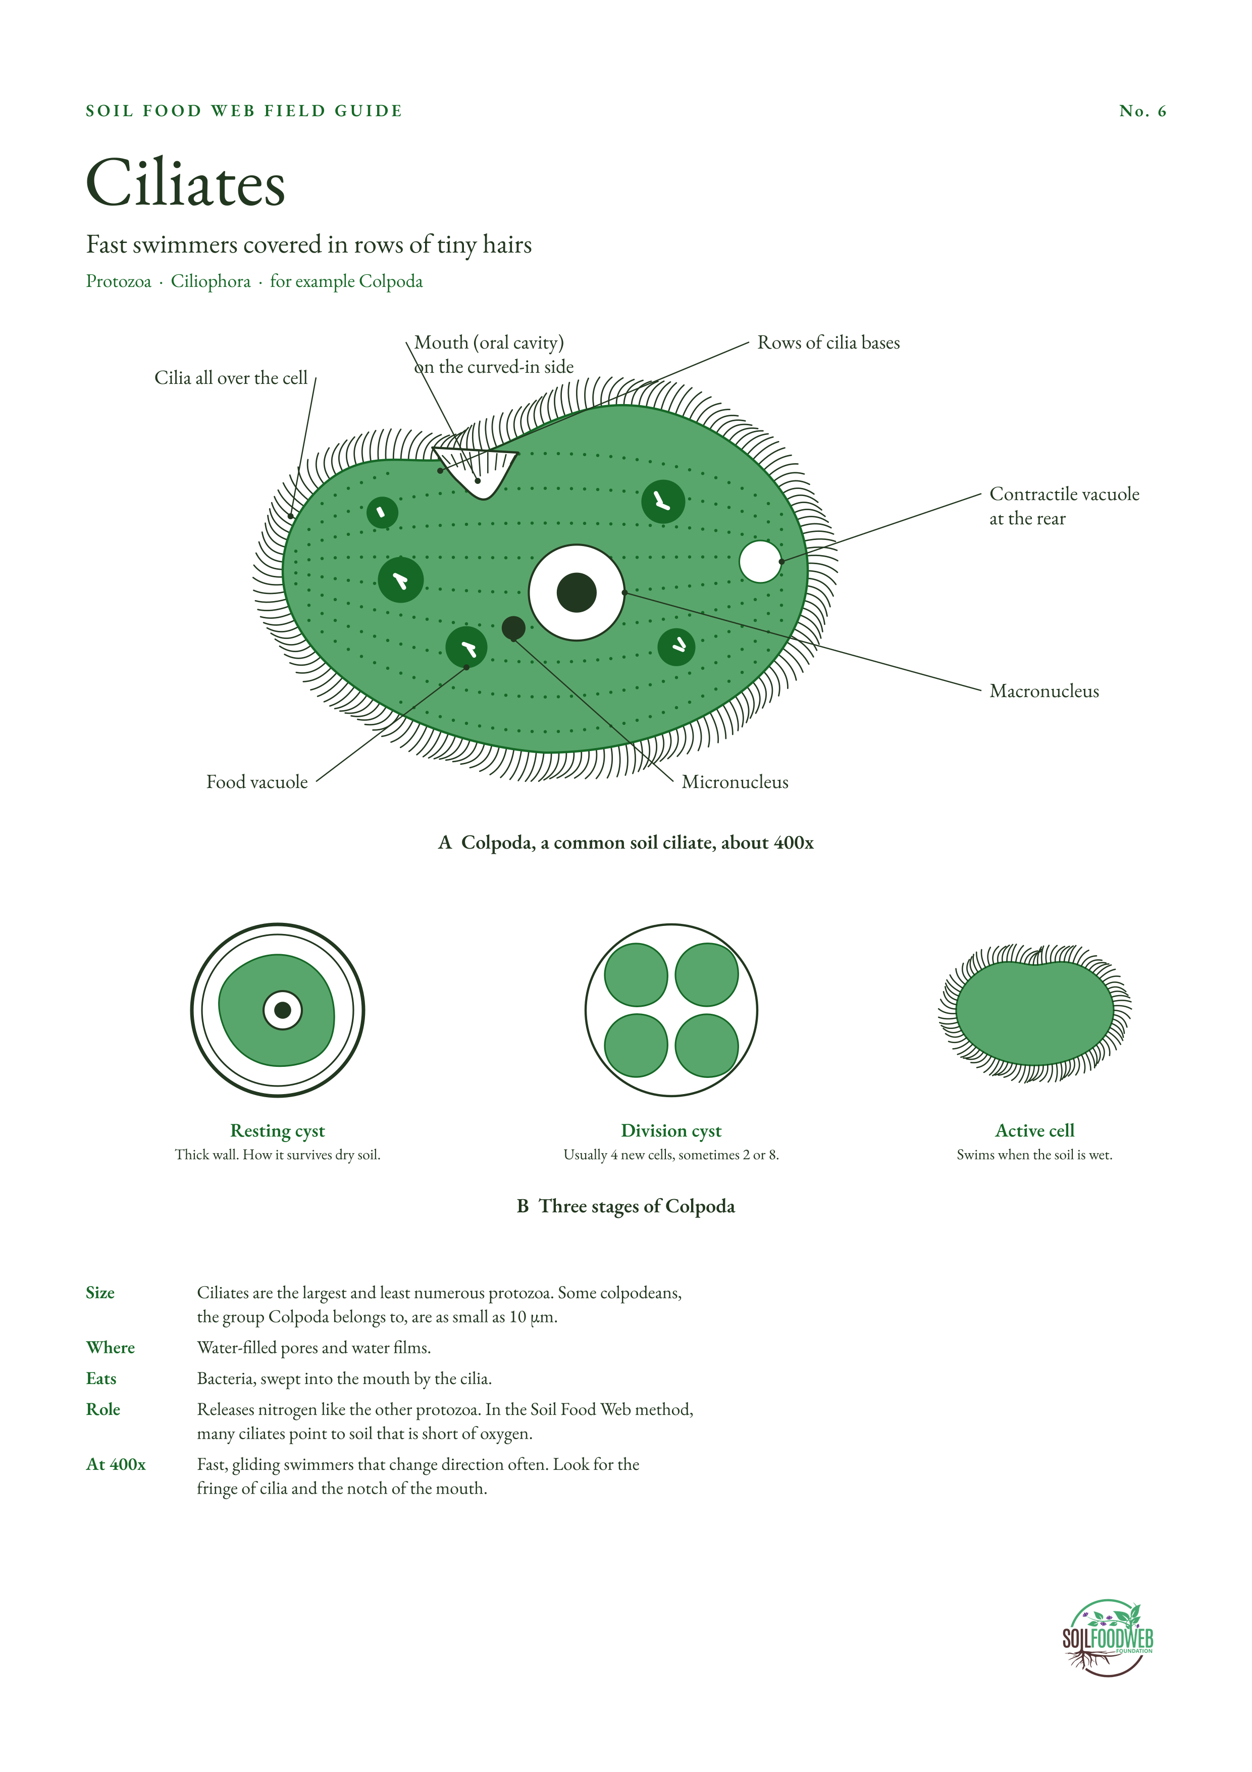
Notes:
No. 6 Ciliates. Sources:
1. Ciliates are the largest and least numerous protozoa (USDA Soil Biology Primer, Protozoa): https://webarchive.library.unt.edu/eot2008/20090115191603/http:/soils.usda.gov/sqi/concepts/soil_biology/protozoa.html
2. Colpoda division cyst gives 2, 4 (most often) or 8 cells (Archiv für Protistenkunde 88, 1936): https://www.zobodat.at/pdf/Archiv-fuer-Protistenkunde_88_1936_0366-0373.pdf
3. Some colpodean ciliates are as small as 10 µm (Ciliate): https://www.wikipedia.org/wiki/Ciliate
4. Many ciliates point to low oxygen, Soil Food Web method (Elaine Ingham, 2015): https://lists.ibiblio.org/sympa/arc/permaculture/2015-08/msg00064.html
5. Ciliates as indicators of anaerobic conditions (practitioner using the method): https://humankindoregon.com/soil-science

Slide 8
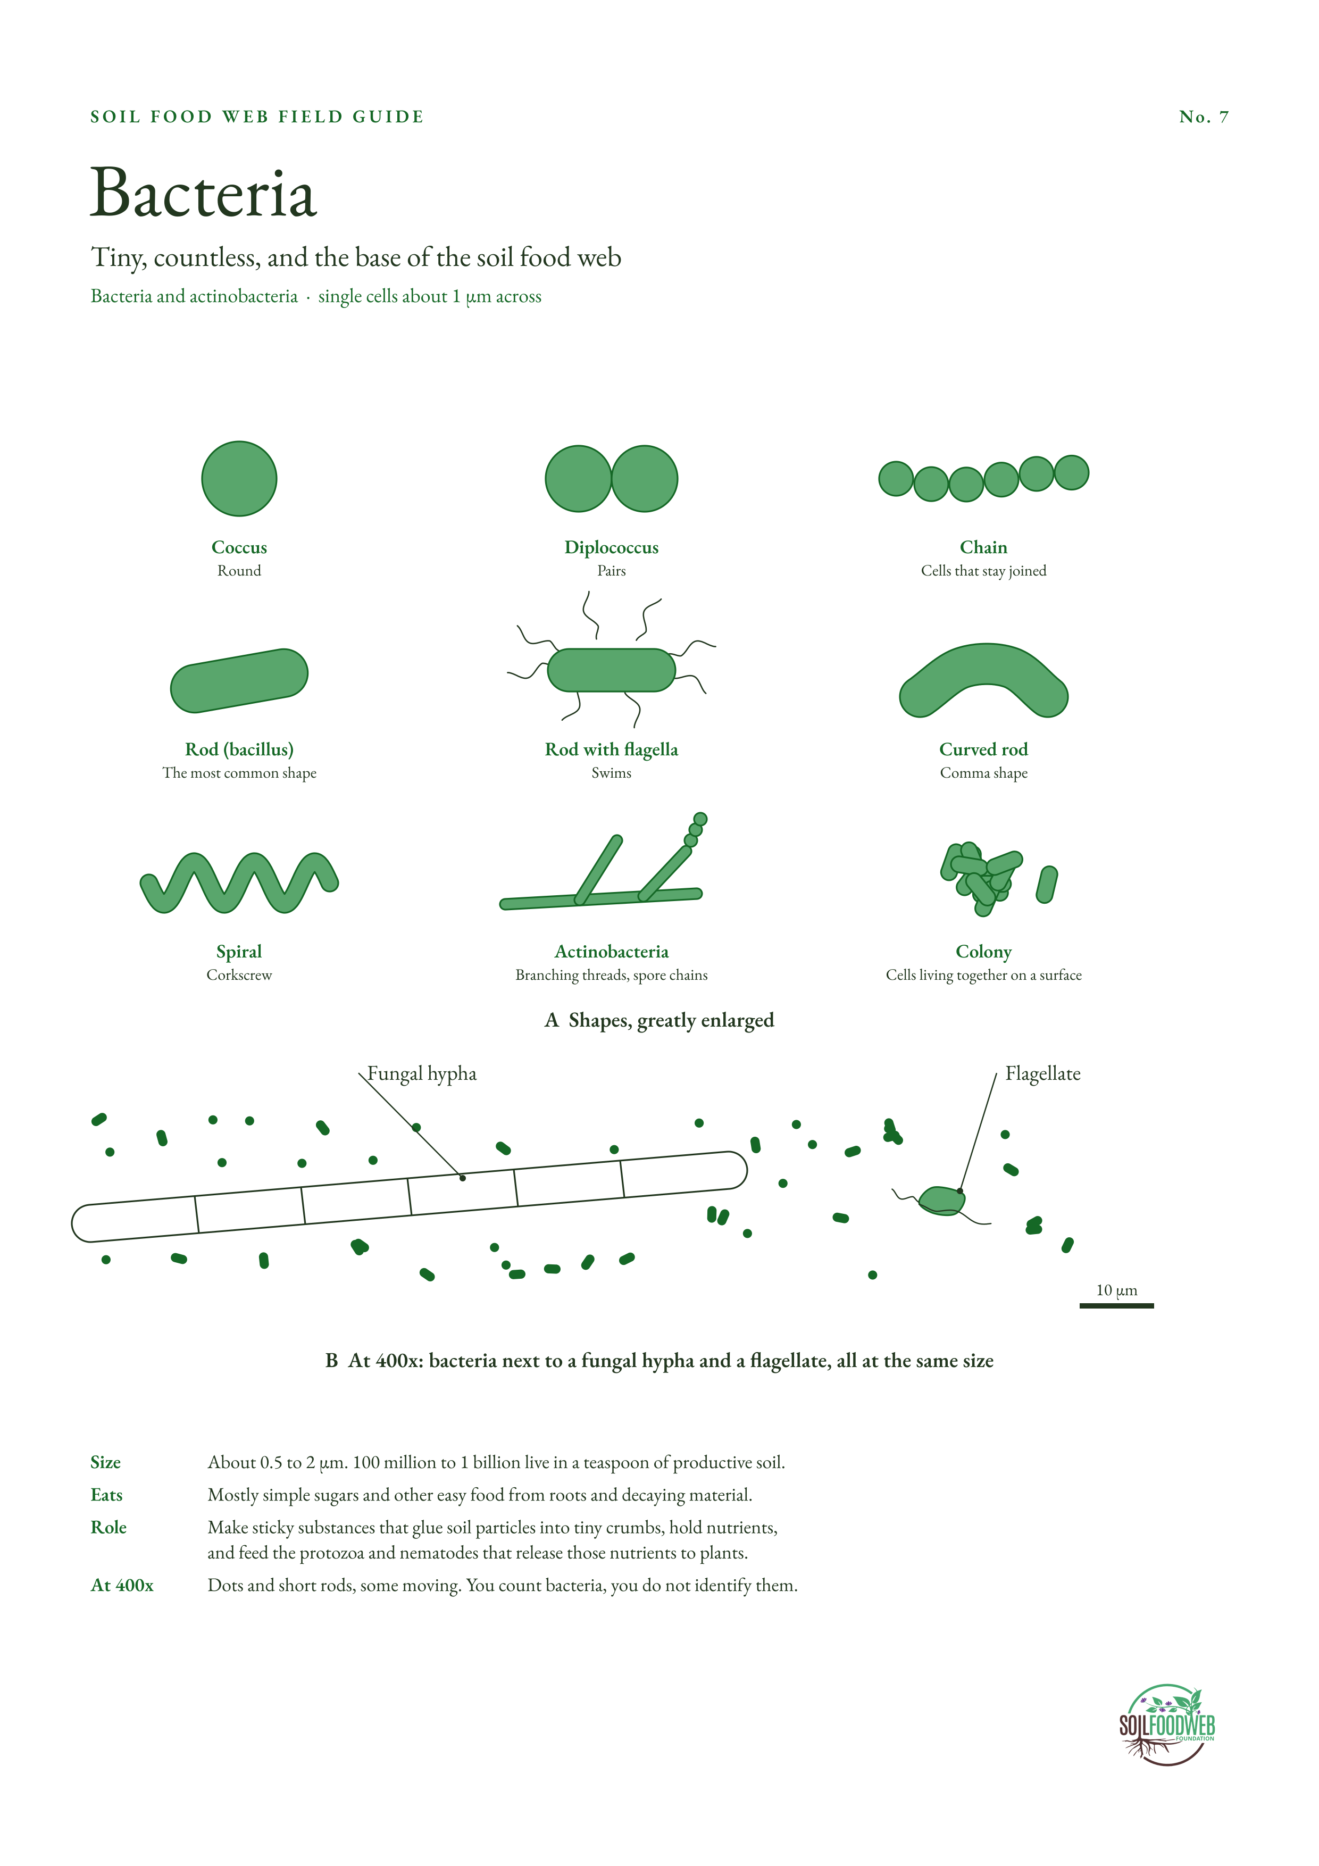
Notes:
No. 7 Bacteria. Sources:
1. 100 million to 1 billion bacteria per teaspoon of productive soil (USDA Soil Biology Primer, Bacteria): https://webarchive.library.unt.edu/web/20130216082737/http:/soils.usda.gov/sqi/concepts/soil_biology/bacteria.html
2. Direct counts are about 10^9 to 10^11 bacteria per gram (Introduction to Microbiology, University of Reading): https://futurelearn.com/info/courses/introduction-to-microbiology/0/steps/51421
3. Actinobacteria filament width 1 to 1.5 µm (Soil Food Web teaching material): https://pt.soilfoodweb.com/?p=2331

Slide 9
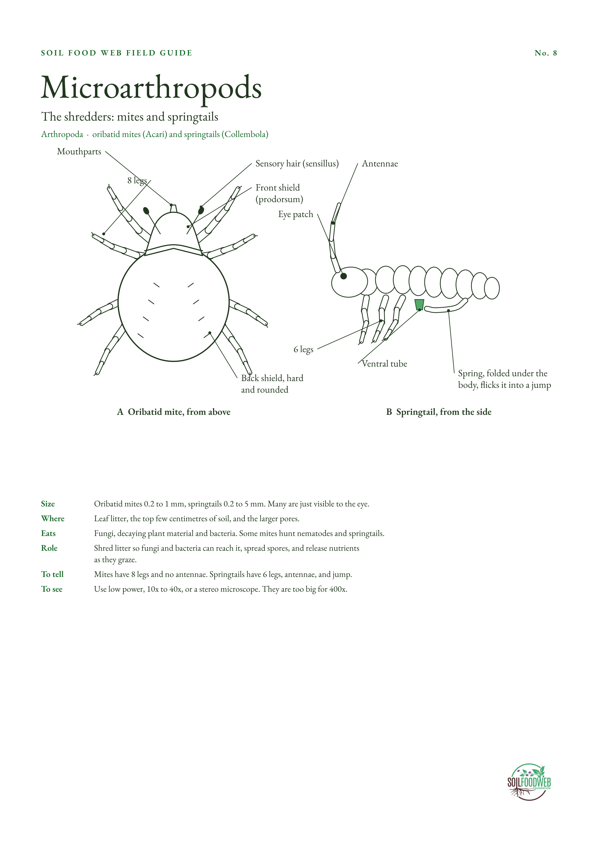
Notes:
No. 8 Microarthropods. Sources:
1. Oribatid mites 0.2 to 1 mm (Massey University, Soil mites): https://soilbugs.massey.ac.nz/acari.php
2. Springtails 0.2 to 5 mm (Massey University, Soil mites and other animals): https://www.massey.ac.nz/~maminor/mites.html
3. Springtail anatomy: ventral tube, catch and spring (collembola.org, F. Janssens): https://collembola.org/taxa/collembo.htm
4. Ventral tube on abdominal segment 1, spring on segment 4 (EvoDevo 5:2, 2014): https://link.springer.com/doi/10.1186/2041-9139-5-2
5. Mites and springtails shred litter and graze fungi (SARE, Farming with Soil Life): https://www.sare.org/publications/farming-with-soil-life/mesofauna-arthropods/

Slide 10
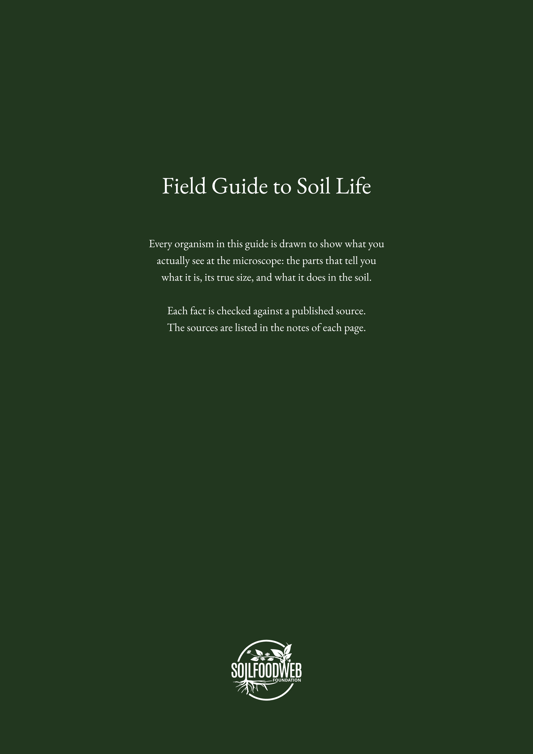
Notes:
Back cover. Soil Food Web Foundation, Field Guide to Soil Life.

