Slide 1
JavaScript
Introduction to JavaScript
JavaScript: developed in 10 days in 1995
Called: Mocha, LiveScript, JavaScript
It was originally developed by Netscape and registered by Sun MicroSystems.
Standard: ECMAScript

Slide 2
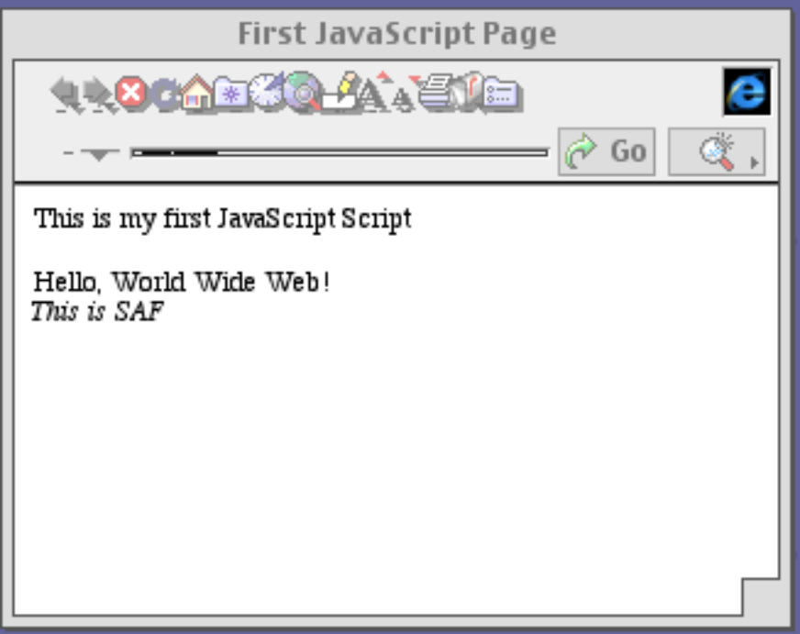
JavaScript
The First JS Script
The second and third
lines of this page were
produced by a JavaScript
script.

Slide 3
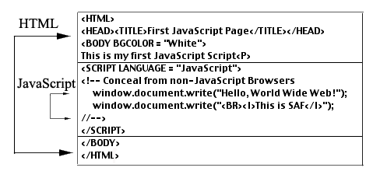
JavaScript
The First JS Script
The <SCRIPT>…</SCRIPT> tags contain the JS
script.

Slide 4
JavaScript
JavaScript Comments
JavaScript comments may appear anywhere on a line.
The comment ends when the line ends.
//This is a sample comment.

Slide 5
JavaScript
JavaScript Basics
JavaScript is an object-oriented language. An object
can contain:
Properties
Methods
Event Handlers

Slide 6
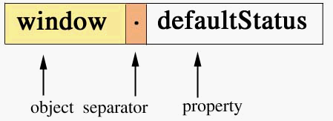
JavaScript
Properties
The window object contains a defaultStatus
property. A period separates the object from its property.

Slide 7
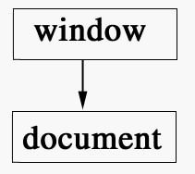
JavaScript
Properties
Objects are arranged hierarchically.
The window object contains the document object as a property.

Slide 8
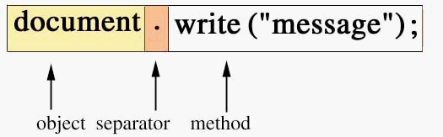
JavaScript
Methods
A method performs a task.
The write() method displays a string on the page.

Slide 9
JavaScript
The write() Method
The write() method contains a single string as a parameter.
The string concatenation operator, +, may be used to combine strings, for example:
document.write(“Hi” + “ There!”);

Slide 10
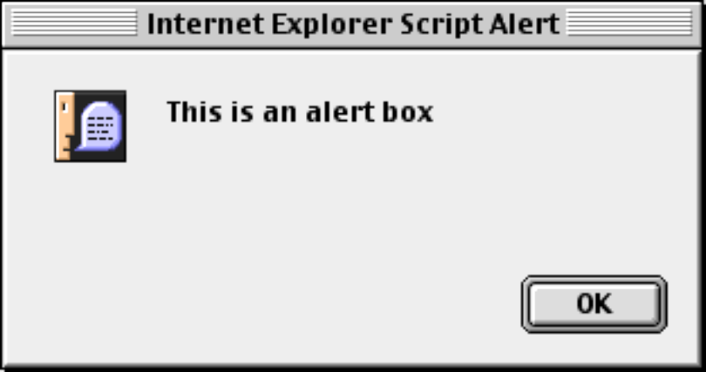
JavaScript
The alert() Method
The alert() method is used
to display warning or error
messages.
<SCRIPT LANGUAGE = “JavaScript”>
<!--
window.alert(“This is an alert box”);
//-->
</SCRIPT>

Slide 11
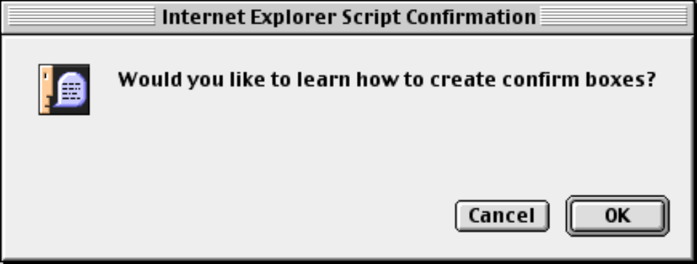
JavaScript
The confirm() Method
The confirm() method returns a true or false answer.
<SCRIPT LANGUAGE = “JavaScript”>
<!--
var reply = confirm(“Would you like to “ +
“learn how to create confirm boxes?”
//-->
</SCRIPT>

Slide 12
JavaScript
The prompt() Method
The prompt() method obtains information from the user.
The first parameter displays a question in the prompt box.
The second, optional, parameter displays default text for the text field.

Slide 13
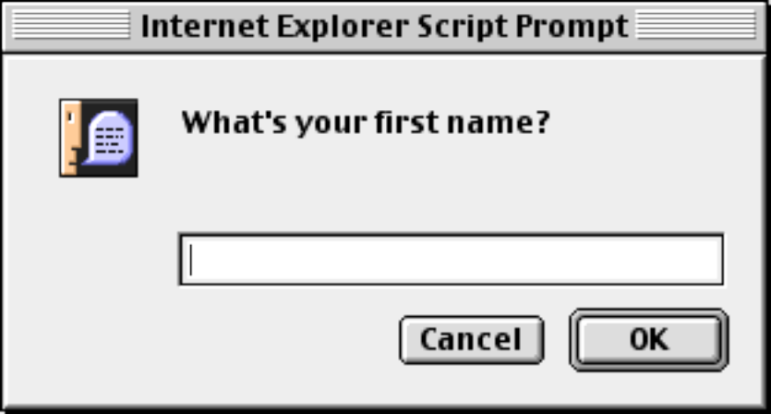
JavaScript
The prompt() Method
<SCRIPT LANGUAGE = “JavaScript”>
<!--
var name =
prompt(“What is your first name?”, “”);
//-->
</SCRIPT>

Slide 14
JavaScript
The newline character:\n
The <BR> and <P> tags cannot be used with the alert(), confirm(), or prompt() methods.
The newline character, \n, should be used instead of the <BR> or <P> tags.

Slide 15
JavaScript
Event Handlers
An event handler responds to an event such as a mouse click.
JavaScript event handlers begin with on, for example, onMouseOver and onMouseOut.

Slide 16
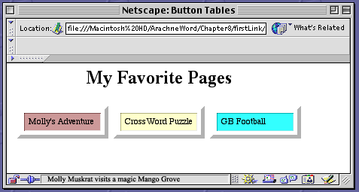
JavaScript
Event Handlers
The mouse passed over the Molly’s Adventure link. Notice
the change in the status line.

Slide 17
JavaScript
Event Handlers
<A HREF = "adventure.html"
onMouseOver = "window.status =
'Molly Muskrat visits a magic Mango Grove';
return true"
onMouseOut = "window.status = '';
return true">
Molly's Adventure</A>
Event handlers should return a value of true to indicate that
they worked correctly.

Slide 18
JavaScript
Arithmetic Statements
JavaScript arithmetic statements are created by using:
Arithmetic operators such as +, -, and /.
Methods in the Math object, such as Math.pow().
The Number object contains constants for the system limits
and error conditions.

Slide 19
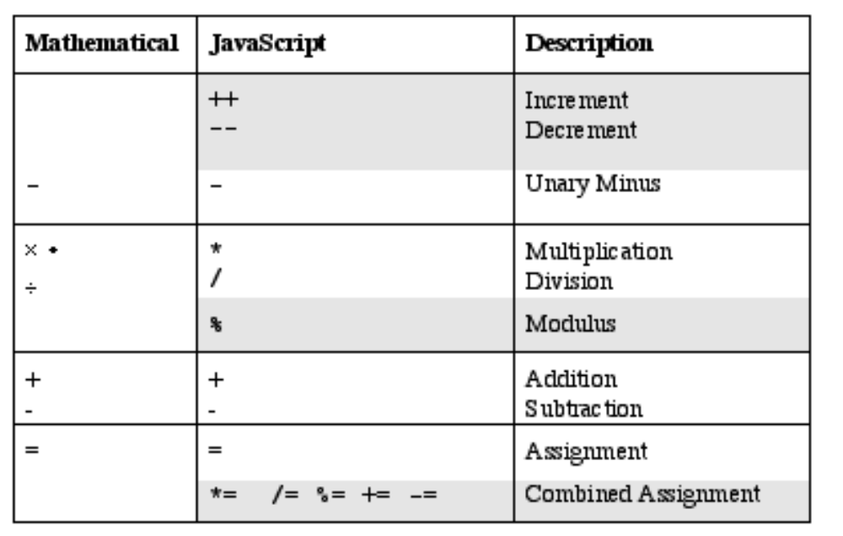
JavaScript
Arithmetic Statements
The JavaScript mathematical operators arranged
by precedence.

Slide 20
JavaScript
Precedence
Operators are evaluated in order of precedence.
Operators of the same precedence are evaluated according to their associativity.
Parentheses are used to override precedence.
Parentheses are evaluated from innermost to outermost.

Slide 21
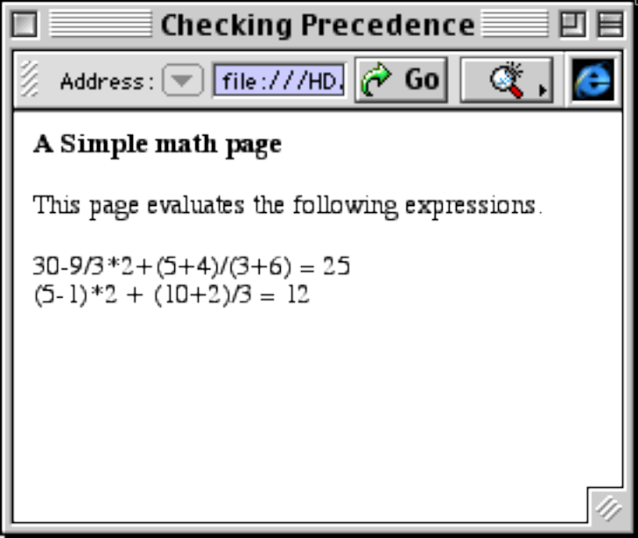
JavaScript
The Simple Precedence Page
This page illustrates JavaScript’s mathematical operators.

Slide 22
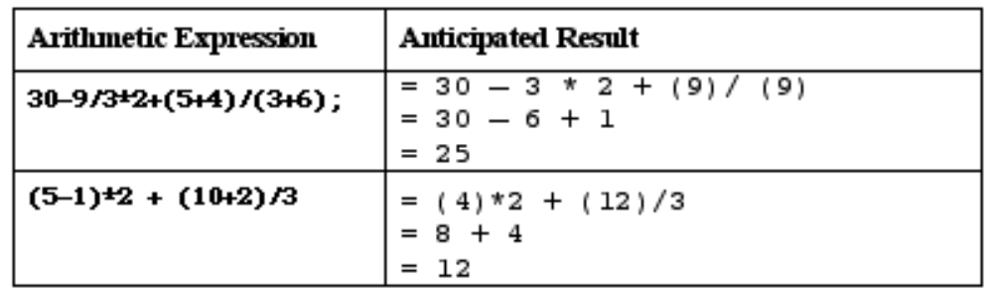
JavaScript
The Simple Precedence Page
When working with arithmetic statements, test data
should be used to verify results.
The test data for the simple precedence page is:

Slide 23
JavaScript
Errors
Syntax Errors indicate a violation of a grammar rule.
Logic Errors stem from a design flaw.
Test Plans and Test Data are used to detect and correct logic errors.

Slide 24
JavaScript
Parsing
The prompt() method returns a string. We must convert
strings to numbers if we want to use them in equations.
The parseInt() function converts a string to an integer.
The parseFloat() function converts a string to an floating-point number.

Slide 25
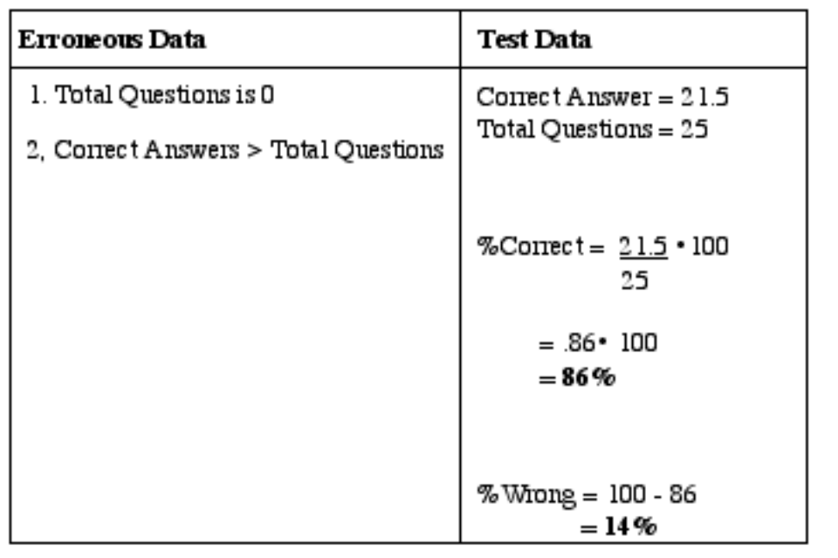
JavaScript
The Test Score Page
A test plan should consider both erroneous data and
erroneous results. This is the test plan for the
Test Score page.

Slide 26
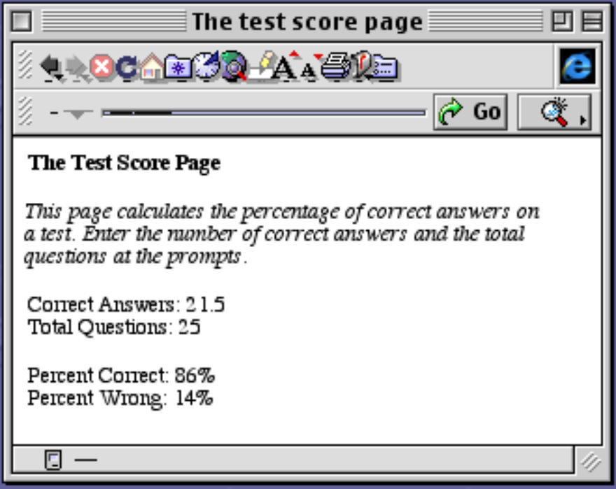
JavaScript
The Test Score Page
The Test Score page is displayed with the test data.

Slide 27
JavaScript
The Test Score Page
The Test Score page uses the parseInt() function to obtain
the the total questions and the parseFloat() function
to obtain the correct answers.
var correct =
parseFloat(prompt(“Correct answers: “, “”));
var total =
parseInt(prompt(“Total questions: “, “”));

Slide 28
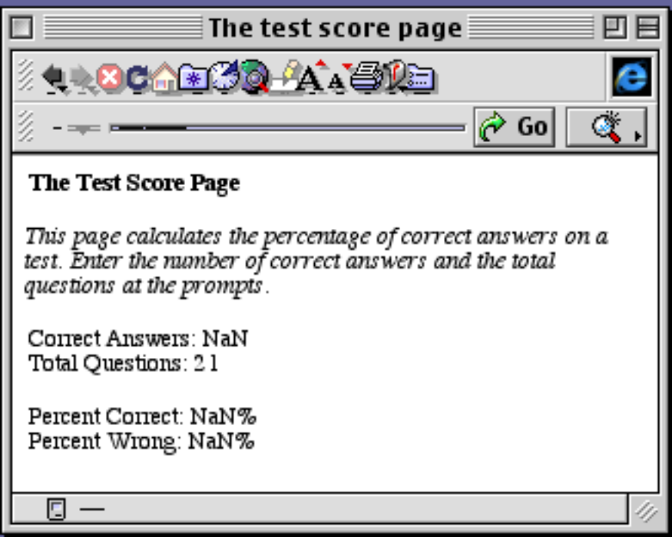
JavaScript
The Number Object
The user did not enter the correct answers.
The Number object displays
NaN (Not a Number.)

Slide 29
JavaScript
The Number Object
The Number object contains five constants:
NaN: Not a Number (Error).
MAX_VALUE: Maximum value for the system.
MIN_VALUE: Minimum value for the system.
POSITIVE_INFINITY: Greater than MAX_VALUE.
NEGATIVE_INFINITY: Greater than
-MAX_VALUE.

Slide 30
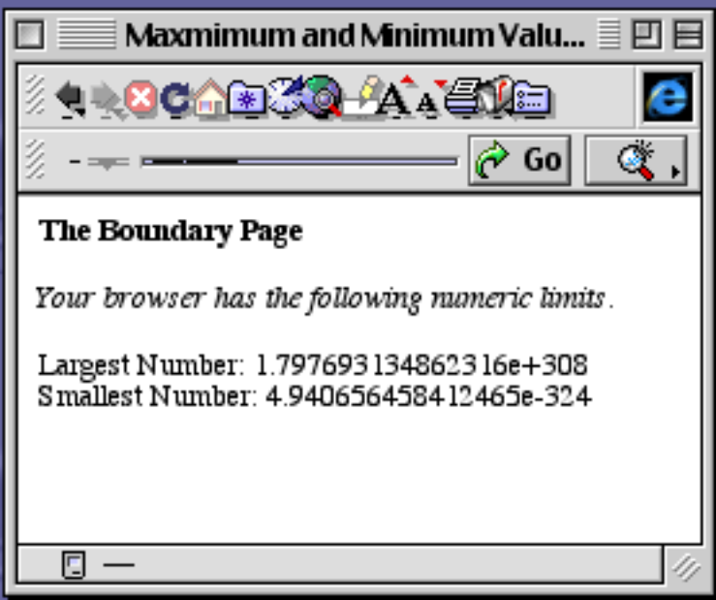
JavaScript
The Number Object
document.write
(Number.MAX_VALUE”);
…
document.write
(Number.MIN_VALUE”);
The maximum and minimum values are displayed.

Slide 31
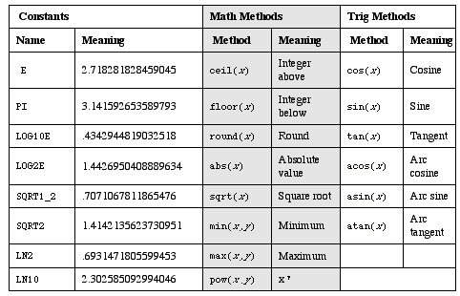
JavaScript
The Math Object
The Math object contains built-in constants and methods.

Slide 32
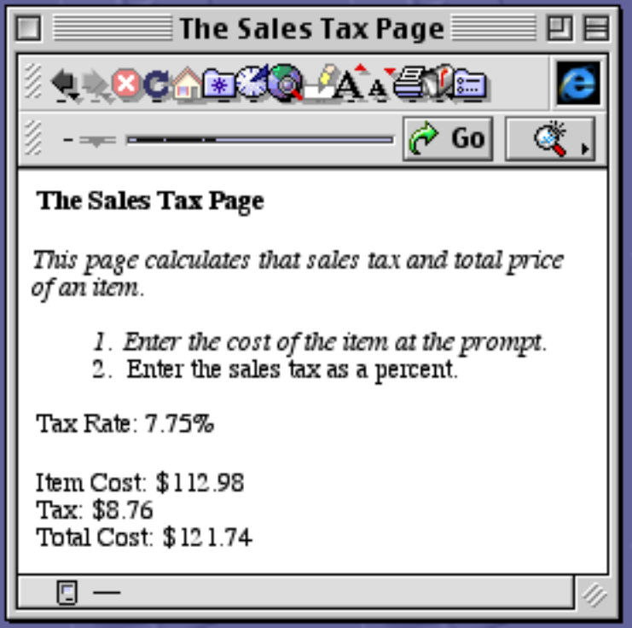
JavaScript
The Sales Tax Page
The Sales Tax page uses methods from the Math object to display results in a “Dollars and Cents” format.

Slide 33
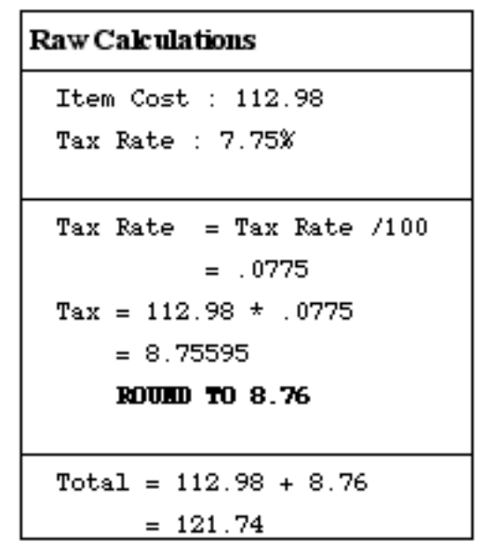
JavaScript
The Sales Tax Page
The test plan for the Sales Tax page includes rounded results.

Slide 34
JavaScript
The Sales Tax Page
Rounding numbers requires the Math.round() and
Math.pow() methods.
amountTax =
Math.round(amountTax * Math.pow(10,2))/
Math.pow(10,2);

Slide 35
JavaScript
Selection Statements
Selection statements let programmers execute a code segment
zero or one times.
JavaScript contains two selection statements.
The if statement and its variants
(if…else, if…else if… else).
The switch statement.

Slide 36
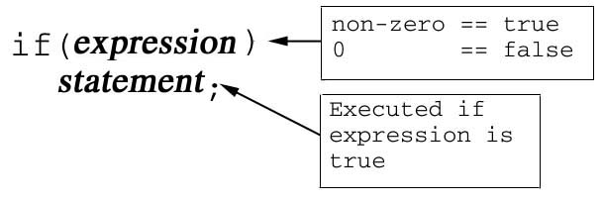
JavaScript
The if Statement
The simplest form of the if statement contains an expression.
If the expression is true, the statement is executed.

Slide 37
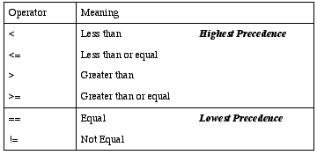
JavaScript
Relational Operators
Relational operators can be used to create expressions.
The JavaScript relational operators are:

Slide 38
JavaScript
The Azalea Page
The Azalea page uses a simple if statement.
if (pH <= 5.5)
document.write
(“Your soil is just right for growing Azaleas”);

Slide 39
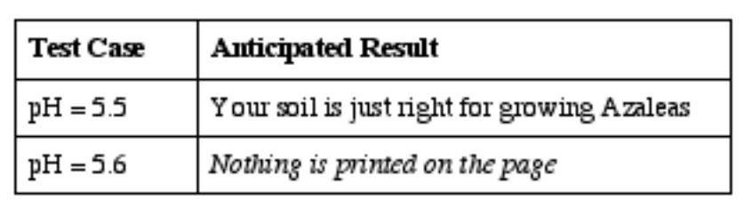
JavaScript
The Azalea Page
The test plan must include both true and false alternatives

Slide 40
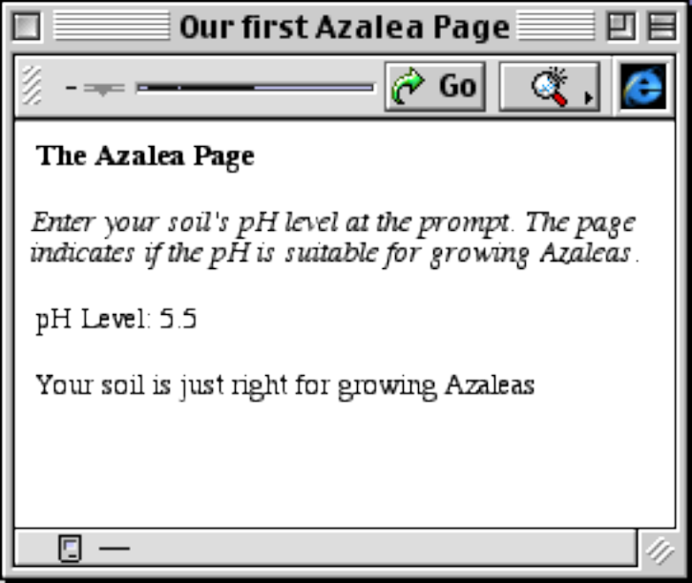
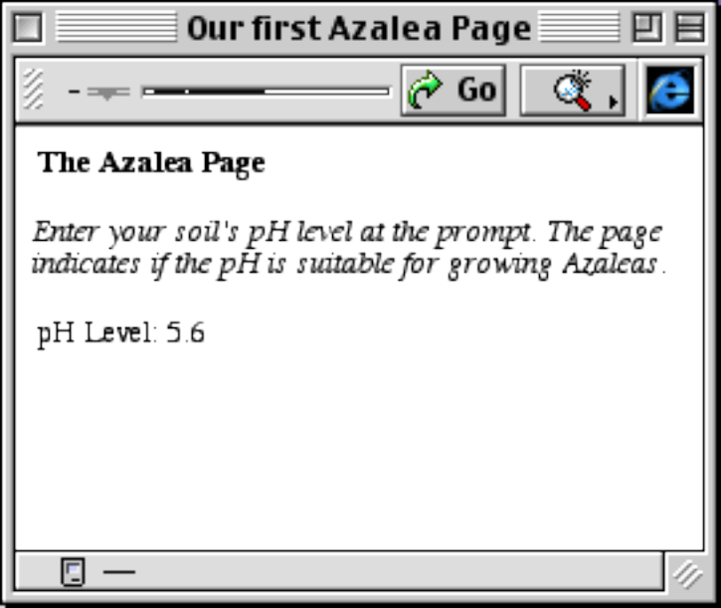
JavaScript
The Azalea Page
The true alternative.
The false alternative.

Slide 41
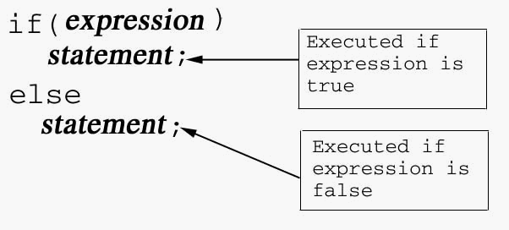
JavaScript
The if…else Statement
The if…else statement includes both true and false alternatives.

Slide 42
JavaScript
The Azalea Page, Version 2
The second version of the Azalea page uses an
if…else statement.
if (pH <= 5.5)
document.write
(“Your soil is just right for growing Azaleas”);
else
document.write
(“Sorry! Your pH is too high for Azaleas”);

Slide 43
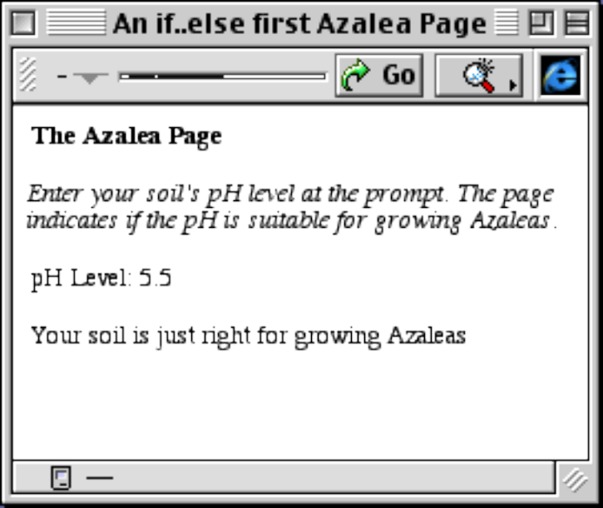
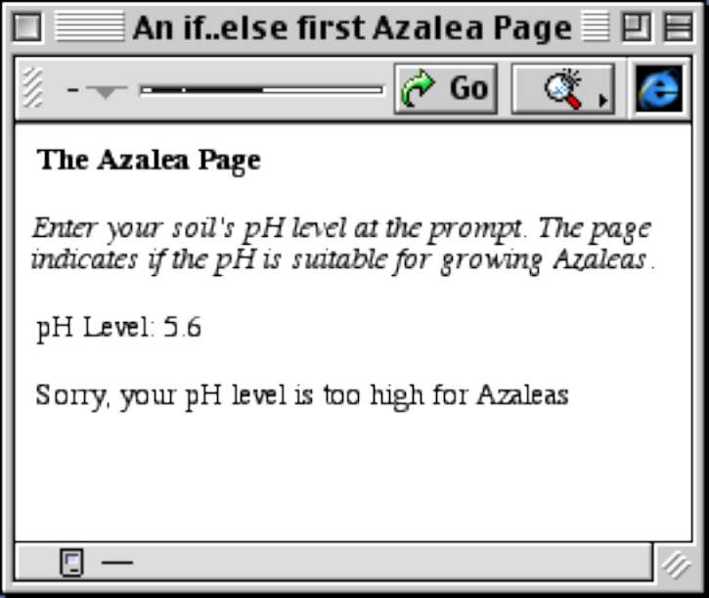
JavaScript
The Azalea Page, Version 2
The true alternative.
The false alternative.

Slide 44
JavaScript
JavaScript Statements
The if statement and its variants (if…else, if…else if… else) execute a single statement.
To execute multiple statements, we use a block.
A create a block, encase the statements in braces: { }.

Slide 45
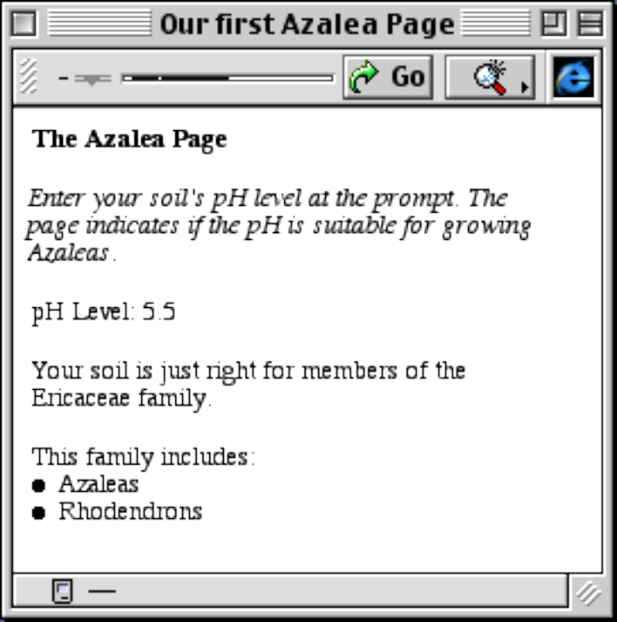
JavaScript
The Azalea Page, Version 3
The block contains several calls to
the document.write() method.
if (pH <= 5.5)
{ …
}

Slide 46
JavaScript
Lexicographic Order
JavaScript uses lexicographic order to compare strings or characters.
Lexicographic order refers to the order that words appear in a dictionary.

Slide 47
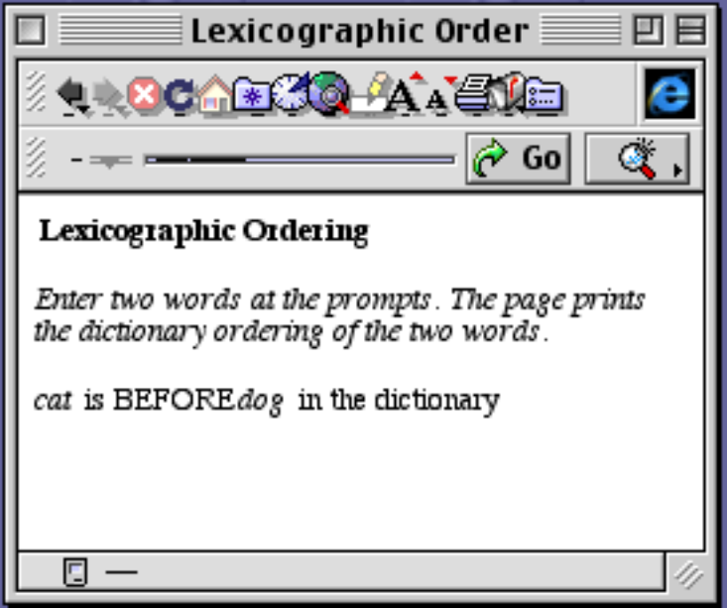
JavaScript
Lexicographic Order
if (word1 < word2)
document.write(“is BEFORE”);
word1 (cat) comes before word2
(dog) in the dictionary.

Slide 48
JavaScript
Logical Operators
Logical operators are used to create complex expressions.
The JavaScript logical operators, in order of precedence are:
! (not)
&& (and)
|| (or)

Slide 49
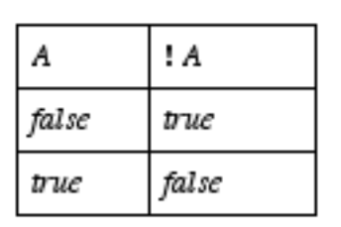
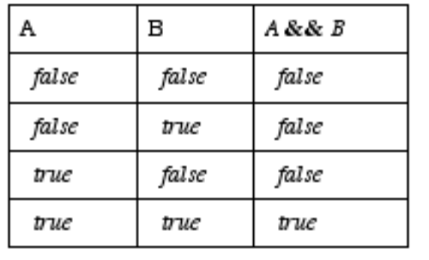
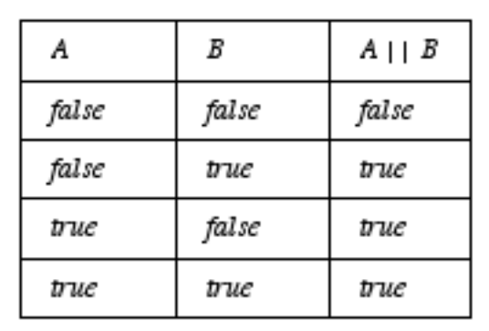
JavaScript
Truth Tables
Truth tables summarize the evaluation of a logical operator.
The Not
Truth Table
The And
Truth Table
The Or
Truth Table

Slide 50
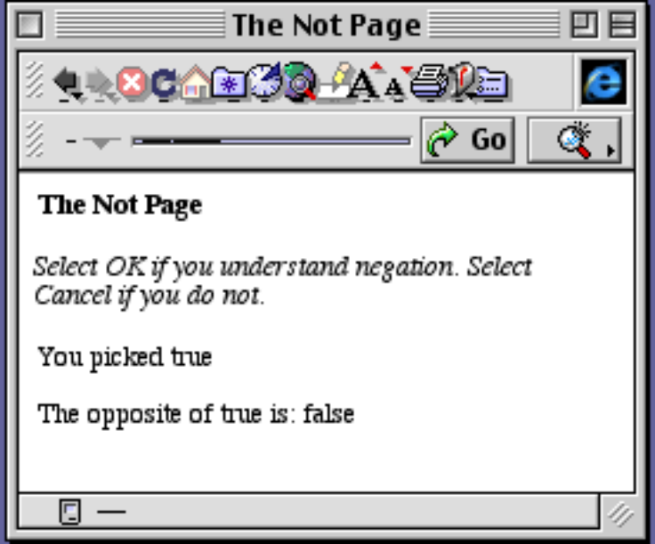
JavaScript
The Not Page
The user selected the OK button
from the confirm window.
The OK button returns a value
of true.
var reply = confirm(“Do you understand negation?”);
…
document.write(!reply);

Slide 51
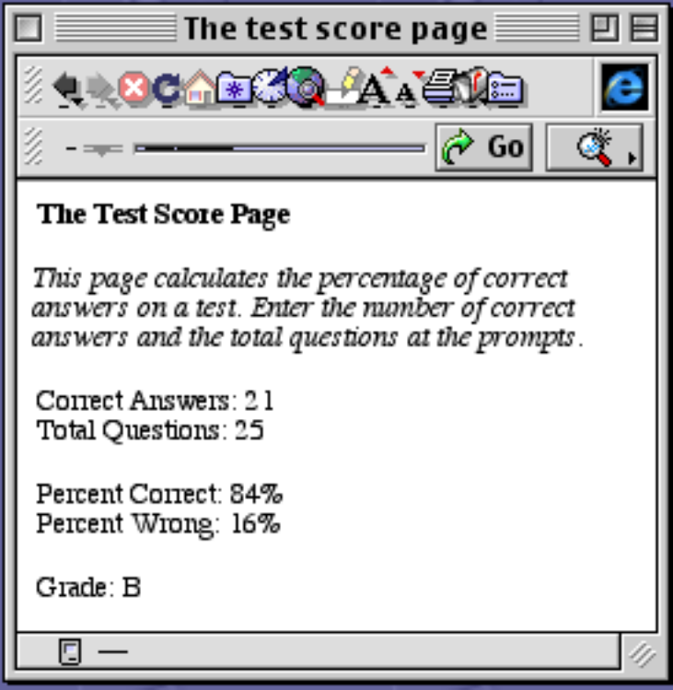
JavaScript
The Test Score Page
The Test Score page uses the
and operator to print the correct
letter grade.

Slide 52
JavaScript
The Test Score Page
One way to find the correct letter grade is:
if (percentCorrect >= 90 && percentCorrect <= 100)
document.write("Grade: A");
if (percentCorrect >= 80 && percentCorrect < 90)
document.write("Grade: B");
if (percentCorrect >= 70 && percentCorrect < 80)
document.write("Grade: C");
if (percentCorrect >= 60 && percentCorrect < 70)
document.write("Grade: D");
if (percentCorrect >= 0 && percentCorrect < 60)
document.write("Grade: F");

Slide 53
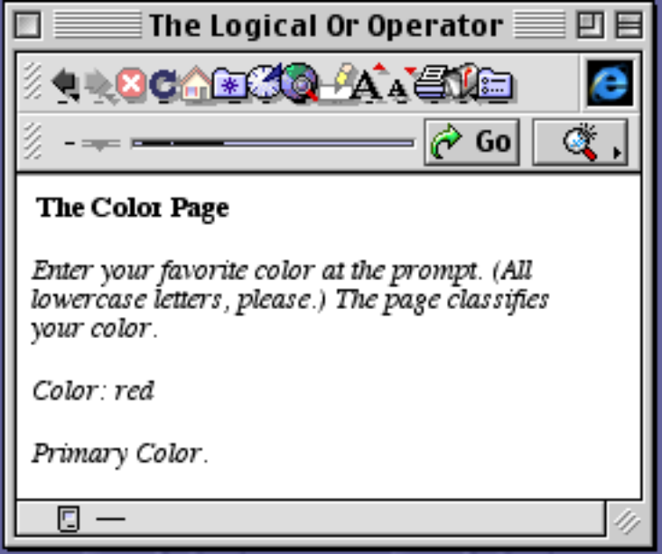
JavaScript
The Primary Colors Page
The Primary Colors page uses the or operator to distinguish between primary, secondary, and other colors.
The user has chosen a
primary color.

Slide 54
JavaScript
The Primary Colors Page
The code that selects the correct message is:
if (color == "red" || color == "blue" ||
color == "yellow")
document.write("<P> Primary Color.");
else if (color == "green" || color == "purple" ||
color == "orange")
document.write("<P>Secondary Color.");
else
document.write
("<P>Not a primary or secondary color.");

Slide 55
JavaScript
The switch Statement
switch (variable) {
case value: statement1;
...
statementn;
break;
case value: case value:
statement1;
...
statementn;
break;
default:statement1;
...
statementn;
}
The general form of the
switch statement.
A switch statement may
contain case, break, or
default statements.

Slide 56
JavaScript
The switch Statement
A switch statement uses a variable.
The case statements are used to match values of the variable.
All statements after a match are executed until a break statement or the end of the switch statement is encountered.
The default statement provides an alternative if a match does not occur.

Slide 57
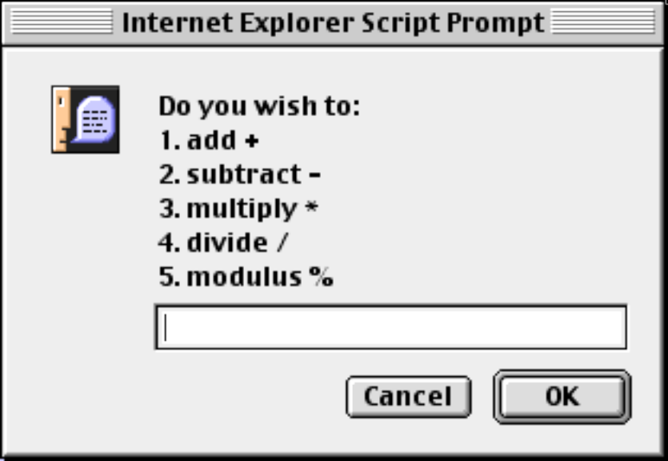
JavaScript
The Arithmetic Expression Page
The Arithmetic Expression page
lets the user choose their option by
selecting a:
Number (1, 2,3, 4, 5)
Word (add, subtract, …)
or
Symbol (+, -, *, /, %)

Slide 58
JavaScript
The switch Statement
A portion of the switch statement used in the Arithmetic
Expressions page.
switch (choice) {
case "add":
case "1":
case "+":document.write
(x + " + " + y + " = " + (x+y));
break;
...
default:document.write
("Sorry! I don't recognize your choice.");
}

Slide 59
JavaScript
Iteration Statements
Iteration statements let programmers execute a code segment
zero or more times. JavaScript contains three iteration
statements.
The for statement.
The do statement.
The do…while statement.

Slide 60
JavaScript
The for Statement
The for statement is typically used for counting. The structure
of the statement is:
for (InitialExpression; Test Expression; Change Expression)
Statement;

Slide 61
JavaScript
The for Statement
Initial Expression: Provides a starting value for an index variable.
Test Expression: Controls the repetition.
Change Expression: Changes the value of the index variable to move it closer to loop termination.
The for statement executes as long as the Test Expression is true.

Slide 62
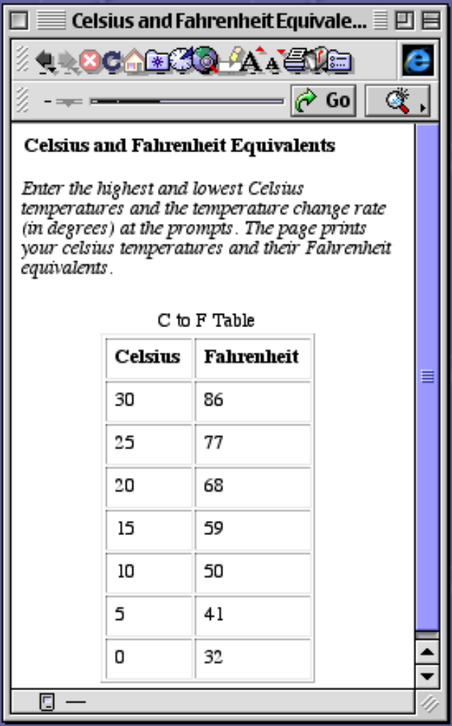
JavaScript
The for Statement
The C To F page uses a for statement
to print the table.

Slide 63
JavaScript
Stepwise Program Development
Stepwise Program Development creates a large
program in small, manageable pieces.
Pseudo-Code is used to develop the pieces.

Slide 64
JavaScript
PseudoCode
The pseudocode for the C To F page is:
Use prompts to obtains the high, low, and temperature change values.
Create the table with borders, caption, and headings.
Use a for statement to:
Convert a Celsius temperature to Fahrenheit.
Put the Celsius and Fahrenheit temperatures in the table.
Close the table.

Slide 65
JavaScript
The for Statement
The for Statement for the F to C Page is:
for (celsius = high; celsius >= low;
celsius += change){
document.write(“<TR><TD>” + celsius +
“</TD><TD>”);
fahrenheit = 9/5*celsius + 32;
document.write(fahrenheit +
“</TD></TR>”);
}

Slide 66
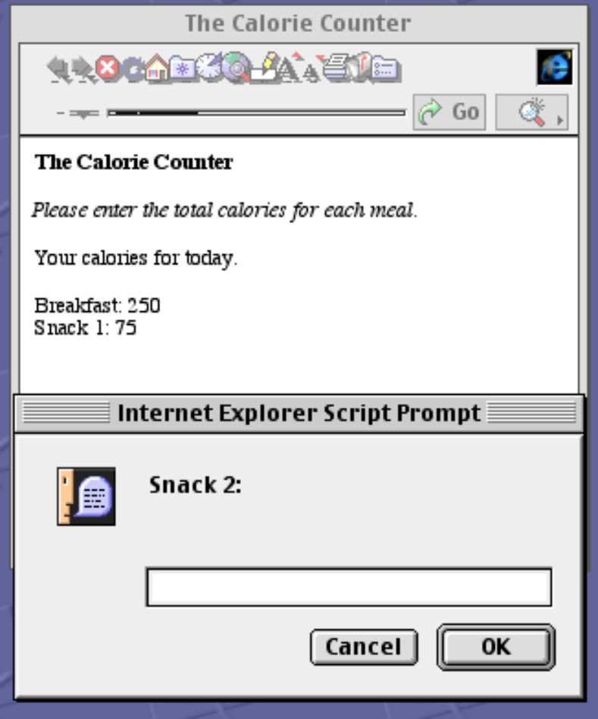
JavaScript
Sums and Products
The for statement is often used
to calculate sums or products.
The Calorie Counter page asks
the user to enter breakfast, lunch,
and dinner calories and two snacks.
The page calculates the total
calories.

Slide 67
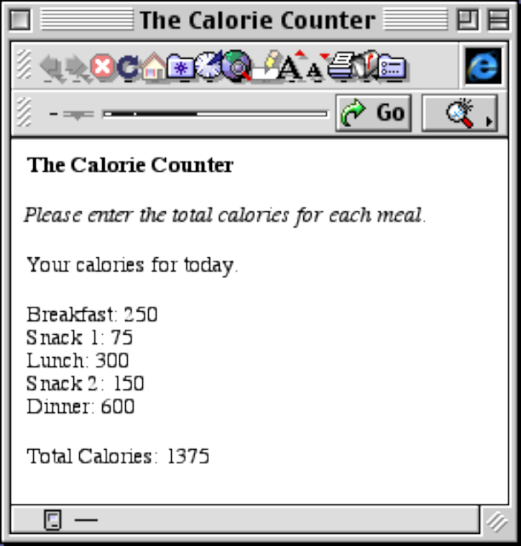
JavaScript
Sums and Products
To sum, we:
Set a summing variable to zero
before the loop begins.
var sum = 0;
Use a for statement to sum.
for(i = 0; i < 5; i++)
{
…
sum += calories;
}

Slide 68
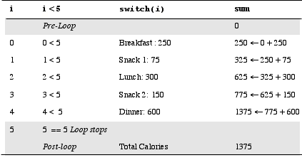
JavaScript
Walk-Throughs
A walk-through is used to verify the correctness
of the iteration statement.

Slide 69
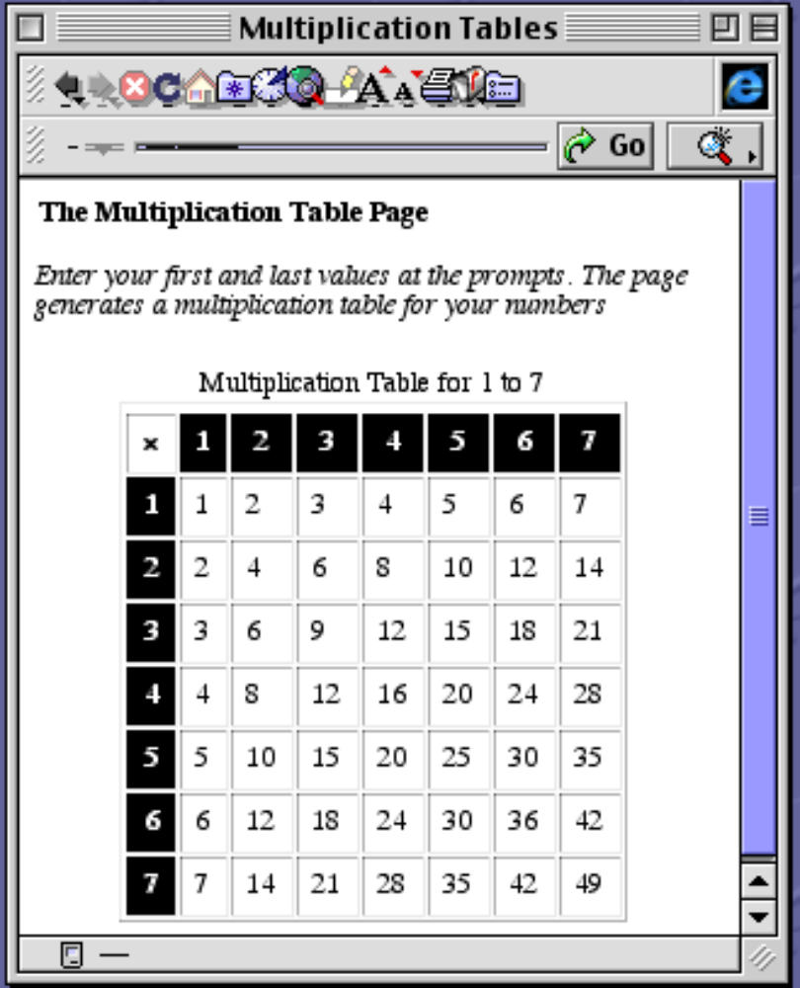
JavaScript
Nested for Statements
The Multiplication Table page
uses a nested for statement to
create the table.
The outer for statement controls
the rows.
The inner for statement controls
the columns within a row.

Slide 70
JavaScript
Nested for Statements
This simple set of nested for statements prints out the
values of the index variables.
for (i = 1; i <= 2; i++)
for (j = 1; j <= 3; j++)
document.write(i + “ “ + j + “<BR>”);

Slide 71
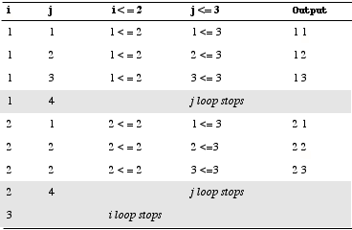
JavaScript
Walk-Through: Nested for
This walk-through shows the output of a simple set of
nested for statements.

Slide 72
JavaScript
The while Statement
The while statement is typically used for error loops. The
structure of the statement is:
while (Expression)
Statement;

Slide 73
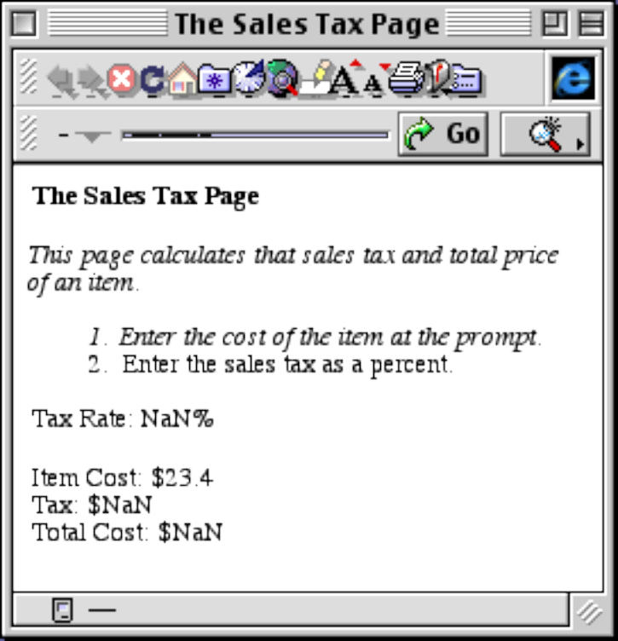
JavaScript
The Sales Tax Page
The original Sales Tax page
does not handle missing data.
In this case, the user forgot to
enter a Tax Rate.

Slide 74
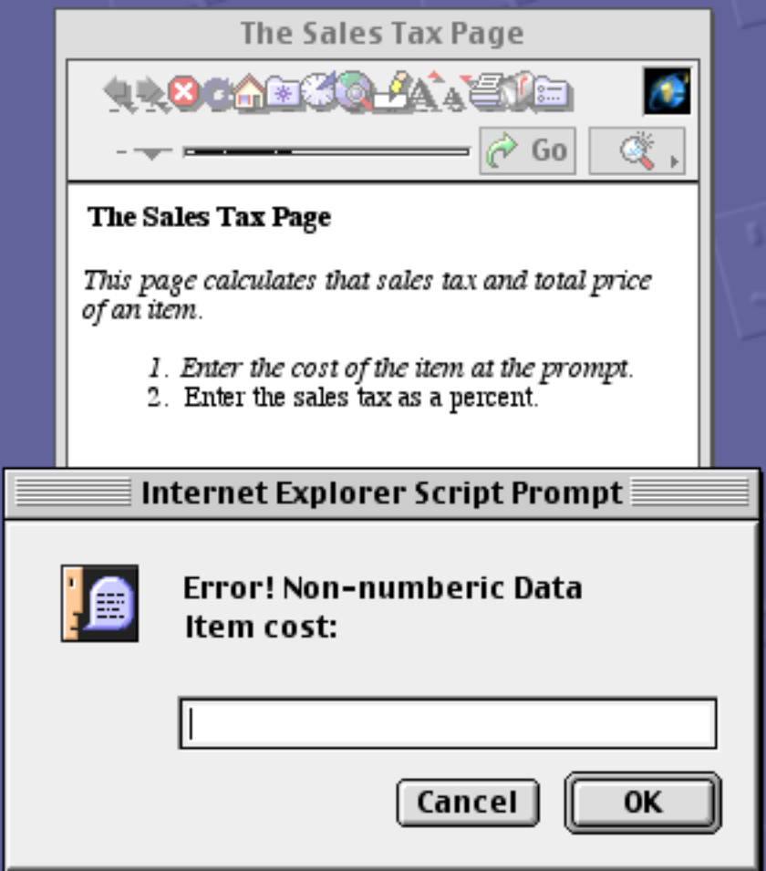
JavaScript
The Sales Tax Page
The code that handles
non-numeric data uses the
isNaN() function.
while (isNaN(itemCost))
itemCost =
parseFloat(
prompt(“Item Cost”,
“”));

Slide 75
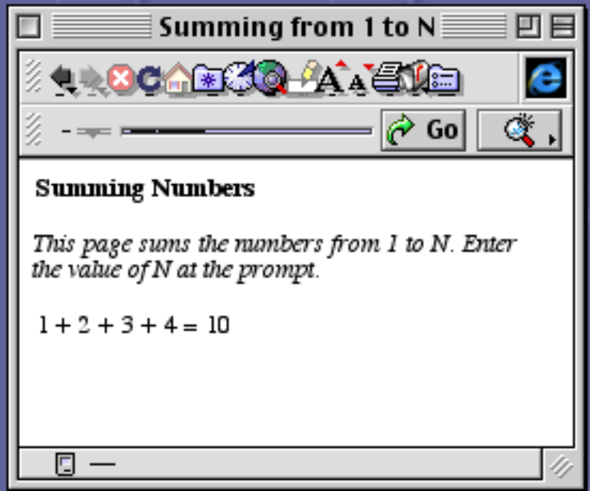
JavaScript
The for and while Statements
Numbers are summed using a
for statement. The code is:
var sum = 0;
for (var i = 1; i <= n;
i++)
sum += i;

Slide 76
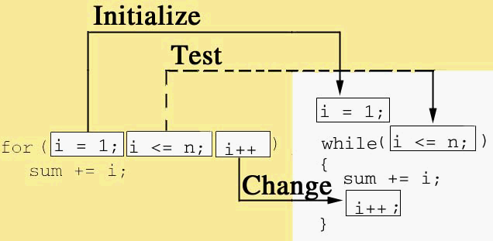
JavaScript
The for and while Statements
The diagram translates the for statement into the equivalent
while statement.

Slide 77
JavaScript
The do.while Statement
The do…while statement is the least frequently used of the
iteration statements. Since the expression is at the foot of the loop,
the do…while statement executes the statement in the body at least
one time.
do
Statement;
while (Expression);

Slide 78
JavaScript
The do.while Statement
We can use the do…while statement to calculate factorials. The
code is:
var factorial = 1;
var i = n;
do {
factorial *= i;
…
i--;
}while (i >= 1);

Slide 79
JavaScript
Functions and Objects
Function Terminology
Function Call: The use of a function.
Function Caller: The statement that invokes a function.
Parameters: Information passed to the function.
Return Value: Information sent back by the function.

Slide 80
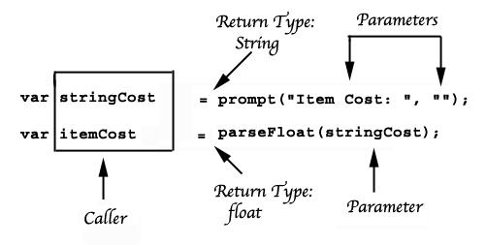
JavaScript
Function Terminology
The diagram shows the function terminology for the
prompt() method and the parseFloat() function.

Slide 81
JavaScript
Function Definition
function Name (Parameter List)
{
statement;
…
statement;
}
The head of a function contains the function’s name and parameter list.

Slide 82
JavaScript
Function Definition
function Name (Parameter List)
{
statement;
…
statement;
}
The body of a function contains the function’s statements.

Slide 83
JavaScript
Function Design Rules
A function should perform one and only one task.
Keep function users on a need to know basis.
Return results to the function caller.

Slide 84
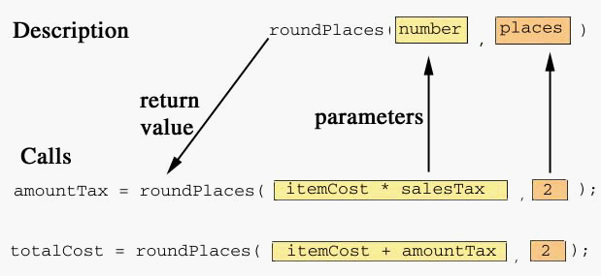
JavaScript
The roundPlaces() Function
The diagram shows the relation between the function header
and the function callls for the roundPlaces() function.

Slide 85
JavaScript
The roundPlaces() Function
The roundPlaces() function uses a return statement to return the rounded number to the caller.
function roundPlaces(number, places)
{
return Math.round(number *Math.pow(10,places))
/ Math.pow(10,places);
}

Slide 86
Alternative function definition
function roundPlaces(number, places)
{
return Math.round(number*Math.pow(10,places))
/ Math.pow(10,places);
}
is the same as:
roundPlaces = function(number, places)
{
return Math.round(number*Math.pow(10,places))
/ Math.pow(10,places);
}

Slide 87
JavaScript
Local Variables
A Local Variable has meaning only within its defining function.
Different functions can use the same names for local variables.
Local variables hide function details from users.

Slide 88
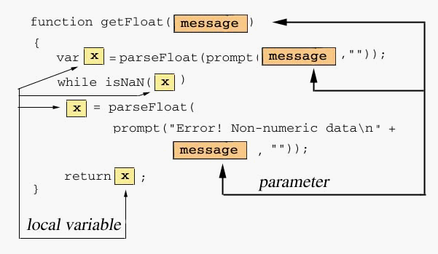
JavaScript
Local Variables
The getFloat() function contains a local variable, x.

Slide 89
JavaScript
Object Terminology
An object contains properties, methods, and possibly event handlers.
A property is an attribute of an object.
A method is a function that is attached to an object.
A constructor is a specialized method that creates a new object.

Slide 90
JavaScript
The Circle Object
Circle
Properties radius
Methods Circle()
getRadius()
setRadius()
area()
circumference()
print()
The constructor.
A method

Slide 91
JavaScript
Creating the Circle Object, I
Creating the Circle object begins with the function definitions.
The getRadius() function returns the radius of a circle object.
function getRadius()
{
return this.radius;
}
Self-reference is used to refer to an object.

Slide 92
JavaScript
Creating the Circle Object, II
The constructor attaches the functions to the object.
function Circle(radius)
{
this.radius = radius;
…
this.getRadius = getRadius;
...
}
The getRadius() function becomes a method of the Circle object.

Slide 93
JavaScript
Using the Circle Object
Two Circle objects are created. Each has access to all
of the Circle methods.
defaultCirle = new Circle(5)
radius = getFloat(“Radius: “);
yourCircle = new Circle(radius);
new is used with the constructor to create a new Circle object.

Slide 94
JavaScript
Pass By Value
The pass-by-value technique evaluates the parameter
used in the call. JavaScript uses pass-by-value for:
Numbers
Booleans (true and false)

Slide 95
JavaScript
Pass By Reference
The pass-by-reference technique passes the memory address
of the parameter used in the call. Any changes to the
formal parameter permanently effect the parameter used in
the call. JavaScript uses pass-by-reference for:
Objects
Arrays

Slide 96
JavaScript
Pass By Constant Reference
The pass-by-constant reference technique passes the
memory address of the parameter used in the call. Since
the address is passed as a constant, the parameter used
in the call cannot be modified by the function. JavaScript
uses pass-by-constant reference for:
Strings
Functions

Slide 97
JavaScript
Arrays
JavaScript arrays are used to store multiple values in the same variable.
Values are accessed by their position in the array.
Positions are numbered from 0 and are encased in brackets, for example, x[0].

Slide 98
JavaScript
Array Subscripts
x Mathematical JavaScript
Notation Notation
50 x₁ x[0]
45 x₂ x[1]
35 x₃ x[2]
8 x₄ x[3]
9 x₅ x[4]
JavaScript subscripts
begin at 0.

Slide 99
JavaScript
Array Properties
length contains the number of elements in the array
prototype lets us add additional properties or methods to the Array object.

Slide 100
JavaScript
Older Array Methods
Array() is the array constructor.
join(Separator) creates a string from array elements.
reverse() reverses the array elements.
sort(Comparator) sorts the array’s elements.

Slide 101
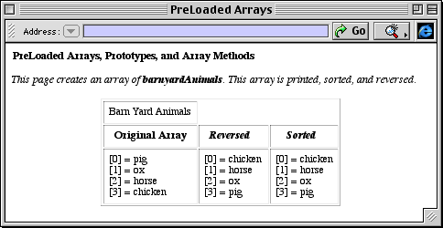
JavaScript
Older JavaScript Methods
The Barnyard Animal page illustrates several Array methods.

Slide 102
JavaScript
Older Array Methods
To create the array, we write:
var barnyardAnimals = new Array(“pig”,“ox”, “horse”, “chicken”);
To sort the array in lexicographic order, we write:
barnyardAnimals.sort();

Slide 103
JavaScript
The print() Method, I
To create a new Array method:
Create a JavaScript function
Create an Array prototype.

Slide 104
JavaScript
The print() Method, II
This function prints each array element and its corresponding
subscript.
function printWithSubscripts()
{
for (var i = 0; i < this.length; i++)
document.write(“[“ + i “ + “]” +
this[i] + “<BR>”);
}

Slide 105
JavaScript
The print() Method, III
The prototype property adds a new print() method that
can be used with any array in the page.
Array.prototype.print = printWithSubscripts;

Slide 106
JavaScript
JavaScript 1.2 Array Methods
push() adds an element to the right end.
unshift() adds an element to the left end.
pop() removes an element from the right end.
shift() removes an element from the left end.

Slide 107

JavaScript
JavaScript 1.2 Array Methods
The New Methods page illustrates
the push(), pop(), shift(),
and unshift() methods.
These methods reflect the
influence of Perl.

Slide 108

JavaScript
The sort() Method
To change the default sort order, we need a compare function.

Slide 109
JavaScript
The sort() Method
function ascending(x,y)
{
return (x-y);
}
This function creates an ascending sort order.
function descending(x,y)
{
return (y-x);
}

Slide 110
JavaScript
The sort() Method
function ascending(x,y)
{
return (x-y);
}
function descending(x,y)
{
return (y-x);
}
This function creates a descending sort order.

Slide 111
JavaScript
The sort() Method
y.sort();
Default lexicographic
order.
y.sort(ascending);
Ascending order
y.sort(descending);
Descending order

Slide 112


JavaScript
Sums and Averages
Arithmetic formulas are easily translated into JavaScript code.
Find the mean of a
list of numbers
Sum a list of numbers

Slide 113

JavaScript
Sums and Averages
The formula for the sum is translated into a JavaScript
for statement.

Slide 114

JavaScript
An Array of Objects
We can create arrays of objects
in JavaScript.
The Pass constructor
function Pass(name, meters)
{//constructor
this.name = name;
this.meters = meters;
this.feet = roundPlaces
(meters/0.3048, 2);
}

Slide 115
JavaScript
An Array of Objects
The array is created and objects are added individually.
var RockyMountainPasses = new Array();
RockyMountainPasses[0] =
new Pass("Vermillion", 1640);
RockyMountainPasses[1] =
new Pass("Logan", 2026);
RockyMountainPasses[2] =
new Pass("Marias", 1609);
RockyMountainPasses[3] =
new Pass("Sunwapta", 2025);

Slide 116
JavaScript
An Array of Objects
We can create the array and the objects at the same time. This
reduces the size of the code.
var RockyMountainPasses = new Array(
new Pass("Vermillion", 1640),
new Pass("Logan", 2026),
new Pass("Marias", 1609),
new Pass("Sunwapta", 2025));

Slide 117
JavaScript
The HTML <FORM> Tag
<FORM NAME = "form name"_{opt}
ACTION = "URL"_{opt}
METHOD = "POST | GET"_{opt}
ENCTYPE = "mimeType"_{opt}
TARGET = "Target Page or Frame"_{opt}
onSubmit = "eventHandler"_{opt}
onReset = "eventHandler"_{opt}>
formElement₁
....
formElement_{n}
</FORM>
The form
attributes are
optional for most
JavaScript
programs.

Slide 118
JavaScript
Text Fields
Text Fields are created with an <INPUT> tag.
<INPUT TYPE = "text"
NAME = "Field Name"
VALUE = "Field Contents"_{opt}
SIZE = "Columns in Use"_{opt}
MAXLENGTH = "Maximum Columns"_{opt}
onBlur = "Event Handler"_{opt}
onFocus = "Event Handler"_{opt}
onSelect = "Event Handler"_{opt}
onChange = "Event Handler"_{opt}>

Slide 119

JavaScript
Text Fields
A text field contains a single line of
text into which the user places
information.

Slide 120
JavaScript
Buttons
Buttons are also created with an <INPUT> tag.
<INPUT TYPE = ”button"
NAME = ”Button Name"
VALUE = ”Label Name"_{opt}
onClick = "Event Handler"_{opt}>

Slide 121
JavaScript
Buttons
A button is frequently used to signal
completion of a form.
The user simply clicks the button.

Slide 122
JavaScript
The First Form Page
The form for the First Form page.
<FORM NAME = "firstForm">
<INPUT TYPE = "text"
NAME = "yourName" SIZE = "10">
<INPUT TYPE = "button" VALUE = "Done"
onClick = "check(this.form)">
</FORM>
The check() function implements the event handler for the button.

Slide 123
JavaScript
The check() Function
function check(form)
{//validate a text form
if (form.elements[0].value == "") {
alert("You didn't enter your name.");
form.yourName.focus();
form.yourName.select();
return;
}
document.write("Glad to meet you, "
+ form.yourName.value + ".<BR><BR>");
}

Slide 124
JavaScript
Text Area
A Text Area uses its own set of tags.
<TEXTAREA NAME = "Text Area Name"
ROWS = "Number Of Rows"_{opt}
COLS = "Number Of Columns"_{opt}
WRAP = "off" | "physical" |"virtual"_{opt}
onBlur = "Event Handler"_{opt}
onFocus = "Event Handerl"_{opt}
onChange = "Event Handler"_{opt}
onSelect = "Event Handler"_{opt}>
Place default text here
</TEXTAREA>

Slide 125

JavaScript
The Text Area Page
The Text Area page copies the text from the first area into the second.
The user may also clear both areas.

Slide 126
JavaScript
The First Form Page
The text areas and buttons are actually placed in a table. This slide only illustrates the tags. The copy and clean buttons change the text areas.
<TEXTAREA NAME = "Original" ROWS = "4"
COLS = "20"></TEXTAREA>
<TEXTAREA NAME = "Copy" ROWS = "4” COLS = "20">
</TEXTAREA>
<INPUT TYPE = "button" VALUE = "Copy"
onClick = "copy(this.form)">
<INPUT TYPE = "button" VALUE = "Clear”
onClick = "clean(this.form)">

Slide 127
JavaScript
The copy() Function
function copy(form)
{//copy from original to copy
form.Copy.value = form.Original.value;
}
The copy() function uses the value property of the textarea object to copy the contents of the first text area.

Slide 128
JavaScript
The First Form Page
The clean() method clears both text areas.
function clean(form)
{//clean the text areas
form.Original.value = "";
form.Copy.value ="";
form.Original.select();
form.Original.focus();
}
The value properties
are set to the null
string.

Slide 129
JavaScript
The clean() Function
function clean(form)
{//clean the text areas
form.Original.value = "";
form.Copy.value ="";
form.Original.select();
form.Original.focus();
}
The select() and
focus() methods
put the blinking cursor
in the first text area.

Slide 130

JavaScript
Radio Buttons
Radio Buttons are used when the user may select only a single button in a set of buttons.

Slide 131
JavaScript
Radio Buttons
Radio buttons are created with an <INPUT> tag.
<INPUT TYPE = "radio"
NAME = "Button Group"
VALUE = "Button Value"_{opt}
CHECKED_{opt}
onClick = "Event Handler"_{opt}>Label

Slide 132
JavaScript
Radio Buttons
JavaScript is used to generate the radio buttons. The Label array is created in a JS script in the head of the page.
<FORM NAME = “football”>
<SCRIPT LANGUAGE = “JavaScript”>
for (var i=0; i < Label.length; i++)
{//use Label array to generate buttons
document.write("<INPUT TYPE = 'radio' NAME = 'web'");
document.write("onClick = 'getPage(this.form)'>");
document.write(Label[i] + "<BR>");
}
</SCRIPT></FORM>

Slide 133
JavaScript
Radio Buttons
The getPage() function implements the event handler for a button click. The if statement loads the URL into the right frame of the page.
The URL array is created in a script in the head of the page.
function getPage(form)
{ //get the page and jump to it
for (var i=0; i < form.web.length; i++)
if (form.web[i].checked)
parent.frames[1].location.href = URL[i];
}

Slide 134

JavaScript
Check Boxes
Check boxes let the user select none, one, or several check boxes.

Slide 135
JavaScript
Check Boxes
Check boxes are created with an <INPUT> tag.
<INPUT TYPE = "checkbox"
NAME = "Box Name"
VALUE = "Box Value"_{opt}
CHECKED_{opt}
onClick = "Event Handler"_{opt}> Label

Slide 136
JavaScript
Check Boxes
JavaScript is used to generate the check boxes. The colors array is created in a JS script in the head of the page.
for (var i = 0; i < colors.length; i++)
{//create the check boxes using colors
document.write("<TD><INPUT TYPE = “ +
“'checkbox' NAME = '");
document.write(colors[i] + "'> ");
document.write(colors[i] + "</TD>");
}

Slide 137
JavaScript
Check Boxes
The process() function creates a string corresponding to the checked boxes. The string is written to the Output text area.
function process(form)
{
form.Output.value = form.Output.defaultValue =
outputString;
for (var i = 0; i < colors.length; i++)
if (form.elements[i].checked)
form.Output.value = form.Output.value +
"\n" + colors[i];
}

Slide 138
JavaScript
Select List
A Select List can mimic either a set of radio buttons or check boxes.
They are used for long lists of alternatives.
Select lists use two types of tags.
<SELECT>…</SELECT> create the list. <OPTION> creates the alternatives.

Slide 139
JavaScript
Select Lists
<SELECT
NAME = "Select Name"
SIZE = "List Size"_{opt}
MULTIPLEopt
onBlur = "Event Handler" _{opt}
onFocus ="Event Handler"_{opt}
onChange = "Event Handler"_{opt}>
<OPTION VALUE = "Option Value"_{opt}>Label
...
<OPTION SELECTED_{opt}>Label
</SELECT>

Slide 140

JavaScript
Select Lists
This single select list lets the user select only one topping.
<FORM Name = "topping">
<SELECT>
<OPTION>Chocolate
<OPTION>Hot Fudge
<OPTION>Strawberry
<OPTION>Caramel
<OPTION>Butterscotch
<OPTION>Cookie Dough
<OPTION>M and M's
<OPTION>Crushed Butterfingers
</SELECT></FORM>

Slide 141

JavaScript
Select Lists
This multiple select list lets the user select several colors.
<FORM NAME = "colorForm">
<SELECT MULTIPLE>
<OPTION>red
<OPTION>white
<OPTION>blue
<OPTION>green
<OPTION>yellow
<OPTION>orange
<OPTION>violet
<OPTION>pink
</SELECT></FORM>

Slide 142

JavaScript
Email
The Shakespearean quiz emails the user’s selections.

Slide 143
JavaScript
Email
<FORM NAME = "brushUP"
METHOD = "POST"
ACTION = "mailto:someone@somewhere"
ENCTYPE = "text/plain">
When emailing form information, we use the POST method.
The ACTION attribute contains the email address.
The encryption is set to plain text.

Slide 144
JavaScript
The String Object
String Properties length prototype
String Methods HTML Equivalent
big() <BIG>..</BIG>
small() <SMALL>..</SMALL>
bold() <B>..</B>
italics() <I>..</I>
blink() <BLINK>..</BLINK>
strike() <STRIKE></STRIKE>
fixed() <TT>..</TT>
sub() <SUB>..</SUB>
sup() <SUP>..</SUP>
fontcolor('Color')<FONT COLOR = 'Color'>..</FONT>
fontsize(1..7) <FONT SIZE = 1..7>..</FONT>

Slide 145

JavaScript
The Bold Italics Page
The Bold Italics page uses the
JavaScript String methods to
create new String methods.

Slide 146
JavaScript
Creating String Methods, I
To create new String methods, we create functions.
function boldItalics(){
return this.toString().bold().italics();
}
function B(){
return this.toString().bold();
}
function I(){
return this.toString().italics();
}

Slide 147
JavaScript
Creating String Methods, II
The prototype property adds the new method to the String object.
String.prototype.BI = boldItalics;
String.prototype.B = B;
String.prototype.I = I;

Slide 148
JavaScript
Using String Methods
The new methods are used with string.
bold = "bold".B();
ital = "italics".I();
document.write("To " + "be".B() +
" written in " + bold + ".<P>");

Slide 149

JavaScript
Older String Methods
JavaScript also contains String methods that convert text or find the location of a character.

Slide 150
JavaScript
JavaScript 1.2 String Methods
JavaScript 1.2 contains additional String methods that reflect the influence of Perl.
Example Result
document.write(message.charCodeAt(5)); 65
document.write(String.fromCharCode(97,98,99)); abc
document.write(message.concat(" Shakespeare")); All the world's
a stage.
Shakespeare
message.split(" "); All a stage
the world's
document.write(message.slice(4)); the world's
a stage
document.write( message.substr(4,3)); the

Slide 151
JavaScript
Regular Expressions
Regular Expressions are used for pattern matching.
Netscape recognizes the RegExp object.
Internet Explorer does not currently reocognize the RegExp object.
Regular Expressions reflect the influence of Perl on JavaScript.

Slide 152
JavaScript
Regular Expressions
Regular Expressions are created with:
Quantifiers which are used to control repetition.
Constructs which are built-in pattern sets.
The regular expression object also contains methods
for searching and matching.

Slide 153
JavaScript
Quantifiers
Quantifier Meaning
* Match zero or more times.
+ Match one or more times.
? Match zero or one.
{n} Match exactly n times.
{n,} Match at least n times.
{n,m} Match at least n times but no more than m times
( ) Override precedence
[ ] Pattern set
\Character Match a meta character.
^ Match at beginning
$ Match at end
. Match any character except new line
| Match either character on left or on right.

Slide 154
JavaScript
Constructs
Construct Meaning
\d Match digits
\D Do not match digits
\w Match Word: letters, digits, underscore
\W Do not match words
\s Match "white space" (space, \n, \t, \r, \f)
\S Do not match white space
\b Match Word boundary (letters only)
\B Do not Match Word boundary (letters only)

Slide 155

JavaScript
The RegEx Page
The RegEx page uses
quantifiers to search for patterns.
The match and the strings to its left and right are printed.

Slide 156
JavaScript
Regular Expression Methods
To use regular expressions, we need a constructor and
at least one of the executable or test methods.
We can construct more than one regular expression object.
Method Meaning
RegExp(regex,"g"_{opt}"i"_{opt}) Constructor
exec(String) Execute regex
compile(String,"gi"_{opt}) Repeat executions
test(String) Test for match (true/false)

Slide 157
JavaScript
The System RegExp Object
There is a single system RegExp object. This object contains
properties that store match information.
Method Meaning
input The test string
multiline Default: false
lastMatch The last matched string
lastParen Last Parenthesis: character
leftContext String to the left of match
rightContext String to the right of match
RegExp.$1 to RegExp.$9 The first 9 parenthesized
expressions

Slide 158
JavaScript
The Date Object: get Methods
The Date object contains methods that return the current time
and/or date.
Most methods return numbers:
Day: 0 = Sunday
Month: 0 = January
Hours: 0-23 (Naval Time)
Minutes: 0-59
Seconds: 0-59
getDate ()
getDay ()
getMonth ()
getYear ()
getFullYear()
getTime()
getHours ()
getMinutes()
getSeconds()

Slide 159
JavaScript
The Date Object: set Methods
The Date object also contains methods that change the properties of a Date object.
Most methods require numeric
parameters:
Month: 0 = January
Year: (Last two digits)
Full Year: (All 4 digits)
Hours: 0-23 (Naval Time)
Minutes: 0-59
Seconds: 0-59
setDate ()
setMonth (0..11)
setYear (0x..xx)
setFullYear(xxxx)
setTime(0..)
setHours (0.23)
setMinutes(0..59)
setSeconds(0.59)

Slide 160
JavaScript
The Date Object: Constructors
The Date object contains several constructors.
new Date()
new Date("Month dd, yyyy hh:mm:ss")
new Date("Month dd, yyyy")
new Date(yy, mm, dd, hh, mm, ss)
new Date(yy, mm, dd)
new Date(milliseconds)

Slide 161

JavaScript
The Dates in History Page
The Dates in History page asks the
user to enter a month, day, and year.
The month is converted to a number.
The weekday is returned.

Slide 162
JavaScript
The Dates in History Page
The findDay() function creates a new date from the user’s information.
function findDay(form)
{//create the date from the user’s info
with (form){
var dateString = elements[0].value + " ";
dateString = dateString + elements[1].value+ ", ";
dateString = dateString + elements[2].value;
}
var aDate = new Date(dateString);
var day = aDate.getDay();
form.elements[3].value = weekDays[day];
}

Slide 163
JavaScript
The Dates in History Page
The getDay() function returns a number. The weekDays array places the string equivalent into the day field .
function findDay(form)
{//create the date from the user’s info
with (form){
var dateString = elements[0].value + " ";
dateString = dateString + elements[1].value+ ", ";
dateString = dateString + elements[2].value;
}
var aDate = new Date(dateString);
var day = aDate.getDay();
form.elements[3].value = weekDays[day];
}

