Slide 1
Environmental Activity & Safety
Recommendation Dashboard
Project Purpose
Turn weather + air quality data into clear daily activity recommendations and safety alerts for Louisville residents.
Executive Presentation • Final Project
Developer: Linnet Bariu
Executive focus
Python • PostgreSQL • Dash • Open-Meteo APIs
Impact • Reliability • Reproducibility
Notes:
Introduce the project as a decision-support tool, not just a dashboard. Emphasize that the system connects real environmental data to recommended actions for non-technical users.

Slide 2
1. Business problem: outdoor planning lacks environmental context
Traditional weather apps show temperature and precipitation, but often miss air quality, UV exposure, and pollution risk.
Business question
The gap
Louisville residents need a simple way to know whether outdoor activities are safe, comfortable, or better moved indoors.
How can we convert environmental data into actionable activity and safety recommendations?
Air quality risk
Input
Weather + air quality signals
Decision logic
Rules evaluate conditions
Output
Activity + safety guidance
Value
Better daily planning decisions
AQI, PM2.5, PM10 and ozone can change outdoor safety.
Weather comfort
Heat, humidity, wind and precipitation affect activity choices.
Sun exposure
UV levels influence sunscreen guidance and outdoor duration.
Stakeholders served: families, fitness enthusiasts, commuters, outdoor planners, and community members seeking safety guidance.
Executive Presentation | Environmental Activity & Safety Recommendation Dashboard | 2
Notes:
Frame the issue in executive terms: people do not just need data, they need a recommendation they can act on. The project reduces uncertainty when planning outdoor activities.

Slide 3
2. Solution: unified environmental decision-support pipeline
The project integrates APIs, cleans and stores data, then presents recommendations through Dash.
Open-Meteo APIs
Python ETL
PostgreSQL
Rules engine
Dash
Weather forecast
Air quality forecast
Requests + Pandas
cleaning, shaping
Normalized storage
forecast + rules data
AQI, UV, rain, temp
condition triggers
KPIs, charts, filters
alerts + activity cards
AQI / PM2.5 / PM10
Outdoor exposure risk
Core design principle
Translate technical environmental indicators into clear user actions.
UV index
Sunscreen and sun avoidance
Precipitation probability
Indoor vs. outdoor planning
Temperature / humidity / wind
Comfort and activity suitability
Executive Presentation | Environmental Activity & Safety Recommendation Dashboard | 3
Notes:
Walk across the pipeline from left to right. The key message is that the technology stack is not the story—the user outcome is. APIs and ETL produce the recommendation experience.

Slide 4
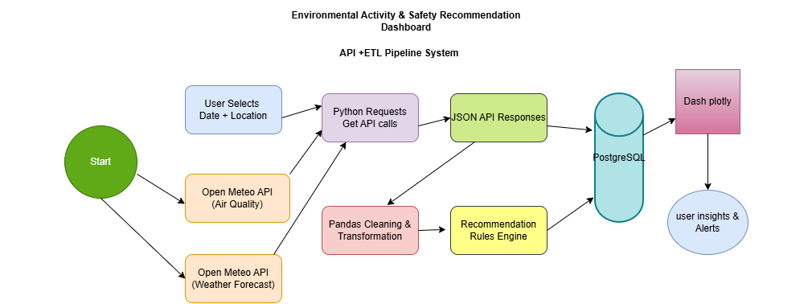
3. Pipeline architecture overview
Production-style flow from API extraction through storage, reporting, and user-facing alerts.
Architecture highlights
API reliability • Pandas transformation • PostgreSQL persistence • rule-based recommendations • Dash decision layer
Executive Presentation | Environmental Activity & Safety Recommendation Dashboard | 4
Notes:
Use this slide to briefly demonstrate the end-to-end thinking. The architecture diagram shows API retrieval, JSON responses, Pandas processing, recommendation logic, PostgreSQL storage, and Power BI delivery.

Slide 5
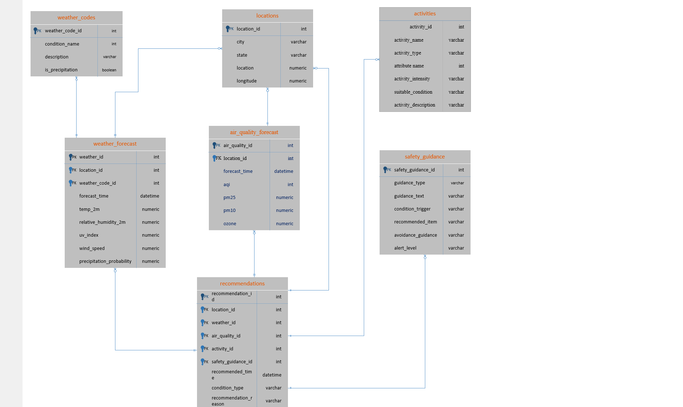
4. Database schema: normalized model supports clean reporting
Forecast observations, reference data, and final recommendations are separated for consistency and reuse.
Schema highlights
locations
City, state, latitude and longitude for supported places
weather_forecast
Temperature, humidity, UV, wind and precipitation records
air_quality_forecast
AQI, PM2.5, PM10 and ozone measurements
activities + safety_guidance
Reusable options and rule messages
recommendations
Final outputs that link conditions to actions
Why it matters
Reusable rules reduce duplicate logic, improve data quality, and make Dash reporting easier to maintain.
Executive Presentation | Environmental Activity & Safety Recommendation Dashboard | 5
Notes:
Connect the schema to business reliability. The normalized design separates reference data from forecasts and recommendations, making the dashboard easier to scale, validate, and maintain.

Slide 6
5. ETL, validation, and error handling approach
The pipeline is designed to be reproducible, auditable, and resilient to missing or failed API data.
Extract
Transform
Load
Validate
Monitor
Requests pulls weather and air quality JSON from Open-Meteo for Louisville, KY.
Pandas cleans fields, handles missing values, standardizes timestamps, and formats relational data.
Processed tables load into PostgreSQL for reporting and downstream recommendation generation.
Checks confirm required columns, valid ranges, non-null keys, and realistic environmental values.
Logging captures API calls, row counts, failures, and rule outputs for troubleshooting.
Validation examples
AQI: 0–500 expected range
UV index: 0–11+ alert categories
Precipitation: 0–100% probability
Foreign keys: forecast + guidance links resolve
Executive Presentation | Environmental Activity & Safety Recommendation Dashboard | 6
Notes:
Emphasize production thinking: a dashboard is only useful if users can trust the data. Validation checks and logging make the pipeline more reliable and maintainable.

Slide 7
6. Recommendation logic: turn conditions into guidance
Rule thresholds convert raw values into activity suggestions and safety alerts.
AQI
Precipitation
Temperature
UV Index
0–50 outdoor OK
51–100 moderate
>100 reduce exposure
0–30% outdoor
30–70% covered plans
>70% indoor options
50–75°F ideal
>85°F heat caution
Cold = layered clothing
0–2 outdoor OK
3–5 SPF 30
6–10 SPF 50
11+ indoor preferred
Example output shown to users
Business value
Condition trigger: High UV + warm conditions
The dashboard removes interpretation burden. Instead of expecting users to understand AQI, UV, PM levels, and rain probability, the system provides a clear decision.
Recommendation: Outdoor walking in shaded areas. Use SPF 50 sunscreen, sunglasses, hydration, and limit direct sun exposure.
Executive Presentation | Environmental Activity & Safety Recommendation Dashboard | 7
Notes:
This slide is the key value story. Explain that the rules translate environmental complexity into practical guidance that a family, commuter, or fitness enthusiast can use quickly.

Slide 8
7. Dashboard demonstration: designed for fast decisions
Dash turns pipeline outputs into KPIs, trend charts, filters, alerts, and recommendation cards.
Dash dashboard view
Executive demo script
AQI
Current air quality
PM2.5
Fine particles
UV Index
Sun exposure
Rain %
Precipitation risk
1
Filter by forecast day and environmental condition.
2
Review KPIs: AQI, PM2.5, PM10, UV, temperature, precipitation.
3
Use trend charts to identify periods of elevated risk.
4
Read recommendation cards and safety alerts for action.
Visual focus
Recommendation card
The dashboard is built for non-technical users: simple condition cards, charts, filters, and recommendation language instead of raw tables.
Suggested activity: shaded walk or indoor fitness
Safety alert: use sunscreen + hydrate
Executive Presentation | Environmental Activity & Safety Recommendation Dashboard | 8
Notes:
Use this slide as your dashboard demo if a live demo is not required. If you have screenshots from Power BI, replace the mockup on the left with your actual screenshot and keep the demo script on the right.

Slide 9
8. Business impact: safer planning, faster decisions, stronger awareness
The project converts public environmental data into operational decision support for daily life and community planning.
Safer activity planning
Improved preparedness
Users receive alerts for poor AQI, high UV, heat, snow, rain, and wind before choosing activities.
Guidance recommends sunscreen, hydration, umbrellas, winter protection, or indoor alternatives.
Community awareness
Reusable analytics asset
Trend views help residents understand how air quality and weather shape outdoor safety.
The same pipeline can scale to new locations, dashboards, or public-health style reporting.
Business value
The primary business value of this project is that it transforms weather and air-quality data into actionable recommendations, helping users make safer, healthier, and more informed daily decisions
Executive Presentation | Environmental Activity & Safety Recommendation Dashboard | 9
Notes:
This is the executive impact slide. Speak less about code and more about outcomes: safety, preparedness, awareness, and a reusable analytics foundation.

Slide 10
9. Link
The Dash. App link
Dash dashboard link: http://127.0.0.1:8050/
Executive Presentation | Environmental Activity & Safety Recommendation Dashboard | 10
Notes:
Close with confidence. State that the repository supports reproducibility and that the project demonstrates production thinking and executive communication.

