Slide 1
1
Preliminaries

Slide 2
Contents
Unit analysis
Exponential and scientific notations
Software development
Algorithms
Software, hardware, and computer storage
Common programming errors

Slide 3
Preliminary One: Unit Analysis
Using consistent and correct units when making computations is crucial
Performing a unit analysis
Include only the units and conversion factors in an equation
Cancel out corresponding units in the numerator and denominator

Slide 4
Preliminary One: Unit Analysis
Engineering and scientific units:
English Engineering system and the International System (SI)‏ are commonly used
Apply one conversion factor at a time and cancel units as you go along to avoid multiplying or dividing by the wrong conversion factor
If the final units do not yield the correct resulting units, then the resulting numerical answer must be incorrect

Slide 5
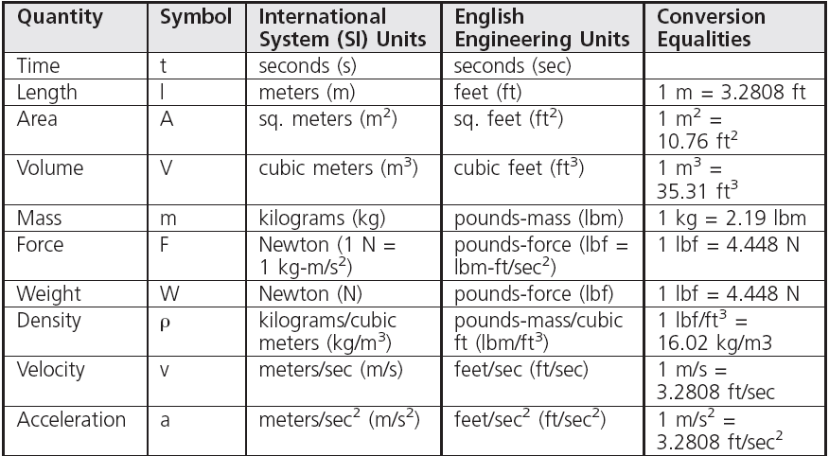
Preliminary One: Unit Analysis
Table 1.1 Commonly Used Physical Quantities

Slide 6
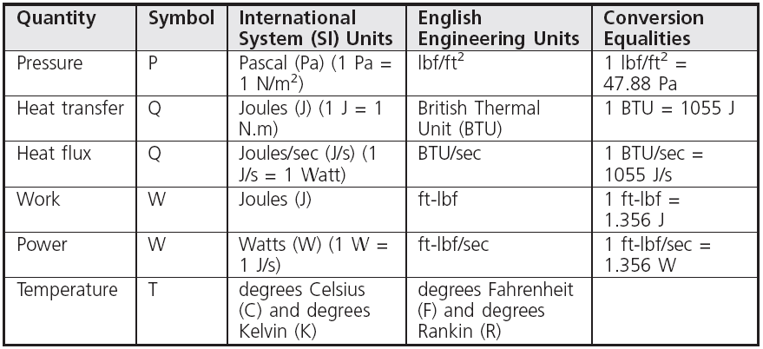
Preliminary One: Unit Analysis
Table 1.1 Commonly Used Physical Quantities (continued)

Slide 7
Preliminary Two: Exponential and Scientific Notations
Many engineering and scientific applications deal with extremely large and extremely small numbers
Written in exponential notation to make entering the numbers in a computer program easier
Written in scientific notation when performing hand calculations for verification purposes

Slide 8
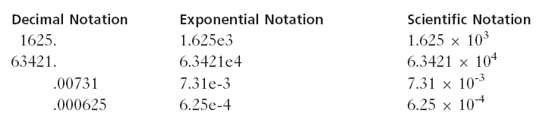
Preliminary Two: Exponential and Scientific Notations
Examples of exponential and scientific notation:

Slide 9
Using Scientific Notation
Essential in understanding what formulas are to be used and verifying calculations, typically by hand
Convenient for evaluating formulas that use very large or very small numbers
Two basic exponential rules
Rule 1: 10^{n} x 10^{m} = 10^{n+m} for any values, positive or negative, of n and m
Rule 2: 1/10^{-n} = 10^{n} for any positive or negative value of n

Slide 10
Using Scientific Notation
If exponent is positive, it represents the actual number of zeros that follow the 1
If exponent is negative, it represents one less than the number of zeros after the decimal point and before the 1
Scientific notation can be used with any decimal number
Not just powers of 10

Slide 11
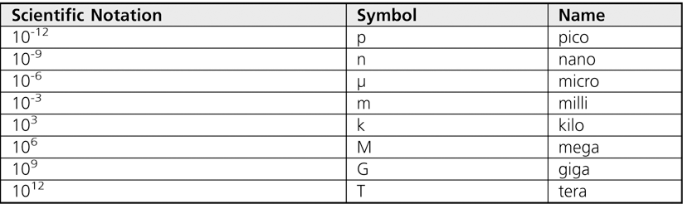
Using Scientific Notation
Common scientific notations have their own symbols
Table 1.2 Scientific Notational Symbols

Slide 12
Preliminary Three: Software Development
Computer program: Self-contained set of instructions used to operate a computer to produce a specific result
Also called software
Solution developed to solve a particular problem, written in a form that can be executed on a computer
Writing a program is almost the last step in a process that determines:
The problem to be solved
The method to be used in the solution

Slide 13
Preliminary Three: Software Development
Software development procedure: Helps developers understand the problem to be solved and create an effective, appropriate software solution
Software engineering:
Concerned with creating readable, efficient, reliable, and maintainable programs and systems
Uses software development procedure to achieve this goal

Slide 14
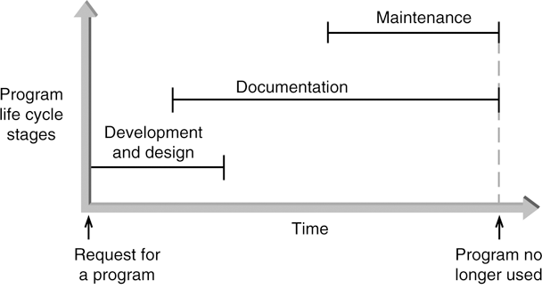
Preliminary Three: Software Development
Figure 1.1 The three phases of program development

Slide 15
Phase I: Development and Design
Program requirement: request for a program or a statement of a problem
After a program requirement is received, Phase I begins
Phase I consists of four steps:
Analysis
Design
Coding
Testing

Slide 16
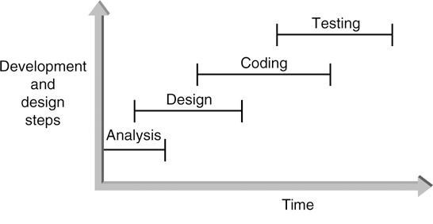
Phase I: Development and Design
Figure 1.2 The development and design steps

Slide 17
Phase I: Development and Design
Step 1: Analyze the Problem
Determine and understand the output items the program must produce
Determine the input items
Both items referred to as the problem's input/output (I/O)‏

Slide 18
Phase I: Development and Design
Step 2: Develop a Solution
Select the exact set of steps, called an “algorithm,” to be used to solve the problem
Find the solution by a series of refinements
Start with initial solution in the analysis step until you have an acceptable and complete solution
Check solution
Refine initial structure until the tasks in the boxes are completely defined

Slide 19
Phase I: Development and Design
Inventory
control
program
Data
entry
section
Calculation
section
Report
section
Figure 1.3 A first-level structure diagram

Slide 20
Phase I: Development and Design
Step 2: Develop a Solution
Example: a second-level structure diagram for an inventory tracking system with further refinements
Inventory
control
program
Data
entry
section
Calculation
section
Report
section
Enter
data
Change
data
Delete
data
Screen
reports
Printer
reports
Figure 1.4 A second-level structure diagram

Slide 21
Phase I: Development and Design
Step 3: Code the Solution
Consists of actually writing a C++ program that corresponds to the solution developed in Step 2
Program statements should conform to certain well-designed patterns or structures that have been defined in solution step

Slide 22
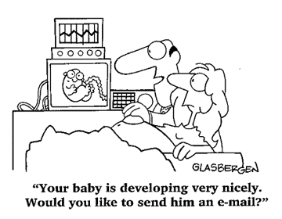
Phase I: Development and Design
Step 3: Code the Solution
Program should contain well-defined patterns or structures of the following types:
Sequence
Selection
Iteration
Invocation

Slide 23
Phase I: Development and Design
Step 3: Code the Solution
Sequence: Defines the order in which instructions are executed
Selection: Allows a choice between different operations, based on some condition
Iteration: Allows the same operation to be repeated based on some condition
Also called looping or repetition
Invocation: Involves invoking a set of statements when needed

Slide 24
Phase I: Development and Design
Step 4: Test and Correct the Program
Testing: Method to verify correctness and that requirements are met
Bug: A program error
Debugging: The process of locating an error, and correcting and verifying the correction
Testing may reveal errors, but does not guarantee the absence of errors

Slide 25
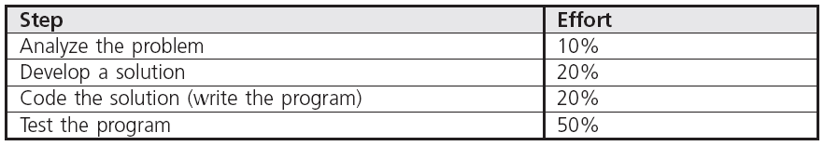
Phase I: Development and Design
Step 4: Test and Correct the Program
Table 1.3 lists the comparative amount of effort typically expended on each development and design step in large commercial programming projects
Table 1.3 Effort Expended in Phase I

Slide 26
Phase II: Documentation
Five main documents for every problem solution:
Program description
Algorithm development and changes
Well-commented program listing
Sample test runs
Users' manual

Slide 27
Phase III: Maintenance
Maintenance includes:
Ongoing correction of newly discovered bugs
Revisions to meet changing user needs
Addition of new features
Usually the longest phase
May be the primary source of revenue
Good documentation vital for effective maintenance

Slide 28
Backup
Process of making copies of program code and documentation on a regular basis
Backup copies = insurance against loss or damage
Consider using off-site storage for additional protection

Slide 29
Preliminary Four: Algorithms
Algorithm:
Step-by-step sequence of instructions that:
Must terminate
Describe how the data is to be processed to produce the desired output

Slide 30

Preliminary Four: Algorithms
Pseudocode: English-like phrases used to describe the steps in an algorithm
Formula: Mathematical equations
Flowchart: Diagrams with symbols

Slide 31
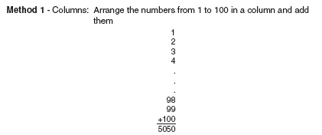
Preliminary Four: Algorithms
Problem: Calculate the sum of all whole numbers from 1 through 100
Figure 1.5 Summing the numbers 1 to 100

Slide 32
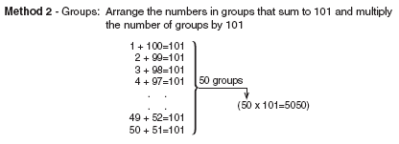
Preliminary Four: Algorithms
Figure 1.5 Summing the numbers 1 to 100

Slide 33
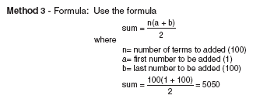
Preliminary Four: Algorithms
Figure 1.5 Summing the numbers 1 to 100

Slide 34
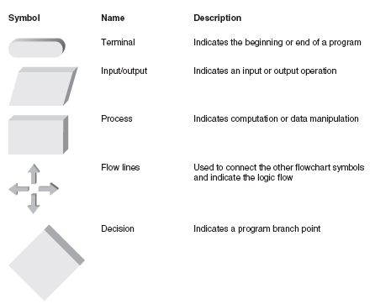
Preliminary Four: Algorithms
Figure 1.6 Flowchart symbols

Slide 35

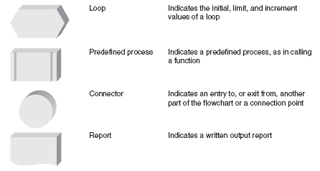
Preliminary Four: Algorithms
Figure 1.6 Flowchart symbols

Slide 36
Preliminary Four: Algorithms
Start
Input
Three
values
Calculate
the
average
Display
the
average
End
Figure 1.7 Flowchart for calculating the average of three numbers

Slide 37
A Closer Look: Software, Hardware, and Computer Storage
Programming: Process of writing a program, or software
Programming language:
Set of instructions used to construct a program
Comes in a variety of forms and types

Slide 38
Machine Language
Only programs that can actually be used to operate a computer
Also referred to as executable programs (executables)
Consists of a sequence of instructions composed of binary numbers
Contains two parts: an instruction and an address

Slide 39
Assembly Language
Substitute word-like symbols, such as ADD, SUB, and MUL, for binary opcodes
Use decimal numbers and labels for memory addresses
Example: ADD 1, 2
Assemblers: Translate programs into machine language

Slide 40
Assembly Language
An assembly-
language
program
Translation
program
(assembler)
A Machine-
language
program
MOV AH, 9
B4 09
10110100 00001001
Figure 1.9 Assembly-language programs must be translated

Slide 41

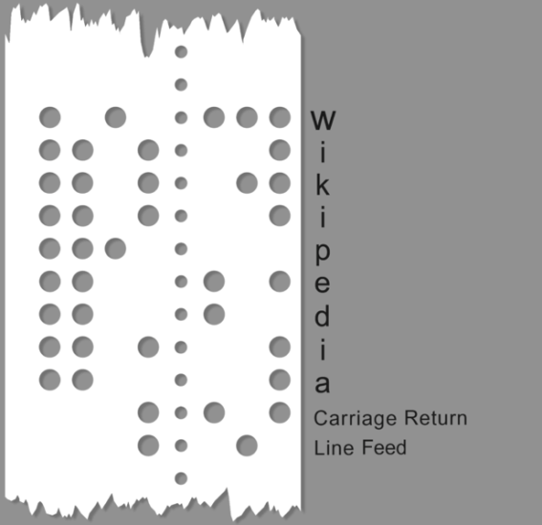
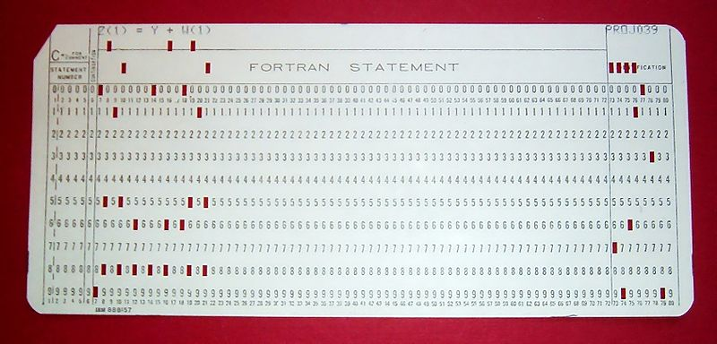
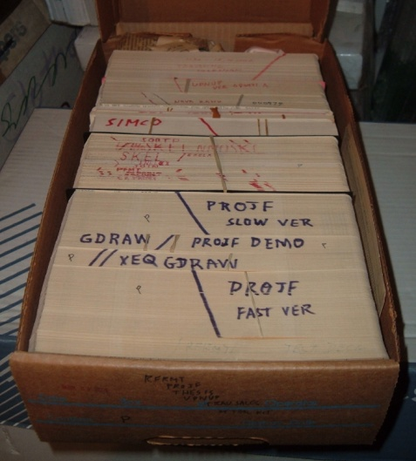
Assembly Language
Punched Tape and Punched Card

Slide 42
Low- and High-Level Languages
Low-level languages: Languages that use instructions tied directly to one type of computer
Examples: machine language, assembly language
High-level languages: Instructions resemble written languages, such as English
Can be run on a variety of computer types
Examples: Visual Basic, C, C++, Java, Fortran

Slide 43
Low- and High-Level Languages
Source code: The programs written in a high- or low-level language
Source code must be translated to machine instructions in one of two ways:
Interpreter: Each statement is translated individually and executed immediately after translation
Compiler: All statements are translated and stored as an executable program, or object program; execution occurs later
C++ is predominantly a compiled language

Slide 44
Low- and High-Level Languages
Large C++ programs may be stored in two or more separate program files due to:
Use of previously written code
Use of code provided by the compiler
Modular design of the program (for reusability of components)‏
Linker: Combines all of the compiled code required for the program

Slide 45
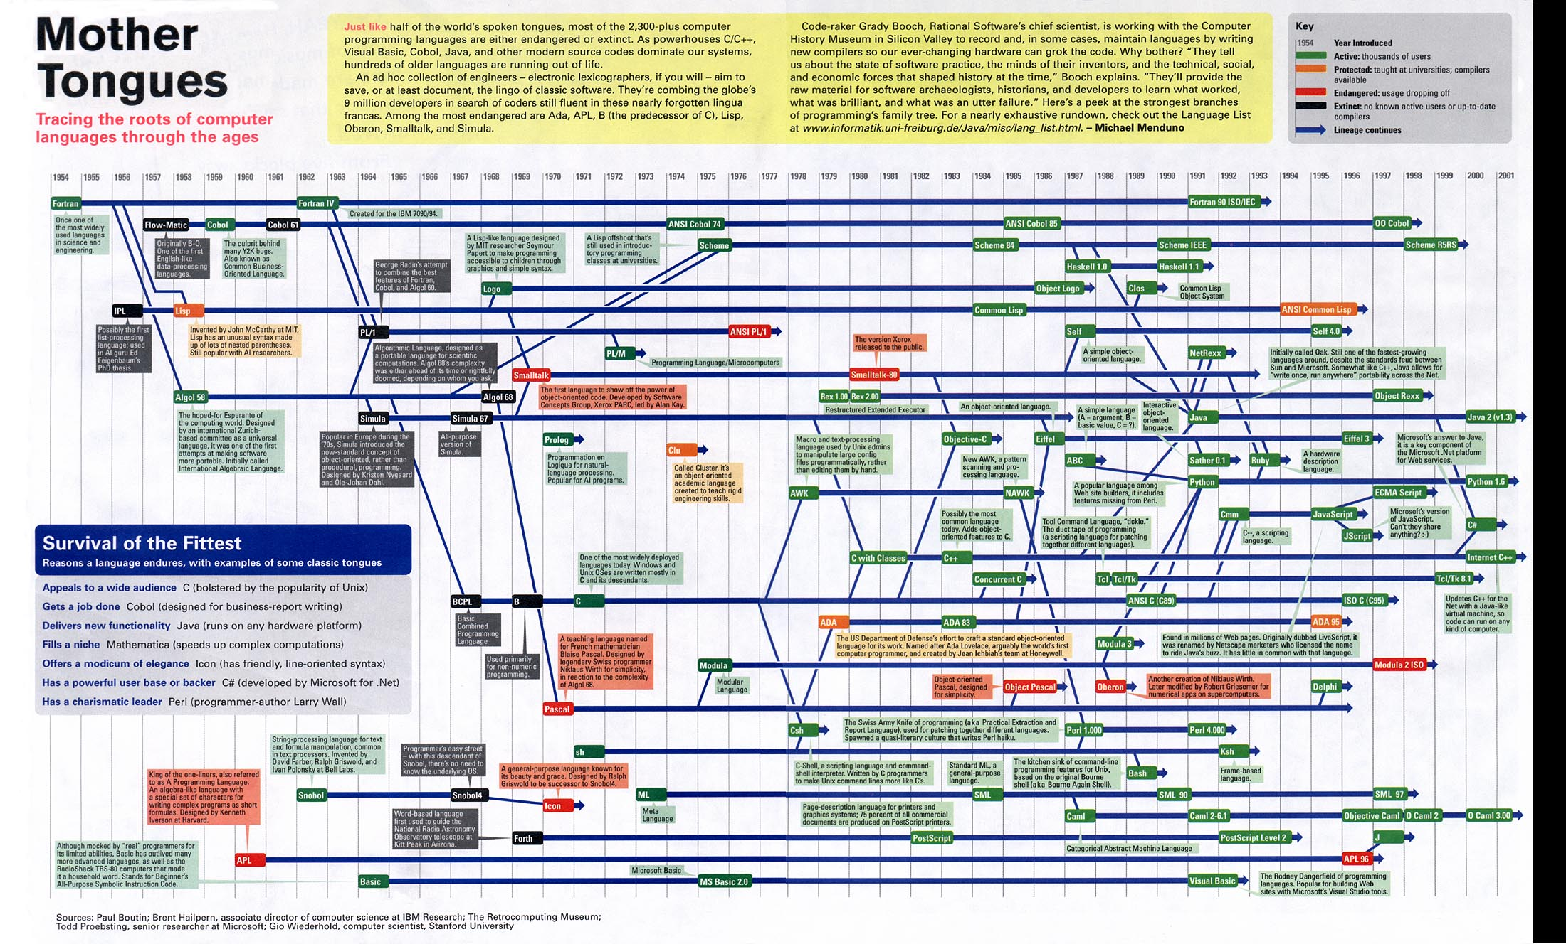
Low- and High-Level Languages

Slide 46
Procedural and Object Orientations
Programs can also be classified by their orientation:
Procedural: Available instructions are used to create self-contained units called procedures
Object-oriented: Reusable objects, containing code and data, are manipulated
Object-oriented languages support reusing existing code more easily
C++ contains features of both

Slide 47
Procedural and Object Orientations
Type in the C++ program
Editor
The C++
source program
Compiler
The C++
object program
Other
Object
files
(library)
Linker
An
executable
program
Figure 1.10 Creating an executable C++ program

Slide 48
Application and System Software
Application software: Programs written to perform particular tasks for users
System software: Collection of programs to operate the computer system
System software must be loaded first; called booting the system
Bootstrap loader: A permanent, automatically executed component to start the boot process

Slide 49
Application and System Software
Operating system: The set of system programs used to operate and control a computer
Also called OS
Tasks performed by the OS include:
Memory management
Allocation of CPU time
Control of input and output
Management of secondary storage devices

Slide 50
Application and System Software‏
Multi-user system: A system that allows more than one user to run programs on the computer simultaneously
Multitasking system: A system that allows each user to run multiple programs simultaneously
Also called multiprogrammed system

Slide 51
The Development of C++
The purpose of most application programs is to process data to produce specific results
Process
the
data
Input data
Output results
Figure 1.11 Basic procedural operations

Slide 52
The Development of C++‏
Early procedural languages included:
FORTRAN: Formula Translation
ALGOL: Algorithmic Language
COBOL: Common Business Oriented Language
BASIC: Beginners All-purpose Symbolic Instruction Code
Pascal
C
Early object-oriented language:
C++

Slide 53
History of C++
C++ began as extension to C, which is procedural language developed in the 1970s at AT&T Bell Laboratories
In early 1980s, Bjarne Stroustrup (also at AT&T) used his background in simulation languages to develop C++
Object-orientation and other procedural improvements were combined with existing C language features to form C++

Slide 54



History of C++
Kenneth Lane Thompson
Dennis MacAlistair Ritchie
http://cm.bell-labs.com/who/dmr/index.html
Bjarne Stroustrup
http://www.research.att.com/~bs/

Slide 55
Computer Hardware
Computer hardware: Components that support the capabilities of the computer
Central processing unit (CPU)
Arithmetic and logic unit (ALU)
Input
Control
Output
Memory
Secondary
storage
Figure 1.14 Basic hardware units of a computer

Slide 56
Computer Hardware
Components include:
Arithmetic and logic unit (ALU): Performs arithmetic and logic functions
Control unit: Directs and monitors overall operations
Memory unit: Stores instructions and data
Input and output (I/O) unit: Interfaces to peripheral devices
Secondary storage: Nonvolatile permanent storage such as hard disks

Slide 57

Computer Hardware‏
Central processing unit (CPU): Also called microprocessor; combines the ALU and control unit on a single chip

Slide 58
Computer Hardware‏
Microprocessor
(CPU)
Memory
Input
Output
Figure 1.15 VLSI chip connections for a desktop computer

Slide 59
Computer Storage
Bit: Smallest unit of data; value of 0 or 1
Byte: Grouping of 8 bits representing a single character
Character codes: Collection of patterns of 0s and 1s representing characters
Examples: ASCII, EBCDIC

Slide 60

Computer Storage
Number codes: Patterns used to store numbers
Twos complement number code: Represents a decimal number as a binary number of 0s and 1s
Determine with a value box
Figure 1.17 Converting 10001101 to a base 10 number

Slide 61

Computer Storage‏
Word: Grouping of one or more bytes
Facilitates faster and more extensive data access
Number of bytes in a word determines the maximum and minimum values that can be stored:
Table 1.4 Word size and Integer Values

Slide 62
Common Programming Errors
Common errors include:
Forgetting to check that all units for numerical values used in a calculation are consistent
Using an incorrect form of a conversion factor
Rushing to write and run a program before fully understanding what’s required
Not backing up a program
Not understanding that computers respond only to explicitly defined algorithms

Slide 63
Summary
To determine correct forms of a conversion factor, perform a unit analysis
Software: Programs used to operate a computer
Programming language types:
Low-level languages
Machine language (executable) programs
Assembly languages
High-level languages
Compiler and interpreter languages

Slide 64
Summary‏
Software engineering: discipline concerned with creating readable, efficient, reliable, and maintainable programs
Three phases in software development:
Program development and design
Documentation
Maintenance

Slide 65
Summary‏
Four steps in program development and design:
Analyze the problem
Develop a solution
Code the solution
Test and correct the solution
Algorithm: Step-by-step procedure that describes how a task is performed
Computer program: Self-contained unit of instructions and data used to operate a computer to produce a desired result

Slide 66

Summary‏
Four fundamental control structures used in coding:
Sequence
Selection
Iteration
Invocation

