Slide 1
2
Problem Solving Using C++

Slide 2
Contents
Modular programs
Programming style
Data types
Arithmetic operations
Variables and declaration statements
Common programming errors

Slide 3
Introduction to C++
Modular program: A program consisting of interrelated segments arranged in a logical and understandable form
Easier to develop, correct, and modify than other kinds of programs
Module: A small segment which is designed to perform a specific task
A group of modules is used to construct a modular program

Slide 4
Introduction to C++
Module 1
Module 2
Module 3
Module 4
Module 5
Module 6
Figure 2.1 A well-designed program is built using modules.

Slide 5
Introduction to C++
Modules in C++ can be classes or functions
Function: Accepts an input and produces an output by processing the input in some fashion
A function’s processing is encapsulated and hidden within the function

Slide 6
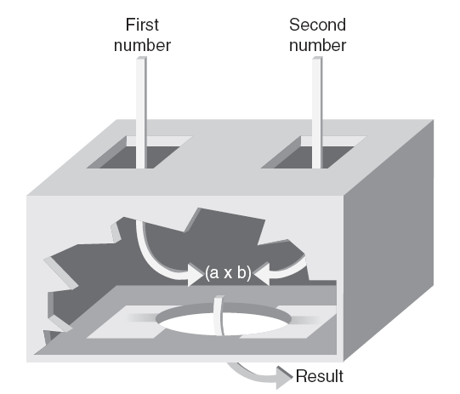
Introduction to C++‏
Figure 2.2 A multiplying function.

Slide 7
Introduction to C++
Class: Contains both data and functions used to manipulate the data
Function: Encapsulates a set of operations
A class encapsulates data plus one or more sets of operations
Identifier: A name given to an element of the language, such as a class or function

Slide 8
Introduction to C++
Rules for forming identifier names:
First character must be a letter or underscore
Only letters, digits, or underscores may follow the initial letter (no blanks allowed)‏
Keywords cannot be used as identifiers
Maximum length of an identifier = 1024 characters

Slide 9
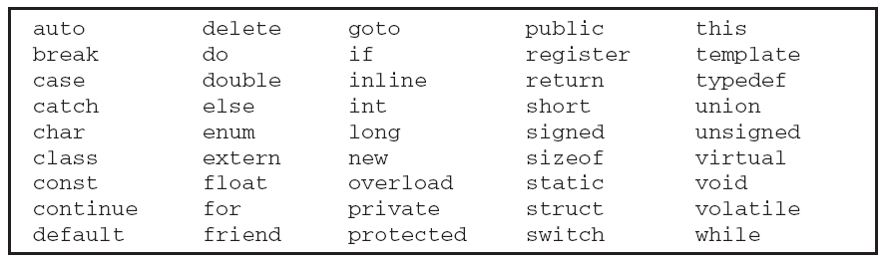
Introduction to C++
Keyword: A reserved name that represents a built-in object or function of the language
Table 2.1: Keywords in C++

Slide 10
Introduction to C++
Examples of valid C++ identifiers:
degToRad intersect addNums
slope bessell multTwo
findMax density
Examples of invalid C++ identifiers:
1AB3 (begins with a number)‏
E*6 (contains a special character)‏
while (this is a keyword)‏

Slide 11
Introduction to C++
Function names
Require a set of parentheses at the end
Can use mixed upper and lower case
Should be meaningful, or be a mnemonic
Mnemonic: A word designed as a memory aid
Examples of function names:
easy() c3po() r2d2() theForce()‏
Note that C++ is a case-sensitive language!

Slide 12

The main() Function
Overall structure of a C++ program contains one function named main(), called the driver function
All other functions are invoked from main()‏

Slide 13
The main() Function
main
1st module
You go first
I’m done
2nd module
You go second
I’m done
3rd module
You go third
I’m done
…
…
last module
You go last
I’m done
Figure 2.3 The main() function directs all other functions.

Slide 14
The main() Function
Function header line: First line of a function, which contains:
The type of data returned by the function (if any)‏
The name of the function
The type of data that must be passed into the function when it is invoked (if any)‏
Arguments: The data passed into a function
Function body: The statements inside a function (enclosed in braces)‏

Slide 15
The main() Function
Each statement inside the function must be terminated with a semicolon
return: A keyword causing the appropriate value to be returned from the function
The statement return 0 in the main() function causes the program to end

Slide 16
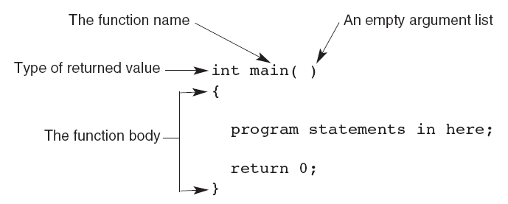
The main() Function
Figure 2.4 The structure of a main() function

Slide 17
The cout Object
cout object: An output object that sends data to a standard output display device
Program 2.1
#include <iostream>
using namespace std;
int main()
{
cout << "Hello there world!";
return 0;
}
The Output from Program 2.1
Hello there world!

Slide 18
The cout Object‏
Preprocessor command: Starts with a #
Causes an action before the source code is compiled into machine code
#include <file name>: Causes the named file to be inserted into the source code
C++ provides a standard library with many pre-written classes that can be included
Header files: Files included at the head (top) of a C++ program

Slide 19
The cout Object
using namespace <namespace name> : Indicates where header file is located
Namespaces qualify a name
A function name in your class can be the same as one used in a standard library class
String: Any combination of letters, numbers, and special characters enclosed in double quotes (a delimiter)‏
Delimiter: A symbol that marks the beginning and ending of a string; not part of the string

Slide 20
The cout Object
Program 2.2
#include <iostream>
using namespace std;
int main()
{
cout << "Computers, computers everywhere";
cout << "\n as far as I can C";
return 0;
}
The Output from Program 2.2
Computers, computers everywhere
as far as I can C

Slide 21
The cout Object
Program 2.3
#include <iostream>
using namespace std;
int main()
{
cout << "Computers everywhere\n as far as\n\nI can see";
return 0;
}
The Output from Program 2.3
Computers everywhere
as far as
I can see

Slide 22
Programming Style
Although more than one C++ statement can be on a single line, good style calls for one statement per line
Opening and closing braces {} for the function body should each be on separate lines
Statements in the function body should be indented

Slide 23
Comments
Comments: Explanatory remarks in the source code added by the programmer
Line comment: Begins with // and continues to the end of the line
Line comment can be on a line by itself, or at the end of a line of code
Line comment cannot be longer than one line

Slide 24
Comments
Program 2.4
// this program displays a message
#include <iostream>
using namespace std;
int main()
{
cout << "Hello there world!"; //this produces the display
return 0;
}

Slide 25
Comments
Block comments: Span across two or more lines
Begin with /* and ends with */
Example:
/* This is a block comment that
spans
across three lines */

Slide 26
Data Types
Data type: A set of values and the operations that can be applied to these values
Two fundamental C++ data groupings:
Class data type (a class): Created by the programmer
Built-in data type (primitive type): Part of the C++ compiler

Slide 27
Data Types
Numerical data types
Integer types
Floating-point
types
Figure 2.5 Built-in data types

Slide 28
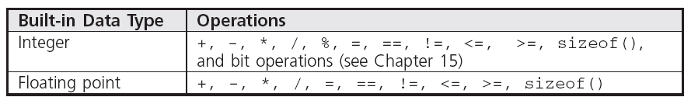
Data Types
Table 2.2 Built-in Data Types Operations

Slide 29
Data Types
Literal (constant): An actual value
Examples:
3.6 //numeric literal
“Hello” //string literal
Integer: A whole number
C++ has nine built-in integer data types
Each provides differing amounts of storage (compiler dependent)

Slide 30
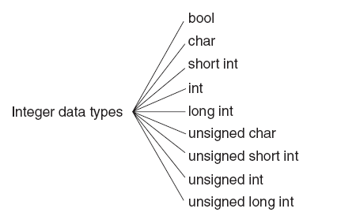
Integer Data Types
Figure 2.6 C++ integer data types

Slide 31
Integer Data Types
int data type: Whole numbers, optionally with plus (+) or minus (–) sign
Example: 2
char data type: Individual character; any letter, digit, or special character enclosed in single quotes
Example: ‘A’
Character values are usually stored in ASCII code

Slide 32
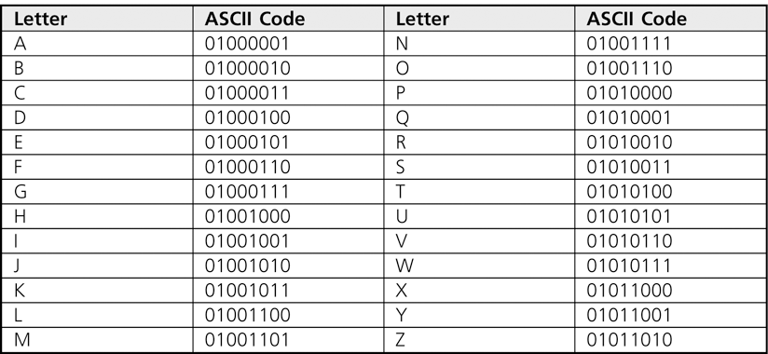
Integer Data Types
Table 2.3 The ASCII Uppercase Letter Codes

Slide 33
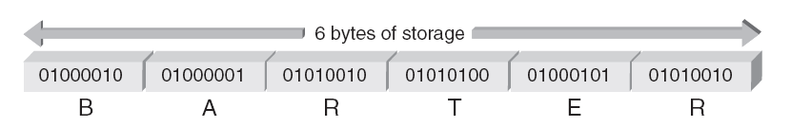
Integer Data Types
When storing the ASCII codes shown in Table 2.3 to represent text, each letter takes one byte of memory and is represented by the associated number from the chart
Figure 2.7 The letters BARTER stored inside a computer

Slide 34
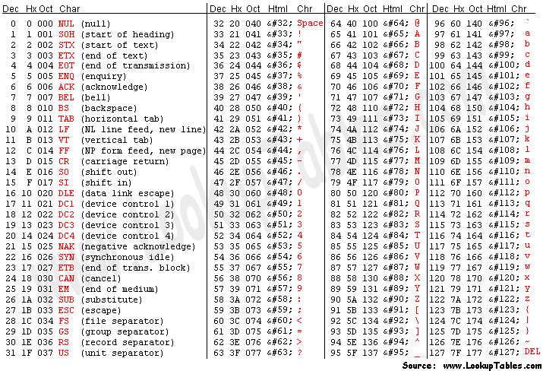
Integer Data Types
ASCII (American Standard Code for Information Interchange)

Slide 35

Integer Data Types
Escape character: The backslash, \
Indicates an escape sequence
Escape sequence: Tells compiler to treat the following characters as special instruction codes

Slide 36
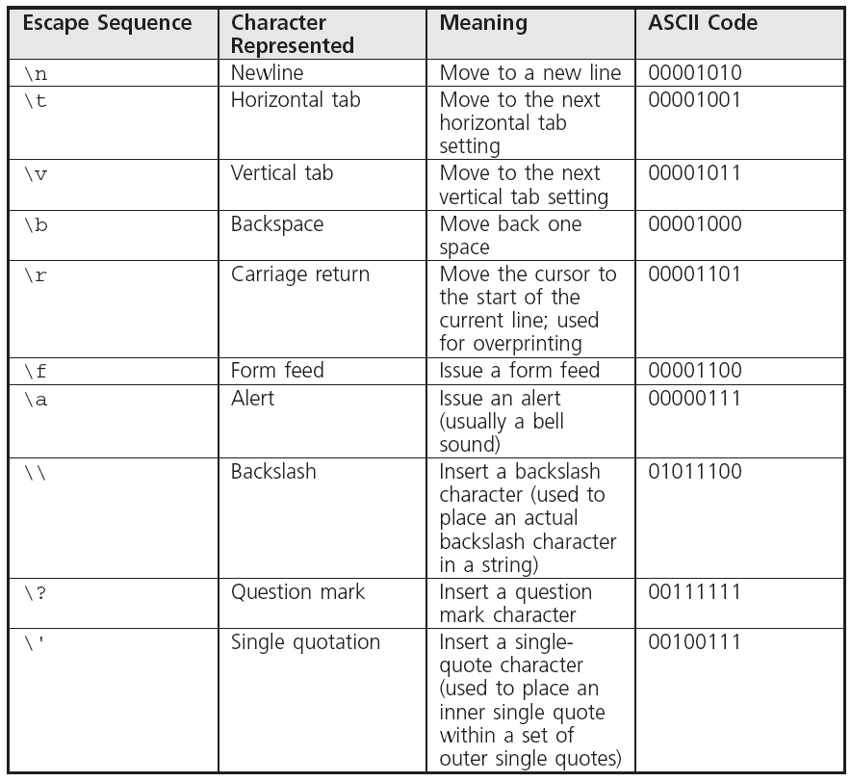
Integer Data Types
Table 2.4 Escape sequences

Slide 37
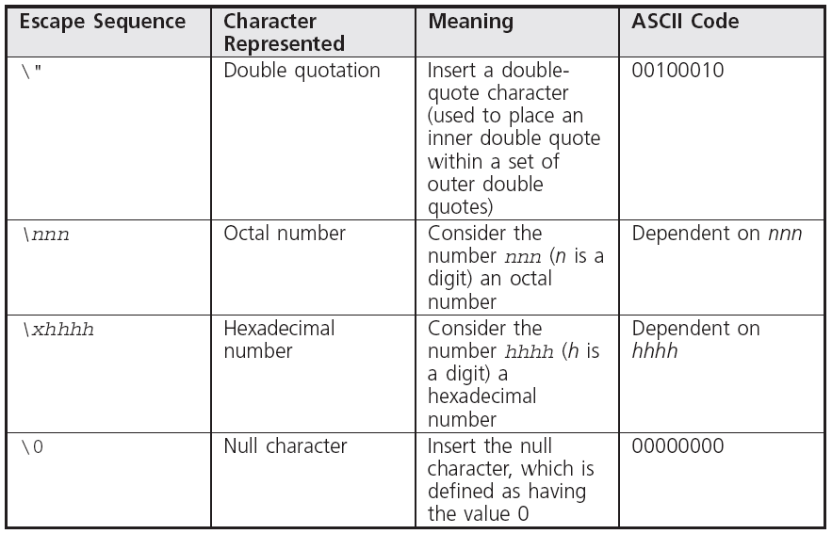
Integer Data Types
Table 2.4 Escape sequences

Slide 38
Integer Data Types
bool data type: Represents Boolean (logical) data
Restricted to two values: true or false
Useful to indicate a condition and take a prescribed course of action

Slide 39
Determining Storage Size
A unique feature of C++ is that you can see where and how values are stored
sizeof() operator provides the number of bytes used to store values of the data type names in the parenthesis
Values returned by sizeof() are compiler dependent

Slide 40
Determining Storage Size
Program 2.5
#include <iostream>
using namespace std;
int main()
{
cout << "\nData Type Bytes"
<< "\n--------- -----"
<< "\nint " << sizeof(int)
<< "\nchar " << sizeof(char)
<< "\nbool " << sizeof(bool)
<< '\n';
return 0;
}
The Output from Program 2.5
Data Type Bytes
--------- -----
int 4
char 1
bool 1

Slide 41
Signed and Unsigned Data Types
Signed data type: One that permits negative, positive, and zero values
Unsigned data type: Permits only positive and zero values
An unsigned data type provides essentially double the range of its signed counterpart

Slide 42
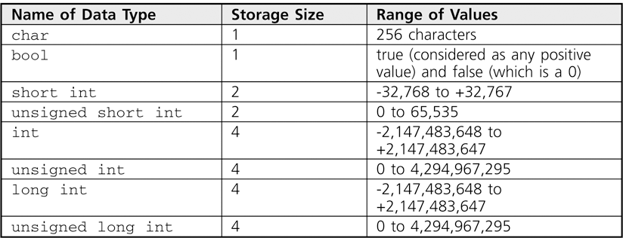
Signed and Unsigned Data Types
Table 2.5 Integer Data Type Storage

Slide 43
Floating-Point Types
Floating-point number (real number): Zero or any positive or negative number containing a decimal point
Examples: +10.625 5. -6.2
No special characters are allowed
Three floating-point data types in C++:
float (single precision)‏
double (double precision)‏
long double

Slide 44
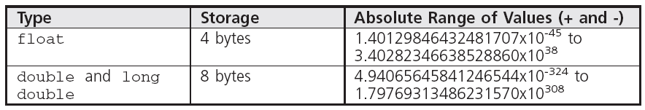
Floating-Point Types
Table 2.6 Floating-Point Data Types

Slide 45
Floating-Point Types
float literal: Append an f or F to the number
long double literal: Append an l or L to the number
Examples:
9.234 // a double literal
9.234F // a float literal
9.234L // a long double literal

Slide 46
Arithmetic Operations
C++ supports addition, subtraction, multiplication, division, and modulus division
Different data types can be used in the same arithmetic expression
Arithmetic operators are binary operators
Binary operators: Require two operands

Slide 47
Arithmetic Operations
Operation
Operator
Addition
+
Subtraction
-
Multiplication
*
Division
/
Modulus division
%

Slide 48
Arithmetic Operations‏
Program 2.6
#include <iostream>
using namespace std;
int main()
{
cout << "15.0 plus 2.0 equals " << (15.0 + 2.0) << endl
<< "15.0 minus 2.0 equals " << (15.0 - 2.0) << endl
<< "15.0 times 2.0 equals " << (15.0 * 2.0) << endl
<< "15.0 divided by 2.0 equals " << (15.0 / 2.0) << endl;
return 0;
}
The Output from Program 2.6
15.0 plus 2.0 equals 17
15.0 minus 2.0 equals 13
15.0 times 2.0 equals 30
15.0 divided by 2.0 equals 7.5

Slide 49
Expression Types
Expression: Any combination of operators and operands that can be evaluated to yield a value
If all operands are the same data type, the expression is named by the data type used (integer expression, floating-point expression, etc.)‏
Mixed-mode expression: Contains integer and floating-point operands
Yields a double-precision value

Slide 50
Integer Division
Integer division: Yields an integer result
Any fractional remainders are dropped (truncated)‏
Example: 15/2 yields 7
Modulus (remainder) operator: Returns only the remainder
Example: 9 % 4 yields 1

Slide 51
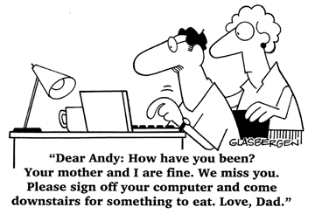
Negation
Unary operator: Requires only one operand
Negation operator (-): Reverses the sign of the number

Slide 52
Operator Precedence and Associativity
Rules for writing arithmetic expressions:
Never place two consecutive binary arithmetic operators side by side
Use parentheses to form groupings
Contents within parentheses are evaluated first
May nest parentheses within other parentheses
Evaluated from innermost to outermost
Use the * operator for multiplication, not parentheses

Slide 53
Operator Precedence and Associativity
Expressions with multiple operators are evaluated by precedence of operators:
All negations occur first
Multiplication, division, and modulus are next, from left to right
Addition and subtraction are last, from left to right

Slide 54
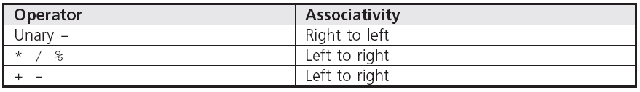
Operator Precedence and Associativity
Associativity: the order in which operators of the same precedence are evaluated
Table 2.8 Operator Precedence and Associativity

Slide 55
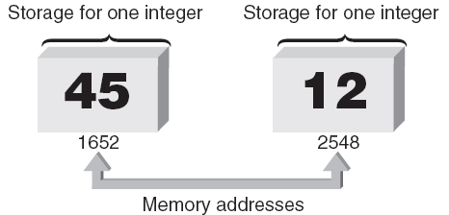
Variables and Declaration Statements
Variable: All integer, float-point, and other values used in a program are stored and retrieved from the computer's memory
Each memory location has a unique address
Figure 2.8 Enough storage for two integers

Slide 56
Variables and Declaration Statements
Variable: Symbolic identifier for a memory address where data can be held
Use identifier naming rules for variable names
Variable names
num1
num2
total
45
12
57
1652
2548
3000
Memory addresses
Figure 2.9 Naming storage locations

Slide 57
Variables and Declaration Statements
Assignment statement: Used to store a value into a variable
Value of the expression on the right side of the = is assigned to the memory location of the variable on the left side of the =
Examples:
num1 = 45;
num2 = 12;
total = num1 + num2;

Slide 58
Variables and Declaration Statements
Declaration statement: Specifies the data type and identifier of a variable; sets up the memory location
Syntax: dataType variableName;
Data type is any valid C++ data type
Example: int sum;
Declarations may be used anywhere in a function
Usually grouped at the opening brace

Slide 59
Variables and Declaration Statements
Character variables: Declared using the char keyword
Multiple variables of the same data type can be declared in a single declaration statement
Example:
double grade1, grade2, total, average;
Variables can be initialized in a declaration
Example:
double grade1 = 87.0;
A variable must be declared before it is used

Slide 60
Variables and Declaration Statements
Program 2.7
#include <iostream>
using namespace std;
int main()
{
double grade1; // declare grade1 as a double variable
double grade2; // declare grade2 as a double variable
double total; // declare total as a double variable
double average; // declare average as a double variable
grade1 = 85.5;
grade2 = 97.0;
total = grade1 + grade2;
average = total/2.0; // divide the total by 2.0
cout << "The average grade is " << average << endl;
return 0;
}
The Output from Program 2.7
The average grade is 91.25

Slide 61
Memory Allocation
Definition statement: A declaration that defines how much memory is needed for data storage
Three items associated with each variable:
Data type
Actual value stored in the variable (its contents)‏
Memory address of the variable
Address operator (&) provides the variable’s address

Slide 62
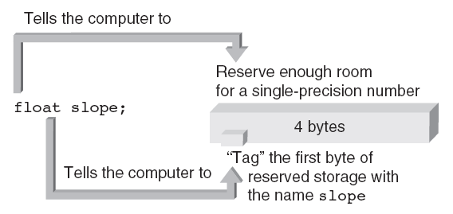
Memory Allocation
Declaring a variable causes memory to be allocated based on the data type
Figure 2.10b Defining the floating-point variable named slope

Slide 63
Memory Allocation
4 bytes of memory
Program 2.10
#include <iostream>
using namespace std;
int main()
{
int num;
num = 22;
cout << “The value stored in num is “ << num << endl;
cout << “The address of num = “ << &num << endl;
return 0;
}
22
0012FED4
Address of first byte used by num
Contents of num
The Output from Program 2.10
The value stored in num is 22
The address of num = 0012FED4

Slide 64
A Case Study: Radar Speed Traps
Step 1: Analyze the Problem
Understand the desired outputs
Determine the required inputs
Step 2: Develop a Solution
Determine the algorithms to be used
Use top-down approach to design
Step 3: Code the Solution
Step 4: Test and Correct the Program

Slide 65
A Case Study: Radar Speed Trap
Analyze the Problem
Output: Speed of the car
Inputs: Emitted frequency and received frequency
Develop a Solution
Algorithm:
Assign values to f_{r} and f_{e}
Calculate and display speed

Slide 66
A Case Study: Radar Speed Trap
Code the Solution
Program 2.11
#include <iostream>
using namespace std;
int main()
{
double speed, fe, fr;
fe = 2e10;
fr = 2.0000004e10;
speed = 6.685e8 * (fr – fe) / (fr + fe);
cout << “The speed is “ << speed << “ miles/hour “ << endl;
return 0;
}
The Output from Program 2.11
The speed is 66.85 miles/hour

Slide 67
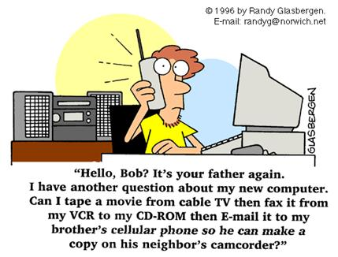
A Case Study: Radar Speed Trap
Test and Correct the Program
Verify that the calculation and displayed value agree with the previous hand calculation
Use the program with different values of received frequencies

Slide 68
Common Programming Errors
Omitting the parentheses after main()‏
Omitting or incorrectly typing the opening brace, {, or the closing brace, }, that signifies the start and end of a function body
Misspelling the name of an object or function
Forgetting to enclose a string sent to cout with quotation marks
Omitting a semicolon at end of statement

Slide 69
Common Programming Errors
Adding a semicolon at end of #include statement
Missing \n to indicate new line
Substituting letter O for zero and vice versa
Failing to declare all variables

Slide 70
Common Programming Errors
Storing an incorrect data type into a variable
Attempting to use a variable with no value
Dividing integer values incorrectly
Mixing data types in the same expression

Slide 71
Summary
A C++ program consists one or more modules, called functions, one of which must be called main()‏
All C++ statements must be terminated by a semicolon
Data types include int, float, bool, char
cout object can be used to display data
cout object requires the preprocessor command #include <iostream>

Slide 72
Summary
Variables must be declared with their data type
A variable can be used only after it has been declared
Variables may be initialized when declared
Definition statement causes computer to allocate memory for a variable
sizeof() operator yields the amount of storage reserved for a variable

