Slide 1
3
Assignment, Formatting, and Interactive Input

Slide 2
Contents
Assignment operations
Formatting numbers for program output
Using mathematical library functions
Program input using the cin object
Symbolic constants
A case study involving acid rain
Common programming errors

Slide 3
Assignment Operations
Assignment Statement: Assigns the value of the expression on the right side of the = to the variable on the left side of the =
Another assignment statement using the same variable will overwrite the previous value with the new value
Examples:
slope = 3.7;
slope = 6.28;

Slide 4
Assignment Operations
Right side of an assignment statement may contain any expression that can be evaluated to a value
Examples:
newtotal = 18.3 + total;
taxes = .06*amount;
average = sum / items;
Only one variable can be on the left side of an assignment statement

Slide 5
Assignment Operations
Program 3.1
// this program calculates the volume of a cylinder,
// given its radius and height
#include <iostream>
using namespace std;
int main()
{
double radius, height, volume;
radius = 2.5;
height = 16.0;
volume = 3.1416 * radius * radius * height;
cout << "The volume of the cylinder is " << volume << endl;
return 0;
}

Slide 6
Assignment Operations
Assignment operator: The = sign
C++ statement: Any expression terminated by a semicolon
Multiple assignments in the same expression are possible
Example:
a = b = c = 25;

Slide 7
Assignment Operations
Coercion: Forcing a data value to another data type
Value of the expression on the right side of an assignment statement will be coerced (converted) to the data type of the variable on the left side during evaluation
Variable on the left side may also be used on the right side of an assignment statement

Slide 8
Assignment Operations
Program 3.2
#include <iostream>
using namespace std;
int main()
{
int sum;
sum = 25;
cout << "The number stored in sum is " << sum << endl;
sum = sum + 10;
cout << "The number now stored in sum is " << sum << endl;
return 0;
}
sum
25
Old value is
overwritten
35
New value is
stored

Slide 9

Assignment Operations
Accumulation statement: Has the effect of accumulating, or totaling
Syntax:
variable = variable + newValue;

Slide 10
Assignment Operations
Additional assignment operators provide short cuts: +=, -=, *=, /=, %=
Example:
sum = sum + 10;
is equivalent to: sum += 10;
price *= rate +1;
is equivalent to:
price = price * (rate + 1);

Slide 11
Assignment Operations
Program 3.3
#include <iostream>
using namespace std;
int main()
{
int sum;
sum = 0;
cout << "The value of sum is initially set to " << sum << endl;
sum = sum + 96;
cout << " sum is now " << sum << endl;
sum = sum + 70;
cout << " sum is now " << sum << endl;
sum = sum + 85;
cout << " sum is now " << sum << endl;
sum = sum + 60;
cout << " The final sum is " << sum << endl;
return 0;
}

Slide 12
Assignment Operations
Counting statement: Adds a fixed value to the variable’s current value
Syntax:
variable = variable + fixedNumber;
Example:
i = i + 1;
count = count + 1;

Slide 13
Assignment Operations
Increment operator ++: Unary operator for the special case when a variable is increased by 1
Prefix increment operator appears before the variable
Example: ++i
Postfix increment operator appears after the variable
Example: i++

Slide 14
Assignment Operations
Example: k = ++n; //prefix increment
is equivalent to:
n = n + 1; //increment n first
k = n; //assign n’s value to k
Example: k = n++; //postfix increment
is equivalent to
k = n; //assign n’s value to k
n = n + 1; //and then increment n

Slide 15
Assignment Operations
Decrement operator --: Unary operator for the special case when a variable is decreased by 1
Prefix decrement operator appears before the variable
Example: --i;
Postfix decrement operator appears after the variable
Example: i--;

Slide 16

Formatting Numbers for Program Output
Proper output formatting contributes to ease of use and user satisfaction
cout with stream manipulators can control output formatting

Slide 17
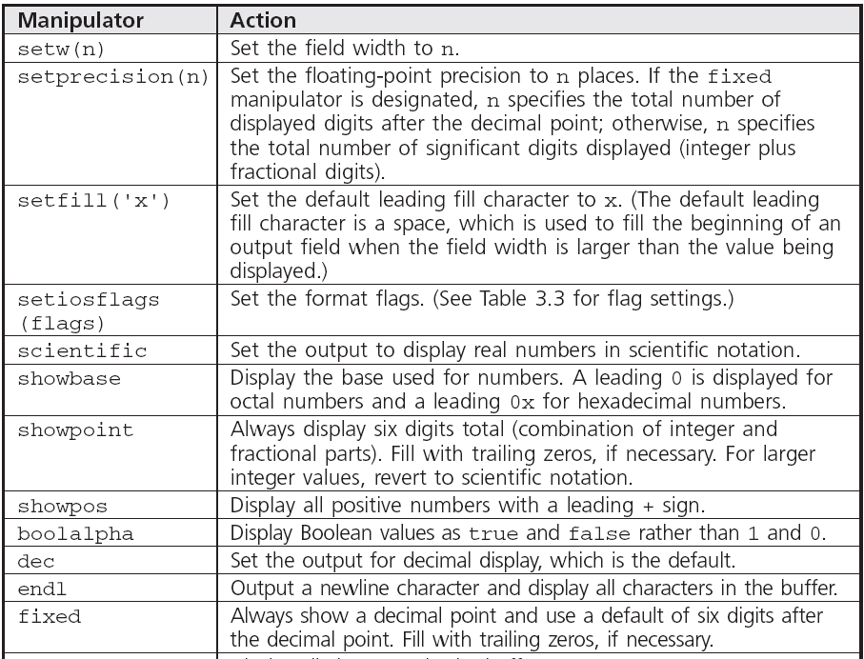
Formatting Numbers for Program Output
Table 3.1 Commonly Used Stream Manipulators

Slide 18
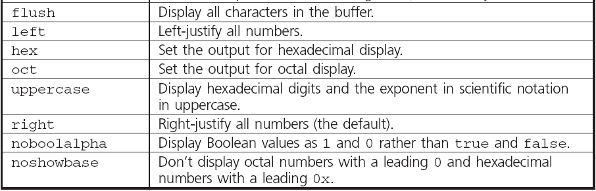
Formatting Numbers for Program Output
Table 3.1 Commonly Used Stream Manipulators

Slide 19
Formatting Numbers for Program Output
Program 3.6
#include <iostream>
#include <iomanip>
using namespace std;
int main()
{
cout << setw(3) << 6 << endl
<< setw(3) << 18 << endl
<< setw(3) << 124 << endl
<< "---\n"
<< (6+18+124) << endl;
return 0;
}
The Output from Program 3.6
6
18
124
---
148

Slide 20
Formatting Numbers for Program Output
The field width manipulator must be included for each value in the data stream sent to cout
Other manipulators remain in effect until they are changed
iomanip header file must be included to use manipulators requiring arguments

Slide 21
Formatting Numbers for Program Output
Formatting floating-point numbers requires three field-width manipulators to:
Set the total width of the display
Force a decimal place
Set the number of significant digits after the decimal point
Example:
cout << "|" << setw(10) << fixed
<< setprecision(3) << 25.67 << "|";
produces this output: | 25.670|

Slide 22
Formatting Numbers for Program Output
setprecision: Sets number of digits after decimal point if a decimal point has been explicitly forced; otherwise, it sets the total number of displayed digits
If the field width is too small, cout ignores the setw manipulator setting and allocates enough space for printing
If setprecision setting is too small, the fractional part of the value is rounded to the specified number of decimal places

Slide 23

Formatting Numbers for Program Output
If setprecision value is too large, the fractional value is displayed with its current size

Slide 24
Formatting Numbers for Program Output
Table 3.2 Effect of Format Manipulators

Slide 25
Formatting Numbers for Program Output
Table 3.2 Effect of Format Manipulators

Slide 26
Formatting Numbers for Program Output
setiosflags manipulator: Allows additional formatting:
Right or left justification
Fixed display with 6 decimal places
Scientific notation with exponential display
Display of a leading + sign
Parameterized manipulator: One which requires arguments, or parameters

Slide 27
Formatting Numbers for Program Output
Table 3.3 Format Flags for Use with setiosflags()

Slide 28
Formatting Numbers for Program Output
Program 3.7
// a program that illustrates output conversions
#include <iostream>
#include <iomanip>
using namespace std;
int main()
{
cout << "The decimal (base 10) value of 15 is " << 15 << endl;
cout << "The octal (base 8) value of 15 is "
<< showbase << oct << 15 <<endl;
cout << "The hexadecimal (base 16) value of 15 is "
<< showbase << hex << 15 << endl;
return 0;
}

Slide 29

Formatting Numbers for Program Output
The Output from Program 3.7
The decimal (base 10) value of 15 is 15
The octal (base 8) value of 15 is 017
The hexadecimal (base 16) value of 15 is 0xf

Slide 30
Formatting Numbers for Program Output
To designate an octal integer constant, use a leading zero
To designate a hexadecimal integer constant, use a leading 0x
Manipulators affect only output; the value stored internally does not change

Slide 31
Formatting Numbers for Program Output
Program 3.8
#include <iostream>
using namespace std;
int main()
{
cout << "The decimal value of 025 is " << 025 << endl
<< "The decimal value of 0x37 is "<< 0x37 << endl;
return 0;
}
The Output from Program 3.8
The decimal value of 025 is 21
The decimal value of 0x37 is 55

Slide 32
Formatting Numbers for Program Output
Manipulators can also be set using the ostream class methods
Separate the cout object name from the method name with a period
Example:
cout.precision(2)

Slide 33
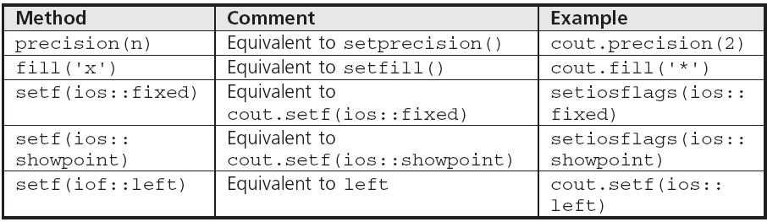
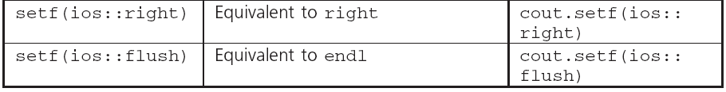
Formatting Numbers for Program Output
Table 3.4 ostream Class Functions

Slide 34
Using Mathematical Library Functions
C++ has preprogrammed mathematical functions that can be included in a program
You must include the cmath header file:
#include <cmath>
Math functions require one or more arguments as input, but will return only one value
All functions are overloaded, and can be used with integer and real arguments

Slide 35
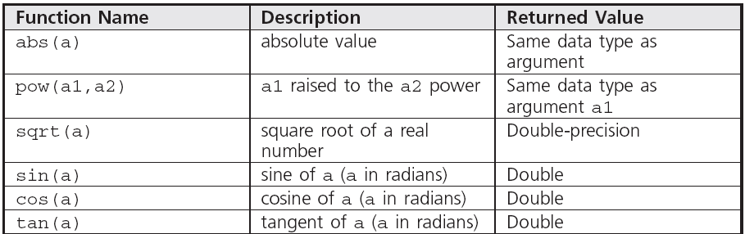

Using Mathematical Library Functions
Table 3.5 Common C++ Functions

Slide 36
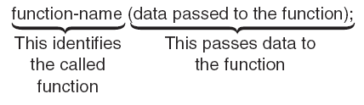
Using Mathematical Library Functions
To use a math function, give its name and pass the input arguments within parentheses
Expressions that can be evaluated to a value can be passed as arguments
Figure 3.10 Using and passing data to a function

Slide 37
Using Mathematical Library Functions
Program 3.9
#include <iostream> // this line may be placed second or first
#include <cmath> // this line may be placed second or first
using namespace std;
int main()
{
int height;
double time;
height = 800;
time = sqrt(2 * height / 32.2);
cout << "It will take " << time << " seconds to fall “
<< height << " feet.\n";
return 0;
}
The Output from Program 3.9
It will take 7.04907 seconds to fall 800 feet.

Slide 38
Using Mathematical Library Functions
Function calls can be nested
Example: sqrt(sin(abs(theta)))
Cast operator: A unary operator that forces the data to the desired data type
Compile-time cast
Syntax: dataType (expression)
Example: int(a+b)

Slide 39
Using Mathematical Library Functions
Run-time cast: The requested conversion is checked at run time and applied if valid
Syntax:
staticCast<data-type> (expression)
Example:
staticCast<int>(a*b)

Slide 40
Program Input Using cin
cin Object: Allows data entry to a running program
Use of the cin object causes the program to wait for input from the keyboard
When keyboard entry is complete, the program resumes execution, using the entered data
An output statement preceding the cin object statement provides a prompt to the user

Slide 41
Program Input Using cin
int main()
{
cin >>
cout <<
}
Figure 3.12 cin is used to enter data; cout is used to display data

Slide 42
Program Input Using cin
Program 3.8
#include <iostream>
using namespace std;
int main()
{
double num1, num2, product;
cout << "Please type in a number: ";
cin >> num1;
cout << "Please type in another number: ";
cin >> num2;
product = num1 * num2;
cout << num1 << " times " << num2 << " is " << product << endl;
return 0;
}
The Output from Program 3.8
Please type in a number: 30
Please type in another number: 0.05
30 times 0.05 is 1.5

Slide 43
Program Input Using cin
cin can accept multiple input values to be stored in different variables
Multiple numeric input values must be separated by spaces
Example:
cin >> num1 >> num2;
with keyboard entry: 0.052 245.79

Slide 44
Program Input Using cin
Program 3.13
#include <iostream>
using namespace std;
int main()
{
int num1, num2, num3;
double average;
cout << "Enter three integer numbers: ";
cin >> num1 >> num2 >> num3;
average = (num1 + num2 + num3) / 3.0;
cout << "The average of the numbers is " << average << endl;
return 0;
}
The Output from Program 3.13
Enter three integer numbers: 22 56 73
The average of the numbers is 50.3333

Slide 45
Program Input Using cin
User-input validation: The process of ensuring that data entered by the user matches the expected data type
Robust program: One that detects and handles incorrect user entry

Slide 46
Symbolic Constants
Symbolic constant: Constant value that is declared with an identifier using the const keyword
A constant’s value may not be changed
Example:
const int MAXNUM = 100;
Good programming places statements in appropriate order

Slide 47
Symbolic Constants
Proper placement of statements:
preprocessor directives
int main()
{
symbolic constants
main function declarations
other executable statements
return value
}

Slide 48
A Case Study: Acid Rain
Acid Rain: Develop a program to calculate the pH level of a substance based on user input of the concentration of hydronium ions
Step 1: Analyze the Problem
Step 2: Develop a Solution
Step 3: Code the Solution
Step 4: Test and Correct the Program

Slide 49
A Closer Look: Programming Errors
Program errors may be detected in four ways:
Before a program is compiled (desk checking)
While it is being compiled (compile-time errors)
While it is being run (run-time errors)
While examining the output after completion
Errors may be:
Typos in the source code
Logic errors

Slide 50
A Closer Look: Programming Errors
Logic errors: Often difficult to detect and difficult to find the source
Program tracing: Stepping through the program by hand or with a trace tool
Debugger: Program that allows the interruption of a running program to determine values of its variables at any point

Slide 51
Common Programming Errors
Failure to declare or initialize variables before use
Failure to include the preprocessor statement when using a C++ preprogrammed library
Passing the incorrect number or type of arguments to a function
Applying increment or decrement operator to an expression instead of an individual variable

Slide 52
Common Programming Errors
Failure to separate all variables passed to cin with the extraction symbol >>
Failure to test thoroughly
Compiler-dependent evaluation when increment or decrement operators are used with variables that appear more than once in the same expression

Slide 53
Summary
Expression: A sequence of one or more operands separated by operators
Expressions are evaluated based on precedence and associativity
Assignment operator: =
Increment operator: ++
Decrement operator: --

Slide 54
Summary
Use #include <cmath> for math functions
Arguments to a function must be passed in the proper number, type, and order
Functions may be included within larger expressions
cin object provides data input from a keyboard; program is suspended until the input arrives

Slide 55
Summary
Use a prompt to alert the user to provide input
Constants are named values that do not change

