Slide 1
4
Selection Structures

Slide 2
Contents
Selection criteria
The if-else statement
Nested if statements
The switch statement
Program testing
Common programming errors

Slide 3
Selection Criteria
if-else statement: Implements a decision structure for two alternatives
Syntax:
if (condition)
statement executed if condition is true;
else
statement executed if condition is false;

Slide 4
Selection Criteria
The condition is evaluated to its numerical value:
A non-zero value is considered to be true
A zero value is considered to be false
The else portion is optional; it is executed only if the condition is false
The condition may be any valid C++ expression

Slide 5
Relational Operators
Relational expression: Compares two operands or expressions using relational operators
Table 4.1 C++’s Relational Operators

Slide 6
Relational Operators
Relational expressions are evaluated to a numerical value of 1 or 0 only:
If the value is 1, the expression is true
If the value is 0, the expression is false
char values are automatically coerced to int values for comparison purposes
Strings are compared on a character by character basis
The string with the first lower character is considered smaller

Slide 7
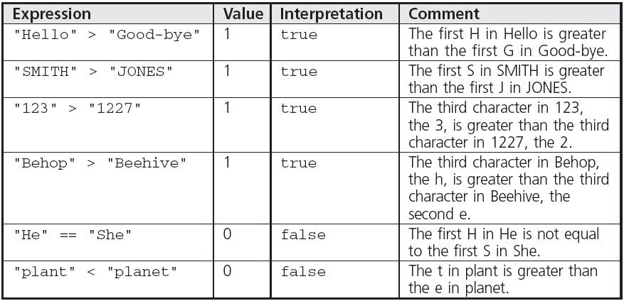
Relational Operators
Examples of string comparisons

Slide 8
Logical Operators
AND (&&): Condition is true only if both expressions are true
OR (||): Condition is true if either one or both of the expressions is true
NOT (!): Changes an expression to its opposite state; true becomes false, false becomes true

Slide 9
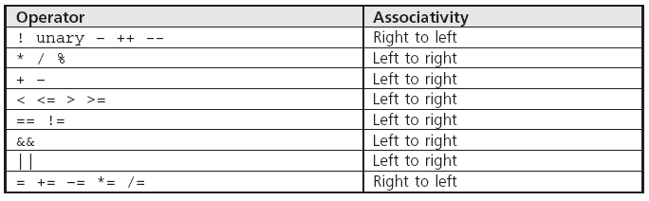
Logical Operators
Table 4.2 Operator Precedence and Associativity

Slide 10
A Numerical Accuracy Problem
Comparing single and double precision values for equality (==) can lead to errors because values are stored in binary
Instead, test that the absolute value of the difference is within an acceptable range
Example:
abs(operandOne – operandTwo) < 0.000001

Slide 11
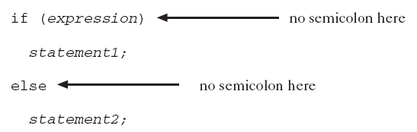
The if-else Statement
if-else performs instructions based on the result of a comparison
Place statements on separate lines for readability
Syntax:

Slide 12
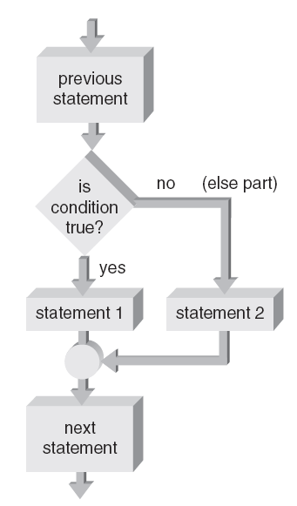
The if-else Statement
Figure 4.2 The if-else flowchart

Slide 13
The if-else Statement
Program 4.1
#include <iostream>
#include <cmath>
using namespace std;
int main()
{
double radius;
cout << "Please type in the radius: ";
cin >> radius;
if (radius < 0.0)
cout << "A negative radius is invalid" << endl;
else
cout << "The area of this circle is "
<< 3.1416 * pow(radius,2) << endl;
return 0;
}

Slide 14
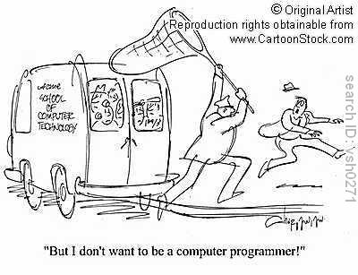
The if-else Statement
The Output from the Program 4.1
Please type in the radius: -2.5
A negative radius is invalid
Please type in the radius: 2.5
The area of this circle is 19.635

Slide 15
Compound Statements
Compound statement: A sequence of single statements contained between braces
Creates a block of statements
Block of statements can be used anywhere that a single statement is legal
Any variable declared within a block is usable only within that block
Scope: The area within a program where a variable can be used
A variable’s scope is based on where the variable is declared

Slide 16
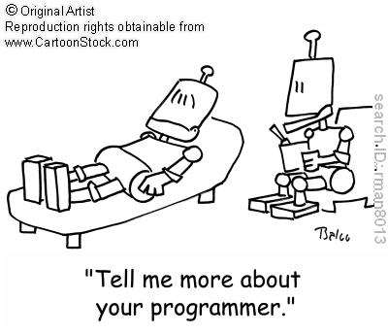
Block Scope
Statements contained in compound statement are a single block of code
Scope of the variable: Area in a program where a variable can be used

Slide 17
Block Scope
Example with Two Blocks of Code
{ // start of outer block
int a = 25;
int b = 17;
cout << “The value of a is ” << a << “ and b is ” << b << endl;
{ // start of inner block
double a = 46.25;
int c = 10;
cout << “a is now ” << a
<< “ b is now ” << b
<< “ and c is ” << c << endl;
} // end of inner block
cout << “a is now ” << a << “ and b is ” << b << endl;
} // end of outer block
The Output from the Example
The value of a is 25 and b is 17
a is now 46.25 b is now 17 and c is 10
a is now 25 and b is 17

Slide 18
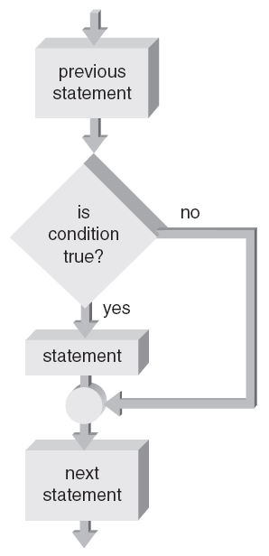
One-Way Selection
One-way selection: An if statement without the optional else portion
Figure 4.3 A one-way selection if statement

Slide 19
Problems Associated with the if-else Statement
Common problems with if-else statements:
Misunderstanding what an expression is
Using the assignment operator (=) instead of the relational operator (==)

Slide 20
Nested if Statements
if-else statement can contain any valid C++ statement, including another if-else
Nested if statement: an if-else statement completely contained within another if-else
Use braces to block code, especially when inner if statement does not have its own else

Slide 21
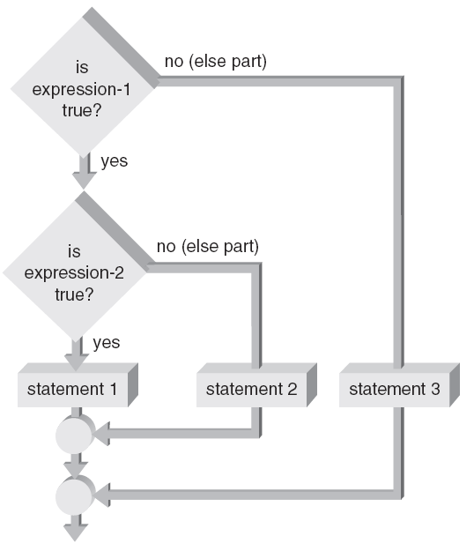
Nested if Statements
Figure 4.4a Nested within the if part

Slide 22
The if-else Chain
if-else chain: A nested if statement occurring in the else clause of the outer if-else
If any condition is true, the corresponding statement is executed and the chain terminates
Final else is only executed if no conditions were true
Serves as a catch-all case
if-else chain provides one selection from many possible alternatives

Slide 23
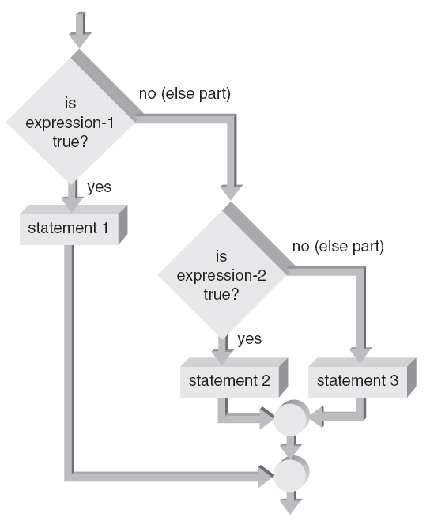
The if-else Chain
Figure 4.4b Nested within the else part

Slide 24
The if-else Chain
General form of an if-else chain
if (expression_1)
statement1;
else if (expression_2)
statement2;
else if (expression_3)
statement3;
.
.
.
else if (expression_n)
statement_n;
else
last_statement;

Slide 25
The if-else Chain
Program 4.5
#include <iostream>
using namespace std;
int main()
{
char code;
cout << "Enter a specification code: ";
cin >> code;
if (code == 'S')
cout << "The item is space exploration grade.";
else if (code == 'M')
cout << "The item is military grade.";
else if (code == 'C')
cout << "The item is commercial grade.";
else if (code == 'T')
cout << "The item is toy grade.";
else
cout << "An invalid code was entered.";
cout << endl;
return 0;
}

Slide 26
The switch Statement
Format:
switch (expression)
{ // start of compound statement
case value_1: <- terminated with a colon
statement1;
statement2;
break;
case value_2: <- terminated with a colon
statementm;
break;
default: <- terminated with a colon
statementaa;
} // end of switch and compound
// statement

Slide 27
The switch Statement
switch statement: Provides for one selection from many alternatives
switch keyword starts the statement
Is followed by the expression to be evaluated
case keyword identifies a value to be compared to the switch expression
When a match is found, statements in this case block are executed
All further cases after a match is found are executed unless a break statement is found

Slide 28
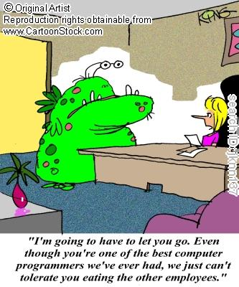
The switch Statement
default case is executed if no other case value matches were found
default case is optional

Slide 29
The switch Statement
Program 4.6
#include <iostream>
using namespace std;
int main()
{
int opselect;
double fnum, snum;
cout << "Please type in two numbers: ";
cin >> fnum >> snum;
cout << "Enter a select code: ";
cout << "\n 1 for addition";
cout << "\n 2 for multiplication";
cout << "\n 3 for division : ";
cin >> opselect;

Slide 30
The switch Statement
Program 4.6 (Continued)
switch (opselect)
{
case 1:
cout << "The sum of the numbers entered is " << fnum+snum
<< endl;
break;
case 2:
cout << "The product of the numbers entered is "
<< fnum*snum << endl;
break;
case 3:
cout << "The first number divided by the second is "
<< fnum/snum << endl;
break;
} // end of switch
return 0;
} // end of main()

Slide 31
The switch Statement
The Output from Program 4.6
Please type in two numbers: 12 3
Enter a select code:
1 for addition
2 for multiplication
3 for division : 2
The product of the numbers entered is 36
OR
Please type in two numbers: 12 3
Enter a select code:
1 for addition
2 for multiplication
3 for division : 3
The first number divided by the second is 4

Slide 32
A Case Study: Solving Quadratic Equations
Data validation: Use defensive programming techniques to validate user input
Includes code to check for improper data before an attempt is made to process it further
Solving quadratic equations: Use the software development procedure to solve for the roots of a quadratic equation

Slide 33
A Closer Look: Program Testing
Theory: A comprehensive set of test runs would test all combinations of input and computations, and would reveal all errors
Reality: There are too many combinations to test for any program except a very simple one
Example:
One program with 10 modules, each with five if statements, always called in the same order
There are 2⁵ paths through each module, and more than 2⁵⁰ paths through the program!

Slide 34
Common Programming Errors
Using the assignment operator (=) instead of the relational operator (==) for an equality test
Placing a semicolon immediately after the condition
Assuming a structural problem with an if-else causes the error instead of focusing on the data value being tested
Using nested if statements without braces to define the structure

Slide 35
Summary
Relational expressions, or conditions, are used to compare operands
If the relation expression is true, its value is 1; if false, its value is 0
Use logical operators && (AND), || (OR), and ! (NOT) to construct complex conditions
if-else allows selection between two alternatives

Slide 36
Summary
An if expression that evaluates to 0 is false; if non-zero, it is true
if statements can be nested
Chained if statement provides a multiway selection
Compound statement: contains any number of individual statements enclosed in braces

Slide 37
Summary
switch statement: Provides a multiway selection
switch expression: Evaluated and compared to each case value
If a match is found, execution begins at that case’s statements and continues unless a break is encountered

