Slide 1
5
Repetition Statements

Slide 2
Contents
Basic loop structures
while loops
Interactive while loops
for loops
Loop programming techniques
Nested loops
do while loops
Common programming errors

Slide 3
Basic Loop Structures
Repetition structure has four required elements:
Repetition statement
Condition to be evaluated
Initial value for the condition
Loop termination
Repetition statements include:
while
for
do while

Slide 4
Basic Loop Structures
The condition can be tested
At the beginning: Pretest or entrance-controlled loop
At the end: Posttest or exit-controlled loop
Something in the loop body must cause the condition to change, to avoid an infinite loop, which never terminates

Slide 5
Pretest and Posttest Loops
Pretest loop: Condition is tested first; if false, statements in the loop body are never executed
while and for loops are pretest loops
Figure 5.1 A pretest loop

Slide 6
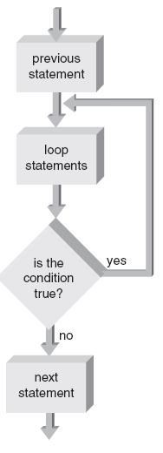
Pretest and Posttest Loops
Posttest loop: Condition is tested after the loop body statements are executed; loop body always executes at least once
do while is a posttest loop
Figure 5.2 A posttest loop

Slide 7
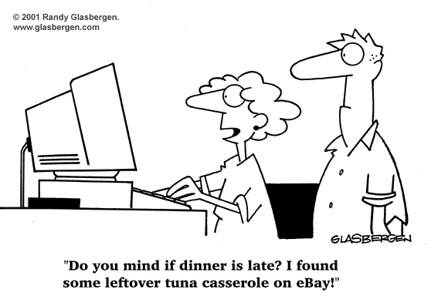
Fixed-Count Versus Variable-Condition Loops
Fixed-count loop: Loop is processed for a fixed number of repetitions
Variable-condition loop: Number of repetitions depends on the value of a variable

Slide 8
while Loops
while statement is used to create a while loop
Syntax:
while (expression)
statement;
Statements following the expressions are executed as long as the expression condition remains true (evaluates to a non-zero value)

Slide 9
while Loops
Program 5.1
#include <iostream>
using namespace std;
int main()
{
int count;
count = 1; // initialize count
while (count <= 10)
{
cout << count << " ";
count++; // increment count
}
return 0;
}
The Output from Program 5.1
1 2 3 4 5 6 7 8 9 10

Slide 10
while Loops
Program 5.3
#include <iostream>
#include <iomanip>
using namespace std;
int main()
{
int num;
cout << "NUMBER SQUARE CUBE\n"
<< "------ ------ ----\n";
num = 1;
while (num < 11)
{
cout << setw(3) << num << " "
<< setw(3) << num * num << " "
<< setw(4) << num * num * num << endl;
num++; // increment num
}
return 0;
}

Slide 11
while Loops
The Output from Program 5.3
NUMBER SQUARE CUBE
------ ------ ----
1 1 1
2 4 8
3 9 27
4 16 64
5 25 125
6 36 216
7 49 343
8 64 512
9 81 729
10 100 1000

Slide 12
while Loops
Example:
Celsius-to-Fahrenheit temperature-conversion
Display Fahrenheit and Celsius temperatures, from 5-50 degrees C, in 5 degree increments
celsius = 5; // starting Celsius value
while (celsius <= 50)
{
fahren = (9.0/5.0) * celsius + 32.0;
cout << setw(4) << celsius
<< setw(13) << fahren << endl;
celsius = celsius + 5;
}

Slide 13

Interactive while Loops
Combining interactive data entry with the while statement provides for repetitive entry and accumulation of totals

Slide 14
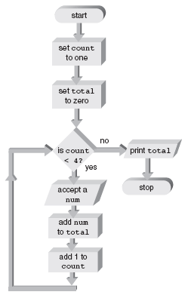
Interactive while Loops
Figure 5.6 Accumulation flow of control

Slide 15
Interactive while Loops
Program 5.6
#include <iostream>
using namespace std;
int main()
{
const int MAXNUMS = 4;
int count;
double num, total;
cout << "\nThis program will ask you to enter "
<< MAXNUMS << " numbers.\n";
count = 1;
total = 0;
while (count <= MAXNUMS)
{
cout << "\nEnter a number: ";
cin >> num;
total = total + num;
cout << "The total is now " << total;
count++;
}
cout << “\n\nThe final total is “ << total << endl;
return 0;
}

Slide 16
Interactive while Loops
Sample run of program 5.6:
This program will ask you to enter 4 numbers.
Enter a number: 26.2
The total is now 26.2
Enter a number: 5
The total is now 31.2
Enter a number: 103.456
The total is now 134.656
Enter a number: 1267.89
The total is now 1402.546
The final total is 1402.546

Slide 17
Sentinels
Sentinel: A data value used to signal either the start or end of a data series
Use a sentinel when you don’t know how many values need to be entered

Slide 18
break and continue Statements
break statement
Forces an immediate break, or exit, from switch, while, for, and do-while statements
Violates pure structured programming, but is useful for breaking out of loops when an unusual condition is detected

Slide 19
break and continue Statements
Example of a break statement:
while( count <= 10)
{
cout << “Enter a number: ”;
cin >> num;
if (num > 76)
{
cout << “You lose!\n”;
break; // break out of the loop
}
else
cout << “Keep on tracking!\n”;
count++;
}
// break jumps to here

Slide 20
break and continue Statements
A continue statement where invalid grades are ignored, and only valid grades are added to the total:
while( count < 30)
{
cout << “Enter a grade: ”;
cin >> grade;
if (grade < 0 || grade > 100)
continue;
total = total + grade;
count++;
}

Slide 21
break and continue Statements
continue statement
Applies to while, do-while, and for statements; causes the next iteration of the loop to begin immediately
Useful for skipping over data that should not be processed in this iteration, while staying within the loop

Slide 22
The Null Statement
Null statement
Semicolon with nothing preceding it
;
Do-nothing statement required for syntax purposes only

Slide 23
for Loops
for statement: A loop with a fixed count condition that handles alteration of the condition
Syntax:
for (initializing list; expression; altering list)
statement;
Initializing list: Sets the starting value of a counter
Expression: Contains the maximum or minimum value the counter can have; determines when the loop is finished

Slide 24
for Loops
Altering list: Provides the increment value that is added or subtracted from the counter in each iteration of the loop
If initializing list is missing, the counter initial value must be provided prior to entering the for loop
If altering list is missing, the counter must be altered in the loop body
Omitting the expression will result in an infinite loop

Slide 25
for Loops
Program 5.9
#include <iostream>
#include <iomanip>
#include <cmath>
using namespace std;
int main()
{
const int MAXCOUNT = 5;
int count;
cout << "NUMBER SQUARE ROOT\n";
cout << "------ -----------\n";
cout << setiosflags(ios::showpoint);
for (count = 1; count <= MAXCOUNT; count++)
cout << setw(4) << count
<< setw(15) << sqrt(double(count)) << endl;
return 0;
}

Slide 26
for Loops
Figure 5.7 for loop flowchart.

Slide 27
for Loops
Program 5.11
#include <iostream>
#include <iomanip>
using namespace std;
int main()
{
const int MAXNUMS = 10;
int num;
cout << endl; // print a blank line
cout << "NUMBER SQUARE CUBE\n"
<< "------ ------ ----\n";
for (num = 1; num <= MAXNUMS; num++)
cout << setw(3) << num << " "
<< setw(3) << num * num << " "
<< setw(4) << num * num * num << endl;
return 0;
}

Slide 28
for Loops
When Program 5.11 is run, the display produced is
NUMBER SQUARE CUBE
_ _ _ _ _ _ _ _ _ _ _ _ _ _ _ _
1 1 1
2 4 8
3 9 27
4 16 64
5 25 125
6 36 216
7 49 343
8 64 512
9 81 729
10 100 1000

Slide 29
A Closer Look: Loop Programming Techniques
These techniques are suitable for pretest loops (for and while):
Interactive input within a loop
Includes a cin statement within a while or for loop
Selection within a loop
Using a for or while loop to cycle through a set of values to select those values that meet some criteria

Slide 30
A Closer Look: Loop Programming Techniques
Program 5.13
#include <iostream>
using namespace std;
// this program computes the positive and negative sums of a set
// of MAXNUMS user entered numbers
int main()
{
const int MAXNUMS = 5;
int i;
double usenum, postot, negtot;
postot = 0; // this initialization can be done in the declaration
negtot = 0; // this initialization can be done in the declaration
for (i = 1; i <= MAXNUMS; i++)
{
cout << "Enter a number (positive or negative) : ";
cin >> usenum;
if (usenum > 0)
postot = postot + usenum;
else
negtot = negtot + usenum;
}
cout << "The positive total is " << postot << endl;
cout << "The negative total is " << negtot << endl;
return 0;
}

Slide 31
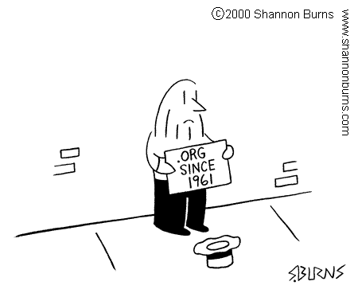
A Closer Look: Loop Programming Techniques
Evaluating functions of one variable
Used for functions that must be evaluated over a range of values
Noninteger increment values can be used

Slide 32
A Closer Look: Loop Programming Techniques
Program 5.14
#include <iostream>
#include <iomanip>
#include <cmath>
using namespace std;
int main()
{
int x, y;
cout << "x value y value\n"
<< "------- --------\n";
for (x = 2; x <= 6; x++)
{
y = 10 * pow(x,2.0) + 3 * x - 2;
cout << setw(4) << x << setw(11) << y << endl;
}
return 0;
}

Slide 33

A Closer Look: Loop Programming Techniques
Interactive loop control
Variable is used to control the loop repetitions
Provides more flexibility at run-time

Slide 34
A Closer Look: Loop Programming Techniques
Program 5.16
#include <iostream>
#include <iomanip>
using namespace std;
// this program displays a table of numbers, their squares and cubes
// starting from the number 1. The final number in the table is
// input by the user
int main()
{
int num, final;
cout << "Enter the final number for the table: ";
cin >> final;
cout << "NUMBER SQUARE CUBE\n";
cout << "------ ------ ----\n";
for (num = 1; num <= final; num++)
cout << setw(3) << num
<< setw(8) << num*num
<< setw(7) << num*num*num << endl;
return 0;
}

Slide 35
Nested Loops
Nested loop: A loop contained within another loop
All statements of the inner loop must be completely contained within the outer loop; no overlap allowed
Different variables must be used to control each loop
For each single iteration of the outer loop, the inner loop runs through all of its iterations

Slide 36
Nested Loops
Figure 5.9 For each i, j loops.

Slide 37
Nested Loops
Program 5.16
#include <iostream>
using namespace std;
int main()
{
const int MAXI = 5;
const int MAXJ = 4;
int i, j;
for(i = 1; i <= MAXI; i++) // start of outer loop <------+
{ // |
cout << "\ni is now " << i << endl; // |
// |
for(j = 1; j <= MAXJ; j++) // start of inner loop |
cout << " j = " << j; // end of inner loop |
} // end of outer loop <-------+
cout << endl;
return 0;
}

Slide 38
do while Loops
do while loop is a posttest loop
Loop continues while the condition is true
Condition is tested at the end of the loop
Syntax:
do
statement;
while (expression);
All statements are executed at least once in a posttest loop

Slide 39
do while Loops
Figure 5.10 The do while loop structure.

Slide 40
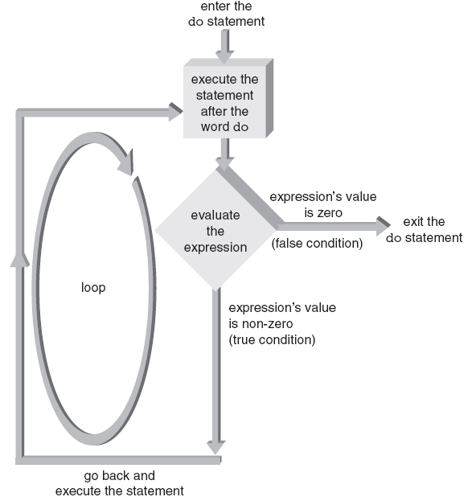
do while Loops
Figure 5.11 The do statement’s flow of control.

Slide 41
Validity Checks
Useful in filtering user-entered input and providing data validation checks
Can enhance with if-else statement
do
{
cout << “\nEnter an identification number: ”;
cin >> id_num;
}
while( id_num < 1000 || id_num > 1999 );

Slide 42
Common Programming Errors
Making the “off by one” error: loop executes one too many or one too few times
Using the assignment operator (=) instead of the equality comparison operator (==) in the condition expression
Testing for equality with floating-point or double-precision operands; use an epsilon value instead

Slide 43
Common Programming Errors
Placing a semicolon at the end of the for clause, which produces a null loop body
Using commas instead of semicolons to separate items in the for statement
Changing the value of the control variable
Omitting the final semicolon in a do statement

Slide 44
Summary
Loop: A section of repeating code, whose repetitions are controlled by testing a condition
Three types of loops:
while
for
do while
Pretest loop: Condition is tested at beginning of loop; loop body may not ever execute; ex., while, for loops

Slide 45
Summary
Posttest loop: Condition is tested at end of loop; loop body executes at least once; ex., do while
Fixed-count loop: Number of repetitions is set in the loop condition
Variable-condition loop: Number of repetitions is controlled by the value of a variable

