Slide 1
6
Modularity Using Functions

Slide 2
Contents
Function and parameter declarations
Returning a single value
Returning multiple values
Rectangular to polar coordinate conversion
Variable scope
Variable storage categories
Common programming errors

Slide 3
Function and Parameter Declarations
Interaction with a function includes:
Passing data to a function correctly when its called
Returning values from a function when it ceases operation
A function is called by giving the function’s name and passing arguments in the parentheses following the function name

Slide 4
Function and Parameter Declarations
functionName (data passed to function);
This identifies
the called
This passes data to
the function
Figure 6.1 Calling and passing data to a function

Slide 5
Function and Parameter Declarations
Program 6.2
#include <iostream>
using namespace std;
void findMax(int, int); // the function declaration (prototype)
int main()
{
int firstnum, secnum;
cout << "\nEnter a number: ";
cin >> firstnum;
cout << "Great! Please enter a second number: ";
cin >> secnum;
findMax(firstnum, secnum); // the function is called here
return 0;
}

Slide 6
Function and Parameter Declarations
Program 6.2 (Continued)
// following is the function FindMax()
void findMax(int, int)
{ // start of the function body
int maxnum; // variable declaration
if( x >= y)
maxnum = x;
else
maxnum = y;
cout << "\nThe maximum of the two numbers is "
<< maxnum << endl;
} // end of function body and end of function

Slide 7
Function and Parameter Declarations
Before a function is called, it must be declared to function that will do calling
Declaration statement for a function is referred to as function prototype
Function prototype tells calling function:
Type of value that will be formally returned, if any
Data type and order of the values the calling function should transmit to the called function
Function prototypes can be placed with the variable declaration statements above the calling function name or in a separate header file

Slide 8
Calling a Function
Requirements when calling a function include:
Using the name of the function
Enclosing any data passed to the function in the parentheses following the function name, using the same order and type declared in the function prototype

Slide 9
Calling a Function
The items enclosed in the parentheses are called arguments of the called function
findMax (firstnum, secnum);
This identifies
the findMax()
function
This causes two value to be passed to findMax()
Figure 6.2 Calling and passing two values to findMax()

Slide 10
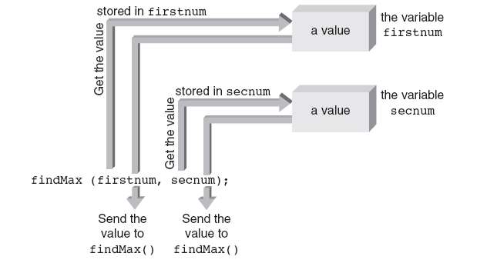
Calling a Function
Figure 6.3 The findMax() function receives actual values

Slide 11
Calling a Function
Figure 6.3:
The findMax() function does not receive the variables named firstnum and secnum and has no knowledge of the variable names
The function receives the values in these variables and must then determine where to store those values before it does anything else

Slide 12
Defining a Function
Every C++ function consists of two parts:
Function header
Function body
Function header’s purpose:
Identify data type of value function returns, provide function with name, and specify number, order, and type of arguments function expects
Function body’s purpose:
To operate on passed data and return, at most, one value directly back to the calling function

Slide 13
Defining a Function
function header line
Function header
{
constant and
variable declarations;
any other C++ statements ;
}
Function body
Figure 6.4 The general format of a function

Slide 14
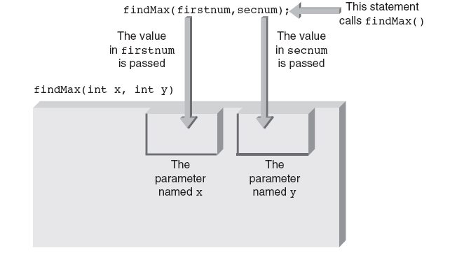
Defining a Function
Figure 6.5 Storing values in parameters

Slide 15
Placement of Statements
General rule for placing statements in a C++ program:
All preprocessor directives, named constants, variables, and functions must be declared or defined before they can be used
Although this rule permits placing both preprocessor directives and declaration statements throughout the program, doing so results in poor program structure

Slide 16
Functions with Empty Parameter Lists
Although useful functions having an empty parameter list are extremely limited, they can occur
Function prototype for such a function requires writing the keyword void or nothing at all between the parenthesis following the function’s name
void emptyParameter( void );

Slide 17
Default Arguments
C++ provides default arguments in a function call for added flexibility
Primary use of default arguments is to extend parameter list of existing functions without requiring any change in calling parameter lists already used in a program
Default arguments are listed in the function prototype and transmitted automatically to the called function when the corresponding arguments are omitted from the function call

Slide 18
Default Arguments
Example: Function prototype with default arguments
void example(int, int = 5, double = 6.78);
Sample valid calls to the example function
example(7,2,9.3); // no defaults used
example(7,2); // same as example(7, 2, 6.78)
example(7); // same as example(7, 5, 6.78)

Slide 19
Reusing Function Names (Overloading)
C++ provides the capability of using the same function name for more than one function
Referred to as function overloading
Only requirement for creating more than one function with same name:
Compiler must be able to determine which function to use based on the parameters’ data types (not the data type of the return value, if any)

Slide 20
Reusing Function Names (Overloading)
Which of the functions is called depends on the argument type supplied at the time of the call
void cdabs(int x) // compute and display the absolute // value of an integer
{
if ( x < 0 )
x = -x;
cout << "The absolute value of the integer is " << x << endl;
}
void cdabs(float x) // compute and display the // absolute value of a float
{
if ( x < 0 )
x = -x;
cout << "The absolute value of the float is " << x << endl;
}

Slide 21
Function Templates
Function template: Single complete function that serves as a model for a family of functions
Function from the family that is actually created depends on the specific function call
Generalize the writing of functions that perform essentially the same operation, but on different parameter data types
Make it possible to write a general function that handles all cases but where the compiler can set parameters, variables, and even return type based on the actual function call

Slide 22
Function Templates
Example of function template:
template <class T>
void showabs(T number)
{
if (number < 0)
number = -number;
cout << "The absolute value of the number "
<< " is " << number << endl;
return;
}
Template allows for one function instead of three
T represents a general data type
T replaced by an actual data type when compiler encounters a function call

Slide 23
Function Templates
Example (continued):
int main()
{
int num1 = -4;
float num2 = -4.23F;
double num3 = -4.23456;
showabs(num1);
showabs(num2);
showabs(num3);
return 0;
}
Output from above program:
The absolute value of the number is 4
The absolute value of the number is 4.23
The absolute value of the number is 4.23456

Slide 24
Returning a Single Value
Function receiving an argument passed by value cannot inadvertently alter value stored in the variable used for the argument
Function receiving passed by value arguments can process the values sent to it in any fashion and return one, and only one, “legitimate” value directly to the calling function

Slide 25
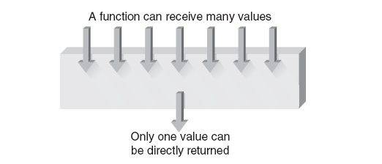
Returning a Single Value
Figure 6.6 A function directly returns at most one value

Slide 26
Returning a Single Value
Returning data from a function
Only one value directly returned from function
Called function header indicates type of data returned
Examples:
void findMax(int x, int y);
findMax accepts two integer parameters and returns no value
int findMax (float x, float y);
findMax accepts two float values and returns an integer value

Slide 27
Returning a Single Value
Program 6.6
#include <iostream>
using namespace std;
double tempvert(double); // function prototype
int main()
{
const int CONVERTS = 4; // number of conversions to be made
int count; // start of declarations
double fahren;
for(count = 1; count <= CONVERTS; count++)
{
cout << "\nEnter a Fahrenheit temperature: ";
cin >> fahren;
cout << "The Celsius equivalent is "
<< tempvert(fahren) << endl;
}
return 0;
}
// convert fahrenheit to celsius
double tempvert(double inTemp)
{
return (5.0/9.0) * (inTemp - 32.0);
}

Slide 28
Inline Functions
Calling a function places a certain amount of overhead on a computer
Placing argument values in a reserved memory region (called the stack) that the function has access to
Passing control to the function
Providing a reserved memory location for any returned value (again, using the stack for this purpose
Returning to the correct point in the calling program

Slide 29
Inline Functions
Paying overhead associated with calling a function is justified when a function is called many times
Can reduce a program’s size substantially
For small functions that are not called many times, overhead of passing and returning values might not be warranted
Inline functions:
Group repeating lines of code together under a common function name
Have the compiler place this code in the program wherever the function is called

Slide 30
Inline Functions
Program 6.7
#include <iostream>
using namespace std;
inline double tempvert(double inTemp) // an inline function
{
return (5.0/9.0) * (inTemp - 32.0);
}
int main()
{
const CONVERTS = 4; // number of conversions to be made
int count; // start of declarations
double fahren;
for(count = 1; count <= CONVERTS; count++)
{
cout << "\nEnter a Fahrenheit temperature: ";
cin >> fahren;
cout << "The Celsius equivalent is "
<< tempvert(fahren) << endl;
}
return 0;
}

Slide 31
Inline Functions
Advantage: Increase in execution speed
Because the inline function is expanded and included in every expression or statement calling it, no execution time is lost because of the call and return overhead a non-inline function requires
Each time an inline function is referenced the complete code is reproduced and stored as an integral part of the program
A non-inline function is stored in memory only once
Inline functions should be used only for small functions that aren’t called extensively in a program

Slide 32
Returning Multiple Values
In typical function invocation, called function receives values from its calling function stores and manipulates the passed values, and directly returns at most one value
Pass by value: When data is passed in this manner
Pass by reference: Giving a called function direct access to its calling function’s variables is referred to as
The called function can reference, or access, the variable whose address has been passed as a pass by reference argument

Slide 33
Passing and Using Reference Parameters
From the sending side, calling a function and passing an address as an argument that’s accepted as a reference parameter is the same as calling a function and passing a value
Whether a value or an address is actually passed depends on the parameter types declared

Slide 34
Passing and Using Reference Parameters
In main() the values are referenced as
firstnum
secnum
One value is stored
One value is stored
xnum
ynum
In newval() the same values are referenced as
Figure 6.7 The equivalence of arguments and parameters in Program 6.8

Slide 35
Passing and Using Reference Parameters
Program 6.9
#include <iostream>
#include <iostream>
using namespace std;
void calc(double, double, double, double&, double&); // function prototype
int main()
{
double firstnum, secnum, thirdnum, sum, product;
cout << "Enter three numbers: ";
cin >> firstnum >> secnum >> thirdnum;
calc(firstnum, secnum, thirdnum, sum, product); // function call
cout << "\nThe sum of the numbers is: " << sum << endl;
cout << "The product of the numbers is: " << product << endl;
return 0;
}
void calc(double num1, double num2, double num3, double& total, double& product)
{
total = num1 + num2 + num3;
product = num1 * num2 * num3;
return;
}

Slide 36
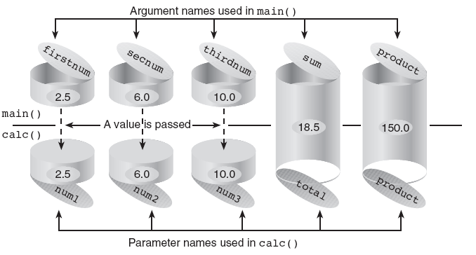
Passing and Using Reference Parameters
Figure 6.8 The relationship between argument and parameter names

Slide 37
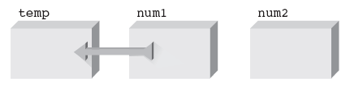
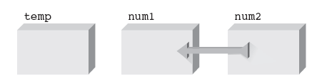
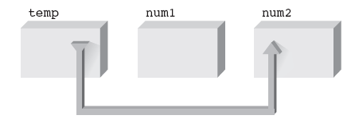
Passing and Using Reference Parameters
Figure 6.9a Save the first value
Figure 6.9b Replace the first value with the second value
Figure 6.9c Change the second value

Slide 38
Passing and Using Reference Parameters
Program 6.10
#include <iostream>
using namespace std;
void swap(double&, double&); // function receives 2 references
int main()
{
double firstnum = 20.5, secnum = 6.25;
cout << "The value stored in firstnum is: " << firstnum << endl;
cout << "The value stored in secnum is: "<< secnum << "\n\n";
swap(firstnum, secnum); // call the function with references
cout << "The value stored in firstnum is now: "
<< firstnum << endl;
cout << "The value stored in secnum is now: "
<< secnum << endl;
return 0;
}
void swap(double& num1, double& num2)
{
double temp;
temp = num1; // save num1's value
num1 = num2; // store num2's value in num1
num2 = temp; // change num2's value
return;
}

Slide 39
A Case Study: Rectangular to Polar Coordinate Conversion
Problem-
solver
algorithm
Get
inputs
Calculation
results
Display
result
Figure 6.10 The problem-solver algorithm

Slide 40
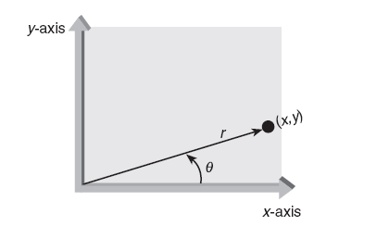
A Case Study: Rectangular to Polar Coordinate Conversion
Figure 6.11 The correspondence between polar (distance and angle) and Cartesian (x and y) coordinates

Slide 41
A Case Study: Rectangular to Polar Coordinate Conversion
Rectangular
to polar
coordinate
conversion
Input x and
y coordinates
Calculate
r and θ
Display
r and θ
Figure 6.12 A top level structure diagram

Slide 42
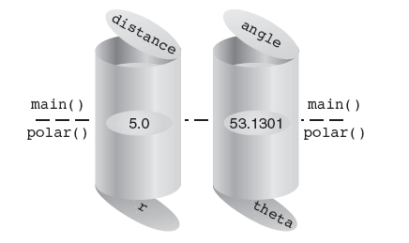
A Case Study: Rectangular to Polar Coordinate Conversion
Figure 6.13 Parameter values when polar() is called

Slide 43
A Case Study: Rectangular to Polar Coordinate Conversion
Program 6.13
#include <iostream>
#include <cmath>
using namespace std;
void getrec(double&, double&); // function prototype
void polar(double, double, double&, double&); // function prototype
void showit(double, double); // function prototype
int main()
{
double x, y, distance, angle;
getrec(x, y);
polar(x, y, distance, angle);
showit(distance, angle);
return 0;
}

Slide 44
A Case Study: Rectangular to Polar Coordinate Conversion
Program 6.13 (Continued)
void getrec(double& x, double& y)
{
cout << "Rectangular to Polar Coordinate"
<< " Conversion Program\n" << endl;
cout << "Enter the x coordinate: ";
cin >> x;
cout << "Enter the y coordinate: ";
cin >> y;
return;
}
void polar(double x, double y, double& r, double& theta)
{
const double TODEGREES = 180.0/3.141593;
r = sqrt(x * x + y * y);
theta = atan(y/x) * TODEGREES;
return;
}

Slide 45
A Case Study: Rectangular to Polar Coordinate Conversion
Program 6.13 (Continued)
void showit(double radius, double angle)
{
cout << "\nThe polar coordinates are: " << endl;
cout << " Distance from origin: " << radius << endl;
cout << " Angle (in degrees) from x-axis: " << angle << endl;
return;
}

Slide 46
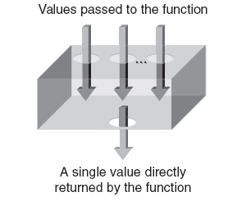
Variable Scope
A function can be thought of as a closed box, with slots at the top to receive values and a single slot at the bottom to return a value
Figure 6.14 A function can be considered a closed box

Slide 47
Variable Scope
Local variables: Variables created in a function that are conventionally available only to the function
Scope: Section of the program where the identifier is valid or “known”
A variable with local scope is simply one with storage locations set aside for it by a declaration statement inside the function that declared them
A variable with global scope has storage created for it by a declaration statement located outside any function

Slide 48
Variable Scope
Program 6.15
#include <iostream>
using namespace std;
int firstnum; // create a global variable named firstnum
void valfun(); // function prototype (declaration)
int main()
{
int secnum; // create a local variable named secnum
firstnum = 10; // store a value into the global variable
secnum = 20; // store a value into the local variable
cout << "From main(): firstnum = " << firstnum << endl
<< "From main(): secnum = " << secnum << endl;
valfun(); // call the function valfun
cout << "\nFrom main() again: firstnum = " << firstnum << endl
<< "From main() again: secnum = " << secnum << endl;
return 0;
}

Slide 49
Variable Scope
Program 6.15 (Continued)
void valfun() // no values are passed to this function
{
int secnum; // create a second local variable named secnum
secnum = 30; // this only affects this local variable's value
cout << "\nFrom valfun(): firstnum = " << firstnum << endl
<< "From valfun(): secnum = " << secnum << endl;
firstnum = 40; // this changes firstnum for both functions
return;
}
The Output from Program 6.15
From main(): firstnum = 10
From main(): secnum = 20
From valfunc(): firstnum = 10
From valfunc(): secnum = 30
From main() again: firstnum = 40
From main() again: secnum = 20

Slide 50
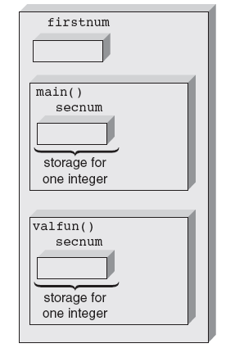
Variable Scope
Figure 6.15 The three storage areas reserved by Program 6.15

Slide 51
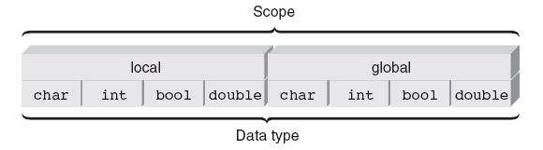
Variable Scope
Figure 6.16 Relating the scope and type of a variable

Slide 52
Scope Resolution Operator
When a local variable has the same name as a global variable, all references to the variable name made within the local variable’s scope refer to the local variable
Program 6.16
#include <iostream>
using namespace std;
double number = 42.8; // a global variable named number
int main()
{
double number = 26.4; // a local variable named number
cout << "The value of number is " << number << endl;
return 0;
}

Slide 53
Scope Resolution Operator
To reference a global variable when a local variable of the same name is in scope, use C++’s scope resolution operator, which is ::
Program 6.16a
#include <iostream>
using namespace std;
double number = 42.5; // a global variable named number
int main()
{
double number = 26.4; // a local variable named number
cout << "The value of number is " << ::number << endl;
return 0;
}

Slide 54
Misuse of Globals
Global variables allow programmers to “jump around” the normal safeguards provided by functions
Instead of passing variables to a function, it is possible to make all variables global: do not do this
Indiscriminate use of global variables destroys the safeguards C++ provides to make functions independent and insulated from each other
Using only global variables can be especially disastrous in large programs with many user-created functions

Slide 55
Variable Storage Categories
A variable’s scope can be thought of as the space in the program where the variable is valid
In addition to space dimension represented by scope, variables have a time dimension that refers to the length of time storage locations are reserved for a variable
This time dimension is referred to as the variable’s lifetime
When and how long a variable’s storage locations are kept before they are released can be determined by the variable’s storage category

Slide 56
Variable Storage Categories
The four available storage categories are:
auto
static
extern
register
auto int num; // auto storage category and int data type
static int miles; // static storage category and int data type
register int dist; // register storage category and int data type
extern int volts; // extern storage category and int data type
auto float coupon; // auto storage category and float data type
static double yrs; // static storage category and double data type
extern float yld; // extern storage category and float data type
auto char inKey; // auto storage category and char data type

Slide 57
Local Variable Storage Categories
Local variables can be members only of the auto, static, or register storage categories
Storage for automatic local variables is reserved or created automatically each time a function is called
As long as the function hasn’t returned control to its calling function, all automatic variables local to the function are “alive”
A local static variable isn’t created and destroyed each time the function declaring it is called
Local static variables remain in existence for the program’s lifetime

Slide 58
Local Variable Storage Categories
Program 6.17
#include <iostream>
using namespace std;
void testauto(); // function prototype
int main()
{
int count; // count is a local auto variable
for(count = 1; count <= 3; count++)
testauto();
return 0;
}
void testauto()
{
int num = 0; // num is a local auto variable
// that is initialized to zero
cout << "The value of the automatic variable num is "
<< num << endl;
num++;
return;
}

Slide 59
Local Variable Storage Categories
Program 6.18
#include <iostream>
using namespace std;
void teststat(); // function prototype
int main()
{
int count; // count is a local auto variable
for(count = 1; count <= 3; count++)
teststat();
return 0;
}
void teststat()
{
static int num = 0; // num is a local static variable
cout << "The value of the static variable num is now "
<< num << endl;
num++;
return;
}

Slide 60
Local Variable Storage Categories
Most computers have a few high-speed storage areas, called registers, located in the CPU that can also be used for variable storage
Because registers are located in the CPU, they can be accessed faster than normal memory storage areas located in the computer’s memory unit

Slide 61
Global Variable Storage Categories
Global variables are created by definition statements external to a function
By their nature, global variables do not come and go with the calling of a function
After a global variable is created, it exists until the program in which it’s declared has finished executing
Global variables can be declared with the static or extern storage category, but not both

Slide 62
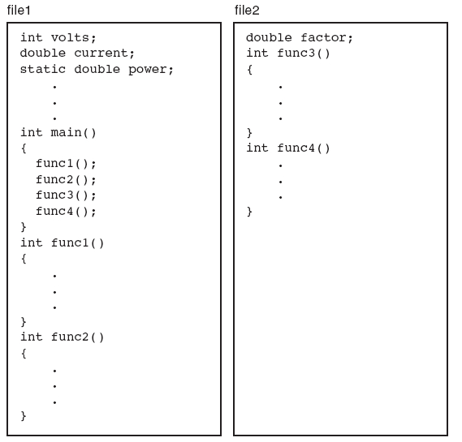
Global Variable Storage Categories
Figure 6.17 A program can extend beyond one file

Slide 63
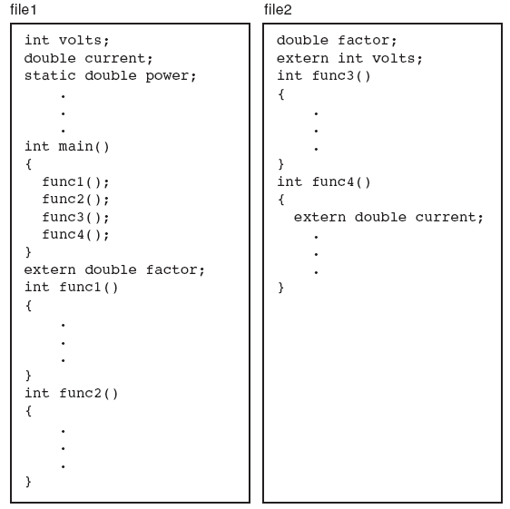
Global Variable Storage Categories
Figure 6.18 Extending the scope of global variables

Slide 64
Common Programming Errors
Passing incorrect data types
Errors that occur when the same variable is declared locally in both the calling and the called functions
Omitting the called function’s prototype before or within the calling function
Terminating a function header with a semicolon
Forgetting to include the data type of a function’s parameters in the function header

Slide 65
Summary
A function is called by giving its name and passing any data to it in the parentheses following the name
A function’s return type is the data type of the value the function returns
Arguments passed to a function when it is called must conform to the parameters specified by the function header in terms of order, number of arguments, and specified data type

Slide 66
Summary
Functions can be declared to all calling functions by means of a function prototype
Every variable has a storage category, which determines how long the value in the variable is retained

