Slide 1
8
I/O File Streams and Data Files

Slide 2
Contents
I/O file stream and methods
Reading and writing character-based files
Random file access
File streams as function arguments
A case study involving pollen count file updates
The iostream class library
Common programming errors

Slide 3
I/O File Stream Objects and Methods
To store and retrieve data outside a C++ program, two things are needed:
A file
A file stream object
A file is a collection of data stored together under a common name, usually on disk, magnetic tape, USB drive, or CD
Each file has a unique file name, referred to as file’s external name

Slide 4
I/O File Stream Objects and Methods
Choose filenames that indicate the type of data in the file
Two basic types of files exist
Text files (also known as character-based files)
Binary files

Slide 5
I/O File Stream Objects and Methods
External name: Unique file name for file
External name is how operating system knows file
Contents of directory or folder are listed by external names
Format of external names: Each computer operating system has its own specifications for external file name
Table 15.1 lists specifications for more commonly used operating systems

Slide 6
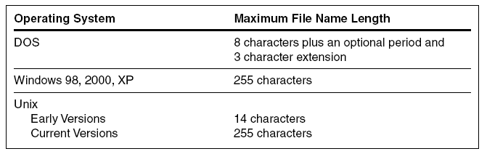
I/O File Stream Objects and Methods
Table 8.1 Maximum Allowable File Name Characters

Slide 7
I/O File Stream Objects and Methods
File naming conventions:
Use descriptive names
Avoid long file names
They take more time to type and can result in typing errors
Manageable length for file name is 12 to 14 characters, with maximum of 25 characters
Choose file names that indicate type of data in file and application for which it is used
Frequently, first eight characters describe data, and an extension describes application

Slide 8
File Stream Objects
File stream: One-way transmission path that is used to connect file stored on physical device, such as disk or CD, to program
Mode (of file stream): Determines whether path will move data from file into program or from program to file
Input file stream: Receives or reads data from file into program
Output file stream: Sends or writes data to file

Slide 9
File Stream Objects
Direction (mode) of file stream is defined in relation to program and not file:
Data that goes into program are considered input data
Data sent out from program are considered output data
Figure 8.1 illustrates data flow from and to file using input and output streams

Slide 10
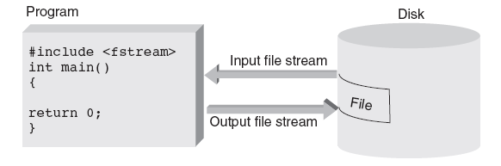
File Stream Objects
For each file your program uses, regardless of file’s type, a distinct file stream object must be created
Figure 8.1 Input and output file streams

Slide 11
File Stream Objects
Distinct file stream object must be created for each file used, regardless of file’s type
For program to both read and write to file, both an input and output file stream object are required
Input file stream objects are declared to be of type ifstream
Output file streams are declared to be of type ofstream

Slide 12
File Stream Objects
Two basic types of files: both store data using binary code
Text (character-based) files: Store each character using individual character code (typically ASCII or Unicode)
Advantage: Allows files to be displayed by word processing program or text editor
Binary-based files: Store numbers in binary form and strings in ASCII or Unicode form
Advantage: Provides compactness

Slide 13
File Stream Methods
Each file stream object has access to methods defined for its respective ifstream or ofstream class, including:
Opening file: connecting stream object name to external file name
Determining whether a successful connection has been made
Closing file: closing connection
Getting next data item into program from input stream
Putting new data item from program onto output stream
Detecting when end of file has been reached

Slide 14
File Stream Methods
open() method:
Establishes physical connecting link between program and file
Operating system function that is transparent to programmer
Connects file’s external computer name to stream object name used internally by program
Before a file can be opened, it must be declared as either ifstream or ofstream object
File opened for input is said to be in read mode

Slide 15
File Stream Methods
Example: inFile.open("prices.dat");
connects external text file named prices.dat to internal program file stream object named inFile
Accesses file using internal object name inFile
Computer saves file under the external name prices.dat
Calling the open() method uses the standard object notation: objectName.open()

Slide 16
File Stream Methods
fail() method: returns true value if file is unsuccessfully opened, false if open succeeded
Good programming practice is to check that connection is established before using file
In addition to fail() method, C++ provides three other methods, listed in Table 8.2, that can be used to detect file’s status
Program 8.1 illustrates statements required to open file for input including error checking routine to ensure that successful open was obtained

Slide 17
File Stream Methods
Example of use of fail() method:
ifstream inFile; // any object name can be used here
inFile.open("prices.dat"); // open the file
// check that the connection was successfully opened
if (inFile.fail())
{
cout << "\nThe file was not successfully opened"
<< "\n Please check that the file currently exists."
<< endl;
exit(1);
}

Slide 18
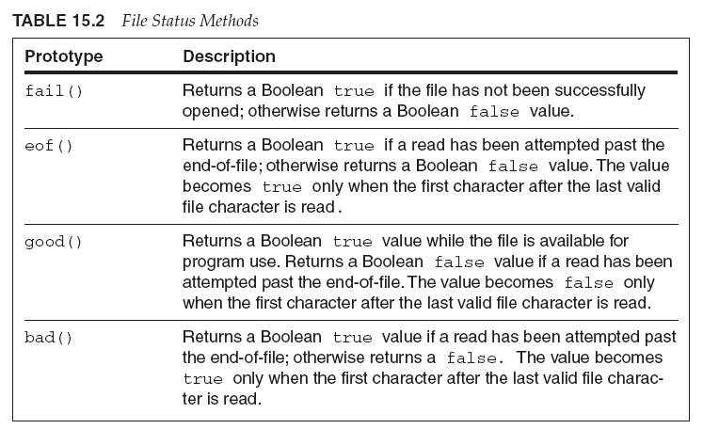
File Stream Methods
Table 8.2 File Status Methods

Slide 19
File Stream Methods
Program 8.1
#include <iostream>
#include <fstream>
#include <cstdlib> // needed for exit()
using namespace std;
int main()
{
ifstream inFile;
inFile.open("prices.dat"); // open the file with the
// external name prices.dat
if (inFile.fail()) // check for a successful open
{
cout << "\nThe file was not successfully opened"
<< "\n Please check that the file currently exists."
<< endl;
exit(1);
}
cout << "\nThe file has been successfully opened for reading"
<< endl;
// statements to read data from the file would be placed here
return 0;
}

Slide 20
File Stream Methods
Different checking required for output files
If file exists having same name as file to be opened in output mode, existing file is erased and all data lost
To avoid this situation, file is first opened in input mode to see if it exists
If it does, user is given choice of explicitly permitting it to be overwritten (when it is later opened in output mode)
Code used to accomplish this is highlighted in Program 8.2

Slide 21
Embedded and Interactive Filenames
Programs 8.1 and 8.2 have two problems
External file name is embedded in program code
There’s no provision for user to enter file name while program is running
As both programs are written, if filename is to change, programmer must modify external filename in call to open() and recompile program
Both these problems can be avoided by assigning filename to string variable

Slide 22
Embedded and Interactive Filenames
Program 8.3b
#include <iostream>
#include <fstream>
#include <cstdlib> // needed for exit()
#include <string>
using namespace std;
int main()
{
string filename;
ifstream inFile;
cout << "Please enter the name of the file you wish to open: ";
cin >> filename;
inFile.open(filename.c_str()); // open the file
if (inFile.fail()) // check for successful open
{
cout << "\nThe file named " << filename << " was not successfully opened"
<< "\n Please check that the file currently exists."
<< endl;
exit(1);
}
cout << "\nThe file has been successfully opened for reading.\n";
return 0;
}

Slide 23
Closing a File
File is closed using close() method
This method breaks connection between file’s external name and file stream, which can be used for another file
Because all computers have limit on maximum number of files that can be open at one time, closing files no longer needed makes good sense
Any open files existing at end of normal program execution are closed automatically by OS

Slide 24
Reading and Writing Character-Based Files
Program 8.4 output:
File named prices.dat is created and saved by computer as text file (the default file type)
prices.dat is sequential file consisting of the following data:
Mats 39.95
Bulbs 3.22
Fuses 1.08
Actual storage of characters in file depends on character codes used by computer
Output file contains 36 characters (Figure 8.2)

Slide 25
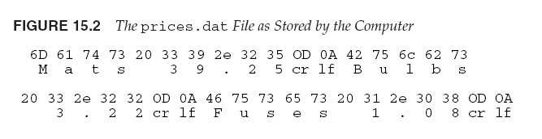
Reading and Writing Character-Based Files
Figure 8.2 The prices.dat File as Stored by the Computer

Slide 26
Reading from a Text File
Almost identical to reading data from standard keyboard
cin object replaced by ifstream object declared in program
Example: The input statement
inFile >> descrip >> price;
reads next two items in file and stores them in variables descrip and price
File stream name directs input to come from file stream rather than standard input device stream

Slide 27
Reading from a Text File
Program 8.5 illustrates how the prices.dat file created in Program 8.4 can be read
Also illustrates method of detecting end-of-file (EOF) marker using good() function (see Table 8.2)
Other methods that can be used for stream input are listed in Table 8.3
Each method must be preceded by stream object name

Slide 28
Reading from a Text File
Program 8.5
#include <iostream>
#include <fstream>
#include <cstdlib> // needed for exit()
#include <string>
using namespace std;
int main()
{
string filename = "prices.dat"; // put the filename up front
string descrip;
double price;
ifstream inFile;
inFile.open(filename.c_str());
if (inFile.fail()) // check for successful open
{
cout << "\nThe file was not successfully opened"
<< "\n Please check that the file currently exists."
<< endl;
exit(1);
}

Slide 29
Reading from a Text File
Program 8.5 (Continued)
// read and display the file's contents
inFile >> descrip >> price;
while (inFile.good()) // check next character
{
cout << descrip << ' ' << price << endl;
inFile >> descrip >> price;
}
inFile.close();
return 0;
}

Slide 30
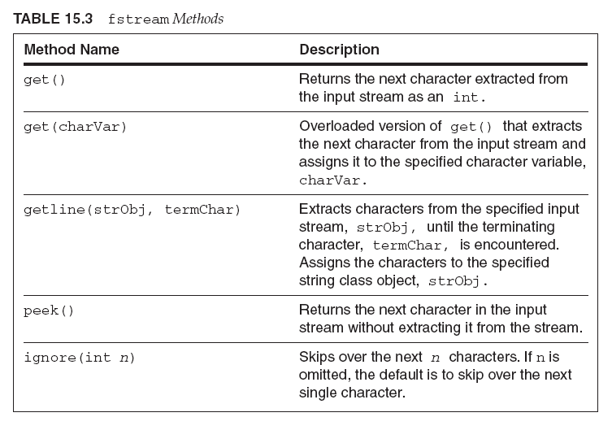
Reading from a Text File
Table 8.3 fstream Methods

Slide 31
Standard Device Files
C++ supports logical and physical file objects
Logical file object: Stream that connects file of logically related data (data file) to a program
Physical file object: Stream that connects to hardware device such as keyboard or printer
Standard input file: Physical device assigned to program for data entry
Standard output file: Physical device on which output is automatically displayed

Slide 32
Other Devices
The keyboard, display, error reporting, and logging streams are automatically connected to the stream objects named cin, cout, cerr, clog
Requires iostream header file
Other devices can be used if the name assigned by system is known
Example: Most personal computers assign name prn to printer connected to computer
Statement outFile.open("prn") connects printer to ofstream object named outFile

Slide 33
Random File Access
File access: Refers to process of retrieving data from a file
Two types of file access
Sequential file access
Random file access
File organization: Refers to the way data is stored in a file
The files you have used and will continue to use have a sequential organization, meaning characters in file are stored in a sequential manner

Slide 34
Random File Access
Each open file has been read in a sequential manner, meaning characters are accessed one after another, which is called sequential access
Although characters are stored sequentially, they don’t have to be accessed in same way
In random access, any character in opened file can be read without having to read all characters stored ahead of it first
To provide random access, each ifstream object creates a file position marker automatically
This markers is a long integer representing an offset from the beginning of file

Slide 35
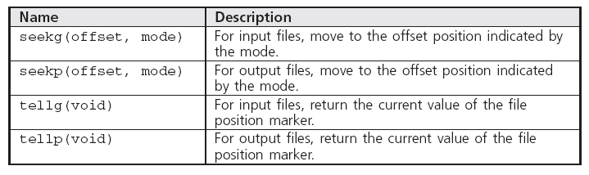
Random File Access
Table 8.4 File Position Marker Methods

Slide 36
Random File Access
seek() method allows programmer to move to any position in file
Character’s position is referred to as its offset from the start of file

Slide 37
Random File Access
Program 8.7
#include <iostream>
#include <fstream>
#include <string>
#include <cstdlib>
using namespace std;
int main()
{
string filename = "test.dat";
char ch;
long offset, last;
ifstream inFile(filename.c_str());
if (inFile.fail()) // check for successful open
{
cout << "\nThe file was not successfully opened"
<< "\n Please check that the file currently exists"
<< endl;
exit(1);
}

Slide 38
Random File Access
Program 8.7 (Continued)
inFile.seekg(0L,ios::end); // move to the end of the file
last = inFile.tellg(); // save the offset of the last character
for(offset = 1L; offset <= last; offset++)
{
inFile.seekg(-offset, ios::end);
ch = inFile.get();
cout << ch << " : ";
}
inFile.close();
cout << endl;
return 0;
}

Slide 39
File Streams as Function Arguments
A file steam object can be used as a function argument
The function’s formal parameter must be a reference to the appropriate stream, either ifstream& or ofstream&
Examples: inOut(), getOpen()

Slide 40
A Case Study: Pollen Count File Update
After a data file has been created, application programs are typically written to read and update the file with current data
In this case study, a file is used as a database storing the ten most recent polling counts, which are used in the summer as allergy “irritability” measures
Analyze the problem
Develop a solution
Code the solution
Test and correct the program

Slide 41
Program 8.10
#include <iostream>
#include <fstream>
#include <cstdlib>
#include <string>
using namespace std;
void openInput(ifstream&); // pass a reference to an ifstream
void openOutput(ofstream&); // pass a reference to an ofstream
double pollenUpdate(ifstream&, ofstream&); // pass two references
int main()
{
ifstream inFile; // inFile is an istream object
ofstream outfile; // outfile is an ofstream object
double average;
cout << "\n\nThis program reads the old pollen count file, "
<< "creates a current pollen"
<< "\n count file, and calculates and displays "
<< "the latest 10-week average.";
openInput(inFile);
openOutput(outfile);
average = pollenUpdate(inFile, outfile);
cout << "\nThe new ten week average is: " << average << endl;
return 0;
}

Slide 42
Program 8.10 (Continued)
// this function gets an external filename and opens the file for input
void openInput(ifstream& fname)
{
string filename;
cout << "\n\nEnter the input pollen count file name: ";
cin >> filename;
fname.open(filename.c_str());
if (fname.fail()) // check for a successful open
{
cout << "\nFailed to open the file named " << filename << "for input"
<< "\n Please check that this file exists"
<< endl;
exit(1);
}
return;
}

Slide 43
Program 8.10 (Continued)
void openOutput(ofstream& fname)
{
string filename;
cout << "Enter the output pollen count filename: ";
cin >> filename;
fname.open(filename.c_str());
if (fname.fail()) // check for a successful open
{
cout << "\nFailed to open the file named " << filename << "for output"
<< endl;
exit(1);
}
return;
}

Slide 44
Program 8.10 (Continued)
double pollenUpdate(ifstream& infile, ofstream& outfile)
{
const int POLNUMS = 10; // maximum number of pollen counts
int i, polreading;
int oldreading, newcount;
double sum = 0;
double average;
cout << "Enter the latest pollen count reading: ";
cin >> newcount;
// read the oldest pollen count
infile >> oldreading;
// read, sum, and write out the rest of the pollen counts
for(i = 0; i < POLNUMS; i++) {
infile >> polreading;
sum += polreading;
outfile << polreading << endl;
}
outfile << newcount << endl;
average = (sum + newcount) / double(POLNUMS);
infile.close();
outfile.close();
cout << "\nThe output file has been written.\n";
return average;
}

Slide 45
A Closer Look: The iostream Class Library
Classes in iostream class library access files by using entities called streams
For most systems the data bytes transferred on a stream represent ASCII characters or binary numbers
Mechanism for reading a byte stream from a file or writing a byte stream to a file is hidden when using a high level language like C++

Slide 46
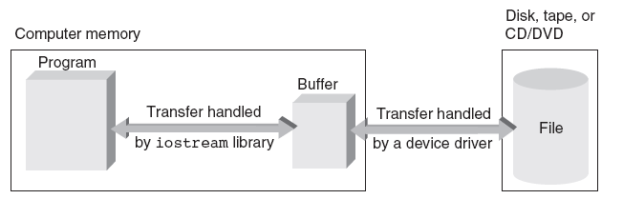
File Stream Transfer Mechanism
Figure 8.5 The data transfer mechanism

Slide 47
Components of the iostream Class Library
iostream class library consists of two primary base classes
streambuf
ios
streambuf class provides the file buffer
ios class contains pointer to the file buffers provided by streambuf class and general routines for transferring text data

Slide 48
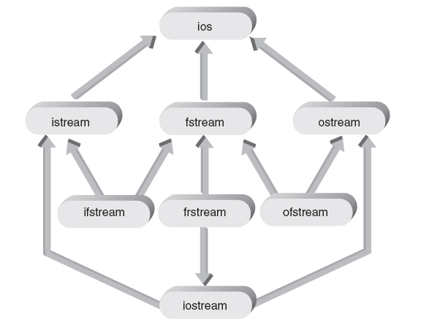
Components of the iostream Class Library
Figure 8.6 The base class ios and its derived classes

Slide 49
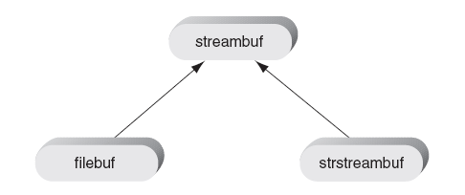
Components of the iostream Class Library
Figure 8.7 The base class streambuf and its derived classes

Slide 50
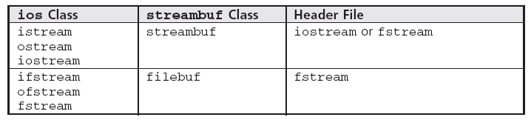
Components of the iostream Class Library
Table 8.5 Correspondence Between Classes in Figures 8.6 and 8.7

Slide 51
In-Memory Formatting
In addition to classes shown in Figure 8.7, a class named strstream is derived from ios class
Uses strstream class shown in Figure 8.7, requires strstream header file, and provides capabilities for writing and reading to and from in-memory defined streams
As output, these streams are typically used to “assemble” a string from a smaller pieces until a complete line of characters is ready to be written to cout or to a file

Slide 52
In-Memory Formatting
strstream object can also be opened in input mode
This stream is used as working storage area, or buffer, for storing complete line of text from file or standard input
After buffer has been filled, and extraction operator is used to “disassemble” the string into component parts and convert each data item into its designated data type

Slide 53
Common Programming Errors
Forgetting to open file before attempting to read from it or write to it
Using file’s external name in place of internal file stream name when accessing a file
Opening file for output without first checking that file with the same name already exists
Opening existing file for output overwrites that file
Not understanding that end of file is detected only after EOF marker has been read and passed over

Slide 54
Common Programming Errors
Attempting to detect end of file by using character variables for EOF marker
Any variable used to accept EOF marker must be declared an integer variable
Using integer argument with seekg() and seekp() functions
This offset must be long integer constant or variable

Slide 55
Summary
Data file is any collection of data stored together in an external storage medium under a common name
Data file is connected to file stream by using fstream open method
File can be opened in input and output mode
All file streams must be declared as objects of ifstream or ofstream class
In addition to any files opened in a function, standard stream objects cin, cout, and cerr are declared and opened automatically when a program runs

