Slide 1
9
Additional Features

Slide 2
Contents
Exception handling
Exceptions and file checking
The string Class
Character manipulation functions
Input data validation
Namespaces and creating a personal library
Common programming errors

Slide 3
Exception Handling
Traditional C++ approach to error handling uses a function to return a specific value to indicate specific operations
Latest C++ compilers have added a technique designed for error detection and handling referred to as exception handling
When an error occurs while a function is executing, an exception is created
An exception is a value, a variable, or an object containing information about the error at the point the error occurs

Slide 4
Exception Handling
Throwing an exception: Process of generating an exception is referred to as
In general two fundamental types of errors can cause C++ exceptions
Those resulting from inability to obtain a required resource, over which the programmer has no control
Errors than can be checked and handled, over which the programmer has control

Slide 5
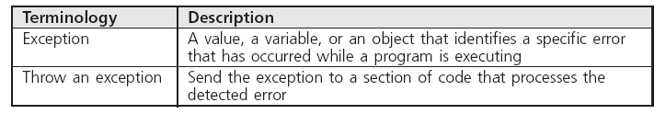
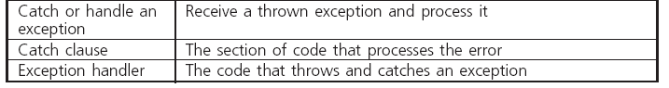
Exception Handling
Figure 9.1 Exception-Handling Terminology

Slide 6
Exception Handling
The general syntax of the code required to throw and catch an exception is:
try
{
// one or more statements,
// at least one of which should
// be capable of throwing an exception;
}
catch(exceptionDataType parameterName)
{
// one or more statements
}

Slide 7
Exception Handling
Program 9.1
#include <iostream>
using namespace std;
int main()
{
int numerator, denominator;
try
{
cout << "Enter the numerator (whole number only): ";
cin >> numerator;
cout << "Enter the denominator(whole number only): ";
cin >> denominator;
if (denominator == 0)
throw denominator; // an integer value is thrown
else
cout << numerator <<'/' << denominator
<< " = " << double(numerator)/ double(denominator) << endl;
}
catch(int e)
{
cout << "A denominator value of " << e << " is invalid." << endl;
exit (1);
}
return 0;
}

Slide 8
Exceptions and File Checking
Error detection and exception handling are used in C++ programs that access one or more files
General exception handling code (section 9.2)
try
{
// one or more statements, at least one
// of which should throw an exception
}
catch(exceptionDataType parameterName)
{
// one or more statements
}
Program 9.3 illustrates file opening exception handling

Slide 9
Opening Multiple Files
Example: Read the data from character-based file named info.txt, one character at a time, and write this data to file named info.bak
Essentially, this is a file-copy program
Figure 9.2 illustrates structure of streams needed to produce file copy
Program 9.5 creates info.bak file as an exact duplicate of info.txt file using procedure described in Figure 9.2

Slide 10
Opening Multiple Files
Computer
Disk
Program
Read
Operating System Interface
info.txt
Write
Operating System Interface
backup.txt
Figure 9.2 The file copy stream structure

Slide 11
Opening Multiple Files
Program 9.5
#include <iostream>
#include <fstream>
#include <cstdlib> // needed for exit()
#include <string>
using namespace std;
int main()
{
string fileOne = "info.txt"; // put the filename up front
string fileTwo = "info.bak";
char ch;
ifstream inFile;
ofstream outFile;
try //this block tries to open the input file
{
// open a basic input stream
inFile.open(fileOne.c_str());
if (inFile.fail()) throw fileOne;
} // end of outer try block
catch (string in) // catch for outer try block
{
cout << "The input file " << in
<< " was not successfully opened." << endl
<< " No backup was made." << endl;
exit(1);
}

Slide 12
Opening Multiple Files
Program 9.5 (Continued)
try // this block tries to open the output file and
{ // perform all file processing
outFile.open(fileTwo.c_str());
if (outFile.fail())throw fileTwo;
while ((ch = inFile.get())!= EOF)
outFile.put(ch);;
inFile.close();
outFile.close();
}
catch (string out) // catch for inner try block
{
cout << "The backup file " << out
<< " was not successfully opened." << endl;
exit(1);
}
cout << "A successful backup of " << fileOne
<< " named " << fileTwo << " was successfully made." << endl;
return 0;
}

Slide 13
The string Class
Provides methods for declaring, creating and initializing a string
String literal: any sequence of characters enclosed in double quotation marks
Examples:
“This is a string”
“Hello World!”
Double quotation marks identify the beginning and end of a string
Quotation marks not stored with string

Slide 14
The string Class
Character position: 0 1 2 3 4
H
e
l
l
o
Figure 9.3 The storage of a string as a sequence of characters

Slide 15
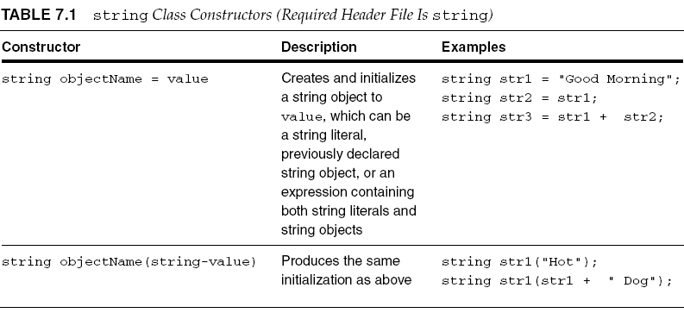
string Class Functions
Table 9.2 string Class Constructors (Required Header File Is string)

Slide 16
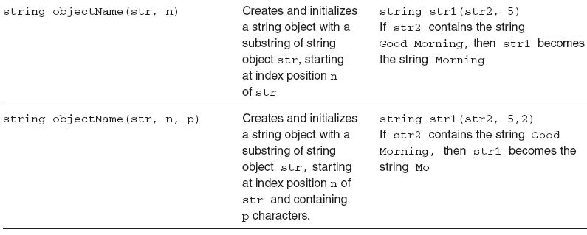
string Class Functions

Slide 17
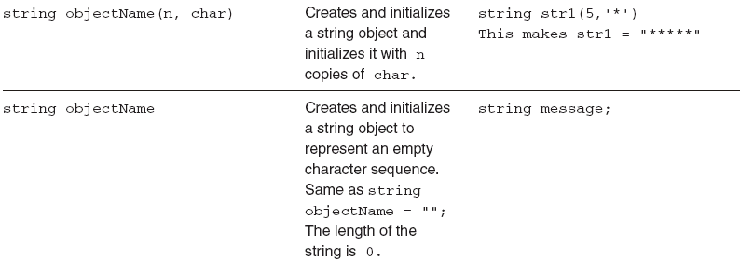
string Class Functions

Slide 18
string Class Functions
Program 9.6
#include <iostream>
#include <string>
using namespace std;
int main()
{
string str1; // an empty string
string str2("Good Morning");
string str3 = "Hot Dog";
string str4(str3);
string str5(str4, 4);
string str6 = "linear";
string str7(str6, 3, 3);
cout << "str1 is: " << str1 << endl;
cout << "str2 is: " << str2 << endl;
cout << "str3 is: " << str3 << endl;
cout << "str4 is: " << str4 << endl;
cout << "str5 is: " << str5 << endl;
cout << "str6 is: " << str6 << endl;
cout << "str7 is: " << str7 << endl;
return 0;
}

Slide 19
string Class Functions
The Output from Program 9.6
str1 is:
str2 is: Good Morning
str3 is: Hot Dog
str4 is: Hot Dog
str5 is: Dog
str6 is: linear
str7 is: ear

Slide 20
string Input and Output
In addition to methods listed in Table 9.2, strings can be:
Input from the keyboard
Displayed on the screen
Additional methods include:
cout: General purpose screen output
cin: General purpose terminal input that stops reading when a whitespace is encountered

Slide 21
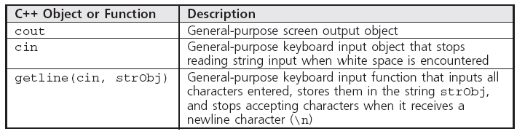
string Input and Output
Table 9.3 string Class Input and Output

Slide 22
string Input and Output
Additional methods include:
getline(cin, strObj): General purpose terminal input that inputs all characters entered into the string named strObj and stops accepting characters when it receives a newline character (\n)
Example: getline(cin, message)
Continuously accepts and stores characters entered at terminal until Enter key is pressed.
Pressing Enter key generates newline character, ‘\n’
All characters except newline stored in string named message

Slide 23
string Input and Output
getline()
characters \n
characters
Figure 9.5 Inputting a string with getline()

Slide 24
string Input and Output
Program 9.7
#include <iostream>
#include <string>
using namespace std;
int main()
{
string message; // declare a string object
cout << "Enter a string:\n";
getline(cin, message);
cout << "The string just entered is:\n"
<< message << endl;
return 0;
}

Slide 25
string Input and Output
Sample run of Program 9.7:
Enter a string:
This is a test input of a string of characters.
The string just entered is:
This is a test input of a string of characters.

Slide 26
string Input and Output
In Program 9.7, the cin object cannot be used in place of getline()
cin reads a set of characters up to a blank space or a newline character
Statement cin >> message cannot be used to enter the characters This is a string
Statement results in word This assigned to message
cin’s usefulness for entering string data limited - blank space terminates cin extraction

Slide 27
string Input and Output
General form of getline() method:
getline(cin, strObj, terminatingChar)
strObj: a string variable name
terminatingChar: an optional character constant or variable specifying the terminating character
Example:
getline(cin, message, ‘!’)
Accepts all characters entered at the keyboard, including newline, until an exclamation point is entered

Slide 28
Caution: The Phantom Newline Character
Unexpected results occur when:
cin input stream and getline() method are used together to accept data
Or when cin input stream is used to accept individual characters
Example: Program 9.8
When value is entered and Enter key is pressed, cin accepts value but leaves the ‘\n’ in the buffer
getline() picks up the code for the Enter key as the next character and terminates further input

Slide 29
Caution: The Phantom Newline Character
Program 9.8
#include <iostream>
#include <string>
using namespace std;
int main()
{
int value;
string message;
cout << "Enter a number: ";
cin >> value;
cout << "The number entered is:\n"
<< value << endl;
cout << "Enter text:\n";
getline(cin, message);
cout << "The string entered is:\n"
<< message << endl;
return 0;
}

Slide 30
Caution: The Phantom Newline Character
Sample run of Program 9.8:
Enter a number: 26
The number entered is 26
Enter text:
The string entered is

Slide 31
Caution: The Phantom Newline Character
Solutions to the “phantom” Enter key problem
Do not mix cin with getline() inputs in the same program
Follow the cin input with the call to cin.ignore()
Accept the Enter key into a character variable and then ignore it
Preferred solution is the first option

Slide 32
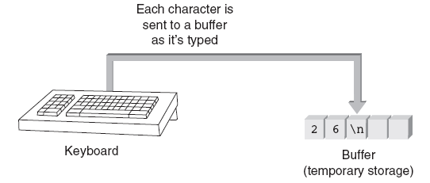
Caution: The Phantom Newline Character
Figure 9.6 Typed characters are first stored in a buffer

Slide 33
String Processing
Methods for manipulating strings (Table 9.4):
Most commonly used string class method is length() which returns the number of characters in the string
Most commonly used methods:
Accessor
Mutator
Additional methods that use standard arithmetic and comparison operators

Slide 34
String Processing
Program 9.10
#include <iostream>
#include <string>
using namespace std;
int main()
{
string str = "Counting the number of vowels";
int i, numChars;
int vowelCount = 0;
cout << "The string: \"" << str "\"" << endl;
numChars = str.length();
for (i = 0; i < numChars; i++)
{
switch(str.at(i)) // here is where a character is retrieved
{
case 'a':
case 'e':
case 'i':
case 'o':
case 'u':
vowelCount++;
}
}
cout << " contains " << vowelCount << " vowels." << endl;
return 0;
}

Slide 35
String Processing
String expressions may be compared for equality using standard relational operators
String characters stored in binary using ASCII or Unicode code as follows:
A blank precedes (is less than) all letters and numbers
Letters are stored in order from A to Z
Digits stored in order from 0 to 9
Digits come before uppercase characters, which are followed by lowercase characters

Slide 36
String Processing
Procedure for comparing strings:
Individual characters compared a pair at a time
If no differences, the strings are equal
Otherwise, the string with the first lower character is considered the smaller string
Examples:
"Hello" is greater than "Good Bye" because the first H in Hello is greater than the first G in Good Bye
"Hello" is less than "hello" because the first H in Hello is less than the first h in hello

Slide 37
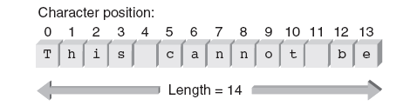
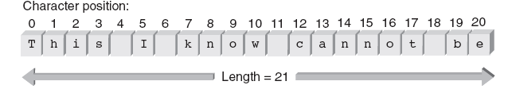
String Processing
string str = “This cannot be”
str.insert(4, “ I know”);
Figure 9.8 Initial storage of a string object
Figure 9.9 The string after the insertion

Slide 38
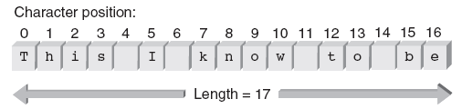
String Processing
str.replace(12, 6, “to”);
Figure 9.10 The string after the replacement

Slide 39
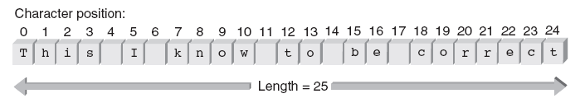
String Processing
str = str + “ correct”
Figure 9.11 The string after the append

Slide 40
Character Manipulation Methods
C++ language provides a variety of character class functions (listed in Table 9.5)
Function declarations (prototypes) for these functions are contained in header files string and cctype
Header file must be included in any program that uses these functions

Slide 41
Character Manipulation Methods
Example: If ch is a character variable, consider the following code segment:
if(isdigit(ch))
cout << "The character just entered is a digit" << endl;
else if(ispunct(ch))
cout << "The character just entered is a punctuation mark" << endl;
If ch contains a digit character, the first cout statement is executed
If ch is a punctuation character, the second statement is executed

Slide 42
Character Manipulation Methods
Program 9.14
#include <iostream>
#include <string>
using namespace std;
int main()
{
int i;
string str;
cout << "Type in any sequence of characters: ";
getline(cin,str);
// cycle through all elements of the string
for (i = 0; i < str.length(); i++)
str[i] = toupper(str[i]);
cout << "The characters just entered, in uppercase, are: "
<< str << endl;
cin.ignore();
return 0;
}

Slide 43
Character I/O
Entry of all data from keyboard, whether a string or a number, is done one character at a time
Entry of string Hello consists of pressing keys H, e, l, l, o, and the Enter Key (as in Figure 7.10)
All of C++’s higher-level I/O methods and streams are based on lower-level character I/O
Table 9.6 lists the basic character I/O methods

Slide 44
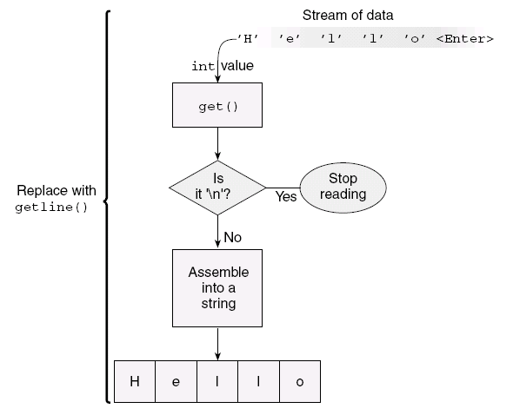
Character I/O
Figure 9.12 Accepting keyboard entered characters

Slide 45
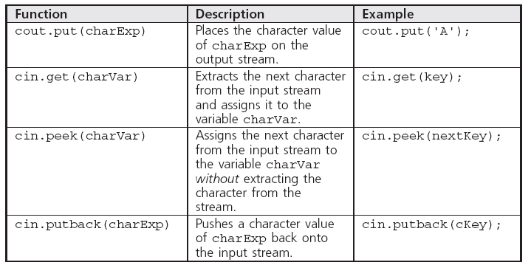
Character I/O
Table 9.6 Basic Character I/O Functions (Require the header file cctype)

Slide 46
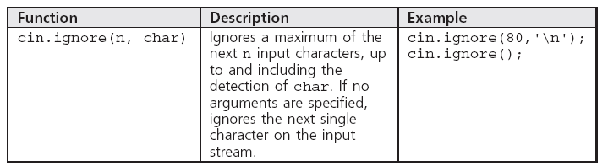
Character I/O
Table 9.6 Basic Character I/O Functions (Require the header file cctype)

Slide 47
The Phantom Newline Revisited
Undesired results can occur when characters are input using the get() character method
Program 9.16 is an example of this problem
Two ways to avoid this:
Follow cin.get() input with the call cin.ignore()
Accept the Enter key into a character variable and then don’t use it further
Program 9.17 applies the first solution to Program 9.16

Slide 48
The Phantom Newline Revisited
Program 9.16
#include <iostream>
using namespace std;
int main()
{
char fkey, skey;
cout << "Type in a character: ";
cin.get(fkey);
cout << "The key just accepted is " << int(fkey) << endl;
cout << "Type in another character: ";
cin.get(skey);
cout << "The key just accepted is " << int(skey) << endl;
return 0;
}

Slide 49
The Phantom Newline Revisited
Program 9.17
#include <iostream>
using namespace std;
int main()
{
char fkey, skey;
cout << "Type in a character: ";
cin.get(fkey);
cout << "The key just accepted is " << int(fkey) << endl;
cin.ignore();
cout << "Type in another character: ";
cin.get(skey);
cout << "The key just accepted is " << int(skey) << endl;
cin.ignore();
return 0;
}

Slide 50
A Second Look at User-Input Validation
Sign of well-constructed, robust program:
Code that validates user input and ensures that program doesn’t produce unintended results caused by unexpected input
User-input validation: Basic technique for handling invalid data input and preventing seemingly innocuous code from producing unintended results
Validates entered data during or after data entry and gives the user a way of reentering data if it is invalid

Slide 51
Input Data Validation
Validating user input is essential
Successful programs anticipate invalid data and prevent it from being accepted and processed
A common method for validating numerical input data is accepting all numbers as strings
After string is validated it can be converted to the correct type

Slide 52
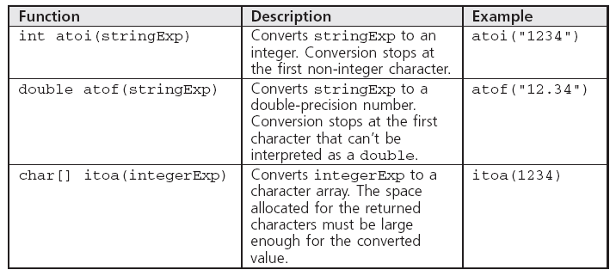
Input Data Validation
Table 9.7 C-String Conversion Functions

Slide 53
Namespaces and Creating a Personal Library
C++ provides mechanisms for programmers to build libraries of specialized functions and classes
Steps in creating a library:
Optionally encapsulate all of the desired functions and classes into one or more namespaces
Store the complete code in one or more files
namespace syntax:
namespace name
{
functions and/or classes in here
} // end of namespace

Slide 54
Namespaces and Creating a Personal Library
After a namespace has been created and stored in a file, it can be included within another file
Supply a preprocessor directive informing the compiler where the namespace is to be found
Include a using directive instructing the compiler which particular namespace in the file to use
Example:
#include <c:\\myLibrary\\dataChecks.cpp>
using namespace dataChecks;

Slide 55
Namespaces and Creating a Personal Library
Program 9.20
#include <c:\\mylibrary\\dataChecks.cpp>
using namespace dataChecks;
int main()
{
int value;
cout << "Enter an integer value: ";
value = getanInt();
cout << "The integer entered is: " << value << endl;
return 0;
}

Slide 56
Common Programming Errors
Forgetting to include string header file when using string class object
Forgetting that newline character, ‘\n’, is a valid input character
Forgetting to convert string class object by using c_str() function when converting string class objects to numerical data types

Slide 57
Summary
String literal is any sequence of characters enclosed in quotation marks
Referred to as a string value, a string constant, and, more conventionally, a string
String can be can be constructed as an object of the string class
string class is common used for constructing strings for input and output purposes
Strings can be manipulated by using functions of the class they’re objects of or by using the general purpose string and character functions

Slide 58
Summary
cin object tends to be of limited usefulness for string input because it terminates input when a blank is encountered
For string class data input, use the getline() function
cout object can be used to display string class strings

