Slide 1
10
Pointers

Slide 2
Contents
Addresses and pointers
Array names as pointers
Pointer arithmetic
Passing addresses
Common programming errors

Slide 3
Addresses and Pointers
High-level languages use memory addresses throughout executable programs
Keeps track of where data and instructions are physically located inside of computer
C++ Attribute: Programmer provided access to addresses of program variables
This capability typically not provided in other high-level languages
Pointer (Pointer Variable): a variable that stores the address of another variable

Slide 4
Addresses and Pointers
Three major attributes of a variable:
Data type: declared in a declaration statement
Value: Stored in a variable by:
Initialization when variable is declared
Assignment
Input
Address: For most applications, variable name is sufficient to locate variable’s contents
Translation of variable’s name to a storage location done by computer each time variable is referenced

Slide 5
Addresses and Pointers
Programmers are usually only concerned with a variable’s value, not its address
Address operator &: determines the address of a variable
& means “address of”
When placed in front of variable num, is translated as “the address of num” - &num
Program 10.1 uses the address operator to display the address of variable num

Slide 6
Addresses and Pointers
Program 10.1
#include <iostream>
using namespace std;
int main()
{
int num;
num = 22;
cout << "num = " << num << endl;
cout << "The address of num = " << &num << endl;
return 0;
}
The Output from Program 10.1
Num = 22
The address of num = 0012FED4

Slide 7
Addresses and Pointers
Four bytes of memory
22
0012FED4
Address of first
Byte used by num
Contents of num
Figure 10.1 A More Comprehensive Picture of the Variable num

Slide 8
Storing Addresses
Address can be stored in suitably declared variables
Example: numAddr = &num;
Statement stores address of num in variable numAddr
numAddr is a pointer (pointer variable)

Slide 9
Storing Addresses
Variable name
Contents
Address of num
numAddr
Figure 10.2 Storing num’s Address in numAddr

Slide 10
Storing Addresses
Example statements store addresses of the variable m, list, and ch in the variables d, tabPoint, and chrPoint
d = &m;
tabPoint = &list;
chrPoint = &ch;
d, tabPoint, and chrPoint are called pointer variables or pointers

Slide 11
Storing Addresses
Variable:
Contents:
Address of m
d
Address of list
tabPoint
Address of ch
chrPoint
Figure 10.3 Storing more addresses

Slide 12
Using Addresses
Indirection Operator * : The * symbol, when followed by a pointer, means “the variable whose address is stored in”
If y is a pointer, then *y means “the variable whose address is stored in y”
Commonly shortened to “the variable pointed to by y”
Example (Figure 10.4):
The content of y is the address FFAA
The variable pointed to by y = qqqq

Slide 13
Using Addresses
FFAA
The content of y is an address
A pointer variable y:
The content at address FFAA
is qqqq
qqqq
FFAA
Figure 10.4 Using Pointer Variable
What is *y?

Slide 14
Using Addresses
Using a pointer requires a double lookup
First an address is retrieved
Address is used to retrieve actual data
Why store addresses if data can be retrieved in one step using variable’s name?
Pointers make it possible to create and delete new storage locations dynamically during program execution

Slide 15
Declaring Pointers
Pointers must be declared before they can store an address
Example: If address in pointer numAddr is the address of an integer, the declaration is:
int *numAddr;
This declaration is read as “the variable pointed to by numAddr is an integer”
The declaration specifies:
The variable pointed to by numAddr is an integer
numAddr is a pointer (because it is used with the indirection operator *)

Slide 16
Declaring Pointers
Program 10.2
#include <iostream>
using namespace std;
int main()
{
int *numAddr; // declare a pointer to an int
int miles, dist; // declare two integer variables
dist = 158; // store the number 158 into dist
miles = 22; // store the number 22 into miles
numAddr = &miles; // store the 'address of miles' in numAddr
cout << "The address stored in numAddr is " << numAddr << endl;
cout << "The value pointed to by numAddr is " << *numAddr << endl;
numAddr = &dist; // now store the address of dist in numAddr
cout << "\nThe address now stored in numAddr is " << numAddr << endl;
cout << "The value now pointed to by numAddr is " << *numAddr << endl;
return 0;
}

Slide 17
Declaring Pointers
Program 10.2 output:
The address stored in numAddr is 0012FEC8
The value pointed to by numAddr is 22
The address now stored in numAddr is 0012FEBC
The value now pointed to by numAddr is 158

Slide 18
Declaring Pointers
Program 10.2 Actions:
Declaration statement int *numAddr; declares numAddr as pointer variable storing the address of an integer variable
Data type determines pointer storage requirements
Statement numAddr = &miles; stores address of variable miles into pointer numAddr
First cout Statement: displays address
Second cout Statement: uses indirection operator to retrieve and display the value pointed to by numAddr (the value stored in miles)

Slide 19
Declaring Pointers
Program 10.2 Actions:
Statement numAddr = &dist; changes numAddr’s value to address of variable dist
This is allowed because the pointer numAddr can be used to point to any integer value (miles and dist are both integer values)
Last two cout statements:
Verify change in numAddr value
Confirm that new stored address points to variable dist

Slide 20
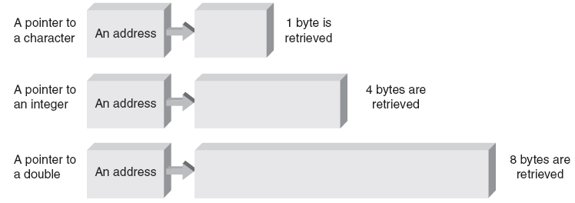
Declaring Pointers
Figure 10.5 Addressing different data types by using pointers

Slide 21
References and Pointers
Reference Pointer: A pointer with restricted capabilities
Hides internal pointer manipulations
Automatic dereference: an indirect access of a variable’s value without using the indirection operator symbol (*)
Instead, uses reference pointer

Slide 22
References and Pointers
Example of automatic dereference:
int b; // b is an integer variable
int &a = b; // a is a reference variable
that stores b's address
a = 10; // this changes b's value to 10
Statement int &a = b; a declared reference pointer
Compiler assigns address of b (not the contents of b)
Statement a = 10; Compiler uses address stored in a to change the value stored in b to 10
Alias a is an alias of b

Slide 23
References and Pointers
Repeat of previous example using pointers instead of automatic dereferencing
int b; // b is an integer variable
int *a = &b; // a is a pointer - store // b's address in a
*a = 10; // this changes b's value to 10
a is a pointer initialized to store address of b
Pointer a can be altered to point to a different variable
Reference variable a (from previous example) cannot be altered to refer to any variable except one to which it was initialized

Slide 24
References and Pointers
For simple cases, using references is easier and is the recommended approach
Passing addresses to a function
For more complex situations, pointers are required
Dynamically allocating new sections of memory for additional variables as a program is running
Using alternatives to array notation

Slide 25
Reference Variables
References are used almost exclusively as formal parameters and return types
Reference variables are available in C++
After a variable has been declared, it can be given additional names by using a reference variable
The form of a reference variable is:
dataType& newName = existingName;
Example: double& sum = total;
The * symbol (indirection operator) is also called the dereferencing operator

Slide 26
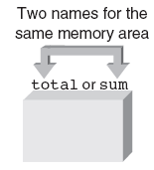
Reference Variables
Figure 10.6 sum is an alternative name for total

Slide 27
Reference Variables
Program 10.3
#include <iostream>
using namespace std;
int main()
{
double total = 20.5; // declare and initialize total
double& sum = total; // declare another name for total
cout << "sum = " << sum << endl;
sum = 18.6; // this changes the value in total
cout << "total = " << total << endl;
return 0;
}

Slide 28
Array Names as Pointers
If grade is a single-dimension array containing five integers, the fourth element is grade[3]
C++ compiler computation of the address of grade[3]: (assuming 4 bytes per integer)
&grade[3] = &grade[0] + (3 * 4);
This statement reads as “the address of grade[3] equals the address of grade[0] plus 12”
Figure 10.10 illustrates the address computation used to locate grade[3]

Slide 29
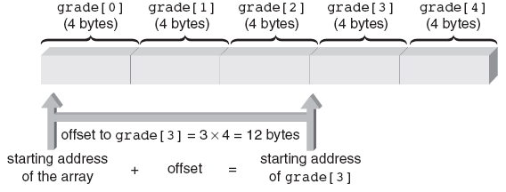
Array Names as Pointers
Figure 10.10 Using a subscript to obtain an address

Slide 30
Array Names as Pointers
Offset: Number of positions beyond first element in array
Using offset we can simulate process used by computer to access array elements
Example (Figure 10.11 and Table 10.1):
Store address of grade[0] in pointer gPtr
Use offset to find location of grade[3]
Expression *(gPtr + 3) references variable that is three integers beyond variable pointed to by gPtr

Slide 31
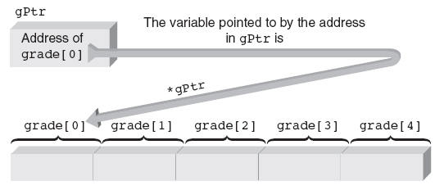
Array Names as Pointers
Figure 10.11 The variable pointed to by *gPtr is grade[0]

Slide 32
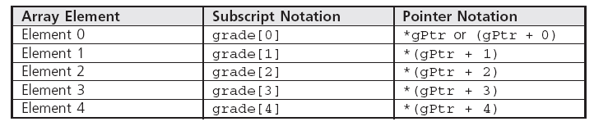
Array Names as Pointers
Table 10.1 Array Elements Can Be Referenced in Two Ways

Slide 33
Array Names as Pointers
Program 10.4
#include <iostream>
using namespace std;
int main()
{
const int ARRAYSIZE = 5;
int i, grade[ARRAYSIZE] = {98, 87, 92, 79, 85};
for (i = 0; i < ARRAYSIZE; i++)
cout << "\nElement " << i << " is " << grade[i];
cout << endl;
return 0;
}

Slide 34
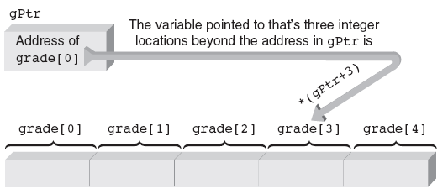
Array Names as Pointers
Figure 10.12 An offset of 3 from the address in gPtr

Slide 35
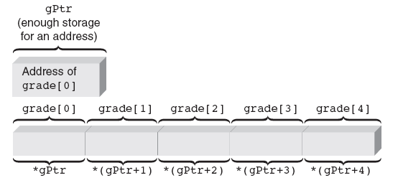
Array Names as Pointers
Figure 10.13 The relationship between array elements and pointers

Slide 36
Array Names as Pointers
Program 10.5
#include <iostream>
using namespace std;
int main()
{
const int ARRAYSIZE = 5;
int *gPtr; // declare a pointer to an int
int i, grade[ARRAYSIZE] = {98, 87, 92, 79, 85};
gPtr = &grade[0]; // store the starting array address
for (i = 0; i < ARRAYSIZE; i++)
cout << "\nElement " << i << " is " << *(gPtr + i);
cout << endl;
return 0;
}

Slide 37
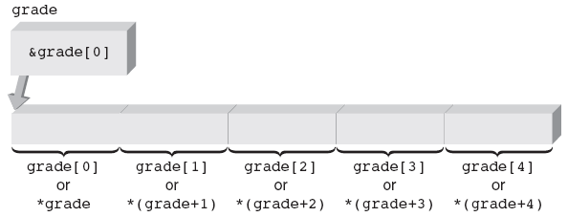
Array Names as Pointers
Figure 10.14 Creating an array also creates a pointer

Slide 38
Array Names as Pointers
Program 10.6
#include <iostream>
using namespace std;
int main()
{
const int ARRAYSIZE = 5;
int i, grade[ARRAYSIZE] = {98, 87, 92, 79, 85};
for (i = 0; i < ARRAYSIZE; i++)
cout << "\nElement " << i << " is " << *(grade + i);
cout << endl;
return 0;
}

Slide 39
Dynamic Array Allocation
Static Array Allocation: As variables are defined, storage is assigned from a memory pool
Specific memory locations are fixed for life of a variable, used or not
Example: Function requests storage for an array of 500 integers
If application requires less than 500 integers, unused storage not released until array goes out of scope
If more than 500 integers required, array size must be increased and the function recompiled

Slide 40
Dynamic Array Allocation
Dynamic Allocation: storage allocated is determined and adjusted as program is run
Useful when dealing with lists
Allows list to expand and contract as list items are added and deleted
Example: constructing list of grades
Don’t know number of grades ultimately needed
Need a mechanism to enlarge and shrink array

Slide 41
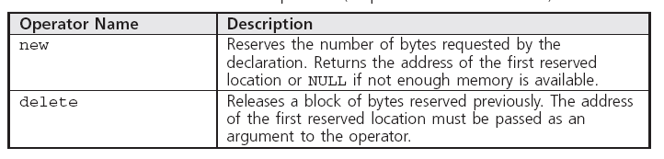
Dynamic Array Allocation
new and delete operators provide the dynamic allocation mechanisms in C++
Table 10.2 The new and delete Operators (Require the new Header File)

Slide 42
Dynamic Array Allocation
Explicit dynamic storage requests for scalar variables or arrays made in declaration or assignment statements
Example 1:
int *num = new int;
Reserves space for an integer variable
Stores address of this variable into pointer num

Slide 43
Dynamic Array Allocation
Example 2: same function as example 1
int *num;
num = new int;
Heap: free storage area of a computer
Consists of unallocated memory, can be allocated to a running program
In examples 1 and 2, new storage comes from free storage area

Slide 44
Dynamic Array Allocation
Example of dynamic allocation of an array:
int *grade = new int[200];
This statement reserves storage for 200 integers and places address of first integer into the pointer grade
Same example with variable dimension
cout << "Enter the number of grades to be processed: ";
cin >> numgrades;
int *grade = new int[numgrades];
Size of array depends on user input
Values accessed by array notation, e.g. grade[i]

Slide 45
Dynamic Array Allocation
Program 10.7
#include <iostream>
using namespace std;
int main()
{
int numgrades, i;
cout << "Enter the number of grades to be processed: ";
cin >> numgrades;
int *grade = new int[numgrades]; // create the array
for(i = 0; i < numgrades; i++)
{
cout << " Enter a grade: ";
cin >> grade[i];
}
cout << "\nAn array was created for " << numgrades << " integers\n";
cout << " The values stored in the array are:";
for (i = 0; i < numgrades; i++)
cout << "\n " << grade[i];
cout << endl;
delete[] grade; // return the storage to the heap
return 0;
}

Slide 46
Pointer Arithmetic
By adding to and subtracting from pointers, we can obtain different addresses
Pointers can be compared using relational operators ( ==, !=, <, >, etc.)
Consider declarations:
int nums[100];
int *nPt;
Set address of nums[0] into nPt using:
nPt = &nums[0];
nPt = nums;

Slide 47
Pointer Arithmetic
After nPt is assigned a valid address, values can be added or subtracted to produce new addresses
Scaling: automatic adjustment of computed address, ensures points to value of correct type
Example (Figure 10.15): nPt = nPt + 4;
Assuming an integer requires 4 bytes, the computer multiplies 4 by 4 and adds 16 to the address in nPt

Slide 48
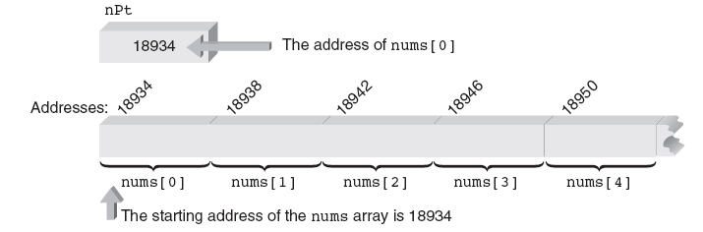
Pointer Arithmetic
Figure 10.15 The nums array in memory

Slide 49
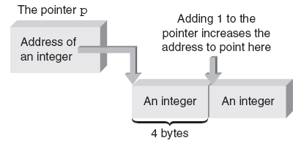
Pointer Arithmetic
Figure 10.16 Increments are scaled when used with pointers

Slide 50
Pointer Arithmetic
Increment and decrement operators can be applied as both prefix and postfix operators
*ptNum++ // use the pointer and then increment it
*++ptNum // increment the pointer before using it
*ptNum-- // use the pointer and then decrement it
*--ptNum // decrement the pointer before using it
Of the four possible forms, *ptNum++ is most common
Allows accessing each array element as the address is “marched along” from starting address to address of last array element

Slide 51
Pointer Arithmetic
Program 10.8
#include <iostream>
using namespace std;
int main()
{
const int NUMPTS = 5;
int nums[NUMPTS] = {16, 54, 7, 43, -5};
int i, total = 0, *nPt;
nPt = nums; // store address of nums[0] in nPt
for (i = 0; i < NUMPTS; i++)
total = total + *nPt++;
cout << "The total of the array elements is " << total << endl;
return 0;
}

Slide 52
Pointer Arithmetic
Program 10.9
#include <iostream>
using namespace std;
int main()
{
const int NUMPTS = 5;
int nums[NUMPTS] = {16, 54, 7, 43, -5};
int total = 0, *nPt;
nPt = nums; // store address of nums[0] in nPt
while (nPt < nums + NUMPTS)
total += *nPt++;
cout << "The total of the array elements is " << total << endl;
return 0;
}

Slide 53
Pointer Initialization
Pointers can be initialized when declared
Example: int *ptNum = &miles;
Above initialization valid only if miles was declared as an integer prior to above statement
The following statements produce an error
int *ptNum = &miles;
int miles;
Arrays can be initialized within declarations
double *zing = &volts[0];
This statement is valid if volts has already been declared as a double-precision array

Slide 54
Passing Addresses
Reference pointers can be used to pass addresses through reference parameters
Implied use of an address
Pointers can be used explicitly to pass addresses with references
Explicitly passing references with the address operator is called pass by reference
Called function can reference, or access, variables in the calling function by using the passed addresses

Slide 55
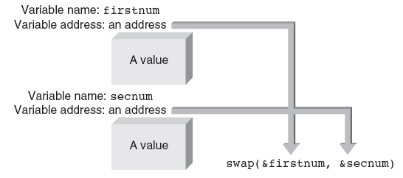
Passing Addresses
Figure 10.17 Explicitly passing addresses to swap()

Slide 56
Passing Addresses
Program 10.10
#include <iostream>
using namespace std;
void swap(double *, double *); // function prototype
int main()
{
double firstnum = 20.5, secnum = 6.25;
swap(&firstnum, &secnum); // call swap
return 0;
}
void swap(double *nm1Addr, double *nm2Addr)
{
cout << "The number whose address is in nm1Addr is "
<< *nm1Addr << endl;
cout << "The number whose address is in nm2Addr is "
<< *nm2Addr << endl;
return;
}

Slide 57
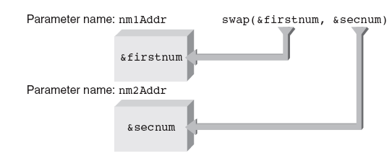
Passing Addresses
Figure 10.18 Storing addresses in parameters

Slide 58
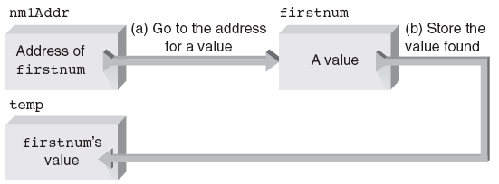
Passing Addresses
Figure 10.19 Indirectly storing firstnum’s value

Slide 59
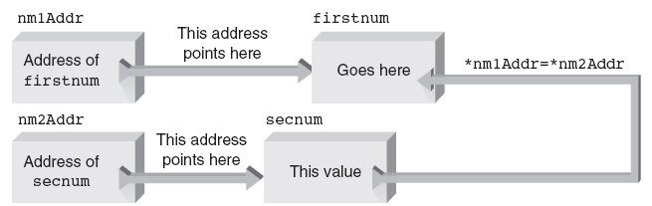
Passing Addresses
Figure 10.20 Indirectly changing firstnum’s value

Slide 60
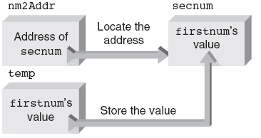
Passing Addresses
Figure 10.21 Indirectly changing secnum’s value

Slide 61
Passing Addresses
Program 10.11
#include <iostream>
using namespace std;
void swap(double *, double *); // function prototype
int main()
{
double firstnum = 20.5, secnum = 6.25;
cout << "The value stored in firstnum is: " << firstnum << endl;
cout << "The value stored in secnum is: " << secnum << "\n\n";
swap(&firstnum, &secnum); // call swap
cout << "The value stored in firstnum is now: "
<< firstnum << endl;
cout << "The value stored in secnum is now: "
<< secnum << endl;
return 0;
}

Slide 62
Passing Addresses
Program 10.11 (Continued)
// this function swaps the values in its two arguments
void swap(double *nm1Addr, double *nm2Addr)
{
double temp;
temp = *nm1Addr; // save firstnum's value
*nm1Addr = *nm2Addr; // move secnum's value into firstnum
*nm2Addr = temp; // change secnum's value
return;
}

Slide 63
Passing Arrays
When an array is passed to a function, its address is the only item actually passed
“Address” means the address of the first location use to store the array
First location is always element zero of the array

Slide 64
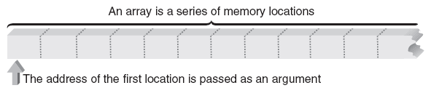
Passing Arrays
Figure 10.22 Array’s address is address of the first location reserved for the array

Slide 65
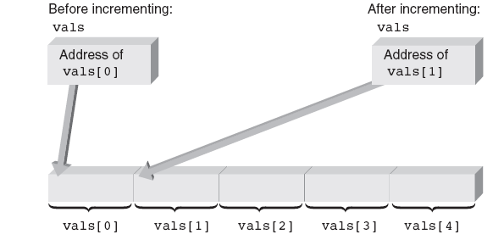
Passing Arrays
Figure 10.23 Pointing to different elements

Slide 66
Passing Arrays
Program 10.12
#include <iostream>
using namespace std;
int findMax(int [], int); // function prototype
int main()
{
const int NUMPTS = 5;
int nums[NUMPTS] = {2, 18, 1, 27, 16};
cout << "\nThe maximum value is "
<< findMax(nums,NUMPTS) << endl;
return 0;
}
// this function returns the maximum value in an array of ints
int findMax(int vals[], int numels)
{
int i, max = vals[0];
for (i = 1; i < numels; i++)
if (max < vals[i])
max = vals[i];
return max;
}

Slide 67
Advanced Pointer Notation
Access to multidimensional arrays can be made using pointer notation
Example: Consider the declaration:
int nums[2][3] = { {16,18,20},
{25,26,27} };
Creates an array of elements and a set of pointer constants named nums, nums[0] and nums[1] (as shown in Figure 10.24)

Slide 68
Advanced Pointer Notation
nums
Nums[0][0] Nums[0][1] Nums[0][2]
Address of nums[0]
Nums[0]
Address of nums[0][0]
16
18
20
Nums[1]
Address of nums[1][0]
25
26
27
Nums[1][0] Nums[1][1] Nums[1][2]
Figure 9.25 Storage of the nums Array and Associated Pointer Constants

Slide 69
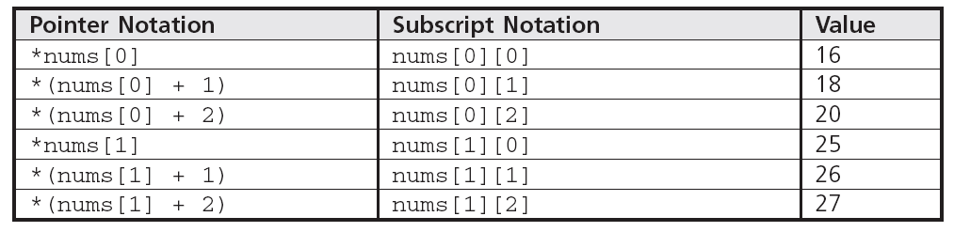
Advanced Pointer Notation
Ways to view two-dimensional arrays
As an array of rows
nums[0] is address of first element in the first row
Variable pointed to by nums[0] is nums[0][0]
The following notations are equivalent:

Slide 70
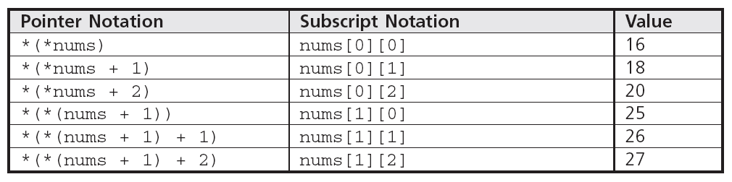
Advanced Pointer Notation
You can replace nums[0] and nums[1] with pointer notations
*nums is nums[0]
*(nums + 1) is nums[1]

Slide 71
Advanced Pointer Notation
Same notation applies when a two-dimensional array is passed to function
The calc function requires two dimensional array nums as a parameter
Suitable declarations
calc(int pt[2][3])
calc(int pt[][3])
calc(int (*pt)[3])
Parenthesis are required
Without parenthesis would evaluate to int *pt[3], array of three pointers to integers

Slide 72
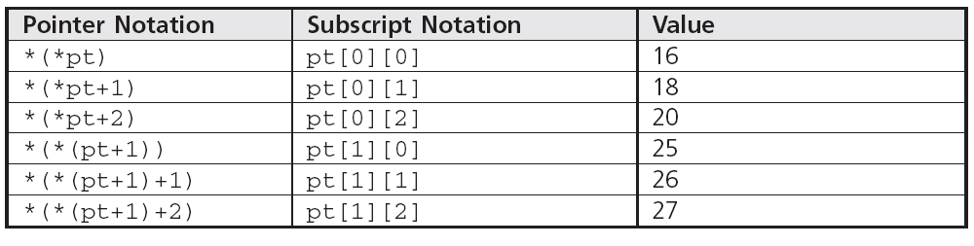
Advanced Pointer Notation
The following is a table of equivalent notations for accessing pt from within calc

Slide 73
Common Programming Errors
Attempting to store address in variable not declared as pointer
Using pointer to access nonexistent array elements
Forgetting to use bracket set, [], after delete operator
Incorrectly applying address and indirection operators
Taking addresses of pointer constants

Slide 74
Common Programming Errors
Taking addresses of a reference argument, reference variable, or register variable
Initialized pointer variables incorrectly
Becoming confused about whether a variable contains an address or is an address

Slide 75
Common Programming Errors
Although a pointer constant is synonymous with an address, it’s useful to treat pointer constants as pointer variables with two restrictions:
Address of a pointer constant can’t be taken
Address “contained in” the pointer can’t be altered
Except for these restrictions pointer constants and pointer variables can be used almost interchangeably

Slide 76
Common Programming Errors
When an address is required, any of the following can be used:
A pointer variable name
A pointer argument name
A pointer constant name
A non-pointer variable name preceded by the address operator
A non-pointer variable argument name preceded by the address operator

Slide 77
Summary
Every variable has a data type, an address, and a value
In C++, obtain the address of variable by using the address operator, &
A pointer is a variable used to store address of another variable
Must be declared
Use indirection operator, *, to declare the pointer variable and access the variable whose address is stored in pointer

Slide 78
Summary
Array name is a pointer constant
Value of the pointer constant is address of first element in array
Any access to an array element with subscript notation can always be replaced with pointer notation
Arrays can be created dynamically as program is executing
Arrays are passed to functions as addresses
Called function always receives direct access to the originally declared array elements

Slide 79
Summary
When a one-dimensional array is passed to a function, the function’s parameter declaration can be an array declaration or a pointer declaration
The following are equivalent:
double a[];
double *a;
Pointers can be incremented, decremented, compared, and assigned
Numbers added to or subtracted from a pointer are scaled automatically
Scale factor is number of bytes required to store the pointer data type

