Slide 1
11
Classes I

Slide 2
Contents
Classes
Basic class functions
Adding class functions
A case study involving the construction of a Date object
Unified Modeling Language (UML) class and object diagrams
Common programming errors

Slide 3
Classes
A procedural program consists of one or more algorithms that have been written in computer-readable language
An object-oriented approach fits graphically windowed environments
Abstract data types: Central to creation of objects; a user defined rather than built-in data type

Slide 4
Abstract Data Types
Data type: Combination of data and associated operations
A data type defines both the types of data and the types of operations that can be performed on the data
Data type = Allowable Data Values + Operational Capabilities
Operations in C++ are an inherent part of each data type

Slide 5
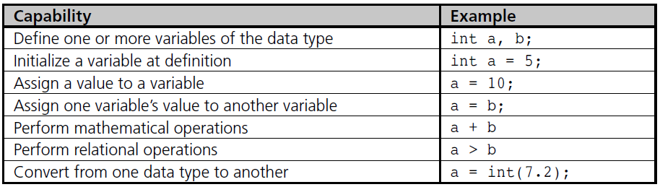
Abstract Data Types
Table 11.1 C++ Built-In Data Type Capabilities

Slide 6
Abstract Data Types
Abstract data type (ADT): User defined type that specifies both a type of data and the operations that can be performed on it
User defined types are required when you want to create objects that are more complex than simple integers and characters
Data structure: How data is stored
Class: C++ name for an abstract data type

Slide 7
Class Construction
A class is usually constructed in two parts:
Declaration section
Declares both the data types and functions for the class
Implementation section
Defines the functions whose prototypes have been declared in the declaration section

Slide 8
Class Construction
Class members: Both the variables and the functions listed in the declaration section
Data members or instance variables: Variables listed in the declaration section
Member functions: Functions listed in the declaration section
When a function is part of a class it is referred to as a method to denote class membership

Slide 9
Class Construction
// class declaration section
class classname // a class name is required
{
private:
// variable declarations
// function prototypes
public:
// variable declarations
// function prototypes
}; // end of class declaration
// class implementation section
// function definitions

Slide 10
Class Construction
Example of class declaration section:
class Complex
{
private:
double realPart;
double imaginaryPart;
public:
Complex(double = 0.0, double = 0.0);
void assignNewValue(double, double);
void showComplexValues();
};
// this is a declaration –
// don't forget the semicolon

Slide 11
Class Construction
Enclosed in braces
Keywords public and private are access specifiers that define access rights
private: Indicates that class member can only be accessed by class functions
Restricting user from access to data storage implementation details is called data hiding
After a class category like private is designated, it remains in force until a new category is specified

Slide 12
Class Construction
public functions can be called from outside the class
In general, all class functions should be public so that they provide capabilities to manipulate class variables from outside the class
The function with same name as class is the class’s constructor function
Used to initialize class data members with values

Slide 13
Class Construction
Implementation section: member functions declared in the declaration section are written
General form for functions written in the implementation section is the same as all C++ functions with the addition of the class name and the scope resolution operator ::

Slide 14
Class Construction
Variables of a user-declared class must:
Be defined before use in a program
Are referred to as objects
An object name’s attribute is referenced with the dot operator
objectName.attributeName
objectName is the name of a specific object
attributeName is the name of a data member defined for the object’s class

Slide 15
Class Construction
The syntax for referring to an object’s method is:
objectName.methodName(parameters)
objectName is the name of the specific object
methodName is name of a function defined for the object’s class

Slide 16
Class Construction
Example: Creation of objects of Complex class in main() function of Program 11.1
int main()
{
Complex a, b, c(6.8, 9.7); // declare 3 objects
// Assign new values to object b’s data members
b.assignNewValues(5.3, -8.4);
a.showComplexValues(); // display object a’s value
b.showComplexValues(); // display object b’s value c.showComplexValues(); // display object c’s value
return 0;
}

Slide 17
Class Construction
Program 11.1
#include <iostream>
using namespace std;
// declaration section
class Complex
{
private: // notice the colon after the keyword private
double realPart; // data member
double imaginaryPart; // data member
// function prototypes
public: // again, notice the colon after the keyword public
Complex(double = 0.0, double = 0.0); // member function
// (constructor)
void assignNewValues(double, double); // member function
void showComplexValues(); // member function
}; // end of class declaration

Slide 18
Class Construction
Program 11.1 (Continued)
// implementation section
Complex::Complex(double real, double imag)
{
realPart = real;
imaginaryPart = imag;
}
void Complex::assignNewValues(double real, double imag)
{
realPart = real;
imaginaryPart = imag;
}
void Complex::showComplexValues()
{
char sign = '+';
if (imaginaryPart < 0.0) sign = ‘-‘;
cout << “The complex number is “
<< realPart << ‘ ‘ << sign << ‘ ‘ << abs(imaginaryPart) << “i\n”;
}

Slide 19
Class Construction
The Output from Program 11.1
The complex number is 0 + 0i
The complex number is 5.3 – 8.4i
The complex number is 6.8 + 9.7i

Slide 20
Terminology
Class: Programmer defined data type from which objects can be created
Objects: Created from classes
Referred to as instances of a class
Process of creating a new object is called instantiation of the object
Each time a new object is instantiated a new set of data members belonging to the object is created
Values contained in these data members determine the object’s state

Slide 21
Basic Class Functions
Constructor: A function used to initialize an object’s data members when the object is created
Accessor: A function that reports information about an object’s state
Mutator: A function that modifies the values stored in an object’s data members

Slide 22
Constructor Functions
A constructor function is any function with the same name as its class
Multiple constructors can be defined for each class as long as they can be distinguished by number and types of their parameters
A constructor’s intended purpose is to initialize a new object’s data members
If no constructor function is written, the compiler supplies a default constructor
In addition to initialization, a constructor can perform other tasks when it is called

Slide 23
Constructor Functions
General format of a constructor includes:
The same name as the class to which it belongs
No return type (not even void)
A constructor that does not require arguments is called the default constructor
className::className(parameter list)
{
// function body
};

Slide 24
Calling Constructors
Constructors are called when an object is created
Declaration can be made in a variety of ways
Date c(4,1,2013);
Date c = Date(4,1,2013);
Date c = 8; // similar to above with // defaults for day and // year
An object should never be declared with empty parentheses
Date a();
Not the same as the declaration Date a;
Does not result in an object being created

Slide 25
Overloaded and Inline Constructors
Primary difference between a constructor and other user-written functions is how the constructor is called
Constructors are called automatically each time an object is created
Most other functions must be called explicitly by name
Inline functions are functions defined in the class declaration section

Slide 26
Destructors
Destructor functions: Counterpart to the constructor functions
Destructors:
Are functions with the same name as constructors but are preceded with a tilde (~)
For the Date class the destructor name is ~Date()
Take no parameters and return no values
There can only be one destructor per class

Slide 27
Destructors
Destructors:
Called automatically when an object goes out of existence
Clean up any undesirable effects the object might leave, such as releasing memory stored in a pointer

Slide 28
Accessor Functions
An accessor function provides a means for reporting on an object’s state
Conventionally called get() functions
Each class should provide a complete set of accessor functions
Accessor functions are extremely important because they provide a means of retrieving and displaying an object’s private data values
double getReal() {return realPart;} // inline accessor
double getImaginary() {return imaginaryPart;} // inline accessor

Slide 29
Mutator Functions
A mutator function provides a means for changing an object’s data member
Conventionally called set() functions
A class can contain multiple mutators, as long as each one has a unique name or parameter list
double setReal(double rl) {realPart = rl;} // inline mutator
double setImaginary(dobule im) {imaginaryPart = im;} // inline mutator

Slide 30
Sharing Functions
Memory locations are allocated to an object only when the object is declared
In this way, each object receives its own set of data members
In contrast, only one copy of a member function is created, which comes into existence when the function is defined

Slide 31
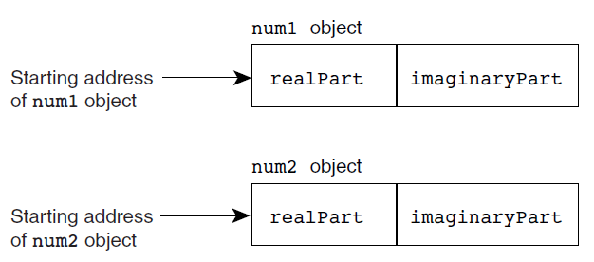
Sharing Functions
Figure 11.1 Storing two Complex objects in memory

Slide 32
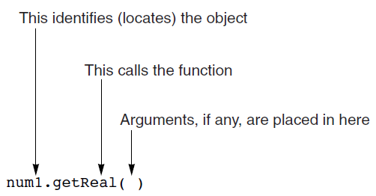
Sharing Functions
Figure 11.2 Calling a member function

Slide 33
The this Pointer
Two questions at this point are as follows:
How is this address passed to getReal()?
Where is this address stored?
Each member function actually receives an extra argument that’s the address of an object
When a function is called, the calling object’s address is passed to it and stored in the function’s this pointer

Slide 34
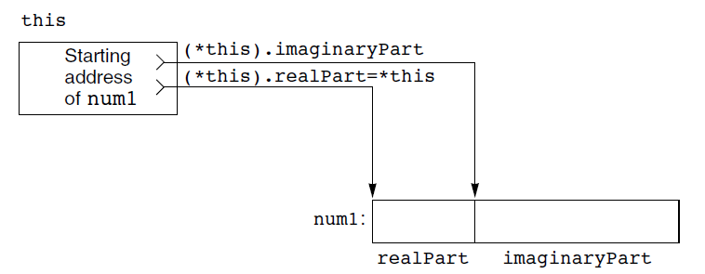
The this Pointer
Figure 11.3 A pointer can be used to access object members

Slide 35
The this Pointer
The expression (*pointer).dataMember can always be replaced with the notation pointer->dataMember
void assignNewValues(double real, double imag)
{realPart = real; imaginaryPart = imag;}
can be written as follows:
void assignNewValues(double real, double imag)
{this->realPart = real; this->imaginaryPart = imag;}

Slide 36
Base/Member Initialization
True initialization has no reliance on assignment
C++ makes initialization possible with base/member initialization list syntax
Initialization list syntax is only available in constructor functions
ClassName(argument list):list of data members (initializers) {}

Slide 37
Adding Class Functions
Most classes typically require additional functions
In C++, there are two basic means of supplying these additional capabilities:
Construct class functions in a similar manner as mutator and accessor functions
Construct class functions that use conventional operator symbols, such as =, *, ==, >=, which are known as operator functions
Both approaches can be implemented as member or friend functions

Slide 38
Member Functions
Member functions can be added to a class by including their prototypes in the declaration section and providing code for the function in the implementation section or as an inline function
The general syntax for each function header is:
returnType className::functionName(parameter list)

Slide 39
Member Functions
Program 11.5
#include <iostream>
#include <cmath>
using namespace std;
// declaration section
class Complex
{
private:
double realPart; // declare realPart as a double variable
double imaginaryPart; // declare imaginaryPart as a double variable
public:
Complex(double = 0.0, double = 0.0); // constructor prototype
void showComplexValues(); // accessor prototype
void assignNewValues(double real, double imag) // inline mutator
{ realPart = real; imaginaryPart = imag; }
double amplitude() // inline member function
{ return (sqrt(pow(realPart,2) + pow(imaginaryPart,2))); }
}; // end of class declaration

Slide 40
Member Functions
Program 11.5 (Continued)
// implementation section
Complex::Complex(double real, double imag) // constructor
{
realPart = real;
imaginaryPart = imag;
cout << “Created a new complex number object.\n”;
}
void Complex::showComplexValues() // accessor
{
char sign = '+';
if(imaginaryPart < 0) sign = '-';
cout << realPart << ' ' << sign << ' ' << abs(imaginaryPart) << 'i';
}

Slide 41
Member Functions
Program 11.5 (Continued)
int main()
{
Complex complexOne(3.0, 4.0); // declare a variable of type Complex
cout << “The value assigned to this complex object is “;
complexOne.showComplexValues();
cout << “\n\nThe amplitude of this complex number is “
<< complexOne.amplitude() << endl;
Return 0;
}

Slide 42
Operator Functions
You can also use the operators C++ provides for built-in data types, such as +, −, ==, >=, and so on to construct class functions
These are referred to as operator functions
They are declared and implemented in the same manner as all functions, except the function name must use the syntax: operator<symbol>

Slide 43
Operator Functions
Only the symbols in Table 11.1 can be used for user-defined purposes
New operator symbols cannot be created
Neither the precedence nor the associativity of the C++ operators can be modified

Slide 44
Assignment Operator
The assignment operator, =, is the one operator that works with all classes without requiring an operator function
For example, if a and b are objects constructed from the Complex class, the statement a = b; sets the values in a’s data members to their equivalent values in b’s data members
This type of assignment is referred to as memberwise assignment

Slide 45
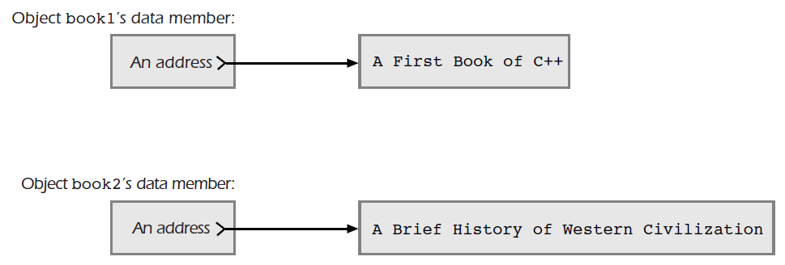
Memberwise Assignment with Pointers
Figure 11.4 Two objects containing pointer data members

Slide 46
Copy Constructors
One type of initialization that closely resembles assignment occurs in C++ when one object is initialized by using another object of the same class
Examples:
Complex b = a;
Complex b(a);
The b object is initialized to the previously declared a object
The constructor performing this type of initialization is called a copy constructor

Slide 47
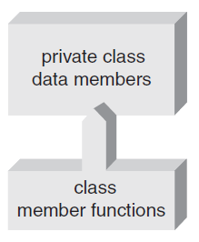
Friend Functions
Private variables can be accessed and manipulated through a class’s member functions
Figure 11.7a Direct access provided to member functions

Slide 48
Friend Functions
External access to private functions can be granted through the friends list mechanism
The friends list members are granted the same privileges as a class’s member functions
Nonmember functions in the list are called friend functions
Friends list: Series of function prototype declarations preceded with the friend keyword

Slide 49
Friend Functions
Program 11.10
#include <iostream>
#include <cmath>
using namespace std;
// declaration section
class Complex
{
// friends list
friend double addReal(const Complex&, const Complex&);
friend double addImag(const Complex&, const Complex&);
private:
double realPart;
double imaginaryPart;
public:
Complex(double real = 0.0, double imag = 0.0) // inline constructor
{realPart = real; imaginaryPart = imag;}
void showComplexValues();
};

Slide 50
Friend Functions
Program 11.10 (Continued)
// implementation section
void Complex:: showComplexValues()
{
char sign = '+';
if(imaginaryPart < 0) sign = '-';
cout << realPart << ' ' << sign << ' ' << abs(imaginaryPart) << 'i';
}
// friend implementationsconst
double addReal(const Complex& a, const Complex& b)
{
return(a.realPart + b.realPart);
}
double addImag(const Complex& a, const Complex& b)
{
return(a.imaginaryPart + b.imaginaryPart);
}

Slide 51
Friend Functions
Program 11.10 (Continued)
int main()
{
Complex a(3.2, 5.6), b(1.1, -8.4);
double re, im;
cout << "The first complex number is ";
a.showComplexValues();
cout << "\nThe second complex number is ";
b.showComplexValues();
re = addReal(a,b);
im = addImag(a,b);
Complex c(re,im); // create a new Complex object
cout << "\n\nThe sum of these two complex numbers is ";
c.showComplexValues();
cin.ignore(); // needed for MS C++ Express users
return 0;
}

Slide 52
A Case Study: Constructing a Date Class
Step 1: Analyze the problem: define operations
Step 2: Develop a solution: define classes and data members
Step 3: Code the solution: as seen in Class 11.1
Step 4: Test and correct the program: testing the Date class entails testing and verifying each class function and operator function

Slide 53
A Closer Look: UML Class and Object Diagrams
When solving any problem, it is often helpful to start by creating a diagram or map or devising a theoretical analogy for the problem you are trying to solve
The first step in constructing an object-based program is developing an object-based model of the program

Slide 54
A Closer Look: UML Class and Object Diagrams
Unified Modeling Language (UML) is a widely accepted technique for developing object oriented programs
A program-modeling language
Uses diagrams and techniques that are easy to understand and support all the features required to implement an object-oriented design

Slide 55
Class and Object Diagrams
Class diagrams are used to describe classes and their relationships
Object diagrams are used to describe objects and their relationships
Both classes and objects are represented with a diagram consisting of a box
In class diagrams, the class name is in bold text and centered at the top of the box
In object diagrams, the object’s name is also centered at the top of the box, underlined

Slide 56
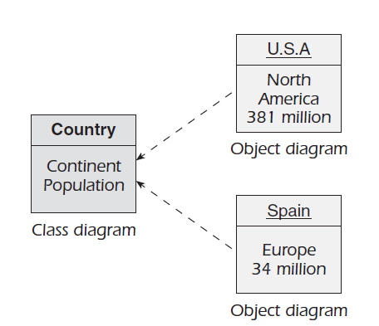
Class and Object Diagrams
Figure 11.10 Including attributes in UML class and object diagrams

Slide 57
Class and Object Diagrams
Visibility defines where an attribute can be seen
Private
Can be used on in its defining class
Cannot be accessed by other classes directly
Indicated by a minus (-) sign in front of attribute name
Public
Used in any other class
Indicated by a plus (+) sign in front of attribute name
Protected
Available to derived classes
Neither plus nor minus sign in front of attribute name

Slide 58
Class and Object Diagrams
Operations are transformations that can be applied to attributes and are coded as C++ functions
Operation names are listed below attributes and separated from them by a line

Slide 59
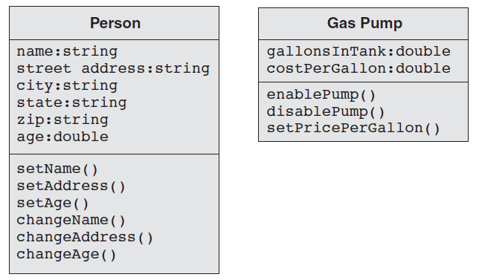
Class and Object Diagrams
Figure 11.12 Including operations in class diagrams

Slide 60
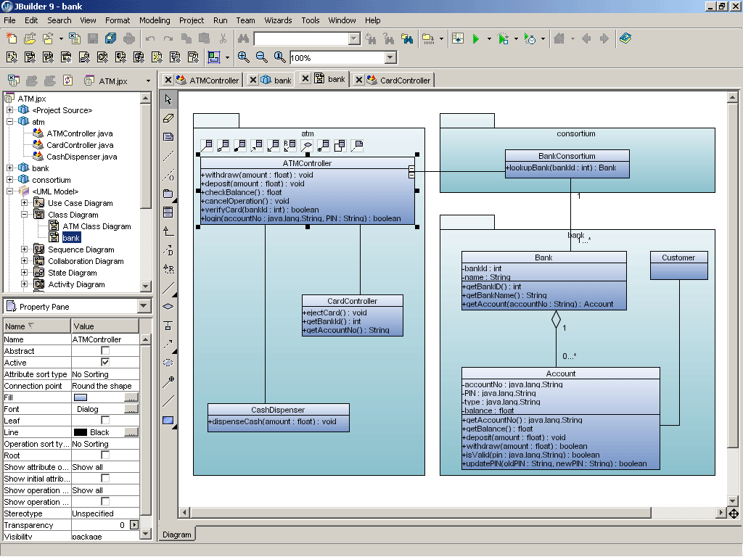
Class and Object Diagrams
http://en.wikipedia.org/wiki/JBuilder
http://www.youtube.com/watch?v=efd0wEYkUk0

Slide 61
Common Programming Errors
Failing to terminate class declaration section with a semicolon
Including the return type with the constructor’s prototype or failing to include the return type with other the functions’ prototypes
Using same name for a data member as for a member function
Defining more than one default constructor
Forgetting to include the class name and scope operator, ::, in the function header

Slide 62
Common Programming Errors
Declaring an object with empty parentheses, as in Complex a();
The correct declaration is Complex a;
Not defining an operator function’s parameter as a reference to an object
Redefining an overloaded operator to perform a function not indicated by its conventional meaning

Slide 63
Summary
A class
Is a programmer-defined data type
Consists of a declaration and implementation section
Class functions can be written inline or included in the class implementation section
A constructor function is a special function that is called automatically each time an object is declared
If no constructor is declared, the compiler supplies a default

Slide 64
Summary
Default constructor is the term for any constructor that does not require arguments
Each class can have only one default constructor
Constructors can be overloaded
A destructor function is called each time an object goes out of scope
User-defined operators can be constructed for classes by using operator functions
A nonmember function can access a class’s private data members if it is granted friend status by the class

