Slide 1
12
Classes II

Slide 2
Contents
Providing class I/O capabilities
Providing class conversion capabilities
Class scope and duration categories
Class inheritance and polymorphism
Virtual functions
Common programming errors

Slide 3
Providing Class I/O Capabilities
In this section, you will be introduced to:
How to adapt the cout and cin classes to work with user-defined data types
The Complex class is used as an example
How to overload the insertion and extraction operators by creating operator functions
How to provide these functions with access to private member data

Slide 4
Step 1: Overload the ostream Insertion Operator <<
The insertion operator is being overridden in the existing C++ class ostream, not one in the user-defined Complex class
This is possible only because the insertion operator function is defined as public in the ostream class
cout << “The complex number is “ << complexOne;

Slide 5
Step 1: Overload the ostream Insertion Operator <<
The operator definition must adhere to the following syntax required by the ostream class:
ostream& operator<<(ostream& variableName, className& objectName)
{
// statements placing data on the output stream
// referenced by the identifier variableName
return variableName;
};

Slide 6
Step 1: Overload the ostream Insertion Operator <<
For overloading the insertion operator to display Complex objects, the user-selected names out and num and the class name Complex are used:
ostream& operator<<(ostream& out, const Complex& num)
{
// statements placing data on the output stream
// referenced by the identifier out
return out;
};

Slide 7
Step 2: Provide Access to the Complex Class
Access to the Complex class is achieved by declaring the overloaded function as a friend
Include the overloaded function’s prototype in the Complex class’s declaration section, preceded by the keyword friend
friend ostream& operator<<(ostream&, const Complex&);

Slide 8
Providing Class I/O Capabilities
Program 12.1
#include <iostream>
using namespace std;
// declaration section
class Complex
{
// prototype for the overloaded insertion operator
friend ostream& operator<<(ostream&, const Complex&);
private:
double realPart;
double imaginaryPart;
// function prototypes
public:
Complex(double real = 0.0, double imag = 0.0)
{ realPart = real; imaginaryPart = imag; }
};

Slide 9
Providing Class I/O Capabilities
Program 12.1 (Continued)
// overloaded insertion operator function
ostream& operator<<(ostream& out, const Complex& num)
{
char sign = '+';
if(num.imaginaryPart < 0) sign = '-';
if(num.realPart == 0 && num.imaginaryPart == 0)
cout << 0;
else if (num.imaginaryPart == 0)
cout << num.realPart;
else if (num.realPart == 0)
cout << num.imaginaryPart << 'i';
else
cout << num.realPart << ' ' << sign << ' '
<< abs(num.imaginaryPart) << 'i';
return out;
}

Slide 10
Providing Class I/O Capabilities
Program 12.1 (Continued)
int main()
{
Complex complexOne(12.5,-18.2);
cout << "The complex number just created is " << complexOne
<< endl;
cin.ignore(); // needed for MS C++ Express users
return 0;
}
The Output from Program 12.1
The complex number just created is 12.5 – 18.2i

Slide 11
Adapting the istream Object cin
The same two steps used for cout apply to cin
Step 1: Overload the istream operator, >>, with an overloaded operator function
Step 2: Provide access to the Complex class by making this function a friend of the Complex class
Program 12.2 includes the function prototypes for the overloaded insertion and extraction operator functions and their definitions

Slide 12
Providing Class Conversion Capabilities
Possibilities for conversion between data types include:
Conversion from built-in type to built-in type
Conversion from class type to built-in type
Conversion from built-in type to class type
Conversion from class type to class type
A conversion makes sense only when there is a meaningful relationship between data types

Slide 13
Built-in to Built-in Conversion
Can be implicit or explicit
Implicit conversion occurs in C++’s operations
Explicit conversion occurs when a cast is used
Two cast notations:
C notation: (dataType)expression
C++ notation: dataType(expression)

Slide 14
Class to Built-in Conversion
The conversion operator function
Converts from user-defined data type to built-in data type
Is a member function having the same name as the built-in data type or class
When name is the same as built-in type, used to convert from class to built-in data type
Conversion operator for class to long conversion would be named operator long()
Has no explicit argument or return type

Slide 15
Built-in to Class Conversion
User-defined casts for converting a built-in type to a class type are created by using constructor functions
Type conversion constructor:
A constructor whose first argument is not a member of its class and whose remaining arguments, if any, have default values
If the first argument is a built-in type, then constructor can be used to cast the built-in to the class type

Slide 16
Built-in to Class Conversion
Constructor function
Is called implicitly to initialize an object
Can be called explicitly after all objects have been declared
Sample conversion construction:
// constructor for converting from long to Date
Date::Date(long findate)
{
year = int(findate/10000.0);
month = int((findate – year * 10000.0)/100.0);
day = int(findate – year * 10000.0 – month * 100.0);
};

Slide 17
Class to Class Conversion
Class to class conversion same as class to built-in
Implemented as conversion operator function
Uses class name rather than built in data type name
Requires forward declaration of class when class not otherwise already known
Program 12.5 gives an example of class to class conversion

Slide 18
Class Scope and Duration Categories
The scope of an identifier defines the portion of a program where the identifier is valid
There are two categories of scope: local and global
Each identifier also has a duration: the length of time storage locations are reserved for the variable or function that the identifier names

Slide 19
Class Scope
Class data members are local to objects created from the class
An object’s data member takes precedence over a global variable of the same name
Class member functions are global in the file where they’re defined but can be called only for objects created from the class

Slide 20
Class Scope
Global (file) scope
Class scope
Local (block) scope
double Test::extend(double amt, double pr)
{
amount = amt;
price = pr;
total = rate * amount * price;
}
Class scope
Global (file) scope
Class scope
Figure 12.2 Example of scopes

Slide 21
Static Data Members
As each class object is created, it gets its own block of memory for its data members
In some cases, it is convenient for every instantiation of a class to share the same memory location for a specific variable

Slide 22
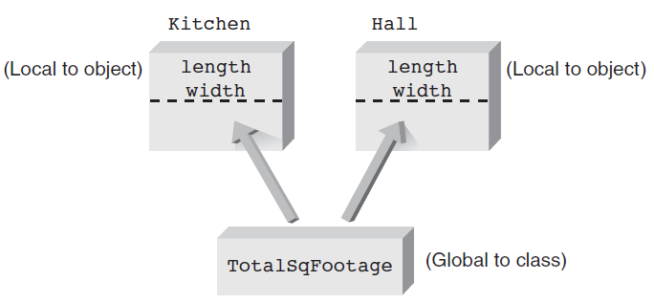
Static Class Members
Figure 12.3 Sharing the static data member TotalSqFootage

Slide 23
Static Member Functions
Static member functions can access only static data members and other static member functions
Their primary purpose is to perform any specialized initialization or operation procedures on static member variables before any object creations

Slide 24
Static Member Functions
Program 12.7
#include <iostream>
using namespace std;
// declaration section
class RoomDimension
{
private:
static double TotalSqFootage;
double length;
double width;
public:
static void dispFootage(); // static member function
RoomDimension(double l = 0.0, double w = 0.0) //Constructor
{length = l; width = w; TotalSqFootage += l * w;}
void resetDimension(double, double);
};
// static member definition
double RoomDimension::TotalSqFootage = 0.0;

Slide 25
Static Member Functions
Program 12.7 (Continued)
// implementation section
void RoomDimension::resetDimension(double len=0.0, double wid=0.0)
{
TotalSqFootage -=length*width;//remove previous square footage
length =len;
width = wid;
TotalSqFootage += len * wid; // add new square footage
dispFootage(); // static function can be called from inside
// function
}
// static function definition
void RoomDimension::dispFootage()
{
cout << "The total square footage is now " << TotalSqFootage
<< endl;
}

Slide 26
Static Member Functions
Program 12.7 (Continued)
int main()
{
RoomDimension::dispFootage(); // static function call
RoomDimension Kitchen(20.0, 15.0);
RoomDimension::dispFootage(); // static function call
RoomDimension Hall(25.0, 4.0);
Hall.dispFootage();//another way of calling the static function
Hall.resetDimension(10, 5);
cin.ignore(); // needed for MS C++ Express users
return 0;
}
The Output from Program 12.7
The total square footage is now 0
The total square footage is now 300
The total square footage is now 400
The total square footage is now 350

Slide 27
Class Inheritance and Polymorphism
Ability to create new classes from existing ones is the underlying motivation and power behind class- and object-oriented programming techniques
Inheritance:
Deriving one class from another class
Polymorphism:
Redefining how member functions of related classes operate based on the class object being referenced

Slide 28
Class Inheritance and Polymorphism
Base class: Initial class used as a basis for a derived class
Also called parent or superclass
Derived class: New class incorporating all the data members and member functions of its base class
Also called child class or subclass
Can, and usually does, add its own data members and member functions
Can override any base class function

Slide 29
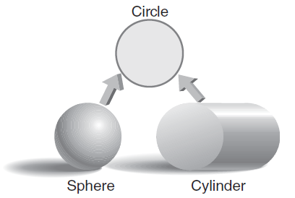
Class Inheritance and Polymorphism
Figure 12.4 Relating object types

Slide 30
Class Inheritance and Polymorphism
Simple inheritance: Derived type has only one base type
Multiple inheritance: Derived type has two or more base types
Class hierarchies: Illustrate the hierarchy or order in which one class is derived from another
Derived class has same form as any other class except: Includes access specifier and base class name
class derivedClassName : classAccess aseClassName

Slide 31
Class Inheritance and Polymorphism
car
truck
minivan
Figure 12.5 An example of multiple inheritance

Slide 32
Class Inheritance and Polymorphism
Class derivations are formally called class hierarchies
Circle is the name of an existing class
Cylinder can be derived as shown below:
class Cylinder : public Circle
{
// place any additional data members and
// member functions in here
} // end of Cylinder class declaration

Slide 33
Access Specifications
Private status ensures that data members can only be accessed by class member functions or friends
No access to nonclass functions except friends
Protected status same as private status except derived classes can access the base class data member

Slide 34
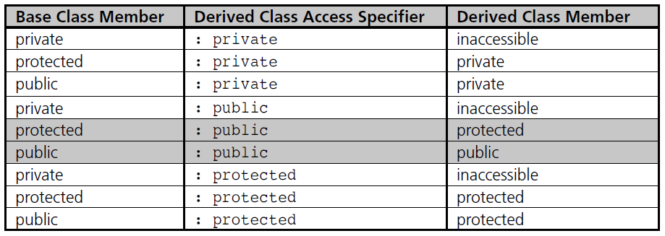
Access Specifications
Table 12.1 Inherited Access Restrictions

Slide 35
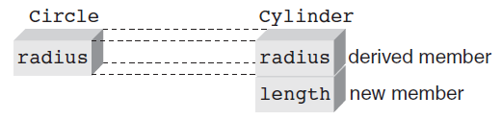
Access Specifications
Figure 12.6 Relationship between Circle and Cylinder data members

Slide 36
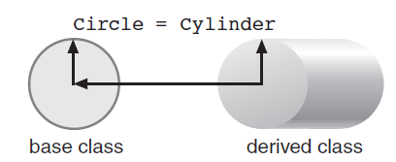
Access Specifications
Figure 12.7 An assignment from derived to base class

Slide 37
Access Specifications
Example: Derive Cylinder class from Circle class
// BASE class declaration
class Circle
{
protected:
double radius;
public:
Circle(double = 1.0); // constructor
double calcval();
};
// class implementation
// constructor
Circle::Circle(double r) // constructor
{
radius = r;
}
// calculate the area of a circle
double Circle::calcval()
{
return(PI * radius * radius);
}

Slide 38
Access Specifications
Example: Derived Cylinder class
// class declaration where
// Cylinder is derived from Circle
class Cylinder : public Circle
{
protected:
double length; // add one additional data member and
public: // two additional function members
Cylinder(double r = 1.0, double l = 1.0) : Circle(r), length(l) {}
double calcval();
};
// class implementation
double Cylinder::calcval() // this calculates a volume
{
return (length * Circle::calcval()); // note the base // function call
}

Slide 39
Access Specifications
Program 12.8
#include <iostream>
#include <cmath>
using namespace std;
// class declaration
const double PI = 2.0 * asin(1.0);
class Circle
{
protected:
double radius;
public:
Circle(double = 1.0); // constructor
double calcval();
};

Slide 40
Access Specifications
Program 12.8 (Continued)
// implementation section for Circle
// constructor
Circle::Circle(double r)
{
radius = r;
}
// calculate the area of a circle
double Circle::calcval()
{
return(PI * radius * radius);
}

Slide 41
Access Specifications
Program 12.8 (Continued)
// class declaration for the derived class
// Cylinder which is derived from Circle
class Cylinder : public Circle
{
protected:
double length; // add one additional data member and
public: // two additional function members
Cylinder(double r = 1.0, double l = 1.0) : Circle(r), length(l) {}
double calcval();
};
// implementation section for Cylinder
double Cylinder::calcval(void) // this calculates a volume
{
return length * Circle::calcval(); // note the base function call
}

Slide 42
Access Specifications
Program 12.8 (Continued)
int main()
{
Circle circle_1, circle_2(2); // create two Circle objects
Cylinder cylinder_1(3,4); // create one Cylinder object
cout << "\nThe area of circle_1 is " << circle_1.calcval() << endl;
cout << "The area of circle_2 is " << circle_2.calcval() << endl;
cout << "The volume of cylinder_1 is " << cylinder_1.calcval()
<< endl;
circle_1 = cylinder_1; // assign a cylinder to a Circle
cout << "\nThe area of circle_1 is now "
<< circle_1.calcval() << endl;
return 0;
}

Slide 43
Virtual Functions
Polymorphism permits using the same function name to invoke:
One response in a base class’s objects
Another response in a derived class’s objects
Notes:
http://openhome.cc/Gossip/CppGossip/VirtualFunction.html
C++ Gossip: 虛擬函式（Virtual function）
之前曾經介紹過函式與運算子的重載（Overload），重載可以使用一個函式名稱來執行不同的實作，這是一種「編譯時期」就需決定的方式，這是「早期繫 結」（Early binding）、「靜態繫結」（Static binding），因為在編譯時就可以決定函式的呼叫對象，它們的呼叫位址在編譯時就可以得知。 「虛擬函式」（Virtual function）可以實現「執行時期」的多型支援，是一個「晚期繫結」（Late binding）、「動態繫結」（Dynamic binding），也就是指必須在執行時期才會得知所要調用的物件或其上的公開介面。 在談虛擬函式之前必須先知道，一個基底類別的物件指標，可以用來指向其衍生類別物件而不會發生錯誤，例如若基底類別是Foo1，而衍生類別是Foo2，則 下面這個指定是可以接受的： Foo1 *fptr; Foo2 f2; fptr = &f2;
多型與動態繫結的基礎從這開始，它們只有在使用指標或參考時才得以發揮它們的特性，然而由於fptr仍是Foo1類型的指標，它只能存取Foo1中有定義 的成員，目前來說也只能操作Foo1中的成員。 注意將衍生類別型態的指標指向基底類別的物件基本是不可行的（雖然可以使用型態轉換的方式來勉強達成，但並不鼓勵），衍生類別的指標並不能存取基底類別的 成員。 虛擬函式是一種成員函式，它在基底類別中使用關鍵字"virtual"宣告（定義），並在衍生類別中重新定義虛擬函式，這將成員函式的操作決議 （Resolution）推遲至執行時期再決定。 虛擬函式可以實現執行時期的「多型」，也就是「一個介面，多種函式」，一個含有虛擬函式的類別被稱為「多型的類別」（Polymorphic class），當一個基底類別型態的指標指向一個含有虛擬函式的衍生類別，您就可以使用這個指標來存取衍生類別中的虛擬函式，下面這個例子是個簡單的示 範： #include <iostream> using namespace std; class Foo1 { public: virtual void show() { // 虛擬函式 cout << "Foo1's show" << endl; } }; class Foo2 : public Foo1 { public: virtual void show() { // 虛擬函式 cout << "Foo2's show" << endl; } }; void showFooByPtr(Foo1 *foo) { foo->show(); } void showFooByRef(Foo1 &foo) { foo.show(); } int main() { Foo1 f1; Foo2 f2; // 動態繫結 showFooByPtr(&f1); showFooByPtr(&f2); cout << endl; // 動態繫結 showFooByRef(f1); showFooByRef(f2); cout << endl; // 靜態繫結 f1.show(); f2.show(); return 0; } 執行結果： Foo1's show Foo2's show Foo1's show Foo2's show Foo1's show Foo2's show showFooByPtr()與showFooByRef()函式並無法事先知道要操作的是哪一個物件的哪一個公開介面，最後的操作要在執行時期才能決 定。 衍生類別中重新定義虛擬函式時，virtual可以根據需求加上，如果再接下來的衍生類別仍想進行多型操作，則加上virtual，如果不打算進行多型操 作，則可以不加上。

Slide 44
Virtual Functions
Two types of function binding
Static binding: Determination of function to call is made at compile time
Dynamic binding: Determination of function to call is made at runtime based on object type making call
Depends on virtual functions
Virtual function
Compiler creates a pointer to a function; assigns value to pointer upon function call

Slide 45
Virtual Functions
Program 12.10
#include <iostream>
#include <cmath>
using namespace std;
// class declaration for the base class
class One
{
protected:
double a;
public:
One(double = 2.0); // constructor
virtual double f1(double); // a member function
double f2(double); // another member function
};

Slide 46
Virtual Functions
Program 12.10 (Continued)
// class implementation for One
One::One(double val) // constructor
{
a = val;
}
double One::f1(double num) // a member function
{
return(num/2);
}
double One::f2(double num) // another member function
{
return( pow(f1(num),2) ); // square the result of f1()
}

Slide 47
Virtual Functions
Program 12.10 (Continued)
// class declaration for the derived class
class Two : public One
{
public:
virtual double f1(double); // this overrides
// class One's f1()
};
// class implementation for Two
double Two::f1(double num)
{
return(num/3);
}

Slide 48
Virtual Functions
Program 12.10 (Continued)
int main()
{
One object_1; // object_1 is an object of the base class
Two object_2; // object_2 is an object of the derived class
// call f2() using a base class object call
cout << "The computed value using a base class object call is "
<< object_1.f2(12) << endl;
// call f2() using a derived class object call
cout << "The computed value using a derived class object call is "
<< object_2.f2(12) << endl;
return 0;
}
The Output from Program 12.10
The computed value using a base class object call is 36
The computed value using a derived class object call is 16

Slide 49
Virtual Functions
class A
class B
class C
Figure 12.8 An inheritance diagram

Slide 50
Common Programming Errors
Using a const reference parameter in both the function prototype and header when overloading the extraction operator, >>
Using the static keyword when defining a static data member or member function
The static keyword should be used only when a data member is being declared in the class’s declaration section
Failing to instantiate static data members in a class’s implementation section

Slide 51
Common Programming Errors
Attempting to make a conversion operator function a friend rather than a member function
Attempting to specify a return type for a conversion operator function
Attempting to override a virtual function without using the same type and number of arguments as the original function

Slide 52
Common Programming Errors
Using the virtual keyword in the class’s implementation section
Functions are declared as virtual only in the class’s declaration section

Slide 53
Summary
The ostream class’s insertion operator, <<, can be overloaded to display objects.
The istream class’s extraction operator, >>, can be overloaded to input values in an object’s data members.

Slide 54
Summary
Four categories of data type conversions
Built-in types to built-in types
Class types to built-in types
Built-in types to class types
Class types to class types
Type conversion constructor: First argument is not a member of its class; any remaining arguments have default values
Conversion operator function: Member function having the name of a class
No explicit arguments or return type

Slide 55
Summary
Data members are local to the objects in which they’re created
If a global variable name is used in a class, the global variable is hidden by the object’s data member of the same name, if one exists
In this case, the global variable can be accessed by using the scope resolution operator, ::
The scope of all member functions is the file in which they’re defined

Slide 56
Summary
A static data member is shared by all class objects and provides a means of communication between objects
Static data members must be declared in the class’s declaration section and are defined outside the declaration section
Static member functions can access only static data members and other static member functions
They must be declared in the class’s declaration section and are defined outside the declaration section

Slide 57
Summary
Inheritance: Capability of deriving one class from another class
Initial class used as basis for derived class: base, parent, or superclass
Derived class: child or subclass
Base class functions can be overridden by derived class functions with same name
Polymorphism: Capability of having the same function name invoke different responses based on the object making the call

Slide 58
Summary
Override functions and virtual functions can be used to implement polymorphism
In static binding, the determination of which function is called is made at compile time; in dynamic binding, the determination is made at runtime
Virtual function: Dynamic binding should take place
Specification made in function’s prototype by placing keyword virtual before the function’s return type
After a function is declared virtual it remains virtual for all derived classes

