Slide 1
13
Structures

Slide 2
Contents
Single structures
Arrays of structures
Structures as function arguments
Linked lists
Dynamic data structure allocation
Unions
Common programming errors

Slide 3
Single Structures
Creating and using a structure involves two steps
Declare record structure
Assign specific values to structure elements
Declaring a structure requires listing data types, data names, and arrangement of data items
Data items, or fields, are called members of structure
Assigning data values to members is called populating the structure

Slide 4
Single Structures
An example structure definition:
struct
{
int month;
int day;
int year;
} birth;

Slide 5

Single Structures
Program 13.1
// a program that defines and populates a record
#include <iostream>
using namespace std;
int main()
{
struct
{
int month;
int day;
int year;
} birth;
birth.month = 12;
birth.day = 28;
birth.year = 86;
cout << "My birth Date is "
<< birth.month << '/'
<< birth.day << '/'
<< birth.year << endl;
return 0;
}

Slide 6
Single Structures
Program 13.2
#include <iostream>
using namespace std;
struct Date // this is a global declaration
{
int month;
int day;
int year;
};
int main()
{
Date birth;
birth.month = 12;
birth.day = 28;
birth.year = 86;
cout << "My birth Date is " << birth.month << '/'
<< birth.day << '/'
<< birth.year << endl;
return 0;
}

Slide 7
Arrays of Structures
Real power of structures realized when same structure is used for lists of data
Example: Process employee data in Figure 13.1
Option 1: Consider each column in Figure 13.1 as a separate list, stored in its own array
Employee numbers stored in array of integers
Names stored in array of strings
Pay rate stored in array of double-precision numbers
Correspondence between items for individual employee maintained by storing employee’s data in same array position in each array

Slide 8
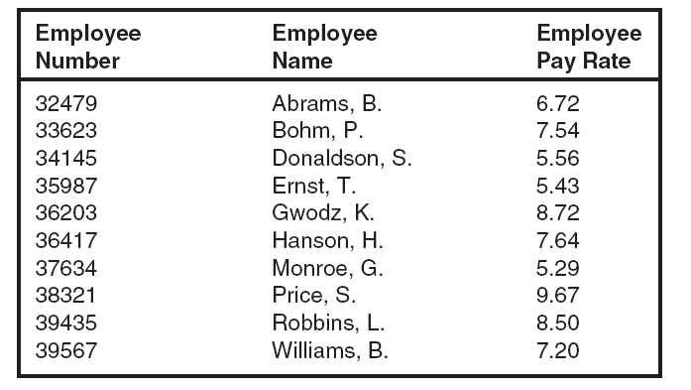
Arrays of Structures
Figure 13.1 A list of employee data

Slide 9
Arrays of Structures
Option 1 is not a good choice
Items related to single employee constitute a natural organization of data into structures
Better option: Use structure shown in Figure 13.2
Data can be processed as single array of ten structures
Maintains integrity of the data organization as a record

Slide 10
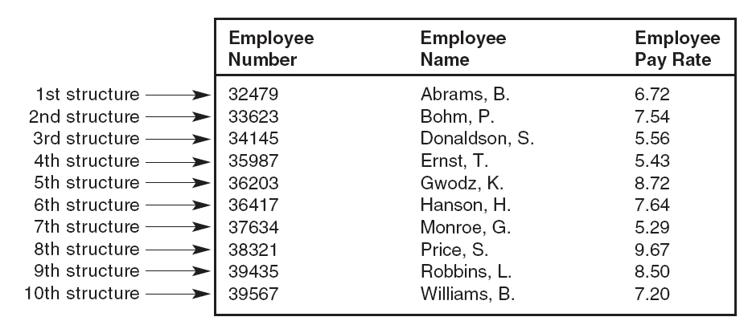
Arrays of Structures
Figure 13.2 A list of structures

Slide 11
Arrays of Structures
Declaring an array of structures: Same as declaring an array of any other variable type
If data type PayRecord is declared as:
struct PayRecord
{
int idNum;
string name;
double rate:
};
An array of ten such structures can be defined as:
PayRecord employee[10];

Slide 12
Arrays of Structures
Referencing an item in an array of structures:
employee[0].rate refers to rate member of the first employee structure in employee array
Including structures as elements of array makes it possible to process list of structures using standard array programming techniques
Program 13.3 displays first five employee records illustrated in Figure 13.2

Slide 13
Arrays of Structures
Program 13.3
#include <iostream>
#include <string>
#include <iomanip>
using namespace std;
struct PayRec // this is a global declaration
{
int id;
string name;
double rate;
};
int main()
{
const int NUMRECS = 5; // maximum number of records
int i;
PayRec employee[NUMRECS] = {
{ 32479, "Abrams, B.", 6.72},
{ 33623, "Bohm, P.", 7.54},
{ 34145, "Donaldson, S.", 5.56},
{ 35987, "Ernst, T.", 5.43},
{ 36203, "Gwodz, K.", 8.72}
};

Slide 14
Arrays of Structures
Program 13.3 (Continued)
cout << endl; // start on a new line
cout << setiosflags(ios::left); // left justify the output
for ( i = 0; i < NUMRECS; i++)
cout << setw(7) << employee[i].id
<< setw(15) << employee[i].name
<< setw(6) << employee[i].rate << endl;
return 0;
}
The Output from Program 13.3
32479 Abrams, B. 6.72
33623 Bohm, P. 7.54
34145 Donaldson, S. 5.56
35987 Ernst, T. 5.43
36203 Gwodz, K. 8.72

Slide 15
Structures as Function Arguments
Individual structure members are passed to a function in same manner as a scalar variable
Example: Given the structure definition
struct
{
int idNum;
double payRate;
double hours;
} emp;
the statement display (emp.idNum); passes a copy of the structure member emp.idNum to a function named display()

Slide 16
Structures as Function Arguments
Passing complete copies of all members of structure to a function
Include name of structure as argument
Example: The function call calcNet(emp); passes a copy of the complete emp structure to calcNet()
A declaration must be made to receive structure

Slide 17
Structures as Function Arguments
Example: Program 13.4 declares a global data type for Employee structure
This type is then used by both main() and calcNet() functions to define specific structures with names emp and temp
The output produced by Program 13.4 is
The net pay for employee 6782 is $361.66

Slide 18
Structures as Function Arguments
Program 13.4
#include <iostream>
#include <iomanip>
using namespace std;
struct Employee
{
int idNum;
double payRate;
double hours;
};
double calculateNet(Employee); // function prototype
int main()
{
Employee emp = {6782, 8.93, 40.5};
double netPay;
netPay = calculateNet(emp); // pass copies of the values in emp

Slide 19
Structures as Function Arguments
Program 11.4 (Continued)
// set output formats
cout << setw(10)
<< setiosflags(ios::fixed)
<< setiosflags(ios::showpoint)
<< setprecision(2);
cout << "The net pay for employee " << emp.idNum
<< " is $" << netPay << endl;;
return 0;
}
double calculateNet(Employee temp) // temp is of data type Employee
{
return(temp.payRate * temp.hours);
}

Slide 20
Structures as Function Arguments
In Program 13.4, both main() and calcNet() use the Employee data type
The variables defined in main() and calcNet() are different structures
Changes to local temp variable in calcNet() are not reflected in emp variable of main()
Same structure variable name could have been used in both functions with no ambiguity
Both structure variables are local to their respective functions

Slide 21
Passing a Pointer
Using a pointer requires modifications to Program 13.4:
Call to calcNet(): calcNet(&emp);
calcNet() function definition:
calcNet(Employee *pt)
Example: Program 13.4a
Declares pt as a pointer to structure of type Employee
pt receives starting address of structure whenever calcNet() is called
calcNet() uses pt to access members of structure

Slide 22
Passing a Pointer
Program 13.4a
#include <iostream>
#include <iomanip>
using namespace std;
struct Employee // declare a global type
{
int idNum;
double payRate;
double hours;
};
double calculateNet(Employee&); // function prototype
int main()
{
Employee emp = {6782, 8.93, 40.5};
double netPay;
netPay = calculateNet(emp); // pass a reference

Slide 23
Passing a Pointer
Program 13.4a (Continued)
// set output formats
cout << setw(10)
<< setiosflags(ios::fixed)
<< setiosflags(ios::showpoint)
<< setprecision(2);
cout << "The net pay for employee " << emp.idNum
<< " is $" << netPay << endl;
return 0;
}
double calculateNet(Employee& temp) // temp is a reference variable
{
return (temp.payRate * temp.hours);
}

Slide 24
Passing a Pointer
Example: Program 13.4a
(*pt).idNum refers to idNum member
(*pt).payRate refers to payRate member
(*pt).hours refers to hours member
These relationships illustrated in Figure 11.5
Parentheses around the expression *pt in Figure 11.5 are necessary to initially access “the structure whose address is in pt”

Slide 25
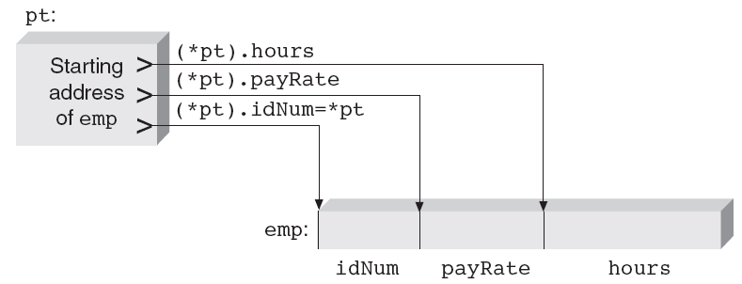
Passing a Pointer
Figure 13.3 A pointer can be used to access structure members

Slide 26
Passing a Pointer
Starting address of emp is also address of first member of the structure (Figure 13.3)
Special notation commonly used
Expression (*pointer).member can always be replaced with notation pointer->member
The following expressions are equivalent:
(*pt).idNum can be replaced by pt->idNum
(*pt).payRate can be replaced by pt->payRate
(*pt).hours can be replaced by pt->hours

Slide 27
Passing a Pointer
Program 13.5 illustrates passing structure’s address
Uses a pointer with -> notation to reference structure directly
When calcNet() is called with statement
netPay = calcNet(&emp);
emp’s starting address is passed to the function
Using this address as starting point, individual members of structure are accessed by including their names with pointer
emp -> hours

Slide 28
Passing a Pointer
Incrementing or decrementing a pointer: Use increment or decrement operators
Expression ++pt->hours; adds one to hours member of emp structure
-> operator has higher priority than increment operator, therefore hours member is accessed first, then increment is applied
Expression (++pt)->hours; increments address before hours member is accessed
Expression (pt++)->hours; increments address after hours member is accessed

Slide 29
Passing a Pointer
Program 13.5
#include <iostream>
#include <iomanip>
using namespace std;
struct Employee
{
int idNum;
double payRate;
double hours;
};
int main()
{
double calculateNet(Employee *); // function prototype
Employee emp = {6786, 8.93, 40.5};
double netPay;
netPay = calculateNet(&emp); // pass an address

Slide 30
Passing a Pointer
Program 13.5 (Continued)
// set output formats
cout << setw(10)
<< setiosflags(ios::fixed)
<< setiosflags(ios::showpoint)
<< setprecision(2);
cout << "The net pay for employee " << emp.idNum
<< " is $" << netPay << endl;
return 0;
}
double calculateNet(Employee *pt) // pt is a pointer to a
{ // structure of Employee type
return(pt->payRate * pt->hours);
}

Slide 31
Passing a Pointer
Example (Fig 13.4): Array of three structures of type employee with address of emp[1] stored in the pointer variable pt
Expression ++pt changes address in pt to starting address of emp[2]
Expression --pt changes address in pt to starting address of emp[0]

Slide 32
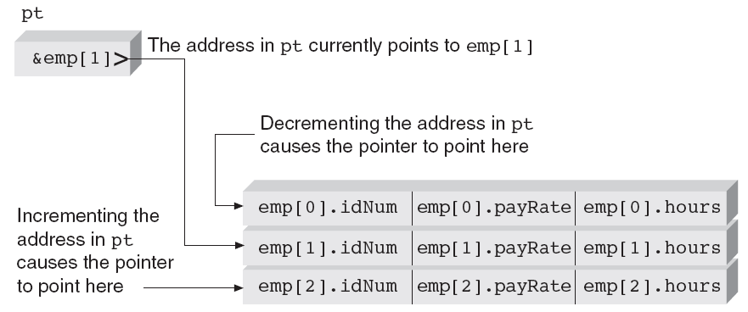
Passing a Pointer
Figure 13.4 Changing pointer addresses

Slide 33
Returning Structures
Structure handling functions receive direct access to structure by receiving structure reference or address
Equivalent to pass by reference
Changes to structure made in function
Functions can also return separate structure
Must declare function appropriately and alert calling function to type of data being returned

Slide 34
Returning Structures
Program 13.6
#include <iostream>
#include <iomanip>
using namespace std;
struct Employee {
int idNum;
double payRate;
double hours;
};
Employee getVals(); // function prototype
int main()
{
Employee emp;
emp = getVals();
cout << "\nThe employee id number is " << emp.idNum
<< "\nThe employee pay rate is $" << emp.payRate
<< "\nThe employee hours are " << emp.hours << endl;
return 0;
}

Slide 35

Returning Structures
Program 13.6 (Continued)
Employee getVals() // returns an employee structure
{
Employee next;
next.idNum = 6789;
next.payRate = 16.25;
next.hours = 38.0;
return(next);
}

Slide 36
Linked Lists
A classic data handling problem is making additions or deletions to existing structures that are maintained in a specific order
Linked lists provide method for maintaining a constantly changing list
Linked list: Set of structures in which each structure contains at least one member whose value is address of next logically ordered structure in list

Slide 37
Linked Lists
Instead of requiring each record to be physically stored in correct order, each new structure is physically added wherever computer has free storage space
Records are “linked” by including address of next record in the record immediately preceding it
Current record contains address of next record no matter where next record is stored

Slide 38
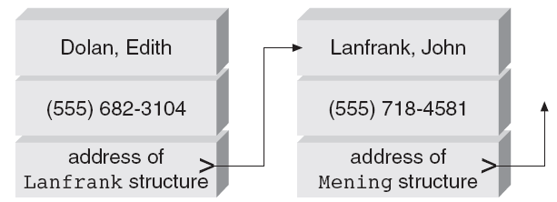
Linked Lists
Figure 13.5 Using pointers to link structures

Slide 39
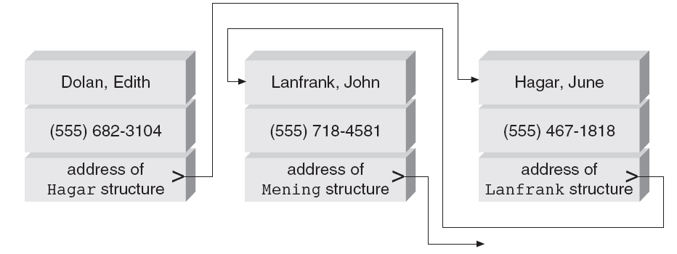
Linked Lists
Figure 13.6 Adjusting addresses to point to the correct structures

Slide 40
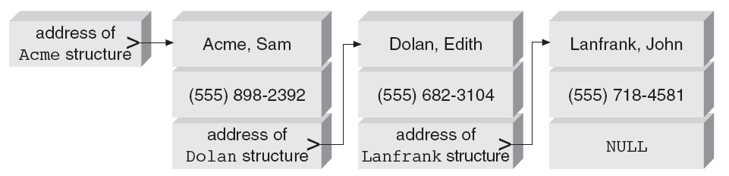
Linked Lists
Figure 13.7 Using initial and final pointer values

Slide 41
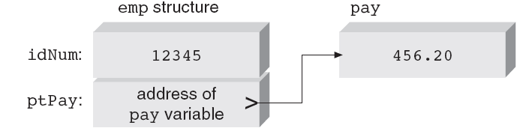
Linked Lists
Figure 13.8 Storing an address in a structure member

Slide 42
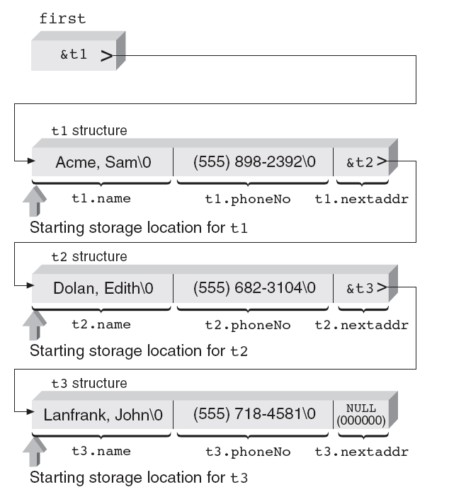
Linked Lists
Figure 13.9 The relationship between structures in Program 13.8

Slide 43
Dynamic Structure Allocation
Dynamic allocation of memory especially useful for lists of structures
Permits lists to expand and contract as records are added or deleted
Additional storage space: Use new operator and indicate amount of storage needed
Expression new(int) or new int requests enough space to store integer number

Slide 44
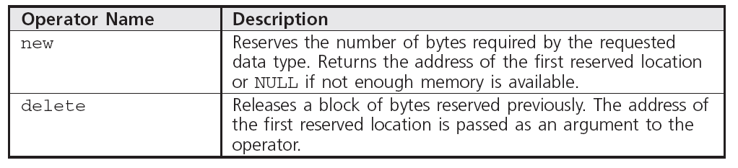
Dynamic Structure Allocation
Dynamic structure allocation uses the new and delete operators
Table 13.1 Operators for Dynamic Allocation and Deallocation

Slide 45
Dynamic Structure Allocation
Dynamically requesting storage for a structure:
If structure has been declared as follows:
struct TeleType
{
string name;
string phoneNo;
};
Expressions new(TeleType) or new TeleType reserve storage for one TeleType structure
Program 13.10 illustrates use of new to dynamically create a structure in response to user input request

Slide 46
Dynamic Structure Allocation
Program 13.10
// a program illustrating dynamic structure allocation
#include <iostream>
#include <string>
using namespace std;
struct TeleType
{
string name;
string phoneNo;
};
void populate(TeleType *); // function prototype needed by main()
void dispOne(TeleType *); // function prototype needed by main()
int main()
{
char key;
TeleType *recPoint; // recPoint is a pointer to a
// structure of type TeleType

Slide 47
Dynamic Structure Allocation
Program 13.10 (Continued)
cout << "Do you wish to create a new record (respond with y or n): ";
key = cin.get();
if (key == 'y')
{
key = cin.get(); // get the Enter key in buffered input
recPoint = new TeleType;
populate(recPoint);
dispOne(recPoint);
}
else
cout << "\nNo record has been created.";
return 0;
}

Slide 48
Dynamic Structure Allocation
Program 13.10 (Continued)
// input a name and phone number
void populate(TeleType *record) // record is a pointer to a
{ // structure of type TeleType
cout << "Enter a name: ";
getline(cin, record->name);
cout << "Enter the phone number: ";
getline(cin, record->phoneNo);
return;
}
// display the contents of one record
void dispOne(TeleType *contents) // contents is a pointer to a
{ // structure of type TeleType
cout << "\nThe contents of the record just created is:"
<< "\nName: " << contents->name
<< "\nPhone Number: " << contents->phoneNo << endl;
return;
}

Slide 49
Dynamic Structure Allocation
Example: Program 13.10
Two variables declared in main()
key declared as a character variable
recPoint declared as pointer to structure of the TeleType type
If user enters y in response to first prompt in main(), a call to new is made for memory to store structure
Address loaded into recPoint can be used to access newly created structure

Slide 50
Dynamic Structure Allocation
Example: Program 13.10
The function populate() prompts user for data to fill structure
The argument passed to populate() in main() is pointer recPoint
The disOne() function displays contents of newly created and populated structure
Address passed to dispOne() is same address that was passed to populate()

Slide 51
Unions
Union: Data type that reserves same area in memory for two or more variables that can be different data types
Definition of union has same form as structure definition
Keyword union replaces keyword struct

Slide 52
Unions
Example: Union val contains a single member that can be character variable named key, integer named num, or double-precision variable named volts
union
{
char key;
int num;
double volts;
} val;

Slide 53
Unions
Typically, second variable is used to keep track of current data type stored in union
struct
{
char uType;
union
{
char *text;
float rate;
} uTax;
} flag;

Slide 54
Unions
Example: Referencing union data member based on type indicator member
Switch(uType)
{
case ‘c’: cout << val.key;
break;
case ‘i’: cout << val.num;
break;
case ‘d’: cout << val.volts;
break;
default : cout << “Invalid type in uType :” << uType;
};

Slide 55
Common Programming Errors
Structures or unions cannot be used in relational expressions
When pointer is used to point to a structure or a union, take care to use address in pointer to point to correct data type
Be careful to keep track of the data stored in a union
Access data in a union by the wrong variable name is a troublesome error to locate

Slide 56
Summary
Structure allows grouping variables under a common variable name
Each variable in structure accessed by structure name, followed by period, followed by variable name
One form for declaring a structure is:
struct
{
// member declarations
} structureName;

Slide 57
Summary
A data type can be created from a structure by using this declaration form:
struct DataType
{
// member declarations
};

Slide 58
Summary
Structures are particularly useful as elements of arrays
Each structure becomes a record in a list of records
Complete structures can be used a function arguments, in which case called function receives a copy of the structure elements
Structure addresses can also be passed as a reference or a pointer
When passed as pointer or reference, function has access to change original structure member values

Slide 59
Summary
Structure members can be any valid C++ data type
May be other structures, unions, arrays, or pointers
When pointer included in structure, a linked list can be created
Unions are declared in same manner as structures
Definition of union creates a memory overlay area
Each union member uses the same memory storage locations

