Slide 1
14
Numerical Methods

Slide 2
Contents
Root finding
The bisection method
Refinements to the bisection method
The secant method
Numerical integration
The trapezoidal rule
Simpson’s Rule
Common programming errors

Slide 3
Introduction to Root Finding
Root finding is useful in solving engineering problems
Vital elements in numerical analysis are:
Appreciating what can or can’t be solved
Clearly understanding the accuracy of answers found

Slide 4
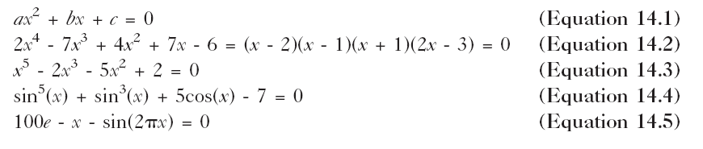
Introduction to Root Finding
Examples of the types of functions encountered in root-solving problems:

Slide 5

Introduction to Root Finding
General quadratic equation, Equation 14.1, can be solved easily and exactly by using the following equation:

Slide 6
Introduction to Root Finding
Equation 14.2 can be solved for x exactly by factoring the polynomial
Equation 14.4 and 14.5 are transcendental equations
Transcendental equations
Represent a different class of functions
Typically involve trigonometric, exponential, or logarithmic functions
Cannot be reduced to any polynomial equation in x

Slide 7
Introduction to Root Finding
Irrational numbers and transcendental numbers
Represented by non-repeating decimal fractions
Cannot be expressed as simple fractions
Responsible for the real number system being dense or continuous
Classifying equations as polynomials or transcendental and the roots of these equations as rational or irrational is vital to traditional mathematics
Less important to the computer where number system is continuous and finite

Slide 8
Introduction to Root Finding
When finding roots of equations, the distinction between polynomials and transcendental equations is unnecessary
Many theorems learned for roots and polynomials don’t apply to transcendental equations
Both Equations 14.4 and 14.5 have infinite number of real roots

Slide 9
Introduction to Root Finding
Potential computational difficulties can be avoided by providing:
Best possible choice of method
Initial guess based on knowledge of the problem
This is often the most difficult and time consuming part of solution
Art of numerical analysis consists of balancing time spent optimizing the problem’s solution before computation against time spent correcting unforeseen errors during computation

Slide 10
Introduction to Root Finding
Sketch function before attempting root solving
Use graphing routines or
Generate table of function values and graph by hand
Graphs are useful to programmers in:
Estimating first guess for root
Anticipating potential difficulties

Slide 11
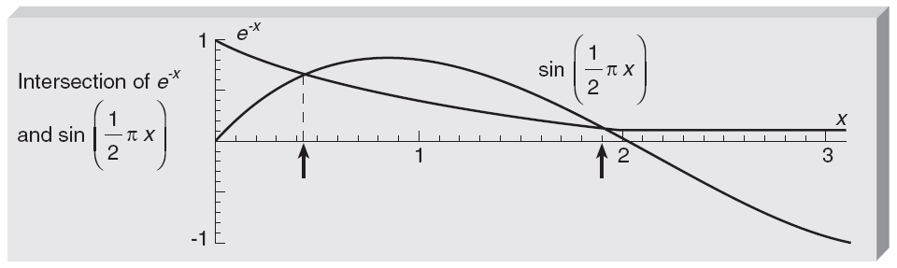
Introduction to Root Finding
Figure 14.1 Graph of e^{-x} and sin(½πx) for locating the intersection points

Slide 12
Introduction to Root Finding
Because the sine oscillates, there is an infinite number of positive roots
Concentrate on improving estimate of first root near 0.4
Establish a procedure based on most obvious method of attack
Begin at some value of x just before the root
Step along x-axis carefully watching magnitude and sign of function

Slide 13
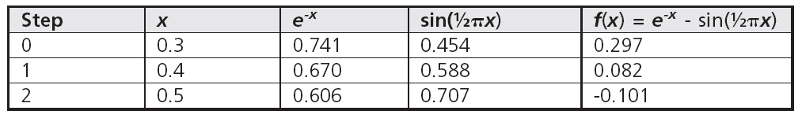
Introduction to Root Finding
Notice that function changed sign between 0.4 and 0.5
Indicates root between these two x values

Slide 14
Introduction to Root Finding
For next approximation use midpoint value, x = 0.45
Function is again negative at 0.45 indicating root between 0.4 and 0.45
Next approximation is midpoint, 0.425

Slide 15
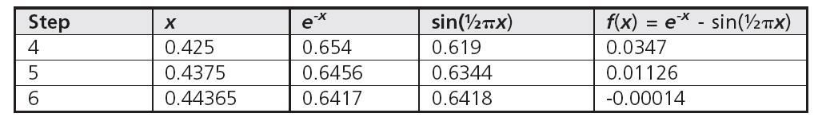
Introduction to Root Finding
In this way, proceed systematically to a computation of the root to any degree of accuracy
Key element in this procedure is monitoring the sign of function
When sign changes, specific action is taken to refine estimate of root

Slide 16
The Bisection Method
Root-solving procedure previously explained is suitable for hand calculations
A slight modification makes it more systematic and easier to adapt to computer coding
Modified computational technique is known as the bisection method
Suppose you already know there’s a root between x = a and x = b
Function changes sign in this interval
Assume
Only one root between x = a and x = b
Function is continuous in this interval

Slide 17
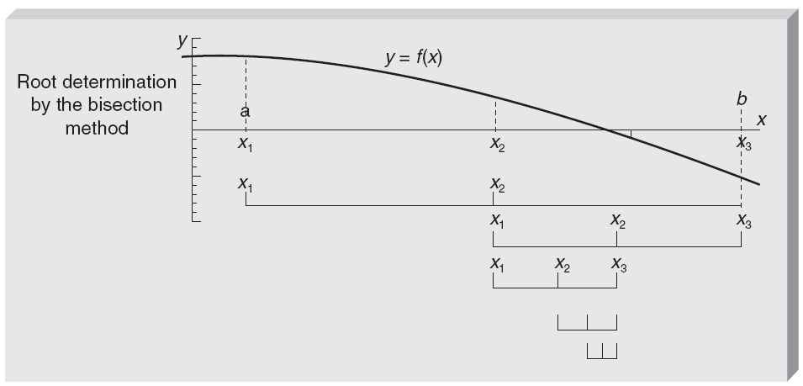
The Bisection Method
Figure 14.2 A sketch of a function with one root between a and b

Slide 18
The Bisection Method
After determining a second time whether the left or right half contains the root, interval is again replaced by the left or right half-interval
Continue process until narrow in on the root at previously assigned accuracy
Each step halves interval
After n intervals, interval’s size containing root is
(b – a)/2n

Slide 19

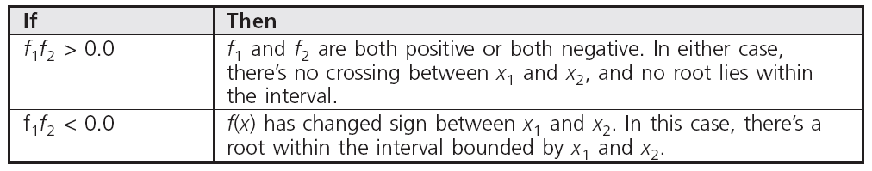
The Bisection Method
If required to find root to within the tolerance, the number of iterations can be determined by:

Slide 20
The Bisection Method
Program 14.1 computes roots of equations
Note following features:
In each iteration after the first one, there is only one function evaluation
Program contains several checks for potential problems along with diagnostic messages along with diagnostic messages
Criterion for success is based on interval’s size

Slide 21
Refinements to the Bisection Method
Bisection method presents the basics on which most root-finding methods are constructed
Brute-force is rarely used
All refinements of bisection method attempt to use as much information as available about the function’s behavior in each iteration
In ordinary bisection method only feature of function monitored is its sign

Slide 22

Regula Falsi Method
Essentially same as bisection method, except it uses interpolated value for root
Root is known to exist in interval ( x₁ ↔ x₂ )
In drawing, f₁ is negative and f₃ is positive
Interpolated position of root is x₂
Length of sides is related, yielding:
Value of x₂ replaces the midpoint in bisection

Slide 23
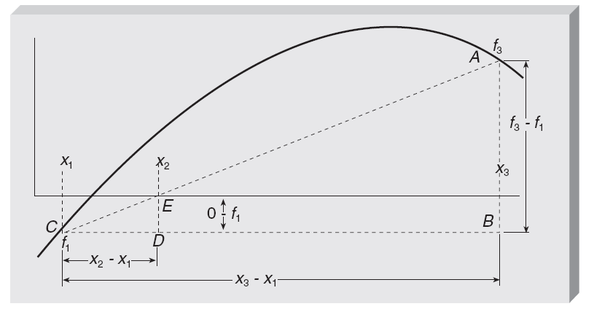
Regula Falsi Method
Figure 14.3 Estimating the root by interpolation

Slide 24
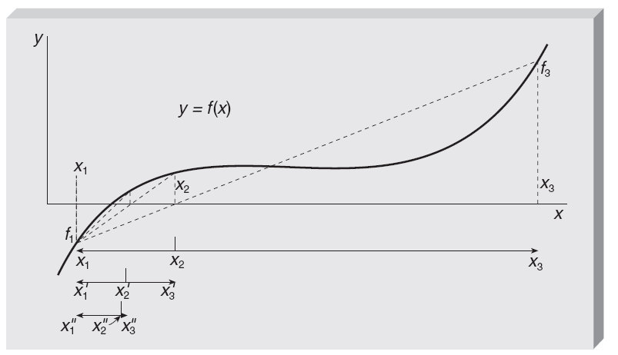
Regula Falsi Method
Figure 14.4 Illustration of several iterations of the regula falsi method

Slide 25
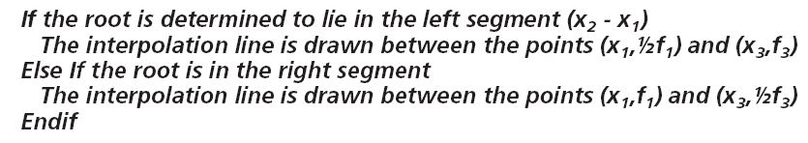
Modified Regula Falsi Method
Perhaps the procedure can be made to collapse from both directions from both directions
The idea is as follows:

Slide 26
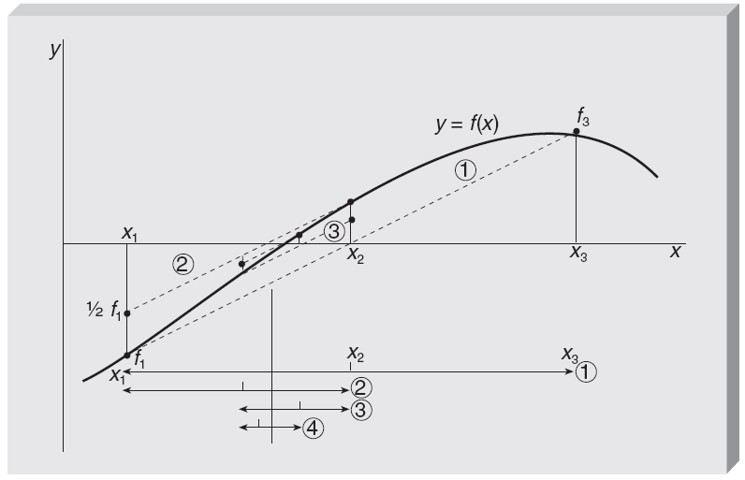
Modified Regula Falsi Method
Figure 14.5 Illustration of the modified regula falsi method

Slide 27
Modified Regula Falsi Method
Using this algorithm, slope of line is reduced artificially
If root is in left of original interval, it:
Eventually turns up in the right segment of a later interval
Subsequently alternates between left and right

Slide 28
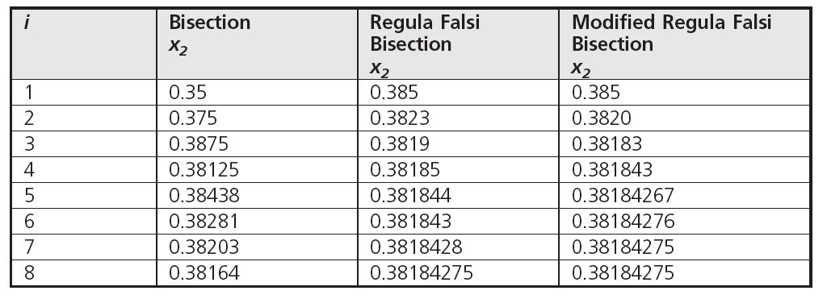
Modified Regula Falsi Method
Table 14.1 Comparison of Root-Finding Methods Using the Function f(x)=2e^{-2x} -sin(πx)

Slide 29
Modified Regula Falsi Method
Relaxation factor: Number used to alter the results of one iteration before inserting them into the next
Trial and error shows that a less drastic increase in the slope results in improved convergence
Using a convergence factor of 0.9 should be adequate for most problems

Slide 30
Summary of the Bisection Methods
Bisection
Success based on size of interval
Slow convergence
Predictable number of iterations
Interval halved in each iteration
Guaranteed to bracket a root

Slide 31
Summary of Bisection Methods
Regula falsi
Success based on size of function
Faster convergence
Unpredictable number of iterations
Interval containing the root is not small

Slide 32
Summary of Bisection Methods
Modified regula falsi
Success based on size of interval
Faster convergence
Unpredictable number of iterations
Of three methods, most efficient for common problems

Slide 33

The Secant Method
Identical to regula falsi method except sign of f(x) doesn’t need to be checked at each iteration

Slide 34

Introduction to Numerical Integration
Integration of a function of a single variable can be thought of as opposite to differentiation, or as the area under the curve
Integral of function f(x) from x=a to x=b will be evaluated by devising schemes to measure area under the graph of function over this interval
Integral designated as:

Slide 35
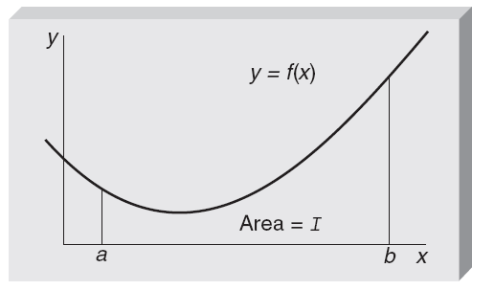
Introduction to Numerical Integration
Figure 14.7 An integral as an area under a curve

Slide 36
Introduction to Numerical Integration
Numerical integration is a stable process
Consists of expressing the area as the sum of areas of smaller segments
Fairly safe from division by zero or round-off errors caused by subtracting numbers of approximately the same magnitude
Many integrals in engineering or science cannot be expressed in any closed form

Slide 37
Introduction to Numerical Integration
Trapezoidal rule approximation for integral
Replace function over limited range by straight line segments
Interval x=a to x=b is divided into subintervals of size ∆x
Function replaced by line segments over each subinterval
Area under function is then approximated by area under line segments

Slide 38
The Trapezoidal Rule
Approximation of area under complicated curve is obtained by assuming function can be replaced by simpler function over a limited range
A straight line, the simplest approximation to a function, lead to trapezoidal rule
Trapezoidal rule for one panel, identified as T₀

Slide 39
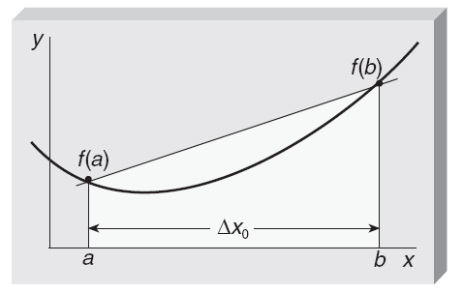
The Trapezoidal Rule
Figure 14.8 Approximating the area under a curve by a single trapezoid

Slide 40
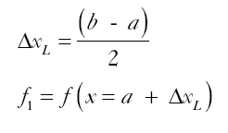
The Trapezoidal Rule
Improve accuracy of approximation under curve by dividing interval in half
Function is approximated by straight-line segments over each half
Area in example is approximated by area of two trapezoids
Where

Slide 41
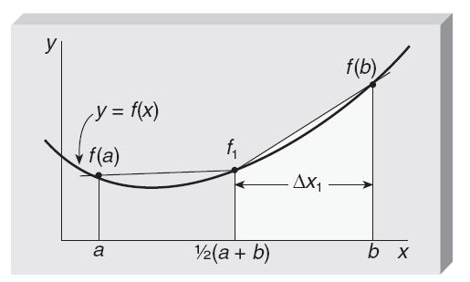
The Trapezoidal Rule
Figure 14.9 Two-panel approximation to the area

Slide 42


The Trapezoidal Rule
Two-panel approximation T₁ can be related to one-panel results, T₀, as:
Result for n panels is:

Slide 43

Computational Form of the Trapezoidal Rule
Equation 14.9 was derived assuming widths of all panels the same and equal to ∆x_{n}
Equation can be generalized to a partition of the interval into unequal panels
By restricting panel widths to be equal and number of panels to be a power of 2,
2∆x₂ = ∆x₁
This results in:

Slide 44
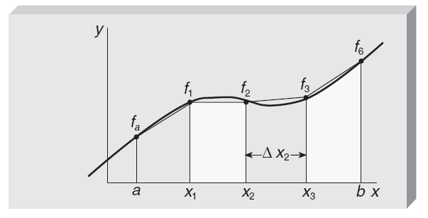
Computational Form of the Trapezoidal Rule
Figure 14.10 Four-panel trapezoidal approximation, T₂

Slide 45
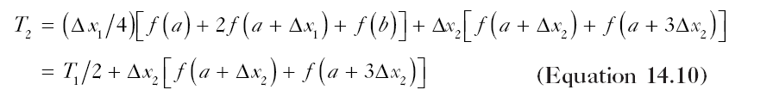

Computational Form of the Trapezoidal Rule
Where

Slide 46
Computational Form of the Trapezoidal Rule
Procedure using Equation 14.11 to approximate an integral by the trapezoidal rule is:
Compute T₀ by using Equation 14.6
Repeatedly apply Equation 14.11 for:
k = 1, 2, . . .
until sufficient accuracy is obtained

Slide 47


Example of a Trapezoidal Rule Calculation
Given the following integral:
Trapezoidal rule approximation to the integral with a = 1 and b = 2 begins with Equation 14.6 to obtain T₀

Slide 48
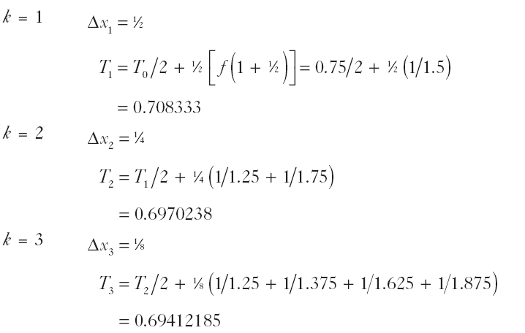
Example of a Trapezoidal Rule Calculation
Repeated use of Equation 14.11 then yields:

Slide 49
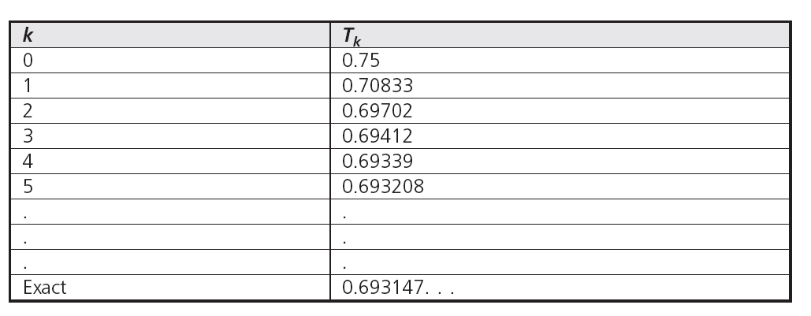
Example of a Trapezoidal Rule Calculation
Continuing the calculation through k = 5 yields

Slide 50
Simpson’s Rule
Trapezoidal rule is based on approximating the function by straight-line segments
To improve the accuracy and convergence rate, another approach is approximating the function by parabolic segments, known as Simpson’s rule
Specifying a parabola uniquely requires three points, so the lowest order Simpson’s rule has two panels

Slide 51
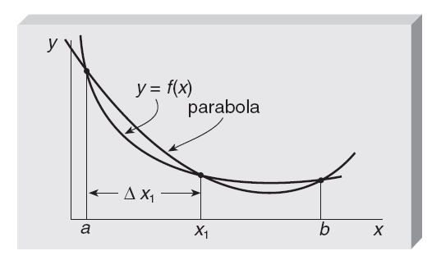
Simpson’s Rule
Figure 14.11 Area under a parabola drawn through three points

Slide 52
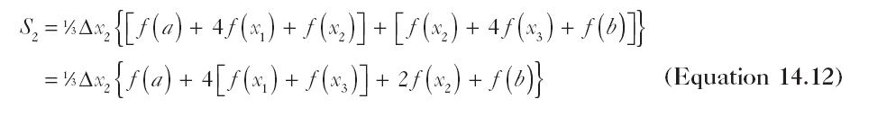


Simpson’s Rule
Where
And

Slide 53
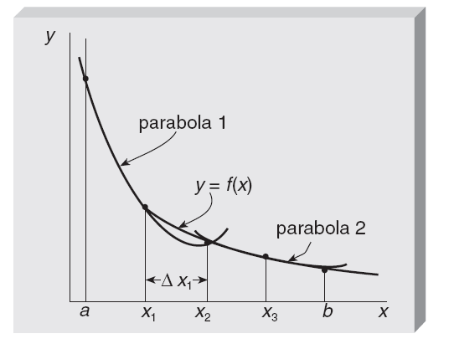
Simpson’s Rule
Figure 14.12 The second-order Simpson’s rule approximation is the area under two parabolas

Slide 54
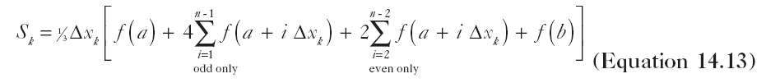

Simpson’s Rule
Generalization of Equation 14.12 for n = 2^{k} panels

Slide 55

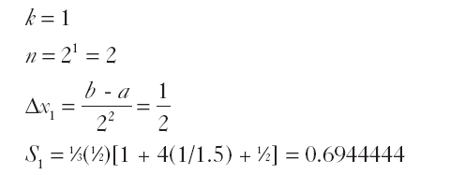
Example of Simpson’s Rule as an Approximation to an Integral
Consider this integral:
Using Equation 14.13 first for k = 1 yields:

Slide 56
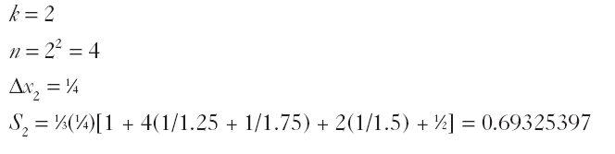
Example of Simpson’s Rule as an Approximation to an Integral
Repeating for k = 2 yields:

Slide 57
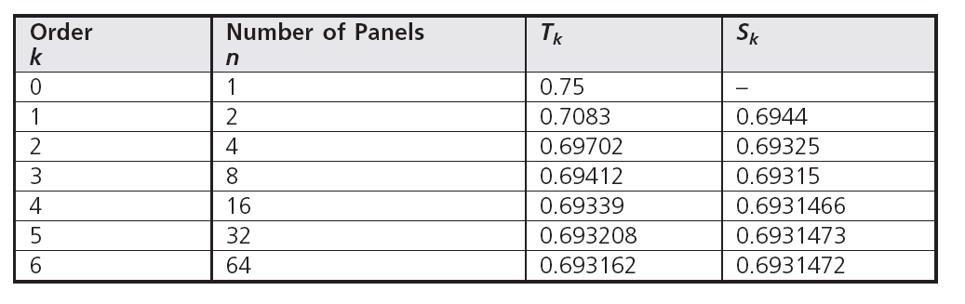

Example of Simpson’s Rule as an Approximation to an Integral
Continuing the calculation yields:
Figure 14.2 Trapezoidal and Simpson’s Rule Results for the Integral

Slide 58
Common Programming Errors
Two characteristics of this type of computation:
Round-off errors occur when the values of f(x₁) and f(x₃) are nearly equal
Prediction of exact number of iterations is not available
Excessive and possibly infinite iterations must be prevented
Excessive computation time might be a problem
Occurs if number of iterations exceeds fifty

Slide 59
Summary
All root solving methods described in chapter are iterative
Can be categorized into two classes
Starting from an interval containing a root
Starting from an initial estimate of a root
Bisection algorithms refine initial interval by:
Repeated evaluation of function at points within interval
Monitoring the sign of the function and determining in which subinterval the root lies

Slide 60
Summary
Regula falsi uses same conditions as bisection method
Straight line connecting points at the ends of the intervals is used to interpolate position of root
Intersection of this line with x-axis determines value of x₂ used in next step
Modified regula falsi same as regula falsi except:
In each iteration when full interval replaced by subinterval containing root, relaxation factor used to modify function’s value at the fixed end of the subinterval

Slide 61

Summary
Secant method replaces the function by:
Secant line through two points
Finds point of intersection of the line with x-axis
Algorithm requires two input numbers:
x₀ and ∆x₀
Pair of values then replaced by pair (x_{1,} and ∆x₁) where x₁ = x₀ + ∆x₀ and

Slide 62
Summary
Secant method processing continues until ∆x is sufficiently small
Success of a program in finding the root of function usually depends on the quality of information supplied by the user
Accuracy of initial guess or search interval
Method selection match to circumstances of problem
Execution-time problems are usually traceable to:
Errors in coding
Inadequate user-supplied diagnostics

Slide 63

Summary
Trapezoidal rule results from replacing the function f(x) by straight-line segments over the panels ∆x_{i}
Approximate value for integral is given by following formula

Slide 64


Summary
If panels are equal size and the number of panels is n = 2^{k} where k is a positive integer, the trapezoidal rule approximation is then labeled T_{k} and satisfies the equation
where

Slide 65
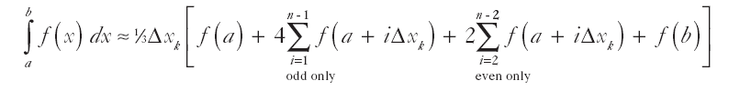
Summary
In next level of approximation
Function f(x) is replaced by n/2 parabolic segments over pairs of equal size panels, ∆x = (b - a)/n
Results in formula for the area known as Simpson’s rule:

