Slide 1
15
Bit Operations

Slide 2
Contents
The AND operator
The inclusive OR operator
The exclusive OR operator
The complement operator
Different-size data items
The shift operators

Slide 3
Introduction
All operators in Table 15.1, except ~, are binary operators, requiring two operands
Each operand is treated as a binary number consisting of a series of 1s and 0s
The bits in each operand are then compared on a bit by bit basis, and the result is determined based on the selected operation

Slide 4
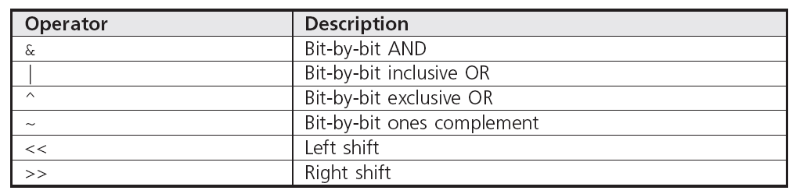
Introduction
Table 15.1 Bit Operators

Slide 5
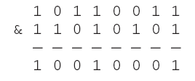
The AND Operator
The AND operator, &, causes a bit-by-bit AND comparison between two operands
The result of each bit by bit comparison is 1 only when both bits being compared are 1s; otherwise 0
Example:

Slide 6
The AND Operator
Program 15.1
#include <iostream>
using namespace std;
int main()
{
int op1 = 0325, op2 = 0263;
int op3 = op1 & op2;
cout << oct << op1 << " ANDed with "<< op2
<< " is " << op3 << endl;
return 0;
}

Slide 7
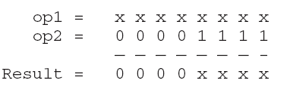
The AND Operator
AND operations are useful for masking, or eliminating, selected bits from an operand
Example:
Variable op2 is called a mask

Slide 8
The AND Operator
Program 15.2
#include <iostream>
using namespace std;
const int TOUPPER = 0xDF;
void upper(char *); // function prototype
int main()
{
char word[81]; // enough storage for a complete line
cout << "Enter a string of both uppercase and lowercase letters:\n";
cin.getline(word,80,'\n');
cout << "\nThe string of letters just entered is:\n"
<< word << endl;
upper(word);
cout << "\nThis string, in uppercase letters, is:\n"
<< word << endl;
}
void upper(char *word)
{
while (*word != '\0')
*word++ &= TOUPPER;
}

Slide 9
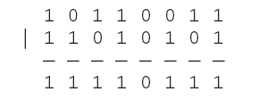
The Inclusive OR Operator
The inclusive OR operator, |, performs a bit-by-bit comparison of its two operands
The result of the OR comparison is 1 if either bit being compared is a 1; otherwise, the result is a 0
Example:

Slide 10
The Inclusive OR Operator
Program 15.3
#include <iostream>
#include <iostream>
using namespace std;
int main()
{
int op1 = 0325, op2 = 0263;
int op3 = op1 | op2;
cout << oct << op1 << " ORed with " << op2
<< " is " << op3 << endl;
return 0;
}

Slide 11
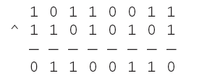
The Exclusive OR Operator
The exclusive OR operator, ^, performs a bit-by-bit comparison of its two operands
The result of the comparison is 1 if one, and only one, of the bits compared is 1, otherwise 0
Example:

Slide 12
The Exclusive OR Operator
Many encryption methods use the exclusive OR operator to code data by exclusive ORing each character in the string with a mask value
Choice of mask value, which is referred to as the encryption key, is arbitrary
Any key can be used

Slide 13
The Complement Operator
The complement operator, ~, is a unary operator that changes each 1 bit in its operand to 0 and each 0 bit to 1
Example: Set the last three bits of op1 to 0, regardless of how op1 is stored in the computer
op1 &= ~07 // 07 is an octal number
Using the complement operator:
Frees programmer from having to determine operand’s storage size
Makes program portable between machines that use different integer storage sizes

Slide 14
Different-Size Data Items
When the bit operators &, |, and ^ are used with operands of different sizes, the shorter operand is always increased in bit size to match the larger operand’s size
When extending 16-bit unsigned integer to 32 bits, additional 0 bits are added to the left of original
When extending 16-bit signed integer to 32 bits, original left-most bit is reproduced in the extra bits added to the number

Slide 15
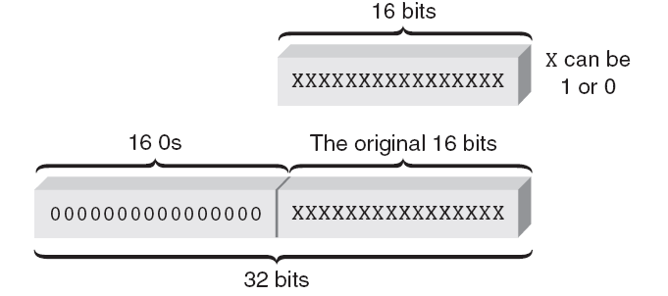
Different-Size Data Items
Figure 15.1 Extending 16-bit unsigned data to 32 bits

Slide 16
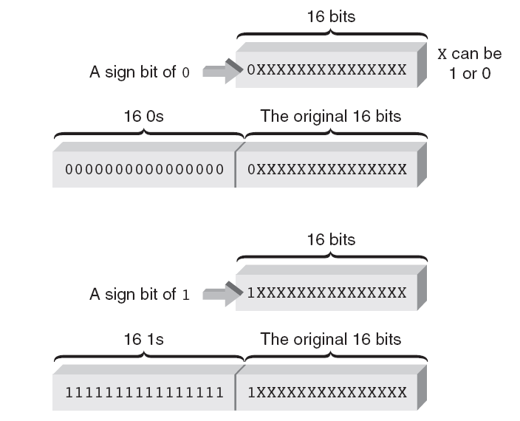
Different-Size Data Items
Figure 15.2 Extending 16-bit signed data to 32 bits

Slide 17
The Shift Operators
The left shift operator, <<, causes the bits in the operand to be shifted to the left by a given amount
Example: op1 = op1 << 4;
For unsigned integers, each left shift corresponds to multiplication by a power of two
This is also true for signed numbers using two’s complement representation as long as leftmost bit does not switch values

Slide 18
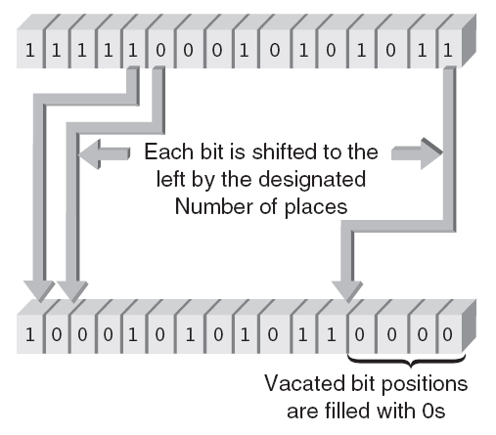
The Shift Operators
Figure 15.3 An example of a left shift

Slide 19
The Shift Operators
The right shift operator, >>, causes the bits in an operand to be shifted to the right by a given amount
Example: op2 = op1 >> 3;
For unsigned integers, leftmost bit not used as sign bit; vacated bits filled with 0’s
For signed numbers, what is filled in the vacated bits depends on the computer
Most computers reproduce the number’s original sign bit

Slide 20
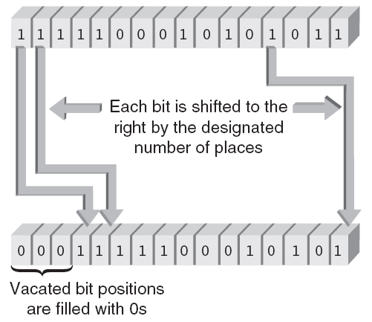
The Shift Operators
Figure 15.4a An unsigned arithmetic right shift

Slide 21
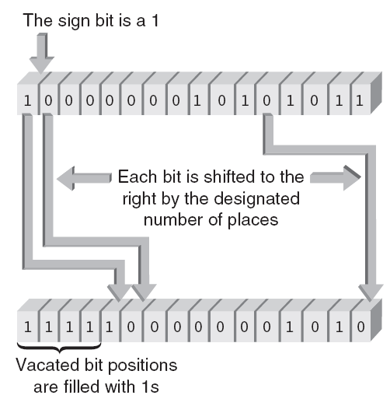
The Shift Operators
Figure 15.4b The right shift of a negative binary number

Slide 22
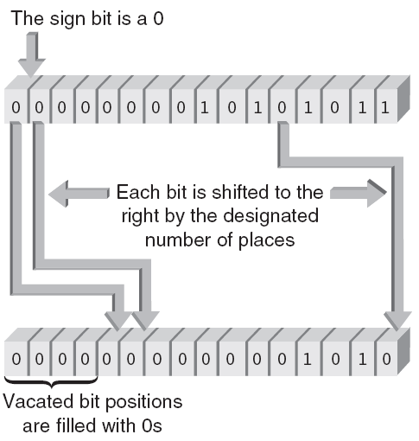
The Shift Operators
Figure 15.4c The right shift of a positive binary number

Slide 23

Summary
Bits of character and integer variables and constants can be manipulated by using C++ bit operators:
AND
inclusive OR
exclusive OR
ones complement
left shift
right shift

Slide 24

Summary
The AND and inclusive OR operators are useful in creating masks that can be used to pass or eliminate bits from the selected operand
Exclusive OR operator is useful in complementing an operand’s bits

Slide 25
Summary
When AND and OR operators are used with operands of different sizes, the shorter operand is always increased in size to match the size of the larger operand
The shift operators produce different results, depending on whether the operand is a signed or an unsigned integer

