Slide 1
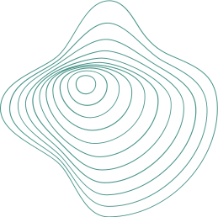
EXPANDED RESEARCH ON
ATTENTION-GUIDED DISCRIMINATIVE REGION LOCALIZATION AND LABEL DISTRIBUTION LEARNING FOR
Bone Age Assessment
C&S Bio 185
By Trevor Brokowski, Marlene Lin, Nikhil Patel, Anish Patel, Shiqin Tan
Notes:
Hello Everyone!

Slide 2
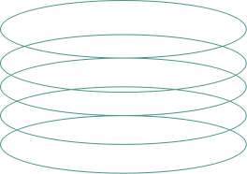
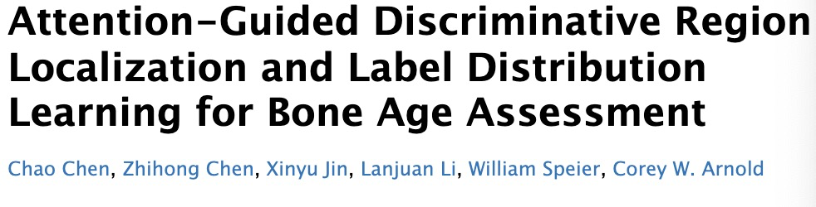
Background
Bone age assessment
Notes:
(Rita)(Marlene’s slide)
Hand radiographs: X-ray of the non-dominant hand, fingers & wrists included
Bone v.s. Chronological age: indicates biological & structural maturity better
Application: growth disorders diagnosis; orthopedic/orthodontic treatments; growth, puberty, ultimate height predictions
Paper’s Solution solve the problems:
Needs manual annotations of region of interests/key points for training
Suboptimal loss function defined by a single age label
However:
Train on specific dataset, so as many other papers’ model
Focus on gender concatenation, we are curious if ethnicity info would help with more accurate bone age assessment

Slide 3
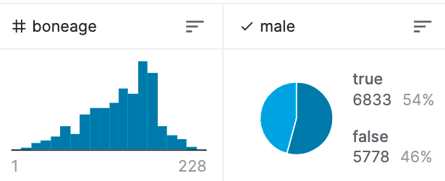
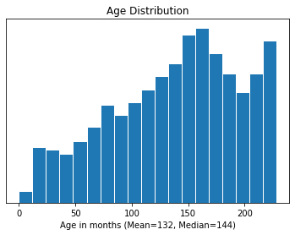
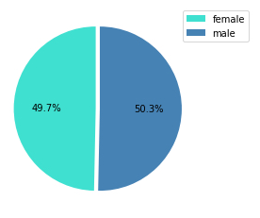
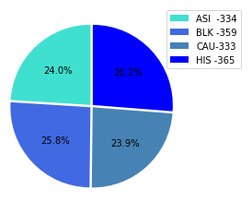
Expanding Research
Transferability to Digital Hand Atlas of USC
RSNA metrics
USC metrics
Notes:
(Rita)(Marlene’s slide)
what
Hand radiographs: X-ray of the non-dominant hand, fingers & wrists included
Bone v.s. Chronological age: indicates biological & structural maturity better
Application: growth disorders diagnosis; orthopedic/orthodontic treatments; growth, puberty, ultimate height predictions
Paper’s Solution solve the problems:
Needs manual annotations of region of interests/key points for training
Suboptimal loss function defined by a single age label
However:
Train on specific dataset, so as many other papers’ model
Focus on gender concatenation, we are curious if ethnicity info would help with more accurate bone age assessment
https://research.aimultiple.com/transfer-learning/#:~:text=Transfer%20learning%20is%20a%20machine%20learning%20technique%20that,ability%20to%20transfer%20their%20knowledge%20as%20an%20example.

Slide 4
Our goal
Understand
ability to transfer to more datasets
concatenate ethnicity to see if overfit
Notes:
(Rita)
So build on to that, our goal of the independent research distills to 2 of the following:
Train on another dataset, to examine the transferability of the model
Concatenate ethnicity info, to evaluate its effectiveness of generating more accurate bone age assessment

Slide 5
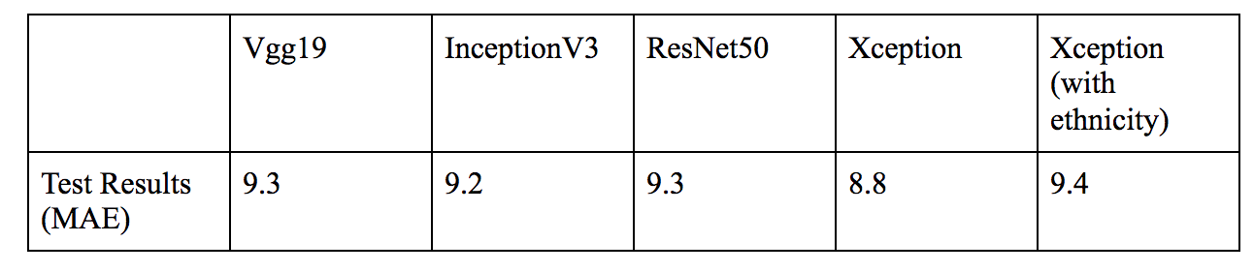
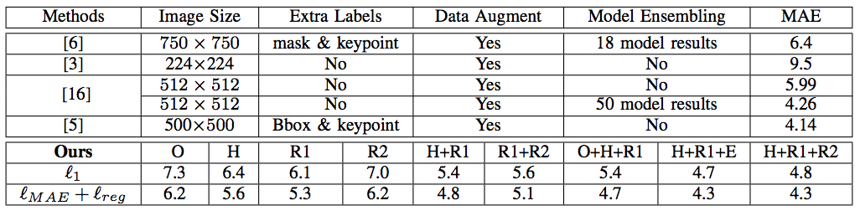
Selected Paper
Model: Xception
Accuracy. More efficient with comparable precision to published BAA methods
Our Result
Model: Xception
Accuracy: Comparable to conventional BAA methods
Training time: 6+ hours
Notes:
(Anish)
PAPER:
For RoI localization: classification utilized InceptionV3 for feature extraction
identifying three regions of interest: region 1, region 2, and hand region
taking images pretrained from ImageNet and utilizing Adam optimizer (batch size of 32) - used 70 epochs, the learning rate is set to 0.0003 for the first 50 epochs and 0.0001 for the last 20
first region localization: most discriminative, using cropped versions of original images
second region localization: inputs include randomized pixellations of region 1, forcing algorithm to create predictions based on those alterations
hand region: cropping hand images smaller, utilizing GAP layer to identify relevant discriminative regions of the hand
Bone Age Expectation Regression: Xception backbone, concatenate gender features with image features and utilizing probability of age distribution instead of single age labelling as inputs to determine overall age of bone based on images, loss functions aimed to minimize Mean Absolute Error loss and regularization loss which were used as evaluation metrics
Accuracy of BAA using CNN networks: Vgg19, InceptionV3, ResNet50, Xception; with and without pretraining, Xception had lowest MAE at 8.8
Comparing study’s methods with other published works, similar accuracy with just localizing hand and region 1 in comparison to methods that utilize other segmentation models, further training and annotations of regions, and even the combination of multiple networks.
Our Results:
Utilizing the USC dataset, we determined RoI localization for region 1, hand region, and cropped version of region 1 using InceptionV3, with more time and computing power the other localizations would also have been determined and hyper parameters could have been included
After localization, we ran our modified regression code using Xception with the concatenated ethnicity feature. Evaluation metrics for loss and MAE were determined with the adam optimizer. For several trials set around 30 epochs, MAE was found to be the lowest at 9.468 with a loss of 9.468 as well. Overall, the code took 6 hours to run on colab via a Google Cloud VM instance, higher epochs with other trials led to runtime disconnect errors after the 6 hour period. Ultimately, we achieve accuracy and similar results to original BAA methods presented in paper. Compared to the NVIDIA GPUS used by the authors, our methods and results could have been made more efficient.

Slide 6
So…How do we get these results?
>>> Ideal Pipeline of Our Implementation
Notes:
(Just transition)

Slide 7
Our Methods
Train, Test, Concatenate
Train
Read
Test
Concatenate
Evaluate
RSNA-BAA.ipynb
Updated Code.ipynb
X
Updated code.ipynb
Final Report.docx
Test USC images on original model
Original dataset & original model
Preprocess & Encoding USC images
Train & Test USC images on concatenated ethnicity model
Compare loss & Mean Absolute Error
Notes:
(Marlene/Trevor)
This is our ideal pipeline of the expanded research.
(Describe …)
However, due to time limitations, we skipped the testing on the original model.

Slide 8
Our Methods
Train, Test, Concatenate
Train
Read
Test
Concatenate
Evaluate
RSNA-BAA.ipynb
Updated Code.ipynb
X
Updated code.ipynb
Final Report.docx
Test USC images on original model
Original dataset & original model
Preprocess & Encoding USC images
Train & Test USC images on concatenated ethnicity model
Compare loss & Mean Absolute Error
Notes:
(Marlene/Trevor)
This is our ideal pipeline of the expanded research.
(Describe …)
However, due to time limitations, we skipped the testing on the original model.

Slide 9
Our Methods
Train, Test, Concatenate
Train
Read
Test
Concatenate
Evaluate
RSNA-BAA.ipynb
Updated Code.ipynb
X
Updated code.ipynb
Final Report.docx
Test USC images on original model
Original dataset & original model
Preprocess & Encoding USC images
Train & Test USC images on concatenated ethnicity model
Compare loss & Mean Absolute Error
Notes:
(Marlene/Trevor)
This is our ideal pipeline of the expanded research.
(Describe …)
However, due to time limitations, we skipped the testing on the original model.

Slide 10
Our Methods
Train, Test, Concatenate
Train
Read
Test
Concatenate
Evaluate
RSNA-BAA.ipynb
Updated Code.ipynb
X
Updated code.ipynb
Final Report.docx
Test USC images on original model
Original dataset & original model
Preprocess & Encoding USC images
Train & Test USC images on concatenated ethnicity model
Compare loss & Mean Absolute Error
Notes:
(Marlene/Trevor)
This is our ideal pipeline of the expanded research.
(Describe …)
However, due to time limitations, we skipped the testing on the original model.

Slide 11
Our Methods
Train, Test, Concatenate
Train
Read
Test
Concatenate
Evaluate
RSNA-BAA.ipynb
Updated Code.ipynb
X
Updated code.ipynb
Final Report.docx
Test USC images on original model
Original dataset & original model
Preprocess & Encoding USC images
Train & Test USC images on concatenated ethnicity model
Compare loss & Mean Absolute Error
Notes:
(Marlene/Trevor)
This is our ideal pipeline of the expanded research.
(Describe …)
However, due to time limitations, we skipped the testing on the original model.

Slide 12
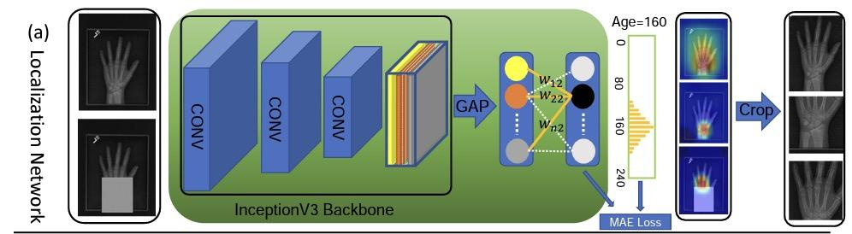
Our Methods
Model: Attention-guided localization
Original x-ray images resized -> localized hand region/localized Region of Interests 1 (carpal bones)
Original image with R1 erased -> localized Region of Interests 2
Notes:
(Marlene) - maybe much less details but put ‘em all down first
We’ll start with a brief review of the original model follows by the attempt at re-implementation on a dataset of size equivalent to the digital hand atlas’s. The entire model could be roughly divided into two parts, the localization network, and the regression network. The localization network is consist of the inceptionV3 backbone with the top layer removed, where inceptionv3 is a deep learning model based on convolution neural networks. Inceptionv3 is followed by a global pooling layer and the fully connected layers with 240 output nodes. Because 240 is the maximum number of months in the age label for the hand x-ray inputs from the rsna dataset. The main purpose of the localization network, as its name suggests is to localize the regions of interests, which are the regions that contribute the most to the classification result, rather than age prediction. ?Backend functions are defined to extract and manipulate the intermediate results from the with the saved weights from training??. The localization networks are run three times to localize different regions of interests. First, the original image is resized to 300x300 pixels, and feed into the model to localize and crop the hand region. second input resize to 560x560 and localized with a heatmap defined over the output of last convu and connection weights between in and out of the fc layer. third, original with r1 erased is feed thru the model again to localize a r2 without the influence of r1.

Slide 13
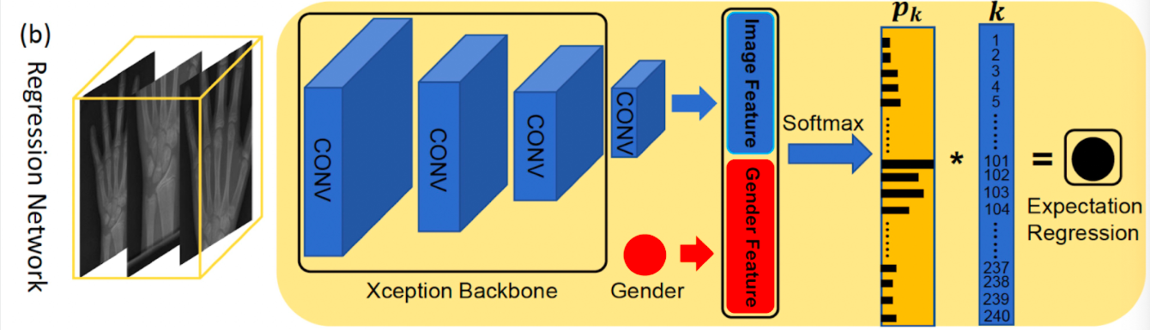


Our Methods
Model: Age regression
Aggregated localized patches -> Mean Age Error
w where
Notes:
(Marlene) -
The localized images are aggregated and feed through the regression network, which uses xception model as the backbone. Xception is determined to be the model that gives the lowest mean age error among some of the other models tested by the paper. Following is the convolution layer, whose output is concatenated with the gender information, encoded as +1 and -1, then feed through the last fclayer with softmax activation output.
soft label and age distribution), the model intends a bone age distribution rather than a single age label to be learned for each instance. Soft labels are created by accounting for the similarity in hand radiographs belonging to neighboring age groups.
The age distribution learned gives the probability of the instance belonging to each of the 240 possible age groups, and the expected age of the distribution is used in the loss function

Slide 14
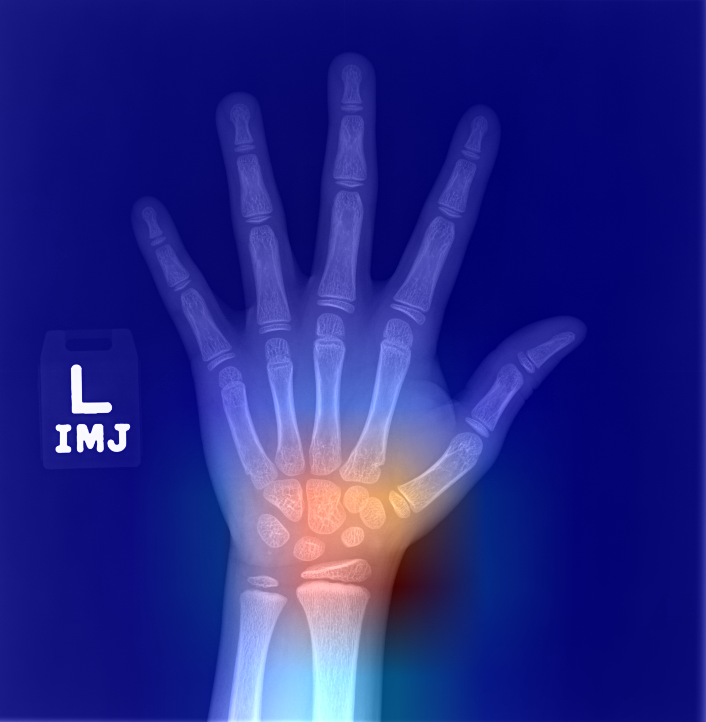
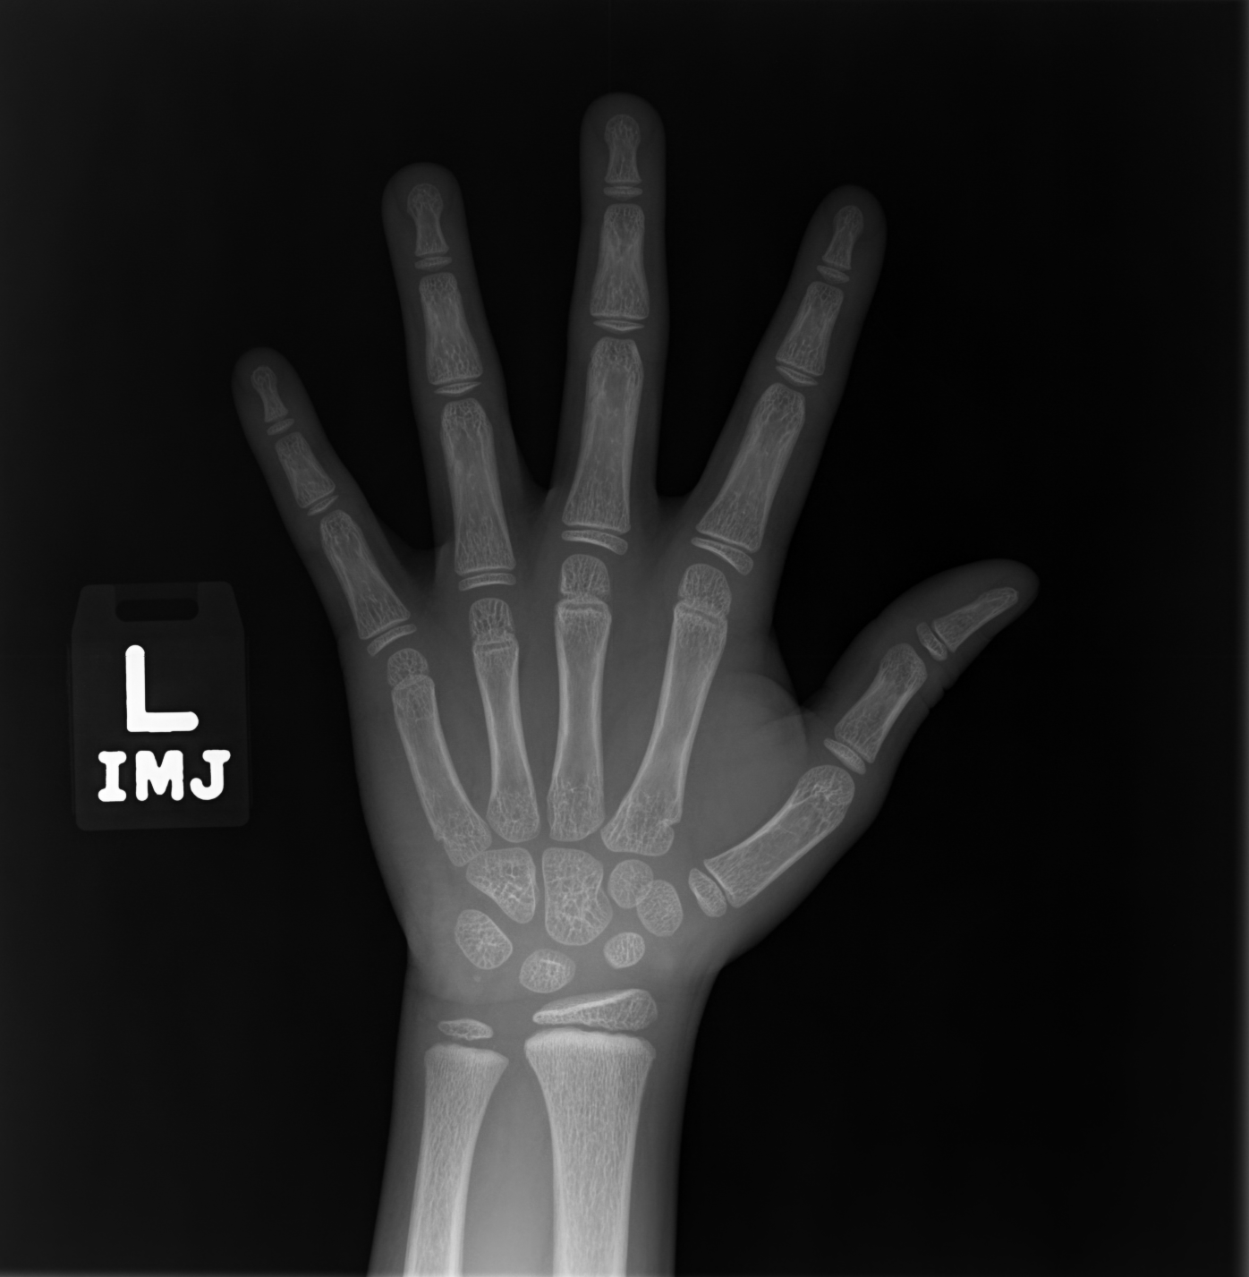
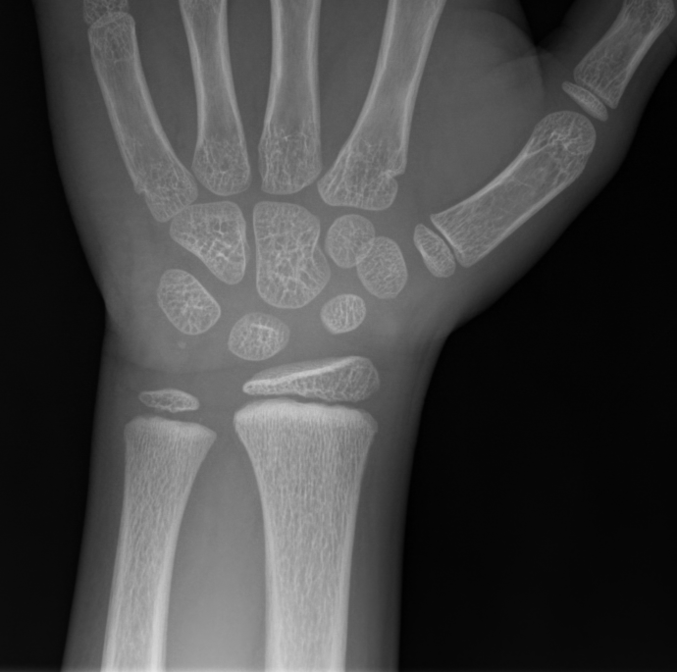
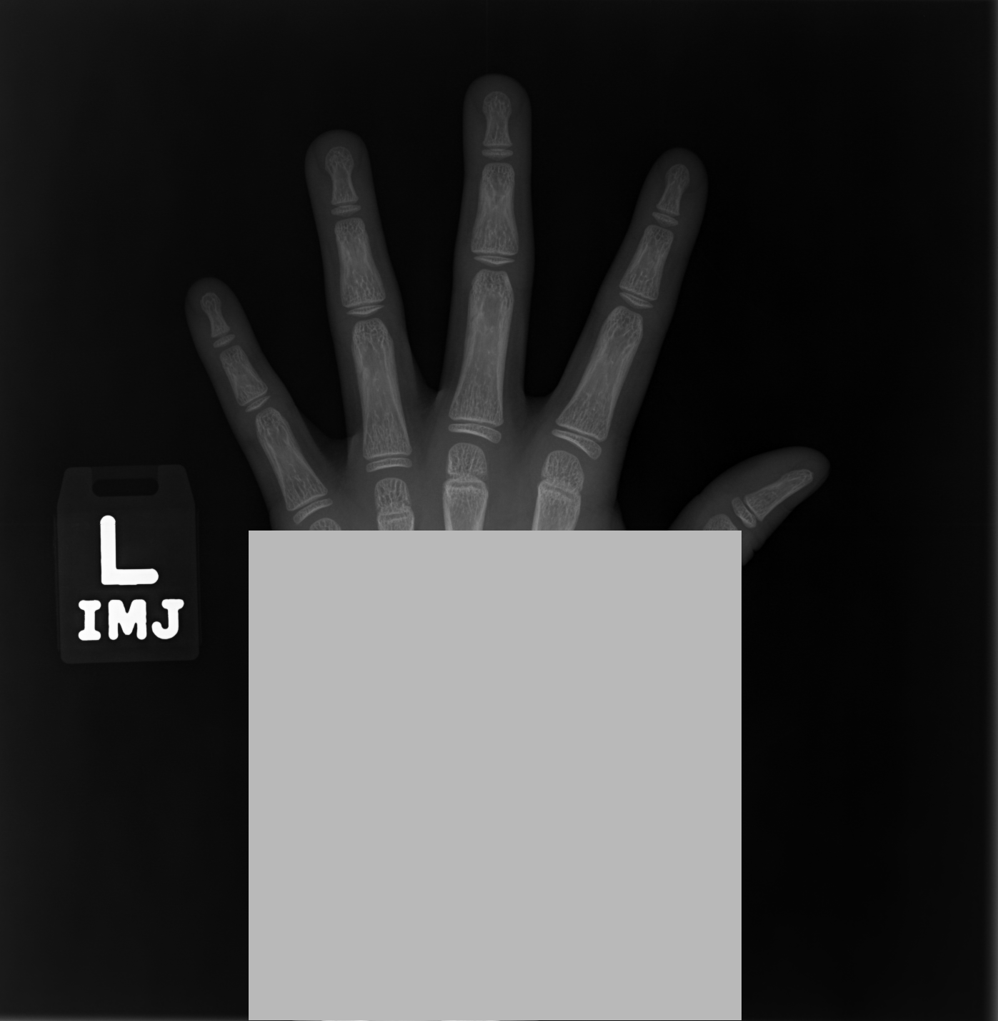
Our Methods
Reimplementation (RSNA dataset)
Data loading:
RSNA: 12, 611 labeled img -> out of ram -> progressive loading -> out of time -> rand. 1390
2. Localized hand & Regions of Interests 1 & Masked out R1：
learning rate = 0.0003 for the first 60 epochs, learning rate = 0.0001 for the next 30 epochs with a batch size of 32
3. Test results (MAE/Month):
val_MAE = 8.2505
learning rate = 0.0003 for the first 40 epochs, learning rate = 0.0001 for the next 20 epochs with a batch size of 16
Notes:
(Marlene) -
a little bit on rsna, data label and size and such
out of ram so try loading progressively while training with imagedatagen, but then decides it just takes too much time even with pro’s resource
so given the lack of time/storage resource to reimplement the original model on all of the instances from rsna, we’ve rand out 1390 samples, same as the size of digital hand atlas. clean up the original code the params are left unchanged, including learning rate, batch_size, split proportion, image resize, heatmap mask threshold, reg term coeff, pretty much everything whose tuning is of significance
example of the cropped hand, hand-erased1, r1 (mIoU and AP score not evaluated because couldn’t draw manual ground truth bounding box)
plot loss, mae of (a),
, loss, mae of (b) from the history pkl,

Slide 15
Our Methods
Reading USC images & Concatenate ethnicity info
Notes:
(Trevor)
Once we ran the original model with the original rsna dataset, we then focused on usign the new usc digital hand atlas dataset and the new ethnicity feature

Slide 16
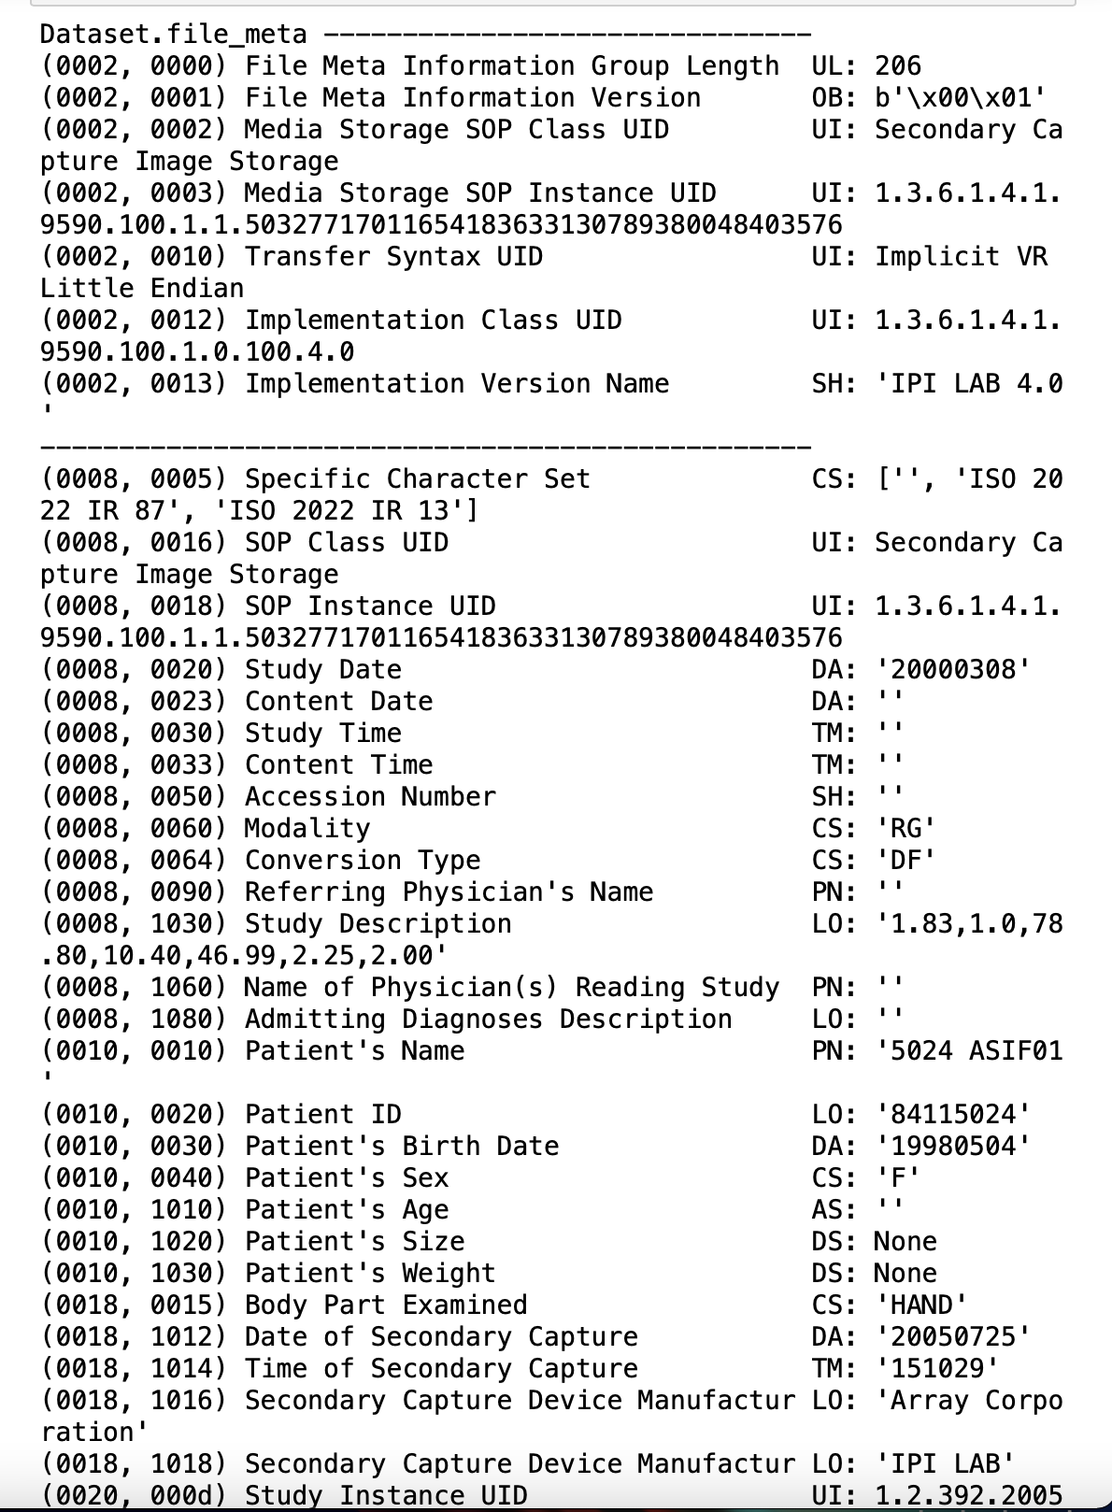
Step 1: Process and extract information from DICOM (.dcm) files
Extract the patient id, gender, ethnicity, age, and, initially, the image*, from the dicom file and the path name using python string manipulation and the os library.
Example Path: “/Digital Hand Atlas/DICOM/ASIF/ASIF01/5024.dcm”
* Due to dimensionality and color channel issues with the Xception base model, the image had to be loaded in using opencv instead of pydicom. (3 color channels vs 1)
Notes:
(Trevor)
The first biggest challenge was that the dataset used for the rsna was a csv file with the patient information and already organized with the corresponding images to the patient information. While the usc dataset consisted of a folder with jpg images and then a folder of the dicom files conisting of the patient information. So, in order to exctract valuable patient informaiton such as id, and date of birth we used the python library called pydicom.
Visualized below is the an example of what a dicom file looks like
In order to extract the necessary information, the age, gender, ethnicity, and information. A mixture of pathname and string manipulation was used to store each feature into its own array, done by searching through the root directory. and then iterating through each filenode until the dcm file was reached.
Once the dcm file was reached, using the stored paths, the gender i.e the F in ASIF and the ethnicity, in this case the ASI in the path name were extracted and appended to the gender and age set. Then, using the dicom study date and the patient’s birthdate the age in months of the patient was able to be calculated and added to the age list.
Finally, the image information had to be added. Initially, the image saved as an array was added to an image list using the pydicom functionality but this saved the image as a 2-d array when, in order to work with the Xception base model, it needed to be a 3-d array. So, opencv was used to load in the images in order to get the images into the proper format and the proper size to be loaded into the model.

Slide 17
Step 2: Concatenate Ethnicity Information.
Created a dictionary that performed one-hot-encoding on the variables.
ASI → [1,0,0,0]
CAU → [0,1,0,0]
HIS → [0,0,1,0]
BLK → [0,0,0,1]
Ethnicity Feature
Concatenate the list of encoded ethnicities after the convolutions as new input layer for the activation function and the prediction output.
Notes:
(Trevor)
One hot encoding is a process by which categorical variables are converted into a form that could be provided to ML algorithms to do a better job in prediction.
With one-hot, we convert each categorical value into a new categorical column and assign a binary value of 1 or 0 to those columns.
One hot encoding makes our training data more useful and expressive, and it can be rescaled easily. By using numeric values, we more easily determine a probability for our values

Slide 18
Discussion
Broader Implications
Concerns: Algorithmic Bias Amplification
AI Models have proven to:
Amplify Healthcare Disparities
Exhibit worse results for minority populations
Replicate biases in training data
Notes:
Nikhil

Slide 19
Discussion
Known Biological Differences: Ethnicity
Recent Studies have show that:
Significant Differences in Bone Density between ethnicities
Rate of bone maturation differs across ethnic lines
Notes:
Nikhil

Slide 20
Discussion
Inclusion of Ethnicity Data in Models
How to combat algorithmic bias?
No consensus: Proposed including ethnicity data by:
Entirely separate models
Including as model input
Including as model output
Adjusting input data for know biological differences across ethnic lines
Notes:
Nikhil

Slide 21
Discussion: Preliminary Results
No significant improvement with Ethnicity.
Important Considerations
Limited Computing Power
Made batching and data set size adjustments to improve training time
No time to tune hyperparameters
Tuning hyperparameters and using larger datasets may improve accuracy beyond baseline
More research is needed to assess this method of ethnicity inclusion
Could be a beneficial method to improve algorithmic bias in radiological applications
Notes:
Nikhil

Slide 22
Thank you
for Listening!
Notes:
Nikhil

Slide 23
Code Availabities
The source code of selected paper is available at their Github page: https://github.com/chenchao666/Bone-Age-Assessment
Our commented code is available at our Google Drive page: https://drive.google.com/drive/folders/1QGTllN27TLcWAEKVbjfl8-M8-E6HzAO8?usp=sharing
The RSNA dataset is available at Kaggle: https://www.kaggle.com/kmader/rsna-bone-age
The Digital Hand Atlas of University of Southern California is available at their lab page: ipilab.usc.edu/research/baaweb/
Notes:
Nikhil

