Slide 2
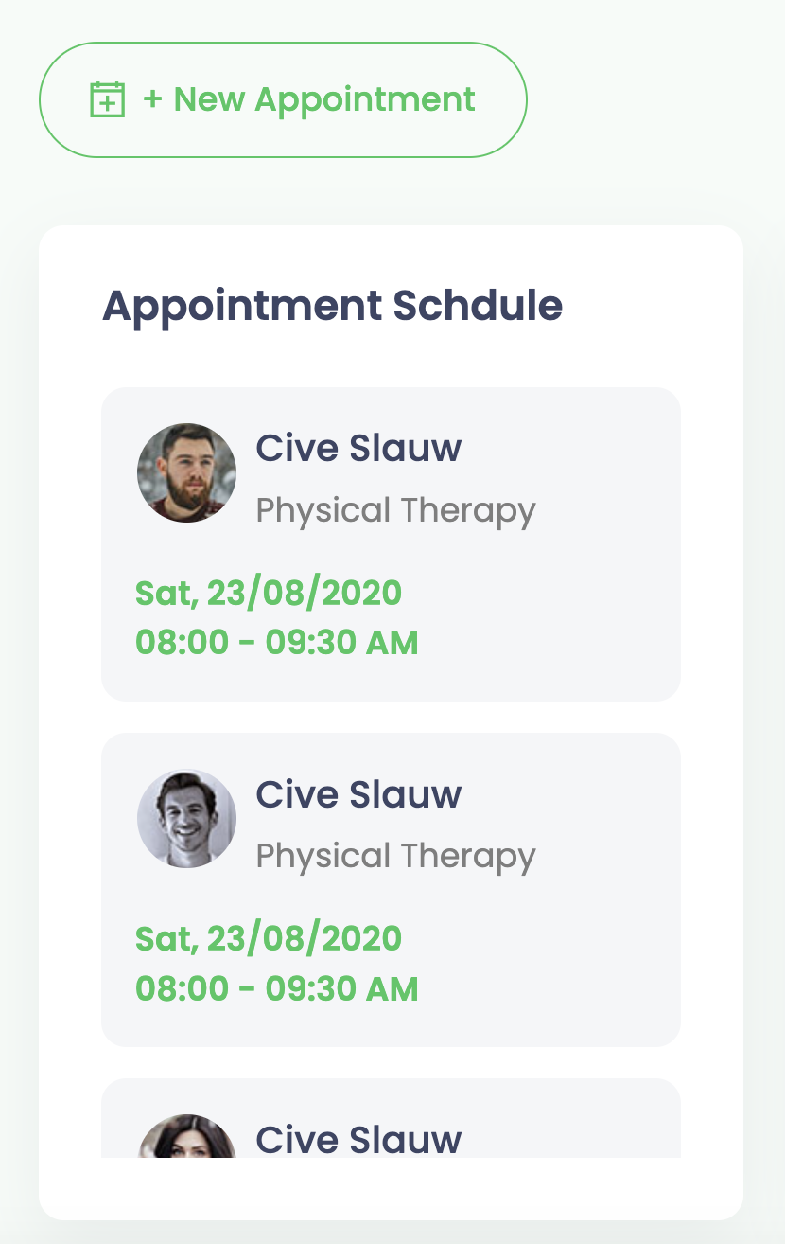
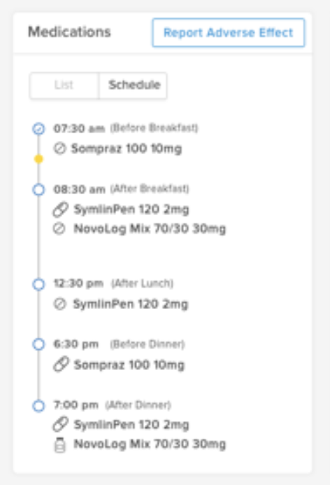
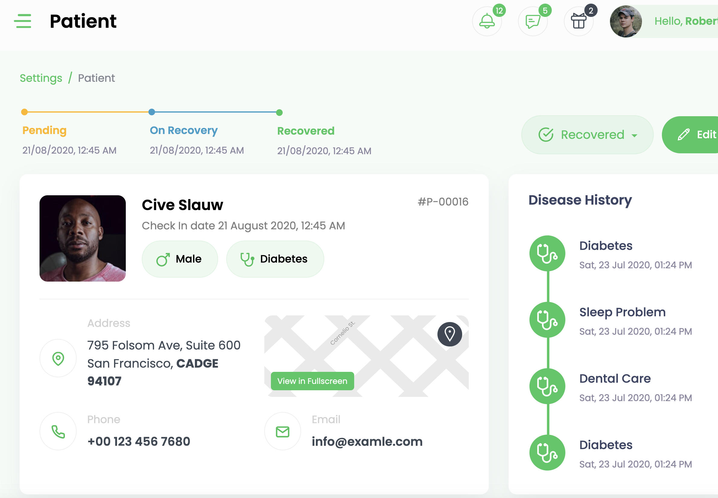
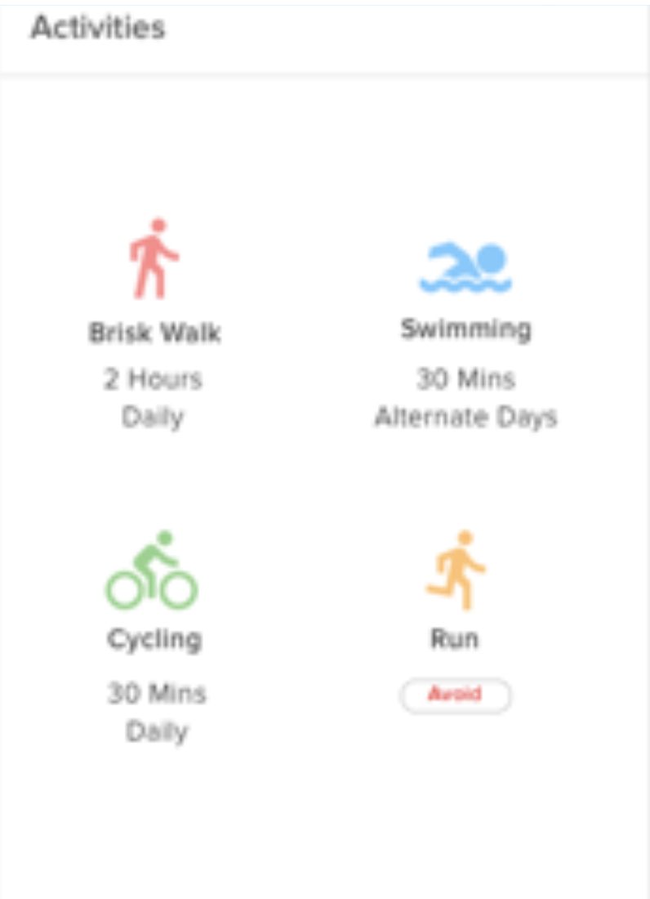
Patient Detail

Slide 3
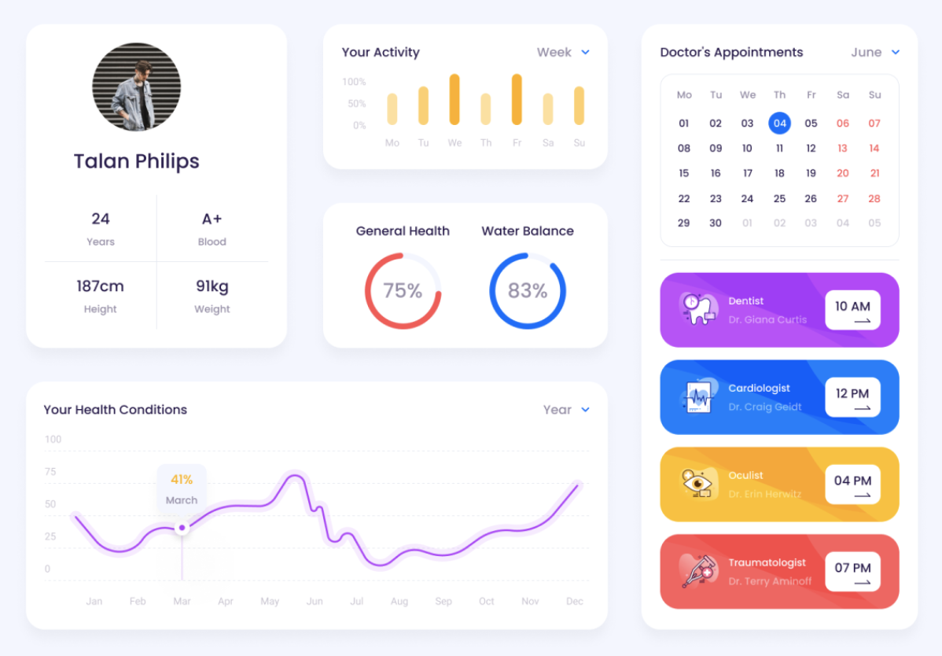
Patient Detail

Slide 4
Patients
Doctors
Settings
Practice (Edit practice)
Practitioners (Add, Edit, Delete)
Offices (Add, Edit, Delete)
Users (Add, Edit, Delete)
Administration
Biomarker Types
Biomarkers
Roles
Add
Patient
Practice
Practitioner
Office
Admin Add
Biomarker
Biomarker Type
Role
Set Relationship
Practice User
Practice Patient
Practice Office

Slide 5
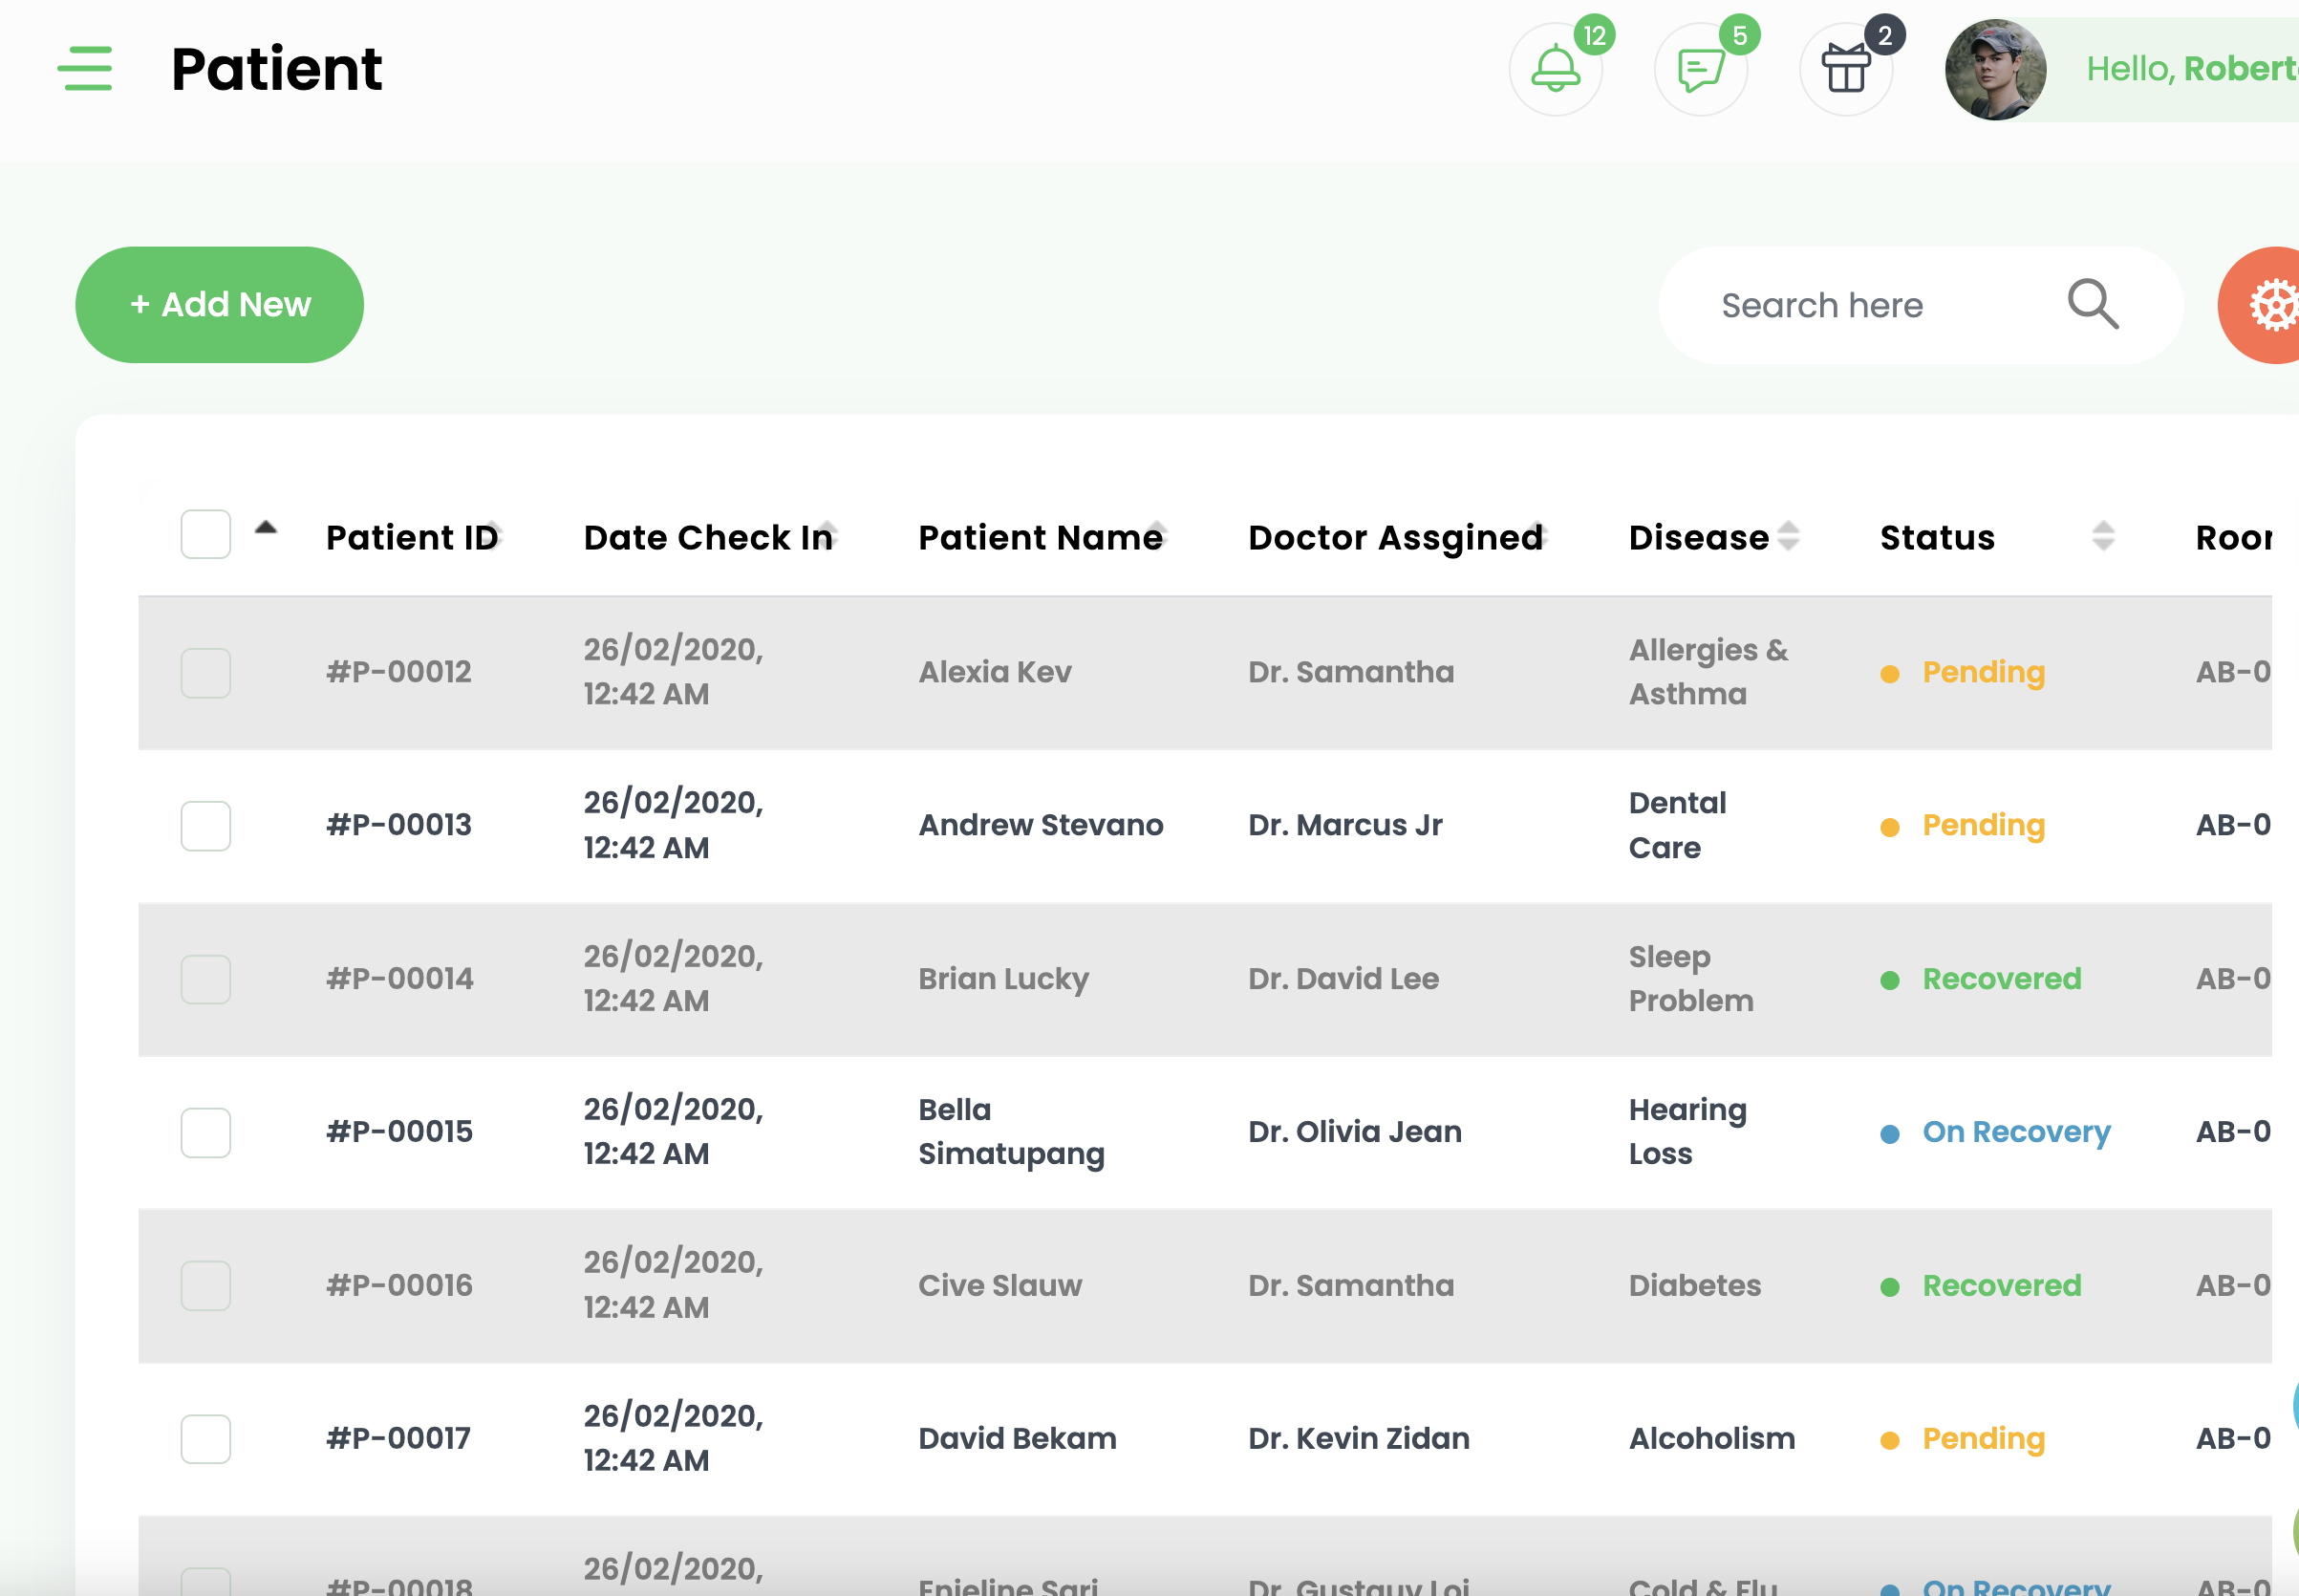
Patients

Slide 6
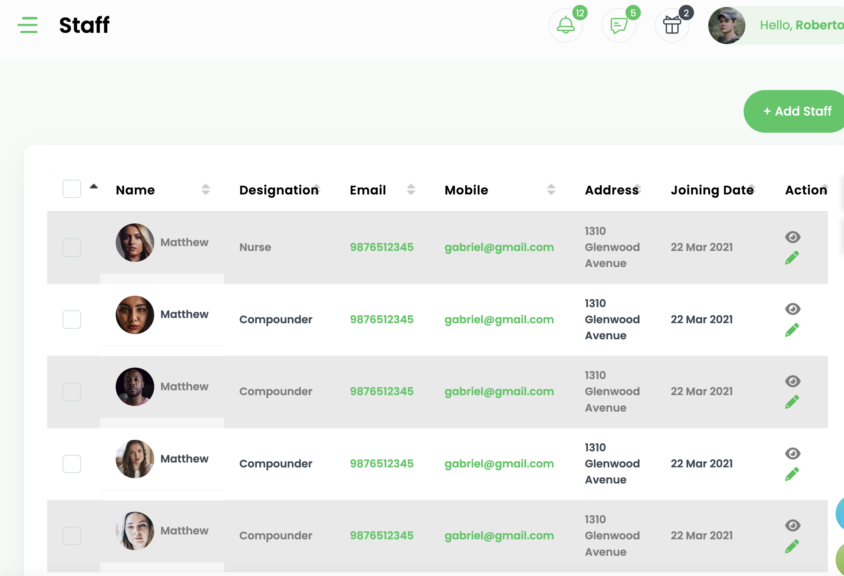
Practitioners

Slide 7
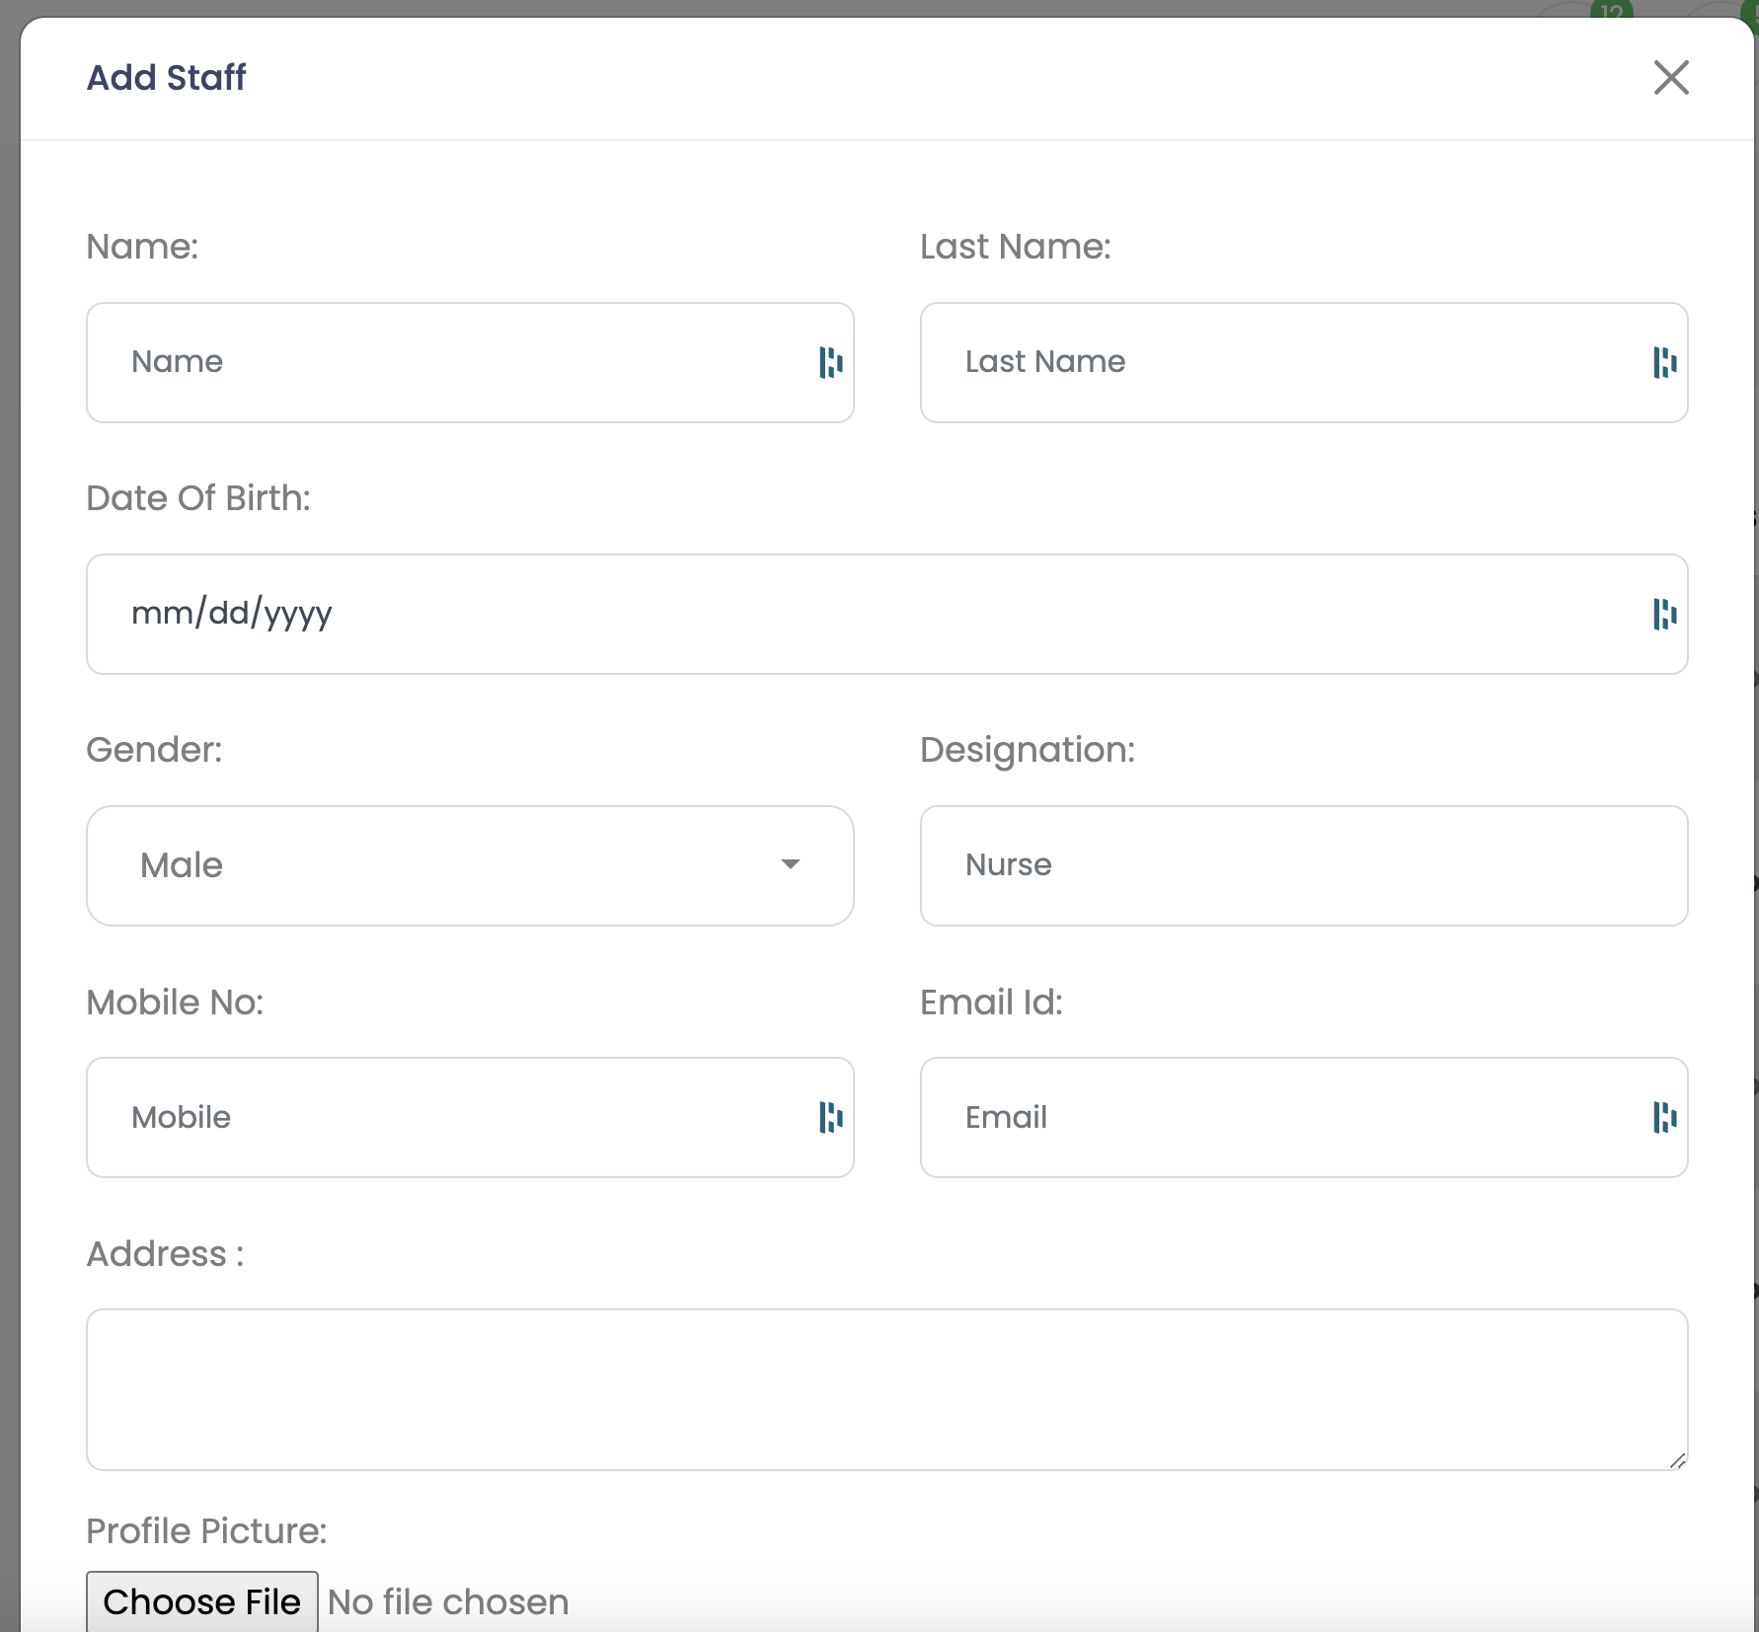
Add
Patient
Practice
Practitioner
Office

Slide 8
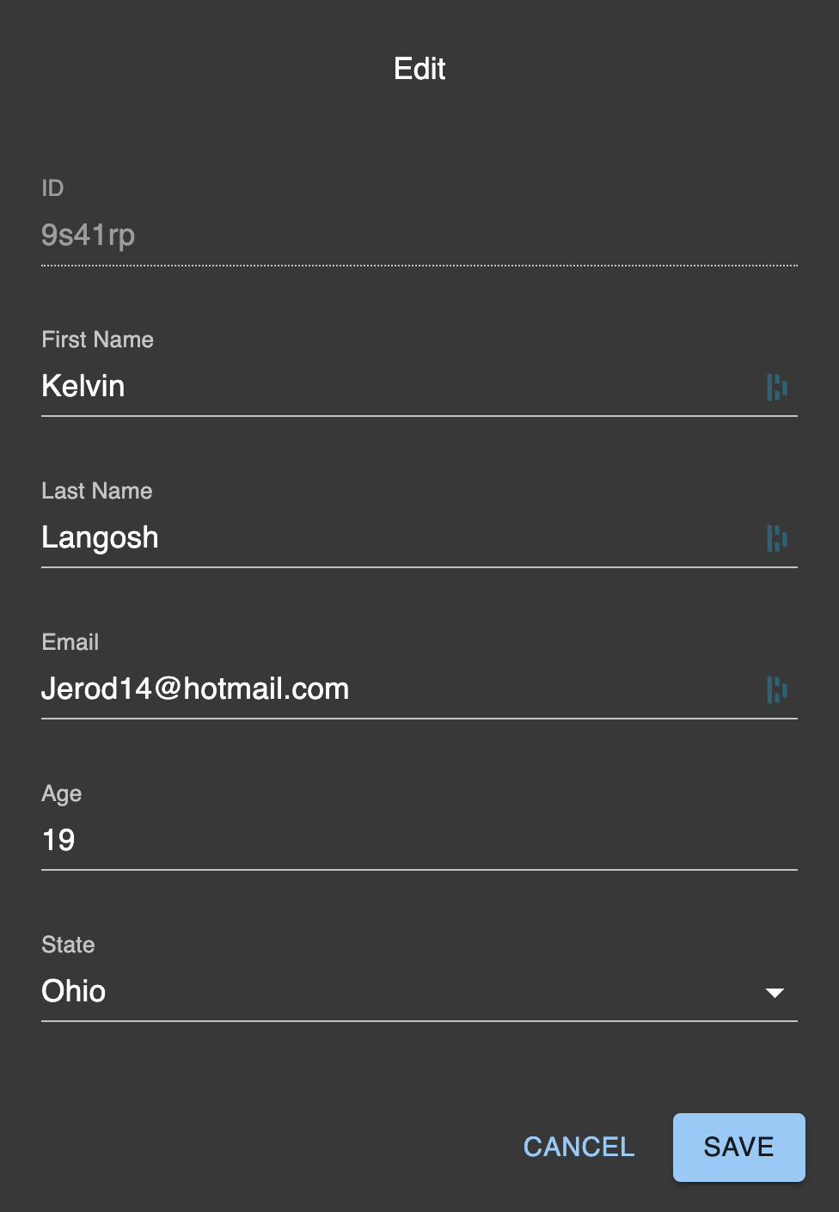
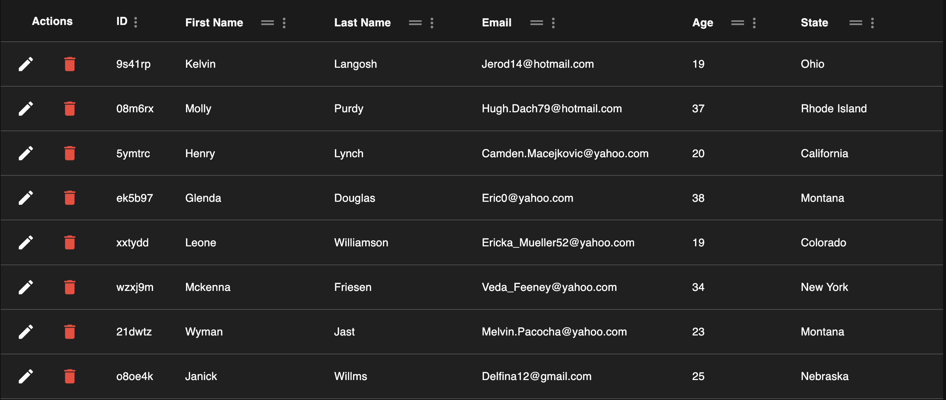
Patients, Add, Edit, Delete

